Slide 1
AI Echo: Your Smartest Conversational Partner
Sentiment Analysis from ChatGPT User Reviews
Using NLP, Machine Learning & Streamlit
Presented by : Ganesh Baskar

Slide 2
Business Problem
🔍 Understanding user sentiment from ChatGPT reviews plays a vital role in:
Pinpointing areas of friction and dissatisfaction
Enhancing overall user satisfaction and engagement
Guiding AI product teams with data-driven insights

Slide 3
Use Cases
💡 Who Benefits from Sentiment Analysis in Reviews:
Product teams uncover evolving user needs and feedback patterns to guide roadmap decisions
UX researchers evaluate conversation flow and engagement quality for continuous design improvement
Content moderators swiftly identify harmful, abusive, or off-topic feedback using sentiment cues
Business leaders gain strategic, sentiment-driven insights to align product vision with user satisfaction

Slide 4
Proposed Solution
AI Echo is a Streamlit-powered application designed to analyze ChatGPT user reviews. It offers:
📥 Seamless intake of textual feedback
💬 Sentiment classification into Positive, Neutral, or Negative categories
📊 Interactive exploratory data analysis (EDA) to uncover hidden insights
📈 Trend detection and keyword frequency visualization
🤖 Machine learning-based predictions for accurate sentiment tagging

Slide 5
Dataset Used
📦 Data Overview for Sentiment Analysis on ChatGPT Reviews
Source: Collected user reviews from ChatGPT through web scraping
Fields Included:
Review content (text)
User rating
Sentiment label (Positive, Neutral, Negative)
Review date
App version
Platform (iOS, Android, etc.)
User location
🧹 Preprocessing Pipeline:
Text cleaning and normalization
Sentiment labeling
TF-IDF vectorization for feature extraction
⚖️ Class Imbalance Handling:
Resampling methods applied to achieve a balanced dataset

Slide 6
Exploratory Data Analysis (EDA)
🔍 Key Insights from Sentiment Analysis of ChatGPT Reviews
Sentiment Breakdown: Positive reviews dominate overall sentiment, followed by negative and then neutral feedback
Temporal Trends: Review activity spikes notably after version updates, reflecting user response to new features or changes
Verified User Behavior: Verified accounts are more likely to leave positive feedback, hinting at higher trust or satisfaction
Review Length Patterns: Longer reviews tend to express stronger emotions—either highly appreciative or deeply critical
Platform Preferences: Web users often provide more neutral assessments compared to the expressive feedback from mobile users
Negative Sentiment Drivers: Common concerns include model hallucinations, processing delays, and accuracy issues

Slide 7
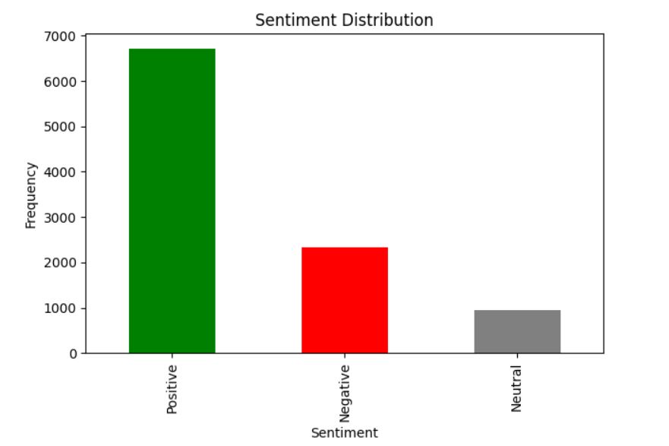
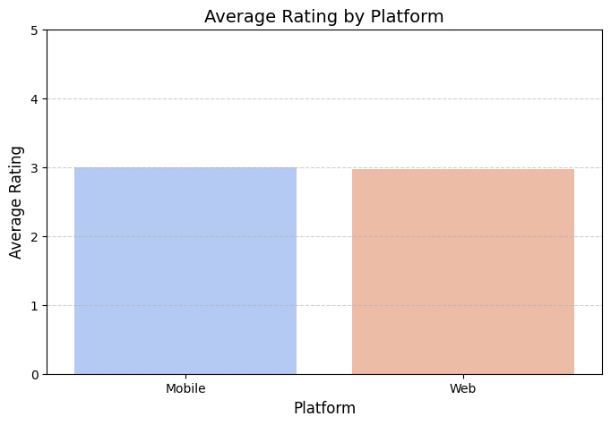
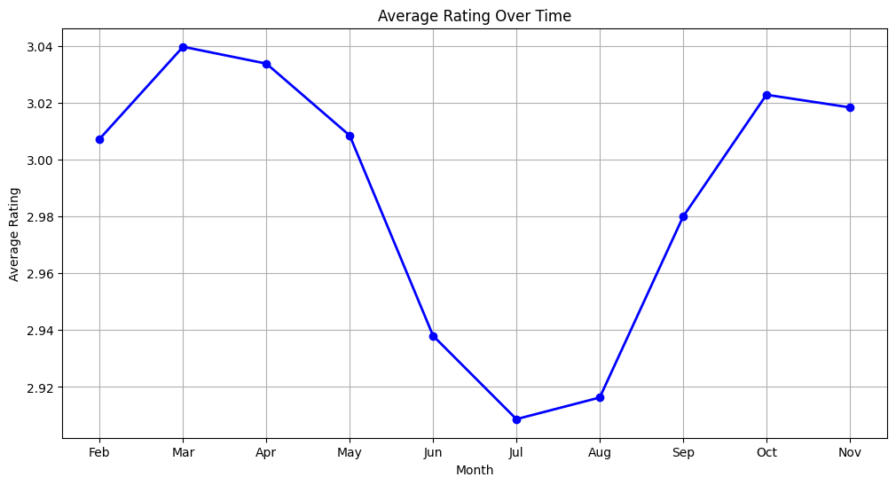
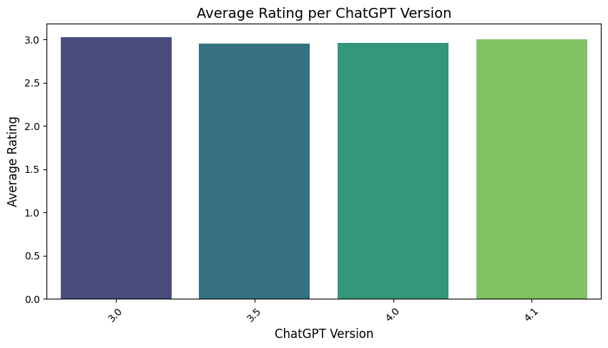

Slide 8
Models Used
TF-IDF Vectorizer for feature extraction
Classical ML models:
• Logistic Regression
• Random Forest
• SVM with class weight
Deep Learning:
• RNN
• LSTM
Evaluated using KFold cross-validation

Slide 9
Model Performance
Accuracy: up to 88% (SVM )
ROC-AUC Score: 0.95 (SVM)
Precision/Recall balanced across classes
SVM chosen for deployment due to speed + accuracy
Evaluation visualizations include confusion matrix, ROC curve, wordcloud

Slide 10
Recommendations
🚀 Future Development Plan for AI Echo
System Integration: Seamlessly embed AI Echo into existing product feedback workflows to enhance sentiment-driven decision-making
Update Prioritization: Leverage user feedback trends to guide feature updates and fix critical pain points
Multilingual Expansion: Extend sentiment analysis capabilities to support reviews in multiple languages, boosting global accessibility
Model Refresh: Schedule quarterly model retraining using newly collected review data to maintain accuracy and relevance
Media Insights: Upgrade the app to handle sentiment analysis for audio and video reviews, enabling richer user experience evaluation

Slide 11
Conclusion
Sentiment Analysis: AI Echo accurately classifies ChatGPT reviews as Positive, Negative, or Neutral using optimized ML models.
Insight Extraction: Review trends reveal spikes post-version updates and stronger sentiments in longer feedback.
User Behavior Patterns: Verified users tend to be more positive, while web users lean toward neutral tone.
Platform-Level Analysis: EDA uncovers patterns across review length, device type, app version, and location.
Improvement Drivers: Findings highlight pain points like hallucinations, delays, and inaccuracies, guiding product enhancements.

