Slide 1
SNAKE AND LADDER VARIATION

Slide 2
NO SNAKE NO LADDER ANALYSIS
100 | 99 | 98 | 97 | 96 | 95 | 94 | 93 | 92 | 91
81 | 82 | 83 | 84 | 85 | 86 | 87 | 88 | 89 | 90
80 | 79 | 78 | 77 | 76 | 75 | 74 | 73 | 72 | 71
61 | 62 | 63 | 64 | 65 | 66 | 67 | 68 | 69 | 70
60 | 59 | 58 | 57 | 56 | 55 | 54 | 53 | 52 | 51
41 | 42 | 43 | 44 | 45 | 46 | 47 | 48 | 49 | 50
40 | 39 | 38 | 37 | 36 | 35 | 34 | 33 | 32 | 31
21 | 22 | 23 | 24 | 25 | 26 | 27 | 28 | 29 | 30
20 | 19 | 18 | 17 | 16 | 15 | 14 | 13 | 12 | 11
1 | 2 | 3 | 4 | 5 | 6 | 7 | 8 | 9 | 10
Number of players : 1
Number of ladders : 0
Number of snakes : 0
Total no of matches : 10,000

Slide 3
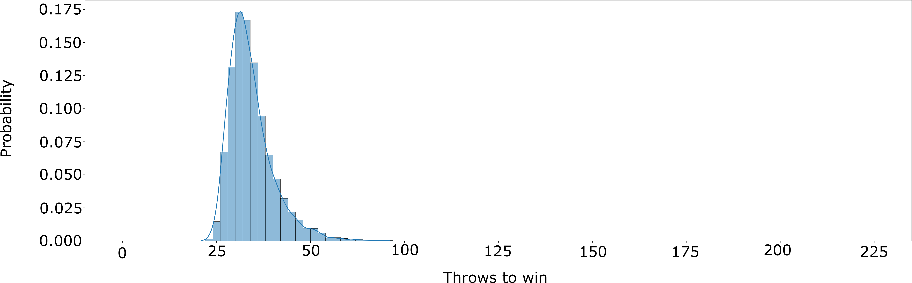
NO SNAKE NO LADDER ANALYSIS

Slide 4
ONE SNAKE ANALYSIS
100 | 99 | 98 | 97 | 96 | 95 | 94 | 93 | 92 | 91
81 | 82 | 83 | 84 | 85 | 86 | 87 | 88 | 89 | 90
80 | 79 | 78 | 77 | 76 | 75 | 74 | 73 | 72 | 71
61 | 62 | 63 | 64 | 65 | 66 | 67 | 68 | 69 | 70
60 | 59 | 58 | 57 | 56 | 55 | 54 | 53 | 52 | 51
41 | 42 | 43 | 44 | 45 | 46 | 47 | 48 | 49 | 50
40 | 39 | 38 | 37 | 36 | 35 | 34 | 33 | 32 | 31
21 | 22 | 23 | 24 | 25 | 26 | 27 | 28 | 29 | 30
20 | 19 | 18 | 17 | 16 | 15 | 14 | 13 | 12 | 11
1 | 2 | 3 | 4 | 5 | 6 | 7 | 8 | 9 | 10
Number of players : 1
Number of ladders : 0
Number of snakes : 1
Total no of matches : 10,000
Snake:
Head : 67
Tail : 11

Slide 5
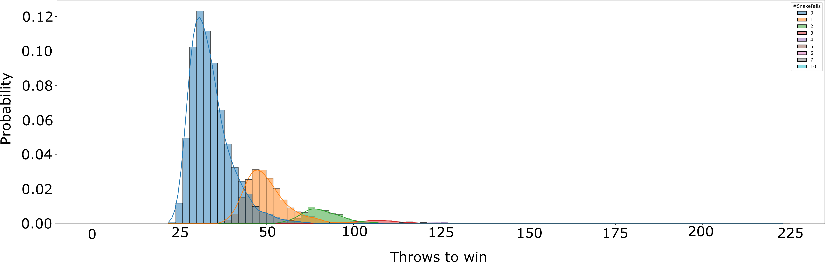
ONE SNAKE ANALYSIS

Slide 6
ONE LADDER ANALYSIS
100 | 99 | 98 | 97 | 96 | 95 | 94 | 93 | 92 | 91
81 | 82 | 83 | 84 | 85 | 86 | 87 | 88 | 89 | 90
80 | 79 | 78 | 77 | 76 | 75 | 74 | 73 | 72 | 71
61 | 62 | 63 | 64 | 65 | 66 | 67 | 68 | 69 | 70
60 | 59 | 58 | 57 | 56 | 55 | 54 | 53 | 52 | 51
41 | 42 | 43 | 44 | 45 | 46 | 47 | 48 | 49 | 50
40 | 39 | 38 | 37 | 36 | 35 | 34 | 33 | 32 | 31
21 | 22 | 23 | 24 | 25 | 26 | 27 | 28 | 29 | 30
20 | 19 | 18 | 17 | 16 | 15 | 14 | 13 | 12 | 11
1 | 2 | 3 | 4 | 5 | 6 | 7 | 8 | 9 | 10
Number of players : 1
Number of ladders : 1
Number of snakes : 0
Total no of matches : 10,000
Ladder:
Base : 28
Top : 66

Slide 7
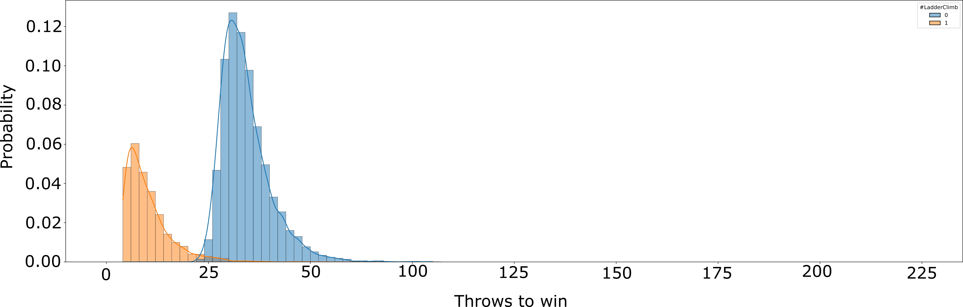
ONE LADDER ANALYSIS

Slide 8
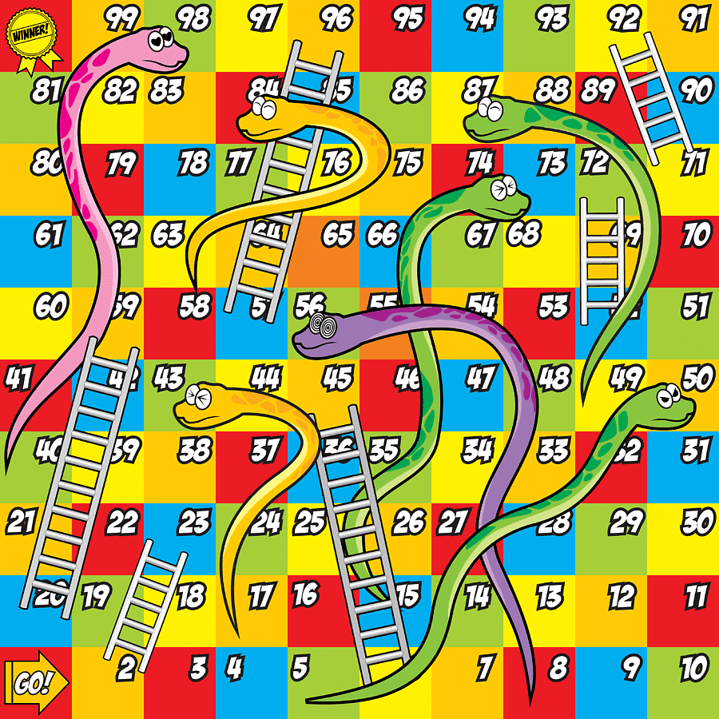
SNAKE AND LADDER ANALYSIS
Number of players : 1
Number of ladders : 6
Number of snakes : 7
Total no of matches : 10,000
Ladder:
[2,23],[6,45],[20,59],
[52,72],[57,96],[71,92]
Here, [2,23]
ladder base : 2
ladder top : 23
Snake:
[43,17],[50,5],[56,8],[73,15],
[84,58],[87,49],[98,40]
Here, [43,17]
Snake head : 43
Snake tail : 17

Slide 9
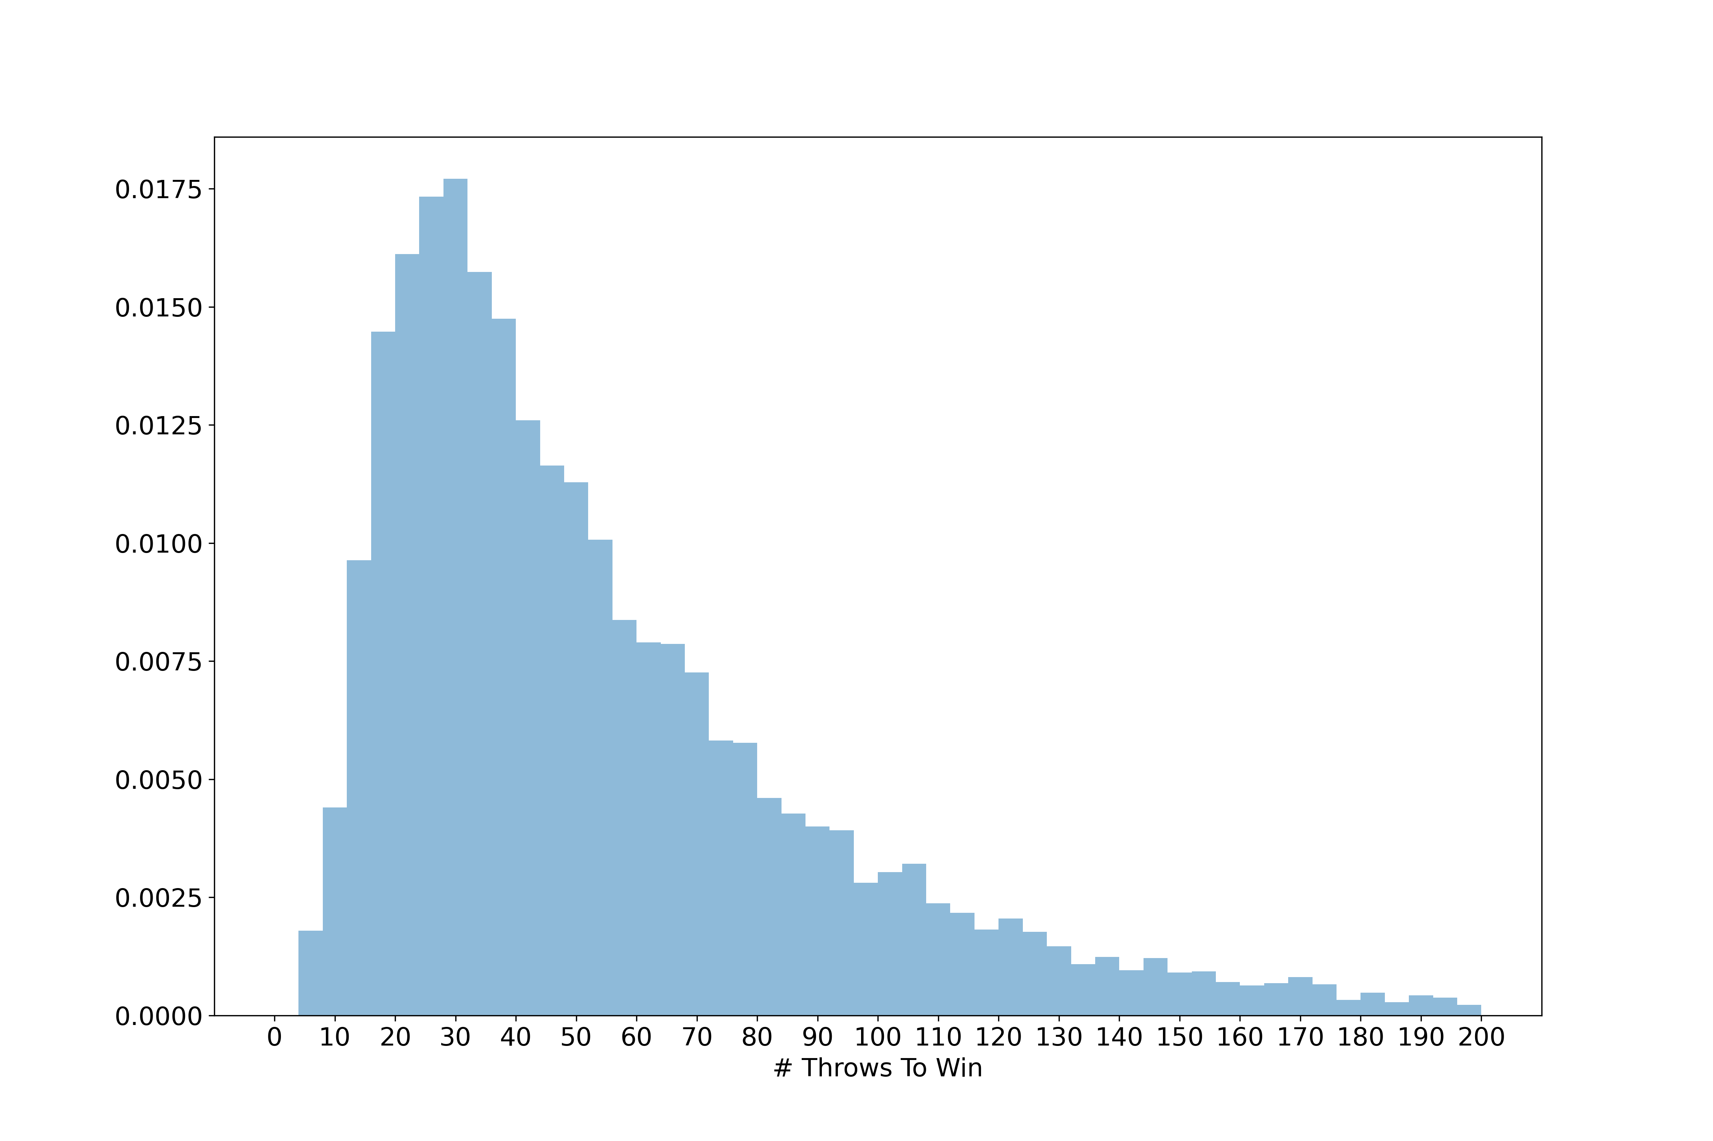
SNAKE AND LADDER ANALYSIS
Mean : 56.1535
Mode : 26

Slide 10
Grid variation

Slide 11

SNAKE AND LADDER (GRID VARIATION)
49 | 48 | 47 | 46 | 45 | 44 | 43 | 42 | 41
32 | 33 | 34 | 35 | 36 | 37 | 38 | 39 | 40
31 | 30 | 29 | 28 | 27 | 26 | 25 | 24 | 23
14 | 15 | 16 | 17 | 18 | 19 | 20 | 21 | 22
13 | 12 | 11 | 10 | 9 | 8 | 7 | 6 | 5
-4 | -3 | -2 | -1 | 0 | 1 | 2 | 3 | 4
-5 | -6 | -7 | -8 | -9 | -10 | -11 | -12 | -13
-22 | -21 | -20 | -19 | -18 | -17 | -16 | -15 | -14
-23 | -24 | -25 | -26 | -27 | -28 | -29 | -30 | -31
-40 | -39 | -38 | -37 | -36 | -35 | -34 | -33 | -32
-41 | -42 | -43 | -44 | -45 | -46 | -47 | -48 | -49
50
Number of players : 1
Number of ladders : 6
Number of snakes : 6
Dice value range : [-3,3]
Total no of matches : 10,000
snake
ladder
-50

Slide 12
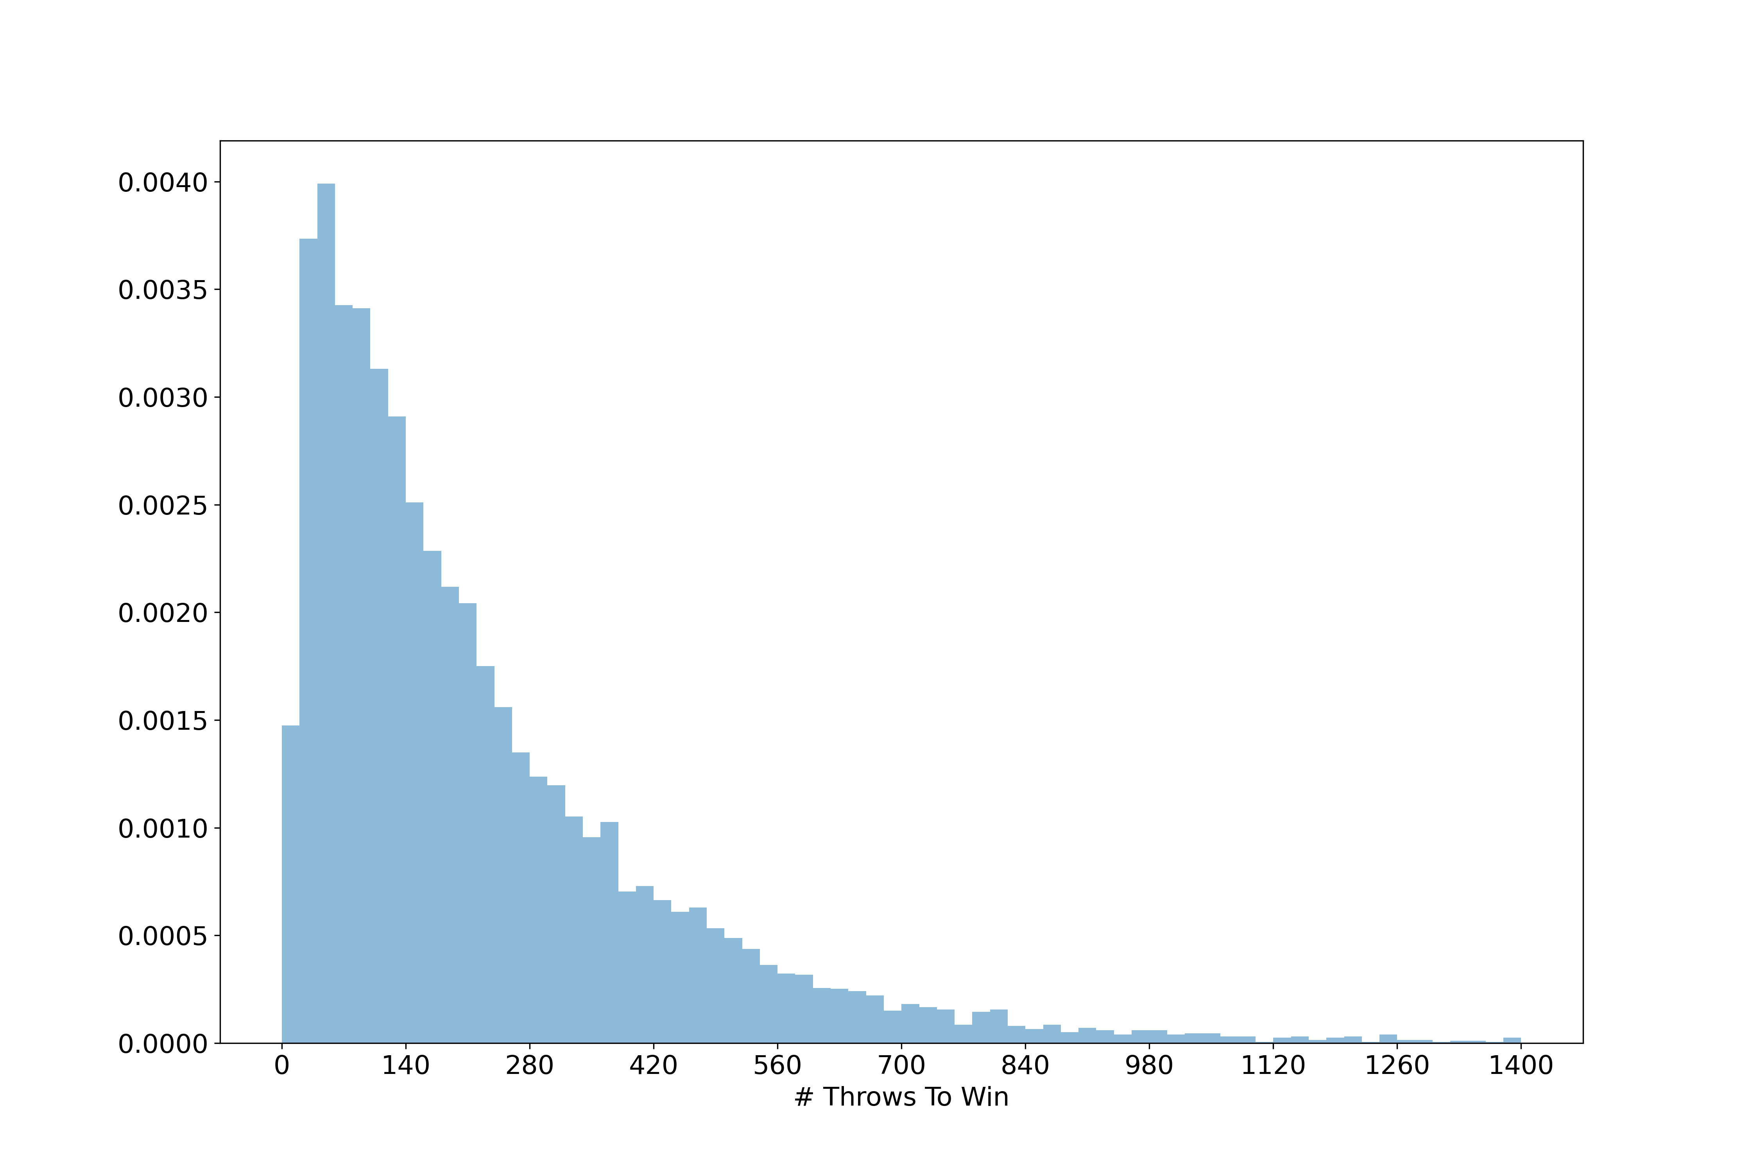
NEW GRID ANALYSIS
Mean : 335.0181
Mode : 43

Slide 13
REDUCE GRID

Slide 14
SNAKE AND LADDER (REDUCE GRID SIZE)
32 | 33 | 34 | 35 | 36 | 37 | 38 | 39 | 40
31 | 30 | 29 | 28 | 27 | 26 | 25 | 24 | 23
14 | 15 | 16 | 17 | 18 | 19 | 20 | 21 | 22
13 | 12 | 11 | 10 | 9 | 8 | 7 | 6 | 5
-4 | -3 | -2 | -1 | 0 | 1 | 2 | 3 | 4
-5 | -6 | -7 | -8 | -9 | -10 | -11 | -12 | -13
-22 | -21 | -20 | -19 | -18 | -17 | -16 | -15 | -14
-23 | -24 | -25 | -26 | -27 | -28 | -29 | -30 | -31
-40 | -39 | -38 | -37 | -36 | -35 | -34 | -33 | -32
Number of players : 1
Number of ladders : 4
Number of snakes : 6
Dice value range : [-3,3]
Total no of matches : 10,000
snake
ladder

Slide 15
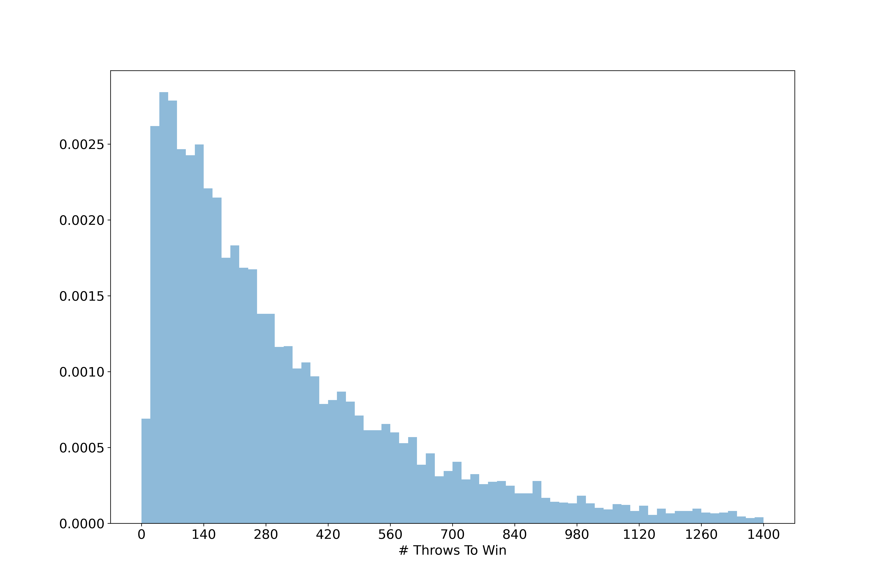
REDUCE GRID ANALYSIS
Mean : 489.7034
Mode : 79

Slide 16
DICE BIASING

Slide 17
SNAKE AND LADDER (DICE BIASING)
49 | 48 | 47 | 46 | 45 | 44 | 43 | 42 | 41
32 | 33 | 34 | 35 | 36 | 37 | 38 | 39 | 40
31 | 30 | 29 | 28 | 27 | 26 | 25 | 24 | 23
14 | 15 | 16 | 17 | 18 | 19 | 20 | 21 | 22
13 | 12 | 11 | 10 | 9 | 8 | 7 | 6 | 5
-4 | -3 | -2 | -1 | 0 | 1 | 2 | 3 | 4
-5 | -6 | -7 | -8 | -9 | -10 | -11 | -12 | -13
-22 | -21 | -20 | -19 | -18 | -17 | -16 | -15 | -14
-23 | -24 | -25 | -26 | -27 | -28 | -29 | -30 | -31
-40 | -39 | -38 | -37 | -36 | -35 | -34 | -33 | -32
-41 | -42 | -43 | -44 | -45 | -46 | -47 | -48 | -49
50
Number of players : 1
Number of ladders : 6
Number of snakes : 6
Dice value range : [-3,3]
Total no of matches : 10,000
Dice biasing:
Player position > 40:
Dice value range : [0,3]
Player position < -40:
Dice value range : [-3,0]
snake
ladder
-50

Slide 18
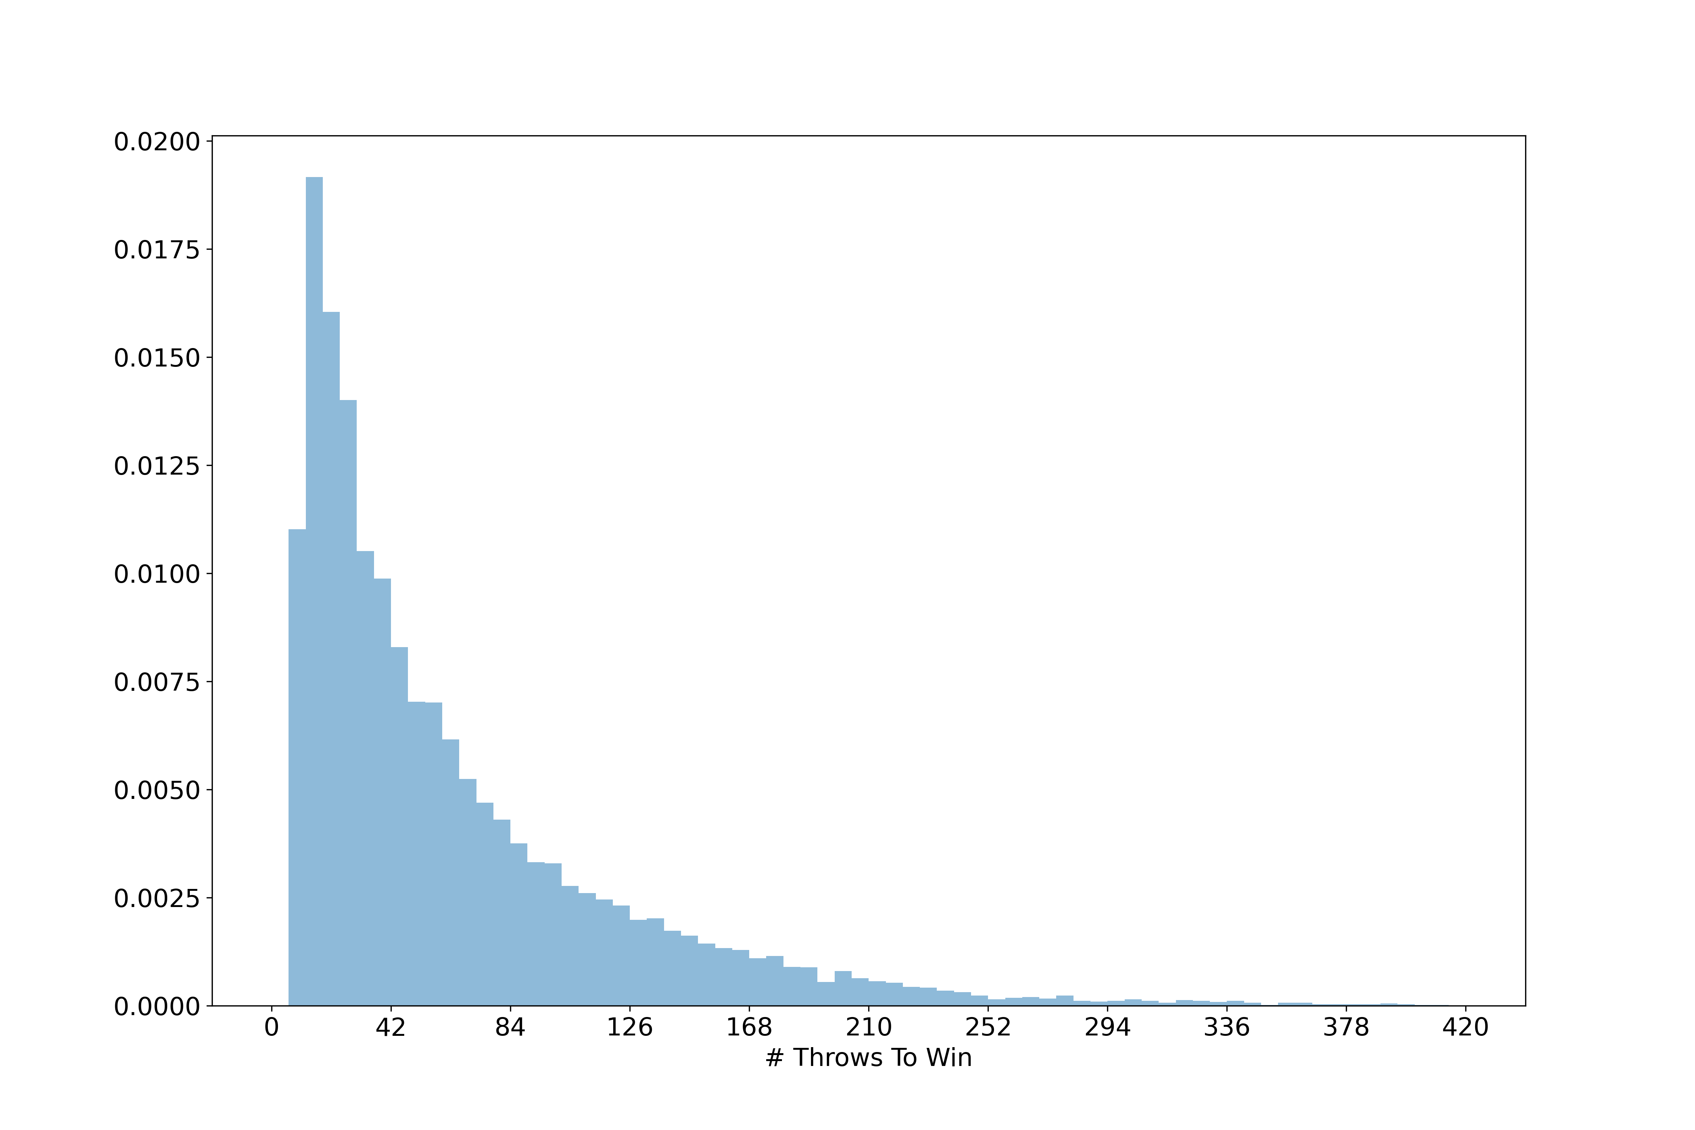
DICE BIASING ANALYSIS
Mean : 64.4626
Mode : 12

Slide 19
REDUCE GRID WITH DICE BIASING

Slide 20
SNAKE AND LADDER (REDUCE GRID SIZE)
32 | 33 | 34 | 35 | 36 | 37 | 38 | 39 | 40
31 | 30 | 29 | 28 | 27 | 26 | 25 | 24 | 23
14 | 15 | 16 | 17 | 18 | 19 | 20 | 21 | 22
13 | 12 | 11 | 10 | 9 | 8 | 7 | 6 | 5
-4 | -3 | -2 | -1 | 0 | 1 | 2 | 3 | 4
-5 | -6 | -7 | -8 | -9 | -10 | -11 | -12 | -13
-22 | -21 | -20 | -19 | -18 | -17 | -16 | -15 | -14
-23 | -24 | -25 | -26 | -27 | -28 | -29 | -30 | -31
-40 | -39 | -38 | -37 | -36 | -35 | -34 | -33 | -32
Number of players : 1
Number of ladders : 4
Number of snakes : 6
Dice value range : [-3,3]
Total no of matches : 10,000
Dice biasing:
Player position > 31:
Dice value range : [0,3]
Player position < -31:
Dice value range : [-3,0]
snake
ladder

Slide 21

REDUCE GRID WITH BIASE ANALYSIS
Mean : 101.7536
Mode : 29

Slide 22
Summary
Normal Snake and ladder:
No snake, no ladder analysis
One snake analysis
One ladder analysis
Snake and ladder analysis
Grid variation
Reduce grid
Dice biasing
Reduced grid with biased

Slide 23
Thank you

