Slide 1
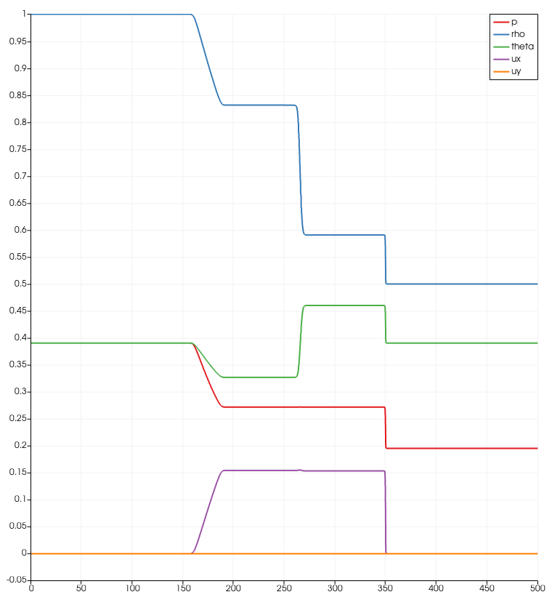
1D – Shock propogation
Comparison density with exact solution:
1
1
2
2
3
3
4
4

