Slide 1
Multiphase LBM
Ganesh Kumar B

Slide 2
Diffuse Interface Methods
Free Energy
Bulk free energy should accommodate coexistence of two phases, possible for double well potential(Eg. Van der Waal, Carnahan Starling etc.,)

Slide 3
Chemical Potential Formulation
Momentum Equation:
Gibbs-Duhem Relation:
Momentum Equation with Chemical potential

Slide 4
Pressure Formulation
Momentum equation:
Where,
Momentum equation:

Slide 5
Van der Waals Equation of State
Where,
20
Solving gives,
;
Non-Ideal Helmholtz Free Energy:
Non-Ideal Chemical Potential:

Slide 6
Expansions around critical point - VdW
Exact Helmholtz free energy(ideal + non ideal part)
Expanded around critical point
Exact Chemical Potential
Expanded Chemical Potential

Slide 7
Carnahan Starling
Where,
and
Solving gives,
Non-Ideal Helmholtz Free Energy:
Non-Ideal Chemical Potential:

Slide 8
Drop Formation

Slide 9
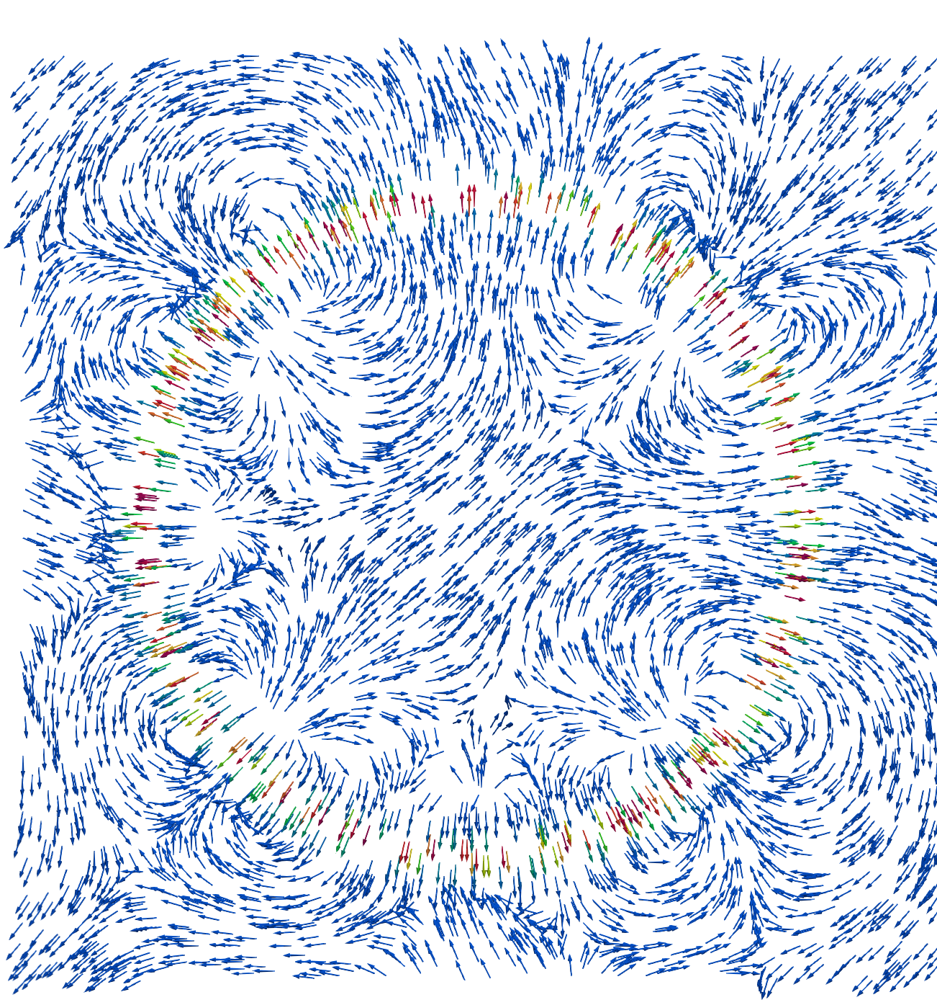
Spurious currents
What are spurious currents?
In a quiescent drop consisting of two-phases:
Spurious Currents: non-zero velocities arising from the simulations
Reason for spurious currents:
From chemical potential External Force:
which drives the flow locally generating these currents

Slide 10
Chemical Potential Formulation - kappa correction

Slide 11
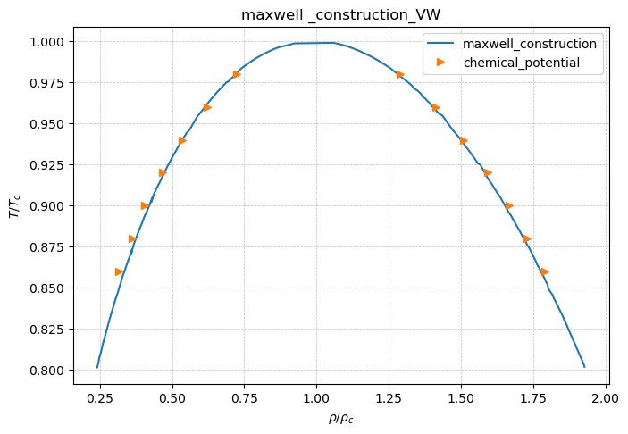
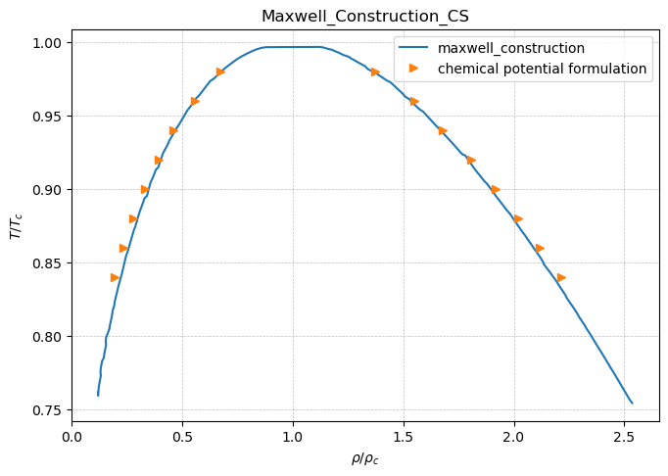
Maxwell-Construction

Slide 12
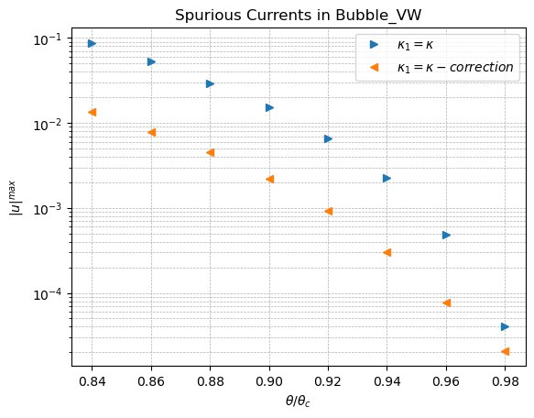
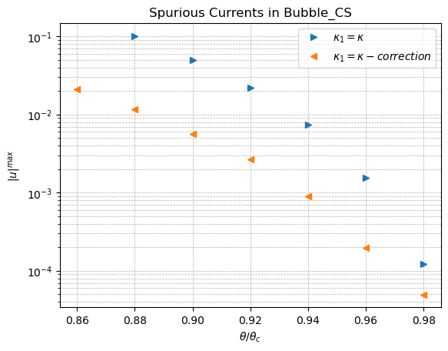
Chemical Potential formulation - kappa correction

Slide 13
Free Energy Formulation
Helmholtz Free Energy:
This relation also holds for non-ideal part of the fluid

Slide 14
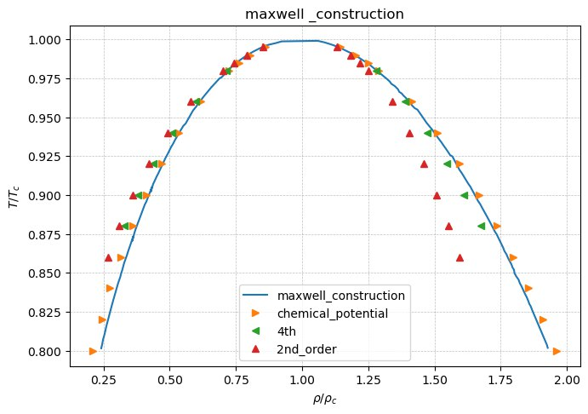
Free Energy Formulation

Slide 15
LBM Theory

Slide 17
Force Addition in LBM

Slide 19
Modification of surface tension

