Slide 1


ADITYA UNIVERSITY
Department of Artificial Intelligence & Machine Learning
CAPSTONE PROJECT • REVIEW I
SOFTWARE MANAGEMENT
DATABASE SYSTEM
A structured relational model for managing projects, people, products, requirements and software issues.
PRESENTED BY
GUIDED BY
ACADEMIC YEAR
25B11AIB48 — S. Aravinda Reddy
25B11AI537 — K.V. Sai Ganesh
25B11AI658 — M. Gangadhar
25B11AIB99 — T Eswar Vardhan
26B21AI151 --- V.Satya Sai
Dr P Kishorekumar
Associate Professor, AIML
2026 – 2027
01
SOFTWARE MANAGEMENT DATABASE SYSTEM • REVIEW I

Slide 2
02 / INTRODUCTION
Introduction
INTRODUCTION
Why a software-management database is needed
Software organizations handle information across projects, clients, employees, teams, products, requirements, releases and issues.
WHAT IS MANAGED
WHAT IS PRODUCED
WHY CONNECT IT
Projects • Clients • Employees • Teams
Products • Requirements • Releases • Issues
A relational database gives related records a structured way to connect.
Structured records • Connected information • Easier management
SOFTWARE MANAGEMENT DATABASE SYSTEM • REVIEW I

Slide 3
03 / PROBLEM STATEMENT
Problem Statement
PROBLEM STATEMENT
The challenge with disconnected records
Managing records separately can lead to duplication, inconsistency and difficulty tracking project ownership, team allocation, requirements and issues.
DUPLICATION
INCONSISTENCY
TRACKING GAPS
Repeated records make information harder to maintain.
Separate records can create conflicting or outdated information.
Ownership, teams, requirements and issues become harder to follow.
Duplicate data • Inconsistent information • Difficult tracking
SOFTWARE MANAGEMENT DATABASE SYSTEM • REVIEW I

Slide 4
04 / PROPOSED RESPONSE
Proposed Response
PROPOSED RESPONSE
A connected relational solution
The project designs a relational database that connects software-management records through well-defined entities, relationships, primary keys and foreign keys.
RELATIONAL MODEL
CONNECTED DESIGN
IMPLEMENTATION BASE
Define entities and suitable attributes for each record.
Establish relationships, cardinality, Primary Keys and Foreign Keys.
Create an ER diagram and relational schema for consistent records.
Entities + Relationships • PK/FK constraints • ER diagram + schema
SOFTWARE MANAGEMENT DATABASE SYSTEM • REVIEW I

Slide 5









05 / GOALS & BOUNDARIES
Objectives & System Scope
SYSTEM SCOPE
OBJECTIVES
PROJECT
CLIENT
Identify major software-management entities.
Details, status, dates, client
Identity and organization
Define suitable attributes.
EMPLOYEE
TEAM
Developers, testers, managers
Teams and allocation
Establish relationships and cardinality.
Design the ER diagram and relational schema.
PRODUCT
REQUIREMENT
Products and versions
Requirements and priorities
Identify Primary Keys and Foreign Keys.
ISSUE
Defects, severity, assignment, status
SOFTWARE MANAGEMENT DATABASE SYSTEM • REVIEW I

Slide 6
06 / DATA MODEL
Entities & Attributes
 | ENTITY | ATTRIBUTES / KEYS
 | PROJECT | Project_ID (PK), Project_Name, Start_Date, End_Date, Status, Client_ID (FK)
 | CLIENT | Client_ID (PK), Client_Name, Email, Phone, Organization
 | EMPLOYEE | Employee_ID (PK), Employee_Name, Email, Designation, Department
 | TEAM | Team_ID (PK), Team_Name, Project_ID (FK), Team_Lead_ID (FK)
 | SOFTWARE_PRODUCT | Product_ID (PK), Product_Name, Version, Product_Type, Project_ID (FK)
 | REQUIREMENT | Requirement_ID (PK), Project_ID (FK), Requirement_Title, Priority, Status
 | ISSUE | Issue_ID (PK), Project_ID (FK), Reported_By (FK), Assigned_To (FK), Severity, Status
SOFTWARE MANAGEMENT DATABASE SYSTEM • REVIEW I

Slide 7
07 / DATA RELATIONSHIPS
Relationships & Cardinality
RELATIONSHIP | CARDINALITY | MEANING
Client → Project | 1 : M | One client can have many software projects.
Project → Team | 1 : M | One project can have multiple teams.
Employee ↔ Team | M : N | An employee can belong to multiple teams.
Project → Software Product | 1 : M | A project can manage multiple products or versions.
Project → Requirement | 1 : M | A project can contain many requirements.
Project → Issue | 1 : M | A project can have many reported issues.
Employee → Issue | 1 : M | An employee can report or be assigned multiple issues.
SOFTWARE MANAGEMENT DATABASE SYSTEM • REVIEW I

Slide 8



08 / RELATIONAL DESIGN
Database Schema & Key Constraints
TABLE | RELATIONAL SCHEMA | KEYS
PROJECT | Project(Project_ID, Project_Name, Start_Date, End_Date, Status, Client_ID) | PK: Project_ID; FK: Client_ID
CLIENT | Client(Client_ID, Client_Name, Email, Phone, Organization) | PK: Client_ID
EMPLOYEE | Employee(Employee_ID, Employee_Name, Email, Designation, Department) | PK: Employee_ID
TEAM | Team(Team_ID, Team_Name, Project_ID, Team_Lead_ID) | PK: Team_ID; FK: Project_ID, Team_Lead_ID
SOFTWARE_PRODUCT | Software_Product(Product_ID, Product_Name, Version, Product_Type, Project_ID) | PK: Product_ID; FK: Project_ID
REQUIREMENT | Requirement(Requirement_ID, Project_ID, Requirement_Title, Priority, Status) | PK: Requirement_ID; FK: Project_ID
ISSUE | Issue(Issue_ID, Project_ID, Reported_By, Assigned_To, Severity, Status) | PK: Issue_ID; FK: Project_ID, Reported_By, Assigned_To
PRIMARY KEY
FOREIGN KEY
INTEGRITY
Uniquely identifies each record.
Connects related records.
Supports consistent relationships.
SOFTWARE MANAGEMENT DATABASE SYSTEM • REVIEW I

Slide 9
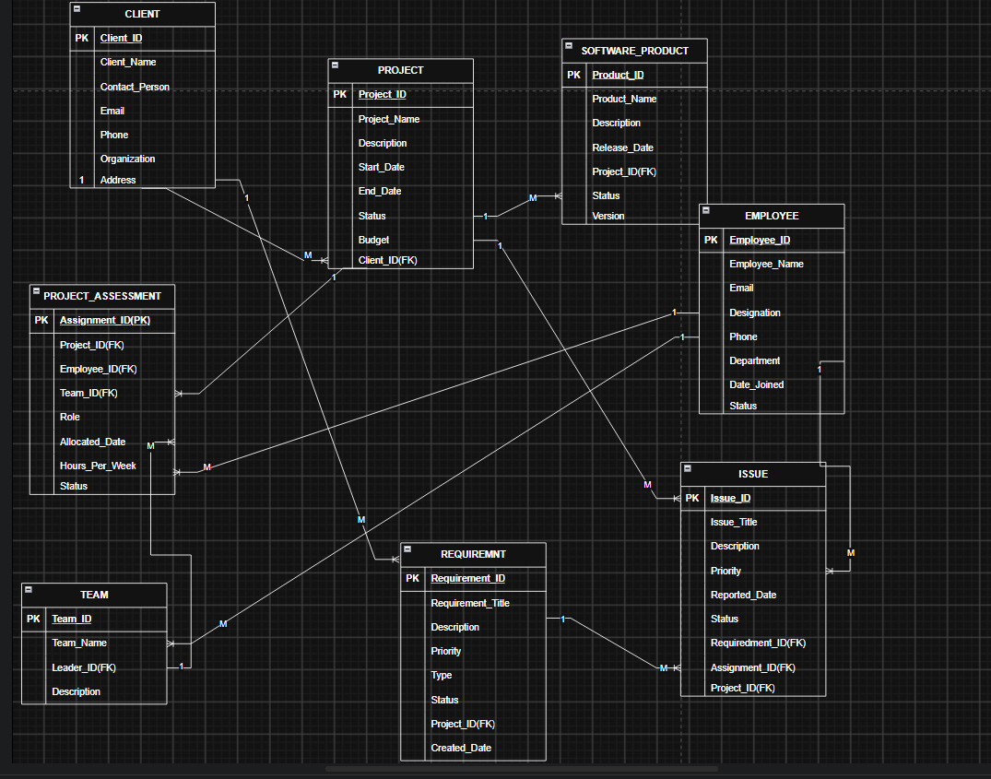
09 / ARCHITECTURE
Entity–Relationship Diagram
SOFTWARE MANAGEMENT DATABASE SYSTEM • REVIEW I

Slide 10



10 / COLLABORATION
Team Responsibilities, GitHub & Next Review
TEAM MEMBER | RESPONSIBILITY
S. ARAVINDA REDDY | Project title, introduction, problem statement and objectives, Scope
M. GANGADHAR | entities, attributes, Primary Keys and Foreign Keys
T ESWAR VARDHAN | relational schema and ER diagram
K.V.SAI GANESH | GitHub repository and PPT documentation
V.SATYA SAI | Relationships, cardinality
GITHUB
NEXT REVIEW
IMPLEMENTATION
Add repository name and link here.
Implement tables, sample records and SQL queries.
Validate relationships, constraints and test data.
SOFTWARE MANAGEMENT DATABASE SYSTEM • REVIEW I

Slide 11

11 / NEXT PHASE
Expected Outcomes & Future Enhancements
EXPECTED OUTCOMES
FUTURE ENHANCEMENTS
Clear conceptual model of software-management data.
Implement using a relational DBMS.
Relational schema with defined PKs and FKs.
Add authentication and role-based access.
Improved organization of connected project records.
Add analytics and reporting dashboards.
Foundation for SQL implementation and testing.
Extend with releases, testing, deployment and audit modules.
Add backup, recovery and data-governance procedures.
SOFTWARE MANAGEMENT DATABASE SYSTEM • REVIEW I

Slide 12
12 / OUTCOME
Conclusion
The proposed Software Management Database System identifies seven major entities required to represent core software-project activities.
The attributes, Primary Keys and Foreign Keys have been identified.
The relationships and cardinalities between the entities have been defined.
QUESTIONS &
DISCUSSION
The ER diagram and relational database schema provide the foundation for implementation.
Review–II can proceed to SQL creation, sample data, queries and testing.
Thank you for your attention.
SOFTWARE MANAGEMENT DATABASE SYSTEM • REVIEW I

Slide 13
THANK YOU

