Slide 1
TOKENS..
Siva sai ganesh sunkara…

Slide 2
Tokens:-
→ A smallest individual unit within program is called Token.
1. Keywords.
2. Identifiers.
3. Literals.
4. Operators.
5. Data Types.

Slide 3
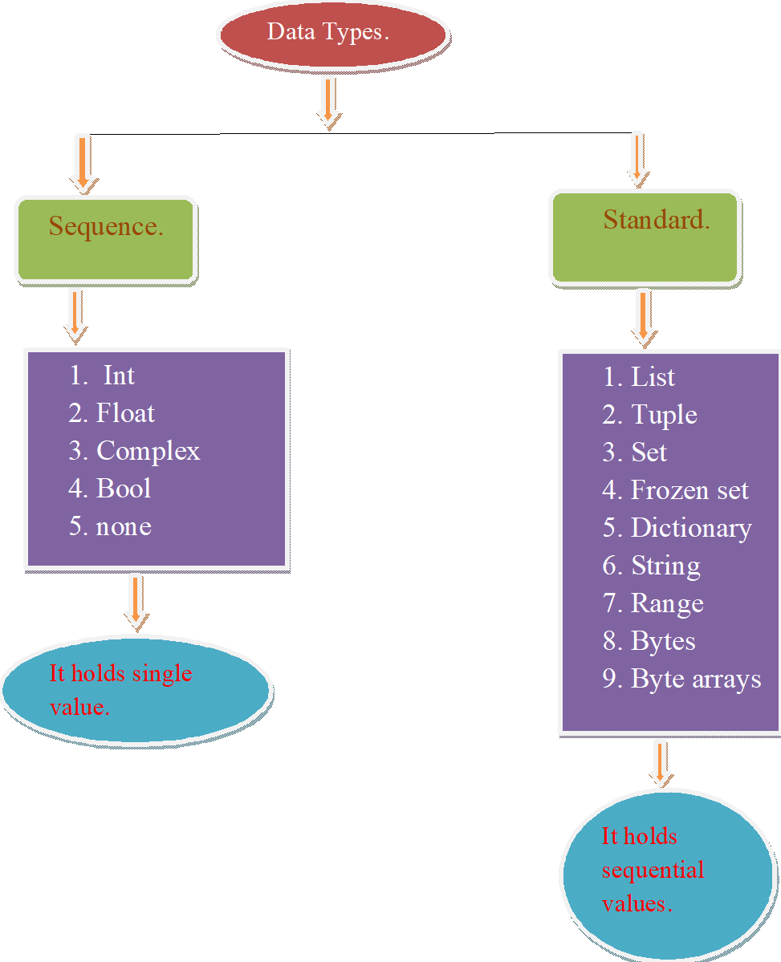

Slide 4
Data types allocates memory for data.
In python data is represented as object.
Each object with having 2 characteristics.
1. properties. → (data of the object)
2. behaviour. →( Functionality of the object)
→The properties and behaviour of object is encapsulated with in class.
→Every data type in python is a class and instance is object.
→All these are predefined classes and exists in bulitins library /modules.
→Arrays are dimensions but sequences are collections.

Slide 5
Variables:-
→ It is an identifier.
→ It is named as memory location / named memory location.
→Each variable in python is reference variable. These variables hold address of objects.
→Variables are changes at that time that is called as Duck type/ Dynamic type.
→By assigning values or object behaviour (duck type).
→A variable is not bind with one type.
→The type get changed based on the values assigned (or) based on object assigned.
Previous values are removed them. And present values are assigned.
Advantages of immutable is to be shared. Because the object is constant.

Slide 6
Literals:-
→ Syntaxical representation of a value / constant.
→Python allows to represent integer values is 4 formats:-
1. Decimal integers.
2. Octal integers.
3. Hexa decimal integers.
4. Binary integers.

Slide 7
Operators:-
1. Arithmetic operators.
2. Relational operators.
3. Logical operators.
4. Assignment operators.
5. Bitwise operators.
6. Membership operators.
7. Identity operators.

