Slide 1
Enhancing Coffee Shopping Experience with Web Technologies.
PROJECT GUIDE:- MR. P RAMPRASAD

Slide 2
ABSTACT
The “Enhancing coffee shopping Experience with web technology (Coffee Selling Website)” is an advanced e-commerce platform designed to offer a superior shopping experience for coffee lovers, leveraging a mono repo architecture to enhance performance, scalability, and maintainability. The front-end utilizes React with Redux for state management, while Next.js enables server-side rendering and static site generation for enhanced performance and SEO. The backend is powered by Node.js, with Cloudflare services providing security, performance, and reliability. TypeScript ensures robust type checking, and Prisma ORM facilitates type-safe interactions with both PostgreSQL and MongoDB databases. Authentication is managed using JSON Web Tokens (JWT) and Next Auth, ensuring secure and scalable user management. Key features include a detailed product catalogue, secure user authentication, a dynamic shopping cart with a streamlined checkout process, comprehensive order management, advanced search and filtering capabilities, and a responsive design for optimal user experience across all devices. This project exemplifies the integration of contemporary web technologies to create a high-performance, user-friendly platform for coffee enthusiasts and sellers alike.

Slide 3
HARDWARE REQUIREMENT
PROCESSOR : Pentium-4
RAM : 4-GB (min)
HARD DISK : 20 GB
KEY BOARD : Standard Windows Keyboard
MOUSE : Two or three Button Mouse
MONITOR : SVGA

Slide 4
TECHNOLOGIES USED
OPERATING SYSTEM : WINDOWS 10
CODING LANGUAGES : JAVASCRIPT AND TYPESCRIPT
FRONT-END : REACT , VITE , NEXTJS , REDUX
BACK-END : NODE JS,EXPRESS JS , ZOD, ORM,TYPESCRIPT
DESIGNING : HTML,CSS,TAILWIND
DATABASE : MONGODB AND POSTGRESQL
OTHERS : GIT , GITHUB

Slide 5
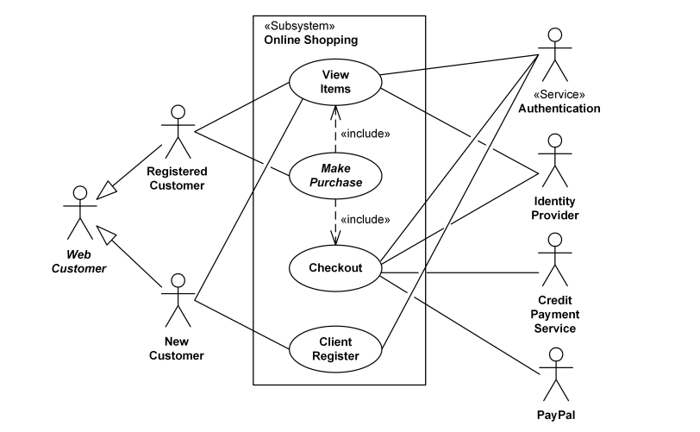
USE CASE UML DIAGRAM

Slide 6
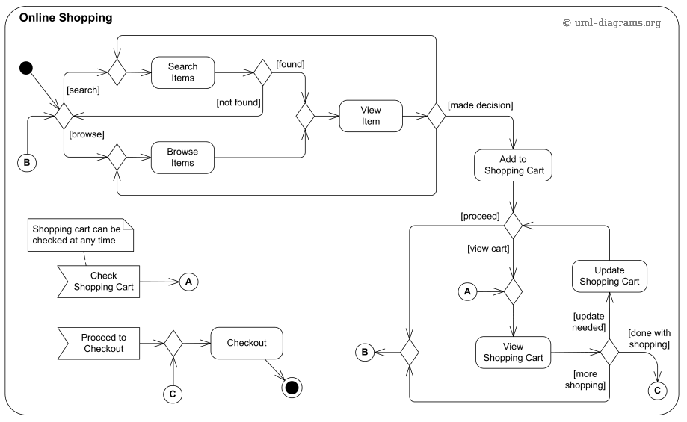
UML ACTIVITY DIAGRAM

Slide 7
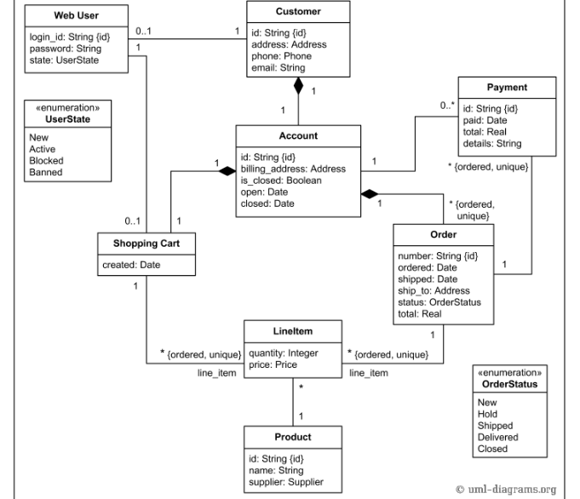
UML CLASS DIAGRAM

Slide 8
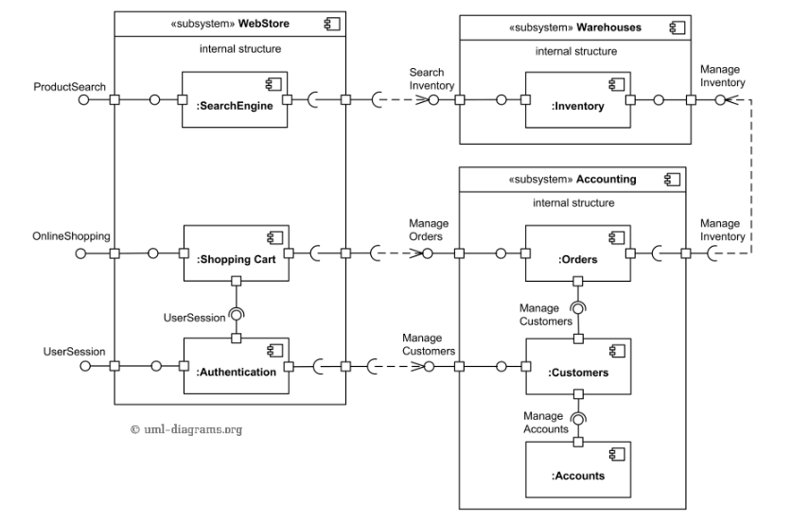
UML COMPONENT DIAGRAM

Slide 9
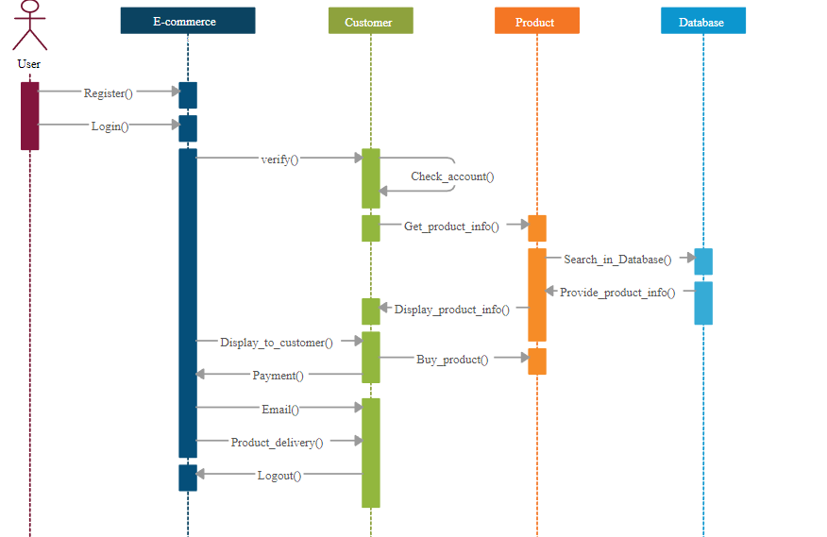
UML SEQUENCE DIAGRAM

Slide 10
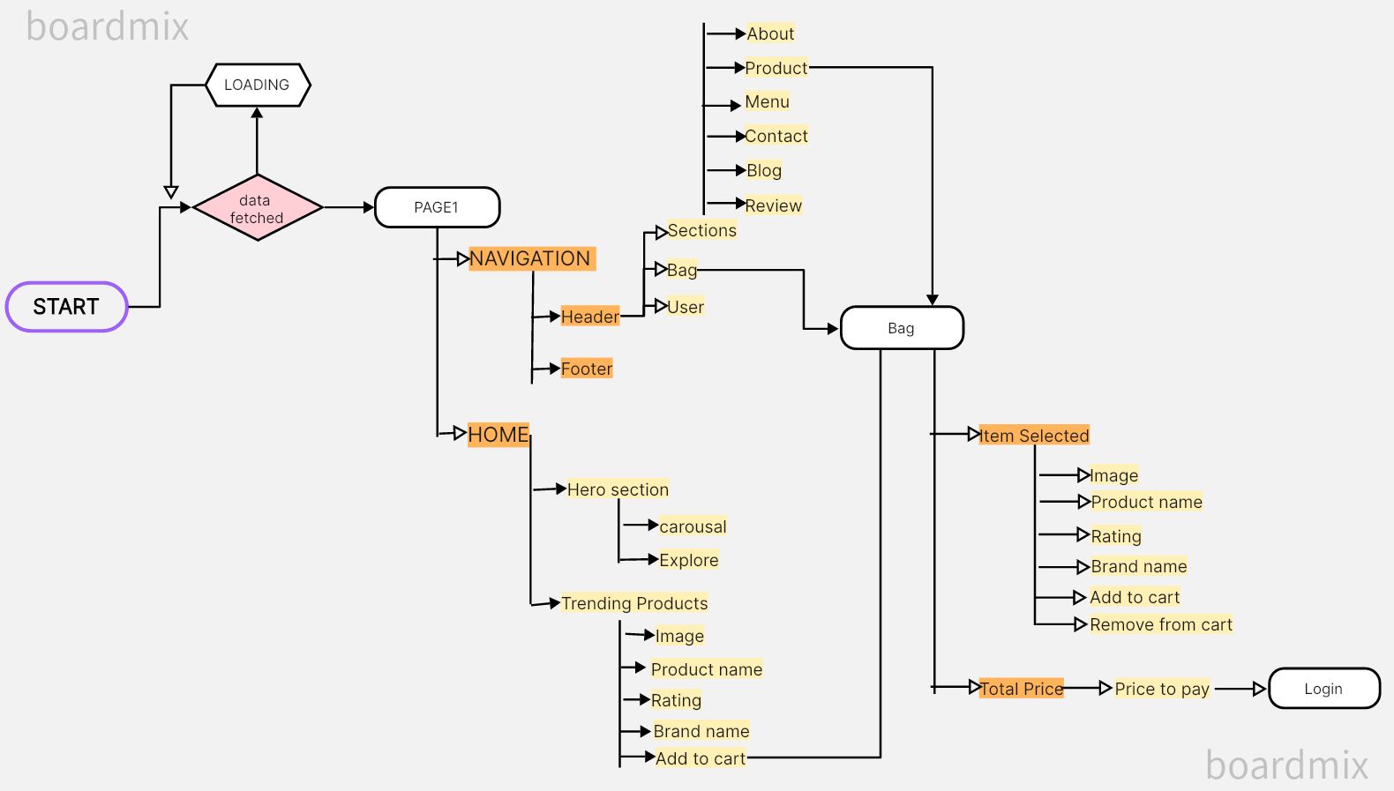
USER FLOW DIAGRAM IN UI

Slide 11
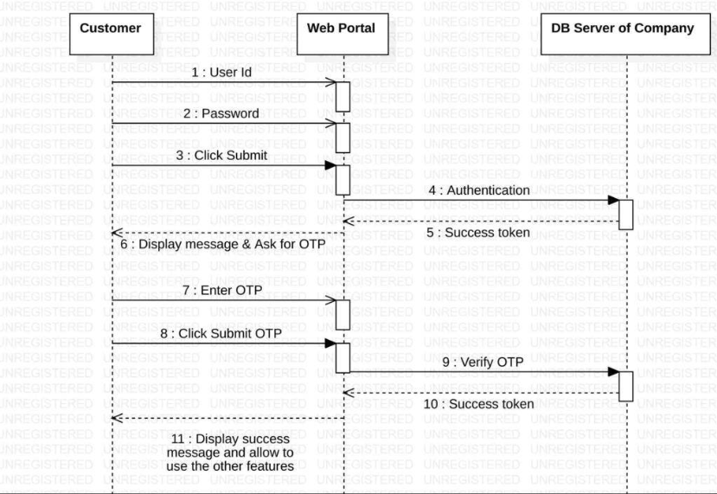
USER AUTHENTICATION SEQUENCE DIAGRAM

Slide 12
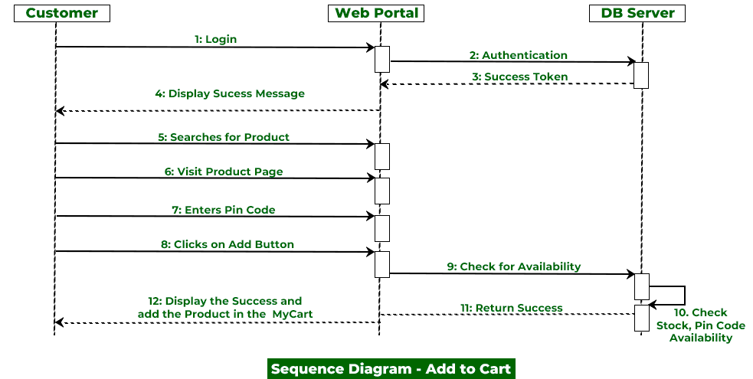
ADD TO CART SEQUENCE DIAGRAM

Slide 13
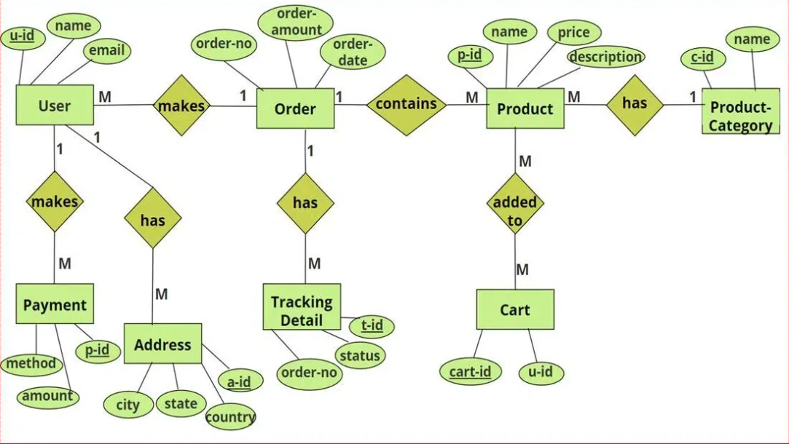
ER DIAGRAM

Slide 14
THANK YOU

