Slide 1

AURORAS PG COLLEGE,NAMPALLY
Enhancing Coffee Shopping Experience with Web Technologies.
PROJECT GUIDE:- MR. P RAMPRASAD
Submission by:-Ganesh Sahu (2129-22-862-11)

Slide 2
INTRODUCTION
The “Enhancing Coffee Shopping Experience with Web Technologies” project is an advanced e-commerce platform meticulously designed to provide a superior and immersive shopping experience for coffee enthusiasts. This platform integrates state-of-the-art web technologies to ensure exceptional performance, scalability, and maintainability. The front-end development leverages React for a dynamic and responsive user interface, paired with Redux for efficient state management. The backend is robustly built using Node.js, and MongoDB is employed for scalable and flexible database management. The architecture is thoughtfully designed to facilitate seamless interactions between the front-end and back-end components, ensuring a smooth and responsive user experience. Key features of the platform include an extensive product catalog, secure user authentication, a dynamic shopping cart with a streamlined checkout process, comprehensive order management, advanced search and filtering capabilities, and a responsive design that ensures optimal user experience across all devices. This project exemplifies the integration of modern web technologies to create a high-performance, user-friendly platform for coffee enthusiasts and sellers alike.

Slide 3
Existing system vs Proposed system
EXISTING SYSTEM
1.Limited reach
2.Mannual process
3.Lack of centralization
4. Inadequate Customer Engagement
5. Inefficient Payment Processes
6. Minimal Tracking
PROPOSED SYSTEM
1.Comprehensive Online Platform
2. Automated Order Management
3.Enhanced Accessibility
4. Customer Engagement Features
5. Analytics and Reporting
6. Secure and Scalable
7. Seamless Payment Integration
8. Real-time inventory Tracking

Slide 4
HARDWARE REQUIREMENT
PROCESSOR : Pentium-4
RAM : 4-GB (min)
HARD DISK : 20 GB
KEY BOARD : Standard Windows Keyboard
MOUSE : Two or three Button Mouse
MONITOR : SVGA

Slide 5
TECHNOLOGIES USED
OPERATING SYSTEM : WINDOWS 10
CODING LANGUAGES : JAVASCRIPT
FRONT-END : REACT , REDUX
BACK-END : NODE JS,EXPRESS JS , BCRYPT,ORM
DESIGNING : HTML,CSS,TAILWIND
DATABASE : MONGODB AND POSTGRESQL
OTHERS : GIT , GITHUB

Slide 6
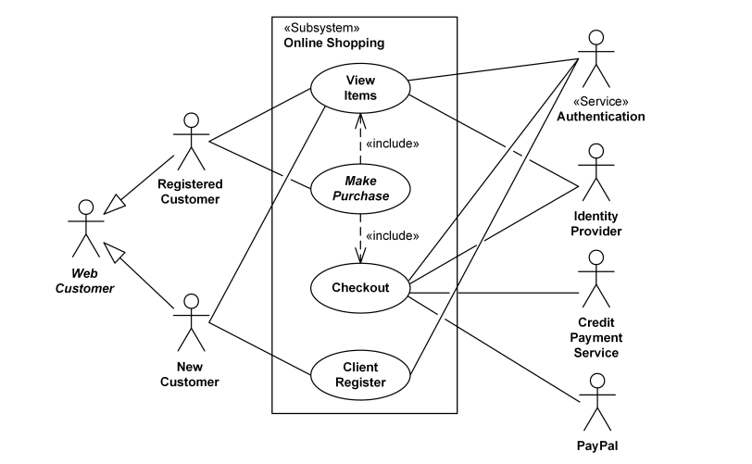
USE CASE UML DIAGRAM

Slide 7
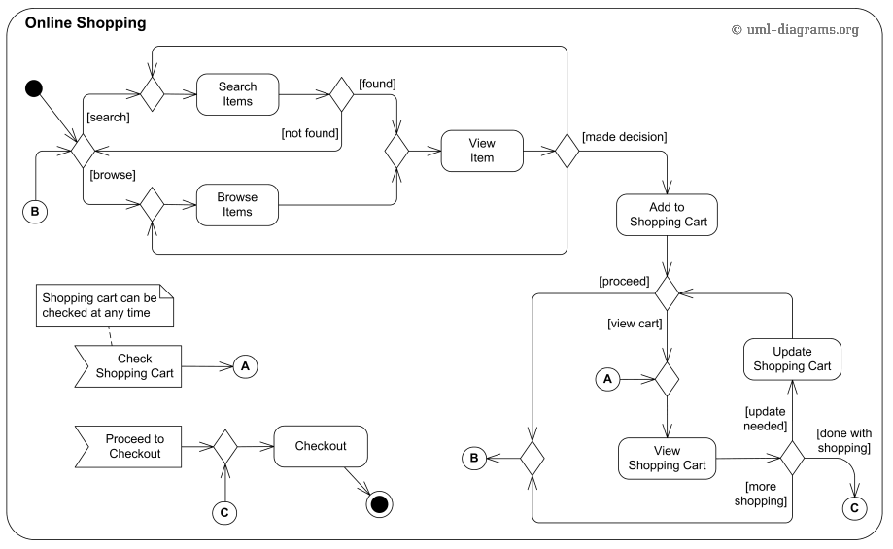
UML ACTIVITY DIAGRAM

Slide 8
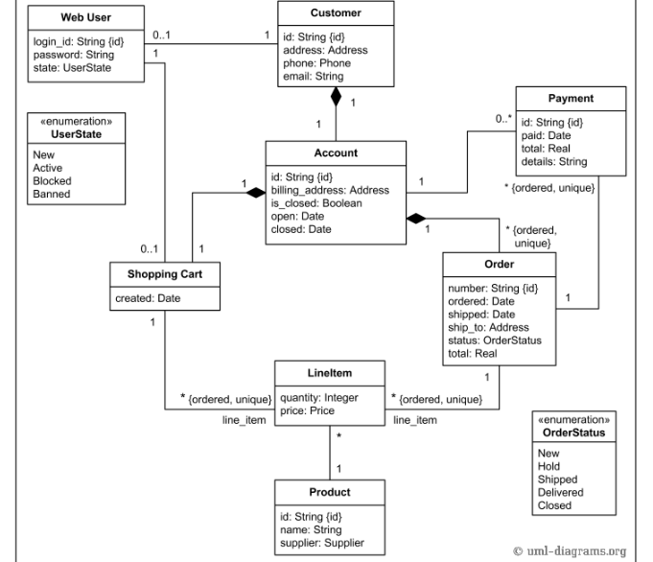
UML CLASS DIAGRAM

Slide 9
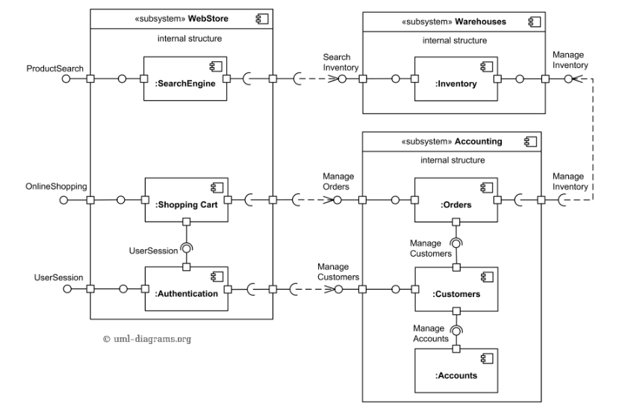
UML COMPONENT DIAGRAM

Slide 10
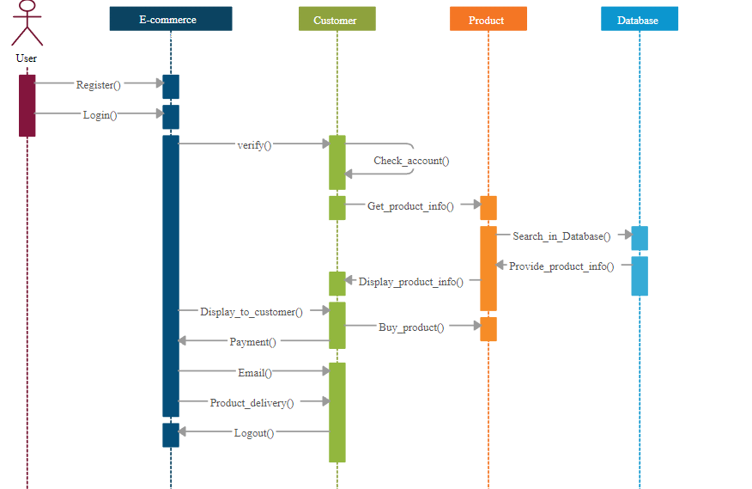
UML SEQUENCE DIAGRAM

Slide 11
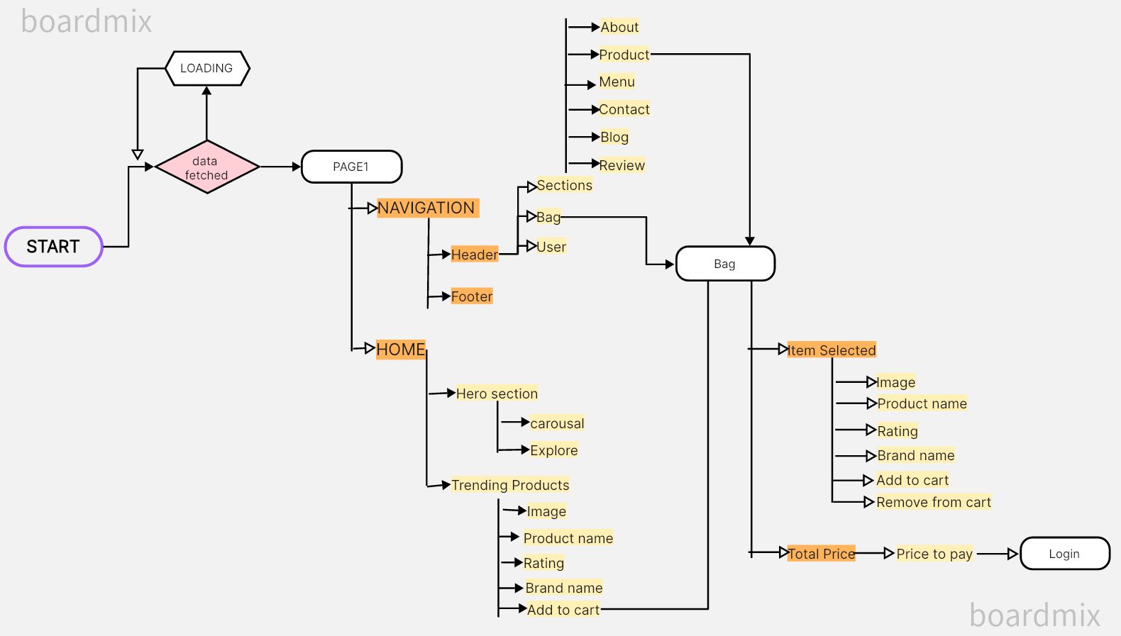
USER FLOW DIAGRAM IN UI

Slide 12
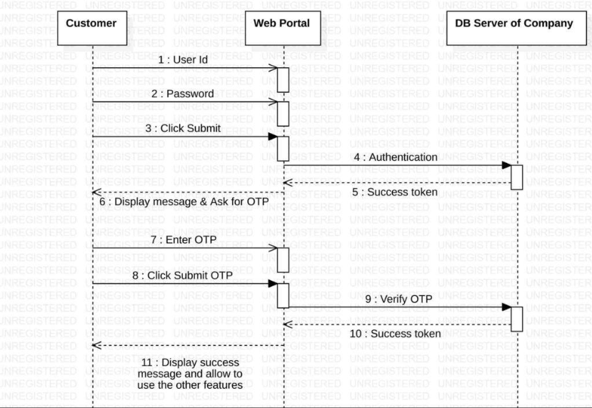
USER AUTHENTICATION SEQUENCE DIAGRAM

Slide 13
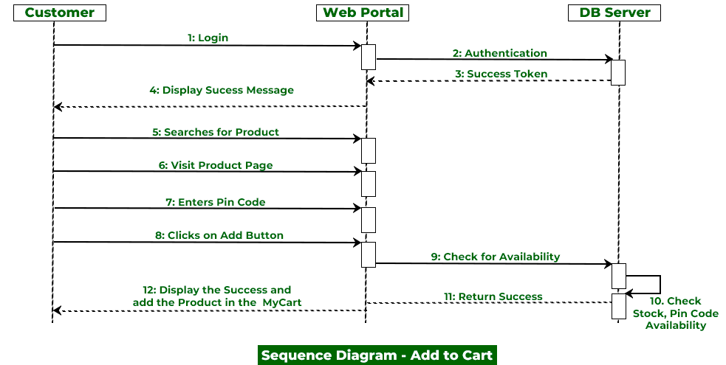
ADD TO CART SEQUENCE DIAGRAM

Slide 14
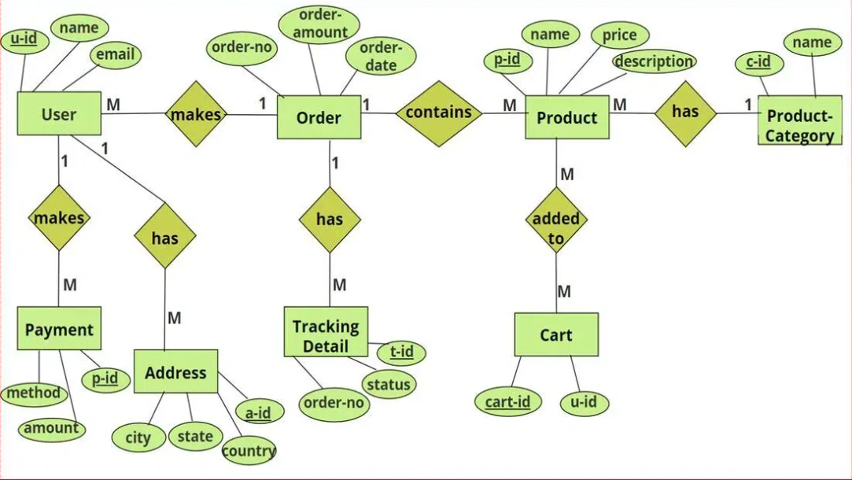
ER DIAGRAM

Slide 15
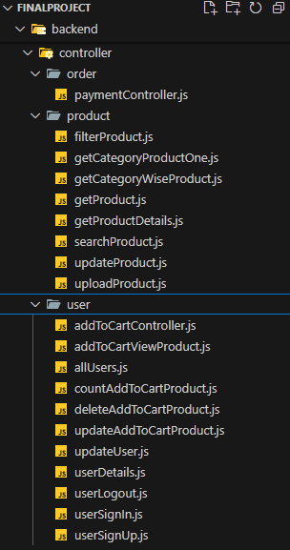
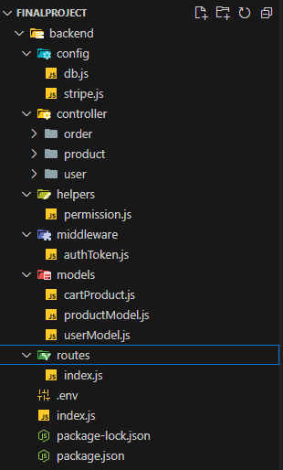
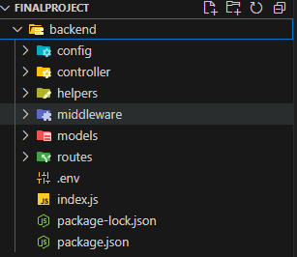
PROJECT STRUCTURE

Slide 16
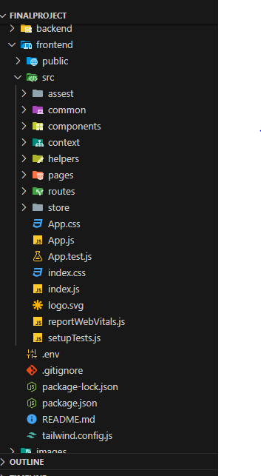
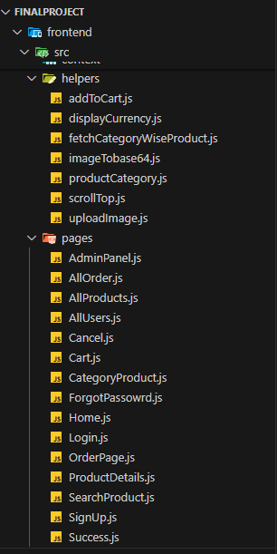
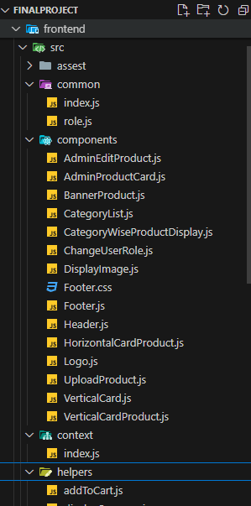
PROJECT STRUCTURE

Slide 17
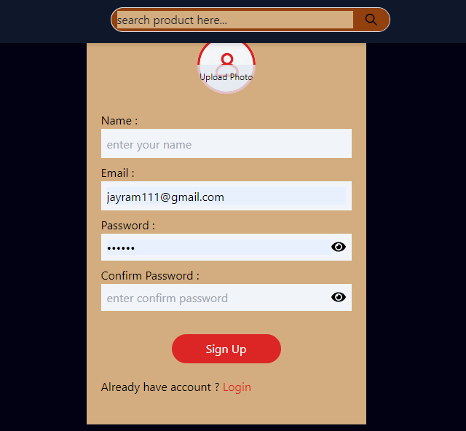
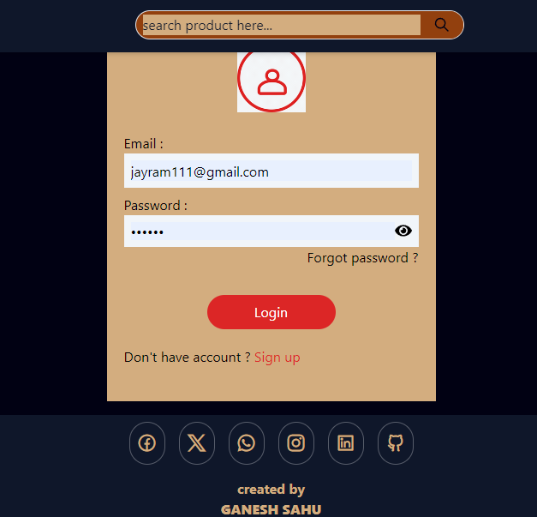
OUTPUT SCREENS

Slide 18
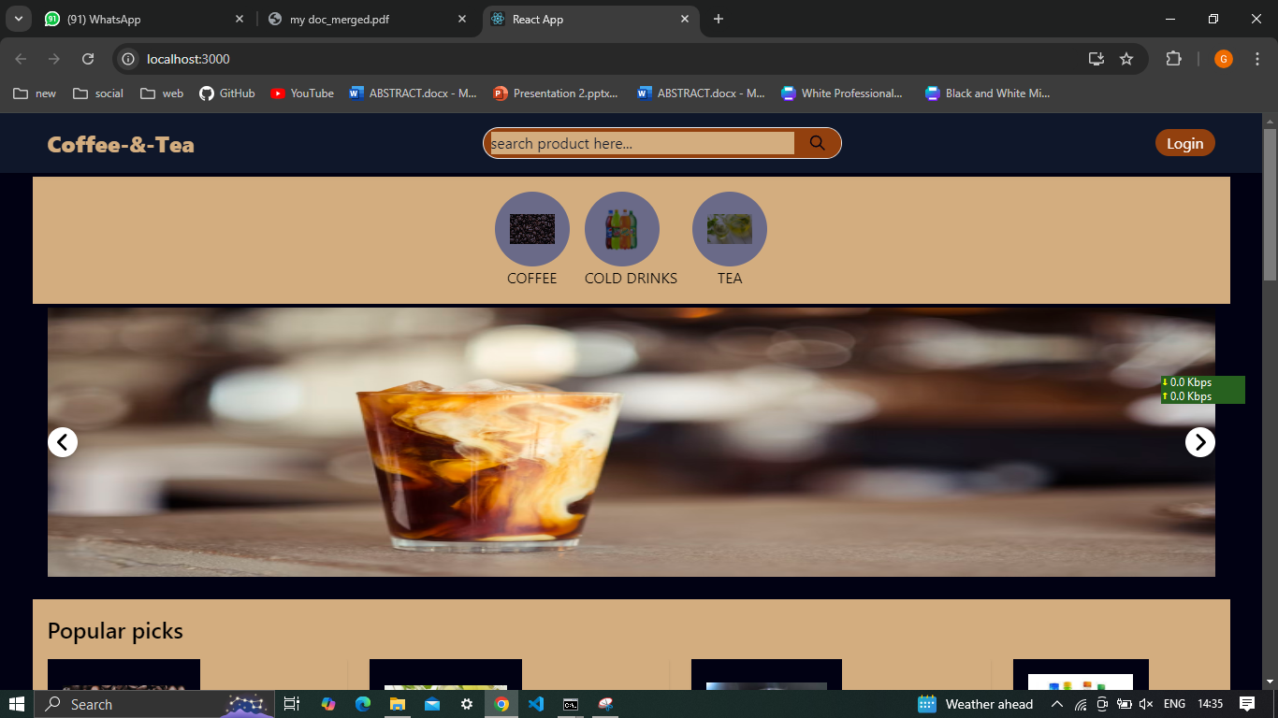
OUTPUT SCREENS

Slide 19
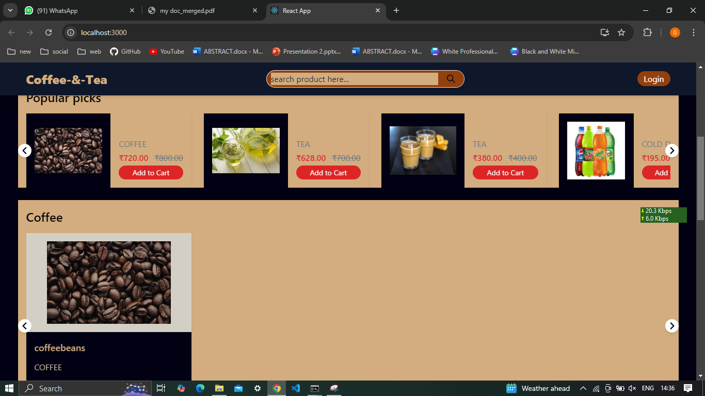
OUTPUT SCREENS

Slide 20
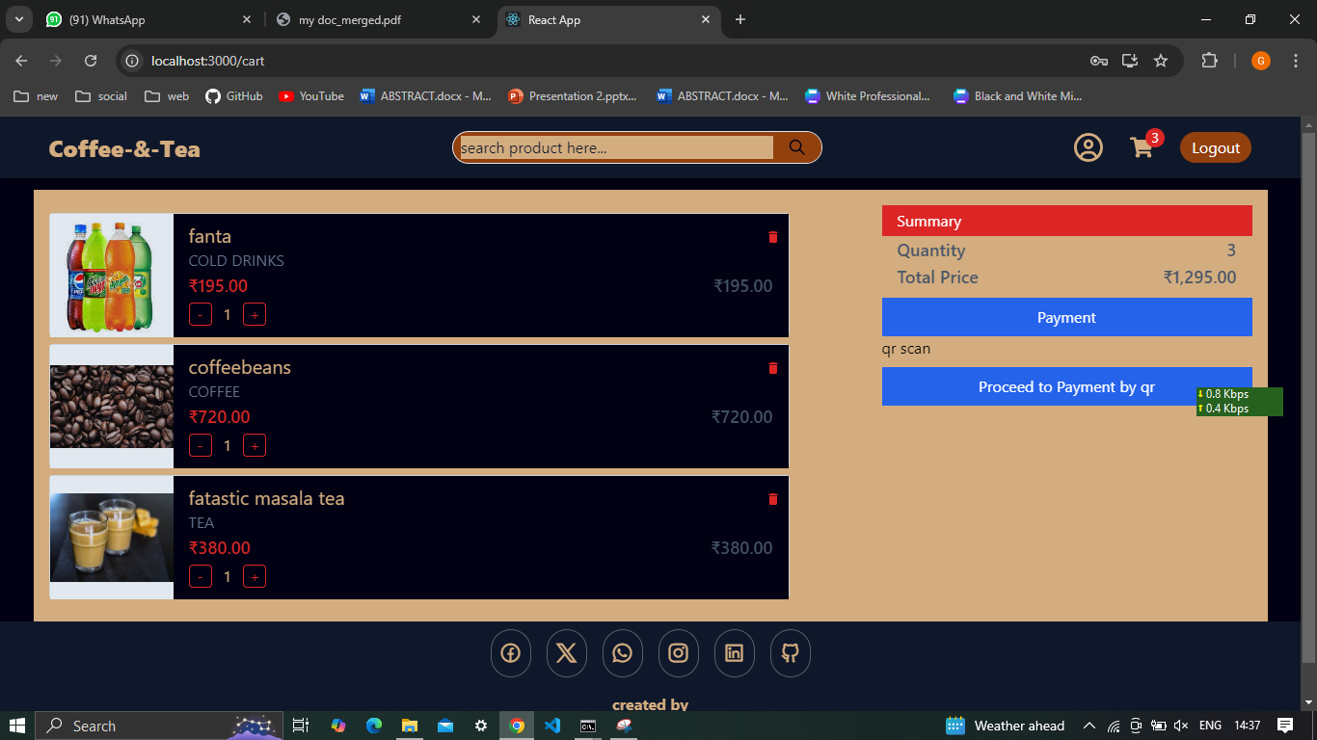
OUTPUT SCREENS

Slide 21
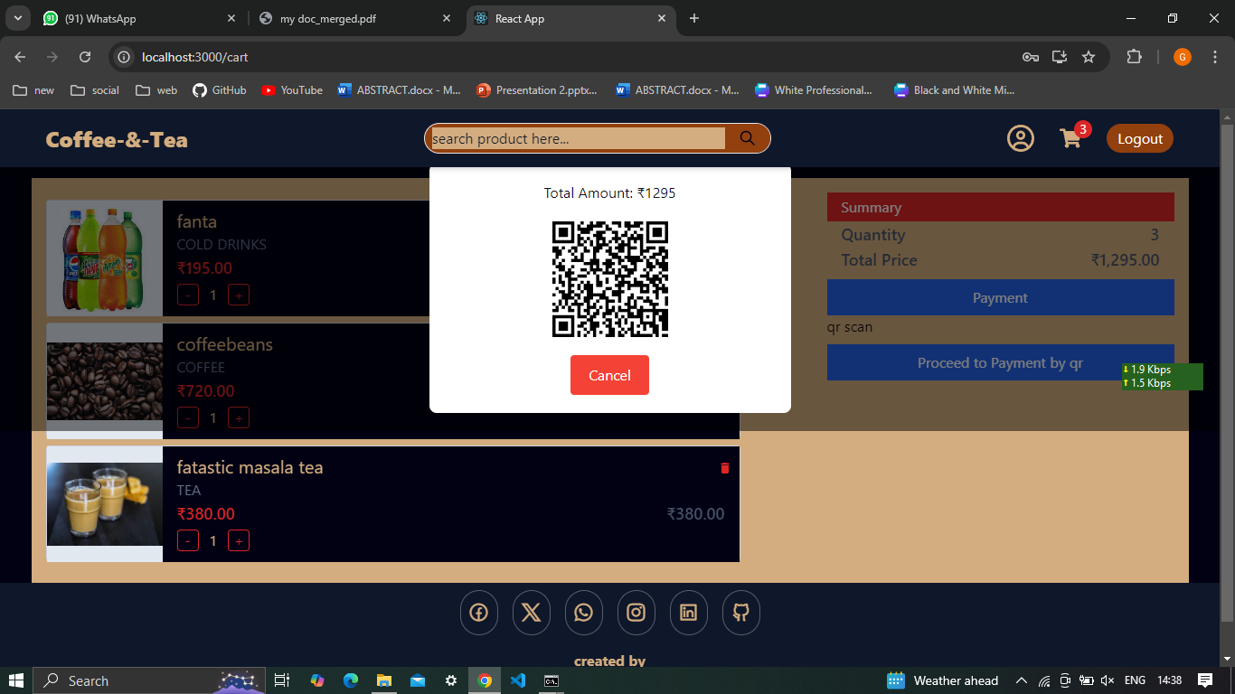
OUTPUT SCREENS

Slide 22
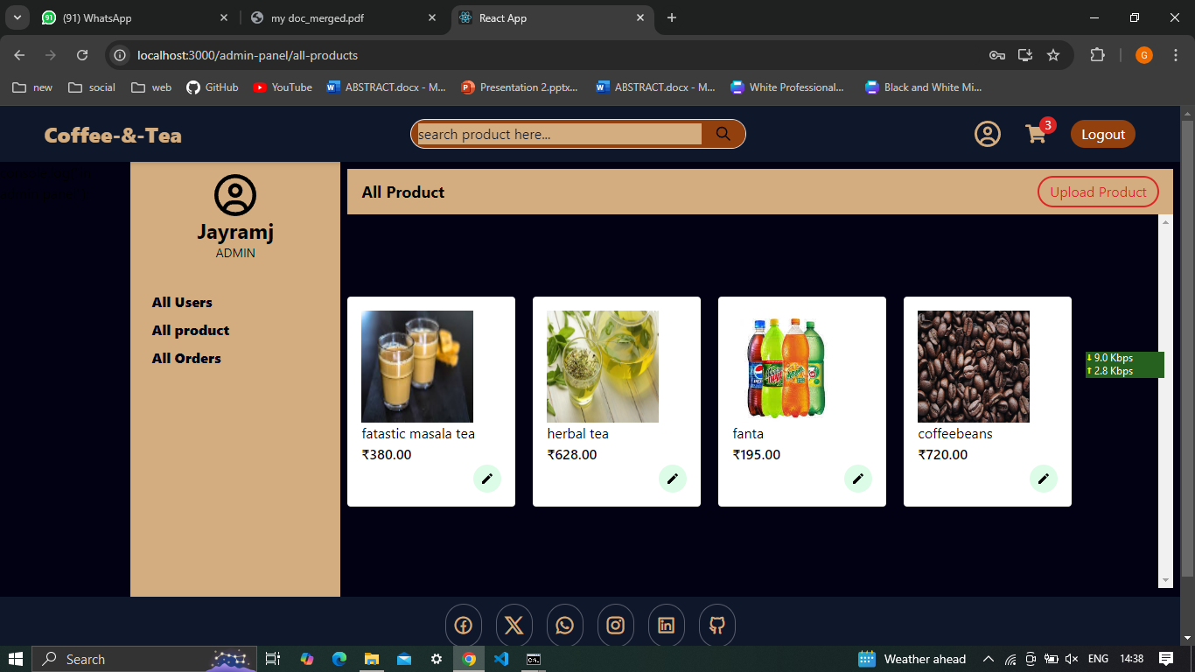
OUTPUT SCREENS

Slide 23
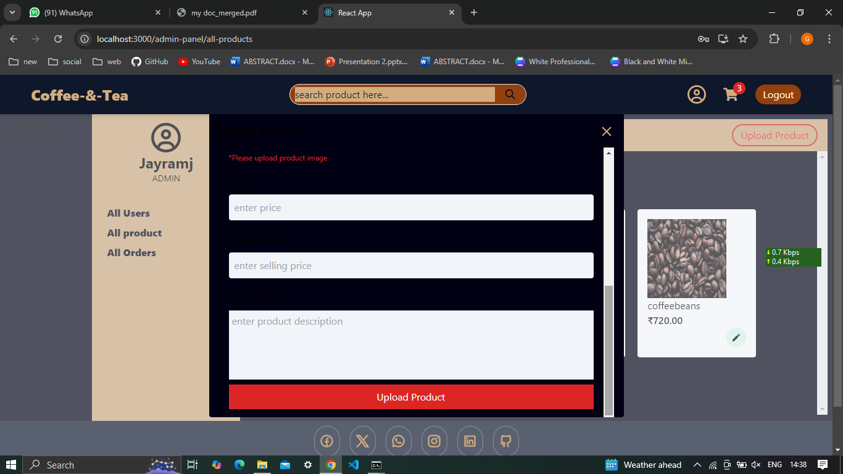
OUTPUT SCREENS

Slide 24
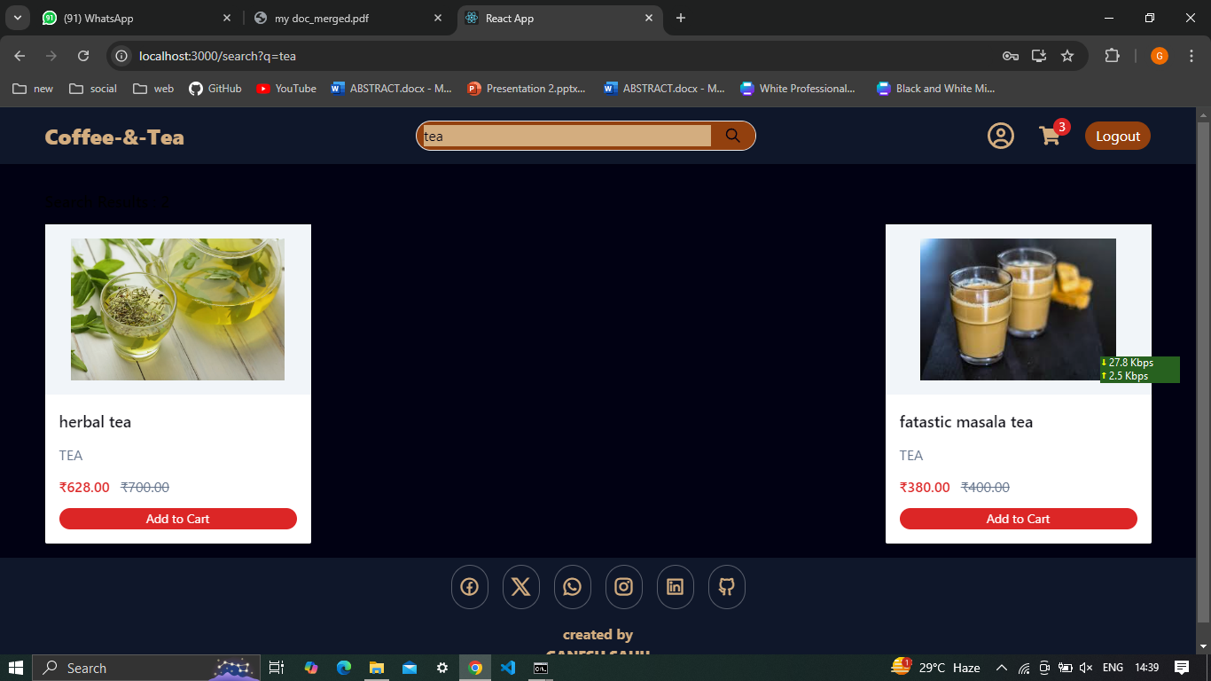
OUTPUT SCREENS

Slide 25
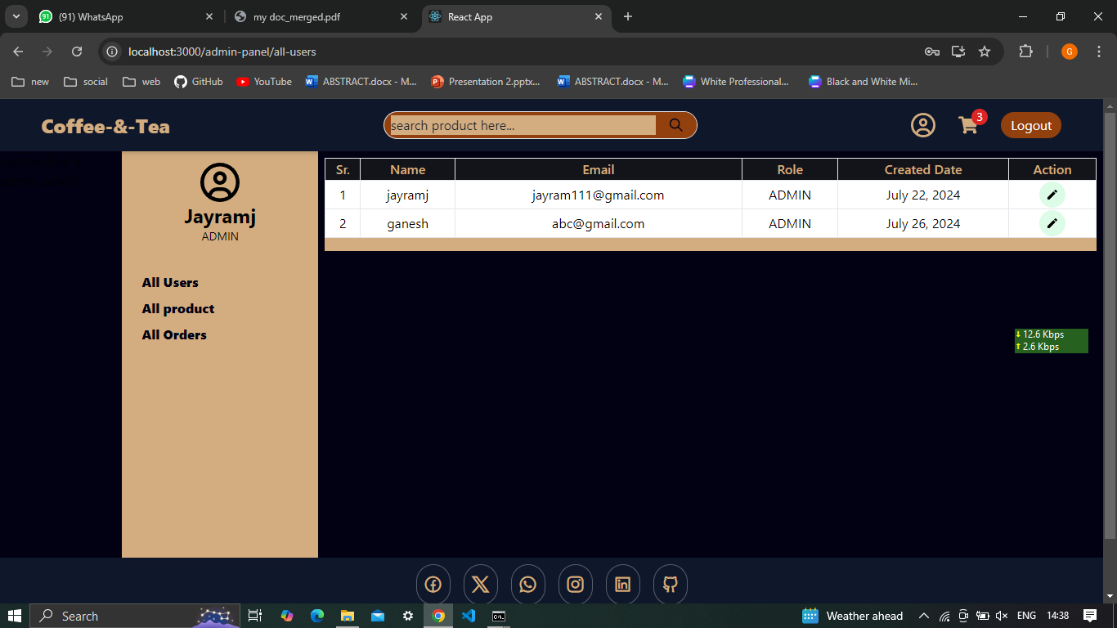
OUTPUT SCREENS

Slide 26
THANK YOU

