Slide 1

Vel Tech Rangarajan Dr. Sagunthala R&D Institute of Science and Technology
School of Computing
Department of Computer Science and Engineering
10211CS224 / FULL STACK APPLICATION DEVELOPMENT (JAVA)
PROJECT REVIEW : MILESTONE PROJECT – 1
Date: 23-03-2026
Relational Inventory Control & Stock Tracking System
SDG: SDG 9 – Industry, Innovation and Infrastructure
Presented By:
V YAMINI – VTU24457–23UECS0580
Courses Handling Faculty:
Dr M MAGESHWARI

Slide 2
INTRODUCTION
Inventory management plays a vital role in businesses to maintain proper stock levels and avoid losses.
Many small and medium enterprises still rely on manual record-keeping methods.
Manual systems often lead to stock mismanagement, data redundancy, and errors.
A relational database-based system ensures structured and efficient data handling.
This project focuses on developing a web-based inventory control system.
It tracks stock availability, product details, and transaction history.
The system ensures data accuracy, real-time updates, and secure access.
It helps organizations improve operational efficiency and decision-making.
1
2
3
4
5
6
7
8
9

Slide 3
PROBLEM STATEMENT
Many organizations manage inventory using spreadsheets or manual registers.
This approach leads to duplicate records and inaccurate stock updates.
Stock shortages or overstocking result in financial losses.
Tracking supplier and product relationships becomes difficult.
Generating reports is time-consuming and error-prone.
There is no centralized system for monitoring stock movement.
Security and data consistency are not guaranteed.
Hence, a reliable relational inventory system is required.
1
2
3
4
5
6
7
8
9

Slide 4
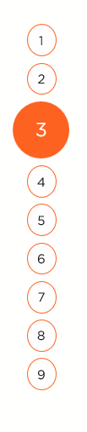
OBJECTIVE(S)
To design and develop a relational database-driven inventory control system for efficient stock tracking.
To implement real-time stock updates, reporting and secure user management.
Implement CRUD operations (Add, Update, Delete products)
Provide real-time database updates using MySQL
Ensure secure login system
1
2
3
4
5
6
7
8
9

Slide 5
PROPOSED SYSTEM
UI: Responsive HTML & CSS design with a sky-blue themed table interface
Database: MySQL storing users and products
Authentication: Secure login with session management
Features:
Add, view, edit, and delete products
Real-time product search by name
Dashboard displaying inventory statistics
Forms: Modal-based product editing interface
Backend: Node.js / Express server with REST APIs
Status: Fully functional, production-ready system
1
2
3
4
5
6
7
8
9

Slide 6
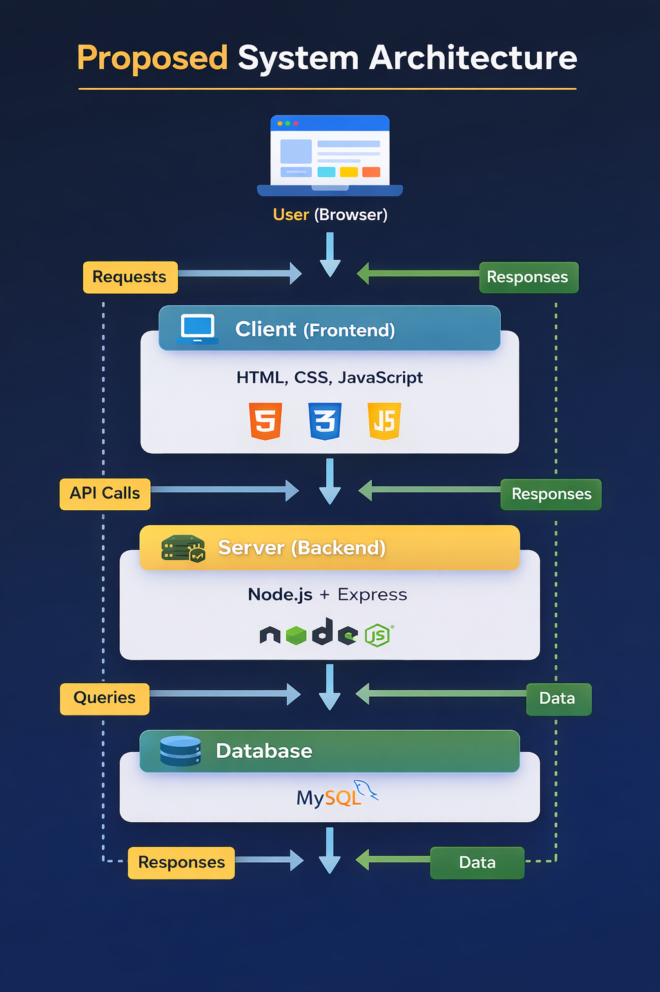
PROPOSED SYSTEM ARCHITECTURE
1
2
3
4
5
6
7
8
9

Slide 7
PROPOSED SYSTEM ARCHITECTURE
🔹 Input: The user enters login details to access the system. The user adds new product information or updates existing details. The user can also search for products using the search option.
🔹 Processing: The system checks and validates the entered data. It handles user login and verifies credentials. It performs add, update, delete, and search operations and processes user requests.
🔹 Database: The MySQL database stores user login details and product information. It updates the data whenever changes are made. It also retrieves data when requested by the system.
🔹 Output: The system displays the dashboard after login. It shows the product list in a table format. It also displays updated stock details and search results to the user.
1
2
3
4
5
6
7
8
9

Slide 8
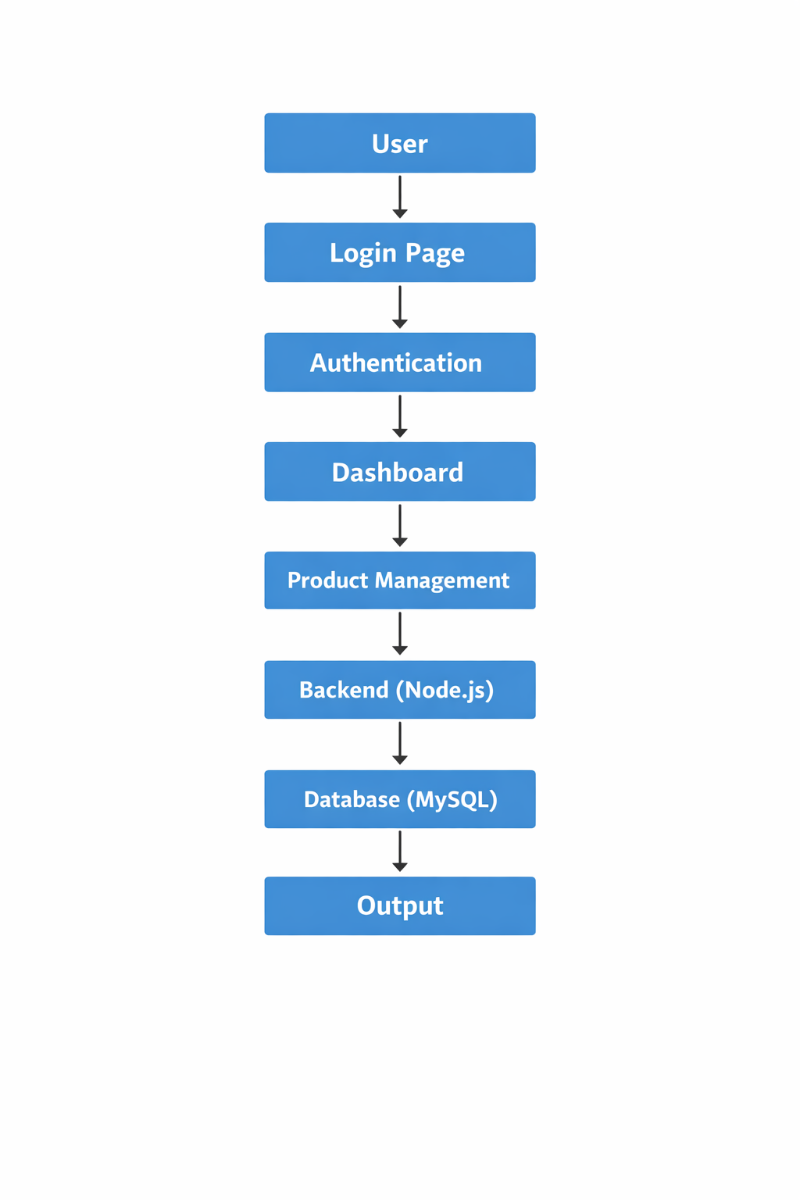
WORKFLOW
1
2
3
4
5
6
7
8
9

Slide 9
TECHNOLOGIES USED
Frontend: HTML, CSS, JavaScript
Backend: Java, Node.js (Express.js)
Database: MySQL
Tools: Visual Studio Code, MySQL Workbench
Environment: Node.js Runtime
Hardware/Software Requirements: Minimum 4GB RAM, JDK 17+, Web Browser
1
2
3
4
5
6
7
8
9

Slide 10
MODULE DESCRIPTION
1
Module 1: User Authentication Handles secure login by verifying username and password. It ensures that only authorized users can access the system and protects the application from unauthorized access.
Module 2: Dashboard Management Displays an overview of the inventory system. It shows important details like total number of products and stock status to help users understand the system quickly.
Module 3: Product Management Allows users to add new products, update existing product details, and delete products. It manages important fields like product name, price, and quantity.
Module 4: Search & View Products Enables users to view all available products in a table format. It also provides a search feature to quickly find products by name.
2
3
4
5
6
7
8
9

Slide 11
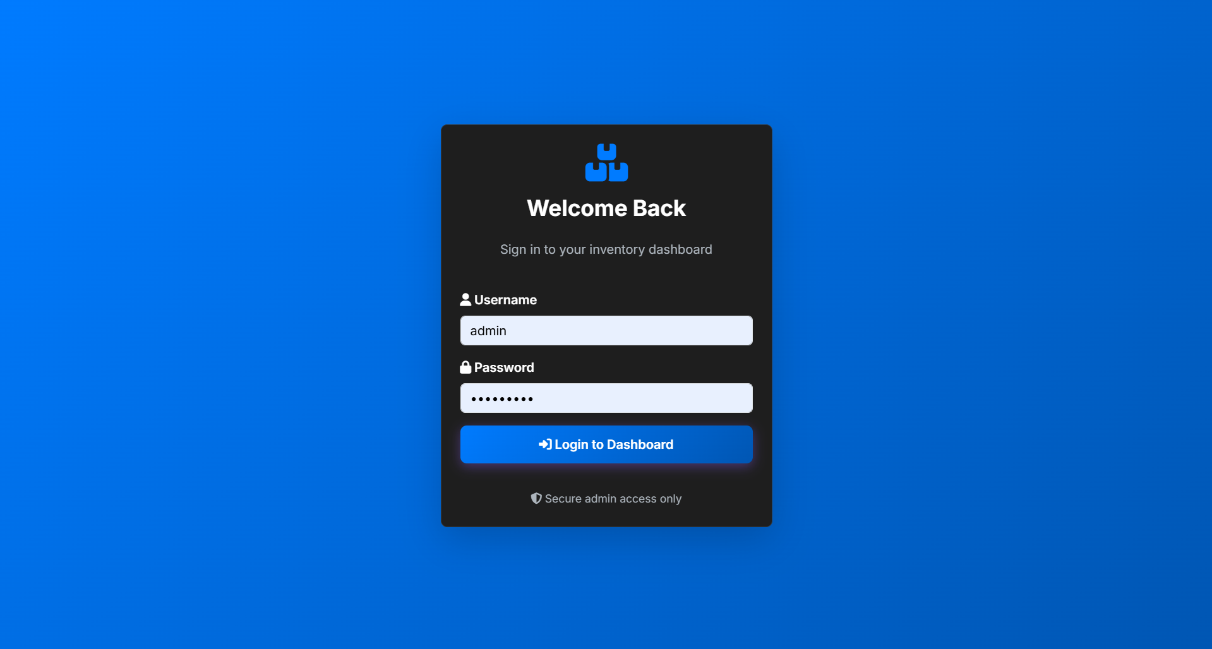
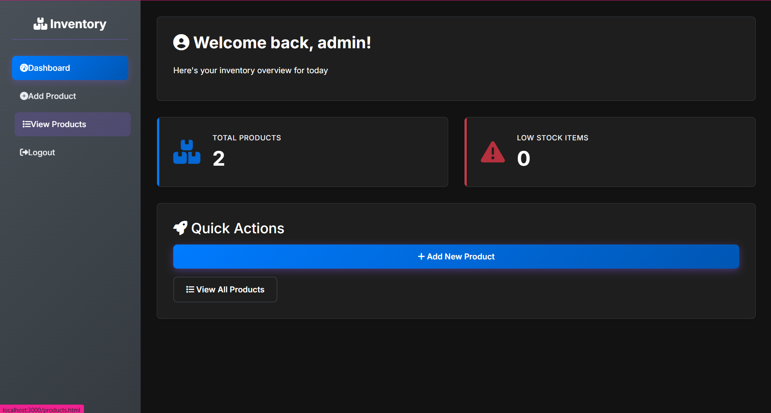
IMPLEMENTATION SCREENSHOTS
Loge Page: Secure authentication page for admin/user access.
Dashboard Page:
1
2
3
4
5
6
7
8(A)
9

Slide 12
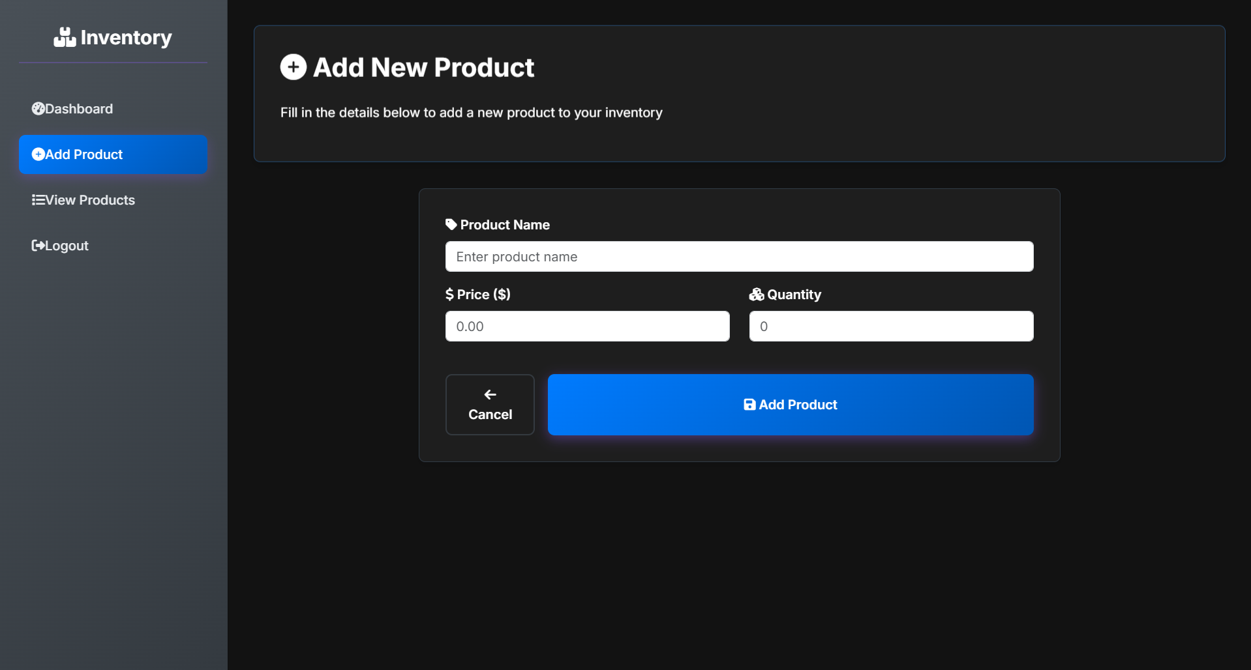
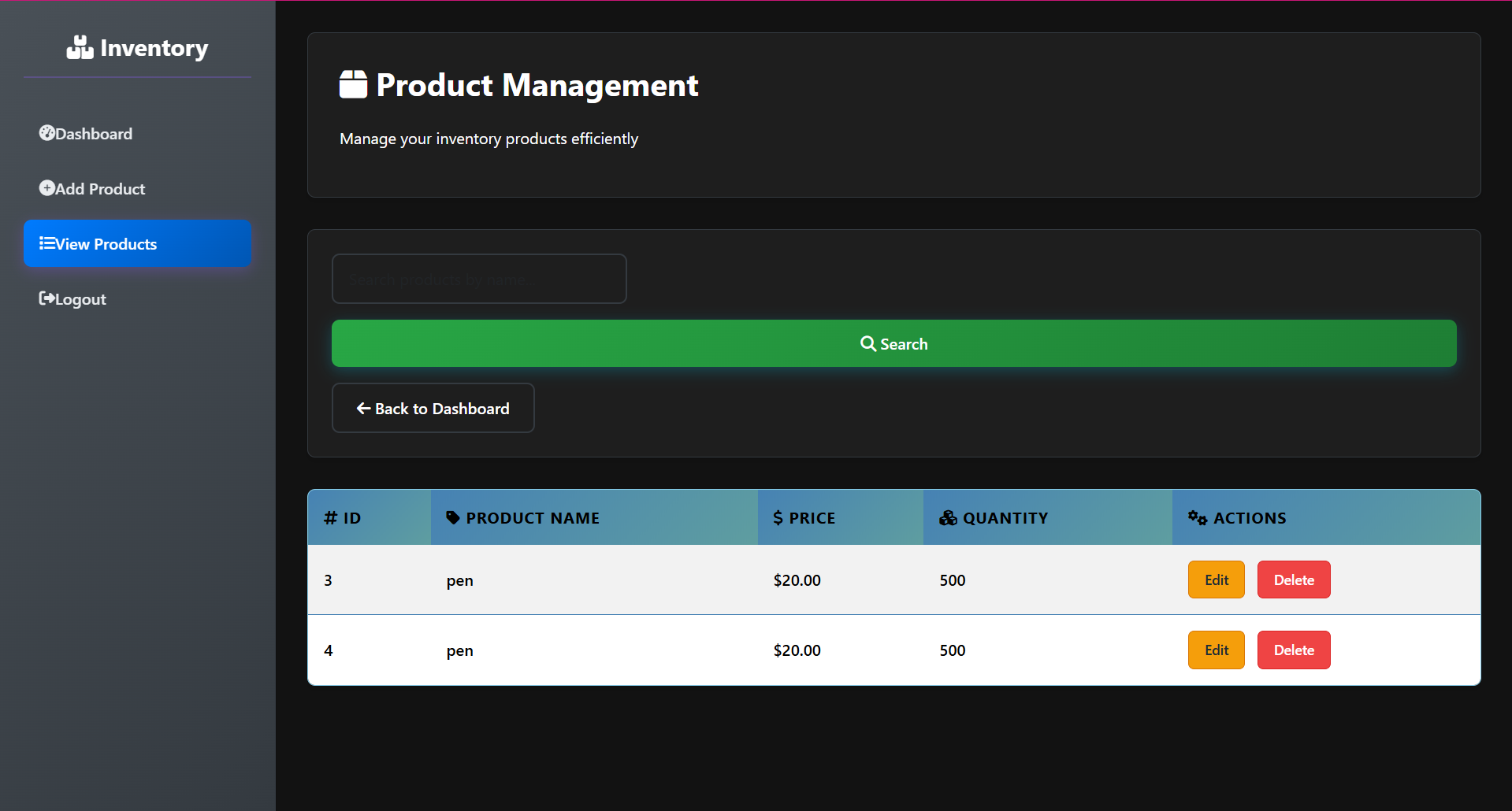
IMPLEMENTATION SCREENSHOTS
Main Module: Product and stock management interface to add/update and view inventory.
1
2
3
4
5
6
7
8
9

Slide 13
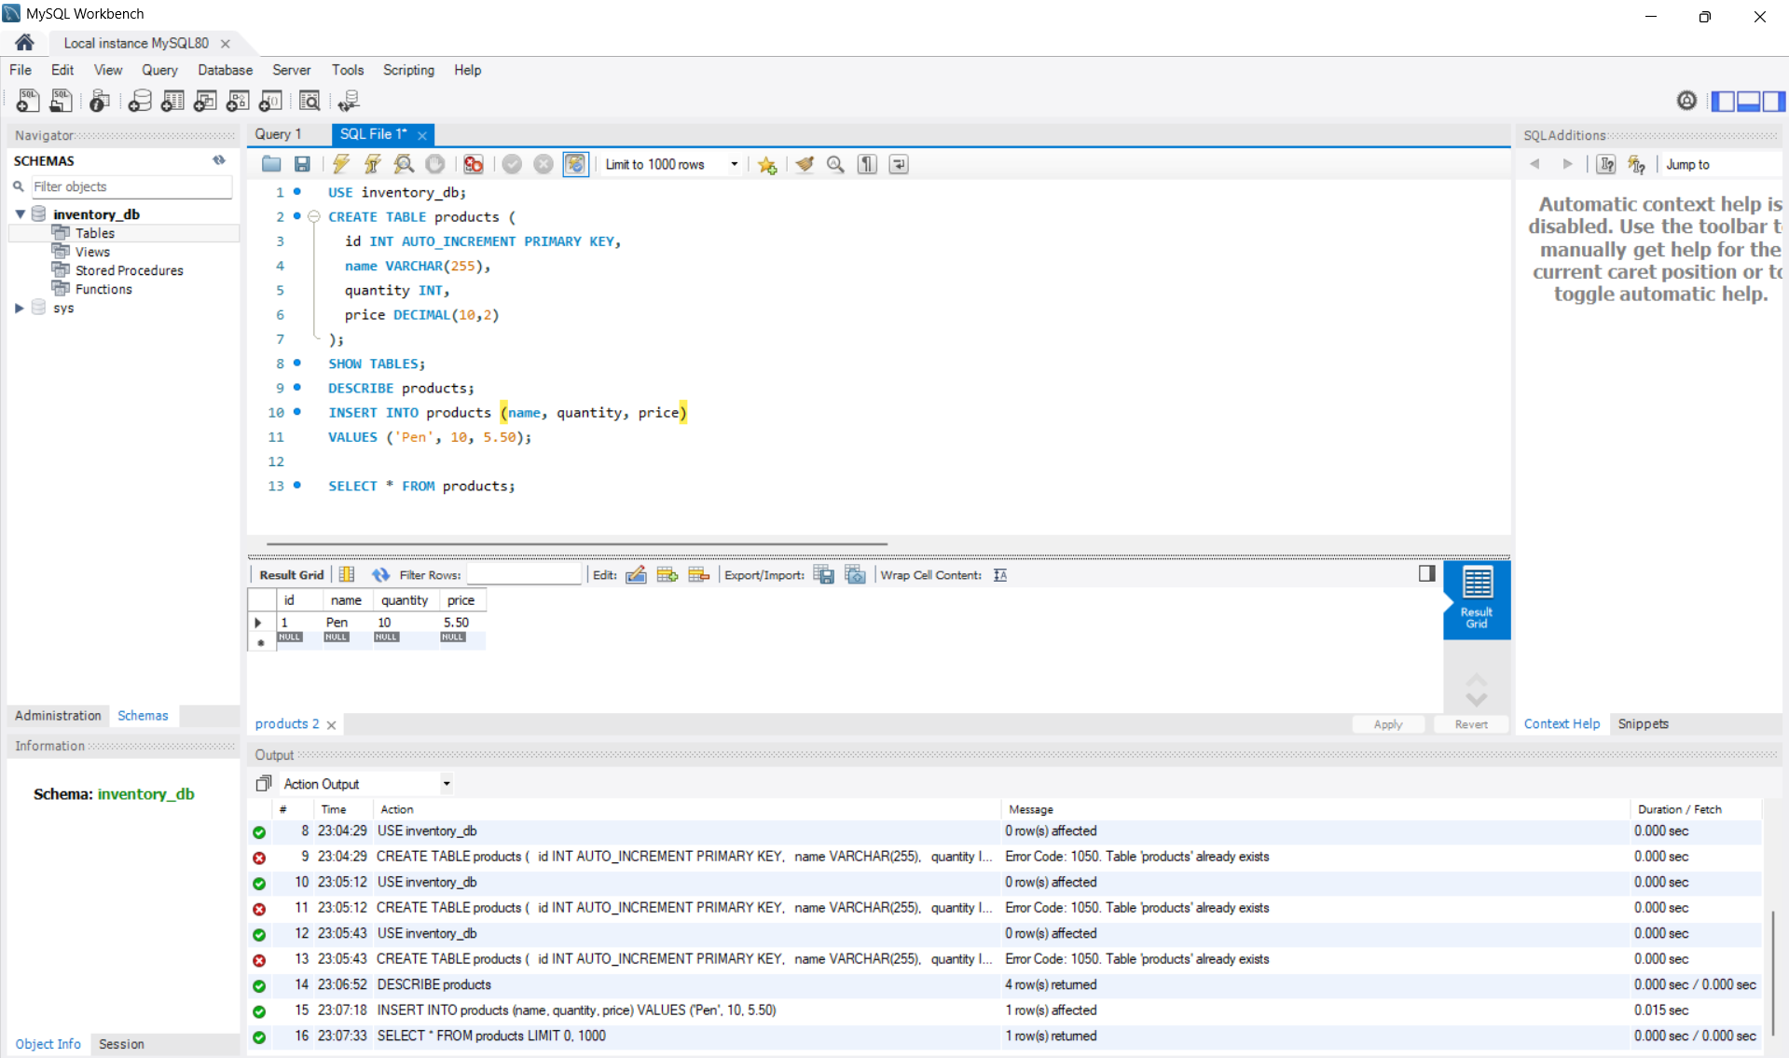
IMPLEMENTATION SCREENSHOTS
Output Page: Displays stock reports and updated inventory details.
1
2
3
4
5
6
7
8(C)
9

Slide 14
ADVANTAGES & LIMITATIONS
ADVANTAGES:
Reduces manual errors
Easy to use and user-friendly interface
Provides real-time stock updates
Fast and efficient data management
LIMITATIONS:
Requires internet/server availability
Limited scalability in basic version
Initial setup cost
Requires technical knowledge for maintenance
1
2
3
4
5
6
7
8
9

Slide 15
Thank you

