Slide 1

Predicting Employee Attrition
Tool : Python

Slide 2
INDEX
1 | Objectives and scope of the Analysis
2 | Dataset describtion
3 | VISUALIZATION Attrition Vs “Age”
4 | VISUALIZATION Attrition Vs “Distance from Home”
5 | VISUALIZATION Attrition Vs “Job Satisfaction”
6 | VISUALIZATIONAttrition Vs “Performance Rating”
7 | Percentage salary hike
8 | VISUALIZATION Attrition Vs “Training Times Last Year”
9 | VISUALIZATION Attrition Vs “Work Life Balance”
10 | VISUALIZATION Attrition Vs “Years at Company”
11 | VISUALIZATION Attrition Vs “Years Since Last Promotion”
12 | VISUALIZATION Attrition Vs “Business Travel, Marital status & Overtime”
13 | Vizualize the correlation among variablesns
14 | Data Pre-Processing
5 | Splitting data into train & test
6 | Count of “Yes” and “No” values of Attrition
7 | Models used / Handling Class imbalance with SMOTE
8 | Imbalance using SMOTE(Oversampling)
19 | RFE for Logistic regression(Recursive Feature Elimination)
0 | Logistic code
1 | Logistic Regression
2 | Random Forest
3 | Decision Tree
4 | Final Model - On Logistic Regression
5 | Test Results on whole Data
6 | Feature selection techniques
27 | Feature importance on Random Forest Classifier
28 | Feature importance on Decision Tree Classifier
29 | CHI2 Method
30 | Boruta On top of Random Forest
31 | Recursive Feature Elimination on Random Forest
32 | Recursive Feature Elimination on Decision Tree
33 | Comparison of Different models based on ROC Curve
34 | Recommendation

Slide 3
Objectives and scope of the Analysis
Problem Statement
The purpose of this project is to estimate the attrition rate of employees, to find out if they are more likely to leave the organization.
Purpose and Objective
To find ways to control attrition rate of employees.
Attrition proves to be a costly and time consuming for the organizational and it also leads to loss of productivity.

Slide 4

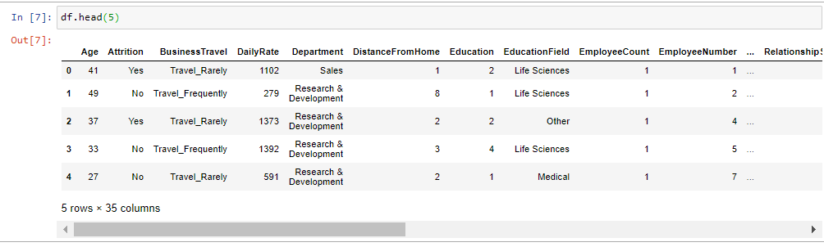


Dataset describtion
People leaving Organization: 16.12%
Displaying first 5 Rows
Displaying Rows and Column
Data Types – Numeric and non numeric (23- Numeric , 8 –Factor)

Slide 5
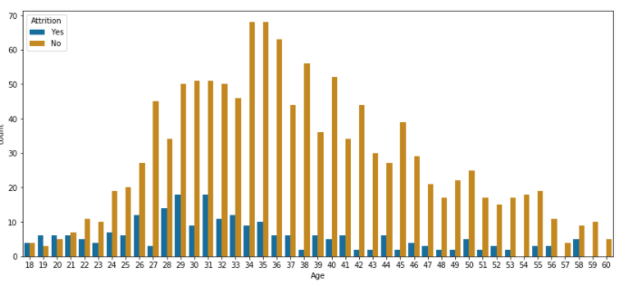
VISUALIZATION Attrition Vs “Age”

Slide 6
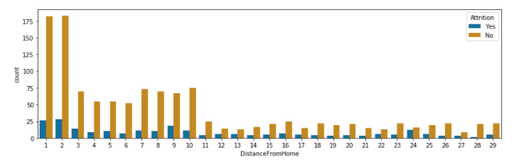
VISUALIZATION Attrition Vs “Distance from Home”

Slide 7
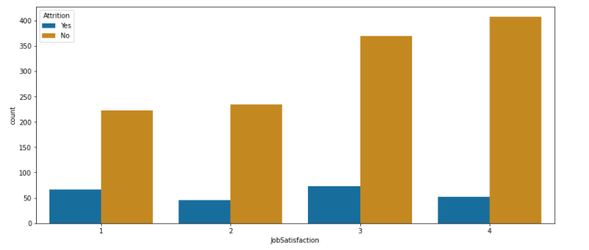
VISUALIZATION Attrition Vs “Job Satisfaction”

Slide 8
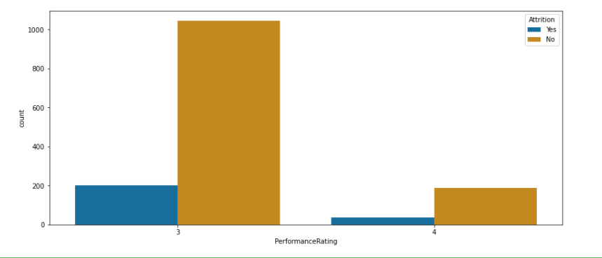
VISUALIZATION Attrition Vs “Performance Rating”

Slide 9
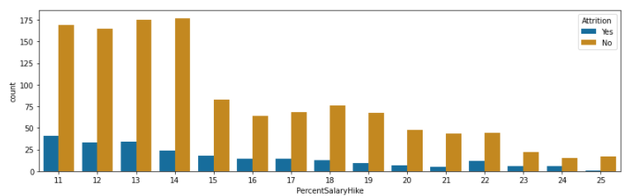
Percentage salary hike

Slide 10
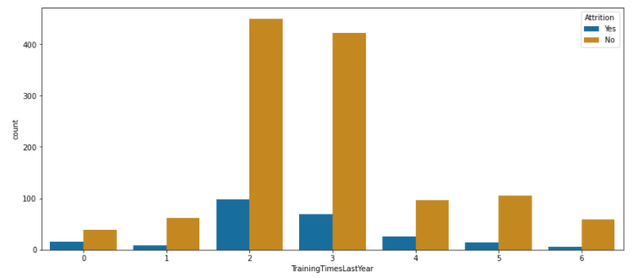
VISUALIZATION Attrition Vs “Training Times Last Year”

Slide 11
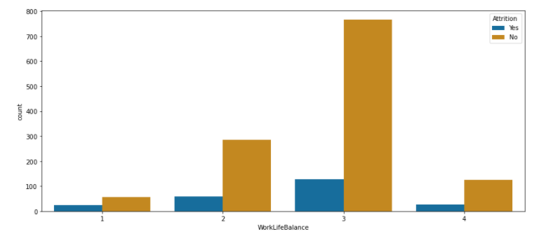
VISUALIZATION Attrition Vs “Work Life Balance”

Slide 12
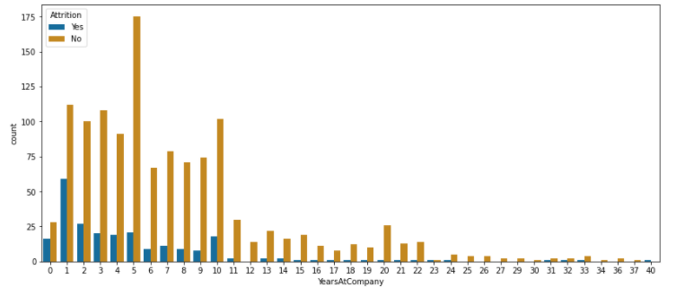
VISUALIZATION Attrition Vs “Years at Company”

Slide 13
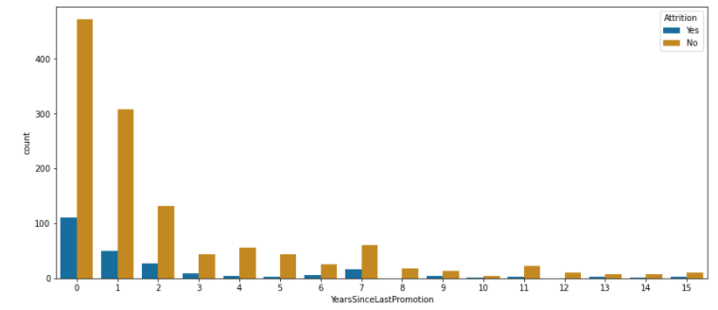
VISUALIZATION Attrition Vs “Years Since Last Promotion”

Slide 14
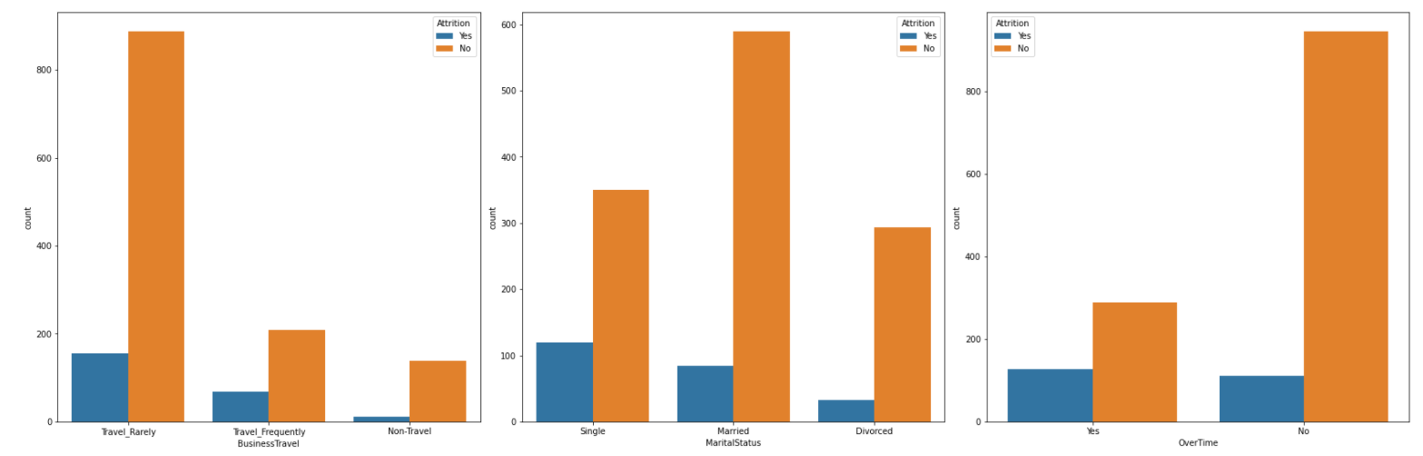
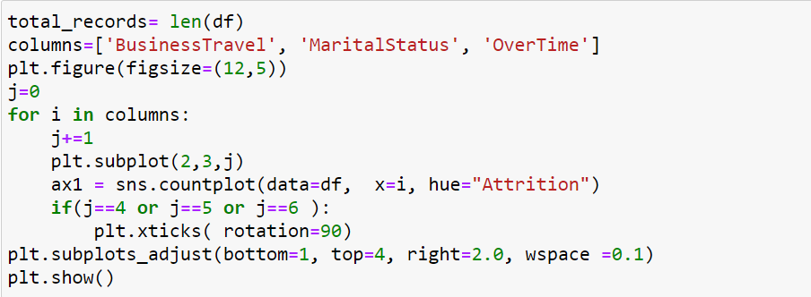
VISUALIZATION Attrition Vs “Business Travel, Marital status & Overtime”

Slide 15
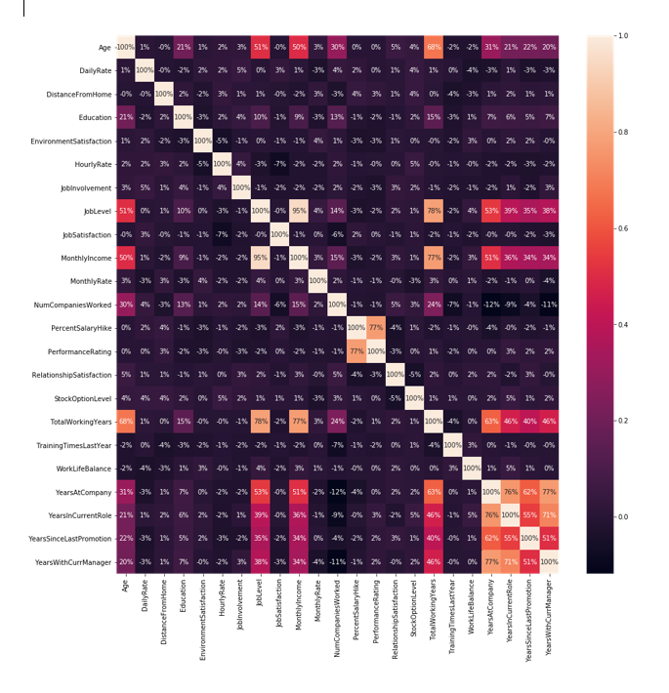

Vizualize the correlation among variablesns
Correlation matrix
This technique determines how one variable moves / changes in relation with the other variable.
It’s a bi-variant analysis measure which describes the association between different variables.
Usefulness of Correlation Matrix –
If two variables are closely correlated, then we can predict one variable from the other.
Correlation plays a vital role in locating the important variables on which other variables depend.
It is used as the foundation for various modelling techniques.
Proper correlation analysis leads to better understanding of data.

Slide 16
Data Pre-Processing
Transforms raw dump into an understandable format
Steps involved :
Check null values→ null values not present in raw dump
Added new column Age_new and deleted original column Age.
Dropping non-relevant columns → Deleted columns (Over18,StandardHours,EmployeeNumber, EmployeeCount)
Converting categorical features into numeric → Attrition, overtime , martial status, Gender, department, job role, business travel and educational field
Splitting data into train and test data sets

Slide 17
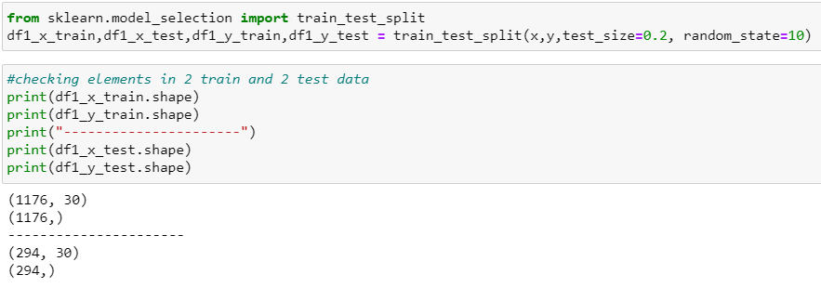
Splitting data into train & test

Slide 18
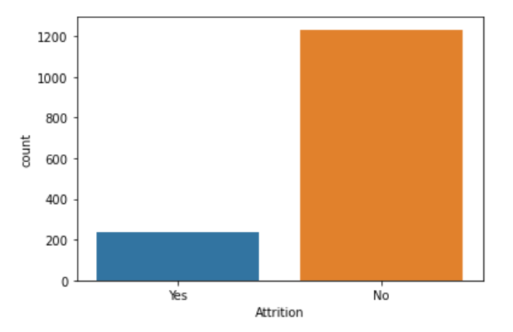
Count of “Yes” and “No” values of Attrition

Slide 19
Handling Class imbalance with SMOTE
Models used
1)Logistic Regression
2)Decision Tree
3)Random Forest
Over sampling Method
Smote - As we have seen the class imbalance in our data points we are opting for the oversampling using SMOTE.
Class weight = Balance

Slide 20
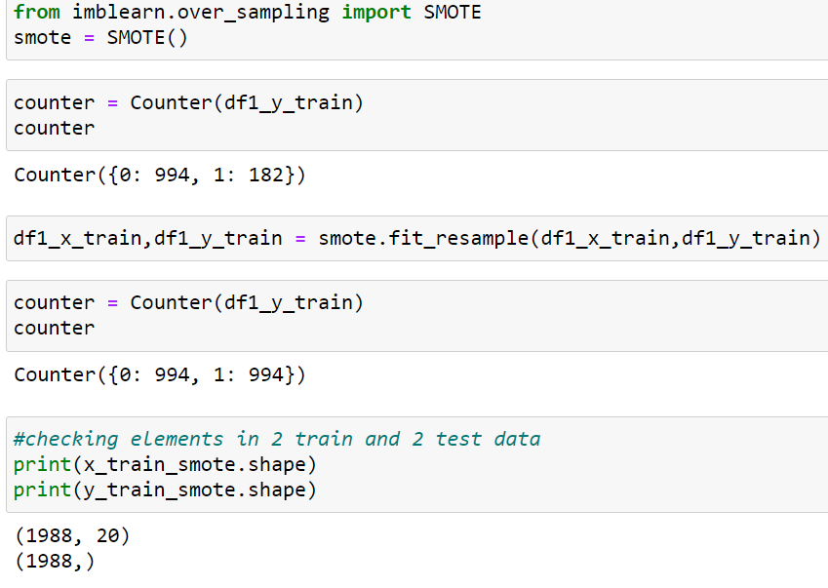
Imbalance using SMOTE(Over_sampling)

Slide 21
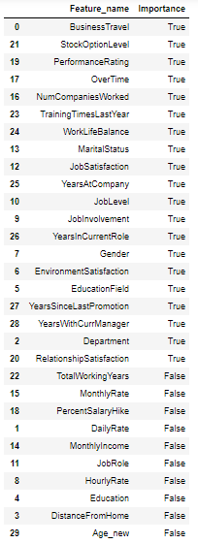
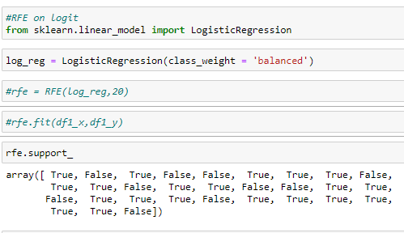
Recursive Feature Selection on LR

Slide 22
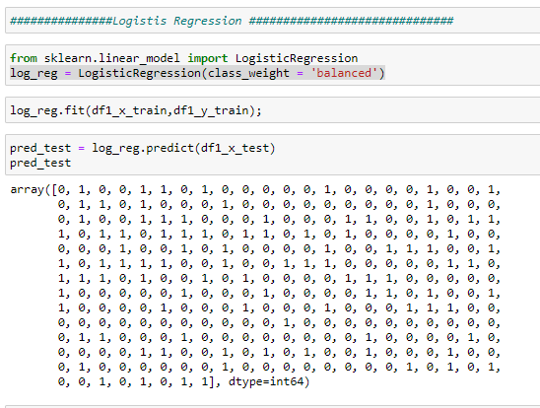
Logistic Regression code

Slide 23
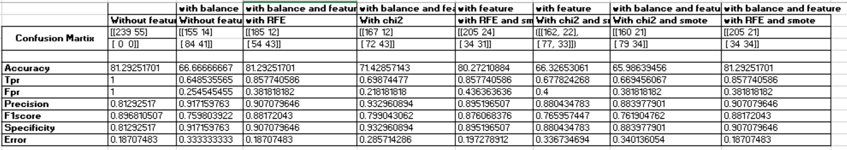
Logistic Regression

Slide 24
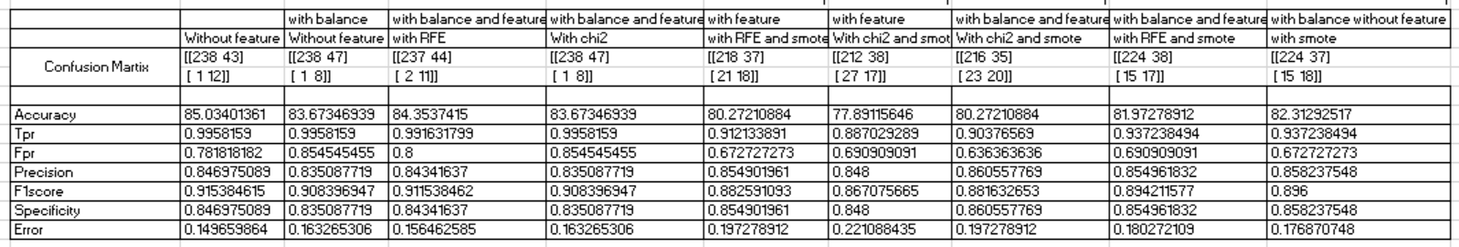
Random Forest

Slide 25
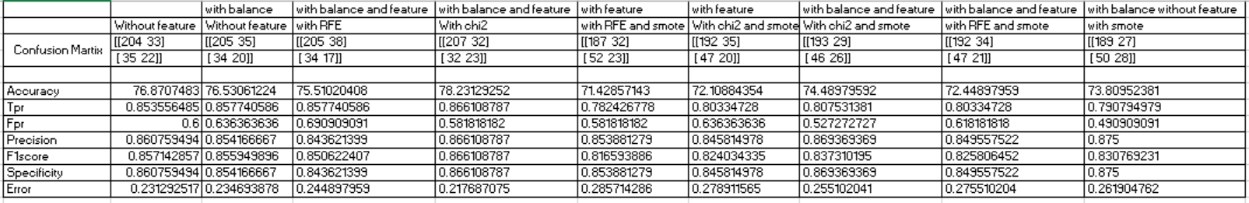
Descision Tree

Slide 26
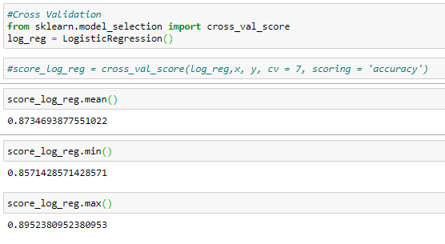
Final Model - On Logistic Regression
Confusion Martix | [[185 12]
 | [ 54 43]]
Accuracy | 81.29251701
Tpr | 0.857740586
Fpr | 0.381818182
Precision | 0.907079646
F1score | 0.88172043
Specificity | 0.907079646
Error | 0.18707483
Cross validation Accuracy
Mean | 0.873469387
Min | 0.847142857
Max | 0.895238095

Slide 27
Test Results on whole Data
Confusion Martix | [917 53]
 | [316 184]
Accuracy | 74.8979591836734
Tpr | 0.743714517437145
Fpr | 0.22362869198312
Precision | 0.94536082474226
F1score | 0.83250113481616
Specificity | 0.94536082474226
Error | 0.25102040816326
Cross validation Accuracy
Mean | 0.873469387
Min | 0.847142857
Max | 0.895238095

Slide 28
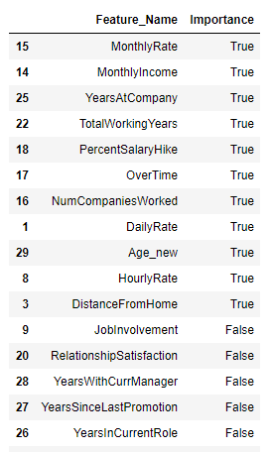
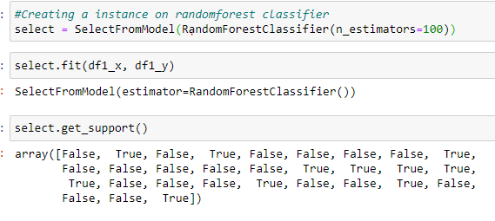
Feature selection techniques

Slide 29
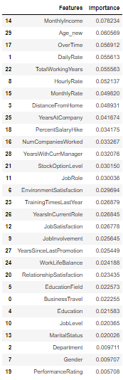
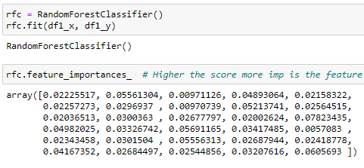
Feature importance on Random Forest Classifier

Slide 30
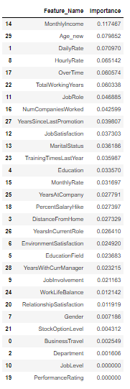
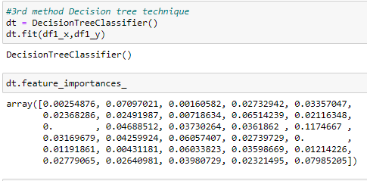
Feature importance on Decision Tree Classifier

Slide 31
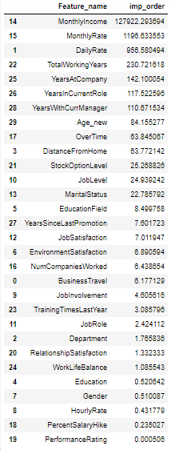
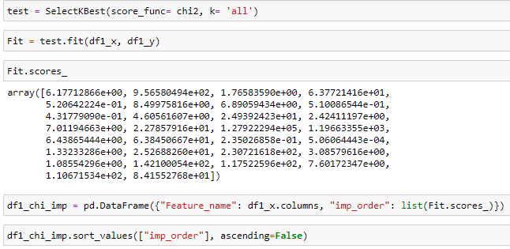
CHI2 Method

Slide 32
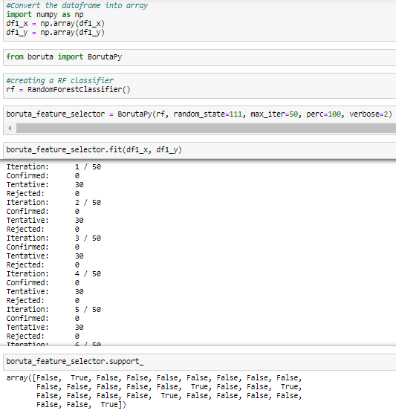
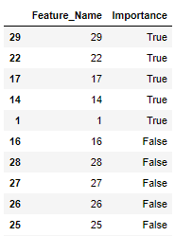

Boruta On top of Random Forest

Slide 33
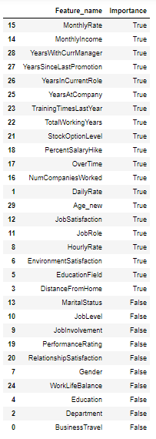
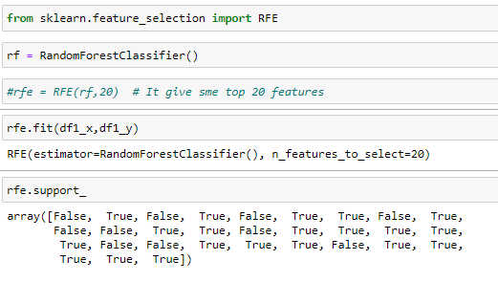
Recursive Feature Elimination on Random Forest

Slide 34
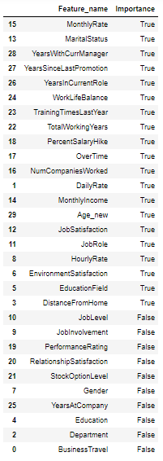
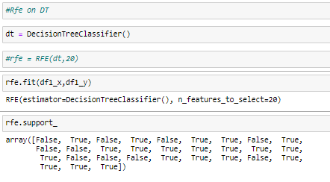
Recursive Feature Elimination on Decision Tree

Slide 35
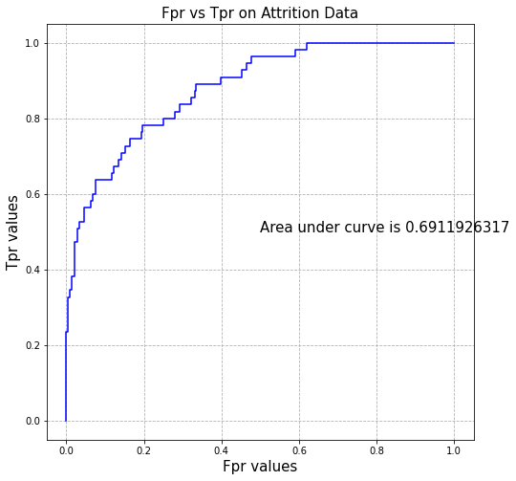
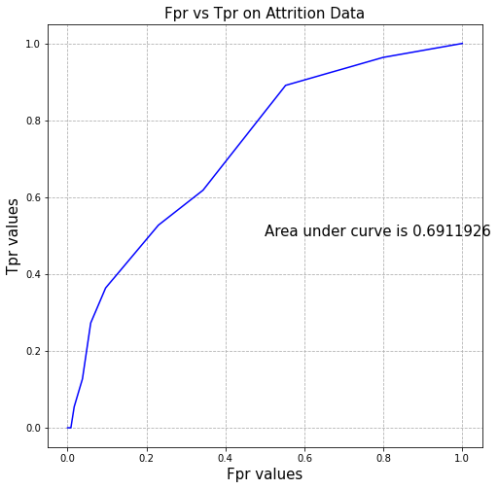
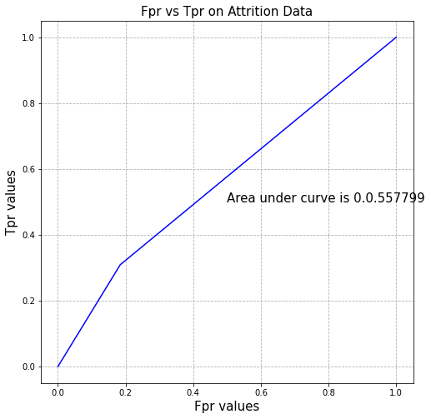
Comparison of Different models based on ROC Curve
Logistic Regression Random Forest Decision Tree

Slide 36
Recommendation
Plan and allocate projects in such a way to avoid the use of overtime.
Employees who hit their one-year anniversary should be identified as potentially having a higher-risk of leaving.
Employees should be provided a minimum of 13% or more salary hike.
Training people on a regular basis to increase their competency is a must.
Increase the perks for the projects involved frequent travel

Slide 37
Thank you

