Slide 1
Project on
Micro-Credit Defaulter Model
Presented by
Ganta Ganesh

Slide 2
Problem Statement
A Microfinance Institution (MFI) is an organization that offers financial services to low income populations. MFS becomes very useful when targeting especially the unbanked poor families living in remote areas with not much sources of income. The Microfinance services (MFS) provided by MFI are Group Loans, Agricultural Loans, Individual Business Loans and so on.
Many microfinance institutions (MFI), experts and donors are supporting the idea of using mobile financial services (MFS) which they feel are more convenient and efficient, and cost saving, than the traditional high-touch model used since long for the purpose of delivering microfinance services. Though, the MFI industry is primarily focusing on low income families and are very useful in such areas, the implementation of MFS has been uneven with both significant challenges and successes.
Today, microfinance is widely accepted as a poverty-reduction tool, representing $70 billion in outstanding loans and a global outreach of 200 million clients.
We are working with one such client that is in Telecom Industry. They are a fixed wireless telecommunications network provider. They have launched various products and have developed its business and organization based on the budget operator model, offering better products at Lower Prices to all value conscious customers through a strategy of disruptive innovation that focuses on the subscriber.
They understand the importance of communication and how it affects a person’s life, thus, focusing on providing their services and products to low income families and poor customers that can help them in the need of hour.
They are collaborating with an MFI to provide micro-credit on mobile balances to be paid back in 5 days. The Consumer is believed to be defaulter if he deviates from the path of paying back the loaned amount within the time duration of 5 days. For the loan amount of 5 (in Indonesian Rupiah), payback amount should be 6 (in Indonesian Rupiah), while, for the loan amount of 10 (in Indonesian Rupiah), the payback amount should be 12 (in Indonesian Rupiah).
The sample data is provided to us from our client database. It is hereby given to you for this exercise. In order to improve the selection of customers for the credit, the client wants some predictions that could help them in further investment and improvement in selection of customers.

Slide 3
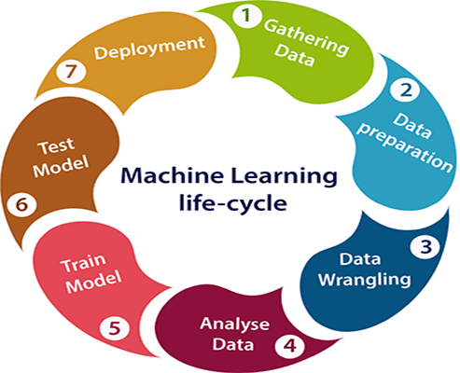
Steps Involved in Building Machine Learning Project
Gathering Data
Data Preparation
Data Wrangling
Analyze Data
Train the model
Test the model
Deployment

Slide 4
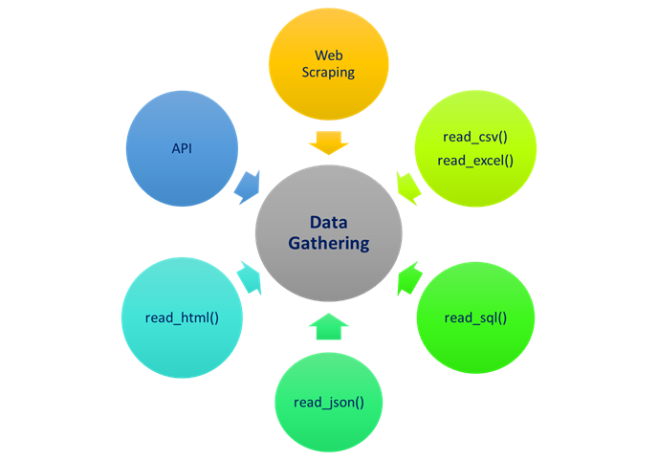
Gathering Data
In this step, we need to identify the different data sources, as data can be collected from various sources such as files, database, internet, or mobile devices.
In our project, we have collected the data from files through available resources and stored in our local storage.

Slide 5
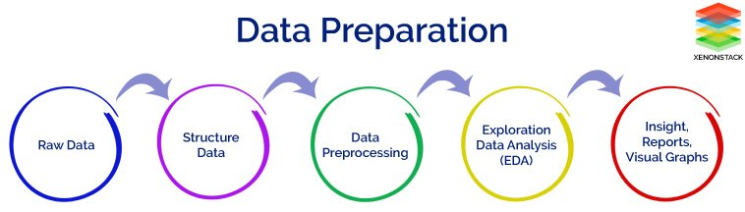
Data Preparation
After collecting the data, we need to prepare it for further steps. Data preparation is a step where we put our data into a suitable place and prepare it to use in our machine learning training.
This step can be further divided into two processes:
Data exploration: It is used to understand the nature of data that we have to work with. We need to understand the characteristics, format, and quality of data. A better understanding of data leads to an effective outcome. In this, we find Correlations, general trends, and outliers.
Data pre-processing: Now the next step is preprocessing of data for its analysis.

Slide 6
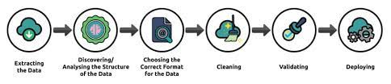
Data wrangling
Data wrangling is the process of cleaning and converting raw data into a useable format. It is the process of cleaning the data, selecting the variable to use, and transforming the data in a proper format to make it more suitable for analysis in the next step. It is one of the most important steps of the complete process. Cleaning of data is required to address the quality issues.
It is not necessary that data we have collected is always of our use as some of the data may not be useful. In real-world applications, collected data may have various issues, including:
Missing Values
Duplicate data
Invalid data
Noise
So, we use various filtering techniques to clean the data.
It is mandatory to detect and remove the above issues because it can negatively affect the quality of the outcome.

Slide 7
Before we start building our model we need to deal with imbalanced data, to resolve this issue we will use over sampling technique.
Imbalanced datasets are those where there is a severe skew in the class distribution, such as 1:100 or 1:1000 examples in the minority class to the majority class.
This bias in the training dataset can influence many machine learning algorithms, leading some to ignore the minority class entirely. This is a problem as it is typically the minority class on which predictions are most important.
One approach to addressing the problem of class imbalance is to randomly resample the training dataset. The two main approaches to randomly resampling an imbalanced dataset are to delete examples from the majority class, called undersampling, and to duplicate examples from the minority class, called oversampling.
Random Oversampling
Random Oversampling includes selecting random examples from the minority class with replacement and supplementing the training data with multiple copies of this instance, hence it is possible that a single instance may be selected multiple times.

Slide 8
Analyze Data
Now the cleaned and prepared data is passed on to the analysis step. This step involves:
Selection of analytical techniques
Building models
Review the result
The aim of this step is to build a machine learning model to analyze the data using various analytical techniques and review the outcome. It starts with the determination of the type of the problems, where we select the machine learning techniques such as Classification, Regression, Cluster analysis, Association, etc. then build the model using prepared data, and evaluate the model.

Slide 9
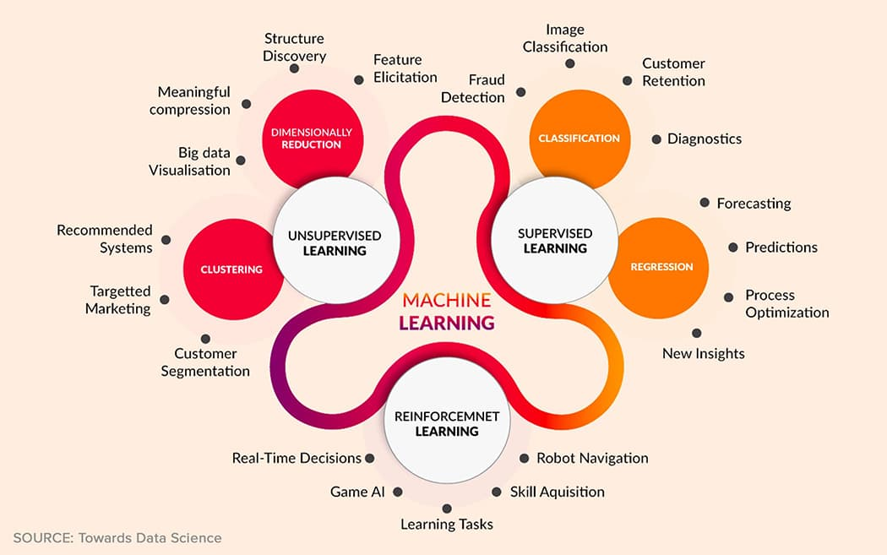
Model Building
We build our model using Classification Models.
Various classifications we used in model building are:
Logistic Regression
Gaussian Naive Bayes Classifier
Decision Tree Classifier
Random Forest Classifier

Slide 10
Logistic Regression
Logistic regression measures the relationship between the categorical dependent variable and one or more independent variables by estimating probabilities using a logistic function, which is the cumulative distribution function of logistic distribution.
Gaussian Naive Bayes Classifier
The Gaussian Processes Classifier is a classification machine learning algorithm. Gaussian Processes are a generalization of the Gaussian probability distribution and can be used as the basis for sophisticated non-parametric machine learning algorithms for classification and regression.
Decision Tree Classifier
Decision Tree is a Supervised learning technique that can be used for both classification and Regression problems, but mostly it is preferred for solving Classification problems. It is a tree-structured classifier, where internal nodes represent the features of a dataset, branches represent the decision rules and each leaf node represents the outcome.
Random Forest Classifier
Random forests is a supervised learning algorithm. It can be used both for classification and regression. It is also the most flexible and easy to use algorithm. A forest is comprised of trees. It is said that the more trees it has, the more robust a forest is. Random forests creates decision trees on randomly selected data samples, gets prediction from each tree and selects the best solution by means of voting. It also provides a pretty good indicator of the feature importance.

Slide 11
Train Model
Now the next step is to train the model, in this step we train our model to improve its performance for better outcome of the problem.
We use datasets to train the model using various machine learning algorithms. Training a model is required so that it can understand the various patterns, rules, and, features.
Test Model
Once our machine learning model has been trained on a given dataset, then we test the model. In this step, we check for the accuracy of our model by providing a test dataset to it.
Testing the model determines the percentage accuracy of the model as per the requirement of project or problem.

Slide 12
AUC-ROC Curve
The Receiver Operator Characteristic (ROC) curve is an evaluation metric for binary classification problems. It is a probability curve that plots the TPR against FPR at various threshold values and essentially separates the ‘signal’ from the ‘noise’. The Area Under the Curve (AUC) is the measure of the ability of a classifier to distinguish between classes and is used as a summary of the ROC curve.
The higher the AUC, the better the performance of the model at distinguishing between the positive and negative classes.

Slide 13
Deployment
The last step of machine learning life cycle is deployment, where we deploy the model in the real-world system.
If the above-prepared model is producing an accurate result as per our requirement with acceptable speed, then we deploy the model in the real system. But before deploying the project, we will check whether it is improving its performance using available data or not. The deployment phase is similar to making the final report for a project.

Slide 14
THANK YOU

