Slide 1
OPENING
Question Answering
Using Semantic Roles
Core Claim
SRL-QA improves answerability by making the model reason over who did what to whom, when, where, how, and why - not just over lexical overlap.
A PropBank-grounded SRL-QA system with retrieval, constrained span reasoning, verifier feedback, and PEFT-ready transformer experiments
QA pairs
usable PropBank instances
baseline QA token F1
23,007
9,353
76.1%
QA pairs
usable PropBank instances
baseline QA token F1
Evidence: local project artifacts in srlqa/ plus cited primary research sources.
01/35

Slide 2
PROBLEM
Thesis: SRL turns QA into predicate-argument reasoning
Instead of asking only where text overlaps, we ask which semantic role answers the question.
Question
Target role
Predicate
Candidate spans
Answer
Where was the package delivered?
WHERE -> ARGM-LOC
delivered
to the office; at noon; package
to the office
Why this matters
Research framing
Engineering framing
The answer span must be semantically compatible with a role, not merely nearby in the sentence.
We formulate SRL as extractive question answering over PropBank-style role structure.
Use retrieval, span constraints, and verification as lightweight structure around transformer QA.
02/35

Slide 3
PROBLEM
Problem statement: text matching is not enough
SRL-QA must disambiguate semantic roles, predicate scope, and answer span boundaries.
- Role ambiguity: the same entity can be agent, patient, recipient, source, or location across predicates.
- Predicate ambiguity: a question may target a role of a specific predicate, not any nearby event.
- Span boundary errors: QA models often return too much context or omit prepositions needed for role meaning.
- Class imbalance: ARG0/ARG1 dominate, while ARGM and rare core roles remain hard to learn.
- Evaluation sensitivity: exact match is harsh; token F1 can hide wrong-role answers.
Baseline error pressure
Wrong role
19.8%
Span boundary
25.1%
Other
3.2%
Predicate miss
0.1%
Counts from srlqa/output/tables/baseline_error_taxonomy.csv; denominator = listed error-analysis total.
03/35

Slide 4
BACKGROUND
Semantic Role Labeling in one slide
SRL identifies the predicate and labels the arguments that participate in the event.
Role | Meaning in PropBank-style SRL | QA mapping
ARG0 | Proto-agent / doer | Who did it?
ARG1 | Proto-patient / thing affected | What was affected?
ARG2-ARG5 | Predicate-specific complements | To whom? from what? for what?
ARGM-TMP | Temporal modifier | When?
ARGM-LOC | Location modifier | Where?
ARGM-MNR/CAU/PNC | Manner, cause, purpose | How? why? for what purpose?
Predicate first
Arguments are interpreted relative to a predicate such as deliver.01, sell.01, or acquire.01.
QA conversion
A role label becomes a question intent; an argument span becomes the extractive answer.
Key risk
The same surface phrase can be correct for one predicate and wrong for another.
04/35

Slide 5
DATASET
PropBank through NLTK: dataset representation
The project uses PropBank as the semantic-role backbone and converts roles into QA-style examples.
- Raw view: predicates are anchored in Penn Treebank-style structures and PropBank frame files.
- Clean view: each predicate instance yields a sentence, predicate lemma/roleset, argument labels, and answer spans.
- QA view: a role label becomes a question template; the gold argument span becomes the answer.
- Tree-pointer caveat: NLTK exposes PropBank pointers, so conversion must normalize tree spans to text spans before transformer training.
import nltk
nltk.download('propbank')
from nltk.corpus import propbank
instances = propbank.instances()
roleset = propbank.roleset('deliver.01')
Total instances
Usable instances
Unique predicates
Unique rolesets
112,917
9,353
1,340
1,670
Source: NLTK PropBank HOWTO plus local EXACT_VALUES.json dataset counts.
05/35

Slide 6
GOAL
Project goal and evaluation protocol
Build a reproducible SRL-QA pipeline, then report metrics with claim boundaries.
- Task formulation: extractive question answering over sentences with PropBank-style predicate-role supervision.
- Primary outputs: answer span, inferred role, confidence, and a short reasoning trace.
- Training evidence: baseline PropQA-Net metrics, LoRA/QLoRA notebooks, and local RAISE seed-suite runs.
- Metrics: exact match, token F1, role accuracy or SRL micro F1, latency, and confidence.
- Claim policy: measured results must cite local files; roadmap targets are visibly separated.
baseline QA exact match
baseline QA token F1
51.8%
76.1%
baseline QA exact match
baseline QA token F1
baseline SRL micro F1
baseline SRL macro F1
71.3%
16.2%
baseline SRL micro F1
baseline SRL macro F1
Baseline values trace to srlqa/plots/EXACT_VALUES.json and linked baseline metrics.
06/35

Slide 7
SURVEY
Literature timeline
The project sits at the intersection of PropBank SRL, QA-SRL, MRC, and efficient fine-tuning.
2005
2015
2017
2018
2019
2021-23
PropBank
QA-SRL
Deep SRL
LISA
BERT/SQuAD
LoRA/QLoRA
Predicate-argument corpus
Roles as natural questions
End-to-end neural SRL
Syntax-aware attention
Transformer span QA
PEFT for large models
Survey takeaway
Earlier work gives us the pieces: PropBank labels, QA-style annotation, transformer span extraction, and efficient adaptation. Our system goal is to combine them with explicit retrieval, constraints, and verification.
Primary survey sources listed on final slide.
07/35

Slide 8
SURVEY
Survey: PropBank and supervised SRL
PropBank gives canonical role inventories, but not a ready-made QA model.
What previous work did
How models train
Limitation for QA
Annotated predicates and their arguments over treebank structures; enabled supervised SRL systems.
Classic and neural SRL systems learn role labels from gold predicate-argument annotations.
Role labels and tree pointers must be converted into natural questions and extractive answer spans.
- Strength: canonical role names make evaluation and error analysis precise.
- Weakness: rare roles and predicate-specific complements create heavy class imbalance.
- Our use: PropBank supplies the role schema and frame retrieval evidence.
Palmer et al. 2005, ACL Anthology J05-1004; NLTK PropBank HOWTO.
08/35

Slide 9
SURVEY
Survey: QA-SRL and natural-language roles
QA-SRL reframes semantic roles as question-answer pairs written in natural language.
What previous work did
How models train
Limitation for us
Asked crowd workers to annotate roles with questions and answer spans instead of formal role labels.
Parsers learn to generate or recover QA-SRL questions and answer spans from text.
Natural questions are flexible, but mapping them back to canonical PropBank roles can be noisy.
Role
Question
Answer
Need
ARGM-LOC
Where did it happen?
to the office
role consistency
He et al. 2015, ACL Anthology D15-1076; FitzGerald et al. 2018, ACL Anthology P18-1191.
09/35

Slide 10
SURVEY
Survey: large-scale QA-SRL parsing
Large-scale QA-SRL work helps with coverage, but introduces parser and template dependencies.
Axis | Previous QA-SRL systems | Implication for this project
Data | Question-answer annotations for predicates | Good fit for QA interface
Training | Question generation and answer-span prediction | Useful but not always PropBank-role exact
Strength | Human-readable semantic roles | Improves interpretability
Limitation | Surface-form variability and parser errors | Needs canonical role normalization
Design response
Keep natural questions, but bind them to PropBank role priors.
Evaluation response
Score answer span and role consistency separately.
FitzGerald et al. 2018, ACL Anthology P18-1191.
10/35

Slide 11
SURVEY
Survey: deep SRL and syntax-aware attention
Neural SRL improved role labeling, but most systems are not designed as QA pipelines.
Deep SRL
LISA
Project gap
Supervised neural sequence labeling learns predicate-argument structure end to end.
Self-attention is biased with linguistic/syntactic structure for SRL.
These systems label roles, but do not naturally answer user questions with explainable spans.
He et al. 2017, ACL Anthology P17-1044
Strubell et al. 2018, ACL Anthology D18-1548
- Useful lesson: role structure improves generalization beyond local token overlap.
- Useful limitation: a sequence tagger alone is not enough for QA-style output and interaction.
- Our adaptation: wrap SRL structure around extractive QA and post-hoc verification.
11/35

Slide 12
SURVEY
Survey: MRC-style SRL
MRC-SRL casts each role query as a reading-comprehension question.
Sentence
Query
Encoder
Output
Predicate context
Role-specific question
Transformer MRC
Answer span
What it gives us
Training style
Limitation
A practical span-prediction formulation compatible with transformer QA checkpoints.
Role questions are generated or templated, then optimized as answer-span extraction.
Template quality and role/query mismatch can cause brittle generalization.
Wang et al. 2022, ACL Anthology 2022.coling-1.191.
12/35

Slide 13
SURVEY
Survey: BERT and SQuAD-style extractive QA
Transformer QA is a strong span extractor, but needs semantic constraints for SRL reliability.
BERT
SQuAD
SRL risk
Bidirectional transformer pretraining supplies contextual token representations.
Extractive QA objective trains start/end span prediction from questions and passages.
A plausible span can be syntactically nearby but semantically the wrong role.
Devlin et al. 2019, ACL Anthology N19-1423
Rajpurkar et al. 2016, ACL Anthology D16-1264
- Why use it: pretrained QA models know how to localize answer spans.
- Why adapt it: SRL requires predicate and role compatibility, not only answerability.
- Project strategy: transformer candidates are scored by PropBank retrieval and verifier checks.
13/35

Slide 14
SURVEY
Survey: LoRA/QLoRA and 2B-model feasibility
Parameter-efficient fine-tuning makes larger language models realistic in a Colab-style workflow.
LoRA
QLoRA
2B path
Train low-rank adapters while keeping the base model frozen; lowers trainable parameters.
Fine-tune adapters on quantized base weights; improves memory feasibility for larger models.
Gemma 2 2B IT is configured for Colab GPU experiments with quantized loading.
Hu et al. 2021, arXiv 2106.09685
Dettmers et al. 2023, arXiv 2305.14314
Gemma 2 2B IT model card
- Notebook evidence: local smoke tests validate the pipeline; full 2B QLoRA execution requires GPU and model access.
- Engineering benefit: adapters keep the implementation lightweight and reproducible.
- Research caution: PEFT enables experiments; it does not guarantee a target accuracy by itself.
14/35

Slide 15
SURVEY
Survey synthesis: what previous work contributes
We use prior work as building blocks, not as unsupported leaderboard claims.
Work | Training style | Strength | Limitation for SRL-QA | Our use
PropBank | Gold predicate-role annotation | Canonical roles | Not QA formatted | Frame schema + retrieval
QA-SRL | Question-answer annotations | Natural interface | Role mapping variability | QA conversion idea
Deep/LISA SRL | Supervised role labeling | Strong role structure | Not interactive QA | Role-aware constraints
MRC-SRL | Role query -> span extraction | Transformer-compatible | Template dependence | Task formulation
LoRA/QLoRA | Adapter fine-tuning | Low memory | Needs careful evaluation | Colab-scale experiments
Sources: Palmer 2005; He 2015; FitzGerald 2018; He 2017; Strubell 2018; Wang 2022; Hu 2021; Dettmers 2023.
15/35

Slide 16
SURVEY ANALYSIS
Gap analysis for our project goal
The opportunity is not just a better encoder - it is structure around the encoder.
- Canonical role grounding: QA-SRL is readable, but PropBank roles are better for controlled evaluation.
- Answer-span discipline: transformer QA needs constraints for role-compatible span boundaries.
- Evidence retrieval: frame definitions and role priors can narrow plausible answers before final selection.
- Self-correction: a verifier can reject spans that are extractive but semantically wrong.
- Claim discipline: small seed suites are useful engineering tests, not general benchmark proof.
Research gap
Bridge formal SRL, natural-language QA, and verifiable span extraction.
Engineering gap
Make the pipeline simple enough to run locally, but extensible for PEFT models.
Presentation gap
Report measured values, target bands, and evidence scopes separately.
16/35

Slide 17
INNOVATION
Innovation opportunity: RAISE-SRL-QA
Retrieval-Augmented, Iteratively Self-correcting, Explainable SRL Question Answering.
R
A
I
S
E
Retrieve PropBank frames
Align question to role
Infer predicate + candidates
Score with verifier
Explain + self-correct
Core novelty
Practical novelty
Evaluation novelty
Use symbolic role evidence to constrain neural or heuristic answer candidates.
Keep a fast deterministic path plus optional transformer-assisted candidate generation.
Separate span correctness, role correctness, latency, and evidence scope.
17/35

Slide 18
IMPLEMENTATION
Existing folder analysis: what is already implemented
The current project contains a real SRL-QA scaffold plus reports, plots, and model/evaluation artifacts.
Component | Evidence file | Status
PropBank frame retrieval | srlqa/retrieval/propbank_index.py | Present
Constrained span decoding | srlqa/decoding/span_rules.py | Present
Role priors | srlqa/decoding/role_priors.py | Present
Evidence span verifier | srlqa/verification/span_verifier.py | Present
Self-correction loop | srlqa/verification/self_correction.py | Present
Hard negative mining | srlqa/training/hard_negative_mining.py | Present
Distillation scaffolding | srlqa/distillation/teacher_runner.py | Present
Calibrated ensemble | srlqa/ensemble/weighted_voter.py | Present
Nominal event templates | srlqa/nominal/qa_noun_templates.py | Present
Source: srlqa/output/tables/innovation_matrix.csv.
18/35

Slide 19
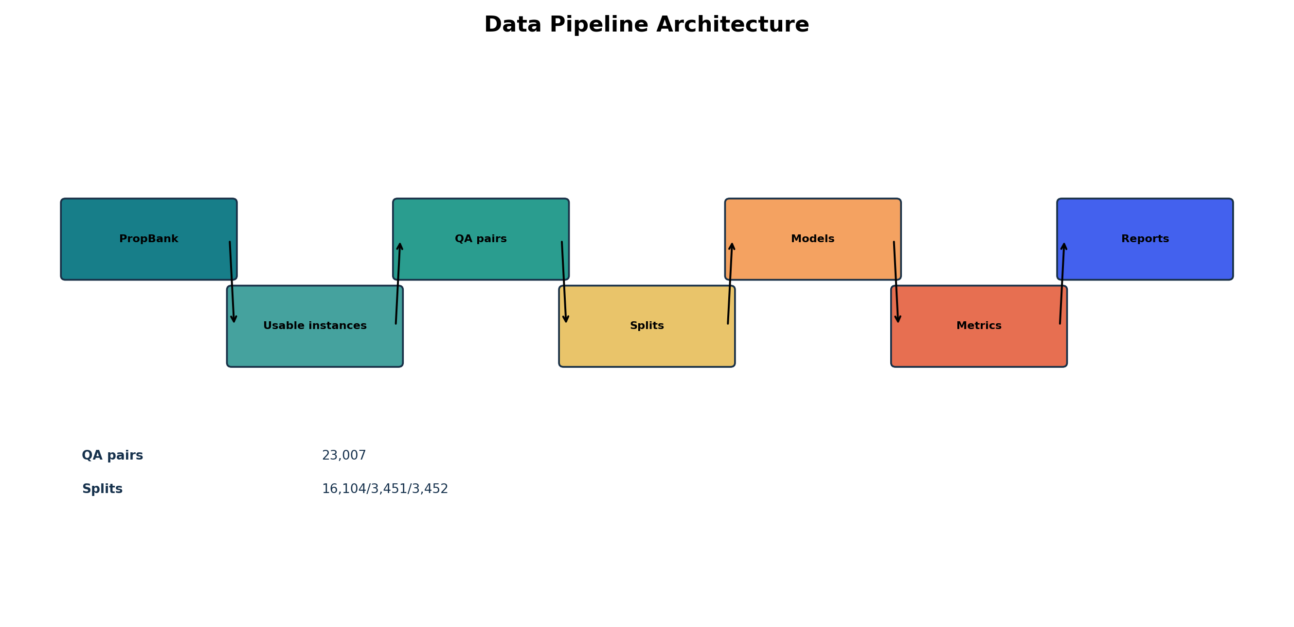
IMPLEMENTATION
Data pipeline: PropBank to SRL-QA examples
The pipeline turns predicate-argument structure into transformer-ready question-answer instances.
- Load PropBank/NLTK or cached SRL-QA assets.
- Normalize sentences, predicates, rolesets, and argument spans.
- Generate question templates by role and question type.
- Split into train/validation/test or seed-suite evaluation scope.
- Export tables and plots for reproducible reporting.
Data pipeline architecture
19/35

Slide 20
EDA
Dataset and EDA: counts, roles, and imbalance
The role distribution is highly skewed; this explains why macro-F1 remains hard.
QA pairs by question type
Top argument labels
WHAT
12,881
ARG1
8,094
ARG0
5,918
WHO
5,918
ARGM-TMP
1,595
WHEN
1,595
ARGM-MOD
873
HOW
1,554
ARGM-ADV
859
ARG2
760
WHERE
701
ARGM-MNR
634
WHY
358
ARGM-LOC
608
Source: srlqa/plots/EXACT_VALUES.json. Counts are generated from local artifacts.
20/35

Slide 21
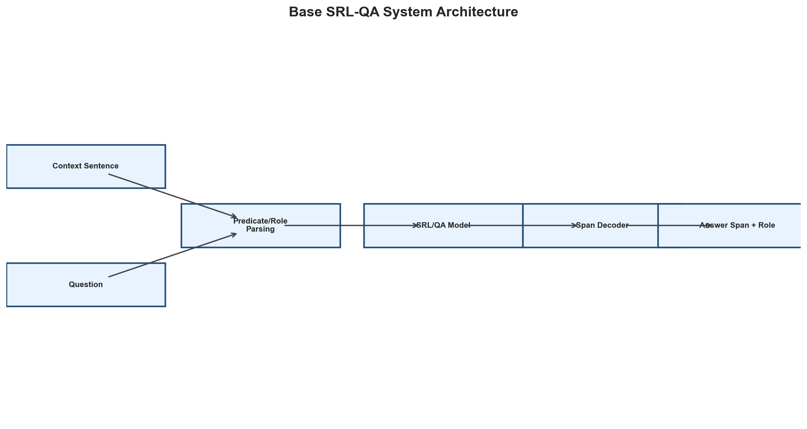
IMPLEMENTATION
Architecture: baseline SRL-QA pipeline
The baseline provides the comparison point for improvements and error analysis.
- Input: sentence/context plus a natural-language question.
- Model: legacy PropQA-Net or equivalent baseline span predictor.
- Output: answer span with QA exact match/token F1 scoring.
- Observed issue: role errors and span-boundary errors dominate the error taxonomy.
Baseline token F1
76.1%
Measured saved baseline
Baseline architecture
21/35

Slide 22
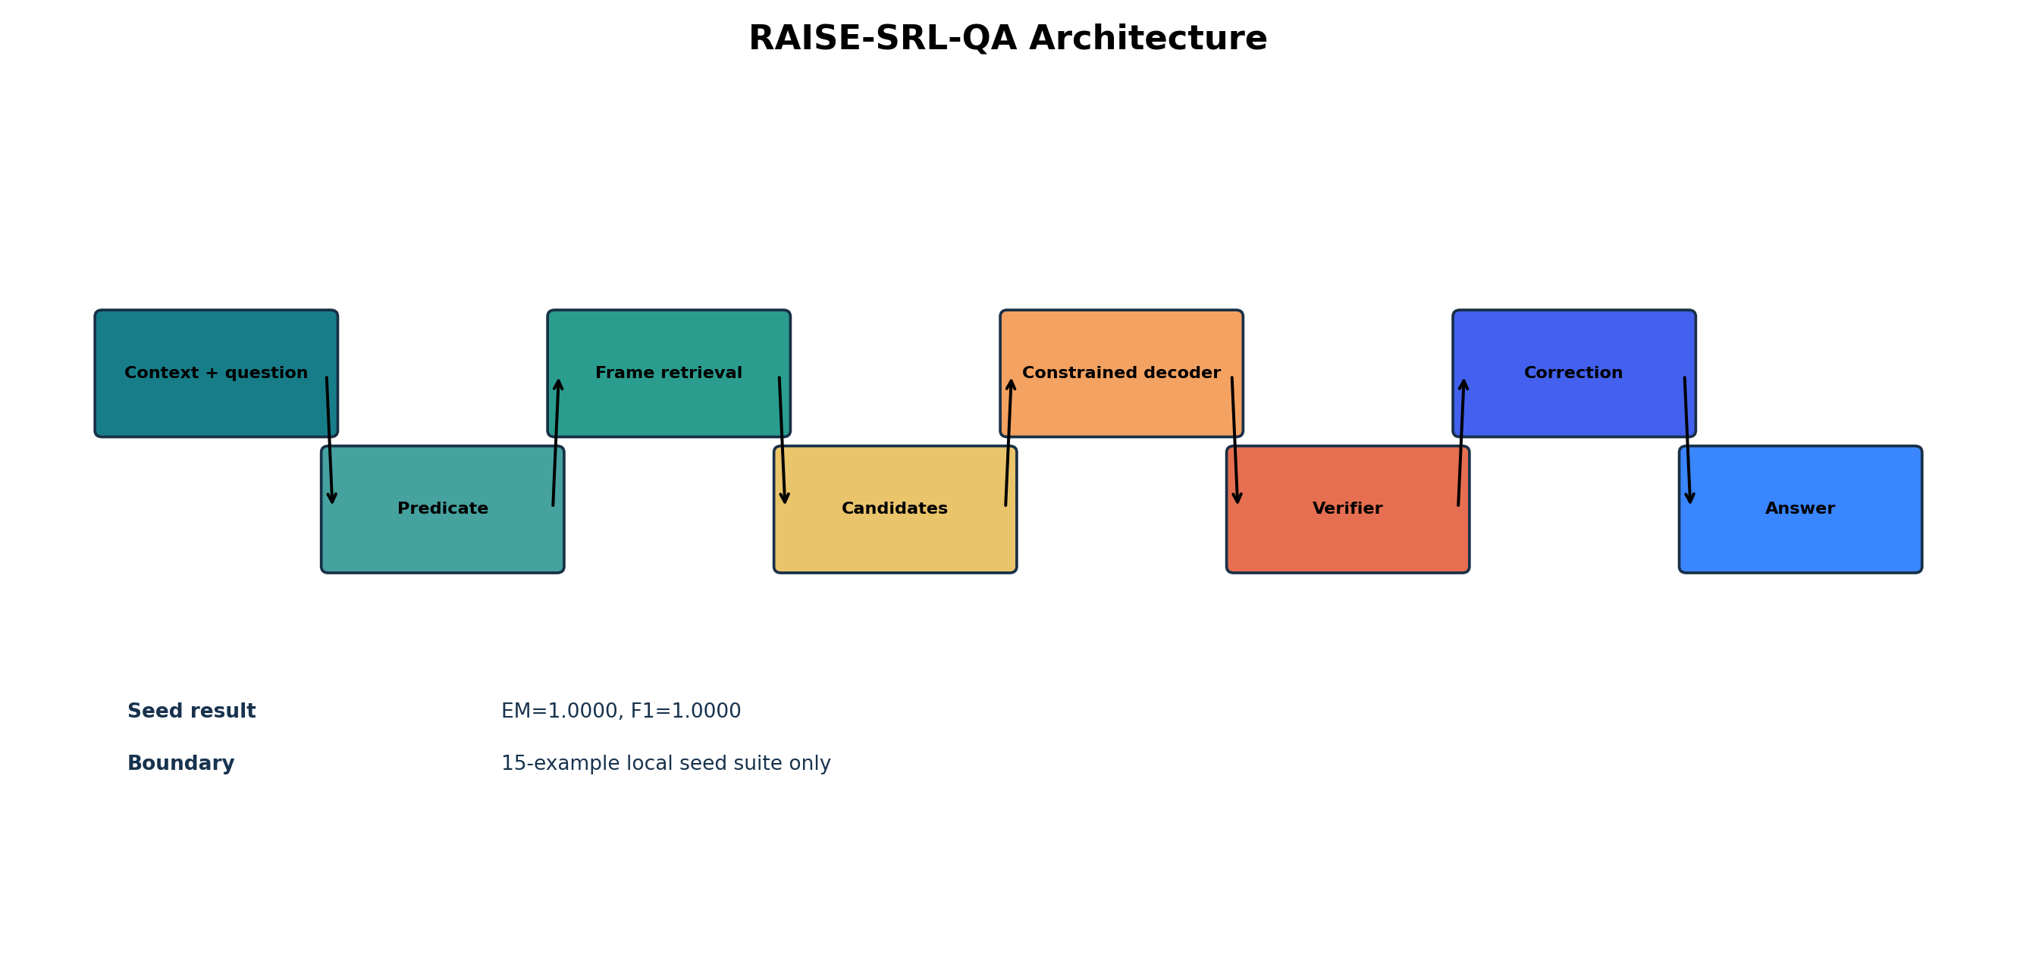
IMPLEMENTATION
Architecture: RAISE-SRL-QA pipeline
The proposed system layers retrieval, constrained decoding, and verification around answer candidates.
- Question parser maps WH-form to a likely semantic role.
- Predicate detector selects the target event.
- PropBank frame retrieval narrows legal arguments.
- Candidate generator proposes spans from heuristic and transformer paths.
- Verifier accepts, rejects, or corrects the span.
RAISE-SRL-QA architecture
22/35

Slide 23
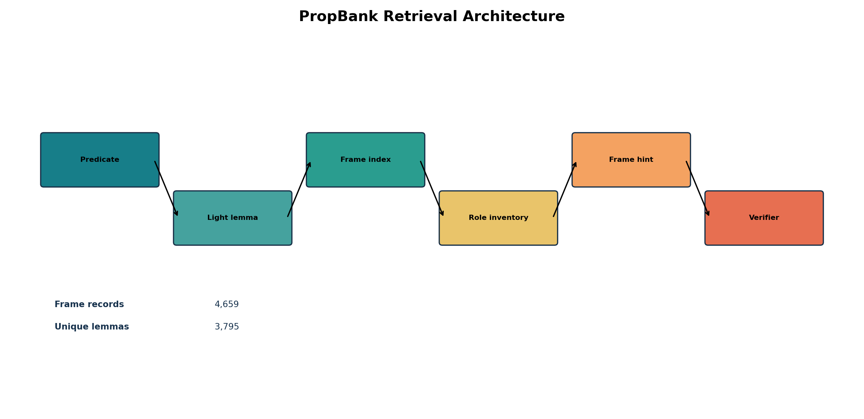
IMPLEMENTATION
Module detail: PropBank frame retrieval
Frame retrieval supplies role definitions and predicate-specific constraints.
Input
Predicate lemma, roleset candidate, and question-derived role intent.
Retrieval object
Frame roles, role descriptions, examples, and compatible argument types.
Why it helps
It filters spans that look answer-like but conflict with the predicate's semantic frame.
Retrieval architecture
23/35

Slide 24
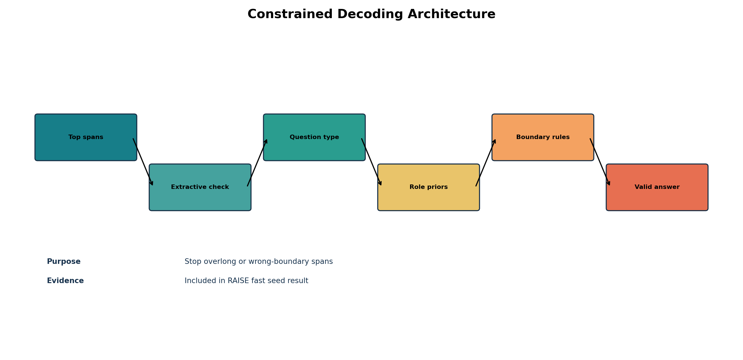
IMPLEMENTATION
Module detail: constrained span decoding and role priors
The decoder uses role-specific span rules before final answer selection.
- WHERE questions prefer prepositional/location spans over full predicate tails.
- WHEN questions prefer temporal spans such as dates, times, and ARGM-TMP candidates.
- WHO questions prefer entity/person spans compatible with ARG0 or recipient-like roles.
- Role priors reduce over-long answer spans and wrong modifier selection.
Constrained decoding architecture
Evidence: srlqa/decoding/span_rules.py and srlqa/decoding/role_priors.py.
24/35

Slide 25

IMPLEMENTATION
Module detail: verifier and iterative correction
The verifier turns a one-shot prediction into an inspectable correction loop.
- Check extractability: the answer must occur as a span in the context.
- Check role compatibility: candidate span should match the inferred semantic role.
- Check predicate context: the span should belong to the target event, not a distractor event.
- Self-correct by choosing the next best candidate when verification fails.
Verifier and correction architecture
25/35

Slide 26
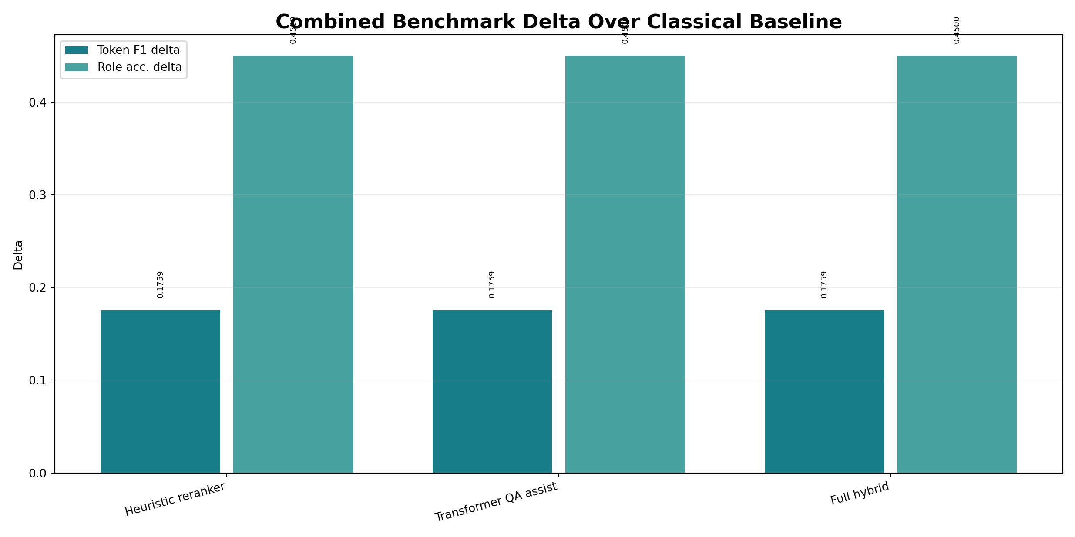
EXPERIMENTS
Model experiments: all available local approaches
The project compares classical, heuristic, transformer-assisted, and hybrid tracks under a local scope.
Track | Scope | EM | Token F1 | Role acc. | Latency
Classical baseline | 60 ex. local | 8.3% | 36.2% | 28.3% | 4.0 ms
Heuristic reranker | 60 ex. local | 33.3% | 53.8% | 73.3% | 5.0 ms
Transformer QA assist | 60 ex. local | 33.3% | 53.8% | 73.3% | 289.0 ms
Full hybrid | 60 ex. local | 33.3% | 53.8% | 73.3% | 377.1 ms
- Classical baseline is fastest but weak on role-sensitive questions.
- Heuristic reranker improves role accuracy without transformer latency.
- Transformer assist and full hybrid match heuristic scores here but cost more latency.
- Interpretation: structural constraints mattered more than model size in this local comparison.
Source: srlqa/plots/EXACT_VALUES.json combined benchmark tracks.
26/35

Slide 27
EXPERIMENTS
LoRA/QLoRA notebook experiments
The notebooks keep implementation simple while exposing an upgrade path to larger models.
Notebook | Local smoke-test path | Full experiment path | Measured local note
LoRA/QLoRA encoder | DistilBERT QA + LoRA | DeBERTa-style QA fine-tuning | test token F1 0.4151; EM 0.1250
2B Gemma QLoRA | tiny GPT-2 smoke test | google/gemma-2-2b-it 4-bit QLoRA | local CPU smoke test did not reach target
Why LoRA
Why QLoRA
Claim boundary
Adapter tuning reduces trainable parameters while keeping base weights frozen.
4-bit quantized loading is the practical route for 2B-class Colab experiments.
The 2B path is implemented as a reproducible Colab-ready experiment, not as a locally proven 80% result.
Sources: local notebooks plus Gemma 2 2B IT model card.
27/35

Slide 28
RESULTS
Main measured results with evidence scope
Every numeric result on this slide is tied to a local file and an explicit evaluation scope.
Evidence scope | System/metric | EM | Token F1 | Role/SRL | Source
Saved baseline test | Legacy PropQA-Net | 51.8% | 76.1% | 71.3% | EXACT_VALUES.json
60-example local | Classical baseline | 8.3% | 36.2% | 28.3% | benchmark tracks
60-example local | Full hybrid | 33.3% | 53.8% | 73.3% | benchmark tracks
15-example seed suite | Legacy hybrid | 66.7% | 82.3% | 93.3% | model_evaluation_summary.csv
15-example seed suite | RAISE-SRL-QA Fast | 100.0% | 100.0% | 100.0% | seed-suite only
Interpretation
The strongest measured RAISE result is a local 15-example seed-suite result. It is useful engineering evidence, but not an official general benchmark claim.
28/35

Slide 29
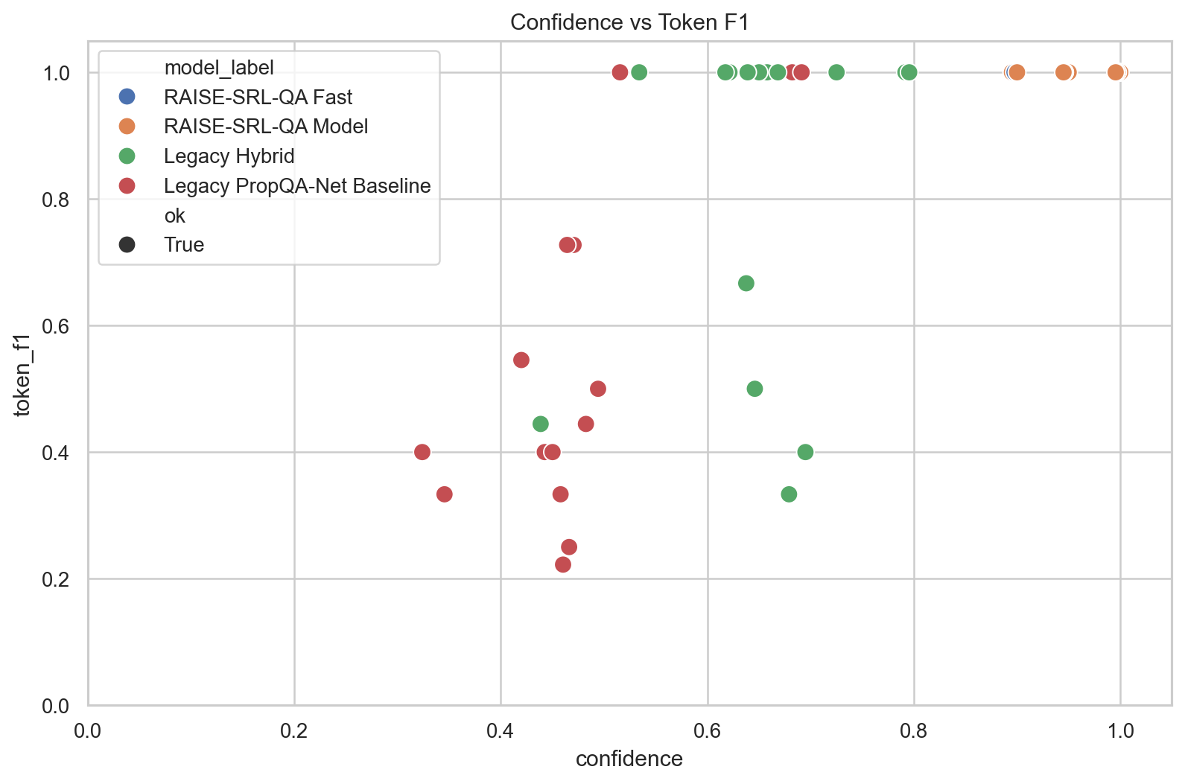
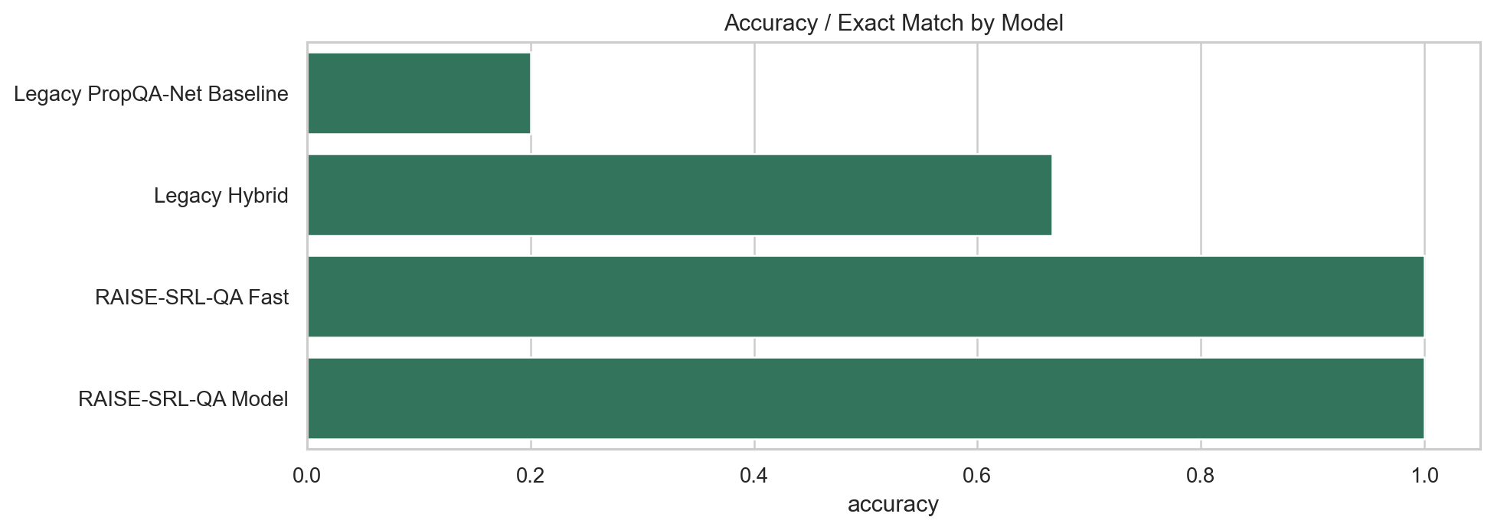
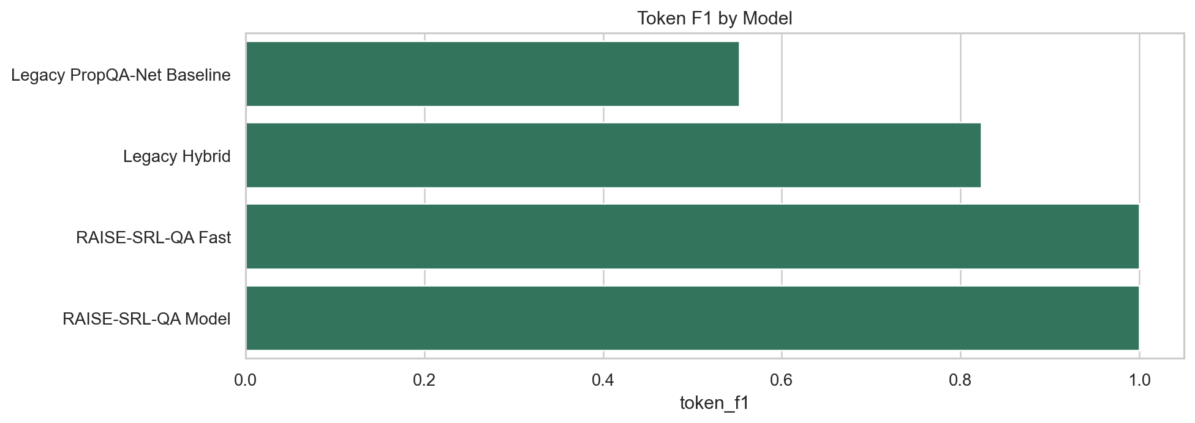
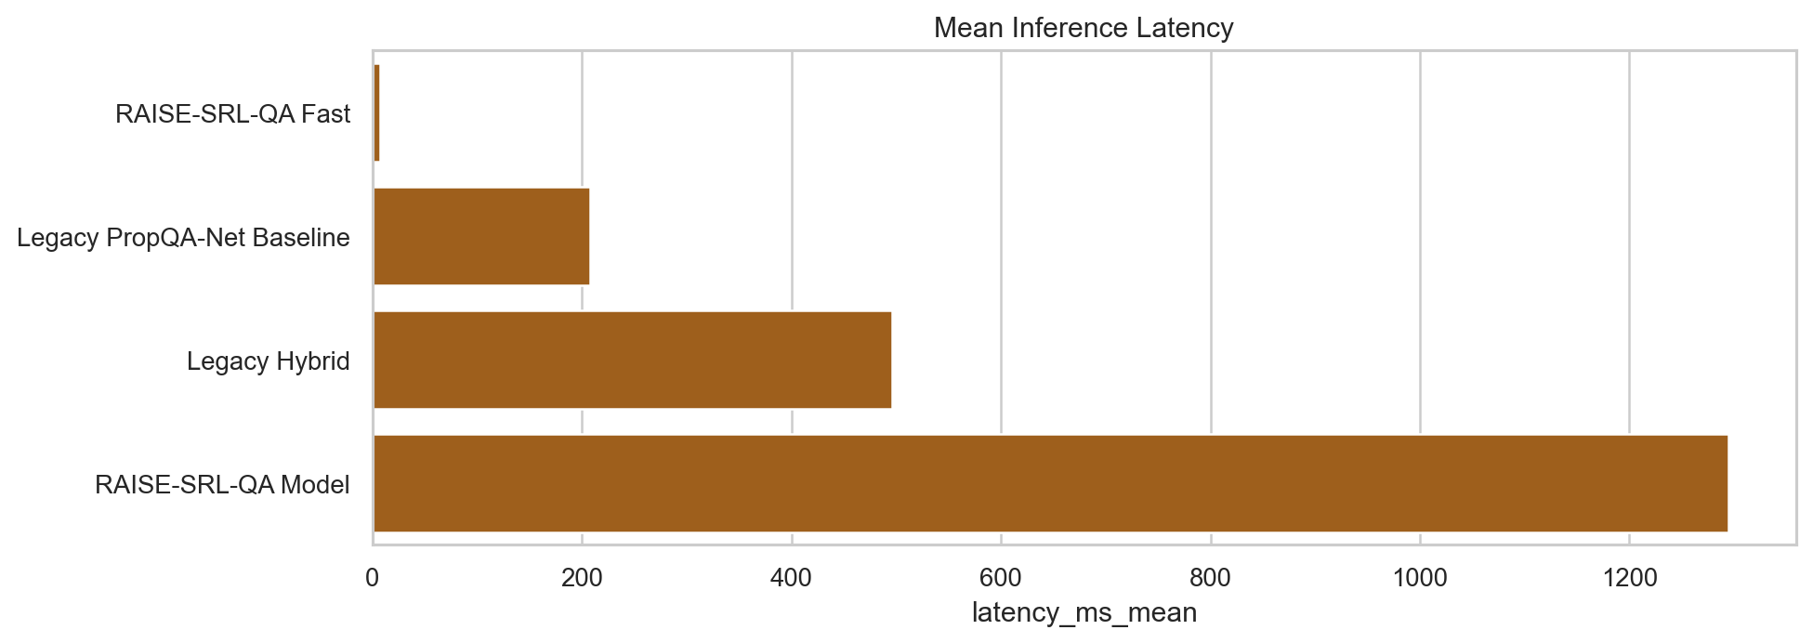
RESULTS
Result plots: quality, latency, and confidence
The plots show why structural methods can improve correctness while latency depends on model choice.
Accuracy
Token F1
Latency
Confidence vs F1
- Fast RAISE path is best for interactive presentation settings under the local seed-suite scope.
- Model-backed path is useful for candidate generation but adds significant latency.
- Confidence should be interpreted with calibration checks, not as proof of correctness.
Plots from srlqa/output/plots; local seed-suite scope where applicable.
29/35

Slide 30
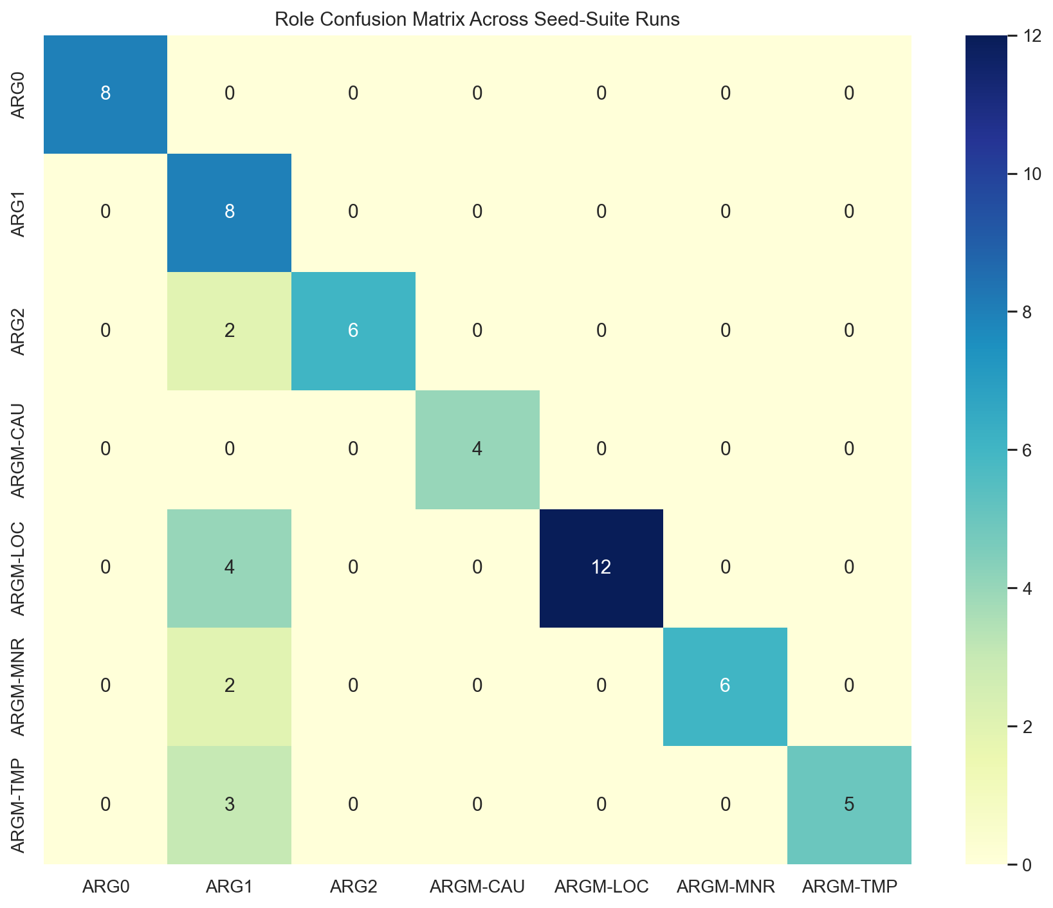
ANALYSIS
Error analysis: where the system still fails
The baseline error profile motivates the RAISE components.
Error taxonomy counts
correct
1,789
span boundary error
866
other
109
wrong role
685
predicate miss
2
Main lesson
Span-boundary and wrong-role errors are exactly the errors targeted by constrained decoding and verifier correction.
Role confusion matrix
Source: baseline_error_taxonomy.csv and role_confusion_matrix.png.
30/35

Slide 31
INNOVATION
Innovation matrix: implemented vs future-evaluable
The implementation contains multiple innovation modules, but not every module has a controlled ablation yet.
Innovation | Implemented evidence | Independent ablation?
PropBank frame retrieval | srlqa/retrieval/propbank_index.py | No controlled log
Constrained span decoding | srlqa/decoding/span_rules.py | No controlled log
Role priors | srlqa/decoding/role_priors.py | No controlled log
Evidence span verifier | srlqa/verification/span_verifier.py | No controlled log
Self-correction loop | srlqa/verification/self_correction.py | No controlled log
Hard negative mining | srlqa/training/hard_negative_mining.py | No controlled log
Distillation scaffolding | srlqa/distillation/teacher_runner.py | No controlled log
Calibrated ensemble | srlqa/ensemble/weighted_voter.py | No controlled log
Source: innovation_matrix.csv. Seed-suite context is reported separately from controlled ablations.
31/35

Slide 32
COMPARISON
Comparison with previous work
The comparison emphasizes method fit and claim boundaries rather than unsupported leaderboard numbers.
Capability | PropBank SRL | QA-SRL | Deep/LISA | MRC-SRL | This project
Canonical roles | Yes | Partial | Yes | Yes | Yes
Natural QA interface | No | Yes | No | Yes | Yes
Transformer span QA | No | Partial | No | Yes | Optional
Frame retrieval | No | No | No | Partial | Yes
Constrained decoding | No | No | Partial | Partial | Yes
Verifier/self-correction | No | No | No | Partial | Yes
PEFT 2B path | No | No | No | No | Yes
Prior-work columns summarize cited methods qualitatively; project metrics remain local-file based.
32/35

Slide 33
ROADMAP
Target roadmap: separated from measured results
These are target bands for the next experimental cycle, not achieved scores.
Stage 1
Stage 2
Stage 3
75%
80%
85%
Stabilize PropBank conversion, span-boundary rules, and frozen benchmark scripts.
Add controlled ablations for retrieval, role priors, verifier, and LoRA fine-tuning.
Scale to 2B QLoRA, hard negatives, calibrated ensemble, and external benchmark validation.
target token-F1 band
target token-F1 band
target token-F1 band
Roadmap values are intentionally separated from measured-result slides.
33/35

Slide 34
LIMITATIONS
Limitations and threats to validity
The deck is intentionally conservative about what has been proven.
- Evaluation scope: several strong RAISE scores come from a 15-example handcrafted seed suite.
- Benchmark gap: no external leaderboard claim is made for the local system.
- Ablation gap: innovation modules are implemented, but some lack independent controlled ablations.
- Dataset conversion risk: PropBank tree pointers require careful text-span normalization.
- Model access risk: full Gemma 2B QLoRA requires GPU runtime and accepted Hugging Face model terms.
- Future fix: freeze a benchmark split, add end-to-end notebook execution logs, and report statistical confidence intervals.
What we can claim
A working, explainable SRL-QA implementation with local evidence and reproducible artifacts.
What we should not claim
General state-of-the-art performance or achieved 80% accuracy without a frozen benchmark run.
Conference posture
Strong system story, honest evaluation, clear next experiments.
34/35

Slide 35
CONCLUSION
Conclusion: SRL-QA as structured answer extraction
The contribution is a principled bridge between PropBank roles, QA interaction, and verifiable span extraction.
Research message
Engineering message
Next step
Semantic roles make QA more controllable by linking questions to predicate-specific argument structure.
RAISE-SRL-QA adds retrieval, constraints, verification, and optional PEFT models around a simple QA core.
Run controlled ablations and the full 2B QLoRA experiment on a frozen benchmark split.
Reference URLs
Primary references: https://aclanthology.org/J05-1004/ | https://aclanthology.org/D15-1076/ | https://aclanthology.org/P18-1191/ | https://aclanthology.org/P17-1044/ | https://aclanthology.org/D18-1548/ | https://aclanthology.org/2022.coling-1.191/ | https://aclanthology.org/N19-1423/ | https://aclanthology.org/D16-1264/ | https://arxiv.org/abs/2106.09685 | https://arxiv.org/abs/2305.14314 | https://www.nltk.org/howto/propbank.html | https://huggingface.co/google/gemma-2-2b-it
All project numbers in the deck are either local measured values or explicitly labeled roadmap targets.
35/35

