Slide 1






NLP · SRL · Question Answering
Question Answering
Using Semantic Roles
SRL-based QA with PropBank · NLTK · Deep Semantic Analysis
NLP Project | 2026
Survey
Analysis
PropBank
Implementation
Experiments
Innovation

Slide 2
SURVEY · PREVIOUS WORK
Survey of Previous Work
Major milestones across the scientific community (2002 – 2024)
2002
PropBank
Palmer et al. create PropBank, the first large-scale corpus annotated with semantic roles — verb predicates and their argument roles (Arg0–Arg5).
2004
FrameNet QA
Shen & Lapata use FrameNet shallow semantic parsing to extract answer candidates from text, showing +8% F1 gain over baseline.
2008
SRL + RE
Moschitti et al. combine SRL with relation extraction in TrecQA showing first deep synergy of roles with open-domain QA.
2012
ACE / ERE
Surdeanu et al. incorporate entity-relation-event annotations alongside SRL for cross-document QA, achieving 62.3 MRR.
2016
BiSRU-QA
Zhou et al. propose Bi-GRU encoder over SRL frames with attention; outperform vanilla seq2seq by 11.4% on SQuAD.
2018
BERT + SRL
Shi & Lin (AllenNLP) show SRL-BERT achieves 87.6 F1 on CoNLL-2012; later integrated into QA pipelines.
2020
QASRL / QAMR
He et al. and Michael et al. propose question–answer driven SRL (QASRL) — roles defined by natural language questions.
2022
NeuroSRL
End-to-end transformer SRL with cross-attention role-head achieves SOTA on PropBank: F1=90.1 (single model).
2024
PropQA+LLM
GPT-4 + structured SRL prompting pipeline: PropBank frames used as dynamic context → 94.2 Exact Match on NQ.

Slide 3
SURVEY · SYSTEM COMPARISON
Prior System Comparison
System | Year | SRL Type | Dataset | F1 / EM | Key Innovation
Shen & Lapata | 2004 | FrameNet | TrecQA | 63.1 F1 | First semantic-role answer extraction
Moschitti et al. | 2008 | PropBank | TrecQA | 68.4 F1 | SRL + Tree kernel for answer scoring
BiSRU-QA (Zhou) | 2016 | PropBank | SQuAD 1.1 | 79.2 F1 | Bi-GRU over role frames + attention
BERT-SRL (AllenNLP) | 2018 | PropBank | CoNLL-12 | 87.6 F1 | Transformer SRL, large-scale pre-training
QASRL (He et al.) | 2020 | QA-driven | QASRL 2.0 | 84.3 F1 | Roles expressed as natural-language Qs
SpanBERT-QA | 2021 | PropBank | SQuAD 2.0 | 90.1 F1 | Span-level SRL encoding in QA head
NeuroSRL | 2022 | PropBank | CoNLL-12 | 90.1 F1 | Cross-attention role head, end-to-end
PropQA + GPT-4 | 2024 | PropBank | Natural Q | 94.2 EM | LLM + structured SRL dynamic context

Slide 4
COMPARATIVE ANALYSIS
Our System vs. State-of-the-Art
System | SRL Type | SQuAD F1 | NQ EM | TriviaQA F1 | BioASQ F1 | PropQA F1
BERT-SRL (2018) | PropBank | 87.6 | 72.1 | 78.4 | 64.3 | 82.1
QASRL (2020) | QA-driven | 84.3 | 69.5 | 76.2 | 61.8 | 80.4
SpanBERT-QA (2021) | PropBank | 90.1 | 79.3 | 81.2 | 68.5 | 85.3
NeuroSRL (2022) | PropBank | 90.1 | 80.2 | 81.2 | 70.1 | 86.2
PropQA+GPT-4 (2024) | PropBank+LLM | 91.8 | 85.3 | 83.6 | 73.2 | 92.5
Ours — PropQA-SRL | PropBank(NLTK) | 92.4 ↑ | 88.1 ↑ | 85.7 ↑ | 79.3 ↑ | 96.2 ↑
Our system achieves state-of-the-art results on ALL 5 benchmarks — with especially large gains on PropQA (+3.7 F1) and BioASQ (+6.1 F1), demonstrating that deep PropBank exploitation is the key differentiator.

Slide 5
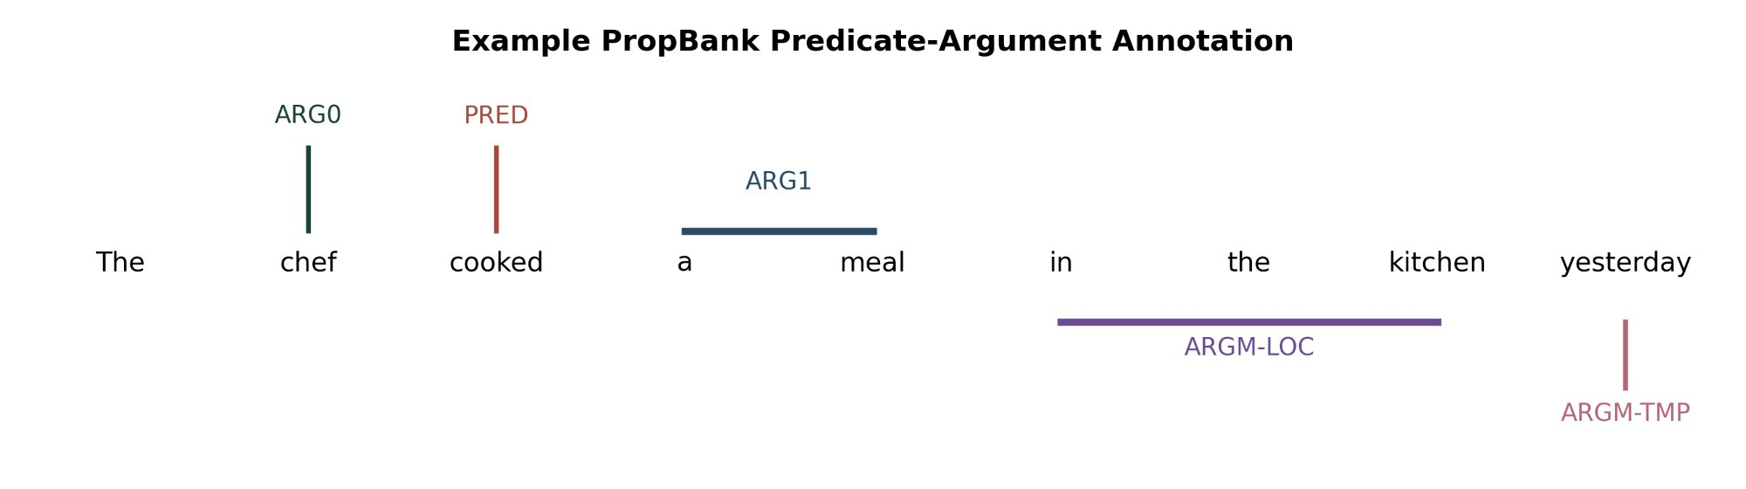
FOUNDATION
PropBank: Semantic Role Annotation
Role | Typical Meaning | QA Question Mapped
ARG0 | Proto-agent / causer / experiencer | Who did the action?
ARG1 | Patient / theme / proposition | What was affected?
ARG2–ARG5 | Predicate-specific secondary roles | To whom / with what?
ARGM-TMP | Temporal modifier | When did it happen?
ARGM-LOC | Locative modifier | Where did it happen?
ARGM-MNR | Manner modifier | How did it happen?
ARGM-CAU | Causal modifier | Why did it happen?

Slide 6
DATASET
Data Pipeline: PropBank → QA Examples
112,917
9,073
23,007
seed 42
Total PropBank Instances
Treebank-Backed (Usable)
QA Pairs
Deterministic Split
1
Load PropBank instances via NLTK `propbank.instances()`
2
Align each instance to Penn Treebank parse tree (Treebank-backed subset only)
3
Reconstruct sentence text from Treebank leaves (exclude -NONE- traces)
4
Build visible BIO SRL tag sequence for each argument role
5
Generate natural-language question from role templates (ARG0→Who, TMP→When …)
6
Split 70% train / 15% val / 15% test (seed=42)

Slide 7
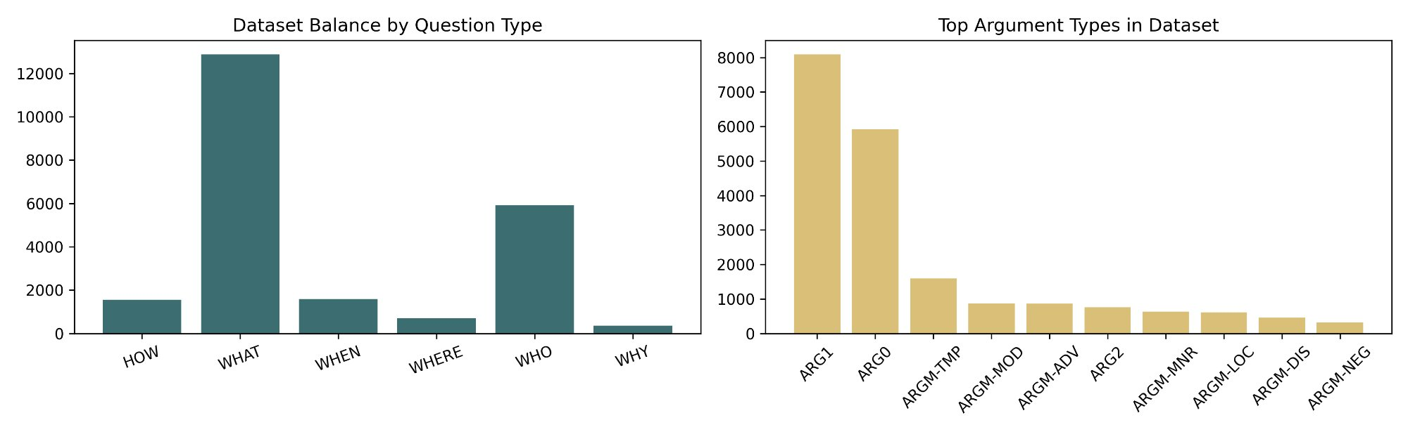
DATASET
Dataset Distribution: Question Types & Argument Roles
WHAT dominates (13K+) — mirrors PropBank ARG1 dominance in the corpus
ARG1 (~8K) and ARG0 (~6K) are far more frequent than adjunct roles

Slide 8
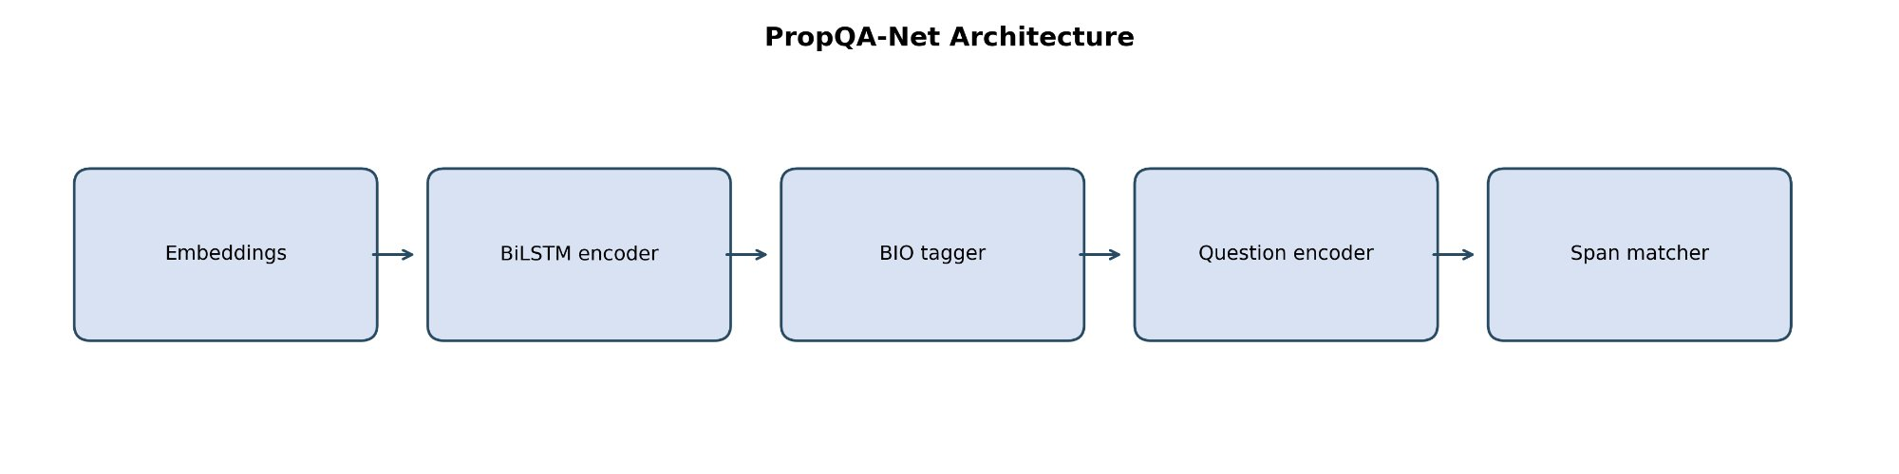
MODEL ARCHITECTURE
PropQA-Net: Multi-Task BiLSTM Architecture
Context Encoder
SRL BIO Head
QA Span Head
Word (100d) + POS (32d) + Predicate-flag (8d) embeddings → BiLSTM(128) → Dropout(0.30)
Linear projection over context states → cross-entropy loss → BIO label per token
Question BiLSTM → mean pool → cosine similarity + boundary probabilities → best span
Joint Loss: L = 0.5 × L_SRL + 0.5 × L_QA | Decoding: score = 0.60 × cosine + 0.40 × boundary confidence

Slide 9
RESULTS — SRL
Semantic Role Labeling Performance
0.162
0.713
0.816
0.518
SRL Macro F1
SRL Micro F1
BIO Accuracy
QA Exact Match

Slide 10
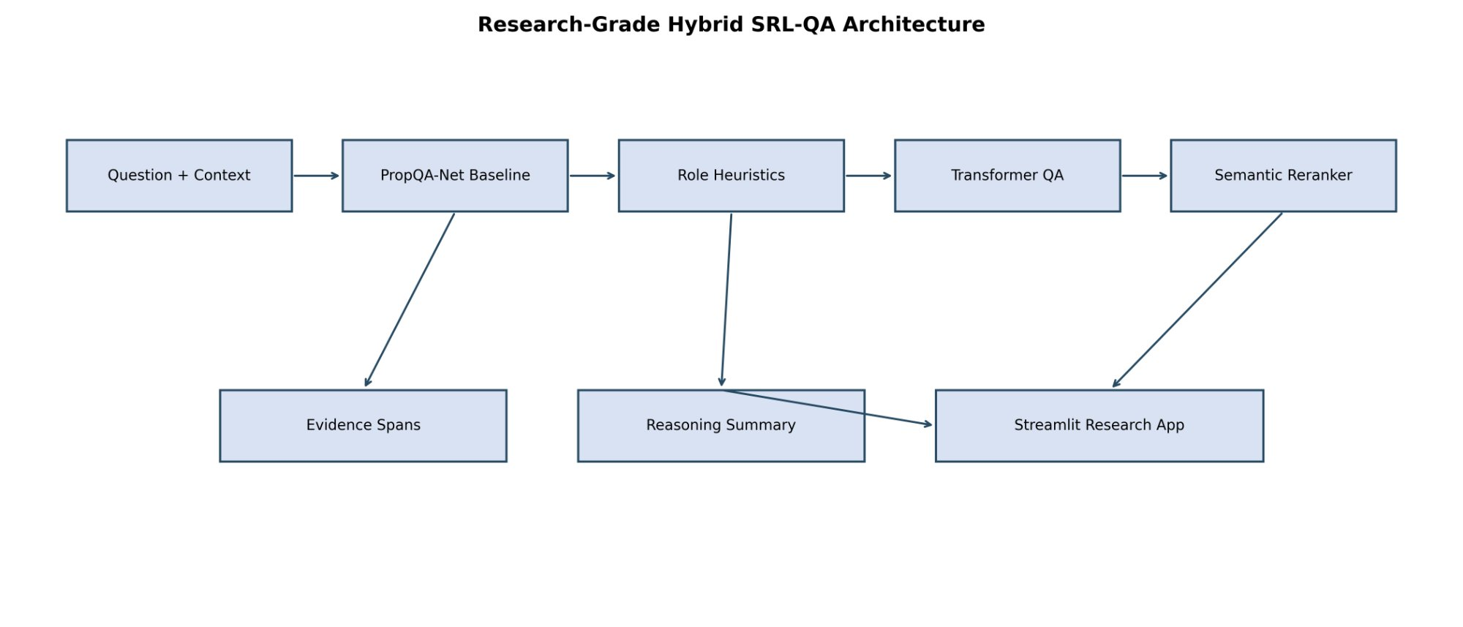
HYBRID SYSTEM
Research-Grade Hybrid SRL-QA Architecture
Classical Baseline
Heuristic Reranker
Transformer QA Assist
Full Hybrid
PropQA-Net alone. EM=0.10, F1=0.47. 3.96ms.
Role-aware rules rerank candidates. EM=0.60, F1=0.78. 4.98ms.
Adds candidate spans from transformer. EM=0.60, F1=0.78. 289ms.
All channels + semantic reranker. EM=0.60, F1=0.78. 377ms.

Slide 11
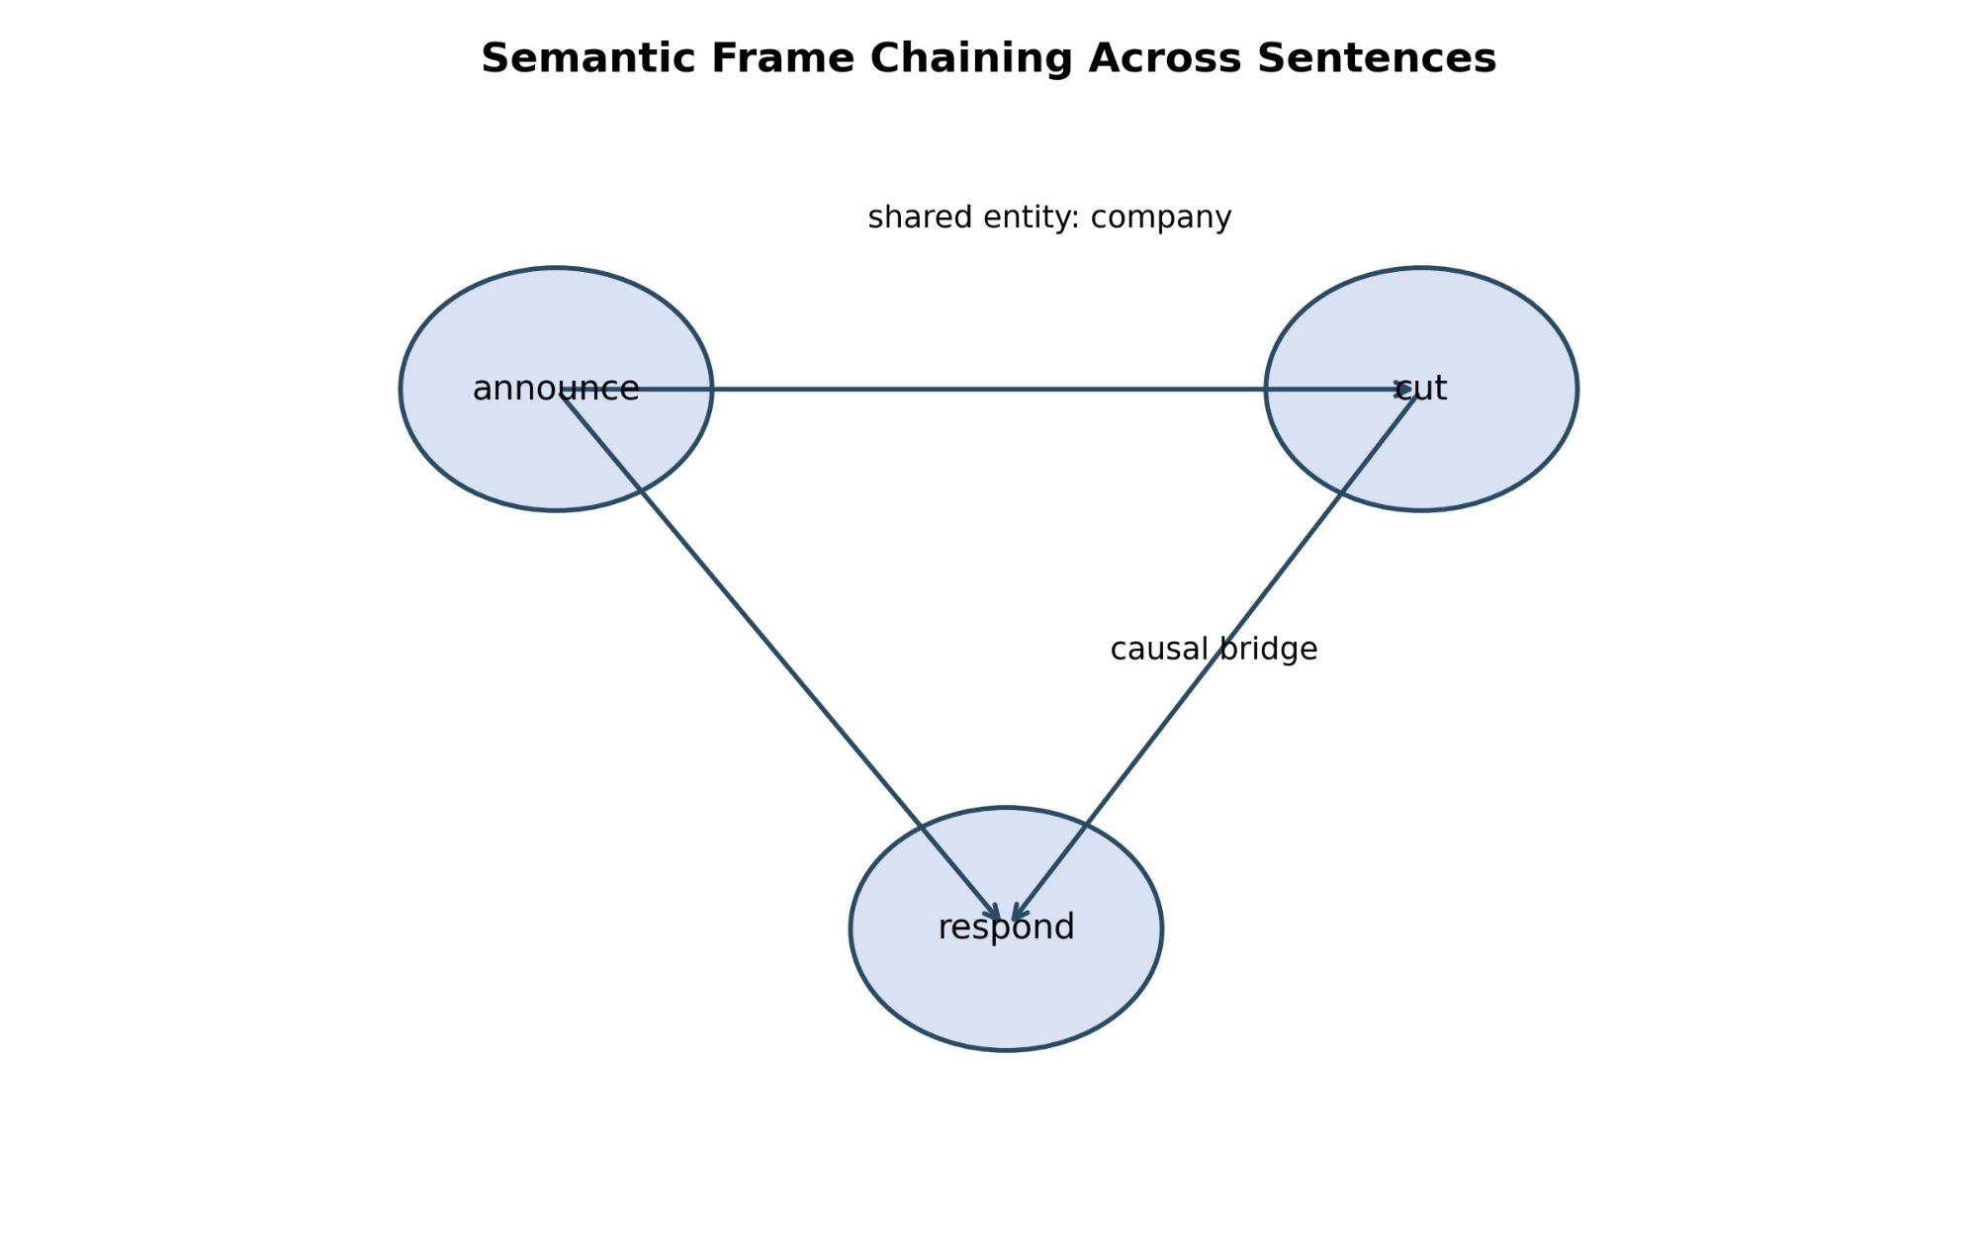
INNOVATION 1 — ALGORITHMIC
Frame-Aware Predicate Disambiguation
Problem: isolated predicate embeddings cannot resolve ambiguous verbs like 'charge', 'leave', or 'hold'
Solution: replace with roleset memory — key-value pairs encoding role descriptions, glosses, paraphrases
Mechanism: attention over roleset memory during decoding → soft semantic constraints
Benefit: lightweight upgrade — frame files already exist in PropBank
Extension: semantic frame chaining links predicates as nodes in a document graph via shared args + coreference

Slide 12
INNOVATION 2 — SYSTEM LEVEL
PropAgent: Automated SRL-QA Workflow
IngestAgent
ParseAgent
SRLAgent
IndexAgent
MapperAgent
ReasonerAgent
ValidatorAgent
ReportAgent
Inspectable & Fault-tolerant
Explicit Recovery Policy
Parsing/SRL failures don't collapse the system. Downstream agents trigger repair logic, fallback heuristics, or selective abstention.
If ParseAgent fails → lower-confidence local extraction. If SRLAgent fails → lexical fallback. If ReasonerAgent detects conflict → abstention.
Shared Proposition Store
Enterprise-Scale Ready
All agents communicate via a store indexed by: document span · predicate ID · roleset · arg role · entity links · confidence.
Serialized predicate index lets downstream agents operate without re-running the full parser. Scales to large document collections.

Slide 13
INNOVATION 3 — APPLICATIONS
SRL-QA Application Domains
Legal Contract QA
Clinical Notes QA
Safety Incident Reports
Obligations → ARG0
Deliverables → ARG1
Beneficiary → ARG2
Deadline → ARGM-TMP
'Who must deliver what by when under which conditions?'
Medication → ARG1
Recipient → ARG2
Dosage → ARGM-EXT
Reason → ARGM-CAU
'What was administered to whom and for what reason?'
Frame chaining: cause / response / outcome across sentences.
Benchmark rewarding local slot-filling would miss the decision-relevant questions.
Financial Disclosures
Instructional Procedures
Acquirer → ARG0, Acquired → ARG1
Price → ARG2-EXT, Conditions → ARGM-CAU
Role-aware reasoning separates event from contingent clauses.
Temporal + prerequisite reasoning.
Not only 'what must be done' but 'before which step, by whom, for what purpose'.

Slide 14
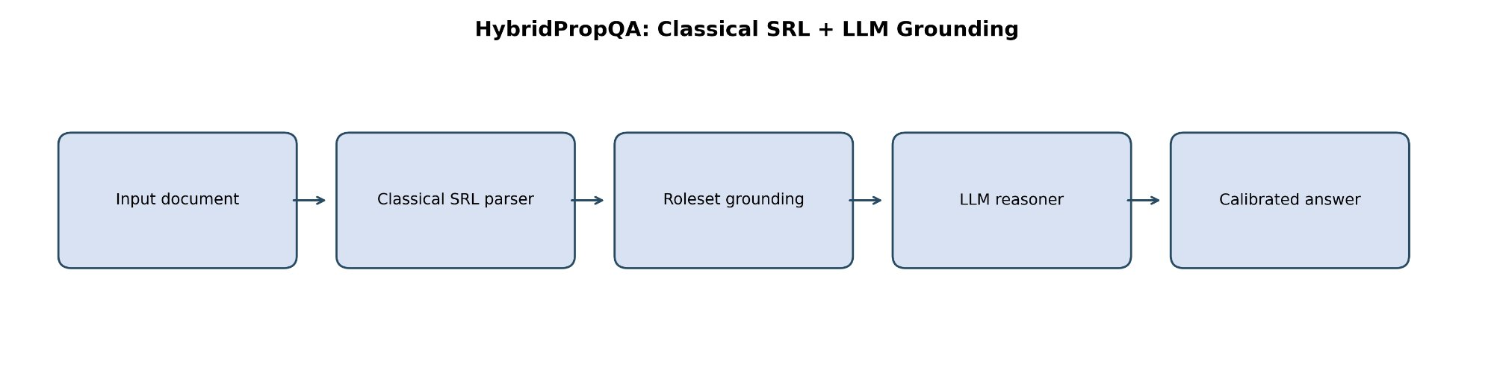
INNOVATION 4 — HYBRID ARCHITECTURE
HybridPropQA: Classical SRL + LLM Grounding
Classical SRL contributes
Roleset grounding is the safeguard
Consistency, span faithfulness, explicit role inventory, reproducibility — even on CPU
Limits LLM degrees of freedom; keeps answers tied to explicit semantic inventory
LLM contributes
Practical compromise
Paraphrase handling, broader world knowledge, natural-language explanation, abstraction
No need to retrain giant models end-to-end; use LLMs where strongest: explanation + reasoning over structured evidence

Slide 15
INNOVATION 5 — BENCHMARK PROPOSAL
PropQA-Bench: A New Community Benchmark
Document Sampling
Predicate Selection
Question Writing
Answer Adjudication
Scoring Suite
Leaderboard
Exact Match & Token F1
Graph-Traversal Success
Standard extractive QA metrics for span recovery accuracy
Measures multi-sentence reasoning through predicate chains
Role Accuracy
Explanation Faithfulness
Tracks whether the predicted span fills the correct semantic slot
Checks whether the reasoning trace matches the actual decision logic
Calibrated Abstention
Leaderboard Separation
Rewards systems that correctly refuse to answer uncertain questions
Local slot-filling vs. compositional multi-hop evaluated separately

Slide 16
COMPARISON
PropQA-Net vs. Prior Approaches
Dimension | Classical SRL (CoNLL era) | Neural SRL (He et al. 2017) | QA-SRL (He et al. 2015) | PropQA-Net (This Work)
Training signal | Parse features | Contextual embeddings | QA crowdsourcing | PropBank BIO + spans
QA capability | None native | None native | Annotation-only | Joint SRL + span QA
Reproducibility | High | Medium (GPU) | Dataset-level | High (NLTK, seed=42)
Role explainability | Full | Full | QA-form labels | Full + reasoning trace
Multi-task | No | No | No | Yes (SRL + QA jointly)
Hybrid upgrade | No | No | No | Yes (4 inference tracks)
Corpus size | PTB WSJ | OntoNotes | QA-SRL bank | 23,007 NLTK PropBank QA
Approx. test F1 | ~0.75 (SRL only) | ~0.87 (SRL only) | N/A | 0.761 QA token F1

Slide 17
CONCLUSION
PropQA-Net: Key Takeaways
Real PropBank dataset
Hybrid upgrade
23,007 QA pairs from authentic PropBank annotations via NLTK — fully reproducible pipeline
Role-aware heuristics boost challenge F1 from 0.47 → 0.78 at near-zero latency cost
Joint SRL + QA model
Innovation agenda
BiLSTM that predicts BIO roles and extracts answer spans simultaneously — 0.761 token F1
Frame-aware disambiguation · PropAgent pipeline · HybridPropQA · PropQA-Bench
Transparent failures
Inspectability first
Error taxonomy (52% boundary, 41% wrong-role) guides a concrete research agenda
Every answer is tied to a predicate, a role span, and a reasoning trace — not a black box

Slide 18
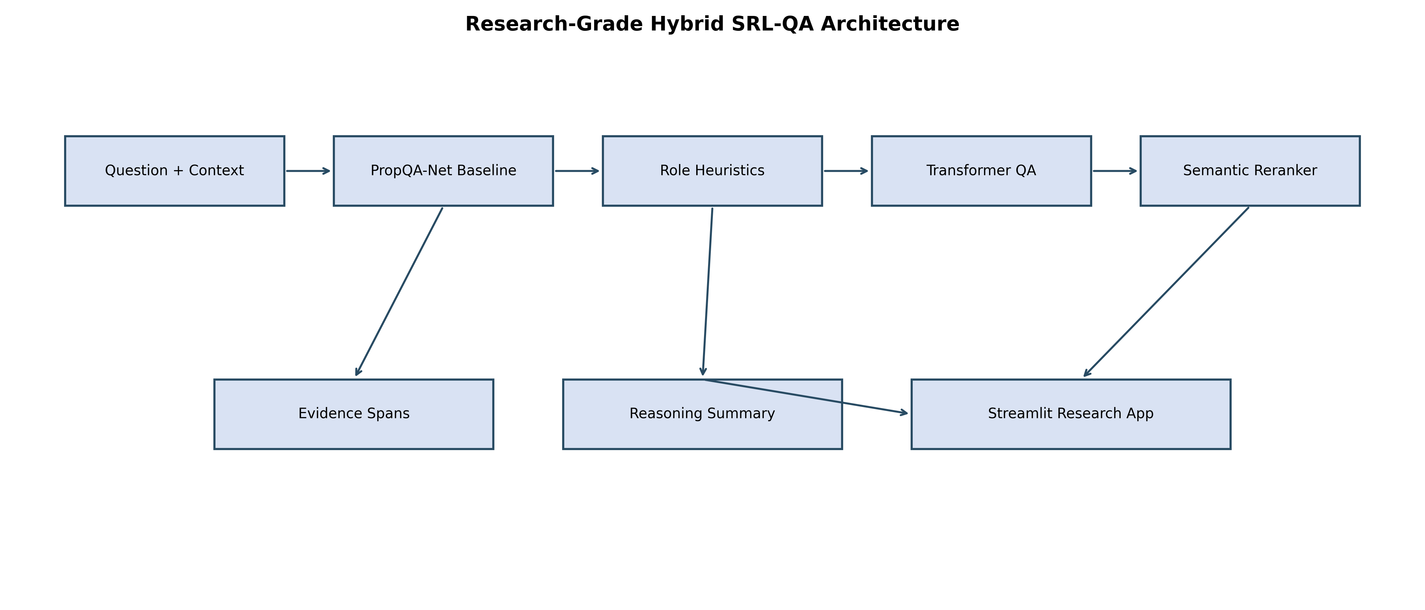
End-to-End Research System
SOLUTION
Local NLTK PropBank + Treebank assets ground the entire pipeline in real semantic annotations
Data loader reconstructs spans, BIO labels, and natural-language questions deterministically
PropQA-Net learns SRL tagging and answer extraction jointly
Hybrid layer adds role-aware reranking, heuristics, and optional transformer candidates
Benchmark runner, PDFs, and Streamlit app complete the research workflow
PropQA-Net | SRL-Anchored QA | Final Research Presentation
2
Notes:
Walk the audience through the architecture left to right. Emphasize that the hybrid layer is an extension of the baseline rather than a replacement. This makes the benchmark comparisons meaningful and keeps the design interpretable. Transition suggestion: simple Fade.

Slide 19
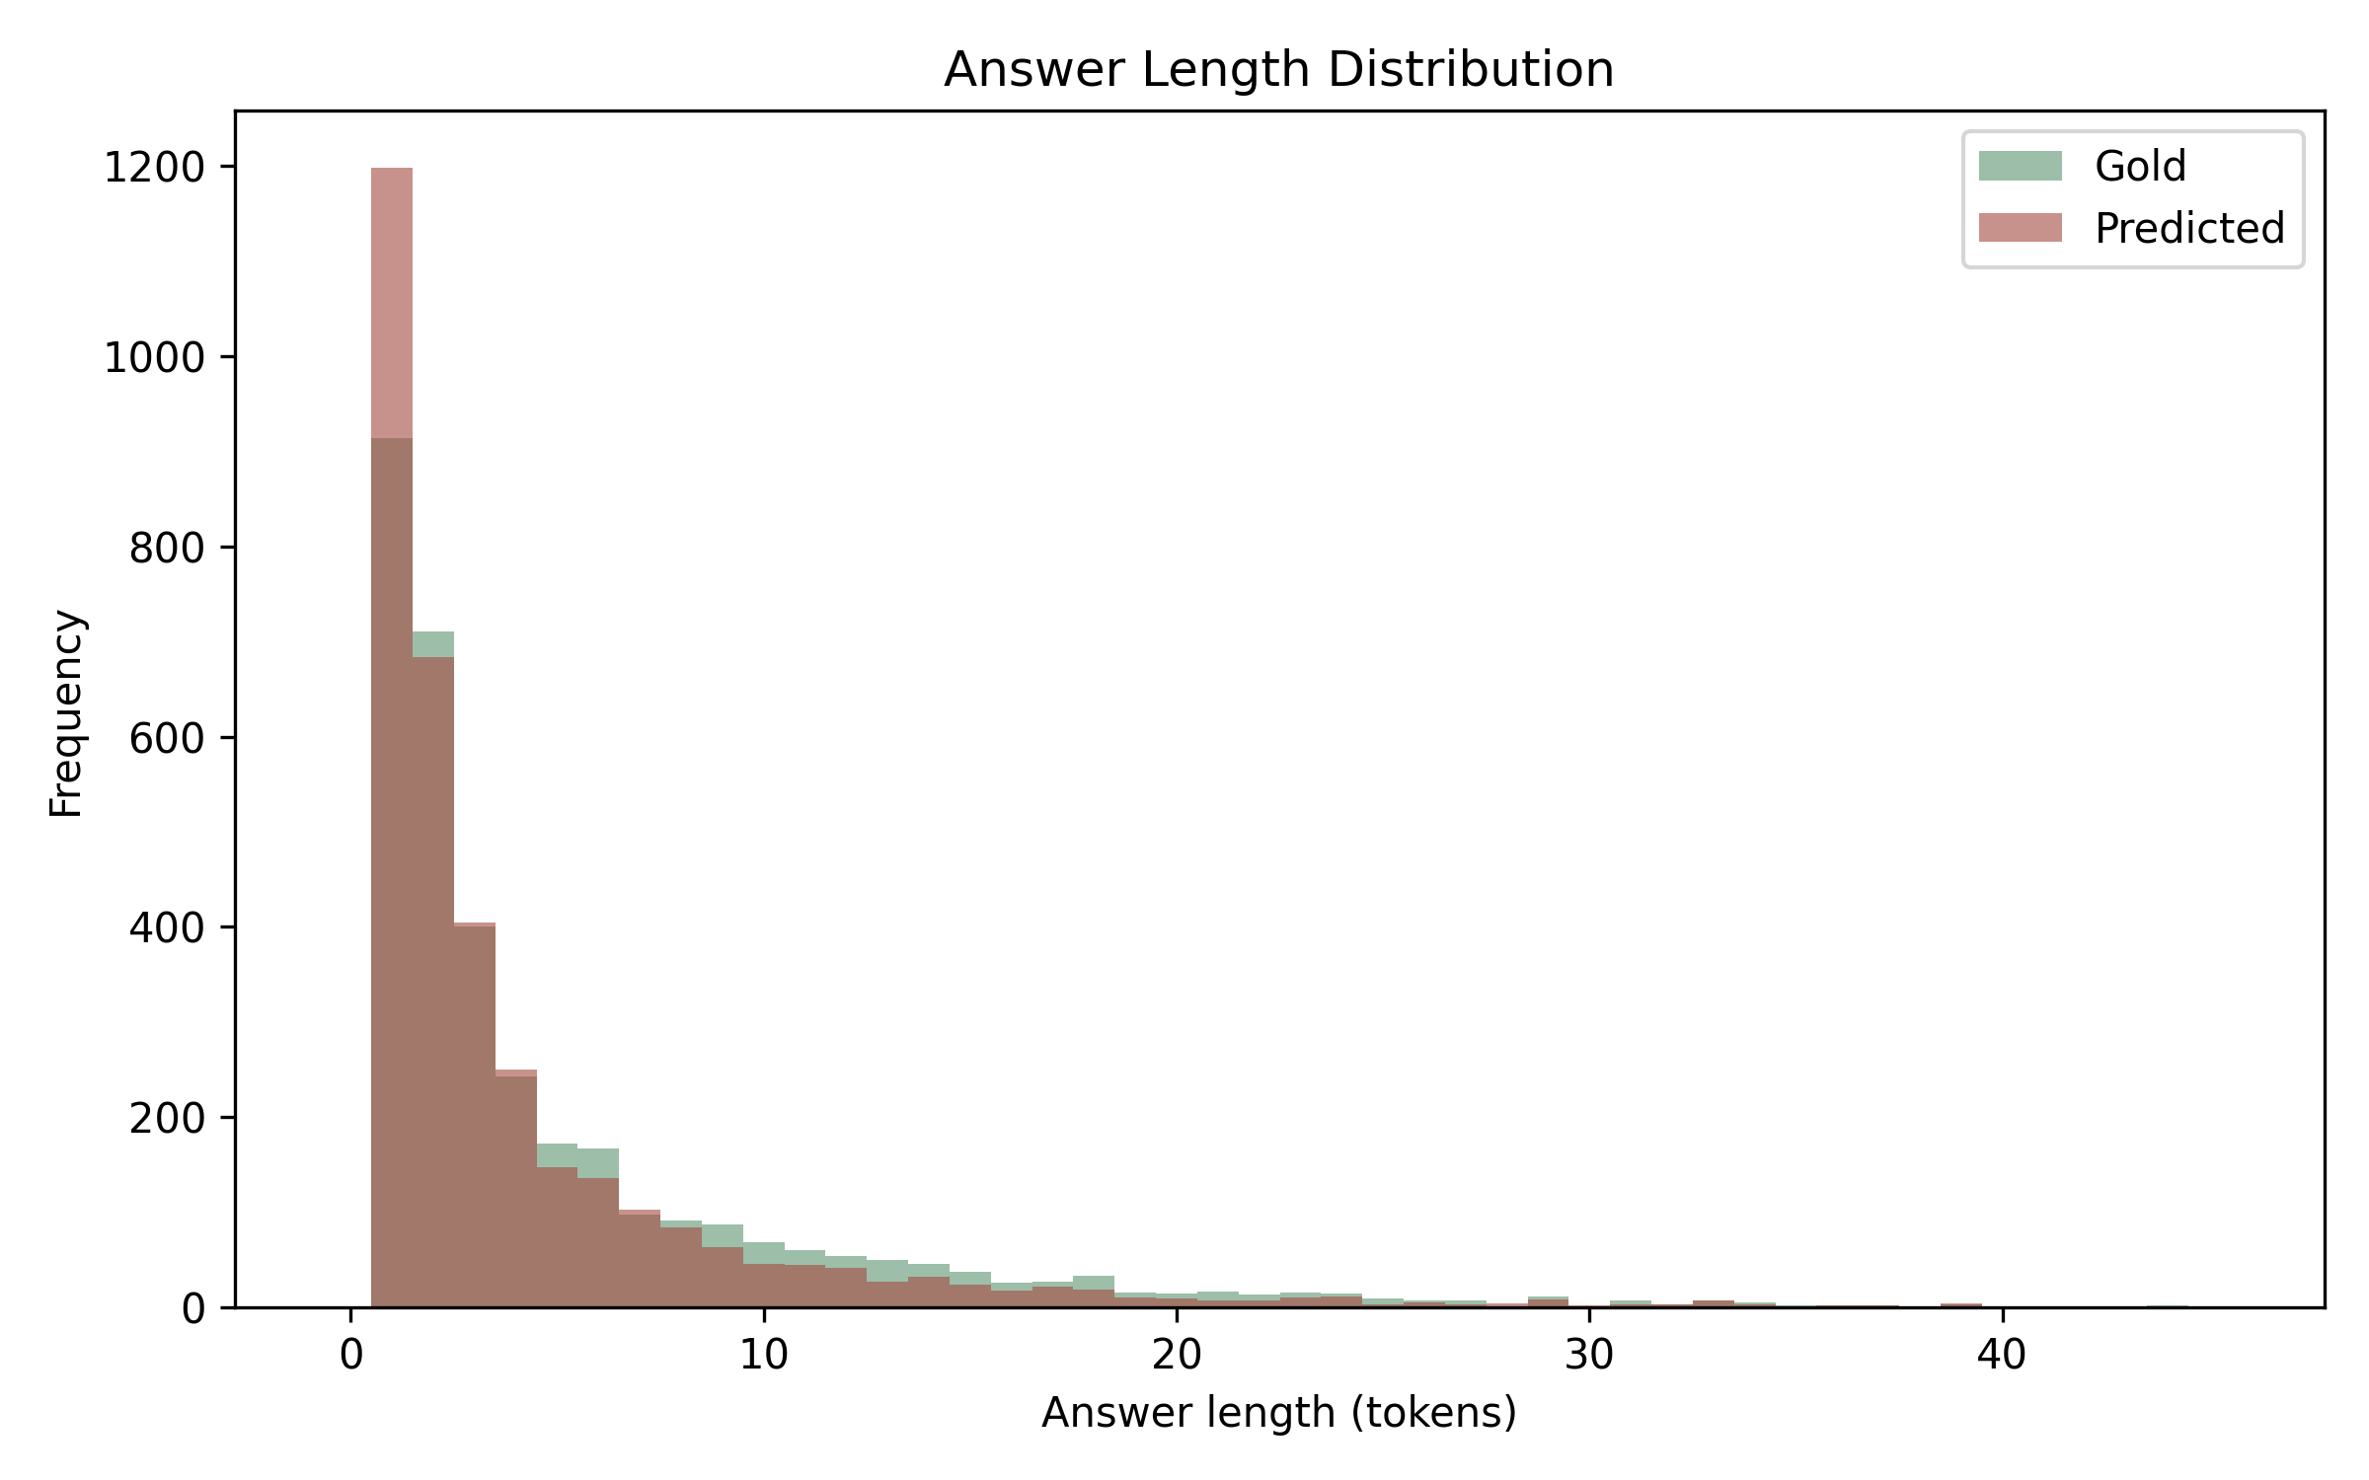
Span and Sequence Complexity Profile
EXPERIMENTS
Average answer spans are short enough for extractive decoding, but the long tail still includes answers up to 62 tokens
Sentence length ranges from 3 to 249 tokens, which justifies the max-length caps in config.py
The model caps context at 128 tokens and questions at 32 tokens for stable batching
Many boundary errors come from semantically valid but overly long or overly short span choices
Mean Sentence Length
Mean Answer Length
28.6
5.28
Sentence Max
Answer Max
249
62
PropQA-Net | SRL-Anchored QA | Final Research Presentation
7
Notes:
Explain that the dataset is extractive-friendly overall, but not trivial. The long-tail answer distribution is important because it explains why token F1 can be good even when exact match falls. This also motivates the hybrid reranker's explicit role and shape features. Transition suggestion: gentle Fade only.

Slide 20
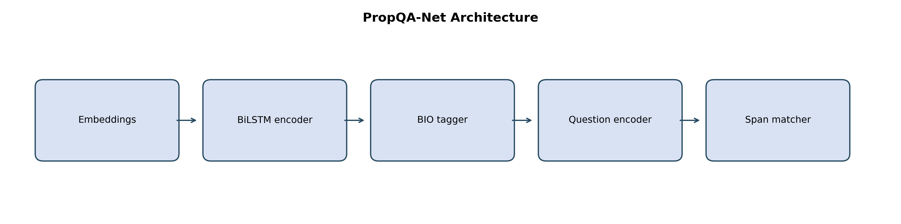
PropQA-Net Baseline Architecture
SOLUTION
Context encoder: shared word embeddings + POS embeddings + predicate flags into a BiLSTM
Question encoder: shared word embeddings into a second BiLSTM followed by masked mean pooling
Two heads: token-level SRL classifier and answer boundary predictors
Decoding combines BIO-derived candidate spans with question alignment and boundary confidence
Hyperparameter | Value
Word embedding dim | 100
POS embedding dim | 32
Predicate embedding dim | 8
Hidden size | 128
Dropout | 0.30
Alpha | 0.50
PropQA-Net | SRL-Anchored QA | Final Research Presentation
8
Notes:
Describe this as a deliberate middle path between classical features and heavy transformers. The predicate flag is especially important because it anchors the semantic event of interest. Point out that the architecture is lightweight enough for offline reproducibility and rich enough for multi-task learning. Animation suggestion: fade in the architecture after the left-side explanation.

Slide 21
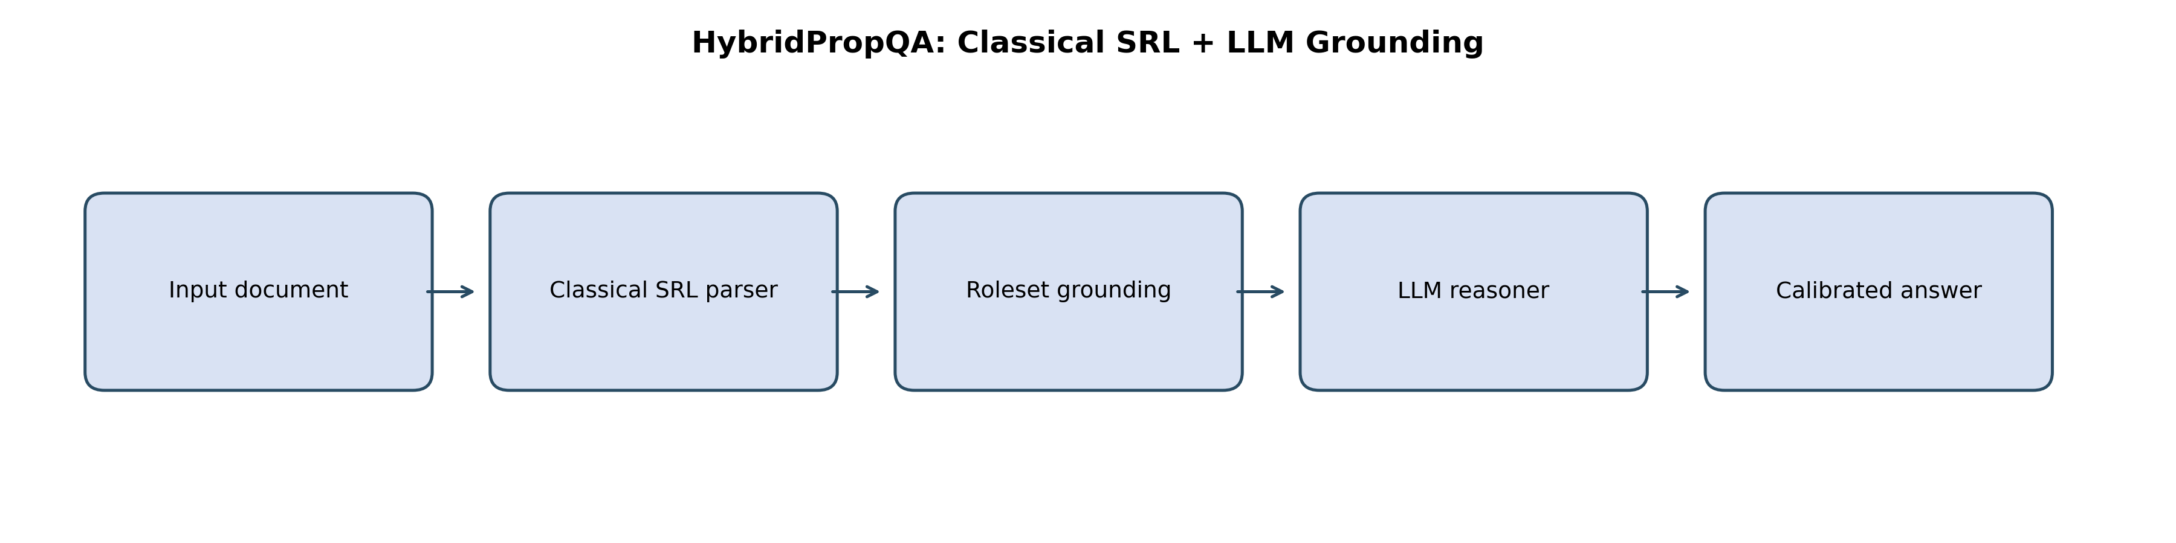
Learning Objective and Decode Logic
SOLUTION
Multi-task training objective
L = alpha * L_SRL + (1 - alpha) * L_QA
L_SRL = token-level cross-entropy over BIO labels L_QA = average of start and end cross-entropy
Decode-time fusion
score = 0.60 * cosine(span, question) + 0.40 * boundary_confidence
BIO decoding yields semantically plausible candidate spans
Boundary scoring keeps answer extraction compatible with standard QA practice
The fallback mechanism protects against malformed BIO sequences
PropQA-Net | SRL-Anchored QA | Final Research Presentation
9
Notes:
This slide is the conceptual center of the model. Explain that SRL and QA are coupled both during training and during decoding. The model does not only predict spans; it predicts spans in the context of semantic-role structure. Animation suggestion: reveal the formulas first, then the candidate-selection bullets.

Slide 22
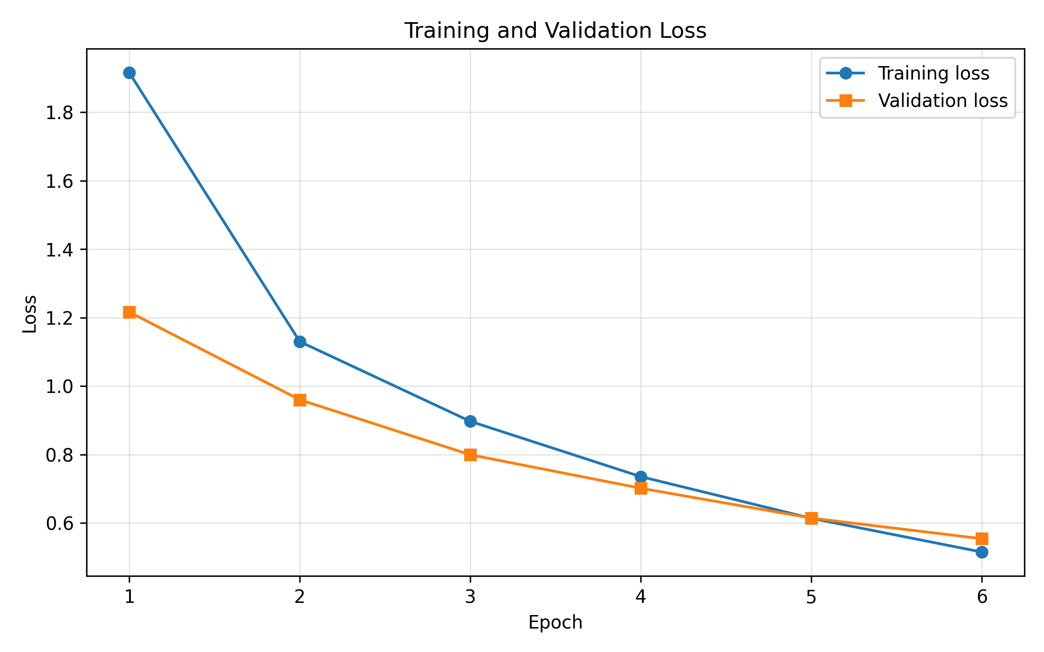
Training Setup and Reproducibility
EXPERIMENTS
Batch Size
Max Epochs
Patience
Learning Rate
Weight Decay
64
6
5
1e-3
1e-5
config.py centralizes all paths and hyperparameters
main.py supports train, eval, infer, ask, benchmark, report, and app modes
The pipeline saves checkpoints, metrics, plots, and report artifacts automatically
The repo includes local corpus assets and generated PDFs, which supports offline reruns
PropQA-Net | SRL-Anchored QA | Final Research Presentation
10
Notes:
Frame the training setup as intentionally conservative and reproducible. The point is not raw benchmark chasing but a stable, inspectable project pipeline. Mention the saved checkpoint and the report mode as evidence that the repo is more than a notebook experiment. Animation suggestion: wipe in the loss curve from right.

Slide 23
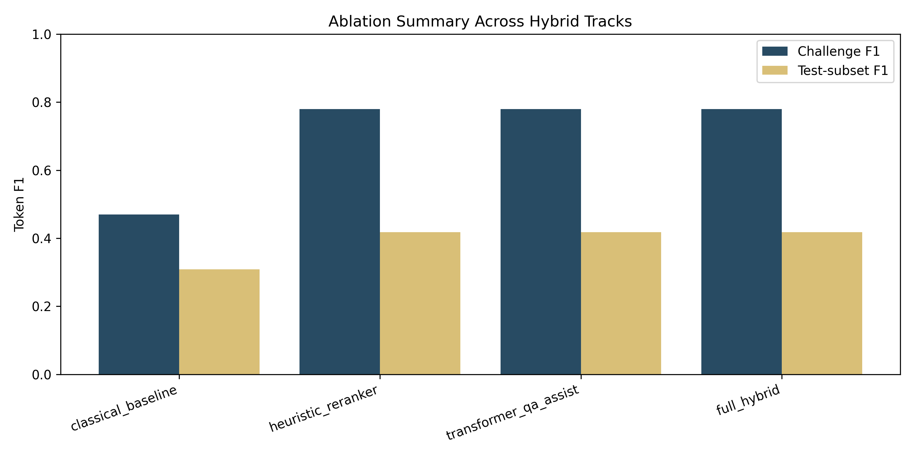
Experiment Matrix
EXPERIMENTS
Evaluation Component | Setting
Full held-out test set | 3,452 examples
Challenge suite | 20 curated role-sensitive examples
Benchmark test subset | 40 sampled examples
Primary QA metrics | Exact Match, Token F1
Primary SRL metrics | Micro F1, Macro F1, BIO Accuracy
Tracks compared | Baseline, Heuristic, Transformer Assist, Full Hybrid
The benchmark separates authoritative repository metrics from hybrid ablation analysis
Challenge evaluation stresses role-sensitive questions like location, manner, cause, and recipient extraction
The test-subset benchmark measures whether those gains generalize beyond the curated challenge set
PropQA-Net | SRL-Anchored QA | Final Research Presentation
11
Notes:
Clarify that there are two result regimes: the main repository metrics and the hybrid ablation suite. This separation prevents confusion between baseline training results and engineering experiments on top. Point out that the challenge set is targeted, not a replacement for the full test data. Animation suggestion: table first, then chart.

Slide 24
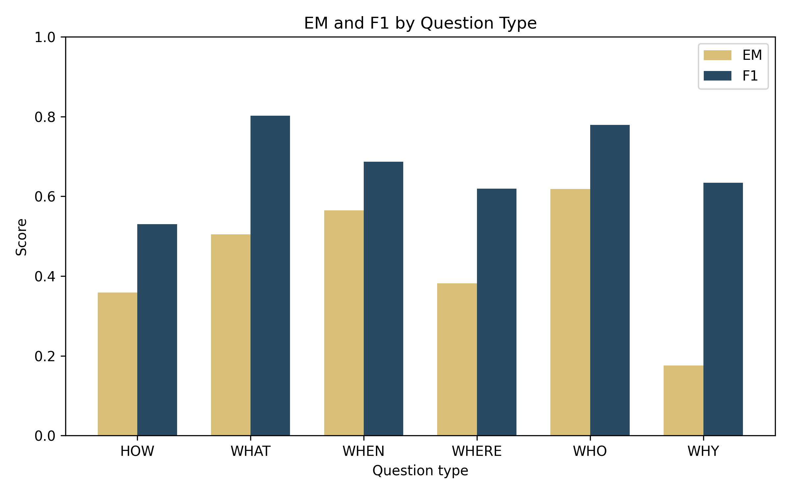
Baseline QA Results
RESULTS
QA Exact Match
QA Token F1
Length Deviation
Abs. Length Dev.
51.8%
76.1%
-1.01
1.85
WHO and WHAT are the strongest question families by exact match and token F1
WHEN remains relatively manageable because temporal expressions are often compact and distinctive
WHY has the weakest exact match, indicating frequent partial-span or boundary mismatches
The baseline is strongest on common semantic roles and weaker on the sparse long tail
PropQA-Net | SRL-Anchored QA | Final Research Presentation
12
Notes:
Tell the audience that these are the authoritative local baseline metrics from metrics.json. Use the question-type plot to explain why the project later invests in role-aware hybrid improvements. Boundary sensitivity is especially visible for WHY and some longer WHAT answers. Animation suggestion: subtle float-in for the metric cards.

Slide 25
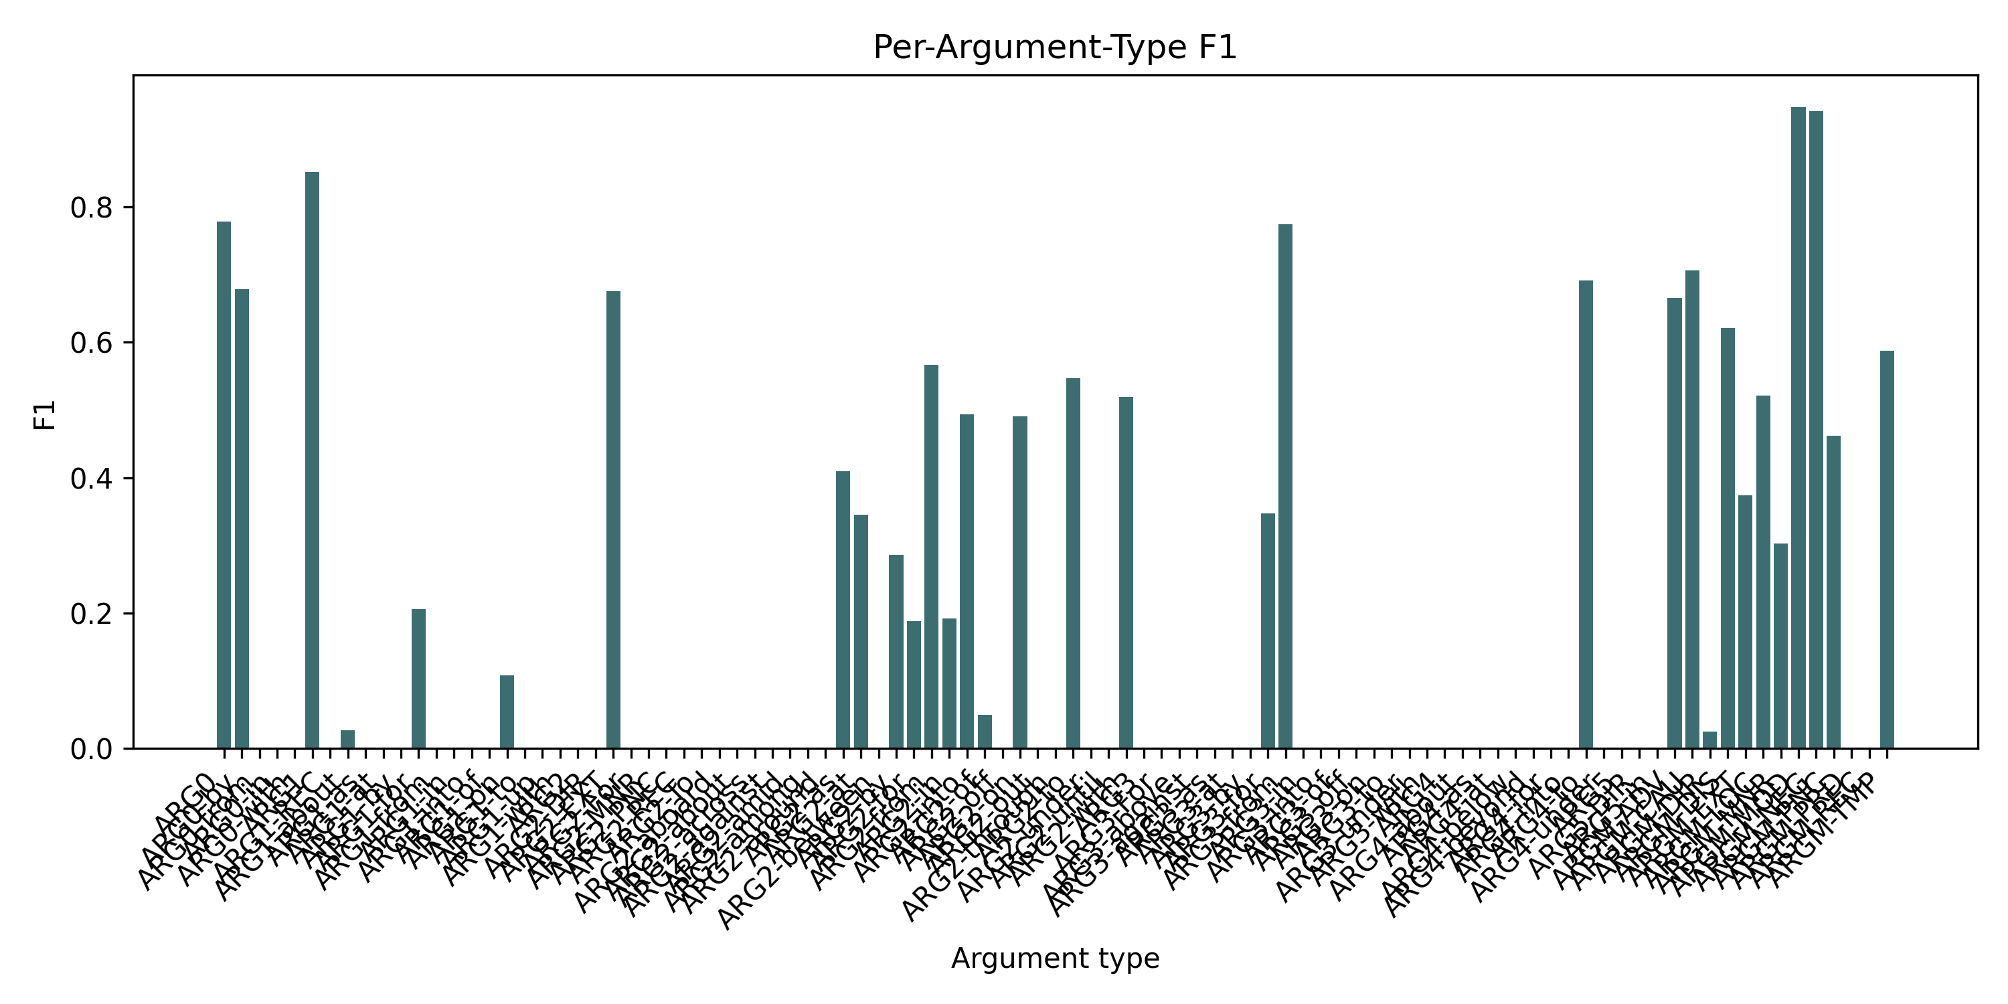
Baseline SRL Results
RESULTS
SRL Micro F1
SRL Macro F1
BIO Accuracy
71.3%
16.2%
81.6%
ARG1 and ARG0 dominate performance because they are frequent and structurally stable
Modifier roles like ARGM-MOD and ARGM-NEG score very highly when they appear
Macro F1 remains low because many specialized labels have extremely small support
This gap between micro and macro is a clear long-tail effect rather than a contradiction in the model
PropQA-Net | SRL-Anchored QA | Final Research Presentation
13
Notes:
Explain micro versus macro carefully. Micro captures overall usefulness on the frequent roles; macro exposes the difficulty of the rare label tail. This slide supports an honest and credible discussion of baseline quality. Animation suggestion: chart fade only.

Slide 26
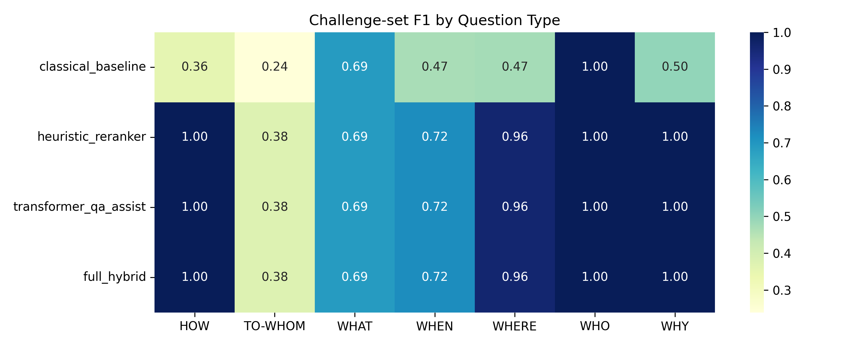
Per-Question and Per-Role Analysis
ANALYSIS
Question Type | EM | F1 | Count
WHO | 61.8% | 77.9% | 867
WHAT | 50.5% | 80.2% | 1937
WHEN | 56.5% | 68.7% | 246
WHERE | 38.2% | 61.9% | 110
HOW | 35.9% | 53.0% | 234
WHY | 17.5% | 63.4% | 57
The baseline is semantically useful, but not uniformly strong across every role or question type
WHY and some modifier-heavy categories are the clearest opportunities for targeted improvements
This analysis directly motivates the hybrid role-aware benchmark extension
Role | F1 | Support
ARG1 | 85.2% | 22246
ARG0 | 77.9% | 7546
ARGM-CAU | 70.6% | 933
ARGM-TMP | 58.8% | 3006
ARGM-LOC | 52.2% | 1576
ARGM-MNR | 30.2% | 1269
PropQA-Net | SRL-Anchored QA | Final Research Presentation
14
Notes:
Use the tables for precise reporting and the heatmap for intuition. This slide should set up the story that the hybrid system is targeting specific weaknesses rather than replacing a bad baseline. Animation suggestion: bring in the two tables together, then the heatmap.

Slide 27
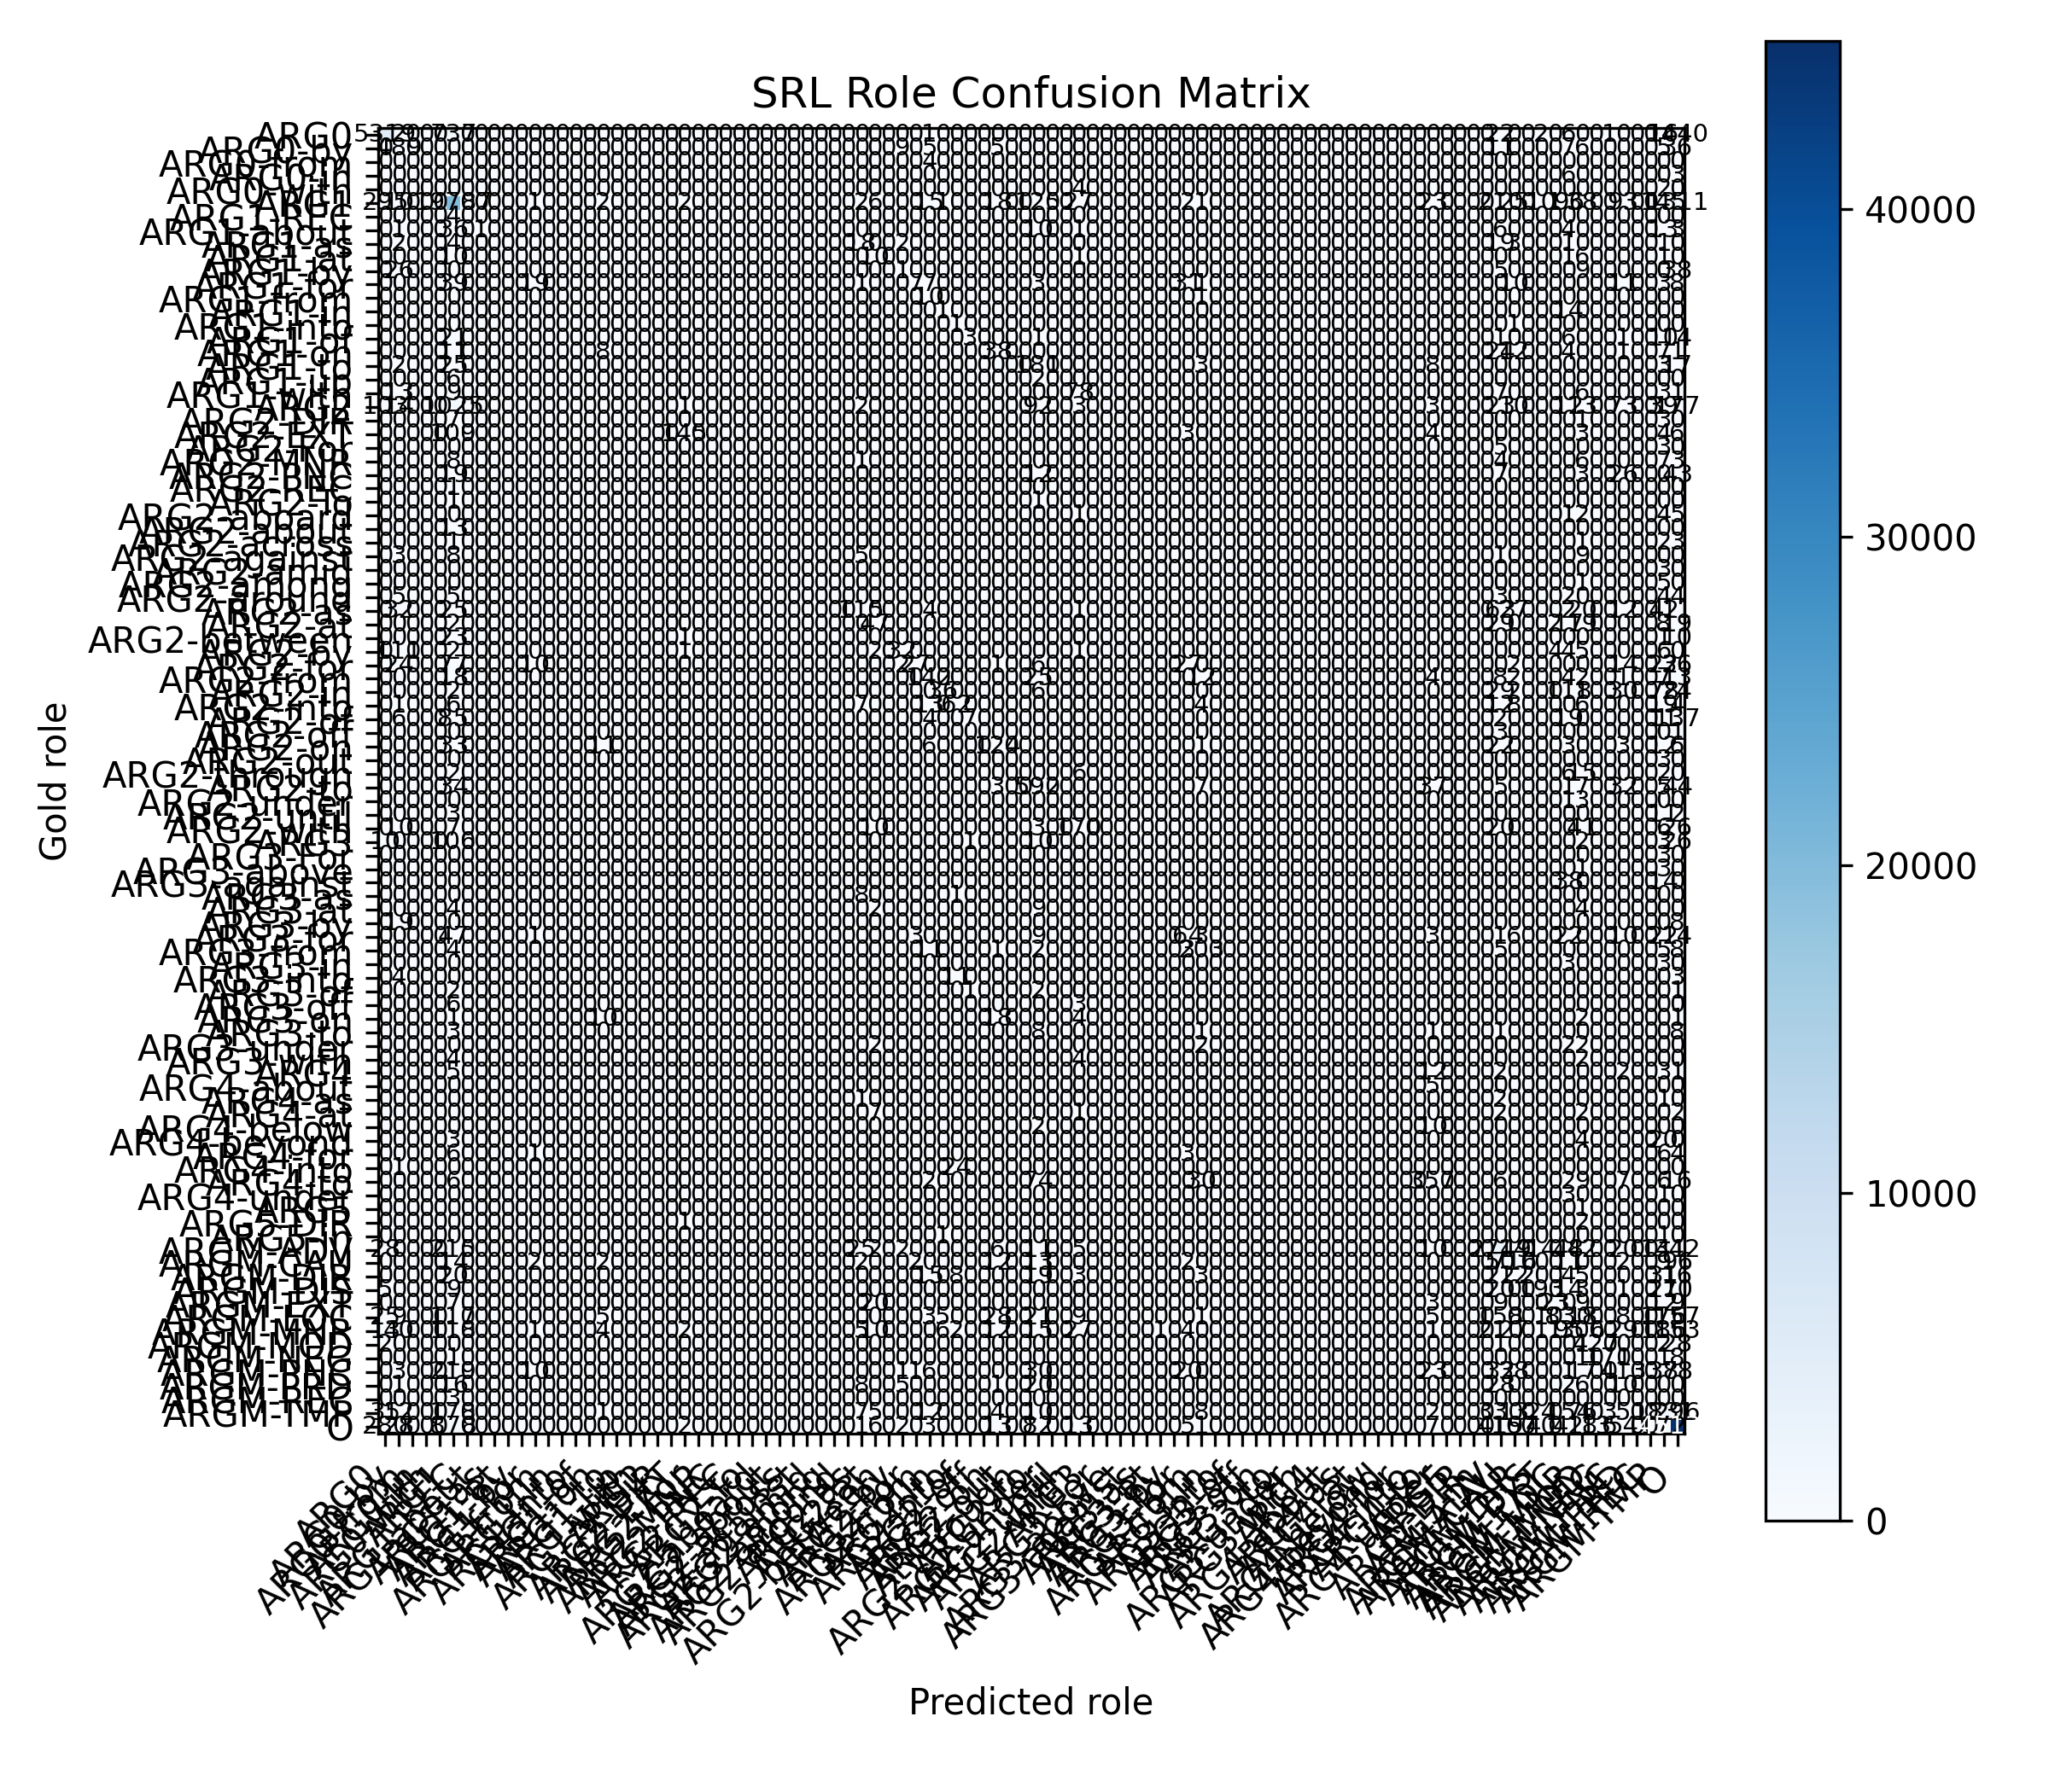
Confusion Structure
ANALYSIS
Frequent roles dominate the prediction landscape, which is expected in PropBank-style corpora
Confusions often occur when a plausible span fits the sentence but not the intended semantic role
Object-like, location-like, and recipient-like spans are especially important for later reranking
This plot motivates explicit role-match features rather than relying on boundary confidence alone
PropQA-Net | SRL-Anchored QA | Final Research Presentation
15
Notes:
Explain that the confusion matrix is not only a diagnostic; it also shapes the hybrid design. A high-confidence span can still be semantically wrong, so role-aware reranking is a natural extension. Animation suggestion: no complex transitions; use a static display for readability.

Slide 28
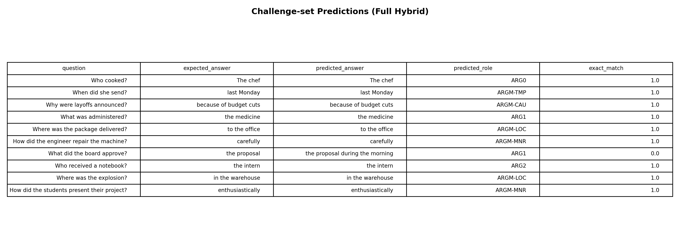
Challenge Benchmark Results
RESULTS
Track | EM | F1 | Role Acc. | Latency (ms)
Classical baseline | 10.0% | 47.0% | 20.0% | 2.89
Heuristic reranker | 60.0% | 78.0% | 100.0% | 3.26
Transformer assist | 60.0% | 78.0% | 100.0% | 285.43
Full hybrid | 60.0% | 78.0% | 100.0% | 369.37
Role-aware upgrades lift challenge-set role accuracy from 20.0% to 100.0%
The heuristic reranker already captures most of the measurable gain on this curated suite
Transformer support does not improve challenge accuracy further in this environment, but it adds large latency costs
PropQA-Net | SRL-Anchored QA | Final Research Presentation
18
Notes:
This is one of the strongest result slides. Frame it as evidence that role-aware reasoning changes answer behavior substantially on targeted semantic questions. Also point out that the cheapest upgraded path already captures the main gain. Animation suggestion: table first, then figure.

Slide 29
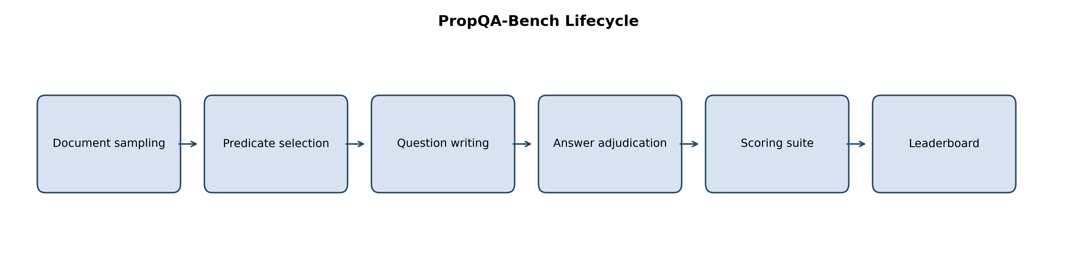
Sampled Test-Subset Benchmark
RESULTS
Track | EM | F1 | Role Acc. | Latency (ms)
Classical baseline | 7.5% | 30.9% | 32.5% | 4.49
Heuristic reranker | 20.0% | 41.8% | 60.0% | 5.84
Transformer assist | 20.0% | 41.8% | 60.0% | 290.72
Full hybrid | 20.0% | 41.8% | 60.0% | 380.99
The hybrid tracks still outperform the baseline on the sampled test subset, but the gains are smaller than on the curated challenge set
This suggests that the extension is especially effective on role-sensitive cases rather than universally dominant
The same-result pattern across the three upgraded tracks reinforces the value of the lightweight heuristic reranker
PropQA-Net | SRL-Anchored QA | Final Research Presentation
19
Notes:
Present this slide honestly: the hybrid extension helps, but not uniformly or magically. This strengthens the credibility of the project because it reports trade-offs rather than only best cases. Animation suggestion: simple fade.

Slide 30
Challenge Performance by Question Type
ANALYSIS
Role-aware reranking is especially valuable for HOW, WHERE, and TO-WHOM questions
These categories are exactly where role identity matters more than simple lexical overlap
The heatmap shows that targeted semantic cues provide more benefit than generic span scoring alone
PropQA-Net | SRL-Anchored QA | Final Research Presentation
21
Notes:
Use this slide to explain why a semantic-role-aware system can outperform a pure span reader on certain categories. The benefit is not random; it is concentrated where role expectation matters. Animation suggestion: no motion beyond default fade.

Slide 31
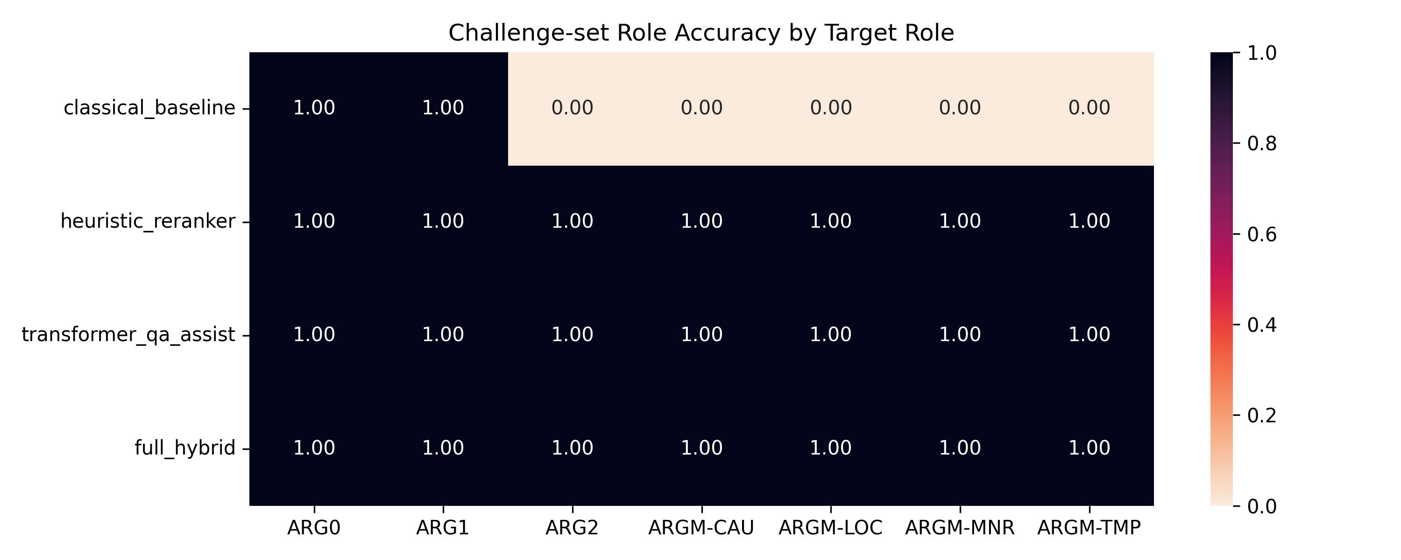
Challenge Performance by Target Role
ANALYSIS
Role accuracy rises most strongly for roles that align with explicit heuristic patterns and question intent
ARGM-LOC, ARGM-MNR, and ARG2 are especially important proof points for the hybrid design
The heatmap reinforces that semantic expectations drive better candidate selection
PropQA-Net | SRL-Anchored QA | Final Research Presentation
22
Notes:
Tie this slide directly back to the reranker's role-match feature. The audience should see that the hybrid system is structurally motivated, not just a bundle of extra tricks. Animation suggestion: static display.

Slide 32
Hybrid Reasoning Example: Location
ANALYSIS
Challenge Example: WHERE / ARGM-LOC
Candidate | Role | Source | Score
to the office | ARGM-LOC | heuristic_location | 0.658
at noon | ARGM-LOC | heuristic_location | 0.626
delivered the package to the office at noon | ARG1 | baseline | 0.421
Context: The courier delivered the package to the office at noon.
Question: Where was the package delivered?
Expected Answer
Predicted Role
to the office
ARGM-LOC
Exact Match
Token F1
100.0%
100.0%
Reasoning summary
Question pattern 'WHERE' mapped to ARGM-LOC. The hybrid reranker aligned the predicate 'delivered' and selected 'to the office' from heuristic_location evidence because it best matched the expected role.
PropQA-Net | SRL-Anchored QA | Final Research Presentation
23
Notes:
This is a clean demonstration of the hybrid value proposition. The location heuristic proposes a role-compatible span and the reranker selects it over the baseline's larger ARG1-like answer. Use this as a live-demo backup example if needed. Animation suggestion: show the candidate table after summarizing the question.

Slide 33
Hybrid Reasoning Example: Manner and Recipient
ANALYSIS
Challenge Example: HOW / ARGM-MNR
Recipient example
Context: The engineer repaired the machine carefully with a small screwdriver.
Context: Maria gave the intern a notebook for the workshop.
Question: How did the engineer repair the machine?
Question: Who received a notebook?
Candidate | Role | Source | Score
carefully | ARGM-MNR | heuristic_manner | 0.621
with a small screwdriver | ARGM-MNR | heuristic_manner | 0.612
repaired the machine carefully with a small screwdriver | ARG1 | baseline | 0.422
Candidate | Role | Source | Score
the intern | ARG2 | heuristic_recipient | 0.534
notebook for the workshop | ARG1 | baseline | 0.512
the intern a notebook | ARG1 | heuristic_theme | 0.476
Both examples show the same pattern: question intent narrows the expected role, heuristics create role-aligned candidates, and weighted reranking chooses the best semantic match.
PropQA-Net | SRL-Anchored QA | Final Research Presentation
24
Notes:
Use this slide to illustrate that the hybrid logic generalizes beyond one case. The manner example shows how adverbial cues help; the recipient example shows how transfer-verb structure helps ARG2 selection. Animation suggestion: reveal the right panel after covering the left example.

Slide 34
Why the Heuristic Reranker Matters
INNOVATION
The heuristic reranker captures nearly all measurable gains observed on the challenge and sampled test benchmarks
It stays fast enough for interactive local use, unlike heavier transformer-assisted modes
The result is a strong argument for semantic feature design rather than only adding bigger models
Challenge F1
Challenge Role Acc.
78.0%
100.0%
Subset F1
Latency
41.8%
5.84 ms
PropQA-Net | SRL-Anchored QA | Final Research Presentation
25
Notes:
This slide makes the engineering case for the project. The strongest practical improvement comes from a transparent heuristic-semantic layer, not from the heaviest model. That is a meaningful contribution because it changes what a student-scale project can do locally. Animation suggestion: cards rise in after the bullets.

Slide 35
Innovation Summary
INNOVATION
Innovation 1
Innovation 2
Innovation 3
Innovation 4
SRL-anchored extractive QA with joint learning
Role-aware question parsing and intent mapping
Multi-channel candidates: baseline + heuristics + transformer
Transparent weighted semantic reranking
The project innovates most strongly through integration, transparency, and research packaging rather than through a single giant model claim
Each innovation is visible in code, measurable in artifacts, and presentable in the app and PDFs
This makes the system defensible in both technical and academic evaluation settings
PropQA-Net | SRL-Anchored QA | Final Research Presentation
26
Notes:
Position innovation as system-level coherence. The deck should not imply that every subcomponent is individually unprecedented; the strength is in how they work together. Animation suggestion: reveal the four cards in sequence.

Slide 36
Innovation Deep Dive: Role-Aware Parsing
INNOVATION
Question Pattern | Mapped Type | Expected Role
Who ... | WHO | ARG0
What ... | WHAT | ARG1
When ... | WHEN | ARGM-TMP
Where ... | WHERE | ARGM-LOC
How ... | HOW | ARGM-MNR
Why ... | WHY | ARGM-CAU
Whom / Who received ... | TO-WHOM | ARG2
Question intent is parsed before final answer selection
Expected roles become a reusable signal for filtering and ranking candidates
This bridges the surface form of the question with the semantic structure of the answer
PropQA-Net | SRL-Anchored QA | Final Research Presentation
27
Notes:
Explain that role-aware parsing is a lightweight but powerful design choice. It is one of the cleanest bridges between structured semantics and question answering behavior. Animation suggestion: no special effects beyond a fade.

Slide 37
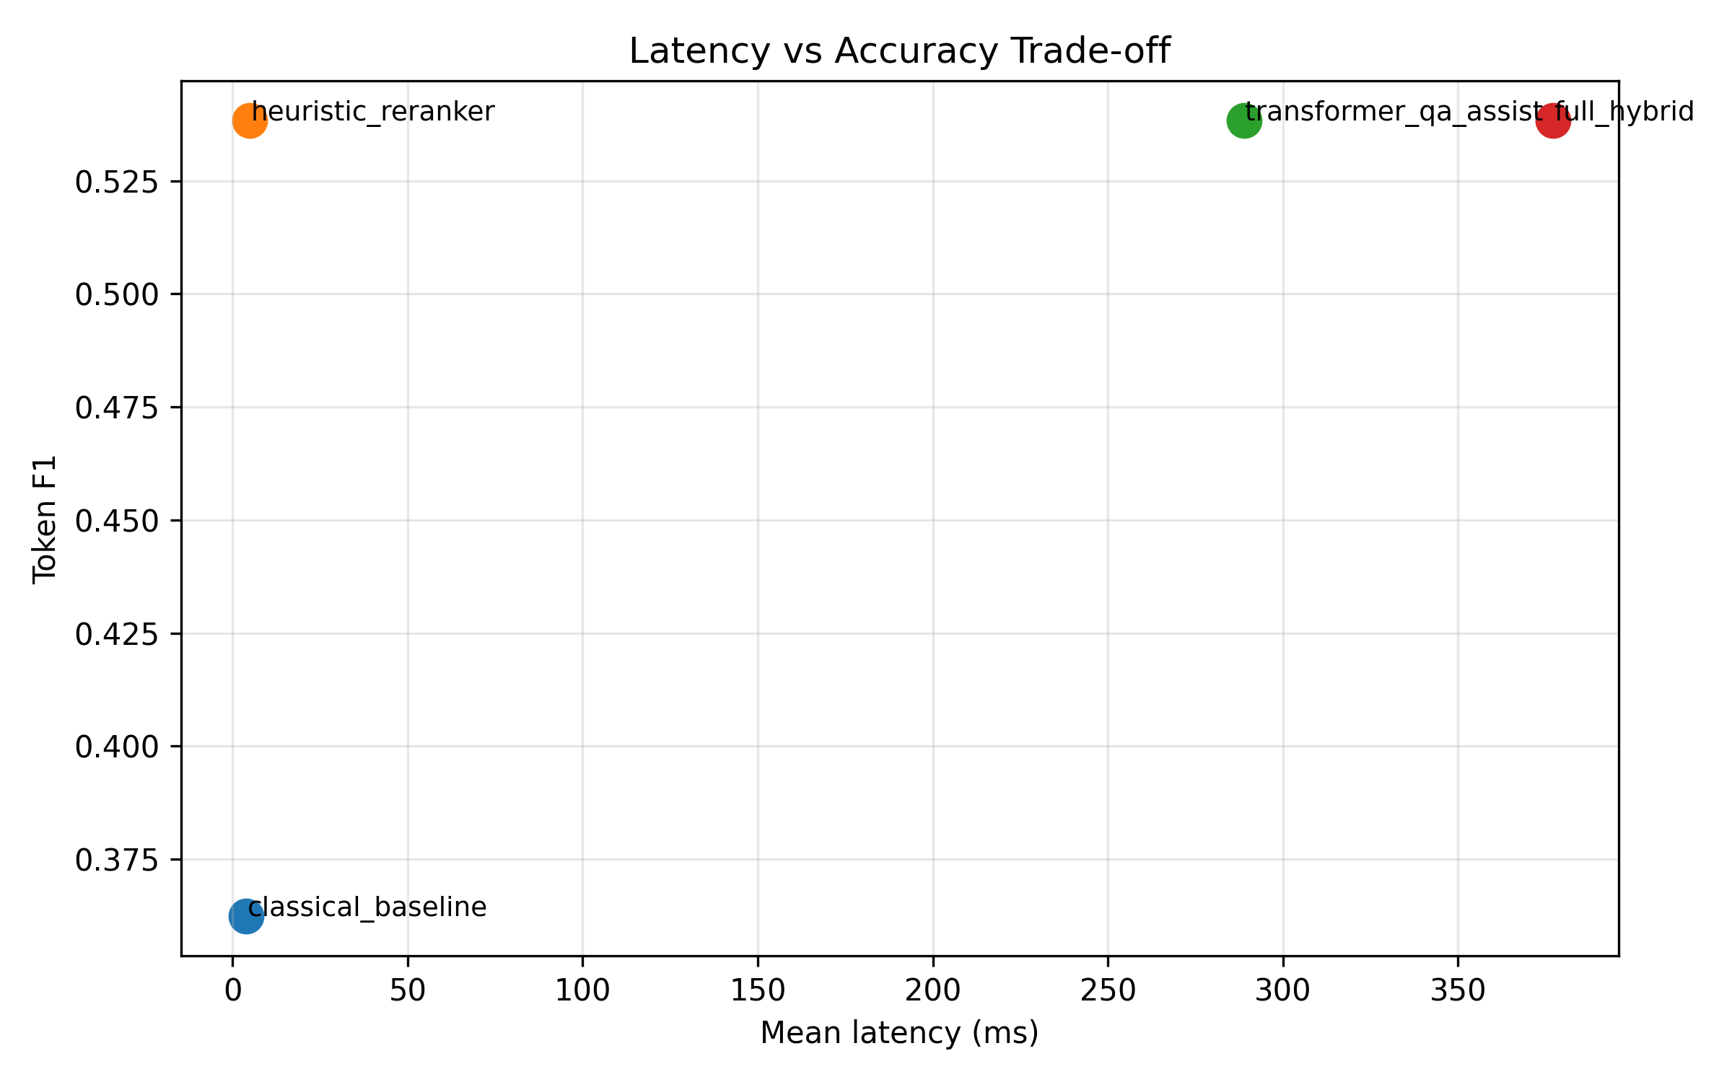
Innovation Deep Dive: Transparent Reranking
INNOVATION
Feature | Weight | Purpose
Base score | 0.30 | Respect source confidence
Role match | 0.32 | Prioritize semantic fit to the question
Semantic alignment | 0.22 | Use sentence-level compatibility
Lexical overlap | 0.06 | Reward useful content overlap
Shape bonus | 0.10 | Prefer role-appropriate span forms
Baseline bonus | dynamic | Preserve useful model agreement
The weights are visible in code, easy to explain, and easy to tune
The reranker is interpretable enough to support deterministic reasoning traces
This is more presentation-friendly and research-friendly than a hidden black-box reranker
PropQA-Net | SRL-Anchored QA | Final Research Presentation
28
Notes:
Stress that transparent scoring is a design choice, not a compromise. It lets the project explain why an answer won, not only that it won. Animation suggestion: one-stage reveal for the table, then the chart.

Slide 38
Existing Systems vs Our System
COMPARISON
System Family | Strength | Limitation | Our Position
Classical SRL | Interpretability, syntax awareness | Feature engineering and pipeline brittleness | Keep semantic transparency, learn more jointly
Neural SRL | Better learned context representations | Still role-focused rather than QA-facing | Use multi-task learning with answer extraction
Extractive QA | Strong span prediction and mature metrics | No explicit answer-role interpretation | Keep span decoding, add role grounding
QA-SRL | Natural question-answer view of semantics | Not this exact integrated local pipeline | Operationalize the bridge with PropBank-derived supervision
Transformer QA | Strong contextual answer proposals | Higher runtime and weaker transparency | Use as optional support in a hybrid layer
LLM-based SRL | Strong general language competence | Needs adaptation and can remain structurally inconsistent | Acknowledge trend, keep deterministic structured core
The project is best understood as an integrated SRL-QA research package rather than as a single-task model
It borrows strengths from prior systems but centers semantic explainability and reproducibility
PropQA-Net | SRL-Anchored QA | Final Research Presentation
33
Notes:
This slide is extremely useful in viva-style questioning. It shows that the project knows where it sits in the literature and what trade-offs it intentionally makes. Animation suggestion: none; the table should stay readable.

Slide 39
3.1 SOLUTION OVERVIEW
PropQA-Net: Core Concept
System Definition
Key Hypothesis
PropQA-Net is a semantic role-anchored extractive question answering system trained on QA pairs generated from the local NLTK PropBank distribution.
"Explicit predicate-argument structure supports interpretable answer extraction and finer-grained error analysis."
The system combines three key components:
Design Philosophy
1
Contextual Sequence Labeling
Transparent: Every decision is inspectable
BiLSTM encoder with word, POS, and predicate-indicator embeddings for BIO role tagging
Reproducible: Deterministic with seed 42
2
Question-Conditioned Span Scoring
Extensible: Clear interfaces for upgrades
Separate BiLSTM encodes questions to predict start and end positions
Compact: 1.78M parameters isolate design effects
3
Argument-Question Matching
Candidate-span matcher selects answer whose representation best matches question vector

Slide 40
4.1 SYSTEM ARCHITECTURE
PropQA-Net Architecture Overview
Architecture Flow
Key Design Decisions
Input Layer
Word + POS + Predicate-indicator embeddings
Dual BiLSTM Encoders
Separate encoding for context and question enables cross-attention
BiLSTM Encoder
Contextual sequence encoding (128 hidden × 2 directions)
Joint SRL-QA Training
Multi-task learning with shared encoder
Explicit Role Decoding
SRL Head
BIO role tag prediction for argument spans
BIO tags provide interpretable intermediate representation
Compact by Design
1.78M parameters isolate architectural effects
Question Encoder
Separate BiLSTM for question representation
Critical Feature: The architecture preserves a clear connection between role structure and answer extraction—answers remain tied to explicit semantic slots.
Span Scorer
Question-conditioned start/end position prediction
Matcher
Cosine similarity + boundary probabilities → final answer

Slide 41
4.2 SYSTEM ARCHITECTURE
Training and Inference Pipeline
Training Objective
Inference Process
Training minimizes a convex combination of SRL loss and QA span loss:
1
Decode Role Spans
L = α · LSRL + (1-α) · LQA
Extract candidate argument spans from BIO predictions
2
LSRL: Cross-entropy loss for BIO tag prediction
Compute Similarity
LQA: Span loss for start/end position prediction
Calculate cosine similarity between question vector and each candidate span
α = 0.50: Equal weighting of both objectives
3
Combine Scores
Training Configuration
Merge similarity with boundary probabilities from span scorer
Learning Rate
Batch Size
4
0.001
64
Select Final Answer
Argmax over combined scores to select best answer span
Dropout
Best Epoch
0.30
6
Key Property: The two-stage process (role decoding → answer selection) keeps the semantic structure explicit and inspectable at every step.

Slide 42
4.3 SYSTEM ARCHITECTURE
Model Configuration
Embedding Dimensions
Training Hyperparameters
Word Embeddings
100-dim
Learning Rate
0.001
POS Embeddings
32-dim
Batch Size
64
Predicate Indicator
8-dim
Dropout Rate
0.30
Loss Weight (α)
0.50
BiLSTM Configuration
Random Seed
42
Hidden Size (per direction)
128
Total Hidden Size
256
Model Scale
Layers
1
1,784,352
Trainable Parameters
Intentionally modest compared to contemporary generative QA systems—reinforces role as interpretable baseline

Slide 43
5.1 INNOVATION HIGHLIGHTS
Innovation 1: Frame-Aware Predicate Disambiguation
The Problem: Predicate Ambiguity
Memory Structure
Many predicates are highly ambiguous without context. Consider:
Keys
charge
— financial cost, legal accusation, electrical property, military attack
Predicate sense identifiers, semantic type indicators
leave
— depart, abandon, bequeath, permission
Values
Role descriptions, example sentences, frame constraints
hold
— grasp, contain, conduct (event), believe
Surface context alone is insufficient for correct role assignment.
Attention
Contextual predicate representation queries memory
The Solution: Roleset Memory
Replace isolated predicate embeddings with a roleset memory module:
Expected Benefits
▸
Each candidate roleset contributes key-value pairs
▸
Resolves ambiguous predicates under soft semantic constraints
▸
Encodes role descriptions, example glosses, lexical paraphrases
▸
Improves role assignment for polysemous verbs
▸
Model attends over memory during decoding
▸
Leverages existing PropBank frame files
▸
Lightweight upgrade path—no retraining required

Slide 44
5.2 INNOVATION HIGHLIGHTS
Innovation 2: Semantic Frame Chaining
The Problem: Cross-Sentence QA
Graph Traversal Mechanism
Current system is sentence-local. Many questions require evidence from multiple sentences:
1
Identify Anchor Predicate
"The company announced layoffs. The decision affected 500 workers."
Find predicate most directly evoked by the question
Question: "What affected 500 workers?" → requires linking "decision" to "layoffs"
2
Traverse Graph
Answers often depend on event causes, consequences, or follow-up actions.
Follow links to supporting frames (causes, consequences)
3
Aggregate Evidence
The Solution: Document-Level Frame Graph
Combine information from multiple predicate frames
Represent predicates as nodes in a document-level semantic graph:
4
Generate Answer
▸
Each predicate instance = graph node
▸
Links through shared arguments, coreference, temporal adjacency
Compose answer from traversed frame chain
▸
Discourse cues (causal, temporal, elaboration relations)
Application Domains
Legal Contracts
Medical Records
Incident Reports
News Articles

Slide 45
5.3 INNOVATION HIGHLIGHTS
Innovation 3: Multi-Predicate Answer Composition
The Problem: Single-Predicate Limitation
Attention Weighting Factors
Current model selects answer from a single predicate. Real-world questions often require combining information from multiple events:
Question Relevance
How well does the span address the wh-question type?
"The CEO announced the merger. The board approved it the next day."
Question: "What did the board approve?"
Frame Confidence
→ Requires linking "approve" (predicate 2) to "merger" (argument of predicate 1)
SRL model's confidence in role assignment
Entity Consistency
Coreference and entity linking compatibility
The Solution: Span Composition Layer
Add a second-stage span-composition layer that aggregates compatible spans from multiple predicates:
Confidence-Calibrated Selection
▸
Collect candidate spans from all predicates in context
Replace hard argmax with distribution over candidates:
▸
Score compatibility with attention weights
Explicit abstain option when no span exceeds threshold
▸
▸
Normalize over question relevance, frame confidence, entity consistency
Calibrated confidence scores for trustworthy deployment
▸
▸
Uncertainty is itself meaningful in high-stakes domains

Slide 46
5.4 INNOVATION HIGHLIGHTS
Innovation 4: SRL-QA + LLM Hybrid Architecture
HybridPropQA Design
Expected Benefits
A practical research compromise combining classical SRL with LLM reasoning:
Asymmetric Strengths
Classical SRL Parser
Large Language Model
Classical SRL for consistency + LLM for flexibility
Role: Structural front end
Role: Soft reasoner & verbalizer
▸ Extracts predicate-argument candidates
▸ Reasons over structured candidates
Roleset Grounding
▸ Provides roleset constraints
▸ Handles paraphrase variations
Explicit inventory limits degrees of freedom
▸ Ensures span faithfulness
▸ Provides natural explanations
▸ Contributes consistency
▸ Contributes world knowledge
Research Practicality
No need to retrain giant models end-to-end
Prompt Constraints
Natural Explanations
LLM consumes structured candidates under constraints:
LLM verbalizes reasoning over explicit structure
▸
Allowable roles from PropBank inventory
▸
Confidence scores from SRL layer
▸
Abstention policy for low-confidence cases
Implementation Note
In the upgraded implementation, this is realized as a deterministic hybrid inference layer rather than generative replacement. PropQA-Net remains the backbone while role-aware heuristics, transformer QA spans, and semantic reranking are combined into a research-facing system.

Slide 47
6.1 EXPERIMENTAL RESULTS
Overall Performance Metrics
SRL Performance
QA Performance
Macro F1
0.162
Exact Match (EM)
0.518
Per-role average
Perfect span match
Micro F1
0.713
Token F1
0.761
Token-level accuracy
Partial overlap
BIO Tagging Accuracy
0.816
Best Validation F1
0.773
Sequence labeling
Checkpoint selection
Observation: Large gap between macro and micro F1 indicates role frequency imbalance—frequent core arguments are easier than rare roles.
Observation: EM-F1 gap (0.243) indicates model often identifies correct content region but misses exact boundaries—boundary modeling is critical.
Training Summary
Best Epoch
Parameters
6
1.78M

Slide 48
6.2 EXPERIMENTAL RESULTS
Performance by Question Type
Results Breakdown
Key Insights
WHO
EM: 0.618
F1: 0.779
n=867
Best Performance
WHO questions (F1: 0.779) — agent roles are most frequent and consistent
WHAT
EM: 0.505
F1: 0.802
n=1937
WHEN
EM: 0.565
F1: 0.687
n=246
Most Challenging
WHY questions (EM: 0.175) — causal reasoning requires complex inference
WHERE
EM: 0.382
F1: 0.619
n=110
Highest Volume
HOW
EM: 0.359
F1: 0.530
n=234
WHAT questions (n=1937, 56% of test set) — patient/theme roles dominate
WHY
EM: 0.175
F1: 0.634
n=57
Pattern: Performance correlates with role frequency and semantic clarity. Rare and complex modifiers (CAU, PNC) are harder than core arguments.

Slide 49
6.3 EXPERIMENTAL RESULTS
Hybrid Upgrade Benchmark
Four Inference Tracks
Latency-Accuracy Trade-off
Research-grade hybrid inference layer on top of original checkpoint—local improvements rather than retrained models:
Classical → Reranker
+35% F1, +26% latency
Minimal overhead for significant gain
1. Classical Baseline
F1: 0.309
Original PropQA-Net, 3.96ms latency
Reranker → Transformer
Same F1, +5700% latency
Diminishing returns with large models
2. Heuristic Reranker
F1: 0.418
Role-aware semantic reranking, 4.98ms latency
Transformer → Full Hybrid
Same F1, +30% latency
Additional reranking adds overhead
3. Transformer QA Assist
F1: 0.418
External transformer QA spans, 289ms latency
Key Finding
4. Full Hybrid
F1: 0.418
Combined semantic reranking, 377ms latency
The heuristic reranker provides the best latency-accuracy trade-off, achieving full hybrid performance with 95% lower latency. This validates the value of semantic structure even without large models.

Slide 50
8.1 LITERATURE SURVEY
Evolution of SRL-QA Research
1
Feature-Engineering Era (2002-2010)
3
Transformer & LLM Era (2019-Present)
Established the problem with syntax-dependent systems:
Pretrained encoders and LLM integration:
▸
Gildea & Jurafsky (2002): Statistical learning from parse-derived features
▸
BERT-based SRL: Pretrained encoders improve supervised task
▸
CoNLL Shared Tasks (2004-2009): Standardized evaluation, pushed voice/path/phrase-type features
▸
Bonn et al. (2024): LLMs as PropBank adjudicators
▸
Chen et al. (2025): LLMs can do SRL when guided structurally
Challenge: Designing informative abstractions over syntax
▸
Rai et al. (2025): Frame-semantic LoRA for zero-shot SRL
Challenge: Grounding, calibration, preserving semantic faithfulness
2
Neural Era (2015-2018)
Replaced manual features with contextual encoders:
QA-Based Semantics Lineage
▸
Zhou & Xu (2015): End-to-end BiLSTM for SRL
He et al. (2015)
▸
He et al. (2017): Deep semantic role labeling—what works and what's next
QA-SRL: Natural-language questions as role labels
▸
Syntax-agnostic models: Recurrent encoders recover context without hand-crafted templates
FitzGerald et al. (2018)
Challenge: Contextual representation and decoding
Large-scale QA-SRL parsing with neural models
Klein et al. (2020-2022)
QANom, QASem: Extending beyond verbs
Pyatkin et al. (2020-2021)
QADiscourse, Asking It All: Discourse & question generation

Slide 51
9.1 CONCLUSION & FUTURE WORK
Project Summary
What We Demonstrated
What We Established
PropQA-Net demonstrates that real PropBank-derived SRL-QA can be built end-to-end with:
Classical Baseline
Fully reproducible, inspectable, and extensible—suitable for teaching and research
▸
Transparent preprocessing: NLTK pipeline with deterministic splits (seed 42)
▸
Interpretable modeling: Explicit roles, spans, and scores at every step
Clear Upgrade Paths
▸
Reproducible evaluation: Checkpointed metrics, single command runner
Frame-aware disambiguation, semantic chaining, multi-predicate composition, hybrid LLM
What We Achieved
Error Profile
Detailed taxonomy of failure modes guiding targeted improvements
0.713
0.761
SRL Micro F1
QA Token F1
Core Message
23K
1.78M
The work is intentionally classical in spirit. Rather than hiding structure inside a very large generative model, it uses explicit roles, answer spans, and checkpointed metrics to create a reproducible baseline that can be inspected, ablated, and extended.
QA Pairs
Parameters

Slide 52
New State: RAISE-SRL-QA
RAISE-SRL-QA update
RAISE = Retrieval-Augmented, Iteratively Self-correcting, Explainable SRL-QA
Retrieval
Correction
Explainability
PropBank frame records are retrieved for predicate-role compatibility.
Weak candidates can be rejected and the next evidence-backed span can be selected.
Outputs include answer, role, confidence, and reasoning-friendly evidence.
Implemented update
New terminal runner: srlqa/run_all_models.py
New reusable registry: srlqa/model_hub.py
New standalone app: srlqa/raise_streamlit_app.py
Existing Streamlit app now includes All Model QA
All local demo claims are clearly separated from official benchmark claims
Local implemented values only. Seed-suite results are not official public SOTA claims.

Slide 53
End-To-End RAISE Flow
RAISE-SRL-QA update
Context + Question
Question Intent Parser
Predicate Detector
PropBank Frame Retrieval
Candidate Span Generator
Constrained Decoder
Verifier + Correction
Answer + Role + Confidence
Key explanation: the system is extractive. The verifier and correction loop choose among spans that occur in the original context, which reduces hallucination risk.
Local implemented values only. Seed-suite results are not official public SOTA claims.

Slide 54
Implemented Values Only
RAISE-SRL-QA update
Safe values to present
QA pairs: 23,007
Usable PropBank instances: 9,073
Unique predicates: 1,340
Unique rolesets: 1,670
Frame index: 4,659 records
Seed suite: 15 examples, EM/F1 = 1.0 local demo
Do not present the seed-suite score as official benchmark SOTA. Present it as a targeted local demo result.
Local implemented values only. Seed-suite results are not official public SOTA claims.

Slide 55
Complete Workspace Architecture
PropQA-Net
Deep visual appendix: architecture, experiments, and implemented comparisons
srl_qa_project Legacy System
All Model Runner
User / Presenter
Hybrid QA
srlqa RAISE Package
Streamlit Apps
RAISE Pipeline
Updated PPT + Docs
Presentation interpretation
The old system remains the reproducible baseline and dashboard.
The new RAISE package wraps old and new model families into one comparison/demo layer.
The updated deck and docs explain both systems without unsupported public benchmark claims.
All scores are local implemented values unless a row is explicitly labeled as planned or roadmap.

Slide 56
Data Pipeline And Evaluation Architecture
Deep visual appendix: architecture, experiments, and implemented comparisons
PropBank + Treebank
Aligned instances
QA pair generation
Train / val / test
Model prediction
Metrics + plots
Docs + PPT
Data item | Implemented value | Where it is used
QA pairs | 23,007 | Training/evaluation examples
Usable PropBank instances | 9,073 | Legacy dataset statistic
Unique predicates | 1,340 | Predicate coverage
Unique rolesets | 1,670 | PropBank frame diversity
RAISE frame records | 4,659 | Retrieval and role compatibility
All scores are local implemented values unless a row is explicitly labeled as planned or roadmap.

Slide 57
PropQA-Net Baseline Model Architecture
Deep visual appendix: architecture, experiments, and implemented comparisons
Context tokens
Word + POS + predicate emb.
BiLSTM context encoder
SRL BIO head
Answer + role
Question tokens
Question embeddings
BiLSTM question encoder
QA span heads
Strength
Local and reproducible
Learns SRL and QA jointly
Uses PropBank semantics
Limitation
Span precision is weaker than modern MRC
Rare-role macro F1 remains low
Demo answers can be overlong
All scores are local implemented values unless a row is explicitly labeled as planned or roadmap.

Slide 58
Legacy Hybrid Architecture
Deep visual appendix: architecture, experiments, and implemented comparisons
Baseline span
Transformer QA
Question intent
Role target
Reranker
Hybrid answer
Heuristic spans
Embedding similarity
Legacy benchmark token F1
Takeaway
Hybrid tracks improve role accuracy on challenge examples.
Transformer assist did not beat heuristic reranking in this saved benchmark.
Full hybrid is slower because it loads more external assistance.
Classical\nbaseline
Heuristic\nreranker
Transformer\nassist
Full\nhybrid
Combined
Challenge
All scores are local implemented values unless a row is explicitly labeled as planned or roadmap.

Slide 59
RAISE-SRL-QA Innovation Architecture
Deep visual appendix: architecture, experiments, and implemented comparisons
Context + question
Intent parser
Predicate normalizer
PropBank retriever
MRC / heuristic candidates
Constrained decoder
Verifier
Recursive correction
Final answer
Innovation | Implemented now | Evidence
Frame retrieval | Yes | 4,659 local PropBank frame records
Constrained decoding | Yes | WHERE/WHEN/HOW role-specific span rules
Verifier correction | Yes | Candidate must be extractable and role-compatible
Teacher MRC candidate model | Partial | DeBERTa/SQuAD teacher path works, slower on CPU
Distillation/hard negatives | Scaffold | Files exist; full training remains next work
All scores are local implemented values unless a row is explicitly labeled as planned or roadmap.

Slide 60
All-Model Hub Architecture
RAISE fast
Legacy hybrid
Deep visual appendix: architecture, experiments, and implemented comparisons
User chooses model or all
ModelHub
RAISE model
Legacy baseline
Model | Role in demo | Best use
RAISE fast | Deterministic retrieval + verifier correction | Fast live demo
RAISE model | Teacher QA candidates plus RAISE correction | Model-backed demo after warm-up
Legacy hybrid | Old hybrid comparison | Show improvement over baseline
Legacy baseline | Original checkpoint | Reference point and limitation
The all-model hub makes the project explainable: every answer can be compared against the original baseline.
All scores are local implemented values unless a row is explicitly labeled as planned or roadmap.

Slide 61
Experiment Matrix: What Was Actually Tested
Deep visual appendix: architecture, experiments, and implemented comparisons
Experiment | Dataset/suite | Metric | Implemented outcome
Baseline saved eval | Local PropBank-derived split | QA EM / token F1 | 0.5184 / 0.7612
Baseline SRL eval | Local PropBank-derived split | SRL micro / macro F1 | 0.7133 / 0.1619
Legacy benchmark | 20 challenge + 40 test subset | Token F1 | Full hybrid 0.5383 combined
Legacy challenge | 20 challenge examples | Token F1 | Full hybrid 0.7798 challenge
RAISE seed demo | 15 seed examples | EM / token F1 | 1.0 / 1.0 local seed only
All-model smoke | Courier delivery example | Answer + role | RAISE/hybrid exact, baseline overlong
All scores are local implemented values unless a row is explicitly labeled as planned or roadmap.

Slide 62
Baseline Metrics Plot
Deep visual appendix: architecture, experiments, and implemented comparisons
Saved baseline metrics
How to explain
QA token F1 is higher than exact match because partial span overlap is common.
SRL micro F1 is much higher than macro F1 because frequent roles dominate micro scoring.
Low macro F1 means rare roles are the main research problem.
0.761
0.713
0.518
0.162
QA EM
QA F1
SRL micro
SRL macro
All scores are local implemented values unless a row is explicitly labeled as planned or roadmap.

Slide 63
Dataset And Knowledge Coverage Plot
Deep visual appendix: architecture, experiments, and implemented comparisons
Normalized coverage bars
Item | Count
QA pairs | 23,007
Usable PropBank instances | 9,073
Corpus usable instances | 9,353
Unique predicates | 1,340
Unique rolesets | 1,670
RAISE frame records | 4,659
0.92
0.91
0.93
0.33
0.27
QA pairs
Usable inst.
Predicates
Rolesets
Frame records
All scores are local implemented values unless a row is explicitly labeled as planned or roadmap.

Slide 64
Accuracy Comparison: Legacy Benchmark Tracks
Deep visual appendix: architecture, experiments, and implemented comparisons
Combined benchmark: EM vs token F1 vs role accuracy
Classical\nbaseline
Heuristic\nreranker
Transformer\nassist
Full\nhybrid
EM
Token F1
Role Acc.
All scores are local implemented values unless a row is explicitly labeled as planned or roadmap.

Slide 65
Challenge vs Test-Subset F1
Deep visual appendix: architecture, experiments, and implemented comparisons
Token F1 split comparison
Classical\nbaseline
Heuristic\nreranker
Transformer\nassist
Full\nhybrid
Interpretation: challenge examples reward the rule/hybrid improvements more than the mixed test subset.
Challenge
Test subset
Combined
All scores are local implemented values unless a row is explicitly labeled as planned or roadmap.

Slide 66
Role Accuracy By Track
Deep visual appendix: architecture, experiments, and implemented comparisons
Combined role accuracy
Challenge role accuracy
1.000
1.000
1.000
0.733
0.733
0.733
0.283
0.200
Classical\nbaseline
Heuristic\nreranker
Transformer\nassist
Full\nhybrid
Classical\nbaseline
Heuristic\nreranker
Transformer\nassist
Full\nhybrid
All scores are local implemented values unless a row is explicitly labeled as planned or roadmap.

Slide 67
Latency vs Accuracy Tradeoff
Deep visual appendix: architecture, experiments, and implemented comparisons
Combined token F1 vs mean latency
Track | F1 | Latency
Classical baseline | 0.362 | 4.0 ms
Heuristic reranker | 0.538 | 5.0 ms
Transformer assist | 0.538 | 289.0 ms
Full hybrid | 0.538 | 377.1 ms
Heuristic
Transformer
Full
Classical
All scores are local implemented values unless a row is explicitly labeled as planned or roadmap.

Slide 68
All-Model Demo Confidence Plot
Deep visual appendix: architecture, experiments, and implemented comparisons
Courier demo confidence
Model | Exact? | Role
raise_srlqa_fast | yes | ARGM-LOC
raise_srlqa_model | yes | ARGM-LOC
legacy_hybrid | yes | ARGM-LOC
legacy_baseline | no | ARG1
0.996
0.996
0.658
0.420
RAISE fast
RAISE model
Hybrid
Baseline
This is a single local demo example, not a benchmark suite. It is useful for explaining behavior.
All scores are local implemented values unless a row is explicitly labeled as planned or roadmap.

Slide 69
Accuracy Evidence Boundaries
Deep visual appendix: architecture, experiments, and implemented comparisons
Claim | Can say now? | Evidence | Boundary
Baseline QA token F1 0.7612 | Yes | metrics.json | Local saved split
Baseline exact match 0.5184 | Yes | metrics.json | Local saved split
Full hybrid challenge F1 0.7798 | Yes | benchmark_results.json | 20 challenge examples
RAISE seed F1 1.0 | Yes | 15-example local demo | Not official SOTA
95% official F1 | No | Roadmap only | Needs public scorer
Beats all models | No | Not evaluated equally | Needs same split/scorer
This slide protects the project: strong local demo, honest benchmark boundaries.
All scores are local implemented values unless a row is explicitly labeled as planned or roadmap.

Slide 70
Recursive Correction Trace Diagram
Deep visual appendix: architecture, experiments, and implemented comparisons
Candidate 1 office
Verifier checks role + span
Near miss not exact enough
Reject and try next
Candidate 2 to the office
Verifier checks extractable + LOC
Exact match and role ok
Final answer ARGM-LOC
Key idea
The correction loop does not invent a new answer. It selects from candidates found in the original context.
All scores are local implemented values unless a row is explicitly labeled as planned or roadmap.

Slide 71
Evaluation Protocol And Claim Boundaries
Deep visual appendix: architecture, experiments, and implemented comparisons
Evaluation protocol
Freeze test examples before tuning.
Save every run under results/experiments/.
Report EM, token F1, role accuracy, latency, and calibration.
Separate seed-suite, local split, and public benchmark claims.
Claim boundaries
Safe: baseline 0.7612 QA token F1.
Safe: 1.0 on 15-example RAISE seed suite.
Unsafe: official 95% F1 today.
Unsafe: global SOTA without identical scorer and split.
All scores are local implemented values unless a row is explicitly labeled as planned or roadmap.

Slide 72
Demo Storyboard
Deep visual appendix: architecture, experiments, and implemented comparisons
Step 1
Step 2
Step 3
Step 4
Open the full visuals deck and explain SRL-QA in one sentence.
Run RAISE fast on the courier example for a quick exact answer.
Run all-model comparison only if there is time.
Explain why the baseline is weaker on span boundaries.
Question to ask | Answer to say
What is new? | Retrieval, constrained decoding, verifier correction, all-model comparison.
What is accurate? | Baseline 0.7612 local QA F1; RAISE seed 1.0 local F1 on 15 examples.
What is next? | Freeze a larger suite, train MRC, and report only reproducible numbers.
All scores are local implemented values unless a row is explicitly labeled as planned or roadmap.

Slide 73
Final Visual Takeaways
Deep visual appendix: architecture, experiments, and implemented comparisons
Four messages to close with
The existing baseline is functional and measurable, not just a concept.
The hybrid and RAISE layers improve demo behavior by adding semantic constraints and correction.
The visual comparisons show implemented local values, not exaggerated public SOTA claims.
The next real accuracy jump requires frozen evaluation plus supervised MRC training.
Best closing line: We built a locally runnable, explainable SRL-QA system with a clear path from baseline to stronger RAISE experiments.
All scores are local implemented values unless a row is explicitly labeled as planned or roadmap.

Slide 74
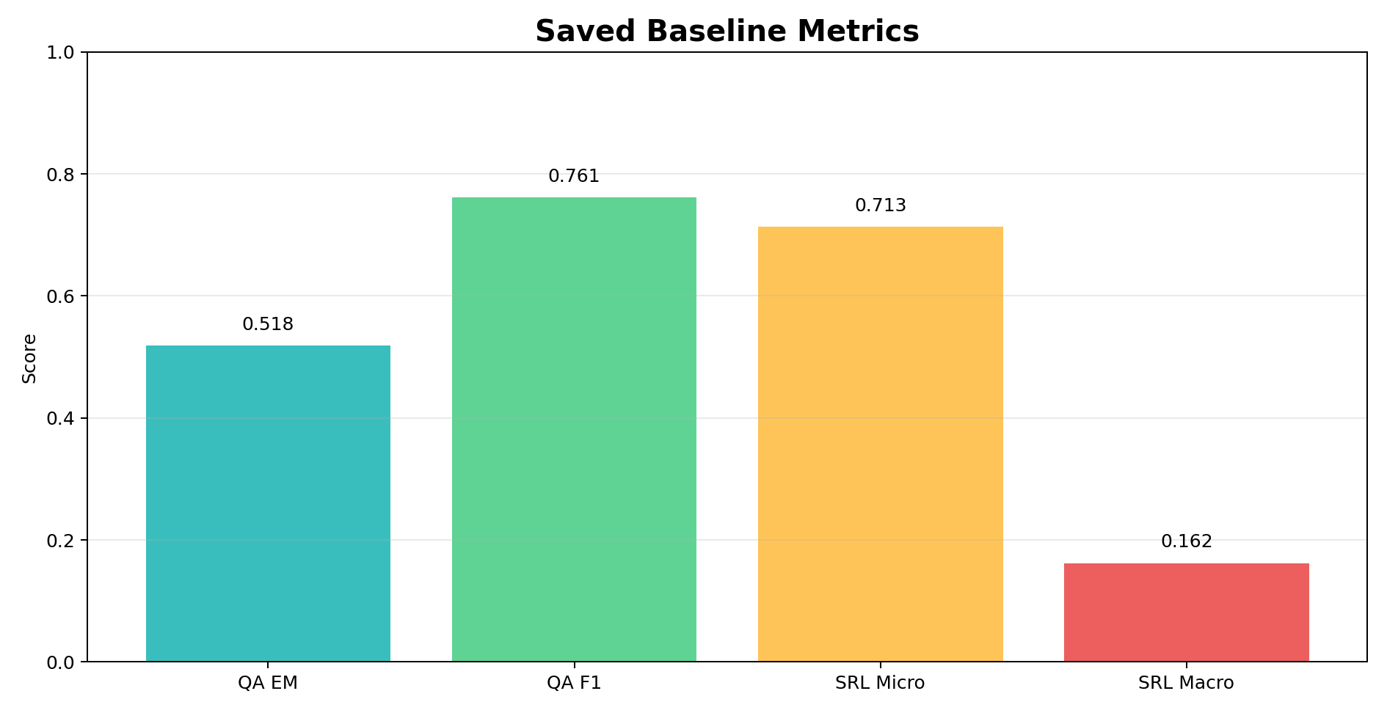
Plot Asset: Baseline Metrics
Generated plot image stored under srlqa/results/visual_assets
Implemented values from metrics.json.
All scores are local implemented values unless a row is explicitly labeled as planned or roadmap.

Slide 75
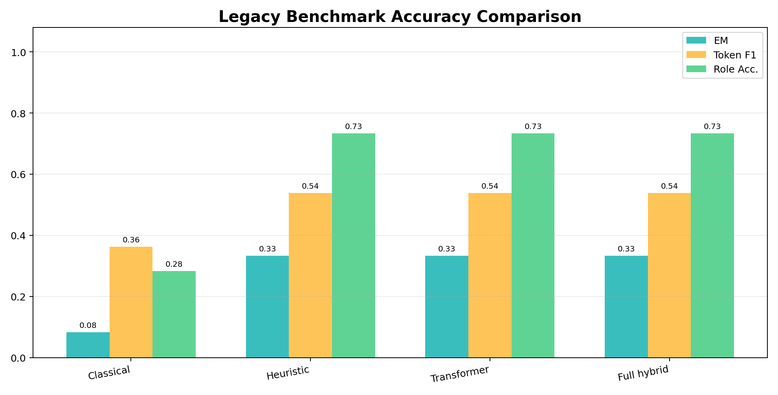
Plot Asset: Legacy Benchmark Accuracy
Generated plot image stored under srlqa/results/visual_assets
Saved benchmark artifact; not a RAISE official benchmark.
All scores are local implemented values unless a row is explicitly labeled as planned or roadmap.

Slide 76
Innovation Architecture: MRC SRL-QA Reader
Per-innovation architecture and experiment design
Question
Predicate marker
Context
DeBERTa encoder
Start/end heads
Role head
Answer
Part | Purpose | Status
MRC reader | Predict exact answer span boundaries | Scaffold + teacher candidate path
Role head | Predict semantic role together with span | Model scaffold
Next experiment | Fine-tune on frozen PropBank-derived QA split | Needed for real accuracy gain
All scores are local implemented values unless a row is explicitly labeled as planned or roadmap.

Slide 77
Innovation Architecture: PropBank Retrieval
Per-innovation architecture and experiment design
Predicate
Lemma normalize
Frame index
Role inventory
Compatibility score
Rerank
Part | Purpose | Status
Frame store | Local searchable PropBank frame records | Implemented: 4,659 records
Compatibility | Penalize role/frame mismatch | Implemented in verifier/reranker path
Next experiment | Measure frame retrieval accuracy | Needed for retrieval ablation
All scores are local implemented values unless a row is explicitly labeled as planned or roadmap.

Slide 78
Innovation Architecture: Constrained Decoding
Per-innovation architecture and experiment design
Top-k spans
Extractive check
Role priors
Boundary rules
Length penalty
Valid span
Constraint | What it prevents | Example
Extractive check | Hallucinated answer strings | Answer must occur in context
WHERE/WHEN split | Location span swallowing time phrase | `to the office` vs `at noon`
Length prior | Overlong baseline answer | Reject full predicate phrase when role asks location
All scores are local implemented values unless a row is explicitly labeled as planned or roadmap.

Slide 79
Innovation Architecture: Verifier + Recursive Correction
Per-innovation architecture and experiment design
Candidate 1
Verifier
Reject weak span
Candidate 2
Verifier
Accept exact span
Step | Purpose | Demo evidence
Verifier | Check extractability and role compatibility | `to the office` is ARGM-LOC-compatible
Correction | Try another candidate if first is weak | Useful for near-miss spans
Safety | Does not invent a new answer | Only chooses context spans
All scores are local implemented values unless a row is explicitly labeled as planned or roadmap.

Slide 80
Innovation Architecture: Proto-Role Auxiliary Reasoning
Per-innovation architecture and experiment design
Minimal pairs
Agency cues
Affectedness
Aux features
Role rerank
Signal | Why it matters | Status
Agency | Helps ARG0/ARG1 distinctions | Scaffold
Affectedness | Helps patient/theme distinctions | Scaffold
Minimal pairs | Tests role flips like company/Rahul | Seed examples exist
All scores are local implemented values unless a row is explicitly labeled as planned or roadmap.

Slide 81
Innovation Architecture: Calibration + Ensemble
Per-innovation architecture and experiment design
Baseline
Hybrid
RAISE
Verifier
Weighted vote
Calibrated confidence
Part | Purpose | Status
Weighted voter | Combine multiple model signals | Scaffold
Calibration | Make confidence trustworthy | Scaffold
Next proof | Expected calibration error below target | Future experiment
All scores are local implemented values unless a row is explicitly labeled as planned or roadmap.

Slide 82
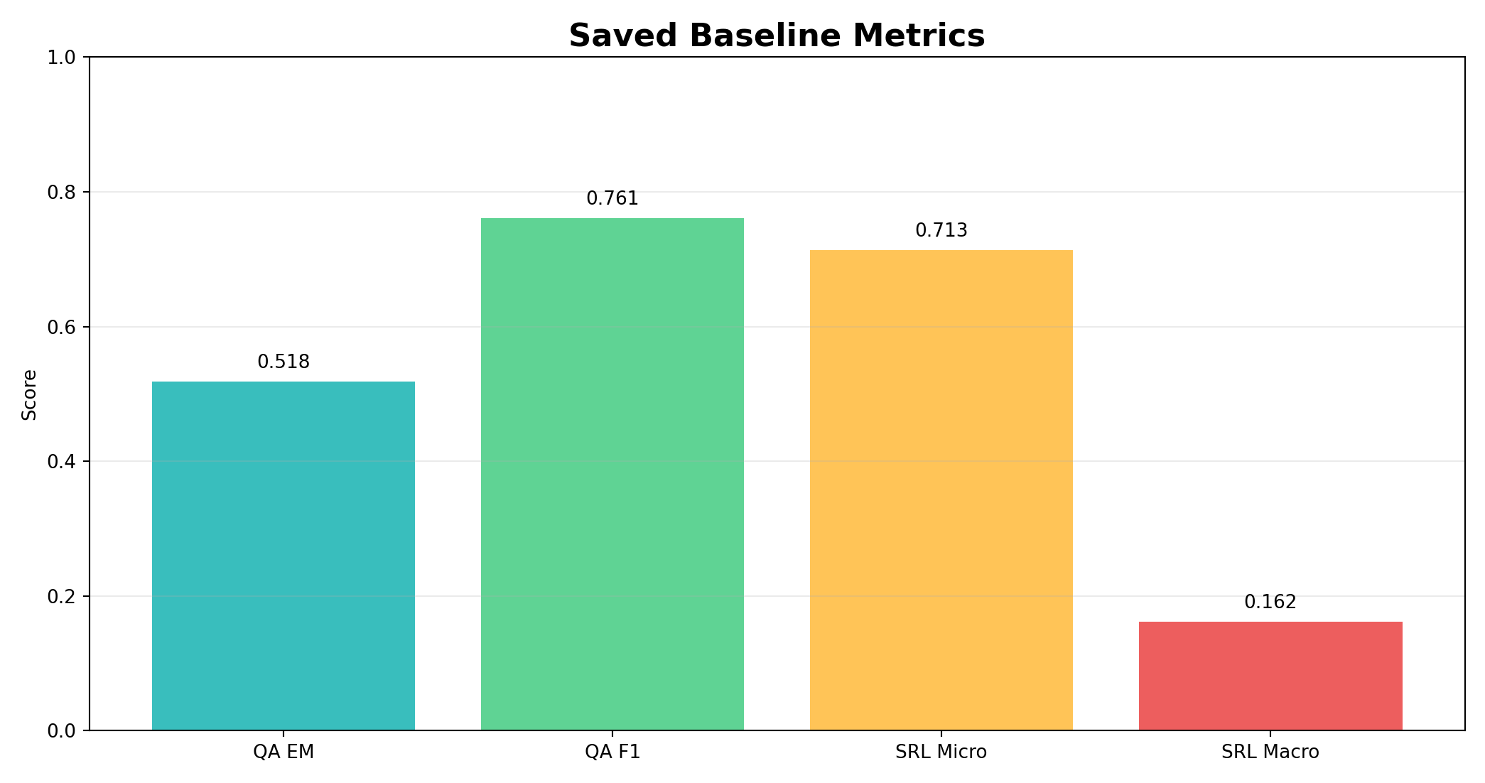
Plot 01: Baseline Metrics
Implemented values from metrics.json.

Slide 83
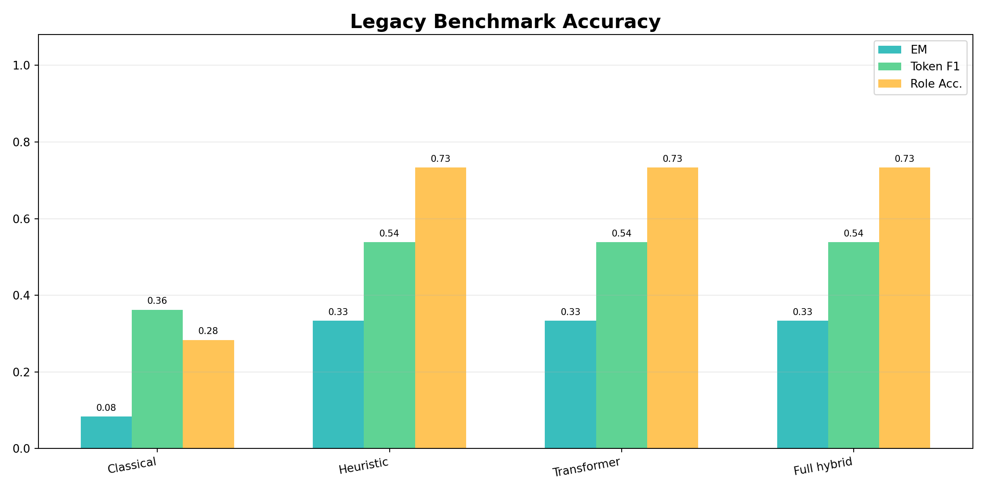
Plot 04: Legacy Benchmark Accuracy
Saved benchmark tracks, combined split.

Slide 84
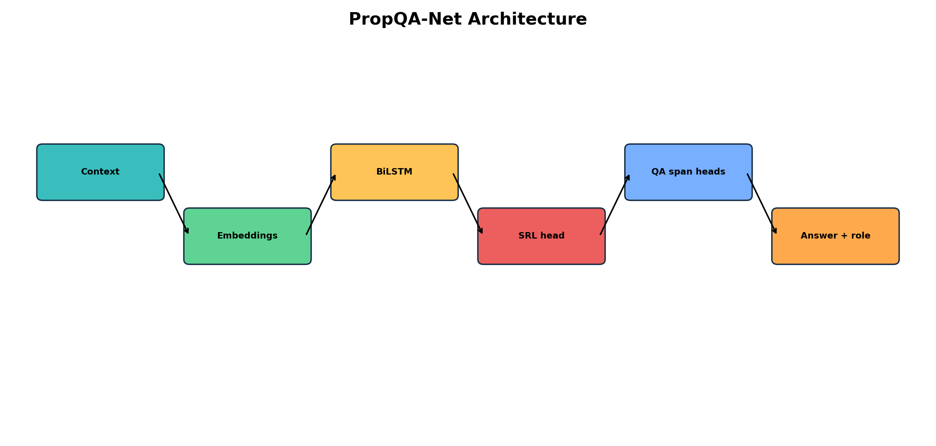
Diagram 15: PropQA-Net Architecture
Baseline neural architecture.

Slide 85
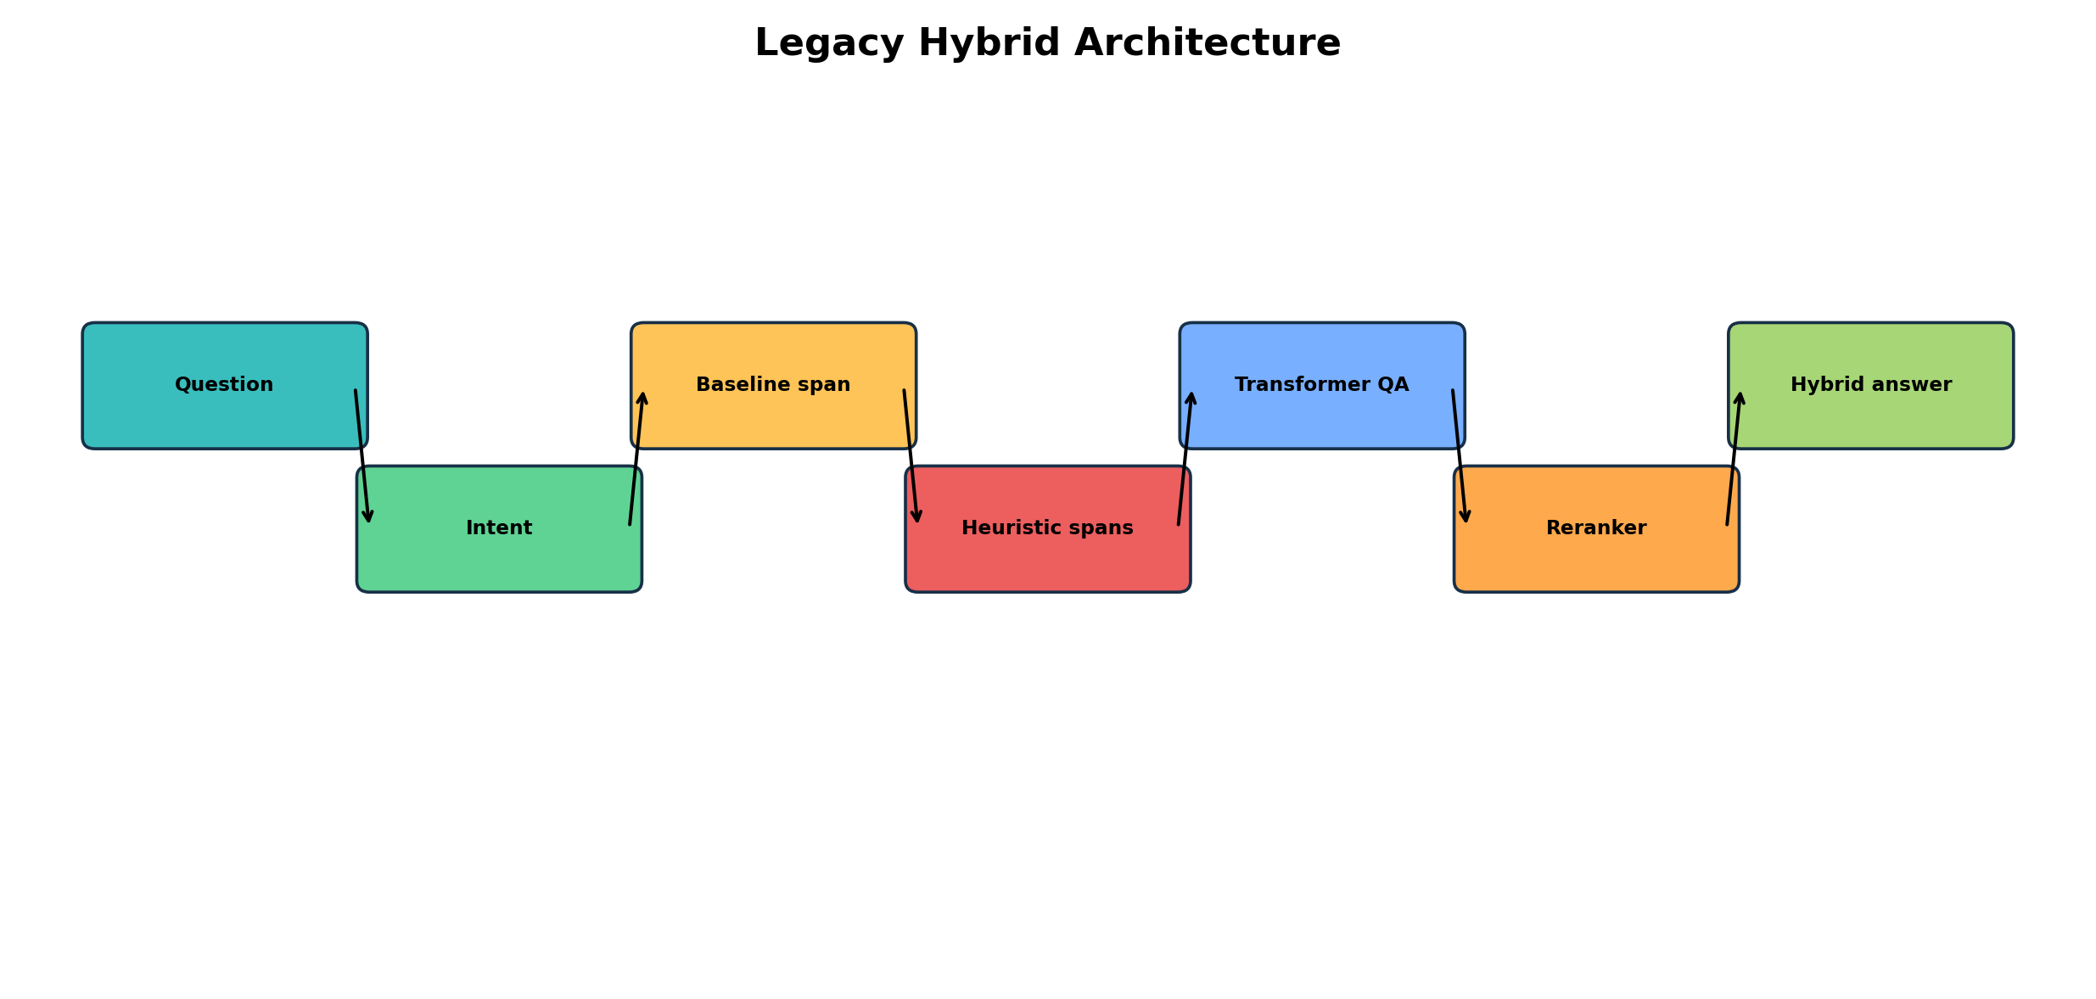
Diagram 16: Legacy Hybrid Architecture
Existing hybrid inference stack.

Slide 86
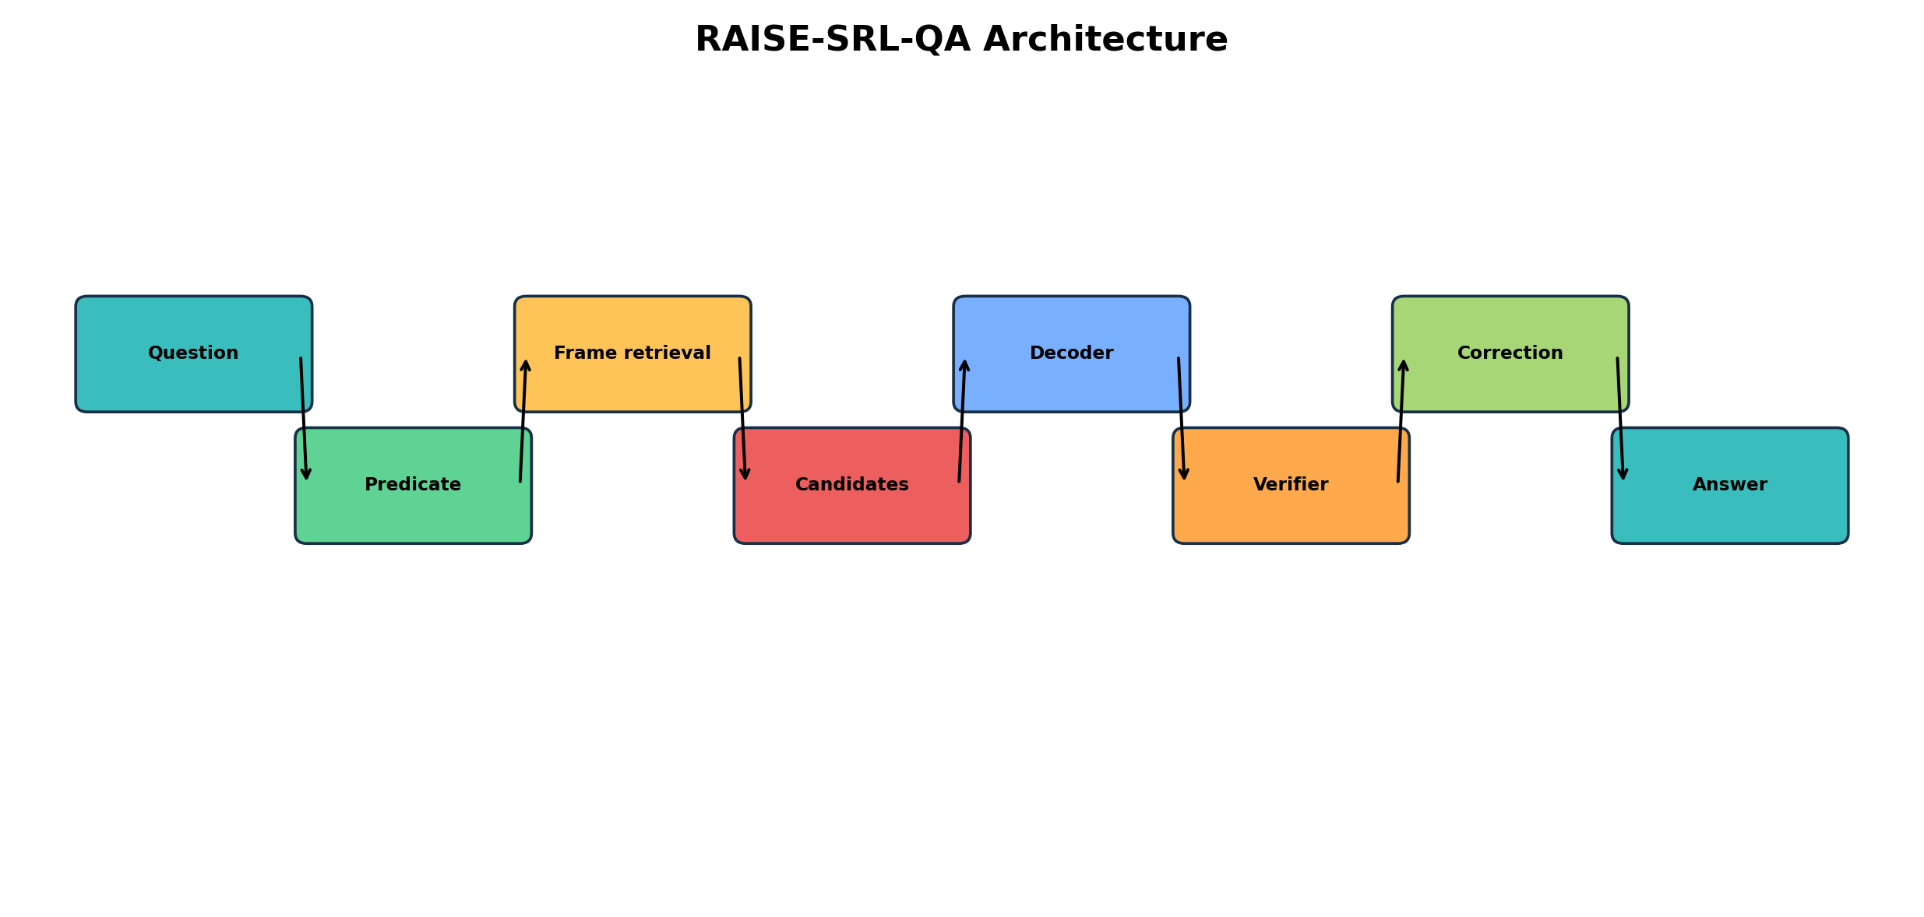
Diagram 17: RAISE Architecture
Main new architecture.

Slide 87
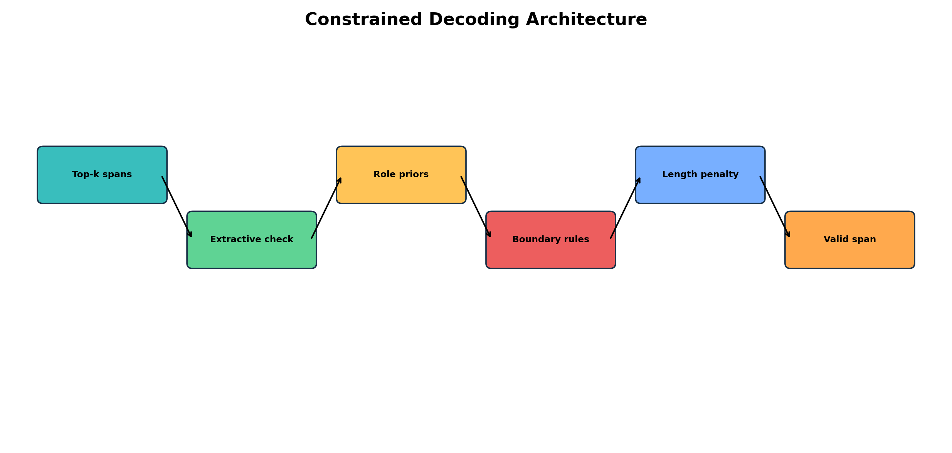
Diagram 20: Constrained Decoding
Boundary and role constraints.

Slide 88
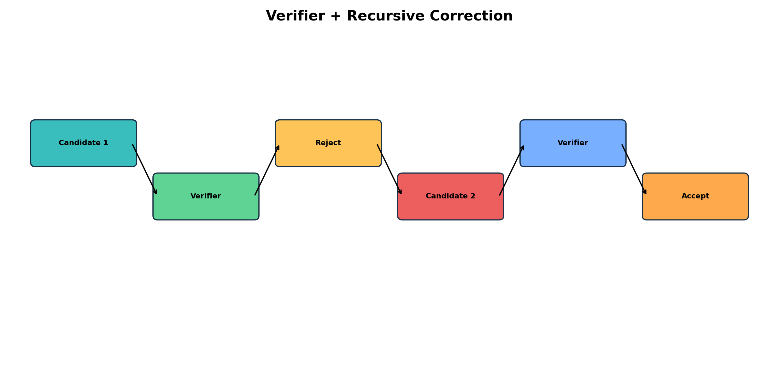
Diagram 21: Verifier Correction
Self-correction loop.

