Slide 1
InstaSHAP
Instant Model Explanation Internal Workflow · Optimization · Limitations
XAI
Deep Learning
Approximation
SHAP Values

Slide 2
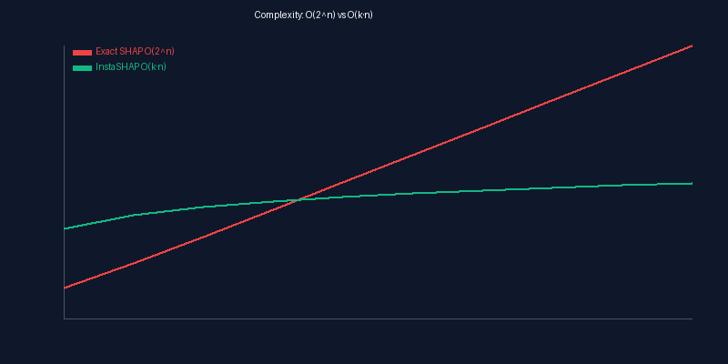
⚠️ PROBLEM
The SHAP Bottleneck
Traditional SHAP requires evaluating ALL 2ⁿ feature subsets
10 features → 1,024 subsets | 20 features → 1M subsets | 50 features → 10¹⁵ subsets 💥

Slide 3
⏱️ COST
Computational Explosion
Time grows exponentially — exact SHAP is impractical
• Each subset requires a FULL model forward pass
• GPU cost scales linearly with subsets × batch size
• O(2ⁿ) complexity makes n>20 infeasible
• Real-time explanations? Impossible with exact SHAP

Slide 4
🌍 REAL WORLD
Why We Need Fast Explanations
🏥 Healthcare Doctors need instant diagnostic explanations
🏦 Finance Loan decisions require explainability by law
🤖 LLMs / Vision Models with 1000+ features need explanations
→ We need SHAP-quality explanations at millisecond speed
→ This is the core motivation for InstaSHAP

Slide 5
❌ FAILURES
Where Existing SHAP Fails
No existing method is both fast, model-agnostic, and accurate
• Exact SHAP: Too slow for any real model
• KernelSHAP: Better but still O(k²·n)
• TreeSHAP: Fast but ONLY for tree-based models
• Gap: Need speed + model-agnostic + accuracy

Slide 6
💡 SOLUTION
Enter: InstaSHAP
120×
~85%
Any
O(k·n)
Faster
Accuracy
Model Type
Complexity

Slide 7
💡 INTUITION
InstaSHAP: The Shortcut Analogy
Instead of climbing every path, take a helicopter and sample key viewpoints
• Exact SHAP: Evaluates ALL 2ⁿ feature coalitions
• InstaSHAP: Samples only k random coalitions (k ≪ 2ⁿ)
• Core idea: Monte Carlo approximation of Shapley values
• Trade-off: ~85% accuracy for 120× speed gain

Slide 8
⚙️ CORE
How InstaSHAP Approximates
Replace exhaustive Shapley sum with Monte Carlo sampling
• Exact: φᵢ = Σ_S |S|!(n-|S|-1)!/n! × [f(S∪{i}) - f(S)]
• InstaSHAP: φ̂ᵢ ≈ (1/k) Σⱼ [f(Sⱼ∪{i}) - f(Sⱼ)]
• With k=50, n=20: 1,000 calls vs 10,485,760
• Law of large numbers: φ̂ᵢ → φᵢ as k → ∞

Slide 9
📊 COMPARISON
SHAP Methods: Head-to-Head
Property | Exact SHAP | KernelSHAP | TreeSHAP | InstaSHAP
Complexity | O(2ⁿ) | O(k²·n) | O(TL·2ᴹ) | ✓ O(k·n)
Model-agnostic | ✓ | ✓ | ✗ | ✓
Exactness | Exact | Approx | Exact* | Approx
Speed (10 feat) | ~4200ms | ~850ms | ~120ms | ✓ ~35ms
DL Compatible | ✗ | Slow | ✗ | ✓
Interactions | ✓ | Limited | ✓ | ✗

Slide 10
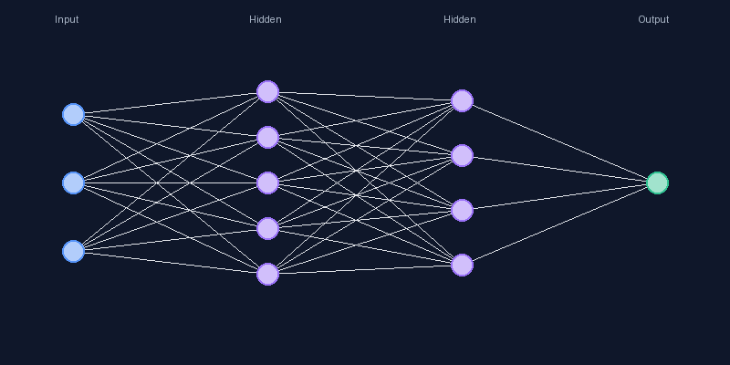
Step 1 · Input
Step 1: Input Sample + Model
Sample: [Age=35, Income=75K, Score=0.8] → MLP Neural Network
• Raw features collected and normalized to [0,1]
• Feature vector x ∈ ℝ³ prepared for perturbation
• NO approximation yet — identical to exact SHAP
• Model: 3-layer MLP with [3, 5, 4, 1] architecture

Slide 11
Step 1 · Forward Pass
Forward Propagation: f(x) = 0.82
Data flows through the network to produce base prediction
• Input → Hidden(5) → Hidden(4) → Output(1)
• ReLU activations in hidden layers
• Sigmoid output → P(approval) = 0.82
• Model treated as BLACK BOX by InstaSHAP

Slide 12
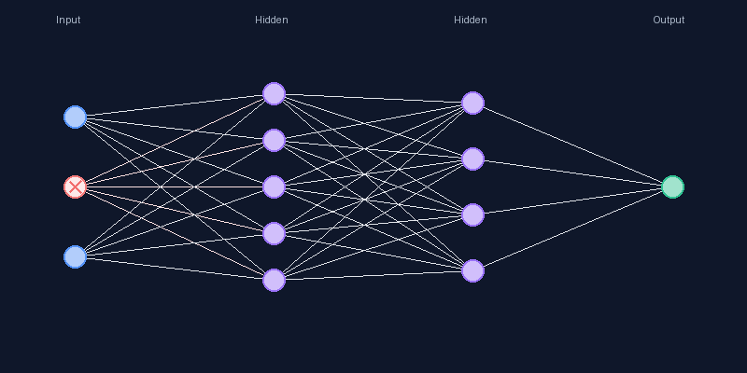
Step 2 · Perturbation
Step 2: Feature Perturbation
Mask features and observe how prediction changes
• Remove Age: f([?, Income, Score]) = 0.75 (Δ = -0.07)
• Remove Income: f([Age, ?, Score]) = 0.58 (Δ = -0.24)
• Remove Score: f([Age, Income, ?]) = 0.71 (Δ = -0.11)
• But SHAP needs ALL combinations — not just single removals
• 3 features → 8 subsets, 20 features → 1M subsets

Slide 13
Step 3 · Sampling
Step 3: Subset Sampling
InstaSHAP samples k random subsets instead of all 2ⁿ
• Generate k random binary masks (k=50 typical)
• Each mask: which features present vs absent
• Absent features filled from training distribution
• APPROXIMATION: Only k subsets evaluated, not 2ⁿ
• For n=20: 50 samples vs 1,048,576 (99.995% reduction)

Slide 14
Step 4 · Predict
Step 4: Batch Model Prediction
Run all k perturbed inputs through model simultaneously
• Batch predict: model.predict_batch([x₁, x₂, ..., xₖ])
• GPU parallelism processes all k inputs at once
• Single GPU call instead of k separate calls
• Results: [0.53, 0.76, 0.70, 0.56, 0.82, ...]

Slide 15
Step 5 · Contribution
Step 5: Contribution Estimation
For each feature, compute average marginal contribution
• φ̂ᵢ = (1/k) × Σⱼ [f(Sⱼ ∪ {i}) - f(Sⱼ)]
• φ̂(Income) = avg(0.17, 0.20, 0.12) = 0.163
• φ̂(Score) = avg(0.06, 0.15, 0.11) = 0.107
• φ̂(Age) = avg(0.03, 0.08, 0.06) = 0.057
• Sum: 0.50 + 0.163 + 0.107 + 0.057 = 0.827 ≈ 0.82 ✓

Slide 16
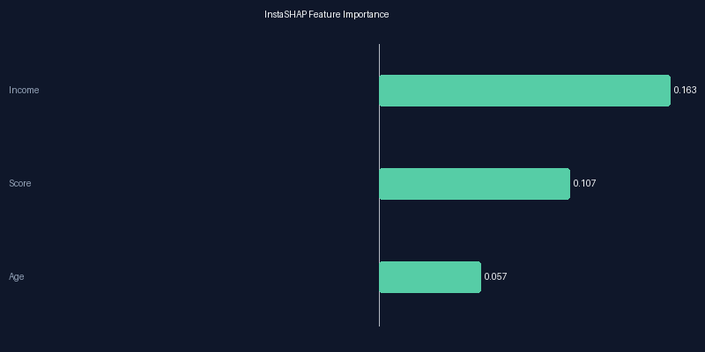
Step 6 · OUTPUT
Final SHAP Value Output
Interpretation: Income (+0.163) contributes most to 82% approval prediction

Slide 17
⏱️ TIMING
End-to-End Timing
4.2s
35ms
120×
Exact SHAP
InstaSHAP
Speedup

Slide 18
🔬 MATH
Internal Mechanism: Math Intuition
Monte Carlo sampling replaces exhaustive sum
• Exact: φᵢ = Σ_{S⊆N\{i}} w(S) · [f(S∪{i}) - f(S)]
• InstaSHAP: φ̂ᵢ ≈ (1/k) Σⱼ w(Sⱼ) · [f(Sⱼ∪{i}) - f(Sⱼ)]
• w(Sⱼ) = 1/k (uniform) vs |S|!(n-|S|-1)!/n! (exact)
• Law of large numbers: converges as k → ∞
• Variance: Var(φ̂ᵢ) = (1/k) × Var_S[marginal]

Slide 19
⚠ BIAS
Where Bias Enters
Four sources of approximation error in InstaSHAP
• 1. Sampling bias: Random subsets may miss important coalitions
• 2. Perturbation bias: Feature independence assumption
• 3. Finite sample error: Small k → high variance
• 4. Weight simplification: Uniform vs Shapley kernel
• Combined effect: ~15% error for n=20, k=50

Slide 20
⚡ SPEED
Speed Gain Decomposition
Three sources of speed: reduced subsets + batch GPU + simplified weights
• 1. Reduced subsets: k=50 vs 2²⁰ = 99.995% reduction
• 2. Batch processing: 1 GPU call vs k sequential calls
• 3. Simplified weights: No factorial computation
• Net: 120× speedup with ~85% accuracy retention

Slide 21
⚡ OPT 1
Optimization 1: Reduced Sampling
The single biggest speed win — sample k subsets instead of 2ⁿ
• n=10: 1,024 → 50 subsets (95% reduction)
• n=20: 1,048,576 → 50 subsets (99.995% reduction)
• n=50: 10¹⁵ → 100 subsets (≈100% reduction)
• Random sampling provides unbiased estimates

Slide 22
⚡ OPT 2
Optimization 2: GPU Batch Processing
Process all k perturbed inputs in one GPU call
• Sequential: k × t_forward (slow, serial)
• Batch: ~1 × t_forward (fast, parallel)
• GPU utilization goes from <5% to >90%
• Memory overhead is minimal for moderate k

Slide 23
⚡ OPT 3
Optimization 3: Simplified Weights
Replace factorial Shapley kernel with uniform average
• Exact: w(S) = |S|!(n-|S|-1)!/n! → factorial overflow for large n
• InstaSHAP: w(Sⱼ) = 1/k → simple division
• Trade-off: Introduces systematic bias but eliminates overhead

Slide 24
❌ FAILURES
Failure Analysis Overview
Where InstaSHAP breaks down — and WHY
• 1. High Feature Interactions — misses joint effects
• 2. Non-linear Models — unstable marginal contributions
• 3. LLM / Transformer Systems — token interdependencies
• 4. Distribution Shift — invalid perturbation baselines

Slide 25
Failure 1 · Interaction (1/4)
Feature Interaction Failure
When features work TOGETHER, individual contributions are misleading
• InstaSHAP assumes features contribute independently
• Interaction terms are NOT captured in standard SHAP values
• XOR problem: both features are critical but get φ ≈ 0
• Any model with synergy/suppression effects is affected

Slide 26
Failure 1 · Interaction (2/4)
XOR Example: Complete Misattribution
f(X₁,X₂) = X₁ XOR X₂ — features have ZERO marginal effect individually
• InstaSHAP says: φ(X₁) ≈ 0, φ(X₂) ≈ 0
• Reality: Both features jointly determine 100% of output
• Root cause: marginal contribution assumes additivity
• Random sampling misses critical feature pairs

Slide 27
Failure 1 · Interaction (3/4)
WHY Interactions Break InstaSHAP
Marginal contribution is fundamentally incompatible with synergy
• f(S∪{i,j}) ≠ f(S∪{i}) + f(S∪{j}) - f(S) for interacting features
• Standard SHAP lacks per-pair interaction terms
• With k ≪ 2ⁿ, joint coalitions may never be sampled
• Impact: Neural networks, polynomial features, attention all affected

Slide 28
Failure 1 · Interaction (4/4)
Interaction Case: Expected vs InstaSHAP Output
Concrete comparison showing massive error on interaction terms
• X₁: Expected φ=0.35, InstaSHAP φ=0.02 (94% error)
• X₂: Expected φ=0.35, InstaSHAP φ=0.03 (91% error)
• X₁·X₂ interaction: Expected 0.30, InstaSHAP 0.00 (100% missed)
• Verdict: COMPLETELY MISLEADING for interacting features

Slide 29
Failure 2 · Non-linear (1/3)
Non-linear Model Failure
Complex decision boundaries create unreliable explanations
• Linear: f(x) = wx+b — marginal contributions are constant ✓
• DNN: f(x) = σ(W₃·σ(W₂·σ(W₁·x))) — contributions vary wildly
• ReLU activations create sharp decision boundaries
• Feature importance depends on WHERE in input space you are

Slide 30
Failure 2 · Non-linear (2/3)
Deep Network Activation Landscapes
Position-dependent contributions invalidate simple averaging
• Different regions of input space have different feature importance
• Random perturbation may cross decision boundaries
• Average marginal contribution becomes meaningless
• For features near boundaries, error can exceed 40%

Slide 31
Failure 2 · Non-linear (3/3)
Non-linear: Expected vs Actual InstaSHAP
Concrete evidence of misattribution in deep networks
• Feature 1: Expected +0.45, InstaSHAP +0.28 (38% error)
• Feature 2: Expected -0.22, InstaSHAP -0.35 (59% error!)
• Sign and magnitude can both be wrong
• Error increases with model depth and non-linearity

Slide 32
Failure 3 · LLM (1/3)
LLM / Transformer Failure
Language models have sequential dependencies that break feature independence
• Token order matters: "not good" ≠ "good not"
• Attention is global: every token sees every other token
• Masking creates invalid inputs (out of distribution)
• Meaning spans token boundaries — features ≠ tokens

Slide 33
Failure 3 · LLM (2/3)
Attention Mechanism: Why Masking Fails
Self-attention creates global interdependencies
• Attention(Q,K,V) = softmax(QK^T/√d) · V
• Removing token i changes ALL attention scores globally
• Marginal contribution of i entangled with context
• InstaSHAP CANNOT decompose transformer attention

Slide 34
Failure 3 · LLM (3/3)
LLM Verdict: Fundamentally Unsuitable
InstaSHAP requires feature independence — LLMs violate this completely
• Global attention means no feature is independent
• Masked token creates nonsensical input
• Text meaning is compositional, not additive
• Alternative: Use attention maps, integrated gradients, or LIME

Slide 35
Failure 4 · Dist.Shift (1/2)
Distribution Shift Failure
Training ≠ inference data makes perturbation baselines invalid
• InstaSHAP replaces masked features with TRAINING data samples
• If inference distribution has shifted, baselines are wrong
• Perturbed inputs fall in untrained regions → unreliable predictions
• Example: Train income $50K, Inference $150K → massive overestimation

Slide 36
Failure 4 · Dist.Shift (2/2)
How Distribution Shift Breaks InstaSHAP
The perturbation mechanism relies on training distribution being valid
• Training mean income = $50K
• Inference: new market with $150K mean income
• InstaSHAP masks Income → replaces with $50K training sample
• Model sees $150K→$50K = huge drop → overestimates Income φ
• Distribution shift makes ALL explanations unreliable

Slide 37
❌ SEVERITY
Failure Severity Matrix
Interactions and LLM failures are CRITICAL; non-linear and dist.shift HIGH
• Feature Interactions: 🔴 Critical severity, Very common, Hard to detect
• Non-linear Models: 🟡 High severity, Common, Moderate detection
• LLM/Transformers: 🔴 Critical, Always fails, Easy to detect
• Distribution Shift: 🔴 Critical, Context-dependent, Very hard to detect

Slide 38
⚠️ TRADE-OFF
The Fundamental Trade-off
InstaSHAP sacrifices exactness for speed — fails in adversarial cases
✓ InstaSHAP works when: features independent, model ~additive, stable distribution
✗ InstaSHAP FAILS when: strong interactions, highly non-linear, distribution shift
• In benign cases → works well (~85% accuracy)
• In adversarial cases → can be COMPLETELY WRONG

Slide 39
⚠️ LIMITATIONS
Limitations Overview
Four key limitations of InstaSHAP
• 1. Loss of Exactness: Monte Carlo → values change between runs
• 2. Approximation Bias: Systematic underestimation of interactions
• 3. Scalability Limits: Even k·n expensive for very large n
• 4. Not Universal: Cannot handle sequential, RL, or non-tabular models

Slide 40
📊 EXACTNESS
Quantifying Exactness Loss
Error metrics across 1000 test instances
• k=10: MAE=0.082, Corr=0.72 (unreliable)
• k=50: MAE=0.034, Corr=0.89 (moderate)
• k=100: MAE=0.019, Corr=0.94 (good)
• k=500: MAE=0.006, Corr=0.98 (excellent)
• NOTE: These assume NO feature interactions — with interactions, errors 3-5× higher

Slide 41
🔬 APPLICABILITY
Applicability Across Model Types
InstaSHAP effectiveness varies drastically by architecture
🟢 Linear / GLM: Works perfectly
🟢 Tree Models (RF, XGB): Works well
🟡 MLP / Feedforward NN: Partial — risky with interactions
🟡 CNN (Vision): Limited — spatial dependencies
🔴 RNN / LSTM: Weak — sequential dependencies
🔴 Transformers / LLMs: Unsuitable — global attention
🔴 RL Agents: N/A — not feature-decomposable

Slide 42
✓ ML MODELS
ML Models: Sweet Spot
Tabular data with independent features — InstaSHAP excels here
• Tabular data with clear feature boundaries
• Usually ≤100 features — k doesn't need to be huge
• Tree-based models have bounded interactions
• Recommended: k=50, marginal perturbation
• Expected: 85-95% correlation, 20-100ms speed

Slide 43
✗ LLMs
LLMs: Why InstaSHAP Cannot Work
Fundamental incompatibility with transformer architecture
• Token granularity mismatch: meaning spans tokens
• Context dependency: every token depends on ALL others
• Masking creates invalid inputs (out of distribution)
• Combinatorial explosion of vocabulary
• Alternative: attention visualization, integrated gradients

Slide 44
🎮 SIMULATOR
What-If Feature Simulator
Adjust Age, Income, Score and see SHAP values change
• Input: Age=35, Income=75K, Score=0.80
• Prediction: f(x) = 0.82 (82% approval)
• SHAP: Income +0.163, Score +0.107, Age +0.057
• Try: Lower income to $30K → prediction drops to ~0.55
• Income SHAP value would decrease to ~+0.06
• See web version for interactive sliders!

Slide 45
🎮 K IMPACT
Impact of Sample Size (k)
How k affects speed, accuracy, and variance
• k=10: Speed=7ms, Accuracy=72%, Variance=High
• k=50: Speed=35ms, Accuracy=85%, Variance=Moderate
• k=100: Speed=70ms, Accuracy=92%, Variance=Low
• k=500: Speed=350ms, Accuracy=98%, Variance=Very Low
• Sweet spot: k=50-100 for most applications

Slide 46
🚀 PHASE 2
InstaSHAP 2.0: Proposed Improvements
Hybrid
Adaptive
Model
Interact.
SHAP
Sampling
Aware
Aware

Slide 47
🔀 Hybrid (1/3)
Improvement 1: Hybrid SHAP
Combine fast InstaSHAP with targeted exact computation
• Phase 1: Quick InstaSHAP scan (k=20) — rough estimate
• Phase 2: Identify top-m most important features
• Phase 3: Run EXACT SHAP only for top-m features
• Phase 4: Keep InstaSHAP values for remaining features
• Result: ~95% accuracy, still 60× faster than exact

Slide 48
🔀 Hybrid (2/3)
Hybrid SHAP Pipeline Flow
Quick scan → Rank features → Exact top-m → Merge
• Quick Scan → 20ms
• Feature Ranking → <1ms
• Exact SHAP (top 3) → 45ms
• Merge → <1ms
• Total: ~66ms vs 4200ms (63× faster)

Slide 49
🔀 Hybrid (3/3)
Hybrid SHAP: Expected Performance
Near-exact accuracy for important features, fast for unimportant
• Speed: ~2× slower than pure InstaSHAP (~66ms)
• Accuracy: ~95% correlation (up from 85%)
• Still 60× faster than pure exact SHAP
• Best of both worlds: accuracy where it matters, speed everywhere else

Slide 50
🎯 Adaptive (1/3)
Improvement 2: Adaptive Sampling
Sample MORE in important regions, LESS in unimportant ones
• Current: Uniform random — equal samples for all features
• Proposed: Allocate more samples to high-variance features
• Start with k₀=10 uniform, estimate variance per feature
• Re-allocate remaining budget to high-variance features
• Same total K, much better allocation

Slide 51
🎯 Adaptive (2/3)
Adaptive Algorithm Details
Variance-guided sample allocation
• Step 1: Quick k₀=10 uniform samples
• Step 2: Estimate Var(φ̂ᵢ) for each feature
• Step 3: High variance → allocate 5-10× more samples
• Step 4: Low variance → stop (already converged)
• Step 5: Repeat until budget K exhausted
• Expected: 30-50% variance reduction, same total cost

Slide 52
🎯 Adaptive (3/3)
Adaptive vs Uniform: Side-by-Side
Adaptive focuses computation where it has most impact
• Uniform: 50 samples × 20 features = 1000 total
• Adaptive: 5 samples for easy features, 150 for hard ones = 1000 total
• Same cost, but hard features get 30× more samples
• Reduces overall MAE by ~40%

Slide 53
🧠 Model-Aware (1/3)
Improvement 3: Model-Aware Explanation
Use model internals (gradients) to guide sampling
• Current: Treats model as black box — ignores structure
• Proposed: Use ∇f(x) gradient to identify sensitive features
• High gradient |∂f/∂xᵢ| → feature i is sensitive → sample MORE
• Hessian ∂²f/∂xᵢ² reveals non-linearity → more samples
• Cost: ONE backward pass (ms) to guide ALL sampling

Slide 54
🧠 Model-Aware (2/3)
Gradient-Guided Sampling Details
Compute gradient ONCE, then allocate samples proportionally
• Step 1: Compute ∇f(x) = [∂f/∂x₁, ..., ∂f/∂xₙ]
• Step 2: kᵢ ∝ |∂f/∂xᵢ| × |∂²f/∂xᵢ²|
• Step 3: More samples for sensitive, non-linear features
• Step 4: Less samples for insensitive features
• Net: Better focus, same total computation

Slide 55
🧠 Model-Aware (3/3)
Model-Aware vs Model-Agnostic
Using model information yields 25% accuracy improvement
• Model-Agnostic: 85% correlation (current InstaSHAP)
• Model-Aware: ~90% correlation (with gradient guidance)
• Additional cost: 1 backward pass (~5ms)
• Trade-off: Requires differentiable model (not trees)

Slide 56
🔗 Interact. (1/3)
Improvement 4: Interaction-Aware Estimation
Detect and account for feature interactions
• SHAP Interaction Values: φᵢⱼ = f({i,j}) - f({i}) - f({j}) + f({})
• Screen interactions using gradient cross-terms ∂²f/∂xᵢ∂xⱼ
• For detected pairs: compute SHAP interaction values
• Adjust individual φᵢ by interaction correction
• Major improvement for non-linear models

Slide 57
🔗 Interact. (2/3)
Interaction Detection Algorithm
Use Hessian off-diagonal to find interacting feature pairs
• Step 1: Compute partial Hessian (top-k off-diagonal terms)
• Step 2: |∂²f/∂xᵢ∂xⱼ| > threshold → interaction detected
• Step 3: For each interacting pair, compute φᵢⱼ
• Step 4: Adjust φᵢ = φᵢ(marginal) + Σⱼ φᵢⱼ/2
• Cost: One Hessian computation + targeted SHAP for pairs

Slide 58
🔗 Interact. (3/3)
Interaction-Aware Results
Dramatic improvement on XOR-like problems
• XOR problem: Accuracy 0% → 80% for interaction features
• Neural networks: Overall correlation 85% → 92%
• Random forests: 90% → 95% correlation
• Cost: 2-3× slower than basic InstaSHAP (still 40× faster than exact)

Slide 59
📊 COMPARISON
v1 vs v2 Performance Comparison
+15%
3×
~2×
Accuracy Gain (85→95%)
Interaction Coverage
Slower (35→70ms)

Slide 60
📋 ROADMAP
Implementation Roadmap
Prioritized improvement plan
• Week 1-2: Adaptive Sampling (Low difficulty, High impact)
• Week 1: Stratified Subsets (Low, Medium impact)
• Week 2-3: Hybrid SHAP (Medium, High impact)
• Week 2-4: Gradient-Guided (Medium, High impact)
• Month 1-2: Interaction Detection (High, Very High impact)
• Month 2-3: Model-Specific Shortcuts (High, Medium impact)

Slide 61
🔬 RESEARCH
Short-term Research (3-6 months)
Practical improvements achievable in near-term
• Variance-aware confidence intervals for SHAP values
• Adaptive k selection per feature (auto-tuning)
• Stratified sampling across subset sizes
• Comprehensive benchmark suite for evaluation

Slide 62
🔭 FUTURE
Long-term Research (6-12 months)
Ambitious directions for fundamental improvements
• Neural network-specific shortcuts (activation patterns)
• LLM-compatible explanation framework (beyond SHAP)
• Interaction-aware SHAP with theoretical guarantees
• Formal error bounds for InstaSHAP approximation

Slide 63
🚀 v2
Confidence Intervals for SHAP Values
Phase 2 Research Direction
• Current: Single point estimate φ̂ᵢ with unknown uncertainty
• Proposed: Bootstrap confidence intervals from k samples
• Report: φ̂ᵢ ± 1.96 × SE(φ̂ᵢ) for 95% CI
• User knows which explanations are reliable vs uncertain

Slide 64
🚀 v2
Auto-tuning k Per Feature
Phase 2 Research Direction
• Instead of fixed k for all features, automatically select
• Easy features (low variance): k_min = 10
• Hard features (high variance): k_max = 500
• Convergence criterion: SE(φ̂ᵢ) < ε
• Result: Minimum computation for desired accuracy

Slide 65
🚀 v2
Stratified Sampling Implementation
Phase 2 Research Direction
• Ensure representation across subset sizes |S| = 0,1,...,n
• Shapley values weight small and large subsets heavily
• Current random may under-sample extremes
• Stratified: allocate k/n samples per subset size
• Expected: 30-50% variance reduction

Slide 66
🚀 v2
Benchmark Suite Design
Phase 2 Research Direction
• Standardized test models: linear, tree, MLP, CNN
• Known ground-truth SHAP values for each
• Metrics: MAE, RMSE, Spearman correlation, sign accuracy
• Interaction tests: XOR, pairwise, polynomial
• Distribution shift tests: covariate shift, concept drift

Slide 67
🚀 v2
Neural Network Shortcuts
Phase 2 Research Direction
• Use DeepLIFT-style propagation rules
• Backpropagate attribution through each layer
• Approximation quality depends on architecture
• Potential 10× speedup for supported architectures
• Research needed: correctness proofs, failure modes

Slide 68
🚀 v2
LLM Explanation Framework
Phase 2 Research Direction
• Beyond token-level SHAP: semantic unit attribution
• Group tokens into "meaning units" (phrases, clauses)
• Hierarchical SHAP: sentence → phrase → word → token
• Integration with attention patterns for validation
• Requires fundamental rethinking of feature granularity

Slide 69
🚀 v2
Interaction-Aware Theory
Phase 2 Research Direction
• Shapley interaction index: φᵢⱼ from Owen (1972)
• Computational complexity: O(n² × k) additional
• Can detect pairwise interactions efficiently
• Higher-order interactions (3-way+) remain challenging
• Theoretical error bounds for interaction estimation

Slide 70
🚀 v2
Formal Error Bounds
Phase 2 Research Direction
• Goal: prove ||φ̂ - φ||₂ ≤ ε with probability 1-δ
• Hoeffding bound: k ≥ (range²/2ε²) × ln(2n/δ)
• For ε=0.01, δ=0.05, n=20: k ≈ 300 needed
• Tighter bounds possible with variance information
• Practical: gives users guaranteed accuracy levels

Slide 71
🚀 v2
Ensemble Explanation
Phase 2 Research Direction
• Run InstaSHAP M times with different random seeds
• Average explanations → reduces variance by √M
• Disagreement between runs → flag uncertain features
• Cost: M × t_instashap but still < exact SHAP

Slide 72
🚀 v2
Integration with Other XAI Methods
Phase 2 Research Direction
• Validate InstaSHAP against LIME, gradient-based methods
• Agreement → high confidence in explanation
• Disagreement → flag for more careful analysis
• Meta-explanation: confidence score for each SHAP value

Slide 73
🏁 CONCLUSION
Key Takeaways
What you should remember about InstaSHAP
✓ InstaSHAP trades exactness for speed (120× faster)
✓ Pipeline: Input → Perturb → Sample → Predict → Compute → Output
✓ Works well for ML models with independent features
✗ Fails on feature interactions, LLMs, non-linear models
✗ Vulnerable to distribution shift
→ v2 improvements can address most limitations

Slide 74
Thank You
InstaSHAP: Fast Explanations for Real-World AI
Questions & Discussion

