Slide 1
MINI PROJECT PRESENTATION | IIIT DHARWAD
Medical Insurance Claim Fraud Detection
Multi-Paradigm ML, Deep Learning, Agentic XAI & Browser Lab
Health Insurance Fraud Intelligence Platform: Leakage-Governed Benchmarks, 10-Model Evaluation & Dual-Path Deployment
Submitted by: B. Varshith (23BDS011) | J. Ganesh Kumar Reddy (23BDS024) | M. Jagadeeswar (23BDS033)
Supervised by: Prof. Ramesh Athe | Dept. of Computer Science & Engineering, IIIT Dharwad | November 2026

Slide 2
Project Scope & Unified Team Ownership
Integrating Classical ML, PyTorch Deep Learning, Agentic AI + XAI, Full-Stack App & Verified Research Lab
Approach 1 & Lab — J. Ganesh Kumar Reddy
(Roll No: 23BDS024)
• Audited source Excel workbook (4,500 claims x 19 cols, SHA-256 verified).
• Identified upstream Cluster proxy leakage & ClaimAmount shortcut risk.
• Built 5 Classical ML baselines (LR, RF, XGBoost, SVM, GradientBoosting).
• Engineered submission/ 32-run 4-experiment ablation suite + Temporal rollout.
• Compiled pure-JS browser Claim Fraud Lab verified within 4.42e-7 parity.
Approach 2 & Full-Stack — M. Jagadeeswar
(Roll No: 23BDS033)
• Designed & trained 5 PyTorch models: FraudMLP, ResidualMLP, CNN1D, TabTransformer & Autoencoder.
• Built unified FastAPI Inference Server (ml-service :8000) serving all 10 ML & DL models.
• Implemented Express proxy routes (/api/ml/*) & offline React fallback.
• Validated TabTransformer (99.11% PR-AUC) and documented Autoencoder negative study.
Approach 3 Agentic & Chat — B. Varshith
(Roll No: 23BDS011)
• Built 6-Agent React pipeline UI & interactive Agentic Dashboard (:5173).
• Implemented Express /agentic/predict emitting 4-stage JSON verification trace.
• Integrated live Google Gemini 2.0 Flash Co-Pilot (POST /api/chat).
• Built Approach-3-Agentic-AI (:8020) XAIExplainer & SHA-256 hash scaffold.
IIIT Dharwad CSE (DSAI) | Medical Insurance Claim Fraud Detection — Approaches 1, 2 & 3
2 / 20

Slide 3
Problem Motivation & Core Technical Challenges
Why Naive Binary Classification Fails on Real-World Healthcare Claims
1. Extreme Class Imbalance (6.00% Positives)
• 4,230 Legitimate (94.0%) vs. only 270 Fraudulent (6.0%) claims.
• An all-negative dummy classifier gets 94% accuracy while catching zero fraud.
• Requires weighted BCE (w+ = 15.67) and PR-AUC instead of accuracy alone.
2. Upstream Proxy Leakage & Shortcut Traps
• Post-hoc 'Cluster' isolates 267/270 frauds into Cluster 1 (inflated offline accuracy!).
• High-cardinality IDs (ClaimID, PatientID, ProviderID) risk overfitting.
• All frauds satisfy ClaimAmount >= $7,465.07—demanding explicit ablation stress tests.
3. Chronological Drift & Threshold Calibration
• Random splits leak future claim patterns backward into training folds.
• Fixed 0.50 cutoffs misalign precision/recall on uncalibrated logits.
• Must test on future dates (>= 2024-03-11) using validation-only thresholds.
4. Investigator Trust, XAI & Audit Parity
• SIU teams need local explanations & audit digests, not opaque scalars.
• Production deployment requires both server APIs & zero-server browser parity.
IIIT Dharwad CSE (DSAI) | Medical Insurance Claim Fraud Detection — Approaches 1, 2 & 3
3 / 20

Slide 4
Literature Survey: Six Research Pillars & Identified Gaps
Synthesis Across 20 Peer-Reviewed & Foundational ML, DL, XAI, and Leakage Studies
Research Theme | Key Verified Citations | Core Insight in Literature | How Addressed in Our Project
Healthcare ML & Classical Ensembles | du Preez et al. (2025, 137 studies); Bauder & Khoshgoftaar (2017); Breiman (2001); Chen & Guestrin (2016) | Tree ensembles (RF, XGBoost, LightGBM) dominate tabular claims, but studies omit temporal checks. | Implemented 5 balanced classical models; audited random & chronological future splits.
Tabular Deep Learning vs. Trees | Johnson & Khoshgoftaar (2019); Huang et al. (2020); Gorishniy (2021); Grinsztajn (2022) | Attention improves neural tabular scoring, yet trees preserve sharp axis-aligned splits on ~10K rows. | Built MLP, ResidualMLP, CNN1D & TabTransformer; proved trees retain 1.00 PR-AUC on Intake.
Autoencoder Anomaly Detection | Sakurada & Yairi (2014); Chalapathy & Chawla (2019) | Reconstruction MSE fails when anomalies sit inside normal covariate convex support. | Trained normal-only PyTorch Autoencoder; openly documented AP=0.0523 negative result.
Metrics, Leakage & Shortcuts | Saito & Rehmsmeier (2015); Kaufman (2012); Geirhos (2020); Chawla (2002) | PR-AUC beats ROC-AUC under skew; leaky proxies and shortcuts invalidate offline scores. | Adopted PR-AUC + val-tuned F1; tested Cluster-free Intake & ClaimAmount-free No-Amount.
XAI, RAG & Agentic Compliance | Lundberg & Lee (2017, SHAP); Lewis et al. (2020, RAG); Kapadiya et al. (2022) | Human SIU review demands factor rationales, policy RAG grounding & tamper-evident hashes. | Built 6-agent UI, Gemini 2.0 Flash /api/chat co-pilot & XAI SHA-256 utility scaffold.
IIIT Dharwad CSE (DSAI) | Medical Insurance Claim Fraud Detection — Approaches 1, 2 & 3
4 / 20

Slide 5
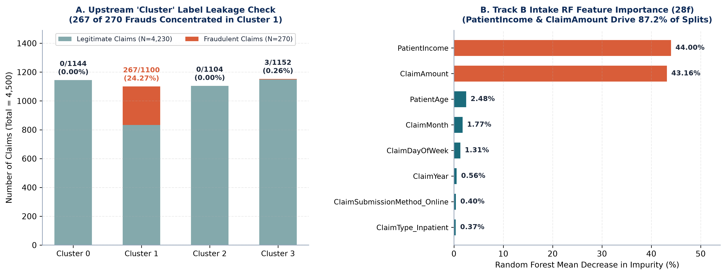
Dataset Audit: Structural Properties & Upstream Proxy Hazards
Health Insurance Fraud Claims.xlsx — 4,500 Claims x 19 Columns (Zero Missing, Zero Duplicates)
Critical Audit Takeaways Shaping Experimental Governance
• Upstream Cluster (0..3) places 267/270 frauds (98.89%) inside Cluster 1 -> Dropping Cluster tests realistic hospital intake (Track B Intake).
• ClaimAmount is >= $7,465.07 for every fraud (mean $8,733.57) vs. $100.12-$9,997.20 legit -> Dropping both tests amount dependency (No-Amount).
IIIT Dharwad CSE (DSAI) | Medical Insurance Claim Fraud Detection — Approaches 1, 2 & 3
5 / 20

Slide 6
Mathematical Problem Formulation
Imbalance-Weighted Risk Minimization, Reconstruction MSE & Validation-Frozen Thresholding
Supervised Objective (Classical & DL)
• Inputs phi(r_i) in R^(d_s) built via train-only StandardScaler + OHE (29f / 28f / 27f).
• Weighted BCE: L = -(1/N_tr) sum [ w+ y_i log sigma(z_i) + (1-y_i) log(1-sigma(z_i)) ], w+ = 15.67.
• AdamW optimization + validation PR-AUC early stopping.
Unsupervised Autoencoder & Threshold Policy
• Autoencoder (29->16->8->16->29) fits strictly legitimate records (y=0) via MSE.
• Cutoff tau_AE = 0.128588 fixed at 95th percentile of validation errors.
• Track B cutoff: tau* = argmax_tau F1(y_val, I(p_val >= tau)), frozen on test.
Contract | Dim | Split Strategy | Train / Val / Test (Frauds) | Primary Hypothesis Tested
Baseline (Track A & B) | 29 | Stratified Seed 42 (70/15/15) | 3,150 (189) / 675 (41) / 675 (40) | Unified 10-model comparison with original schema (includes Cluster).
Intake (Track B) | 28 | Stratified Seed 42 (70/15/15) | 3,150 (189) / 675 (41) / 675 (40) | Realistic claim screening without upstream Cluster proxy.
No-Amount (Track B) | 27 | Stratified Seed 42 (70/15/15) | 3,150 (189) / 675 (41) / 675 (40) | Stress test measuring non-monetary predictors when amount is withheld.
Temporal Intake | 28 | Chronological Date Split | 3,152 (199) / 677 (34) / 671 (37) | Forward-in-time test (Train <= 2023-11-21; Test >= 2024-03-11).
IIIT Dharwad CSE (DSAI) | Medical Insurance Claim Fraud Detection — Approaches 1, 2 & 3
6 / 20

Slide 7
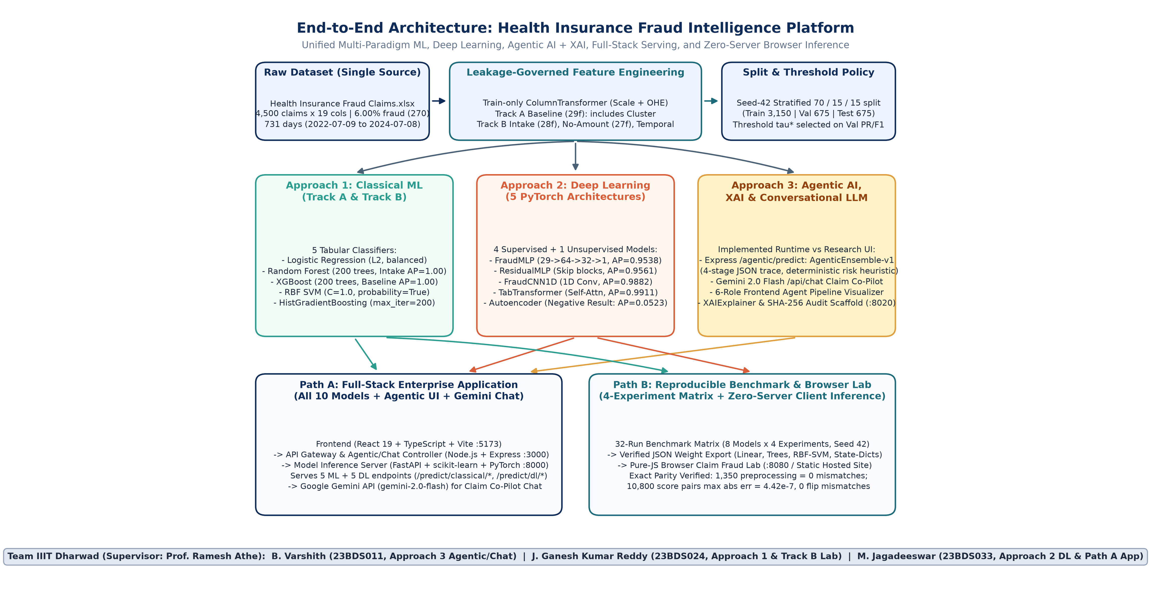
Unified System Architecture: Approaches 1–3 & Dual Deployment
Coordinating Three Modeling Pillars Across Enterprise Microservices (Path A) and Browser Lab (Path B)
IIIT Dharwad CSE (DSAI) | Medical Insurance Claim Fraud Detection — Approaches 1, 2 & 3
7 / 20

Slide 8
Approach 1: Classical Machine Learning Pipelines
Five Diverse Classifiers Balancing Interpretability, Margin Separation & Nonlinear Tree Ensembles
Model | Inductive Bias & Key Hyperparameters | Track A PR-AUC | Track B Intake PR-AUC (F1) | Runtime Profile
LogisticRegression | L2 linear hyperplane; class_weight='balanced', max_iter=1000 | 91.86% | 85.25% (0.7327) | ~0.01s train; linear coefficients
RandomForest | 200 bagged decision trees; class_weight='balanced', seed 42 | 99.94% | 100.00% (0.9873) | 0.61s train; Champion Intake Model
XGBoost | 200 boosted trees; depth 5, lr 0.05, scale_pos_weight=15.67 | 100.00% | 100.00% (0.9877) | 0.17s train; 100% Test Recall
SVM (RBF Kernel) | Radial basis margin + Platt scaling; class_weight='balanced' | 92.52% | 81.81% (0.7711) | Drops -10.7 AP without Cluster
HistGradientBoosting | Histogram-binned boosting; max_iter=200, lr=0.08 | 97.65% | 97.65% (0.9873) | 1.0000 PR-AUC & F1 on Temporal
Why Orthogonal Tree Ensembles Dominate Structured Insurance Claims
• Capture sharp boundary thresholds naturally (ClaimAmount interacting with PatientIncome & ProviderSpecialty) without feature scaling distortion.
• Maintain robustness across 22 sparse one-hot categorical indicators where smooth kernels (RBF SVM) & hyperplanes degrade once Cluster is dropped.
IIIT Dharwad CSE (DSAI) | Medical Insurance Claim Fraud Detection — Approaches 1, 2 & 3
8 / 20

Slide 9
Approach 2: Five PyTorch Deep Learning Architectures
Comparing Feedforward, Residual, 1D-Convolutional, Self-Attention & Unsupervised Reconstruction Models
1. FraudMLP & 2. ResidualMLP
• FraudMLP: Linear(d->64)->BN->ReLU->Drop(0.2)->Linear(64->32)->BN->ReLU->1 (0.73ms).
• ResidualMLP: Pre-activated identity skip blocks improving gradient flow (0.67ms, AP=95.61%).
3. FraudCNN1D (Highest DL F1)
• Reshapes aligned 29f/28f vectors into 1D channel sequence for local convolution filters.
• Captures adjacent numeric/OHE interactions; attains 98.82% PR-AUC & 90.91% F1 (0.77ms).
4. TabTransformer (Best DL PR-AUC)
• Projects discrete categoricals via Multi-Head Self-Attention contextual embeddings.
• Leads all DL architectures at 99.11% PR-AUC & 99.94% ROC-AUC (18.65ms batch latency).
5. Unsupervised Autoencoder (29 -> 16 -> 8 -> 16 -> 29): Controlled Negative Result
• Trained exclusively on legitimate training records (y = 0) minimizing Mean Squared Reconstruction Error without fraud labels.
• Validation 95th percentile cutoff tau_AE = 0.128588 yielded PR-AUC = 5.23% (below 6.0% base rate), ROC-AUC = 46.02%, F1 = 2.99% (TP=1, FN=39, FP=26).
• Scientific Root Cause: Frauds lie inside legitimate covariate support (ClaimAmount 7,465-9,978 sits within legit 100-9,997), so normal encoder-decoder reconstructs them accurately.
IIIT Dharwad CSE (DSAI) | Medical Insurance Claim Fraud Detection — Approaches 1, 2 & 3
9 / 20

Slide 10
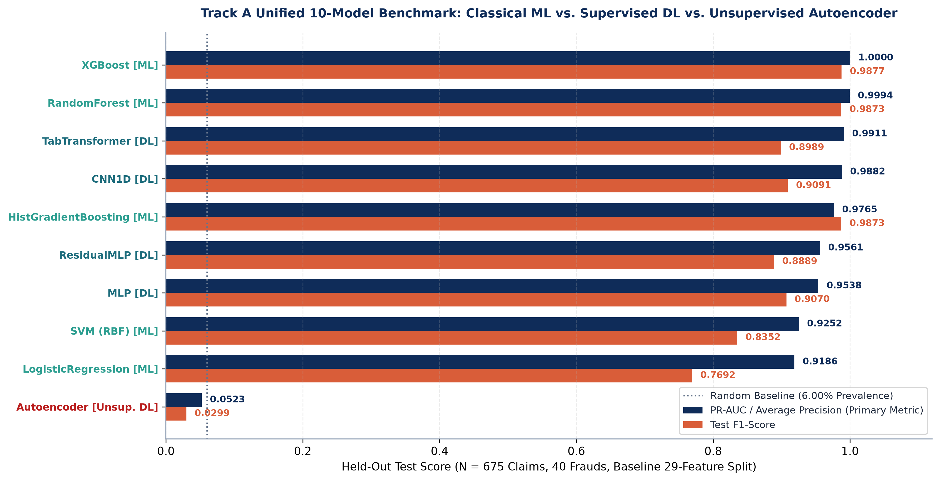
Results — Track A Unified 10-Model Test Benchmark (29f)
Held-Out Test Split (N = 675 Claims, 40 Frauds, Standard Cutoff 0.50 / AE MSE 0.1286)
IIIT Dharwad CSE (DSAI) | Medical Insurance Claim Fraud Detection — Approaches 1, 2 & 3
10 / 20

Slide 11
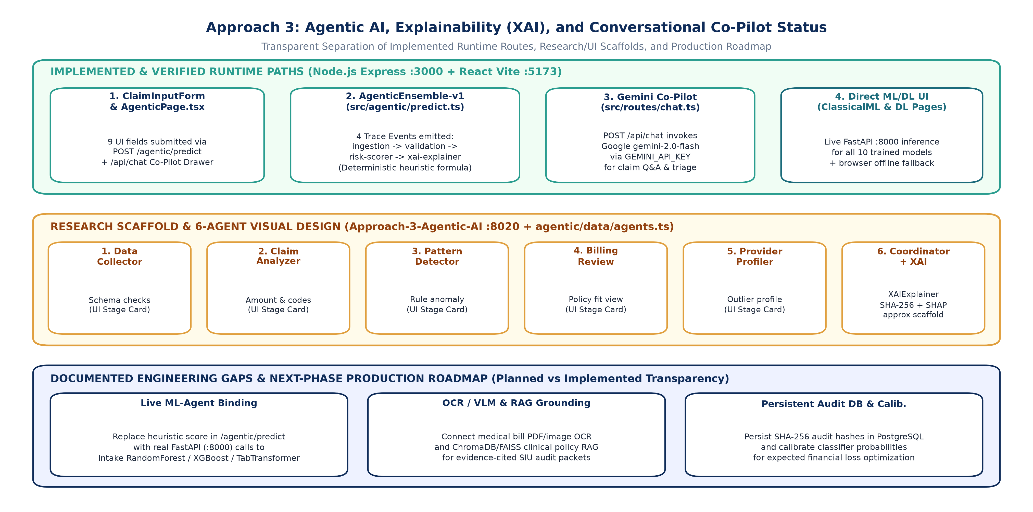
Approach 3: Agentic Triage, XAI & Gemini Co-Pilot
Honest Architecture Separating Verified Runtime Endpoints from Research UI & Future LangGraph/RAG
IIIT Dharwad CSE (DSAI) | Medical Insurance Claim Fraud Detection — Approaches 1, 2 & 3
11 / 20

Slide 12
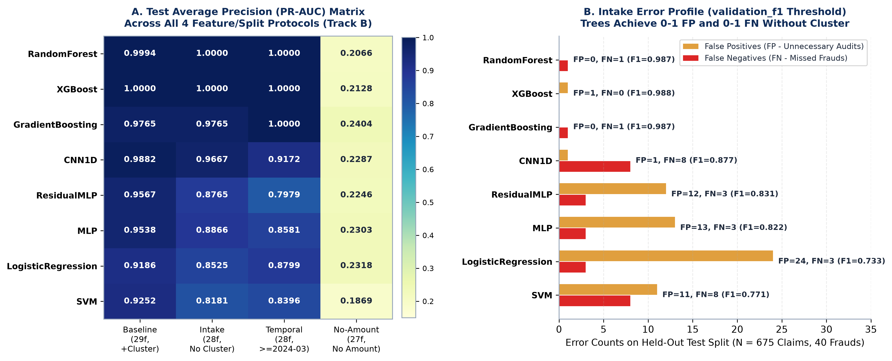
Results — Track B Sensitivity & Chronological Ablations
32 Runs (8 Models x 4 Protocols) Quantifying Cluster Leakage, Temporal Stability & Amount Dependence
Key Findings from 32 Controlled Runs
• Trees ignore Cluster removal (RF/XGB 1.00 PR-AUC) while SVM/MLPs drop 6.6-10.7 AP; Trees reach 1.00 F1 chronologically; No-Amount collapses all models to 0.19-0.24 AP.
IIIT Dharwad CSE (DSAI) | Medical Insurance Claim Fraud Detection — Approaches 1, 2 & 3
12 / 20

Slide 13
Track B Quantitative Ledger Across All 4 Experimental Protocols
Test PR-AUC (Average Precision) and Validation-F1 Tuned F1 Score on Held-Out Splits
Model | Baseline (29f) AP / F1 | Intake (28f) AP / F1 | No-Amount (27f) AP / F1 | Temporal (>=2024-03) AP / F1 | Intake Threshold & Errors
RandomForest (Default) | 0.9994 / 0.9750 | 1.0000 / 0.9873 | 0.2066 / 0.3636 | 1.0000 / 1.0000 | tau*=0.4167 | 0 FP, 1 FN
XGBoost | 1.0000 / 0.9877 | 1.0000 / 0.9877 | 0.2128 / 0.3524 | 1.0000 / 1.0000 | tau*=0.2121 | 1 FP, 0 FN
GradientBoosting (HGB) | 0.9765 / 0.9873 | 0.9765 / 0.9873 | 0.2404 / 0.3636 | 1.0000 / 1.0000 | tau*=1.0000 | 0 FP, 1 FN
CNN1D (Best Track B DL) | 0.9882 / 0.9268 | 0.9667 / 0.8767 | 0.2287 / 0.2788 | 0.9172 / 0.8108 | tau*=0.9691 | 1 FP, 8 FN
ResidualMLP | 0.9567 / 0.9286 | 0.8765 / 0.8315 | 0.2246 / 0.3438 | 0.7979 / 0.7229 | tau*=0.2751 | 12 FP, 3 FN
MLP | 0.9538 / 0.9136 | 0.8866 / 0.8222 | 0.2303 / 0.3077 | 0.8581 / 0.6957 | tau*=0.8359 | 13 FP, 3 FN
LogisticRegression | 0.9186 / 0.7835 | 0.8525 / 0.7327 | 0.2318 / 0.3191 | 0.8799 / 0.7397 | tau*=0.7618 | 24 FP, 3 FN
SVM (RBF) | 0.9252 / 0.8974 | 0.8181 / 0.7711 | 0.1869 / 0.3041 | 0.8396 / 0.7619 | tau*=0.5859 | 11 FP, 8 FN
IIIT Dharwad CSE (DSAI) | Medical Insurance Claim Fraud Detection — Approaches 1, 2 & 3
13 / 20

Slide 14
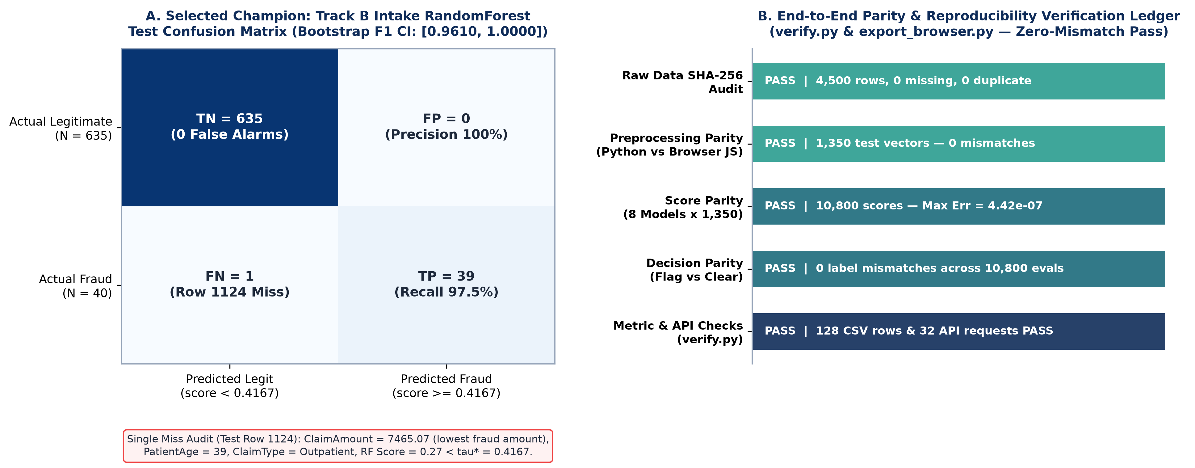
Champion Forensics, Bootstrap CIs & Browser Parity Verification
Inspecting Row 1124 & Verifying 10,800 Score Comparisons Within 4.42e-7 Tolerance
IIIT Dharwad CSE (DSAI) | Medical Insurance Claim Fraud Detection — Approaches 1, 2 & 3
14 / 20

Slide 15
Path A Implementation: Three-Tier Enterprise Web Platform
React 19 UI (:5173) -> Node.js/Express Gateway (:3000) -> FastAPI ML/DL Server (:8000)
Tier 1: React 19 + TypeScript UI (:5173)
• Pages: HomePage overview, ClassicalMLPage (5 models + offline fallback), DLPage (all 5 DL models + gauge), AgenticPage (6-role cards).
• Interactive Gemini Co-Pilot drawer (ChatBox.tsx) explaining risk outputs in plain English.
• Submits unified claim JSON schema across all UI tabs.
Tier 2: Node.js + Express (:3000)
• Routes /api/ml/* proxy cleanly to FastAPI :8000 classical & DL prediction endpoints.
• Active /agentic/predict serves deterministic 4-stage AgenticEnsemble-v1 audit trace.
• Route /api/chat invokes Google @google/genai (gemini-2.0-flash) with claim context.
Tier 3: Python FastAPI Server (:8000)
• classical_service.py loads sklearn/XGBoost pipelines via joblib across 5 endpoints.
• dl_service.py loads frozen 29f scaler & PyTorch .pt checkpoints for MLP, ResidualMLP, CNN1D, TabTransformer & Autoencoder.
• Pydantic validation enforces strict types & bounds.
IIIT Dharwad CSE (DSAI) | Medical Insurance Claim Fraud Detection — Approaches 1, 2 & 3
15 / 20

Slide 16
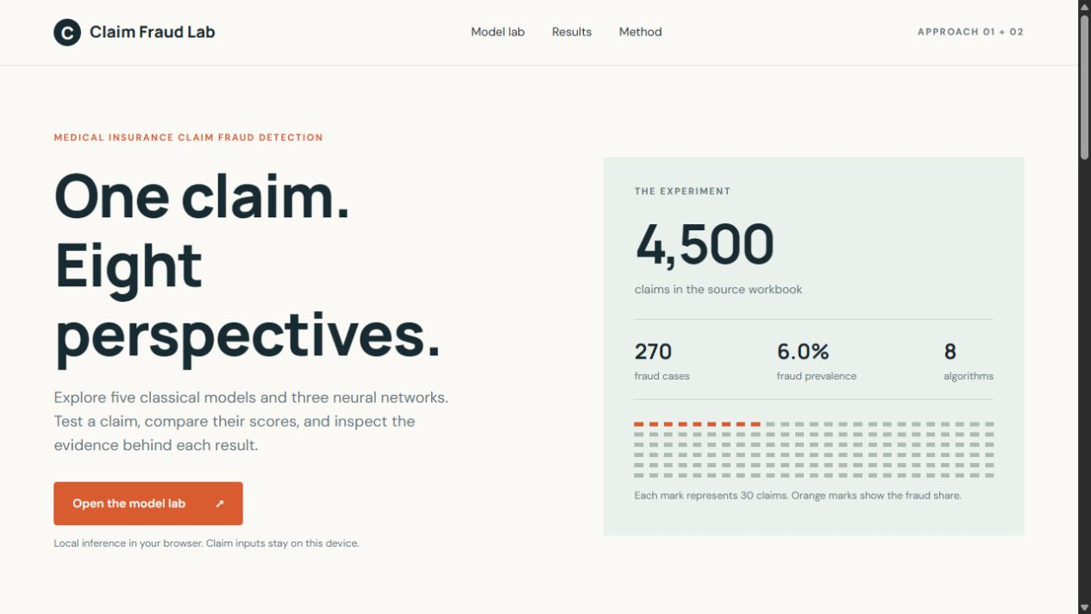
Path B Innovation: Zero-Server Browser Claim Fraud Lab (:8080)
Exact Pure-JavaScript Execution of All 8 Supervised Models Without Backend Round-Trips
Export & Parity Guarantees
• export_browser.py compiles StandardScaler means/scales, OHE categories, Logistic weights, RF/XGB/HGB decision trees, RBF support vectors & neural layers into JSON.
• Runs live locally on :8080 or as a zero-backend static web bundle.
• Verified via verify.py across 1,350 preprocessing rows (0 errors) & 10,800 score pairs (max abs diff 4.42e-7, 0 label flips).
IIIT Dharwad CSE (DSAI) | Medical Insurance Claim Fraud Detection — Approaches 1, 2 & 3
16 / 20

Slide 17
Summary of Key Project Innovations
Five Distinct Engineering & Scientific Advances Beyond Baseline Notebooks
1. Leakage-First Feature Governance
• Dual-track architecture isolates Cluster & ClaimAmount shortcuts via explicit 4-protocol matrix.
2. Honest Heterogeneous 10-Model Evaluation
• Includes both TabTransformer self-attention (99.11% AP) and a transparent Autoencoder negative result (5.23% AP).
3. Exact Python-to-Browser Parity Compiler
• Zero-server JS implementation matches PyTorch, XGBoost, RF & RBF SVM within 4.42e-7.
4. Validation-Only Thresholds & Bootstrap CIs
• No test peeking: thresholds optimize F1 strictly on val folds, paired with 1,000-rep CIs.
5. Modular Three-Tier Stack + Gemini 2.0 Flash Co-Pilot
• Combines FastAPI (:8000) checkpoints, Express (:3000) Agentic/Chat gateway, React (:5173) UI & SHA-256 XAI hashing.
IIIT Dharwad CSE (DSAI) | Medical Insurance Claim Fraud Detection — Approaches 1, 2 & 3
17 / 20

Slide 18
Complete Deliverables & Documentation Suite (PDF + LaTeX + Office)
All Reports, IEEE Manuscript, Code Modules & Documentation Unified
Deliverable Category | Generated Workspace Artifact(s) | Contents & Format Fidelity
Literature Survey | docs/01_LITERATURE_SURVEY.md + deliverables/01_Literature_Survey.pdf | 6 thematic research pillars, 20 verified DOIs, synthesis gap matrix.
Problem Formulation | docs/02_PROBLEM_FORMULATION.md + deliverables/02_Problem_Formulation.pdf | Dataset audit, weighted BCE, Autoencoder MSE, threshold & parity contracts.
Innovation & Implementation | docs/03_INNOVATION_AND_IMPLEMENTATION.md + deliverables/03_Innovation_and_Implementation.pdf | 5 core innovations + Approach 1-3 blueprints + Path A/B deployment.
Full Documentation | docs/04_FULL_PROJECT_DOCUMENTATION.md + deliverables/04_Full_Project_Documentation.pdf | Module map, Track A & B metrics, runbook, REST API spec, limitation log.
IIIT Dharwad Report | deliverables/MiniProjectReport_LaTeX/ + deliverables/MiniProjectReport.pdf | Built from MiniProjectTemplate.zip (Title, Certificate, ToC/LoF/LoT, Ch 1-5, BibTeX).
IEEE Conference Paper | deliverables/IEEE_Paper_LaTeX/ + IEEE_Paper.pdf + IEEE_Paper.docx | IEEEtran two-column manuscript in LaTeX, compiled PDF & editable DOCX.
Presentation & Notes | deliverables/Project_Presentation.pptx + Project_Presentation.pdf + Notes.md | 20-slide widescreen deck in editable PPTX & inspected PDF + speaker script.
IIIT Dharwad CSE (DSAI) | Medical Insurance Claim Fraud Detection — Approaches 1, 2 & 3
18 / 20

Slide 19
Audited Limitations & Next-Phase Production Roadmap
Engineering Transparency Balancing Current Strengths with Concrete Future Upgrades
Observed Boundaries & Honest Limitations
• Synthetic Corpus Reliance on ClaimAmount: Removing ClaimAmount collapses AP from 1.00 to 0.19-0.24 because zero frauds exist below $7,465.07.
• Uncalibrated Classifier Scores: Neural pos_weight=15.67 and raw RF proportions require CalibratedClassifierCV for expected-loss calculation.
• Approach 3 Runtime Gap: Express /agentic/predict uses deterministic heuristic rather than live calls to :8000 ML/DL endpoints.
• Document & Database Gap: Clinical bill OCR/VLM parser, policy RAG & PostgreSQL remain planned phase-2 extensions.
Next-Phase Engineering Roadmap
• 1. Bind /agentic/predict to FastAPI (:8000) Intake RandomForest + TabTransformer scores with SHAP explanations.
• 2. Calibrate probabilities (isotonic/Platt scaling) on held-out validation splits for financial triage optimization.
• 3. Integrate medical invoice OCR/VLM + ChromaDB clinical policy RAG for evidence-grounded SIU packets.
• 4. Store immutable SHA-256 audit hashes in PostgreSQL & evaluate on multi-institutional clinical corpora.
IIIT Dharwad CSE (DSAI) | Medical Insurance Claim Fraud Detection — Approaches 1, 2 & 3
19 / 20

Slide 20
Conclusion & Key Takeaways
• Data discipline matters as much as architecture: isolating Cluster leakage exposes non-tree fragility immediately.
• Random Forest & XGBoost lead realistic Intake & Chronological rollouts (1.0000 PR-AUC; 0.9873 Random / 1.0000 Temporal F1).
• TabTransformer (0.9911 PR-AUC) & CNN1D (0.9882 PR-AUC) lead supervised DL; Autoencoder negative result (0.0523 AP) proves manifold overlap.
• Both an enterprise 3-tier app (React + Node + FastAPI + Gemini Chat) and a verified 4.42e-7-parity browser lab are operational.
Thank You — Questions & Live System Demonstration

