Slide 1
Medical insurance
claim fraud detection
Approach 1 and Approach 2
Five classical models and three neural models
20 October 2026
Notes:
Research and demonstration based on the repository workbook. This deck covers the classical and neural comparison. It reports retrospective internal benchmarks and does not assert insurer deployment readiness.

Slide 2
Dataset and classification task
4,500 claims from the supplied workbook
270
6.0%
fraud labels
fraud prevalence
An all-legitimate classifier reaches 94% accuracy while detecting no fraud.
No missing cells or duplicate complete rows. Dates span July 2022 to July 2024.
02
Notes:
Source: Health Insurance Fraud Claims.xlsx. The workbook origin and currency are undocumented.
Evidence: submission/results/metrics.csv and predictions.csv. Measured 20 October 2026.

Slide 3
Shared data partitions and feature contracts
Training transformations never fit on validation or test rows
Partition | Claims | Fraud
Training | 3,150 | 189
Validation | 675 | 41
Test | 675 | 40
29 features
Original benchmark
28 features
Intake without Cluster
Every contract excludes ClaimStatus and identifiers. The amount ablation also removes ClaimAmount.
03
Notes:
Preprocessing follows training-only fitting. Source: https://scikit-learn.org/stable/common_pitfalls.html
Evidence: submission/results/metrics.csv and predictions.csv. Measured 20 October 2026.

Slide 4
Approach 1 classical algorithms
Five existing model families, retrained on the shared partitions
Algorithm | Main configuration
Logistic Regression | Balanced weights, maximum 2,000 iterations
Random Forest | 300 trees, balanced weights
XGBoost | 100 trees, depth 6, learning rate 0.3
SVM | RBF kernel, balanced weights, sigmoid-margin score
Histogram GB | 100 boosting iterations, balanced weights
Class weights use training data. The same encoded fields feed both approaches.
04
Notes:
Evidence: submission/results/metrics.csv and predictions.csv. Measured 20 October 2026.

Slide 5
Approach 2 neural algorithms
Existing MLP plus two implemented architectures
Algorithm | Architecture
MLP | 64 and 32 dense hidden units, 20% dropout
Residual MLP | 64-unit projection and two residual blocks
1D CNN | Kernel-3 convolutions, 8 and 16 channels, dense 32
AdamW, learning rate 0.001, batch size 128 and weighted binary cross entropy.
Maximum 100 epochs. Patience 15. Best checkpoint by validation AP.
05
Notes:
Source for weighted loss: https://docs.pytorch.org/docs/stable/generated/torch.nn.BCEWithLogitsLoss.html. Residual MLP is a project implementation, not a reproduction of a published baseline.
Evidence: submission/results/metrics.csv and predictions.csv. Measured 20 October 2026.

Slide 6
Evaluation protocol
One defined procedure across all eight algorithms
01 Fit preprocessing and model weights on training rows.
02 Select neural checkpoints by validation average precision.
03 Choose a decision threshold that maximizes validation F1.
04 Freeze the model and threshold before reporting test metrics.
Model ranking uses validation AP, then validation F1 and declared model order.
06
Notes:
Evidence: submission/results/metrics.csv and predictions.csv. Measured 20 October 2026.

Slide 7
Evaluation formulas
Fraud is the positive class
Measure | Calculation
Accuracy | (TP + TN) / all claims
Precision | TP / (TP + FP)
Recall | TP / (TP + FN)
F1 | 2 TP / (2 TP + FP + FN)
Average precision | Sum of recall increments × corresponding precision
AP and ROC AUC evaluate ranking. Precision, recall and F1 depend on the threshold.
07
Notes:
Sources: https://scikit-learn.org/stable/modules/model_evaluation.html and https://scikit-learn.org/stable/modules/generated/sklearn.metrics.average_precision_score.html. AP uses step weighting, not trapezoidal PR integration.
Evidence: submission/results/metrics.csv and predictions.csv. Measured 20 October 2026.

Slide 8
Original and intake model ranking
Test average precision on the same random partitions
Removing Cluster preserves strong tree performance. Other model families lose ranking quality.
08
Notes:
Evidence: submission/results/metrics.csv and predictions.csv. Measured 20 October 2026.

Slide 9
Approach 1 intake test results
675 claims, including 40 fraud labels. Each model uses its validation threshold.
Model | AP | Precision | Recall | F1 | FP / FN
Logistic Regression | 0.8525 | 60.7% | 92.5% | 0.7327 | 24 / 3
Random Forest | 1.0000 | 100.0% | 97.5% | 0.9873 | 0 / 1
XGBoost | 1.0000 | 97.6% | 100.0% | 0.9877 | 1 / 0
SVM | 0.8181 | 74.4% | 80.0% | 0.7711 | 11 / 8
Histogram GB | 0.9765 | 100.0% | 97.5% | 0.9873 | 0 / 1
Random Forest is the selected default under the defined validation ranking rule.
09
Notes:
Evidence: submission/results/metrics.csv and predictions.csv. Measured 20 October 2026.

Slide 10
Approach 2 intake test results
The CNN has the highest neural AP. Threshold choice determines its recall.
Model | AP | Precision | Recall | F1 | FP / FN
MLP | 0.8866 | 74.0% | 92.5% | 0.8222 | 13 / 3
Residual MLP | 0.8765 | 75.5% | 92.5% | 0.8315 | 12 / 3
1D CNN | 0.9667 | 97.0% | 80.0% | 0.8767 | 1 / 8
The CNN follows the fixed encoded feature order, which has no inherent spatial meaning.
Greater architecture complexity does not establish a better operating point.
10
Notes:
Evidence: submission/results/metrics.csv and predictions.csv. Measured 20 October 2026.

Slide 11
Random Forest operating point
Intake contract. Threshold selected on validation: 0.4167.
Actual class | Below threshold | Flagged
Legitimate | 635 | 0
Fraud | 1 | 39
100.0% precision
97.5% recall
0.9873 F1
Accuracy = 674 / 675 = 99.8519%. Perfect AP can coexist with a missed fraud case.
11
Notes:
Evidence: submission/results/metrics.csv and predictions.csv. Measured 20 October 2026.

Slide 12
Amount sensitivity changes the conclusion
Test AP after removing Cluster and then claim amount
Model | Original | No Cluster | No Cluster or amount
Logistic Regression | 0.9186 | 0.8525 | 0.2318
Random Forest | 0.9994 | 1.0000 | 0.2066
XGBoost | 1.0000 | 1.0000 | 0.2128
SVM | 0.9252 | 0.8181 | 0.1869
Histogram GB | 0.9765 | 0.9765 | 0.2404
MLP | 0.9538 | 0.8866 | 0.2303
Residual MLP | 0.9567 | 0.8765 | 0.2246
1D CNN | 0.9882 | 0.9667 | 0.2287
Random Forest AP falls from 1.0000 to 0.2066 without amount. The dataset has a strong shortcut risk.
12
Notes:
Evidence: submission/results/metrics.csv and predictions.csv. Measured 20 October 2026.

Slide 13
Chronological evaluation
Training ends 21 November 2023. Validation ends 10 March 2024.
Later test period: 671 claims, including 37 fraud cases. Tree models have no errors in this internal split.
13
Notes:
Evidence: submission/results/metrics.csv and predictions.csv. Measured 20 October 2026.

Slide 14
Decision threshold sensitivity
Intake test F1 at the fixed and validation-selected policies
Validation tuning can help or hurt on test data. The test outcome does not choose the policy.
14
Notes:
Evidence: submission/results/metrics.csv and predictions.csv. Measured 20 October 2026.

Slide 15
Uncertainty and dataset limits
Strong internal results require careful interpretation
Random Forest recall interval: 92.5% to 100.0%.
F1 interval: 0.9610 to 1.0000.
The 1,000-resample bootstrap fixes the fitted model and threshold. It omits training and threshold-selection variability.
Data origin and label creation are undocumented. The random test split has appeared in earlier analyses.
Amount dependence and a degenerate AP interval prevent claims of external certainty.
15
Notes:
Evidence: submission/results/metrics.csv and predictions.csv. Measured 20 October 2026.

Slide 16
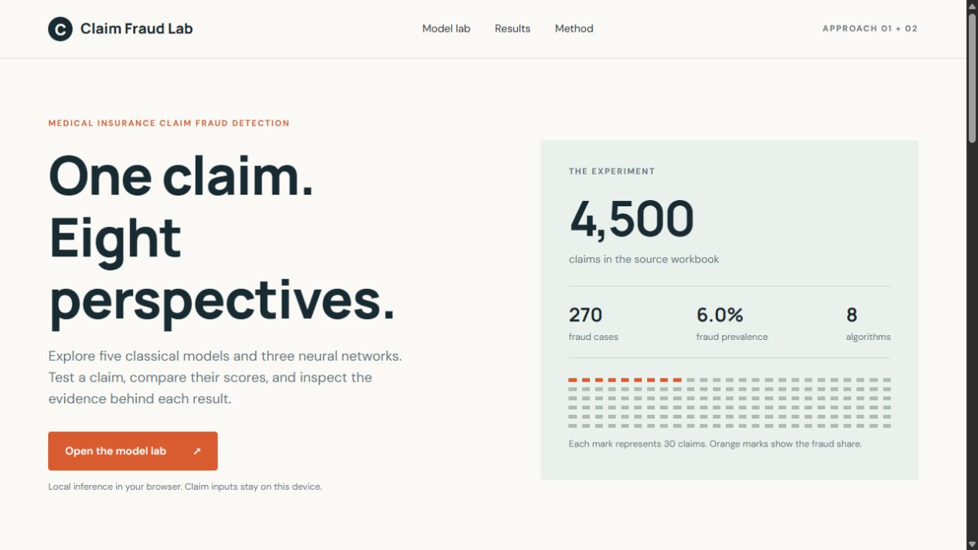
Claim Fraud Lab website
Both approaches share one working prediction interface
Select either approach
Test a claim or compare all 8
Switch experiment results
Download prediction JSON
Inference runs locally in the browser from exported fitted parameters.
16
Notes:
Evidence: submission/results/metrics.csv and predictions.csv. Measured 20 October 2026.

Slide 17
Demonstration and consistency checks
A local Python API independently evaluates the saved artifacts
1,350 preprocessing comparisons match exactly.
10,800 browser and Python scores match within 0.000001.
No threshold decision mismatches.
128 metric rows reconcile with independent formulas.
32 API prediction requests pass.
Demo: load examples, test models, compare all eight, then inspect amount sensitivity.
17
Notes:
Evidence: submission/results/metrics.csv and predictions.csv. Measured 20 October 2026.

Slide 18
Conclusions
A reproducible comparison and model-testing demonstration
Tree models lead the internal benchmark.
The intake Random Forest detects 39 of 40 fraud cases with no false alerts.
Removing amount exposes substantial performance loss.
Independent claims and documented labels are the next research priority.
Live site: claim-fraud-lab-ravi-2026.clearbell16.chatgpt.site
18
Notes:
References: project workbook and submission/results artifacts; scikit-learn AP, model evaluation and common pitfalls documentation; PyTorch BCEWithLogitsLoss; Gorishniy et al., Revisiting Deep Learning Models for Tabular Data, NeurIPS 2021. https://proceedings.neurips.cc/paper_files/paper/2021/hash/9d86d83f925f2149e9edb0ac3b49229c-Abstract.html
Evidence: submission/results/metrics.csv and predictions.csv. Measured 20 October 2026.

