Slide 1
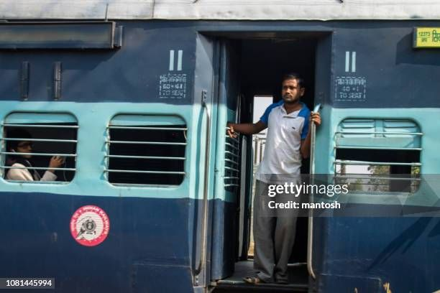
Railway Ticket Management system

Slide 2
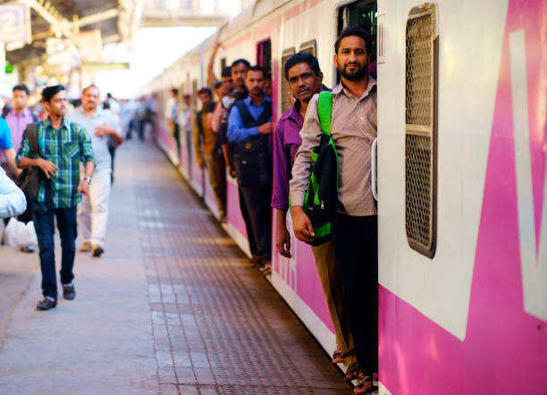
Abstract
This railway ticket management system
,which contain entity like train , passenger,
Station , ticket , That help Railway management by finding meaningful insight
Such as fare , train and passenger detail
Which help for making decision
Based on this we make draw conclusion.

Slide 3
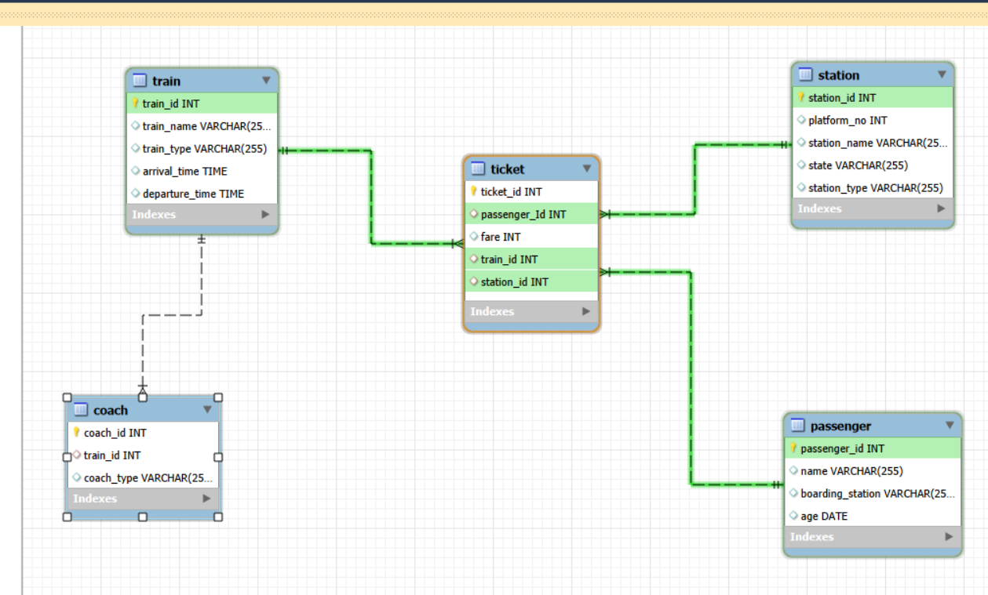

Slide 4
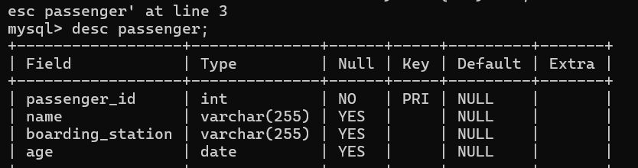
Table name :- Passenger

Slide 5
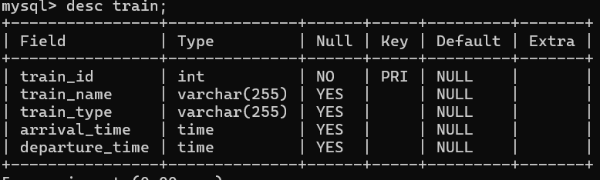
Table Name :- Train

Slide 6
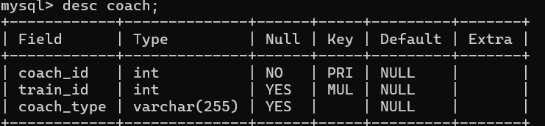
Table Name :- coach

Slide 7
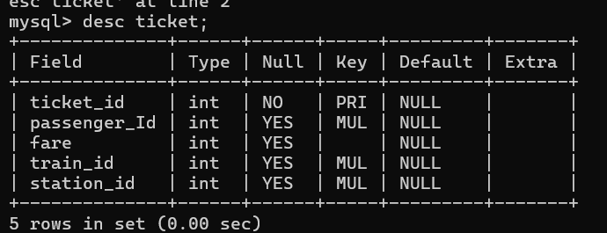
Table Name :-Ticket

Slide 8
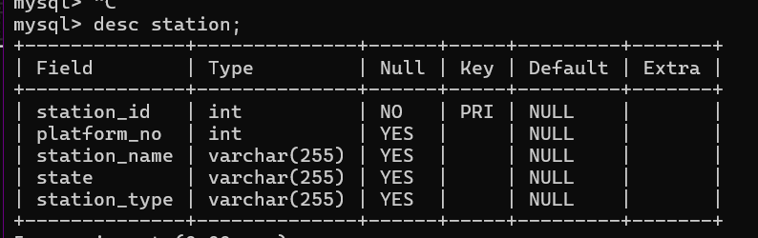
Table name :- station

Slide 9
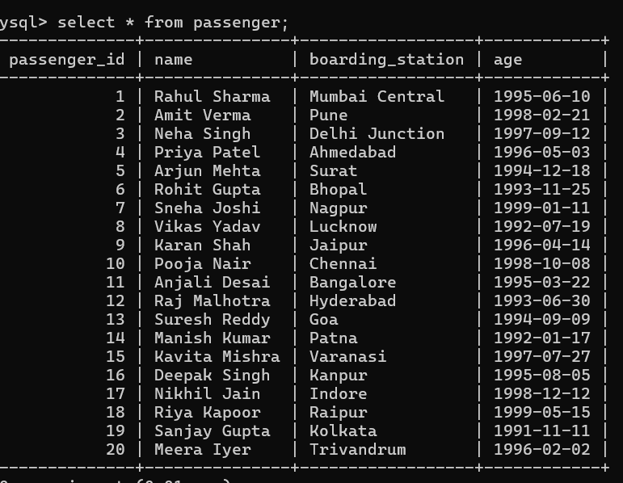
Content of table :-Passenger

Slide 10
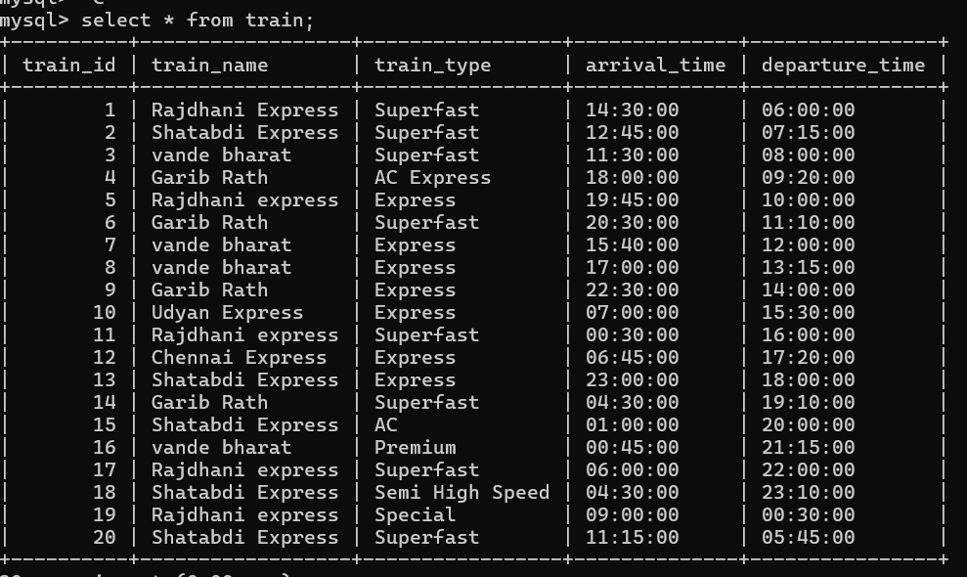
Content of table:- Train

Slide 11
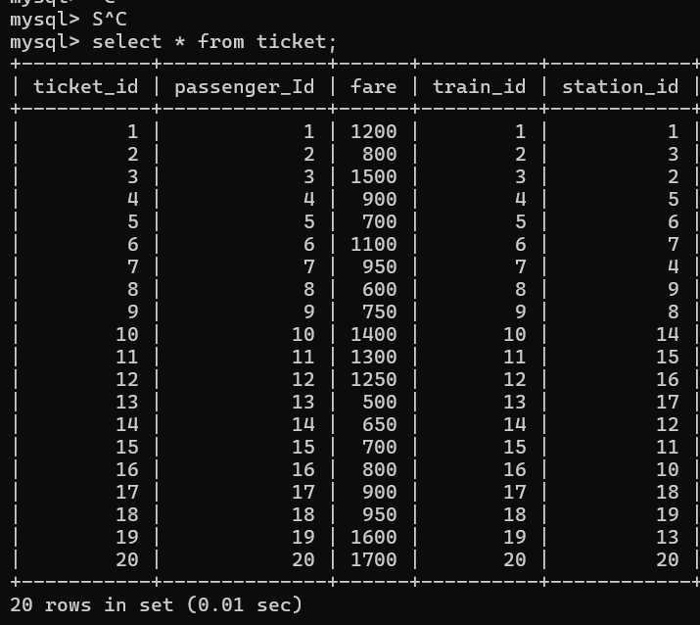
Content of table:- Ticket

Slide 12
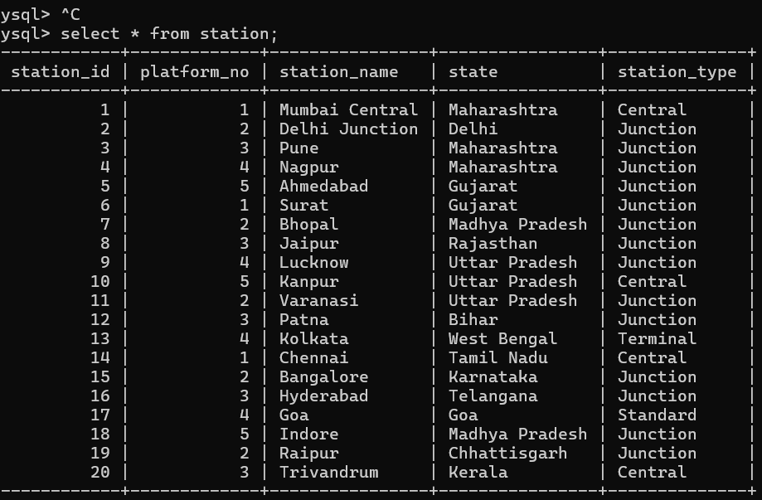
Content of table:- station

Slide 13
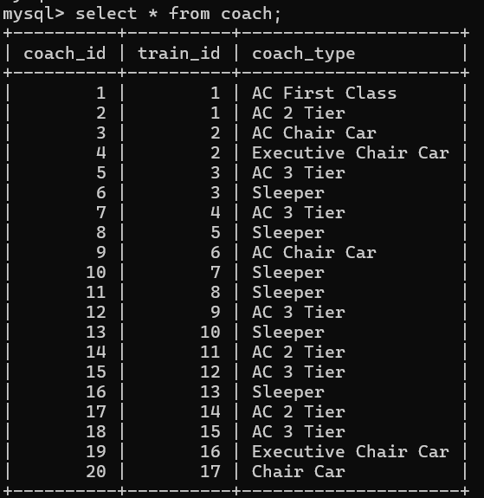
Content of table :- Coach

Slide 14
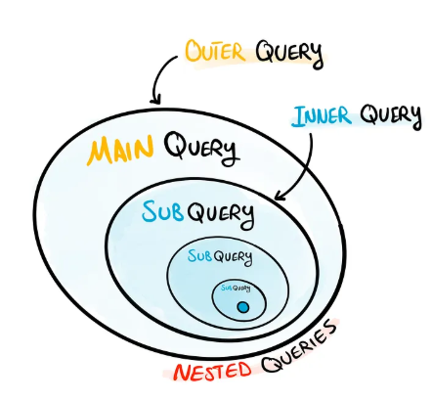
Subquery

Slide 15
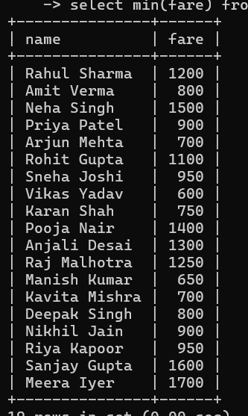
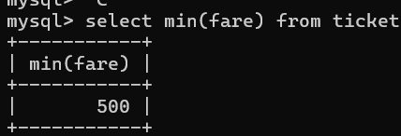
-- Find passengers who paid more fare than the min fare of all passengers.
Subquery 1
select * from passenger p
inner join ticket t
on p.passenger_id=t.passenger_id
where t.fare >(
select min(fare) from ticket);
ticket);

Slide 16
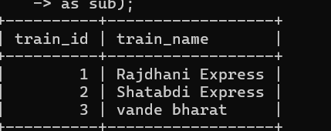
Subquery 2
-- - Display train names that have more coaches than the average number of coaches per train.
select t.train_id,t.train_name from train t
join coach c
on t.train_id=c.train_id
group by t.train_id,t.train_name
having count(c.coach_id)>(
select avg(avg_couch) from (
select count(coach_id) as avg_couch from coach
group by train_id)
as sub);

Slide 17
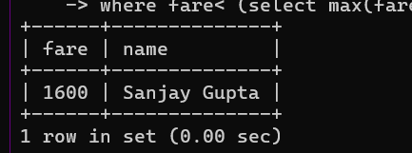
Find passengers who paid the second highest fare.
Subquery 3
select t.fare, p.name from passenger p
join ticket t
on p.passenger_id=t.passenger_id
where t.fare =
(select max(fare) from ticket
where fare< (select max(fare) from ticket) );

Slide 18
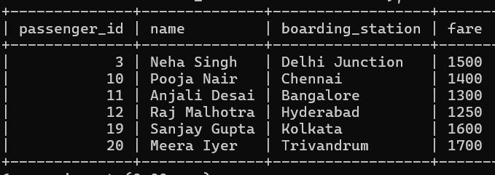
-- Find the names of passengers who paid a fare greater than the maximum fare paid by any passenger boarding from the station named “Mumbai Central”.
Subquery 3
);
select * from passenger p
inner join ticket t
on p.passenger_id=t.passenger_id
where t.fare>(
select avg(t.fare) from ticket t
join station s
on t.station_id=s.station_id
where s.station_name="Mumbai Central");

Slide 19
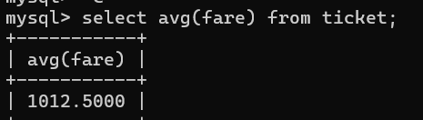
--Find train names where fare is greater than the average fare of that train.
Subquery 4
select * from train t
join ticket t1
on t.train_id=t1.train_id
where fare >(select avg(fare) from ticket t3 where t1.train_id=t3.train_id)

Slide 20
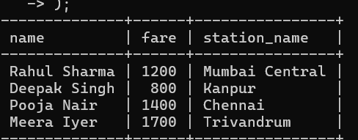
-- find the name, fare, station of passengers who booked tickets at stations of type “Central”.
Subquery 5
select p.name,t.fare,s.station_name from station s
join ticket t
on s.station_id=t.station_id
join passenger p
on p.passenger_id=t.passenger_id
where s.station_type in (
select station_type from station
where station_Type="central"
);

Slide 21
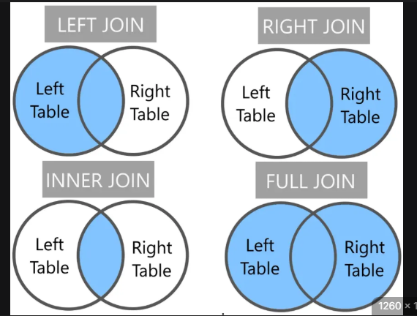
JOINS IN SQL

Slide 22
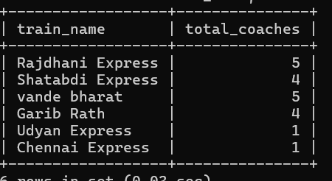
-- List train name and total number of coaches available for each train.
Join 1
SELECT t.train_name, COUNT(c.coach_id) AS total_coaches
FROM train t
JOIN coach c
ON t.train_id = c.train_id
GROUP BY t.train_name;

Slide 23
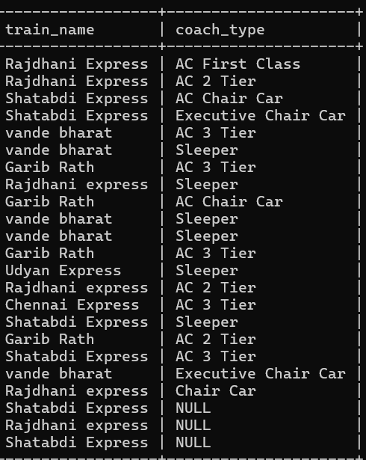
-- Show train names along with their coach types.
Join 1
select t.train_name,c.coach_type from train t
left join coach c
on c.train_id=t.train_id;

Slide 24
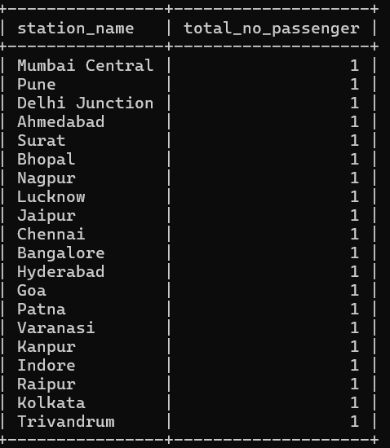
-- Show station name and number of passengers boarding from each station.
Joints 2
select s.station_name,count(p.passenger_id)as total_no_passenger from passenger p
join ticket t
on p.passenger_id=t.passenger_id
join station s
on s.station_id=t.station_id
group by s.station_name;

Slide 25
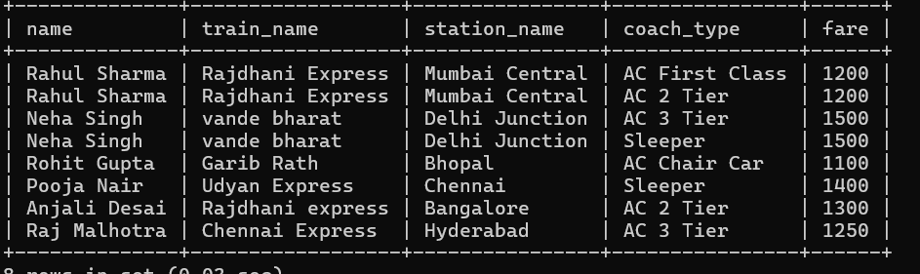
Join 4
-- Show passenger name, train name, station name, coach type, and fare, where the fare is higher than the average fare of all tickets.
select p.name,t1.train_name,s.station_name,c.coach_type,t.fare from passenger p
join ticket t
on p.passenger_id=t.passenger_id
join train t1
on t.train_id=t1.train_id
join station s
on s.station_id=t.station_id
join coach c
on t1.train_id=c.train_id
where t.fare>(select avg(fare) from ticket);

Slide 26
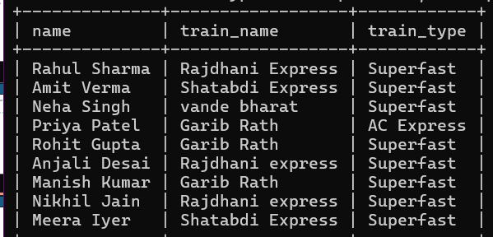
Join 4
-- Display passenger name and train name for passengers traveling in Superfast ,ac express trains only.
select p1.name,t.train_name,t.train_type from train t
inner join ticket t2
on t.train_id=t2.train_id
inner join passenger p1
on p1.passenger_id=t2.passenger_id
where t.train_type in ('superfast','ac express');

Slide 27

Prepared by Ganesh Omprakash karli IT vedant

Slide 28


