Slide 1

Automating LinkedIn Connection Follow-up using Power Automate
Presented by: THATAVARTHI . VENKATA NAGA GANESH
Project Tool: Microsoft Power Automate (Mobile & Web)
Linkedin : t-v-n-ganesh28

Slide 2
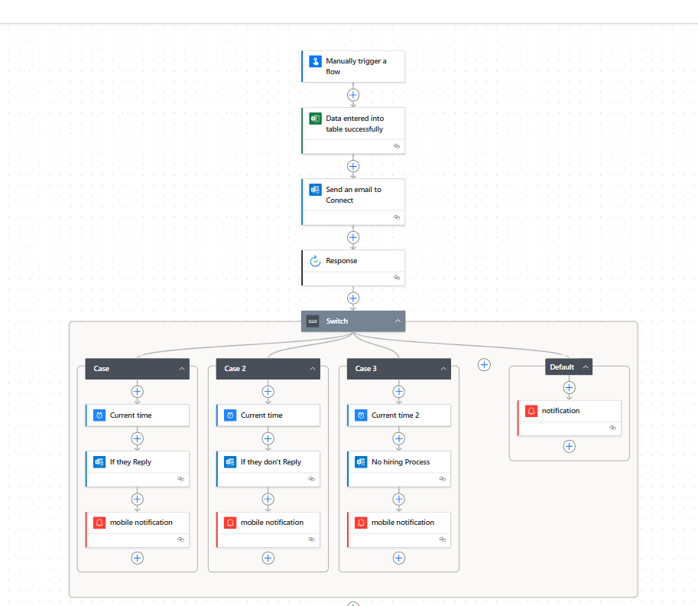
Workflow Diagram

Slide 3
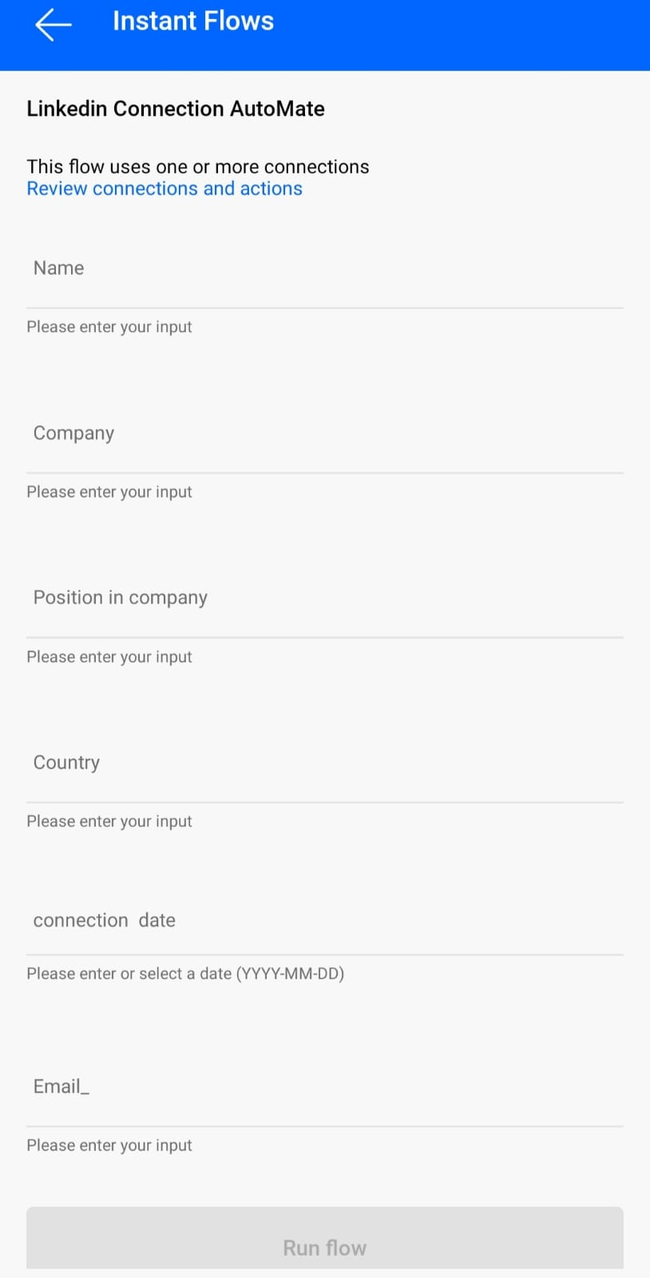
Project Overview
Objective: Automate follow-up communication with new LinkedIn connections.
Platform Used: Microsoft Power Automate (with Excel, Outlook, and Mobile Notification).
We may enter data manually by using Power Automate App

Slide 4
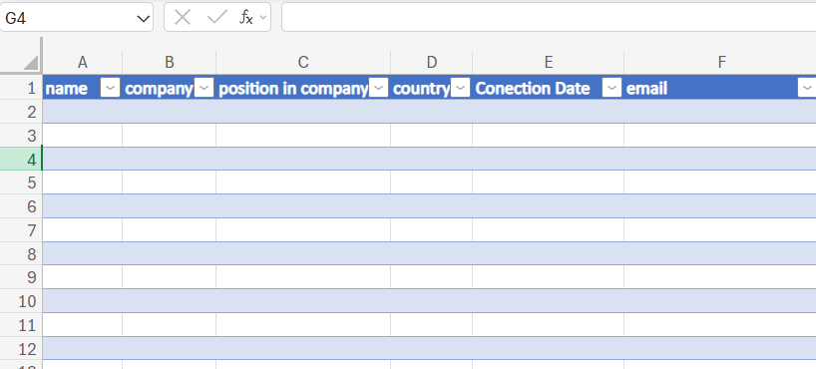
Automate entered Data in Excel
Manual Data Entry
Trigger: Flow begins when a user manually enters new LinkedIn connection details via Power Automate mobile app.
Data fields entered:
  Name
  Email
  Company
  Location
  Position
  Date of Connection

Slide 5
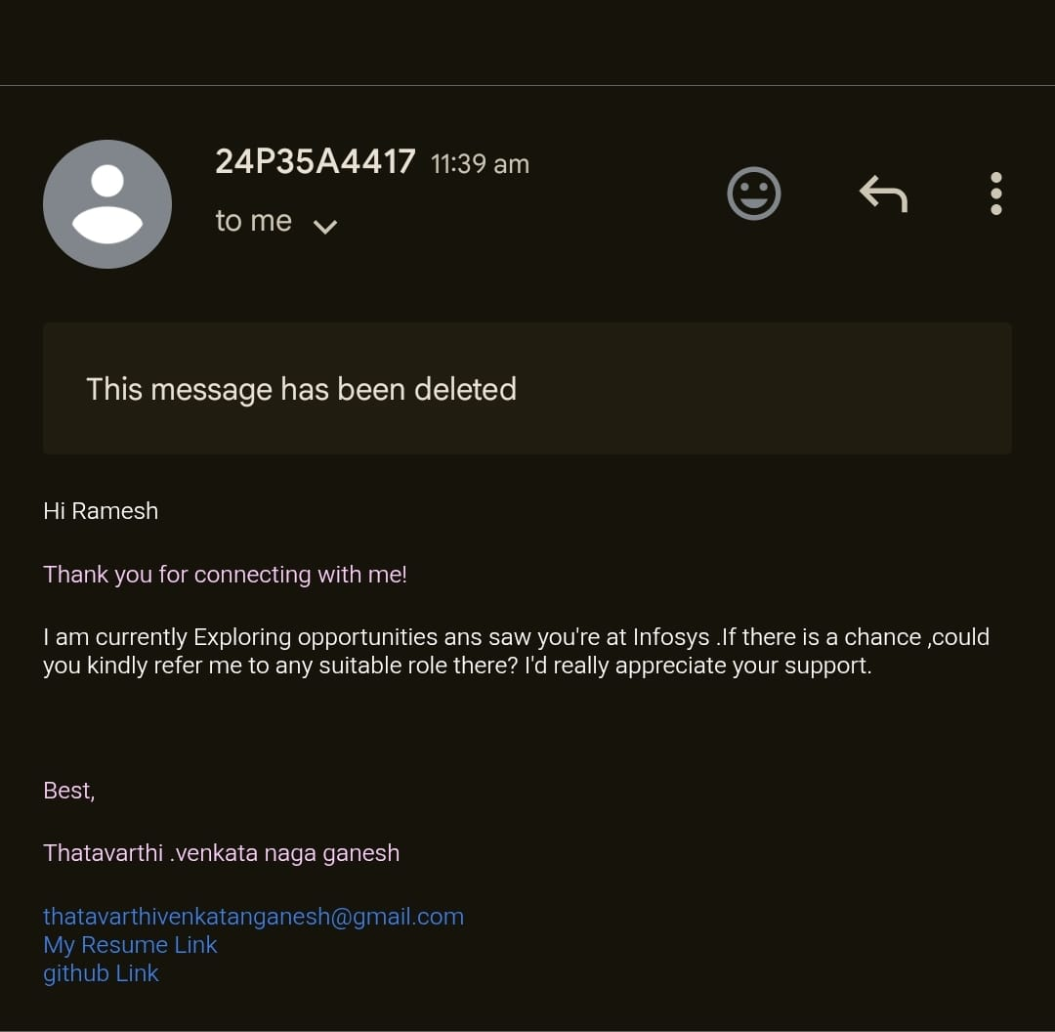
Automated Email to Connection
Automated Email to Connection
After data entry:
An automated email is sent to the LinkedIn connection.
Purpose: To express interest in job opportunities at their company.

Slide 6
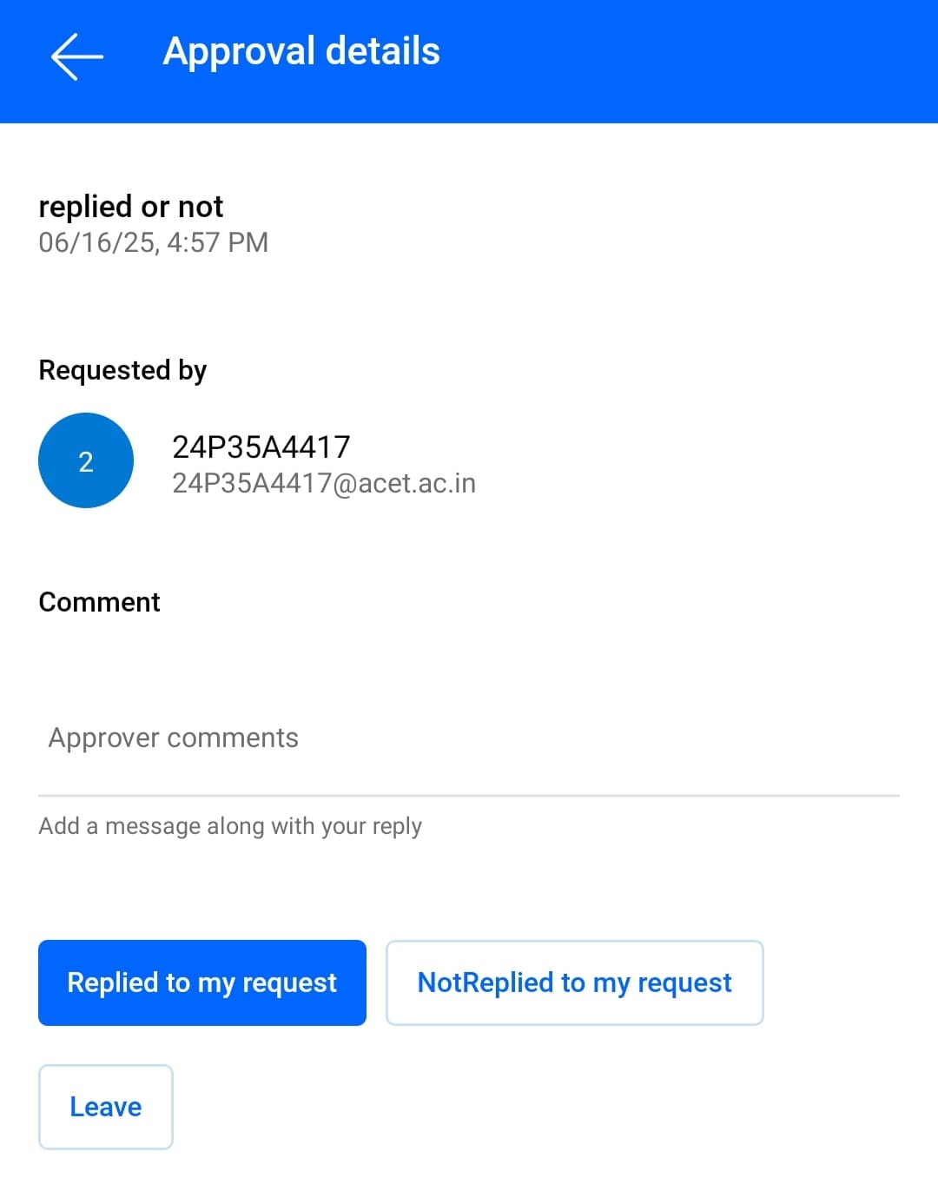
Approve
Approval Response Screen
Depending Upon the Reply Message
I can select one option
Allows adding optional comments.
Three action buttons:
  Replied to my request
  Not Replied to my request
  Leave
User’s choice drives the next action in the Power Automate flow.

Slide 7
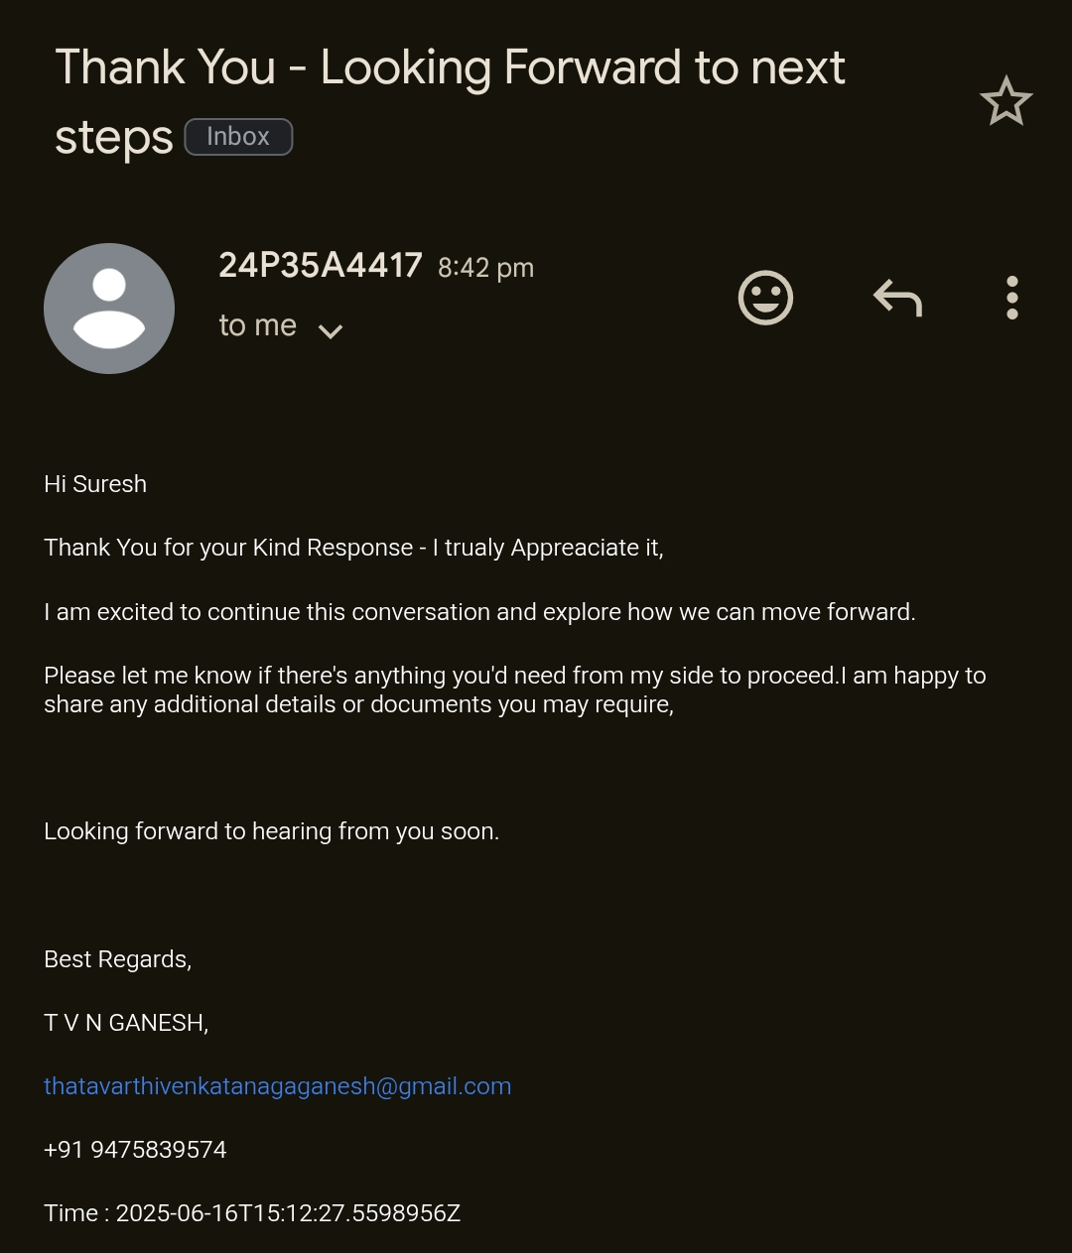
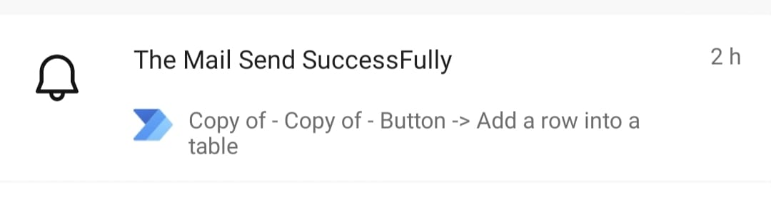
Response Handling Logic
Case 1: If They Reply
The recipient has responded positively to the email sent.
Actions performed by the flow:
  ✅ The current time is recorded to log the response time.
  📥 The response message is saved for documentation or follow-up.
  📱 A mobile notification is sent

Slide 8
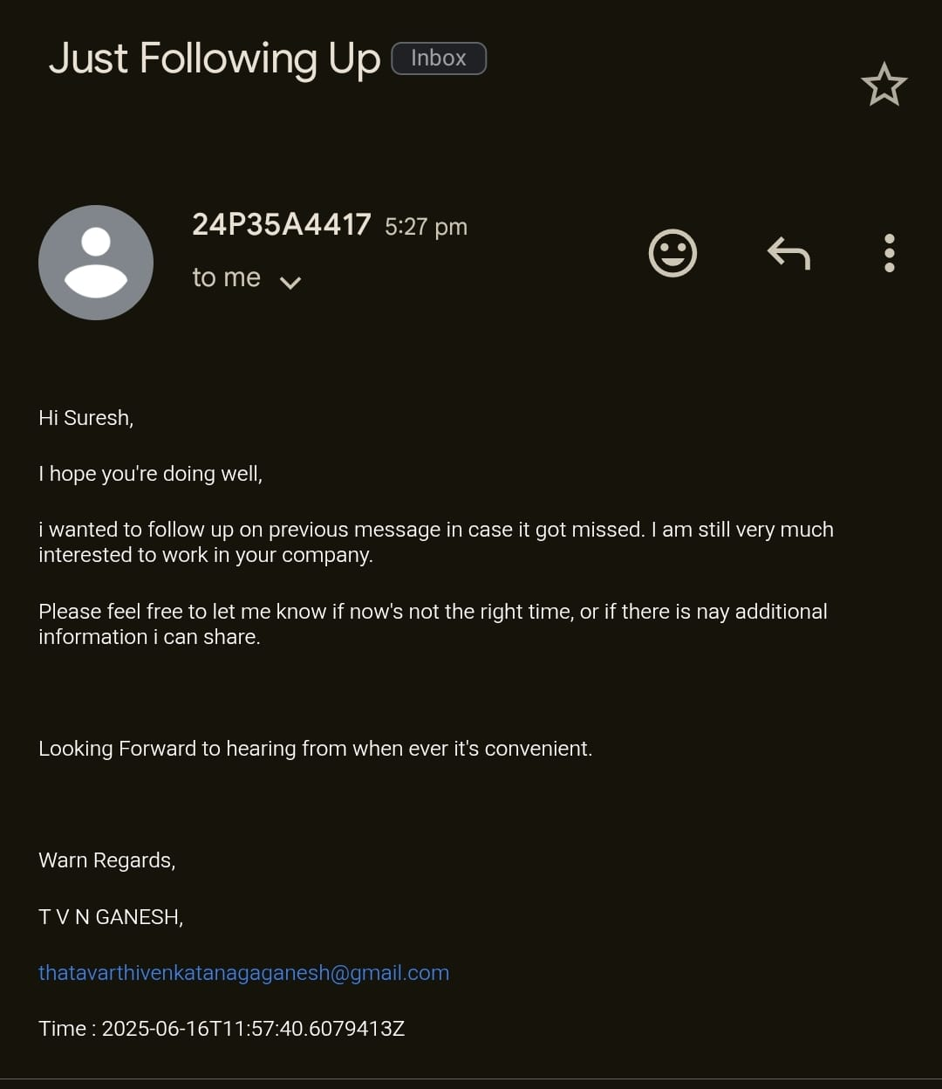
Response Handling Logic
Case 2 – If No Reply After 7 Days
Title: If No Reply After 7 Days
The recipient did not respond within 7 days.
Actions performed by the flow:
  🕒 The current time is captured to track the 7-day threshold.
  ⏳ A condition is triggered indicating that no reply was received.
  📱 A mobile notification is sent

Slide 9
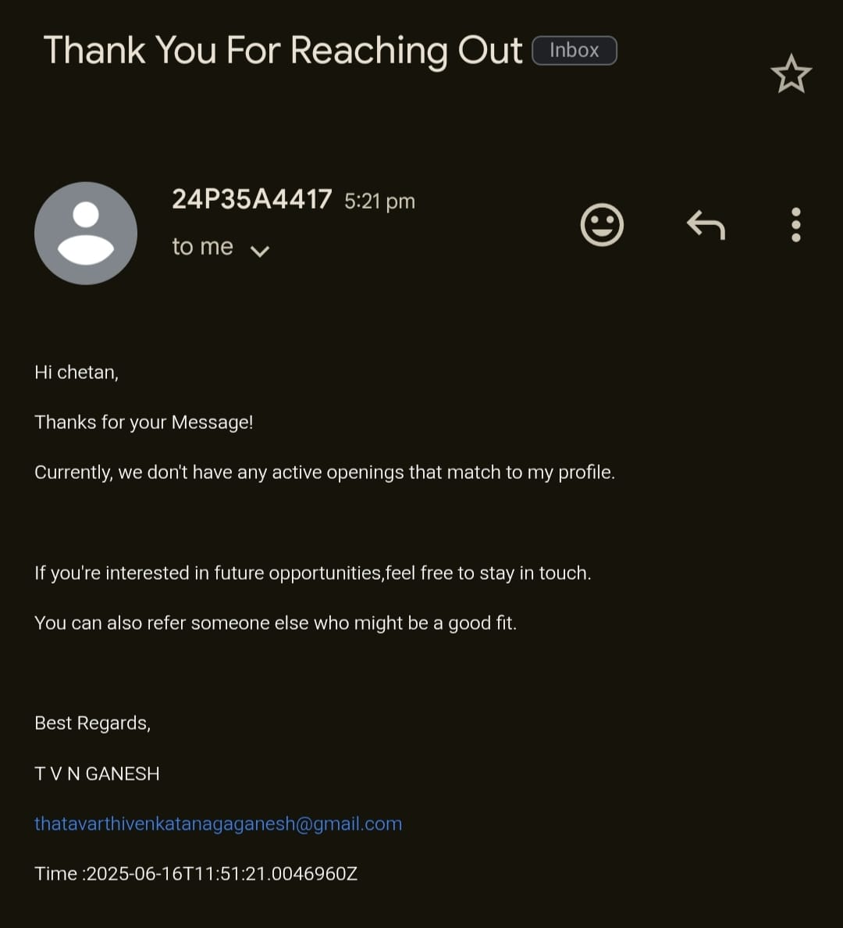
Response Handling Logic
Case 3: No Hiring Process
The recipient replied indicating that their company is not currently hiring.
Actions performed by the flow:
  🗒️ The response is recorded with a note mentioning "No hiring process."
  📱 A mobile notification is sent

Slide 10
Benefits of the Automation
Benefits of the Automated LinkedIn Connection Flow
✅ Saves time in tracking responses manually.
🎯 Maintains a professional approach to job exploration.
📊 Keeps all connection data centralized in Excel for easy access and analysis.
📱 Sends real-time mobile notifications for key updates.
🔁 Automates repetitive tasks, reducing human error.
🧠 Improves follow-up decisions based on response status (replied, not replied, no hiring).
📩 Ensures timely communication with potential employers.
📁 Maintains a record of interactions and outcomes for future reference.
🌐 Works seamlessly across devices (mobile, desktop).
🕒 Improves productivity by freeing up time for other job search efforts.

Slide 11
Conclusion
Efficient for job-seeking professionals and network managers.
Future Scope:
Automate resume sharing.
Add LinkedIn scraping to auto-fill details.
Track analytics of response rates.
Presented By:
Thatavarthi . Venkata Naga Ganesh
S/o T.Satyanarayana

