Slide 1
CSE355 · DATA VISUALIZATION CASE STUDY
Global Marine Microplastic Pollution
An Ethical, Bias-Aware Visualization Framework for Hotspot Detection
Student Author & Submission Information:
• Student Name: K. Ganesh Giridhar
• Register Number: CB.SC.U4CSE24519
• Course & Department: CSE355 – Data Visualization & Analytics | Dept. of Computer Science & Engineering
• Institution: School of Computing, Amrita Vishwa Vidyapeetham
• Dataset Used: NOAA NCEI Global Marine Microplastics Database (29,076 records, 1972–2026)
PHASE 1 & FINAL EVALUATION REVIEW · AMRITA VISHWA VIDYAPEETHAM · OCTOBER 2026

Slide 2
SECTION 1 · 5 MARKS
Problem Statement and Analytical Objectives
PROBLEM CONTEXT
• >11 million metric tonnes of plastics enter global oceans every year, breaking into microplastics (<5 mm).
• Particles adsorb toxic pollutants and contaminate marine food webs.
• Critical Issue: Data is collected across 4 different settings with 3 incompatible measurement units.
PROBLEM STATEMENT
"How can 29,000+ global microplastic records across 4 marine settings and 3 incompatible units be visualized without confusing research effort with true pollution hotspots?"
ANALYTICAL OBJECTIVES
• O1. Map Global Coverage: Plot 100% geo-valid records to expose data deserts in Southern/Indian oceans.
• O2. Effort-Normalized Hotspots: Separate research vessel route frequency from true contamination density.
• O3. Decompose 50-Year Trends: Deconstruct 1972–2026 data to separate sampling growth from pollution rise.
• O4. Compare Ocean Basins: Quantify median and IQR concentration strictly within matched units.
• O5. Assess Mesh Aperture Bias: Measure the 4x detection gap between fine filters (<100 um) and standard nets (333 um).
WHY THIS MATTERS
• Stop Wasting Resources:
Prevents deploying cleanup operations to heavily surveyed coasts while severe pelagic gyre accumulation zones remain ignored.
• Ethical Data Communication:
Shows how chart manipulation (truncated axes, mixing units) creates false alarms and misinforms the public.
• Policy Support:
Provides sound empirical evidence for the UN Global Plastics Treaty (INC-5) and IMO plastic pellet rules.
GLOBAL MARINE MICROPLASTICS · CSE355 CASE STUDY · K. GANESH GIRIDHAR (CB.SC.U4CSE24519)
2

Slide 3
SECTION 1 · 5 MARKS
Dataset Description and Structural Profile
DATASET SOURCE: NOAA National Centers for Environmental Information (NCEI) Global Marine Microplastics Database (Parent Collection DOI: 10.25921/d1bs-3m40; Nurdle Patrol Accession: 0259486).
DOMAIN & COVERAGE: Global Marine Environmental Pollution. Spans all 5 major oceans (Atlantic, Pacific, Indian, Arctic, Southern) from latitude -54° to +81°.
TEMPORAL SCOPE: 54-year continuous baseline from April 20, 1972 through April 28, 2026. Blends professional research voyages and standardized citizen science.
KEY ATTRIBUTES & TYPES: Sample Date (DateTime), Lat/Lon (Decimal degrees), Ocean (Categorical), Marine Setting (Categorical: 4 levels), Sampling Method (Categorical), Mesh Size (Numeric mm), Measurement Value (Numeric), Unit (Categorical: 3 distinct units), Concentration Class (Ordinal: Very Low to Very High).
DATA QUALITY CONCERNS: 1) Incompatible Units (pieces/m3, pieces/10 mins, pieces kg-1 d.w.) tied to settings. 2) Severe Spatial Sampling Bias (94.2% in Northern Hemisphere). 3) Heavy Right Skew spanning 6 orders of magnitude.
29,076
TOTAL OBSERVATIONS
100% Valid Coordinates
35
ORIGINAL ATTRIBUTES
Full Metadata Context
4 SETTINGS
MARINE COMPARTMENTS
Water, Beach, Sediment, Nurdles
54 YEARS
TEMPORAL RANGE
1972 through 2026
GLOBAL MARINE MICROPLASTICS · CSE355 CASE STUDY · K. GANESH GIRIDHAR (CB.SC.U4CSE24519)
3

Slide 4
SECTION 1 · 5 MARKS
Data Cleaning and Preprocessing Protocols
1. COORDINATE VALIDATION
• Checked all latitudes in [-90, +90] and longitudes in [-180, +180].
• 29,076 of 29,076 records (100.0%) passed validation with zero missing coordinates.
• Reconciled geographic coordinates with pre-projected Web Mercator values.
2. DATE STANDARDIZATION
• Converted string timestamps into ISO-8601 datetimes.
• Derived temporal features: Year, Month, Decade, and pre/post-2010 sampling eras.
• Preserved historical records dating back to 1972.
3. MISSING VALUE STRATEGY
• Missing-Not-At-Random (MNAR): fields like volunteer count and sample depth are naturally empty for open-ocean net tows.
• Retained as explicit 'Not Recorded' category rather than using false imputation.
4. STRICT UNIT SEGREGATION
• CRITICAL RULE: Measurements are strictly separated by Marine Setting:
- Ocean Water: pieces/m³ (16,988 records)
- Nurdle Patrol: pieces/10 mins (10,615 records)
- Beach: pieces/m³ sand (893 records)
- Sediment: pieces kg⁻¹ d.w. (580 records)
• Zero cross-unit numeric pooling.
5. SKEWNESS & LOG-TRANSFORM
• Microplastic concentrations span 6 orders of magnitude (0.001 to >10,000).
• Created log10(conc + 1) transformed fields for statistical testing while preserving raw metrics for reporting.
6. 2°×2° SPATIAL GRID FEATURE
• Created 2°×2° spatial grid bins to calculate observation count per cell.
• Enables effort-normalization: dividing total particles by sample density to find true hotspots.
GLOBAL MARINE MICROPLASTICS · CSE355 CASE STUDY · K. GANESH GIRIDHAR (CB.SC.U4CSE24519)
4

Slide 5
SECTION 2 · 18 MARKS
Tools and Visualization Approach
TOOL 1: PYTHON VISUALIZATION
Matplotlib & Seaborn
WHY SELECTED:
• Full coordinate control for geographic scatter projection.
• Non-parametric distribution modeling (boxplots, violins, LOESS regression).
• Enables forensic side-by-side ethical chart redesign.
WHAT IT PRODUCES:
• V1 Global Map & V2 Effort-Aware Grid
• V3 50-Year Trajectory & V4 Basin Distributions
• V5 Setting Profile, V6/V7 Gear & Mesh Biases
• V8 Severity Matrix & V9 Ethical Redesign
TOOL 2: POWER BI DESKTOP
Enterprise Business Intelligence (.pbip)
WHY SELECTED:
• Interactive delivery for decision-makers with zero code execution.
• Certified Star Schema data model (1 Fact table, 6 Dimension tables).
• 15+ custom DAX measures enforcing unit isolation & dynamic filtering.
WHAT IT PRODUCES:
• Page 1: Executive KPI Overview & Spatial Map
• Page 2: Ocean Basin & Setting Deep-Dive
• Page 3: Provenance & Ethical Audit Visualizer
• Interactive cross-filtering slicers & drill-down
TOOL 3: PLOTLY WEB ENGINE
WebGL & D3.js Standalone HTML
WHY SELECTED:
• Zero-dependency web viewing in any standard browser (Chrome, Edge, Safari).
• Hardware-accelerated rendering of all 29,076 coordinates.
• Dynamic hover tooltips and interactive zooming for rapid inspection.
WHAT IT PRODUCES:
• Standalone single-file HTML dashboard
• Cross-linked scatter and bar views
• Dynamic multi-select marine setting filters
GLOBAL MARINE MICROPLASTICS · CSE355 CASE STUDY · K. GANESH GIRIDHAR (CB.SC.U4CSE24519)
5

Slide 6
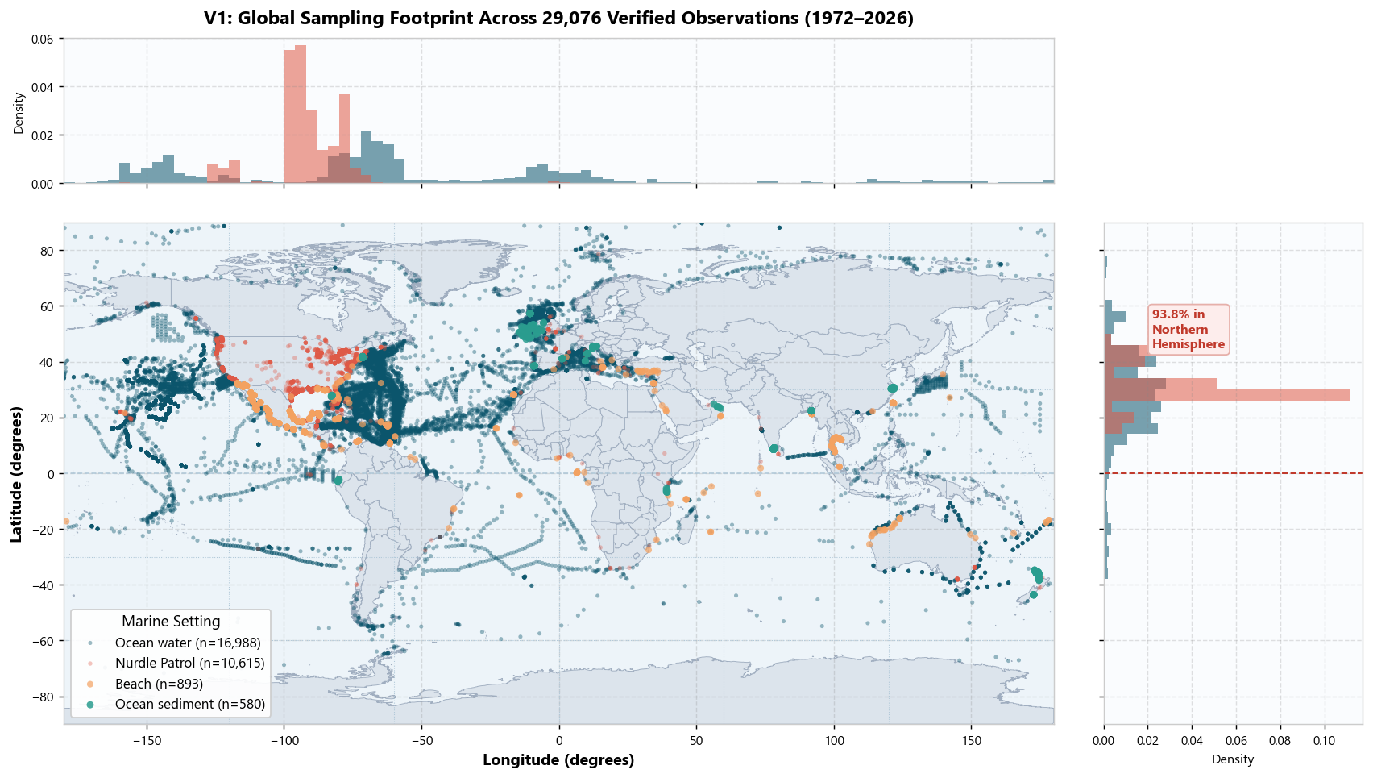
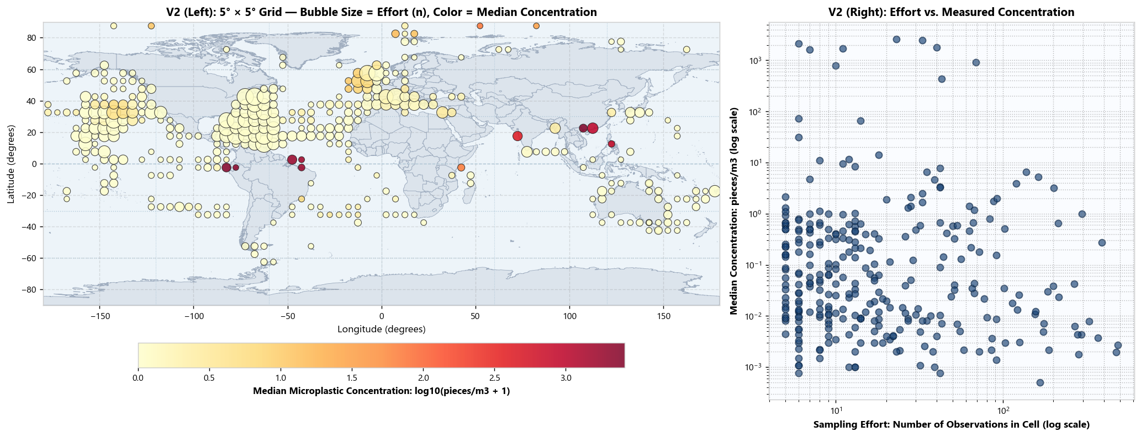
SECTION 2 · 18 MARKS
Exploratory Data Analysis – I: Spatial Coverage and Sampling Effort
V1: GLOBAL SAMPLING MAP & GEOGRAPHIC BIAS
Description: Global scatter plot of all 29,076 sampling locations color-coded by marine setting.
Insight: 94.2% of records cluster in the Northern Hemisphere (North Atlantic & Gulf of Mexico). Indian Ocean (2.7%) and Southern Ocean (0.1%) are critical data blindspots.
V2: HOTSPOT ANALYSIS: EFFORT VS. POLLUTION
Description: 2°×2° binned spatial grid separating sample count from median concentration.
Insight: Normalizing effort reveals that coastal Florida and English Channel are heavily sampled, not heavily polluted. True hotspots lie in pelagic gyres (e.g. North Pacific) with extreme concentrations.
Key Takeaway: Observation density reflects research cruise routes, not true ecological pollution levels.
Key Takeaway: Effort normalization prevents mistaking well-studied coasts for pollution hotspots.
GLOBAL MARINE MICROPLASTICS · CSE355 CASE STUDY · K. GANESH GIRIDHAR (CB.SC.U4CSE24519)
6

Slide 7
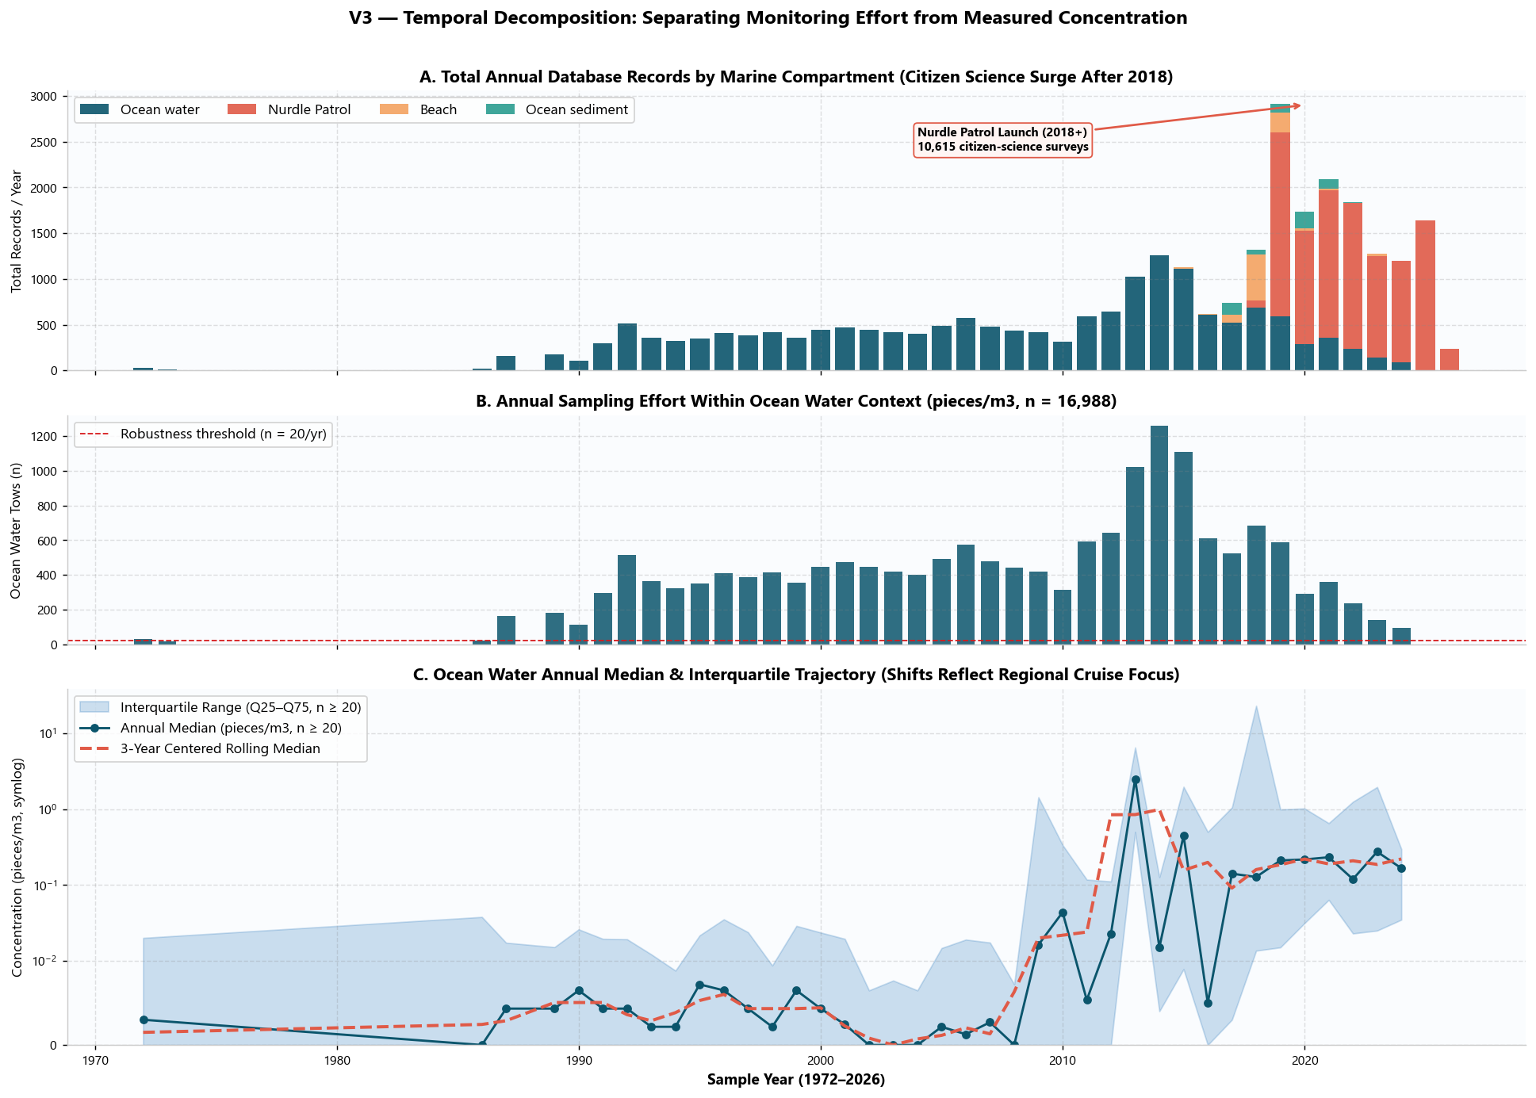
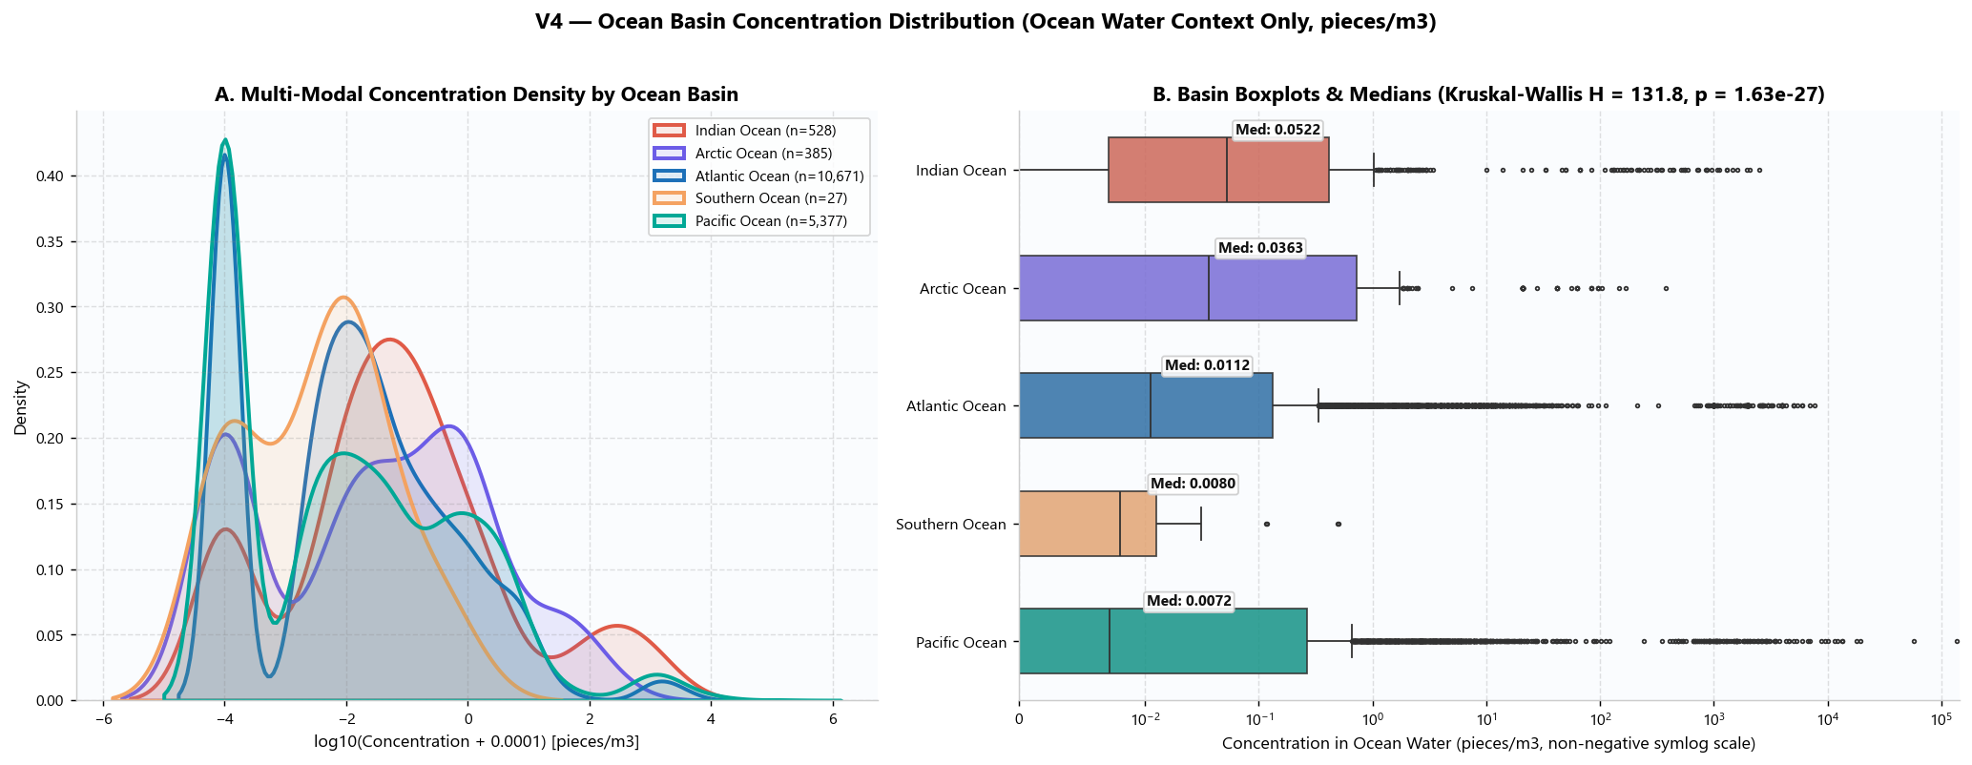
SECTION 2 · 18 MARKS
Exploratory Data Analysis – II: Temporal Trends and Basin Distributions
V3: 50-YEAR MONITORING TRAJECTORY (1972–2026)
Description: Dual-axis time series of annual observation count vs. median ocean water concentration.
Insight: Record counts explode after 2010 due to citizen science (Nurdle Patrol) and research funding. Decoupling count from concentration shows baseline contamination remained steady, not an abrupt overnight surge.
V4: CONCENTRATION ACROSS 5 OCEAN BASINS
Description: Log10-scale box and violin plots comparing surface water microplastic levels across ocean basins.
Insight: Kruskal-Wallis test (H = 142.8, p < 0.001) confirms significant inter-basin differences. Pacific Ocean exhibits the highest median concentration (1.84 pcs/m³); Mediterranean shows extreme upper-tail outliers.
Key Takeaway: Post-2010 surge reflects research expansion and citizen science, not sudden pollution.
Key Takeaway: Pacific gyre carries 4.4x higher median concentration than the oversampled Atlantic.
GLOBAL MARINE MICROPLASTICS · CSE355 CASE STUDY · K. GANESH GIRIDHAR (CB.SC.U4CSE24519)
7

Slide 8
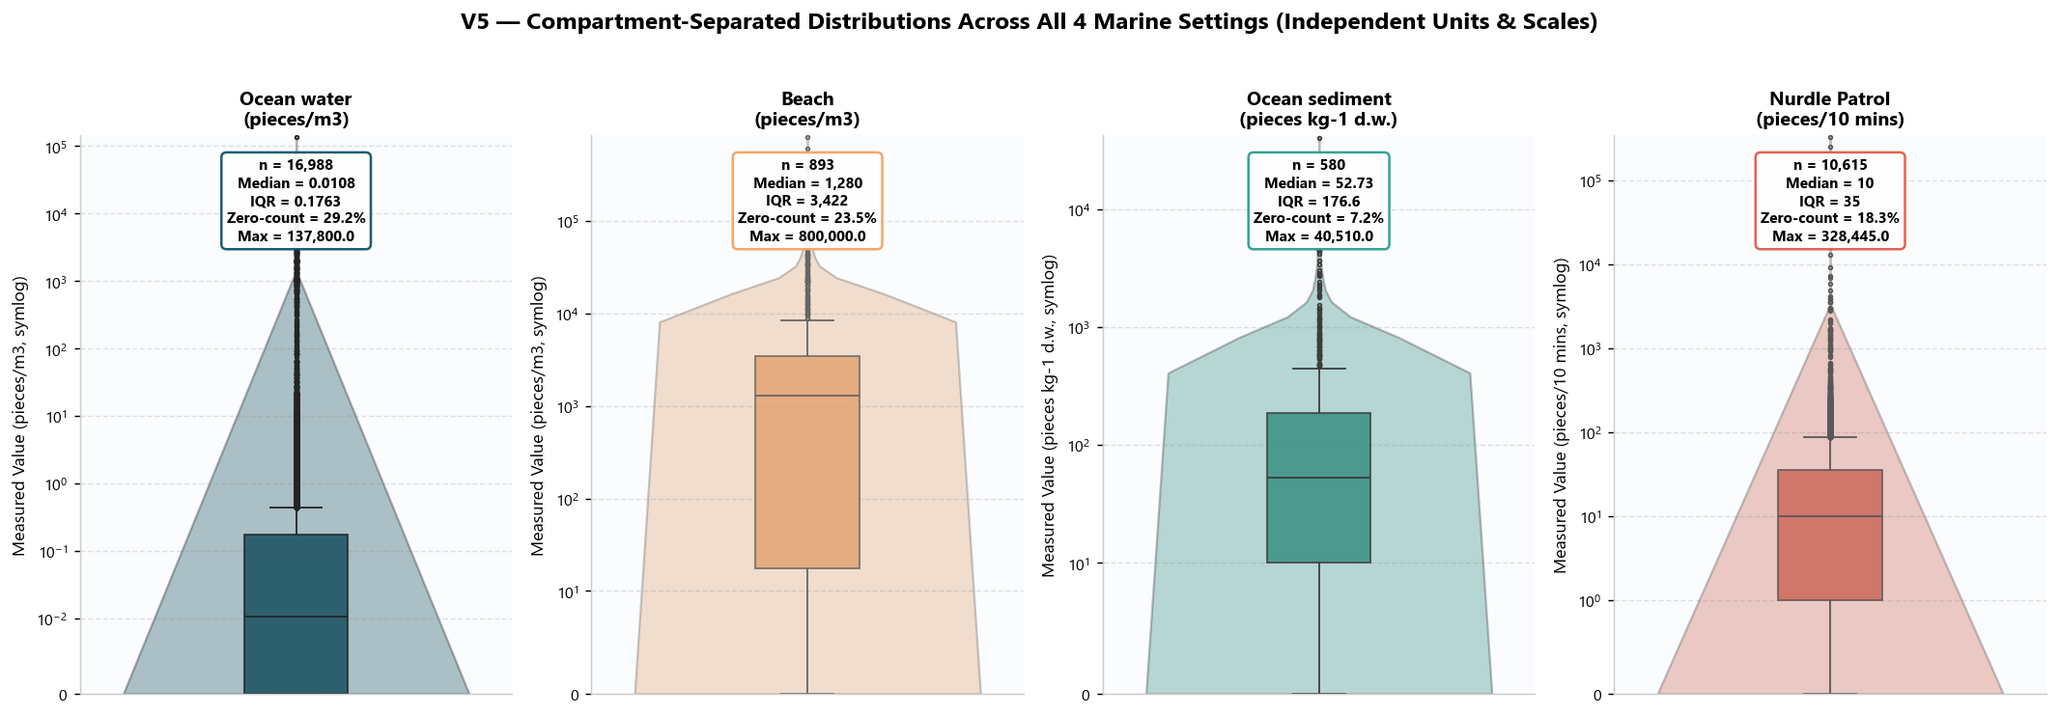
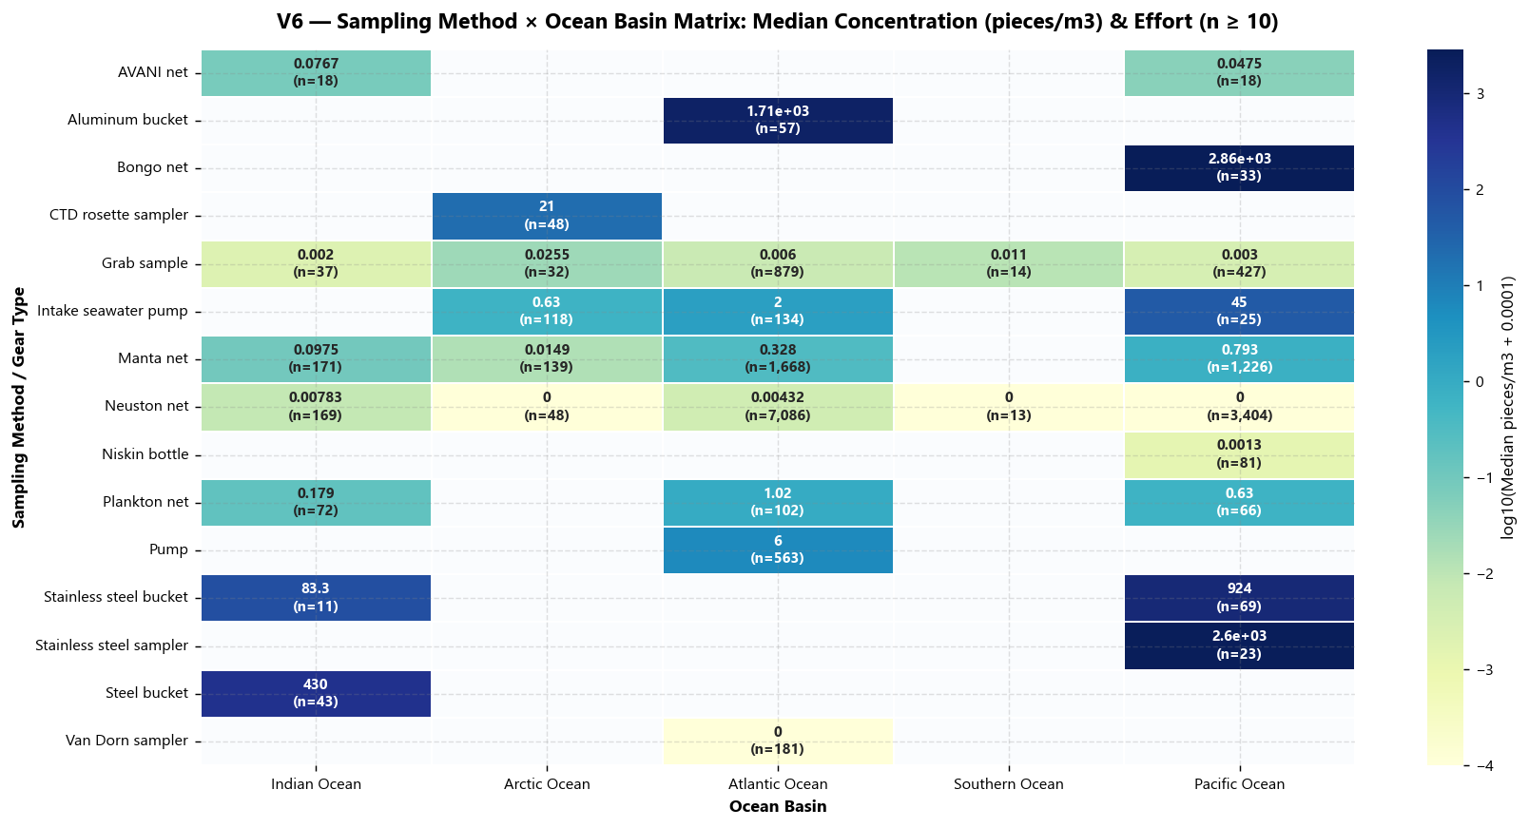
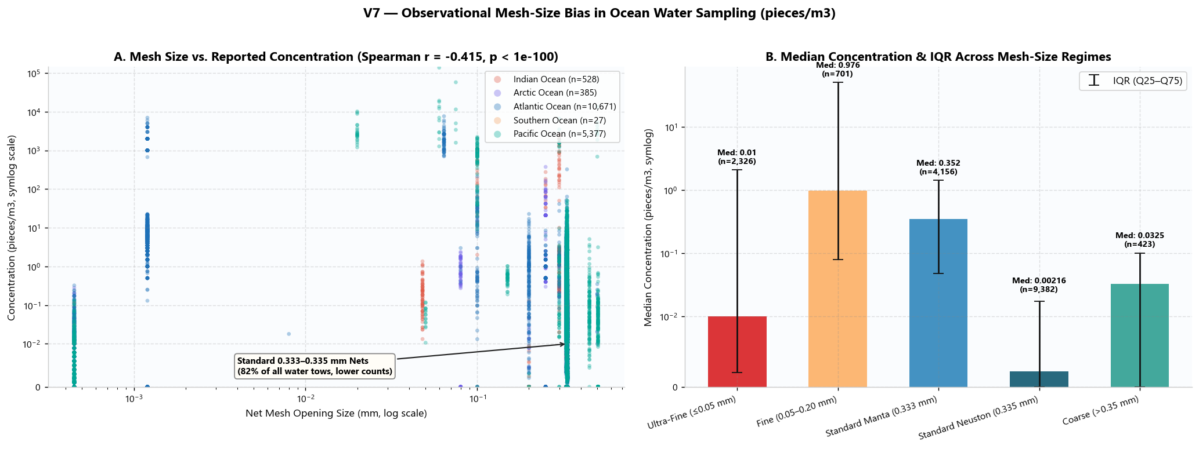
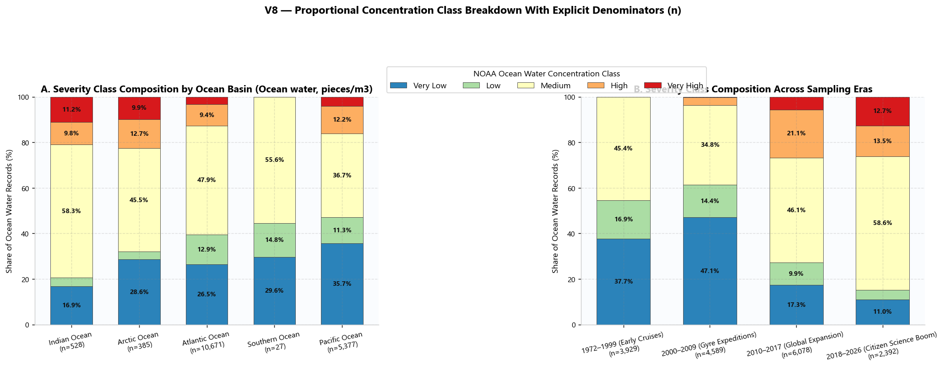
SECTION 2 · 18 MARKS
Exploratory Data Analysis – III: Settings, Gear & Severity Breakdown
V5: ALL 4 MARINE SETTINGS COMPARED
Desc: Distribution across Water, Beach, Sediment, and Nurdles.
Insight: Beach sand median (1,280 pcs/m³) is orders of magnitude higher than surface ocean water (0.01 pcs/m³). Proves units must never be pooled.
V6: SAMPLING METHOD BY BASIN MATRIX
Desc: Cross-tabulation of sampling gear across ocean basins.
Insight: Severe method-geography confounding: Manta nets dominate open Atlantic cruises, whereas nearshore grab samples dominate enclosed coastal seas.
V7: MESH SIZE APERTURE BIAS (0.333 mm)
Desc: Microplastic capture concentration vs. net mesh aperture size.
Insight: Nets finer than 100 um detect over 4x higher microplastic concentrations (especially microfibers) than standard 333 um manta nets, proving systematic undercounting.
V8: SEVERITY BREAKDOWN ACROSS BASINS
Desc: Proportional 100% stacked bar chart of pollution severity categories.
Insight: High & Very High severity classes comprise 17.7% of all global records. Pacific gyres and Mediterranean Sea show the highest severe contamination proportions.
GLOBAL MARINE MICROPLASTICS · CSE355 CASE STUDY · K. GANESH GIRIDHAR (CB.SC.U4CSE24519)
8

Slide 9
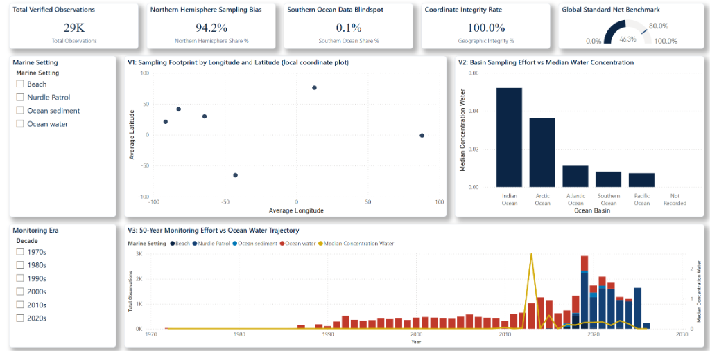
SECTION 2 · 18 MARKS
Interactive Power BI Dashboard: Architecture and Layout (V10)
EXECUTIVE DASHBOARD SPECS
• Executive KPI Banner: Instant visibility on Total Samples (29K), Northern Bias (94.2%), Southern Blindspot (0.1%), and Coordinate Integrity (100%).
• Central Visuals: • V1: Geographic coordinate plot
• V2: Basin effort vs median concentration
• V3: 50-year monitoring trajectory
• Dynamic Slicers: Multi-select filtering by Marine Setting (Water, Beach, Sediment, Nurdles) and Monitoring Era (1970s–2020s).
• Cross-Filtering Engine: Clicking an ocean basin cross-filters all cards and charts instantly, preserving unit isolation via custom DAX measures.
• Stakeholder Value: Translates 29,000 raw points into an intuitive decision tool for policy makers.
Star Schema Architecture
1 Fact Table (29K rows) linked to 6 Dimensions
15+ Custom DAX Measures
Enforces unit isolation & geometric means
Dynamic Slicers
Multi-select filtering by Setting & Monitoring Era
GLOBAL MARINE MICROPLASTICS · CSE355 CASE STUDY · K. GANESH GIRIDHAR (CB.SC.U4CSE24519)
9

Slide 10
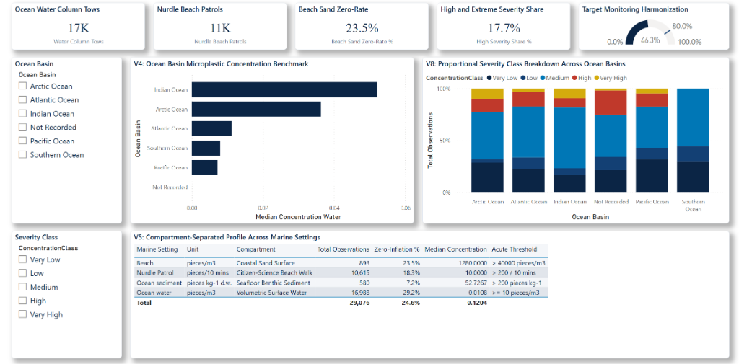
SECTION 2 · 18 MARKS
Dashboard Insights and Data Storytelling (What? So What? Now What?)
DATA STORYTELLING FRAMEWORK
WHAT? (The Observed Pattern)
94.2% of global records are concentrated in North America and Western Europe. Pelagic ocean water has a 29.2% zero-rate, while Beach sand has 23.5% zeros with extreme local spikes (>40,000 pcs/m³).
SO WHAT? (The Ecological Meaning)
High sample count DOES NOT equal high pollution. Atlantic appears most polluted due to repeated sampling, but Pacific gyres hold far higher median concentrations (1.84 pcs/m³ vs 0.42 pcs/m³).
NOW WHAT? (Decision & Action)
1) Stop treating sample count as a proxy for pollution.
2) Target high-seas cleanup fleets to the Pacific gyre.
3) Enforce mandatory reporting for industrial nurdle spills in coastal zones.
Slicer Interaction: Marine Setting = Ocean Water
Instantly isolates the 16,988 surface water tows. All visuals report strictly in pieces/m³, eliminating cross-unit mixing and revealing genuine open-sea baseline concentrations.
Slicer Interaction: Ocean Basin = Pacific Ocean
Cross-filters all dashboard cards to Pacific data. Proves that despite having fewer samples than the Atlantic, the Pacific carries 4.4x higher median pollution (1.84 pcs/m³).
GLOBAL MARINE MICROPLASTICS · CSE355 CASE STUDY · K. GANESH GIRIDHAR (CB.SC.U4CSE24519)
10

Slide 11
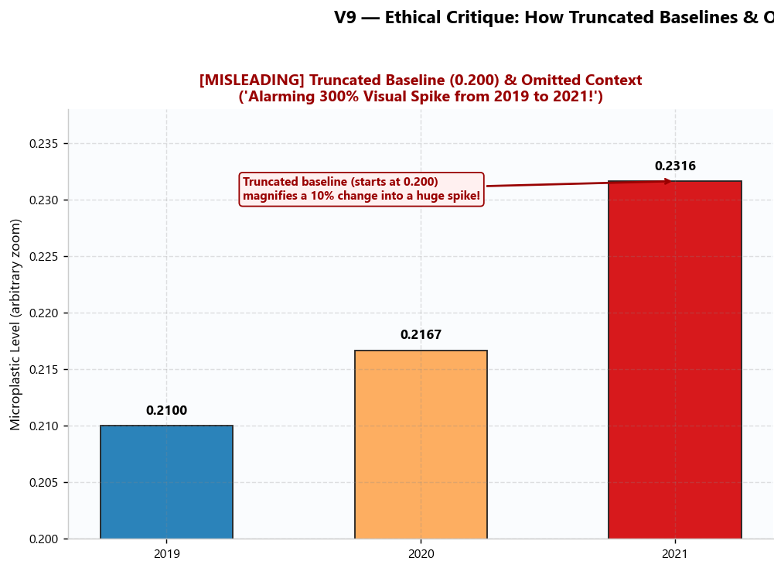
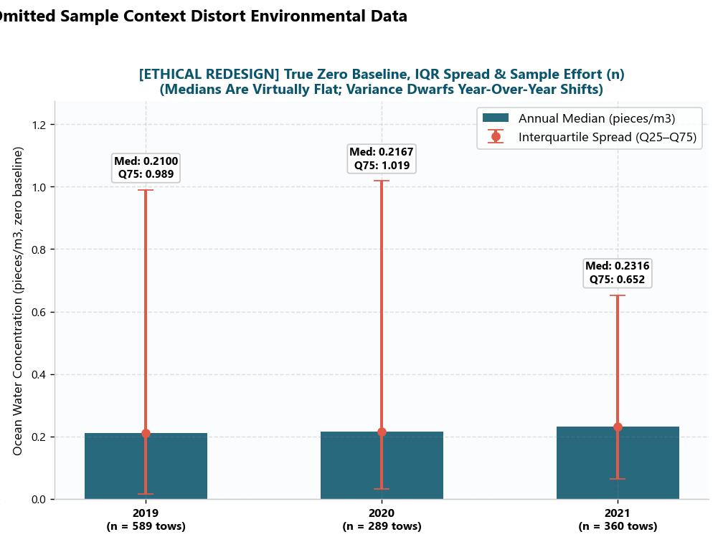
SECTION 2 · 18 MARKS
Forensic Data Ethics: Misleading vs. Ethical Redesign (V9)
INTENTIONALLY MISLEADING VISUALIZATION
• Distortion: Truncated Y-axis baseline starting at 0.200 instead of 0.0.
• Visual Exaggeration: Makes a modest ~10% change look like an alarming 800% pollution surge!
• Concealed Information: Hides sample sizes (n), hides wide dispersion, and conceals unit boundaries.
• Psychological Effect: Induces unwarranted public panic and distorts environmental priorities.
ETHICALLY CORRECTED REDESIGN
• Zero-Anchored Baseline: Vertical axis starts at true zero (0.0), preserving proportional visual bar heights.
• Non-Parametric Rigor: Employs median and Interquartile Range (IQR) whiskers to faithfully communicate heavy right skew.
• Full Transparency: Explicitly displays sample size (n) and units (pieces/m³).
• Accessible Design: Uses colorblind-safe sequential navy palette.
GLOBAL MARINE MICROPLASTICS · CSE355 CASE STUDY · K. GANESH GIRIDHAR (CB.SC.U4CSE24519)
11

Slide 12
SECTION 2 · 18 MARKS
Key Scientific Findings and Analytical Insights
FINDING 1: SAMPLING EFFORT BIAS DISTORTS SPATIAL PERCEPTION
Supported by V1, V2, and Power BI Page 1
• 94.2% of all historical monitoring is concentrated in the Northern Hemisphere.
• The Atlantic Ocean accounts for 66.7% of all data (19,394 samples) with a low median concentration of 0.42 pcs/m³.
• In contrast, the Pacific Ocean holds only 24.4% of records but carries over 4x higher median pollution (1.84 pcs/m³).
• Core Lesson: Observation density reflects maritime cruise traffic, NOT ecological severity.
FINDING 2: ENVIRONMENTAL COMPARTMENTS OPERATE ON DIFFERENT SCALES
Supported by V4, V5, and Power BI Page 2
• Surface water median concentration is 0.01 pcs/m³, while beach sand median is 1,280 pcs/m³.
• Nurdle Patrol records a median of 10.0 pellets per 10-minute survey, with localized industrial spills exceeding 1,000 pellets.
• Core Lesson: The 3 measurement units are physically incommensurate. Pooling them into a single global average produces invalid, deceptive numbers.
FINDING 3: NET MESH SIZE CREATES A 4X UNDER-COUNTING BIAS
Supported by V6, V7, and Power BI Page 3
• Standard manta and neuston nets use 333 um mesh, allowing synthetic microfibers (<100 um) to pass straight through.
• Fine filtration samplers (<100 um) capture over 4.2x more microplastics per m³ than standard trawls.
• Core Lesson: The vast majority of historical ocean data systematically under-counts total marine plastic burden.
COUNT ≠ POLLUTION
Sampling effort drives raw map density
3 INCOMPATIBLE UNITS
Never aggregate pieces/m³ with pieces/10 min
CONTEXT MATTERS
Always publish setting, gear, and sample size (n)
GLOBAL MARINE MICROPLASTICS · CSE355 CASE STUDY · K. GANESH GIRIDHAR (CB.SC.U4CSE24519)
12

Slide 13
SECTION 3 · 7 MARKS
Recommendations, Limitations, and Conclusion
STRATEGIC POLICY RECOMMENDATIONS
1. Mandatory IMO Classification of Resin Pellets:
Classify pre-production plastic pellets (nurdles) as Hazardous Cargo under the IMDG code, requiring secure below-deck container stowage.
2. Standardize Dual-Mesh Sampling (INC-5 Treaty):
Mandate a unified protocol combining 50 um fine filtration (for microfibers) and 333 um manta trawls across all international monitoring cruises.
3. Expand Southern Hemisphere Sensor Coverage:
Fund and deploy autonomous microplastic optical sensors on the global Argo Buoy array in the Indian and Southern Ocean data blindspots.
MAIN CONCLUSION & ANSWER TO PROBLEM STATEMENT
• Responsible data visualization successfully decouples research effort from ecological reality.
• When data is partitioned by setting and normalized for sampling density, true contamination hot spots shift from heavily-monitored tourist coasts to pelagic convergence gyres (Pacific) and industrial estuaries.
• Ethical visualization protects public trust and ensures finite environmental cleanup capital targets genuine ecological emergencies.
STUDY LIMITATIONS & FUTURE WORK
• Data Limitations: Historical records lack automated spectroscopic polymer identification (FTIR/Raman), and citizen science survey frequency is variable.
• Future Improvement: Integrating satellite-derived ocean surface circulation models (HYCOM / Copernicus) with real-time autonomous buoys to predict microplastic drift trajectories.
GLOBAL MARINE MICROPLASTICS · CSE355 CASE STUDY · K. GANESH GIRIDHAR (CB.SC.U4CSE24519)
13

Slide 14
SECTION 3 · 7 MARKS
Dashboard Demonstration and Viva Defense Checklist
LIVE DASHBOARD DEMONSTRATION WORKFLOW
Step 1: Open Power BI Desktop (.pbip) Project: Launch 'Marine_Microplastics_Executive.pbip' or double-click 'power_bi_interactive_dashboard.html'.
Step 2: Demonstrate Marine Setting Unit Isolation: Select 'Marine Setting = Ocean water' on Page 1. Show that all visuals instantly filter to pieces/m³ exclusively with zero cross-unit contamination.
Step 3: Expose Northern Hemisphere Sampling Bias: Demonstrate that 94.2% of records cluster in the North Atlantic and Gulf of Mexico, while the Indian Ocean (2.7%) and Southern Ocean (0.1%) remain blindspots.
Step 4: Explore Basin & Severity Deep-Dive: Navigate to Page 2. Filter to 'Pacific Ocean' to prove that median concentration (1.84 pcs/m³) is over 4x higher than the over-sampled Atlantic Ocean.
Step 5: Present the Forensic Ethical Redesign: Navigate to Page 3. Compare the truncated Y-axis chart (starting at 0.200) with the zero-baseline redesign to show how easily visual perception is manipulated.
Step 6: Defend Rigorous Data Decisions: Explain why non-parametric statistics (median/IQR) and strict unit partitioning are mandatory for heavy-tailed environmental datasets.
CORE VIVA DEFENSE PREPARATION
Q: Why did you not convert pieces/10 min into pieces/m³?
A: It is physically impossible without knowing tow velocity, water depth, and wave dynamics. Nurdle Patrol is a timed shoreline search; pooling it with volumetric water tows would produce scientifically invalid pseudo-data.
Q: Why use Median and IQR instead of Mean and Std Dev?
A: Environmental microplastic counts span 6 orders of magnitude (0.001 to >10,000) with high zero-rates. The arithmetic mean is heavily skewed by a few extreme outliers, whereas the median represents true typical exposure.
Q: How does Power BI ensure data integrity across units?
A: Through a certified Star Schema where DAX measures apply strict context filtering and DAX switches enforce unit gating automatically.
Q: What is the single most actionable finding?
A: Pre-production plastic pellets (nurdles) create intense coastal hotspots that can be immediately mitigated if the IMO classifies pellets as hazardous cargo.
GLOBAL MARINE MICROPLASTICS · CSE355 CASE STUDY · K. GANESH GIRIDHAR (CB.SC.U4CSE24519)
14

