Slide 1

E-commerce Olist Store Analysis
Presented By Group-4

Slide 2
Team Members
Joel J
Naiyar Ashfaque
Jitesh Kumar Singh
Shriganesh Acharya
Cheemala Ravi Teja
Lagan Ganesh Tandon
Ashutosh Mahadev Rajguru

Slide 3
AGENDA
Introduction
Overview
KPI’S
Insights & Recommendations
Dashboard
Challenges Faced
Conclusion

Slide 4
Overview
The Olist Store Analysis project focuses on dissecting and understanding the operational dynamics and performance metrics of Olist, an e-commerce platform in Brazil.
The Olist Store Analysis project aims to analyze customer purchasing patterns and payment statistics on an E- commerce platform, Olist.
This project covers several key performance indicators (KPIs) such as weekday vs weekend sales, payment statistics, delivery time, and customer behavior.
The analysis is based on nine CSV files, which are cleaned and manipulated to extract valuable insights.

Slide 5
KPI’S
Weekdays and weekend payment statistics
Number of Orders with Review score 5 and Payment type as Credit card
Average numbers of delivery days taken for pet shop
Average price and payment value of Sao Paulo city
Average shipping days vs review scores

Slide 6
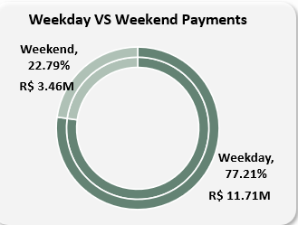
KPI . 1
Weekday Vs Weekend Payment Statistics
This Kpi analyzes the distribution of payment amounts processed on Weekdays compared to Weekends.
Majority (77.21%) of occur on weekdays, Representing 11.71M.
This Suggest that the Primary economic activity and transactions are concentrated during the traditional work week.
Conversely, Only 22.79% of payments happen on weekends, totaling 3.46M .
This indicates a significant drop in economic activity during these days.
Recommendation:
Boost Weekend revenue with targeted promotions and consider extending customer service hours to capture potential demand.

Slide 7
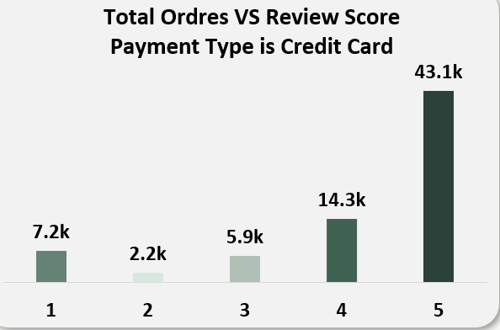
KPI . 2
Number of Orders with Review score 5 and Payment type as Credit card
The analysis focuses exclusively on orders paid via Credit Card, suggesting this payment type is widely accepted or preferred.
Majority of the total orders (43.1k) have a review score of 5, indicating a high level of customer satisfaction for these transactions.
A significant drop is observed for lower review scores, with only 7.2k orders rated 1 and 2.2k orders rated 2.
Orders with moderate scores (3 and 4) account for 5.9k and 14.3k, respectively.
Recommendation:
Investigate low scores (1 and 2) with targeted surveys to address key issues and improve service.
Focus on moderate scores (3) by identifying improvement opportunities to turn neutral experiences into positive ones.

Slide 8

KPI . 3
Average Numbers of Delivery Days
Taken for Pet Shop
This KPI analyzes the average number of days taken to deliver orders to customers for the pet shop.
The average shipping duration for orders in the "Pet Shop" category is 11 days, which might be longer than expected, potentially affecting customer satisfaction
Recommendation:
Optimize shipping logistics and collaborate with faster delivery partners to reduce shipping time for pet-related orders.

Slide 9
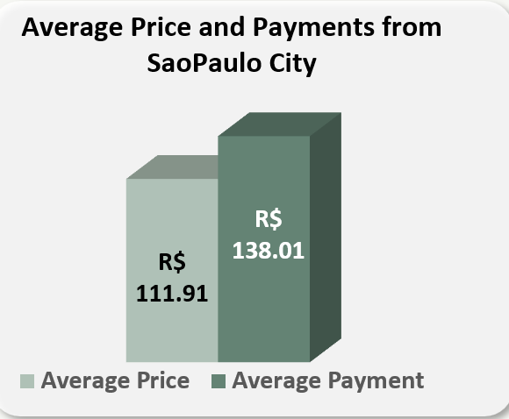
KPI . 4
Average Price and Payment Value of Sao Paulo City
This Kpi analysis the average price and payment values from customers of Sao Paulo city.
The average price of products sold in Sao Paulo is R$ 111.91.
Customers in Sao Paulo typically pay R$ 138.01 on average, which is higher than the average product price.
The difference of R$ 26.10 suggests additional charges such as taxes, delivery fees, or upselling.
Recommendation:
Introduce small discounts or loyalty rewards to encourage repeat purchases while maintaining profitability
Provide a clear breakdown of the additional charges to improve customer trust and satisfaction.

Slide 10
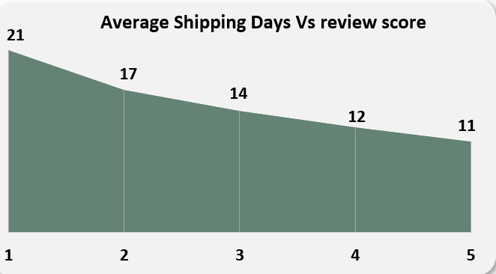
KPI . 5
Average Shipping Days Vs Review Scores
This KPI analyzes the relationship between shipping days and review scores.
Review scores improve consistently as shipping times decrease
Orders with a 21-day shipping time received the lowest review score of 1.
Faster shipping times lead to higher review scores, with 11 days correlating to the highest score of 5.
Recommendations:
Focus on reducing average shipping times to enhance customer satisfaction and boost review scores.
Offer expedited shipping options to customers for better experiences and higher ratings.

Slide 11
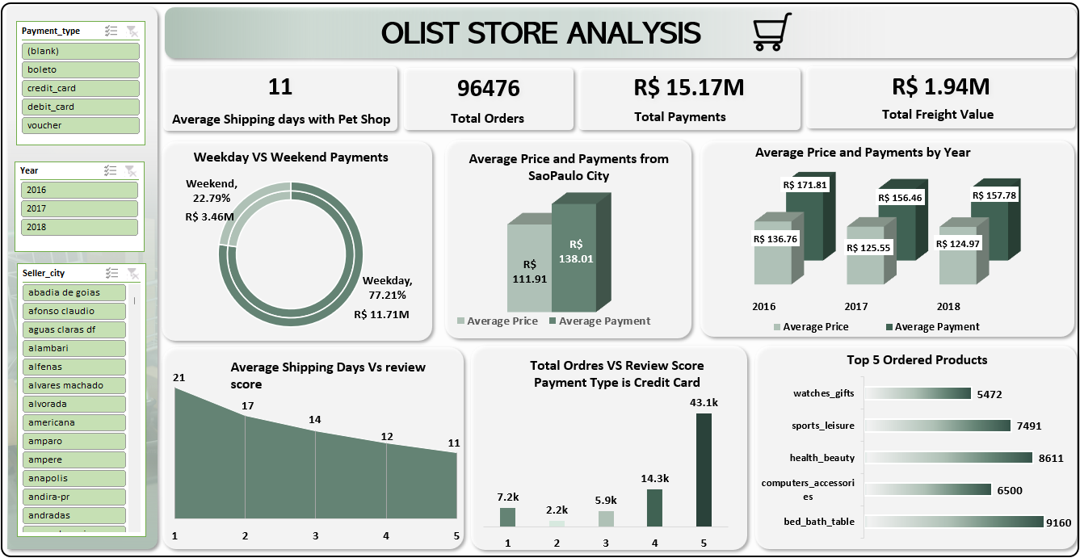
DASH BOARD

Slide 12
Challenges Faced
Faced difficulties while joining datasets due to duplicate values in key columns, requiring data deduplication and cleaning before merging
Encountered a column with category names in a different language, necessitating translation to English for uniformity and better analysis

Slide 13
Conclusion
The dashboard highlights key metrics of the Olist store, such as shipping efficiency, customer review correlations, and financial performance.
Key insights include a higher payment volume on weekdays, rising average payments over the years, and top-selling categories like health & beauty and bed & bath.
It emphasizes improving shipping timelines and maintaining product diversity to sustain growth.

Slide 14
Thank You!

