Slide 1
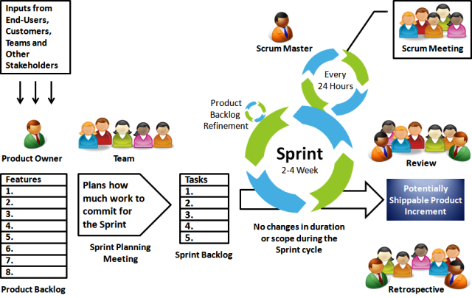
Scrum Framework
scrum meeting:15 min/day

Slide 2
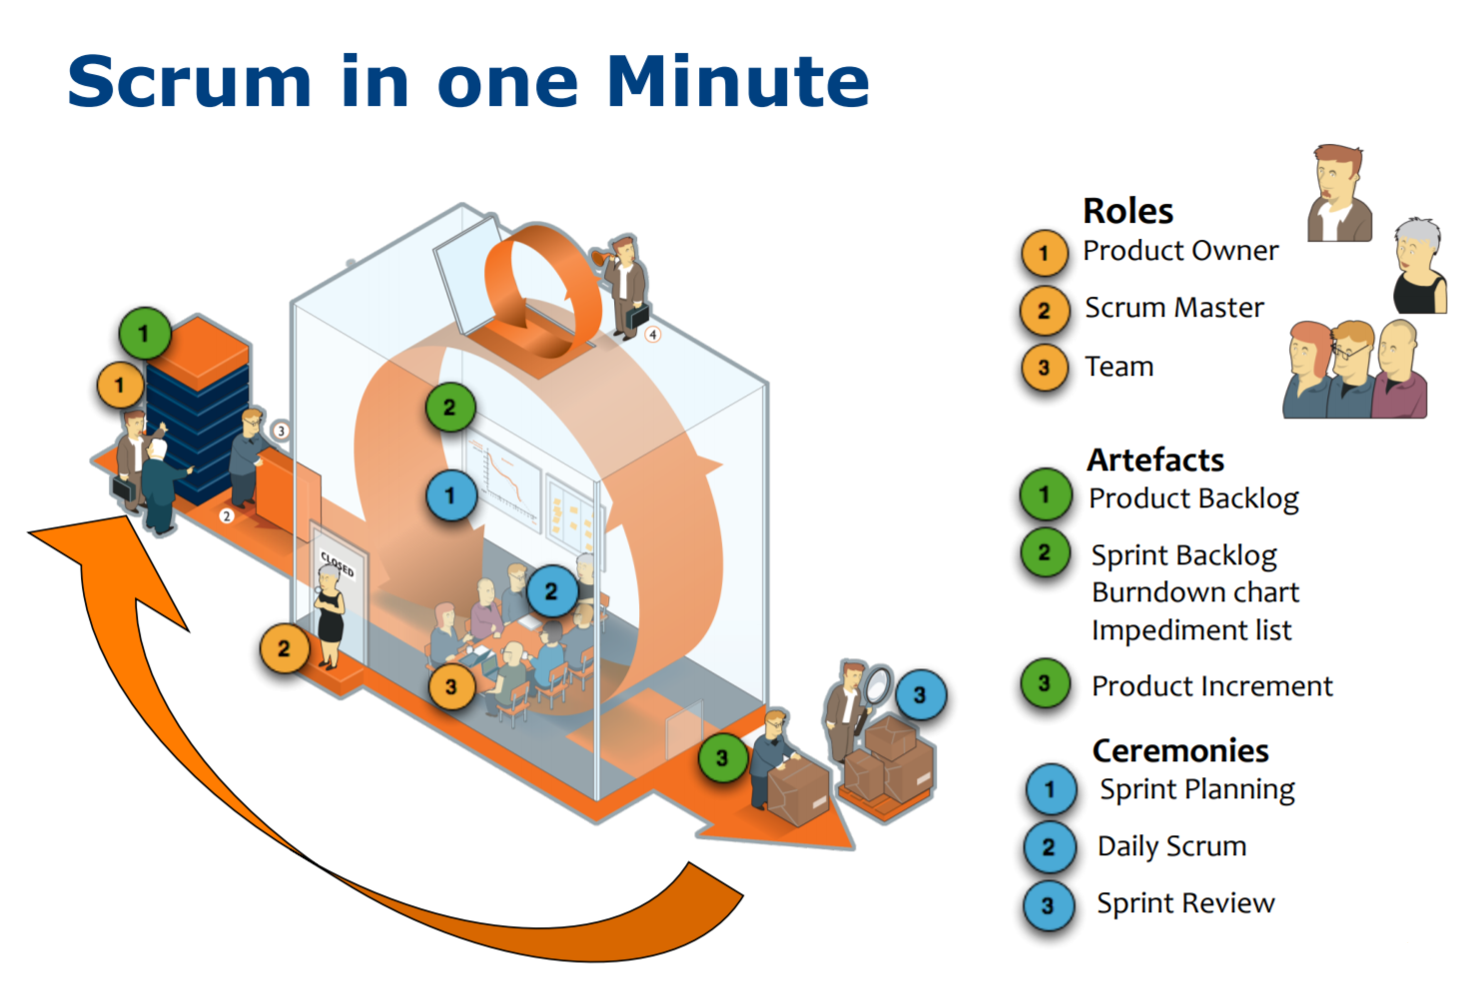

Slide 3
Definition of Ready (DoR) | Definition of Done
User Story is clear | Code produced (all 'to do' items in code completed)
User Story is testable | Code commented, checked in and run against current version in source control
User Story is feasible | Peer reviewed (or produced with pair programming) and meeting development standards
User Story defined | Builds without error
User Story Acceptance Criteria defined | Unit tests written and passing
User Story dependencies identified | Deployed to system test environment and passed system tests
User Story sized by Development Team | Passed UAT (User Acceptance Testing) and signed off as meeting requirements
Scrum Team accepts User Experience artefacts | Any build/deployment / configuration changes are implemented / documented / communicated
Performance criteria identified, where appropriate | Relevant documentation / diagrams produced and / or updated
Team has a good idea what it will mean to Demo the User Story | Remaining hours for task set to zero and task closed

