Slide 1
Enhancing Road Safety:Integrted vehicle Safety System
Presented By:
Yash dhake
Ganesh Wankhade
Yash Wankhede

Slide 2
CONTENT :
INTRODUCTION
BLOCK DIAGRAM
FLOW CHART
COMPONENTS USED
SOFTWARE USED
APPLICATIONS
FUTURE SCOPE
CONCLUSION

Slide 3
Introduction:
The Integrated Vehicle Security System aims to enhance road safety by implementing advanced security measures in vehicles. This system integrates cutting-edge technology to provide real-time monitoring and protection for drivers and passengers. Through a combination of hardware and software, the IVSS ensures safety and security on the road.

Slide 4
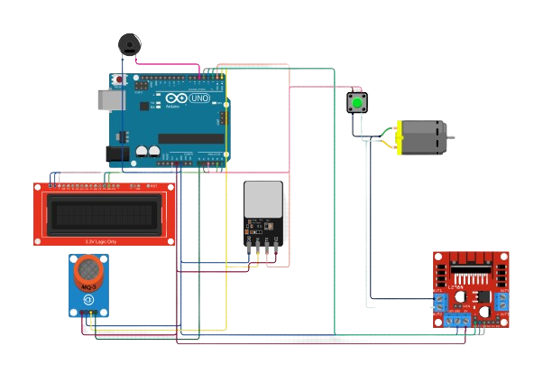
Circuit Diagram:

Slide 5
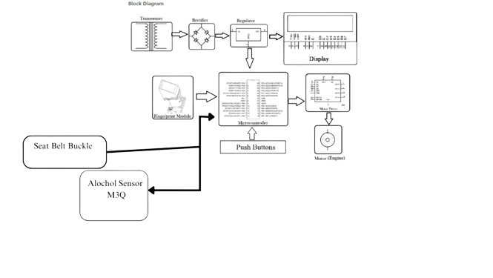
Flow Chart:

Slide 6
Components Used:
Atmega Microcontroller
Buzzer
Cables and Connectors
DC Motor
Diodes
Fingerprint Sensor
IC
IC Sockets
LCD Display
MC Programming Language: C
PCB and Breadboards
Push Buttons
Adapter

Slide 7
Software used:
Cirkit Studio.
Arduino Compiler
Code:

Slide 8
#include <SPI.h> // Include SPI library for fingerprint scanner (if applicable)
#include <SoftwareSerial.h> // Include SoftwareSerial library if needed (for serial communication)
// Define pin connections (adjust based on your specific hardware setup)
const int alcoholSensorPin = A0;
const int fingerprintScannerPin = 10; // Adjust based on fingerprint scanner module
const int relayPin = 8;
const int seatbeltSwitchPin = 2;
const int ledAlcoholDetectedPin = 13;
const int ledEngineReadyPin = 12;
const int buzzerPin = 11;
// Fingerprint scanner variables (if applicable)
FingerprintScanner fingerScanner(fingerprintScannerPin); // Replace with appropriate initialization
int alcoholSensorReading = 0;
bool isSeatbeltBuckled = false;
bool isEngineReady = false;
bool fingerprintMatched = false;
void setup() {
Serial.begin(9600); // Start serial communication for debugging (optional)
pinMode(alcoholSensorPin, INPUT);
pinMode(fingerprintScannerPin, INPUT); // Adjust based on module
pinMode(relayPin, OUTPUT);

Slide 9
pinMode(seatbeltSwitchPin, INPUT);
pinMode(ledAlcoholDetectedPin, OUTPUT);
pinMode(ledEngineReadyPin, OUTPUT);
pinMode(buzzerPin, OUTPUT);
digitalWrite(relayPin, LOW); // Engine initially off
// Initialize fingerprint scanner (if applicable)
if (!fingerScanner.init()) {
Serial.println("Fingerprint scanner initialization failed!");
while (1); // Halt if scanner initialization fails
}
fingerScanner.enrollFingerprint(1); // Enroll a fingerprint (replace 1 with desired ID)
}
void loop() {
alcoholSensorReading = analogRead(alcoholSensorPin);
isSeatbeltBuckled = digitalRead(seatbeltSwitchPin) == HIGH;
// Alcohol detection (adjust threshold based on sensor datasheet and calibration)
if (alcoholSensorReading > ALARM_THRESHOLD) {
digitalWrite(ledAlcoholDetectedPin, HIGH);
digitalWrite(buzzerPin, HIGH);
isEngineReady = false;

Slide 10
Serial.println("Alcohol detected! Engine locked.");
} else {
digitalWrite(ledAlcoholDetectedPin, LOW);
digitalWrite(buzzerPin, LOW);
}
// Fingerprint verification (if applicable)
if (!fingerprintMatched) {
fingerprintMatched = fingerScanner.isFingerprintDetected();
if (fingerprintMatched) {
Serial.println("Fingerprint matched!");
}
}
// Engine readiness check (all conditions must be met)
isEngineReady = isSeatbeltBuckled && fingerprintMatched;
digitalWrite(ledEngineReadyPin, isEngineReady ? HIGH : LOW);
// Engine control (replace with actual engine control logic for your vehicle)
if (isEngineReady) {
// Simulate engine start (replace with actual engine control)
Serial.println("Engine ready to start!");
digitalWrite(relayPin, HIGH); // Simulate engine on (replace with actual control)
} else {
digitalWrite(relayPin, LOW); // Engine remains off
}
delay(500); // Delay between checks

Slide 11
Applications:
Automotive Safety: Enhances vehicle safety by preventing drunk driving and unauthorized vehicle access.
Personalized Security: Provides a personalized vehicle access system through fingerprint recognition.
Seatbelt Compliance: Encourages and enforces the usage of seatbelts for driver safety.

Slide 12
Future Scope:
Advanced Driver Assistance Systems (ADAS) Integration: Consider incorporating ADAS features like lane departure warning, blind spot detection, and drowsiness monitoring for a more comprehensive safety approach.
Cloud Connectivity and Mobile App Integration: Explore internet connectivity to enable remote vehicle diagnostics, location tracking, and emergency assistance initiation through a mobile application.
Biometric Authentication Expansion: Integrate additional biometric authentication methods like facial recognition or iris scanning for enhanced security and personalized user experience.
Voice Control Integration: Implement voice control functionalities for features like engine start/stop or adjusting cabin temperature, minimizing driver distraction..

Slide 13
Future Scope:
Accident Detection and Emergency Response: Develop a system that can detect accidents and automatically trigger emergency response services, potentially saving lives.
Microcontroller Upgrade: As technology evolves, explore upgrading the Atmega328 to a more powerful microcontroller to handle the demands of increasingly complex functionalities

Slide 14
Conclusion:
This project presented an Integrated Vehicle Safety System using the Atmega328 microcontroller. The system combines alcohol sensing, engine locking, fingerprint start, and seatbelt interlock to promote responsible driving. It deters drunk driving, enhances security, and encourages seatbelt usage.
While the Atmega328 provides a solid foundation, future advancements can integrate ADAS features, cloud connectivity, and advanced biometrics. Upgrading the microcontroller can further expand functionalities. This system has the potential to evolve into a comprehensive safety solution, significantly improving road safety and driver well-being.

