Slide 1

Building Advanced Text Summarization Systems
This presentation explores the cutting-edge techniques used to develop powerful text summarization systems, combining the latest advancements in neural machine translation, recurrent neural networks, and attention mechanisms.

Slide 2
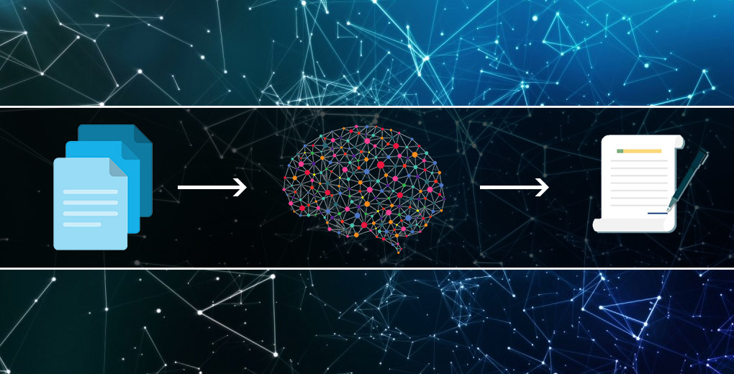
Introduction to Text Summarization
1
Concise Extraction
2
Diverse Applications
Summarization aims to extract the key information from lengthy text and present it in a more concise form. Source text to short form or target text
From news articles to research papers, summarization technology has a wide range of real-world use cases.
3
Challenges
Accurately capturing the essence of a text while maintaining coherence and readability requires sophisticated natural language processing.

Slide 3
Traditional Approaches to Summarization
Extraction-based
Abstraction-based
Hybrid Approaches
Identifying and extracting the most salient sentences or phrases from the original text. Target Text and words will be same as the source text
Generating new, more concise text that captures the key ideas and concepts. Here Target text and words will not be the same they will change in the summary from the source text
Combining extraction and abstraction techniques for more comprehensive summarization.

Slide 4

The Rise of Neural Networks in NLP
1
Breakthroughs
Advancements in deep learning and neural network architectures have revolutionized natural language processing (NLP).
2
Representation Learning
Neural networks can learn rich, contextual representations of language, capturing semantic and syntactic nuances.
3
Computational Power
Increased computational resources and access to large datasets have enabled the training of powerful NLP models.

Slide 5
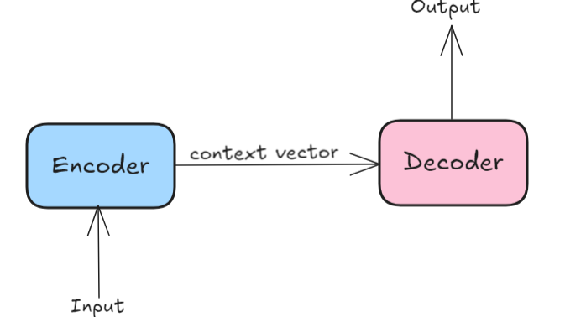
Seq2Seq Models and Neural Machine Translation
Sequence-to-Sequence
Neural Machine Translation
Seq2Seq models can encode an input sequence and generate an output sequence, enabling tasks like translation and summarization.
Seq2Seq models have revolutionized machine translation, achieving human parity on certain language pairs.
Encoder(Inp-seq) -Decoder (Next word gen) Architecture
Attention Mechanism
Attention allows the model to focus on the most relevant parts of the input when generating the output.
The encoder and decoder components of Seq2Seq models work together to transform inputs to outputs.

Slide 6
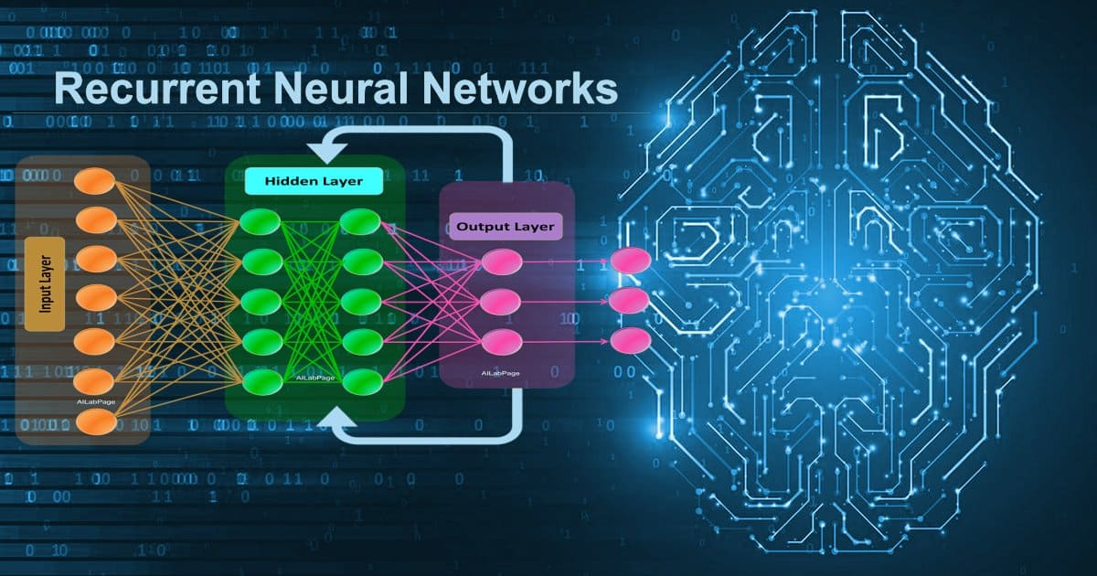



Recurrent Neural Networks (RNNs) for Summarization
Sequential Processing
RNNs can process text sequentially, maintaining a hidden state that encodes contextual information.
Pattern Capture
RNNs can learn to recognize patterns in language, which is crucial for effective summarization.
Efficiency
RNNs can generate summaries in a single pass, making them computationally efficient compared to other approaches.

Slide 7
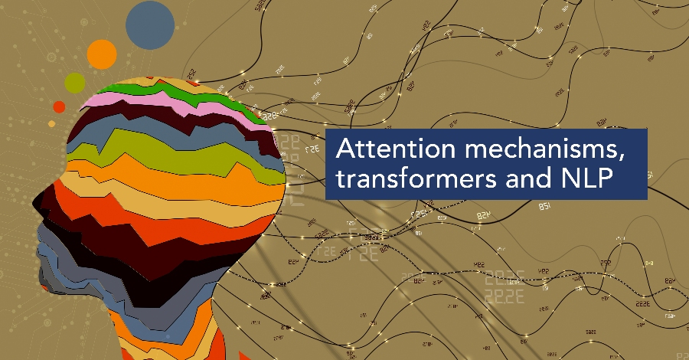



Attention Mechanisms in Summarization Models
Targeted Focus
Attention allows the model to dynamically focus on the most relevant parts of the input when generating the summary.
Improved Coherence
Attention helps maintain context and coherence in the summarized text, resulting in more natural-sounding output.
Interpretability
Attention maps provide insights into the model's decision-making process, making the summarization more transparent.

Slide 8
Combining NMT, RNNs, and Attention for Summarization
Neural Machine Translation
Recurrent Neural Networks
Attention Mechanisms
Leveraging the power of Seq2Seq models trained on machine translation tasks to generate high-quality summaries.
Utilizing RNNs to process text sequentially and capture the contextual relationships within the input.
Integrating attention to help the model focus on the most salient parts of the input when generating the summary.

Slide 9
Evaluation Metrics and Techniques
ROUGE
Human Evaluation
A popular metric that measures the overlap between the generated summary and reference summaries.
Gathering feedback from human raters to assess the quality, coherence, and usefulness of the summaries.
Automated Metrics
Task-Specific Evaluation
Using other NLP metrics, such as BLEU and METEOR, to provide a more comprehensive evaluation.
Assessing the performance of the summarization system in the context of its intended application.

Slide 10
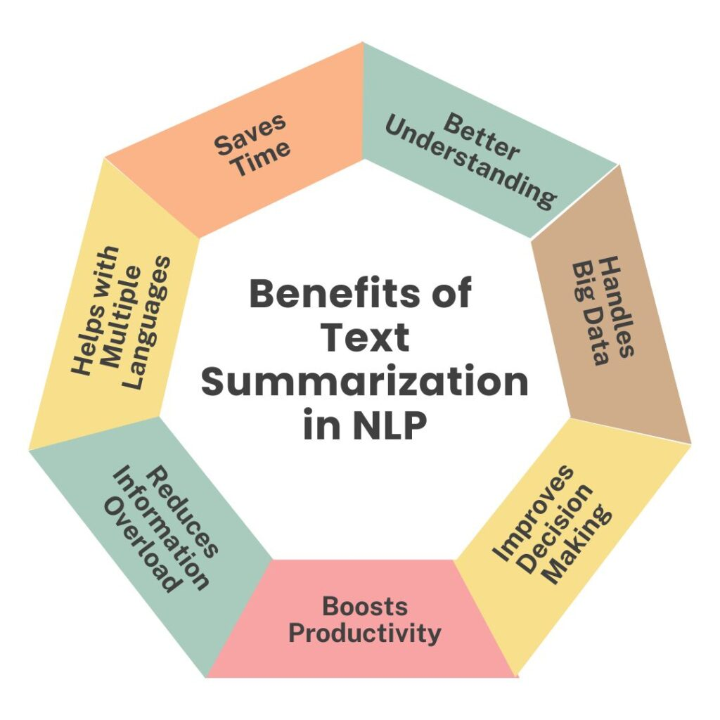
Real-World Applications and Challenges
News Summarization
Providing concise overviews of current events and breaking news stories.
Academic Summarization
Generating summaries of research papers and scientific literature.
Social Media Summarization
Extracting key insights from the vast amount of user-generated content on social platforms.
Handling Domain-Specific Content
Adapting summarization models to handle specialized vocabulary and concepts in various domains.

