Slide 1

ST.THOMAS INSTITUTE FOR SCIENCE AND TECHNOLOGY
Smart Recipe Generation through Food Image and
Cooking Recipe Analysis

Slide 2
Smart Recipe Generation through Food Image and
Cooking Recipe Analysis
Adimalupu Ganesh
STI21CS011
Navafa Noushad
STI21CS047
Joel Blesson
STI21CS038
Darshan Kumar
STI21CS024
GUIDED BY :
MRS. BINDHYA PS
ASST. PROFESSOR, CSE

Slide 3

Smart Recipe Generation through Food Image and Cooking Recipe Analysis

Slide 4
1 INTRODUCTION & OVER VIEW
2 CHALLANGES IN COOKING TODAY
3 PROPOSED SOLUTIONS
4 METHODOLOGIES
5 HOW ITS WORKS
6 KEY FEATURES & BENEFITS
7 USE CASES
8 TRAINING MODEL
CONTENT
9 SYSTEM ARCHITECTURE
10 TRAINING WITH DIFFERENT MODELS
11 EXAMPLE
12 EVALUTAING THE MODELS
13 WORKING
14 FORMULA EXPLAINATION
15 CONCLUSION
16 REFERENCES

Slide 5
Introduction
Overview
Context: High obesity rates and associated health risks (e.g., diabetes, cancer) have led to a growing need for effective diet management.
Problem: Traditional food journaling is effort-intensive, leading to low user compliance.
Objective: Develop an automated system that simplifies food logging through image recognition and recipe analysis, with a focus on domestic cooking.
Approach:
Utilize advanced machine learning and natural language processing techniques.
Integrate comprehensive food nutrient profiles and contextual ingredient information.
Prototype: Android app "CHEF.AI" for food recognition and healthy meal recommendations.
Key Benefits:
Streamlines food logging and diet management.
Provides personalized and health-oriented food recommendations.
Potential for broad application in personal health management.

Slide 6
Challenges in Cooking Today
Difficulty in meal planning and finding new recipes.
Managing dietary restrictions and preferences.
Reducing food waste by using available ingredients.
Need for quick and convenient meal solutions.
Challenges in Current Diet Management:
Manual Effort: Existing food journaling tools require significant user input, leading to low adherence over time.
Accuracy Issues: Traditional methods often lack precision in portion size estimation and nutrient calculation.

Slide 7
Challenges in Cooking Today
Motivation:
Health Impact: With rising obesity and related diseases, there's an urgent need for more effective and user-friendly diet management solutions.
Technological Potential: Advances in AI, machine learning, and natural language processing offer new opportunities to overcome existing limitations and improve food recognition accuracy.
User Experience: Simplifying the food logging process can lead to better user compliance and more accurate dietary monitoring.
Goal:
To create a system that enhances the accuracy and ease of food logging through innovative technology, ultimately supporting healthier eating habits.

Slide 8
Literature Survey: Food Image Recognition and Classification
Early Efforts: Initial attempts focused on feature engineering, using Support Vector Machines (SVM) with the Pittsburgh fast-food image dataset (PFID). Despite limited performance, accuracy improvements (19% to 28%) were achieved using multiple kernel learning algorithms.
Dataset Development: The emergence of various datasets like UEC-FOOD100, UEC-FOOD256, and Food-101 expanded the scope of food image recognition. For example, Food-101 with a Random Forest classifier achieved 50.7% accuracy.
Contextual Information Utilization: Incorporating user preferences and food co-occurrence in meals improved classification performance. A fully connected undirected graph model achieved 44% accuracy on images collected in natural eating conditions.
Recent Advances:
Myers et al. utilized multi-label CNN classifiers to predict food items and their nutritional content both in and out of restaurants. Challenges in volume estimation were addressed by combining manual image segmentation and depth estimation.
Sun et al. applied the YOLO architecture for food detection, enabling nutrient content retrieval via a nutrition database.
Facebook developed a food classifier that identifies ingredients in prepared food images by associating them with recipes and ingredient images.

Slide 9
Proposed Solution
Automated Food Recognition:
Use advanced image processing techniques to recognize food items from images taken by mobile devices.
Leverage deep learning models, particularly Convolutional Neural Networks (CNNs), for accurate ingredient identification.
Recipe Analysis and Integration:
Extract and analyze recipe data using Natural Language Processing (NLP) to understand the context of ingredients and their nutritional profiles.
Integrate this data into the food recognition system to improve accuracy and provide meal recommendations.
User-Friendly Mobile Application:
Develop a mobile app, FoodInsight, to implement the system.
Allow users to easily log food items and receive personalized dietary advice based on recognized ingredients and recipes.

Slide 10
Methodology
Image Data Collection:
Compile a dataset of over 86,000 images representing 130 classes of food ingredients.
Utilize transfer learning with pre-trained CNN models to classify these images.
Recipe Database Construction:
Crawl over 10,000 recipes from Allrecipes.com, including ingredient lists and nutritional information.
Apply NLP techniques to parse and standardize recipe data for integration into the recognition system.
Model Training and Optimization:
Train the CNN models on the collected image dataset.
Use Conditional Random Fields (CRF) to optimize ingredient classification by considering co-occurrence probabilities from the recipe data.
System Integration:
Combine image recognition with recipe analysis to enhance the accuracy of food logging.
Implement the system in the FoodInsight app for real-time user interaction and feedback.
Methodology:

Slide 11
Input dietary preferences (e.g., vegan, gluten-free).
Add ingredients you currently have.
How Be My Chef.Ai Works ?
Exclude ingredients you dislike.
Tap "Generate Recipe" for customized meal ideas.

Slide 12
Key Features and Benefits
Personalized Recipe Recommendations:
In order to provide customized recipe recommendations, AI food recipe generators can examine user preferences, dietary requirements, and item availability. These generators can provide recipes that are customized to each user’s requirements by learning about their dietary restrictions and taste preferences. This results in a meal that is specifically catered to.
Variety and Creativity:
The ability to introduce consumers to a wide range of recipes and culinary styles they may not have previously explored is one of the main advantages of AI food recipe generators. These recipe generators may produce recipes with unusual flavor combinations and cooking methods from a variety of cuisines. Users can broaden their culinary horizons and discover new and intriguing recipes thanks to this diversity, which promotes culinary experimentation and creativity.

Slide 13
Key Features and Benefits
Efficiency and Time Savings:
AI-powered food recipe generators make meal planning easier by giving consumers rapid access to a sizable recipe database. Users don’t need to spend hours looking for food ideas; they can quickly get a list of appropriate dishes by entering their preferences and dietary restrictions into the generator. Because of its efficiency, meal planning and preparation are easier and more convenient for users, saving them a great deal of time and effort.
Health and Nutrition:
A lot of AI food recipe generators have nutrition and health-focused features that let users filter meals according to dietary preferences like low-carb, vegetarian, or gluten-free. By giving users access to recipes that suit their preferences and health objectives, these generators can assist users in making better informed decisions regarding their diet and nutrition.

Slide 14
Key Features and Benefits
Reduced Food Waste:
By offering recipes based on components that customers currently have on hand, AI food recipe generators also contribute to the reduction of food waste. Utilizing foods that could otherwise be thrown away helps consumers prepare meals more sustainably and reduce food waste.
Learning and Skill Development:
AI-powered food recipe generators can also be useful educational resources for home cooks who want to get better at cooking. These generators frequently offer detailed instructions, culinary tricks, and methods to assist users improve their cooking skills and self-assurance in the kitchen. Additionally, through the wide variety of recipes that the AI generates, users can learn about new ingredients, cooking techniques, and flavor profiles.

Slide 15
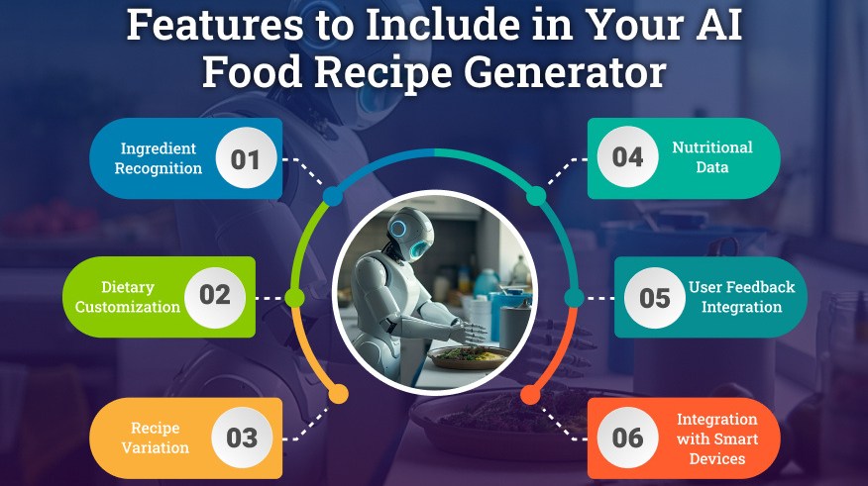

Slide 16
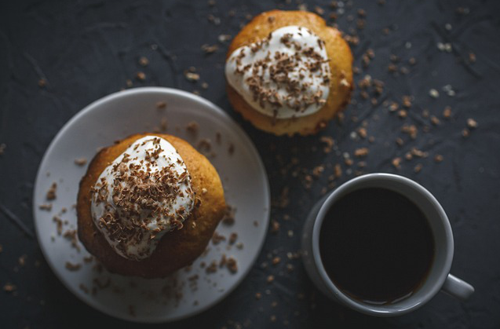
Use Cases
Applications of Be My Chef
Home cooks looking for meal ideas.
People with special diets.
Meal planners and preppers.
Managing leftovers creatively.
Cooking inspiration for new cuisines.

Slide 17

Model Training and Data
Dataset: Recipe 1M, custom datasets of ingredient images.
Training: Supervised learning for ingredient recognition, unsupervised learning for user preferences.
Evaluation Metrics: Ingredient Matching (IM), user satisfaction scores.

Slide 18
AI and Machine Learning Integration
Deep Learning Architecture
Ingredient Recognition: Using CNNs like ResNet-50 for identifying ingredients from images.
Recipe Generation: Encoder-decoder framework with reinforcement learning and coverage loss to ensure ingredient matching.
Personalization: User preference models using collaborative filtering and similarity measures (e.g., Euclidean Distance, Pearson Correlation).
Uses convolutional neural networks (CNN) for image recognition of ingredients.
Natural language processing (NLP) for understanding user inputs.
Reinforcement learning for recipe optimization.
Integration with existing recipe databases.

Slide 19
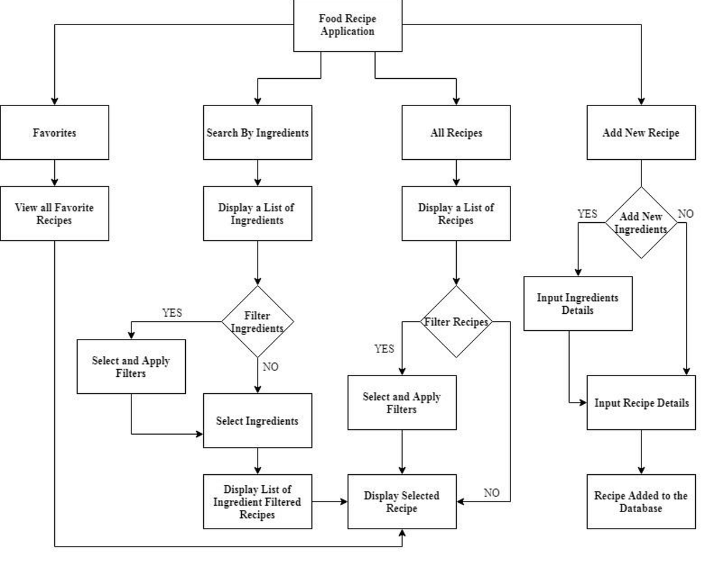
System Architecture
User inputs dietary preferences and available ingredients.
AI model processes inputs and recognizes ingredients.
Recipe generation module creates tailored recipes.
User feedback loop for continuous improvement.

Slide 20
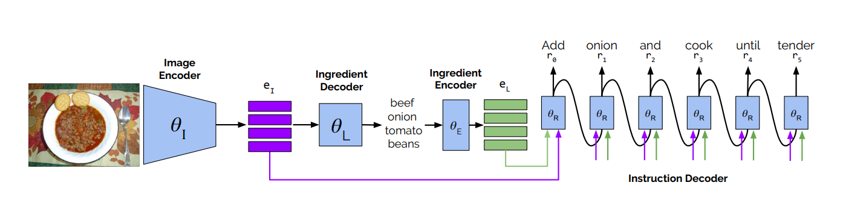
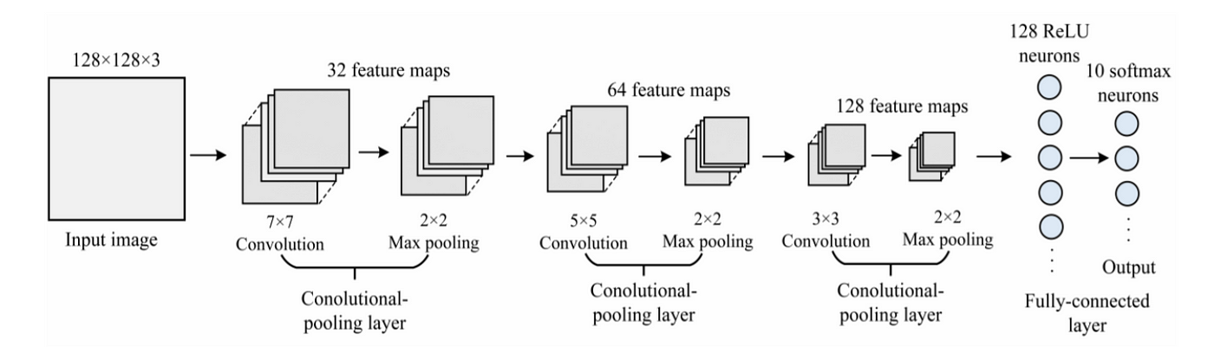

Slide 21
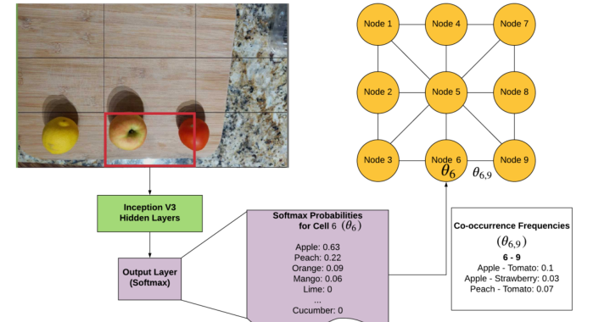

Slide 22
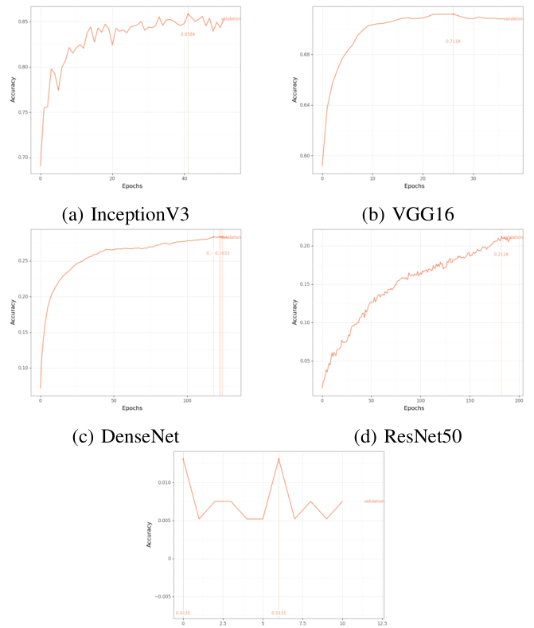
Understanding the Graphs:
The provided image displays four line graphs, each representing the training accuracy of a different deep learning model: InceptionV3, VGG16, DenseNet, and ResNet50.
The x-axis in each graph represents the number of epochs (training iterations), while the y-axis represents the accuracy achieved by the model during training.Key Observations:Overall Trends: All four models exhibit a general upward trend in accuracy as the number of epochs increases, indicating successful learning.
InceptionV3: This model shows a steady and consistent increase in accuracy, reaching a plateau around the 30th epoch.
VGG16: VGG16 also demonstrates a steady improvement, but its final accuracy is slightly lower than InceptionV3.
DenseNet: DenseNet exhibits a rapid initial increase in accuracy, followed by a more gradual improvement. It reaches a plateau at a slightly higher accuracy than VGG16 but lower than InceptionV3.
ResNet50: ResNet50 shows a unique pattern with a sharp initial increase followed by a dip in accuracy before resuming a steady rise. It eventually reaches a plateau similar to VGG16.

Slide 23
Interpreting the Results:
Model Performance: InceptionV3 appears to be the best-performing model based on the final accuracy achieved. However, the choice of the best model might depend on other factors such as computational cost, training time, and specific application requirements.
Training Dynamics:
The different shapes of the curves suggest varying training dynamics for each model. For example, ResNet50's initial dip in accuracy might be attributed to its specific architecture or training strategy.
Hyperparameter Tuning:
The performance of these models can be further improved by fine-tuning hyperparameters such as learning rate, batch size, and regularization techniques.
Conclusion:
The graphs provide valuable insights into the training behavior of different deep learning models. By analyzing these trends, researchers and practitioners can make informed decisions about model selection and optimization for specific tasks.

Slide 24
The primary goal of this algorithm is to recommend recipes that are similar to a given set of ingredients. It achieves this by analyzing the composition of recipes in a dataset and identifying patterns or clusters of ingredients that frequently occur together.
Key Components and Steps:
Ingredient Clustering: The algorithm groups ingredients into clusters based on their co-occurrence in recipes. This helps to identify common ingredient combinations.
Ingredient Weighting: Each ingredient within a cluster is assigned a weight based on its relative abundance in the recipe. More abundant ingredients are given higher weights.
Cluster Similarity: The similarity between a recipe and a given set of ingredients is calculated based on the similarity of the ingredient clusters in the recipe to the predicted clusters.
Recipe Ranking: Recipes are ranked based on their overall similarity scores, with the most similar recipes appearing at the top.
Formulas:
Weight of an Ingredient Cluster: w(c) = ∑ w(i)
Normalized Weight of an Ingredient Cluster: w'(c) = w(c) / ∑ w(c)
Probability of a Cluster: p(c) = |{r | r contains an ingredient in c}| / R
Similarity Value for a Cluster: s_i = w'(c_i) * e^(-log p(c_i))
Similarity of a Recipe to a Given Predicted Set of Ingredients: s_r = ∑ s_i
The algorithm prioritizes recipes that contain ingredient clusters that are similar to the predicted clusters and have a high weight (i.e., are abundant in the recipe).
Rarer ingredient clusters are also given more weight in the similarity calculation, as they may be more distinctive and indicative of specific recipe types.
By combining these factors, the algorithm is able to effectively recommend recipes that are likely to match the user's preferences based on the given ingredients.

Slide 25
“
Cooking is an art, but all art requires knowing something about the techniques and materials.
— Nathan Myhrvold

Slide 26
CONCLUSION
Be My Chef represents a significant advancement in how we approach cooking and meal planning. By leveraging advanced AI and machine learning technologies, it offers users a personalized and intuitive way to discover new recipes that align with their dietary preferences and available ingredients
This app not only saves time and reduces food waste but also inspires culinary creativity and ensures that meal preparation is convenient and enjoyable. As we continue to refine and enhance the features of Be My Chef, we aim to revolutionize the home cooking experience, making it more accessible, diverse, and sustainable for everyone. We are excited about the potential of this project to transform kitchens and mealtimes around the world, and we look forward to your support and feedback as we bring this innovative solution to life.

Slide 27
REFERENCES
[1] Lukas Bossard, Matthieu Guillaumin, and Luc Van Gool. Food-101–
mining discriminative components with random forests. In European
conference on computer vision, pages 446–461. Springer, 2014.
[2] Micael Carvalho, R ́emi Cad`ene, David Picard, Laure Soulier, Nicolas
Thome, and Matthieu Cord. Cross-modal retrieval in the cooking
context: Learning semantic text-image embeddings. In The 41st In-
ternational ACM SIGIR Conference on Research & Development in
Information Retrieval, pages 35–44, 2018.
[3] Jing-jing Chen, Chong-Wah Ngo, and Tat-Seng Chua. Cross-modal
recipe retrieval with rich food attributes. In Proceedings of the 25th
ACM international conference on Multimedia, pages 1771–1779, 2017.
[4] Jing-Jing Chen, Chong-Wah Ngo, Fu-Li Feng, and Tat-Seng Chua. Deep
understanding of cooking procedure for cross-modal recipe retrieval. In
Proceedings of the 26th ACM international conference on Multimedia,
pages 1020–1028, 2018.
[5] Mei Chen, Kapil Dhingra, Wen Wu, Lei Yang, Rahul Sukthankar, and
Jie Yang. Pfid: Pittsburgh fast-food image dataset. In 2009 16th IEEE
International Conference on Image Processing (ICIP), pages 289–292.
IEEE, 2009.
[6] Gianluigi Ciocca, Paolo Napoletano, and Raimondo Schettini. Food
recognition: a new dataset, experiments, and results. IEEE journal of
biomedical and health informatics, 21(3):588–598, 2016.
[7] Jia Deng, Wei Dong, Richard Socher, Li-Jia Li, Kai Li, and Li Fei-
Fei. Imagenet: A large-scale hierarchical image database. In 2009 IEEE
conference on computer vision and pattern recognition, pages 248–255.
Ieee, 2009.
[8] Shaobo Fang, Chang Liu, Fengqing Zhu, Edward J Delp, and Carol J
Boushey. Single-view food portion estimation based on geometric
models. In 2015 IEEE International Symposium on Multimedia (ISM),
pages 385–390. IEEE, 2015.
[9] Erica Greene. Extracting structured data from recipes using conditional
random fields, Apr 2015.
[10] Hamid Hassannejad, Guido Matrella, Paolo Ciampolini, Ilaria De Mu-
nari, Monica Mordonini, and Stefano Cagnoni. Food image recognition
using very deep convolutional networks. In Proceedings of the 2nd
International Workshop on Multimedia Assisted Dietary Management,
pages 41–49, 2016.
[11] Kaiming He, Xiangyu Zhang, Shaoqing Ren, and Jian Sun. Deep
residual learning for image recognition. In Proceedings of the IEEE
conference on computer vision and pattern recognition, pages 770–778,
2016.
[12] Ye He, Chang Xu, Nitin Khanna, Carol J Boushey, and Edward J
Delp. Context based food image analysis. In 2013 IEEE International
Conference on Image Processing, pages 2748–2752. IEEE, 2013.
[13] Luis Herranz, Weiqing Min, and Shuqiang Jiang. Food recognition
and recipe analysis: integrating visual content, context and external
knowledge. arXiv preprint arXiv:1801.07239, 2018.
[14] Gao Huang, Zhuang Liu, Laurens Van Der Maaten, and Kilian Q
Weinberger. Densely connected convolutional networks. In Proceedings
of the IEEE conference on computer vision and pattern recognition,
pages 4700–4708, 2017.

