Slide 1
Mutual Fund Analytics Platform
Bluestock Fintech Capstone | Final Presentation
40 Schemes
46K NAV Records
32.8K Transactions
7 Project Days

Slide 2
Problem & Objective
Mutual fund data is spread across NAV, AUM, SIP, transaction, holdings, and benchmark datasets.
Analysts need a repeatable pipeline to clean, validate, store, analyze, and visualize this data.
The project builds a complete analytics platform for fund comparison, investor analytics, and risk insights.
Goal: Convert raw mutual fund data into decision-ready insights

Slide 3
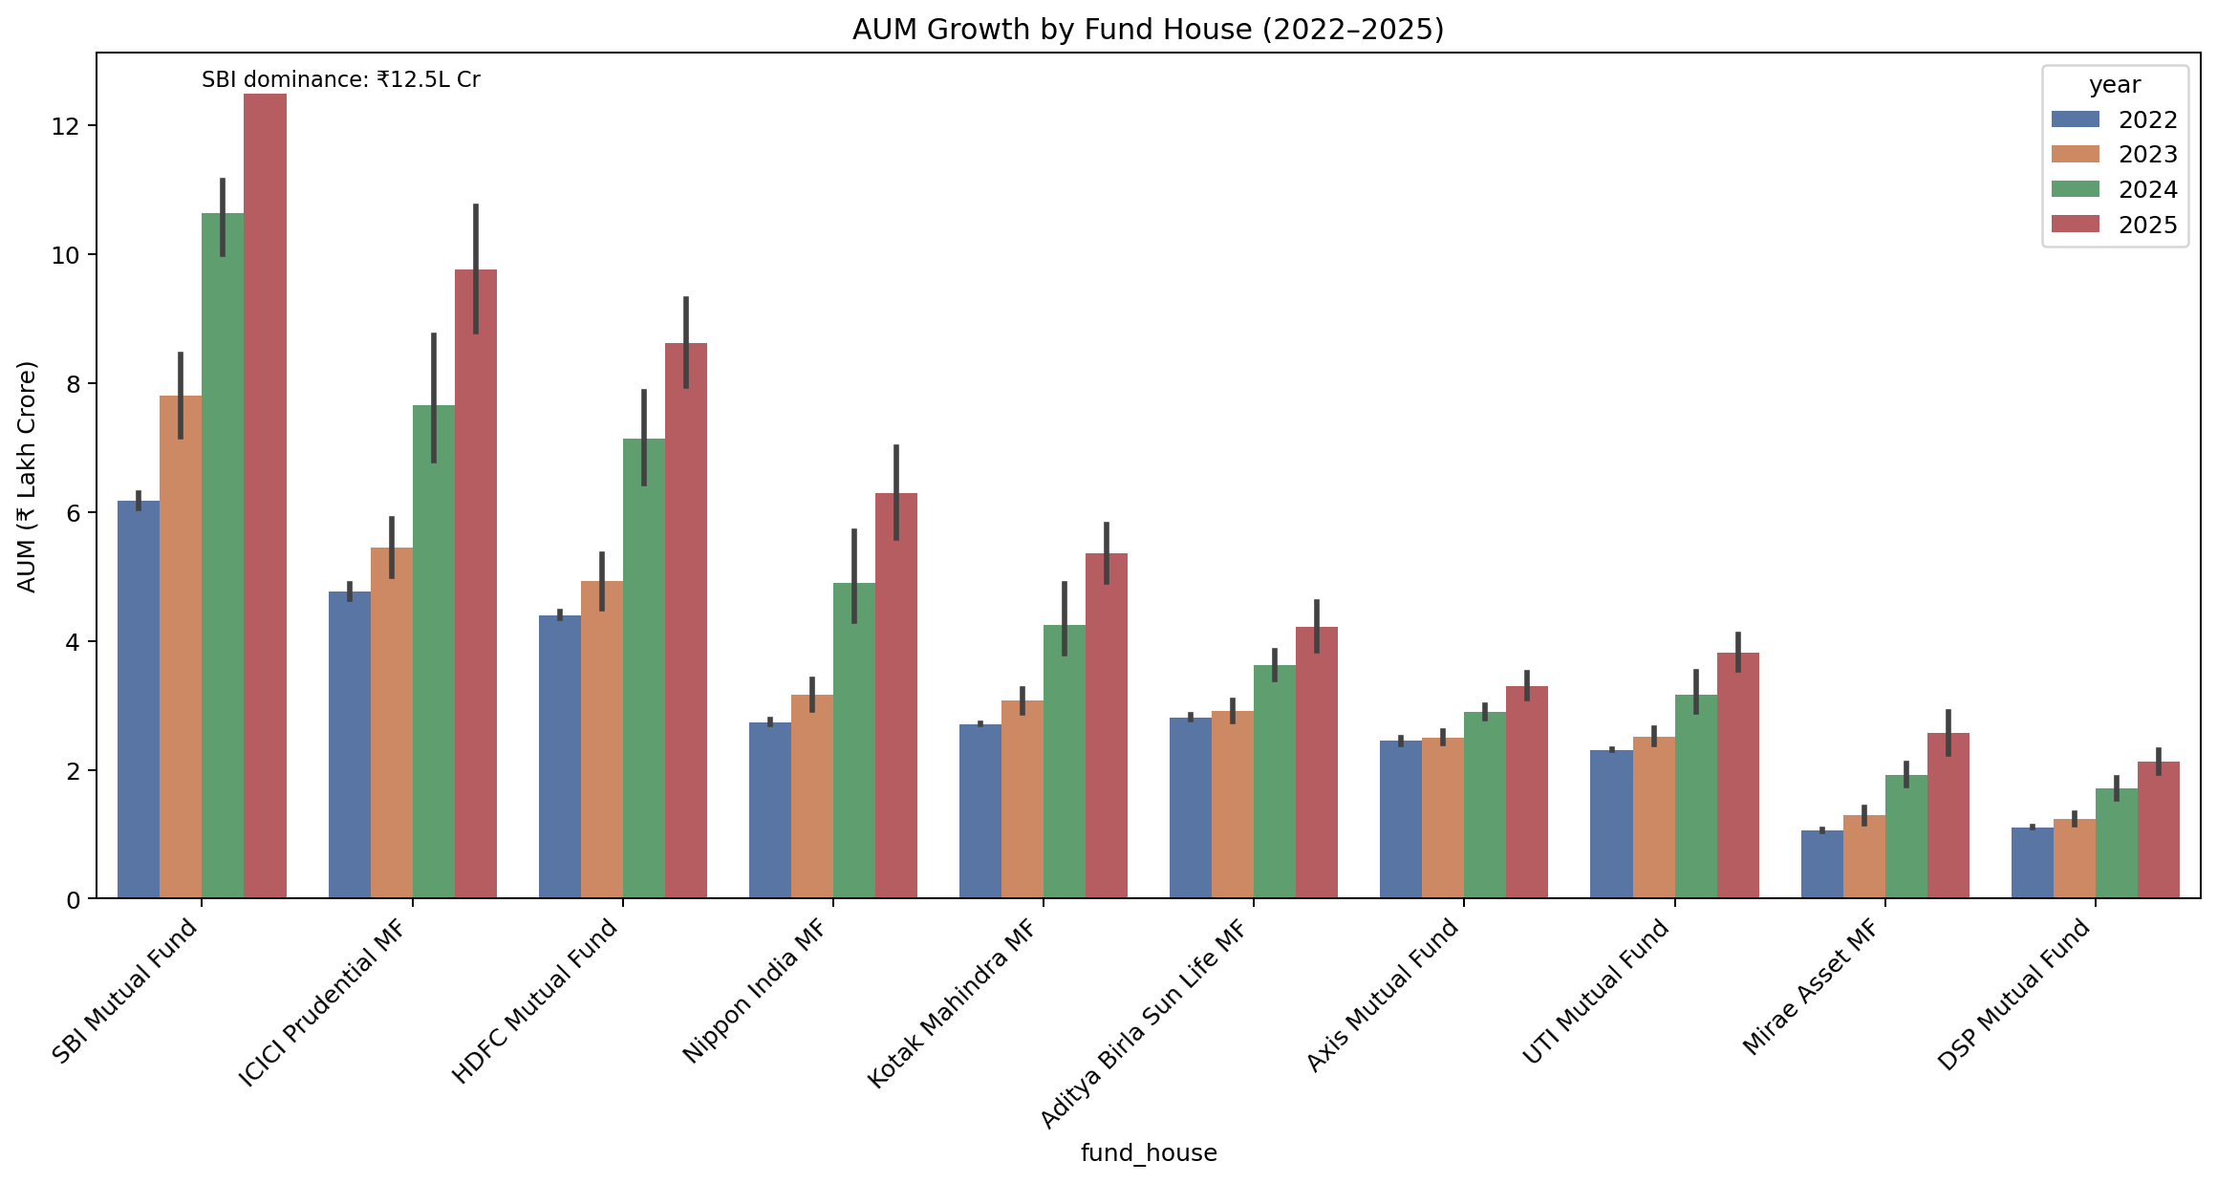
Data Sources
40 fund master records with fund house, category, plan, benchmark, expense ratio and risk profile.
46,000 NAV history records for daily trend and return calculations.
32,778 investor transactions for cohort, SIP, geography and demographic analysis.
AUM, SIP inflow, folio count, category inflow, holdings and benchmark index datasets.

Slide 4
Architecture
Raw CSV + API
Python ETL
Cleaned CSVs
SQLite DB
Analytics Notebooks
Power BI Dashboard
Data ingestion and validation are handled in Python.
Star schema supports fund, date, NAV, transactions, performance and AUM analysis.
Reports, charts and dashboard screenshots complete the business presentation layer.

Slide 5
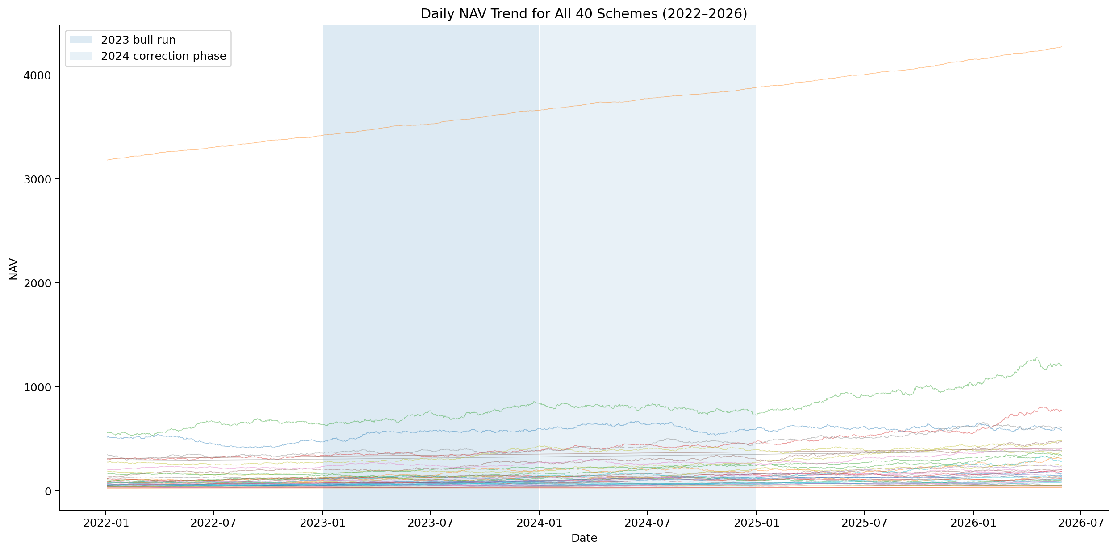
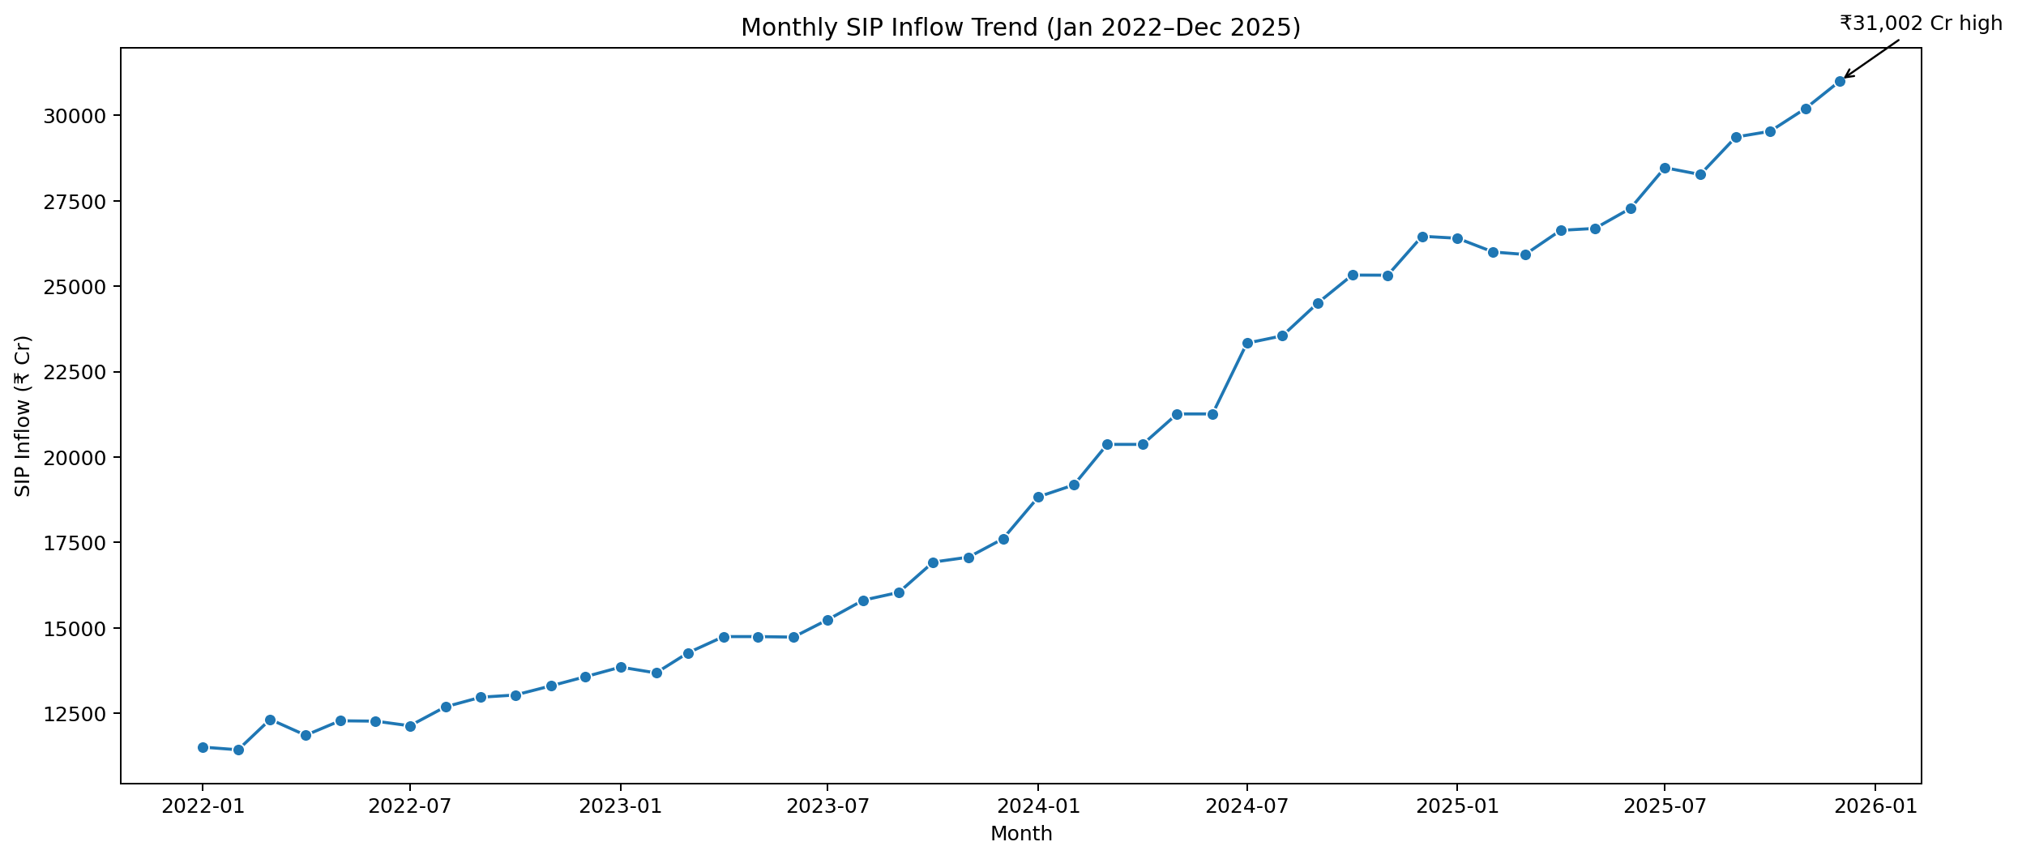
EDA Highlights - NAV and SIP
NAV trends show market cycles across schemes.
SIP inflows rise strongly through the observed period.
Retail participation is visible through SIP and folio growth.

Slide 6
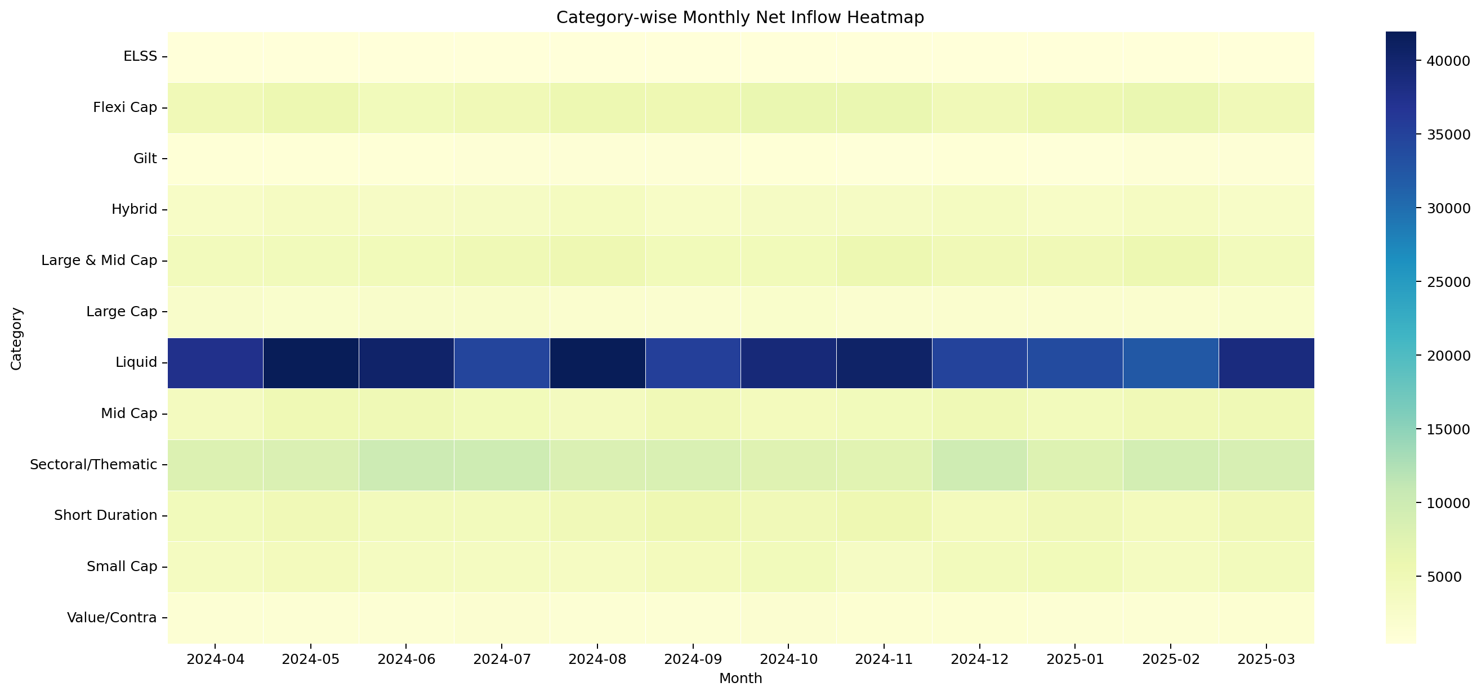
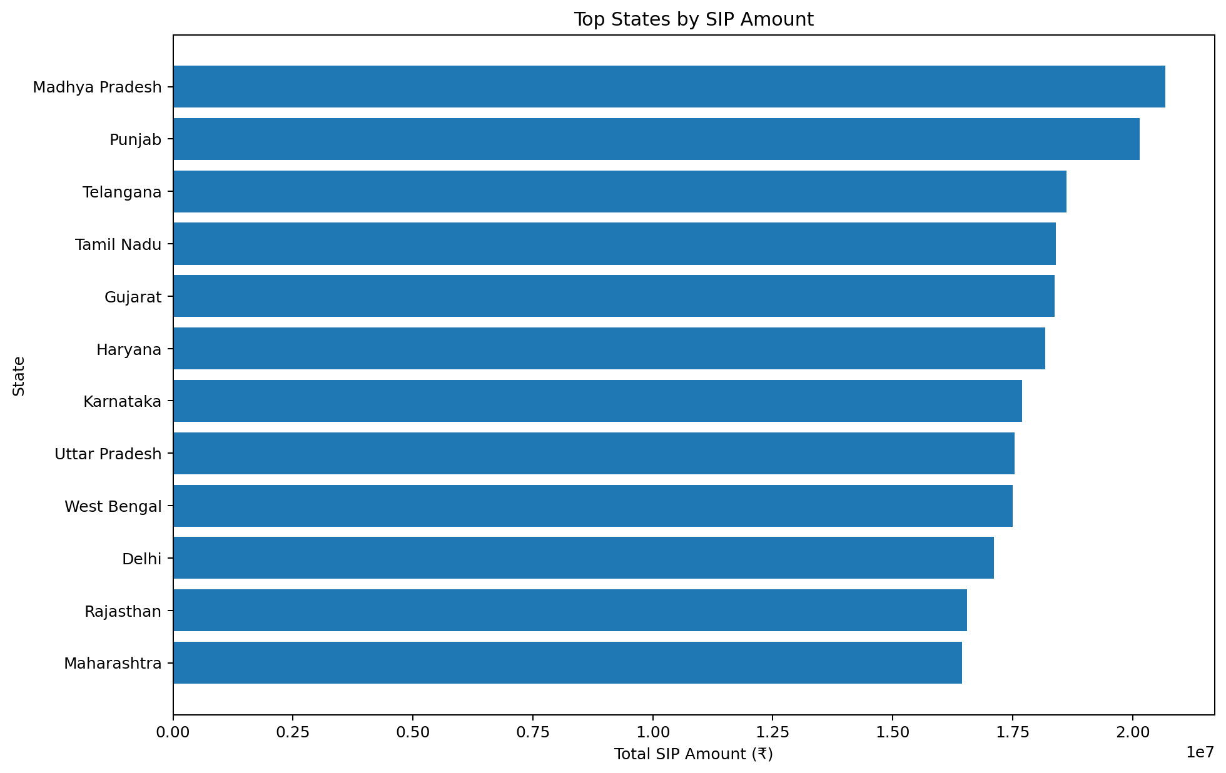
EDA Highlights - Investors and Categories
Category inflow heatmap highlights changing investor preferences.
State-wise SIP amount supports geographic prioritization.
City tier and age group analysis add investor segmentation.

Slide 7
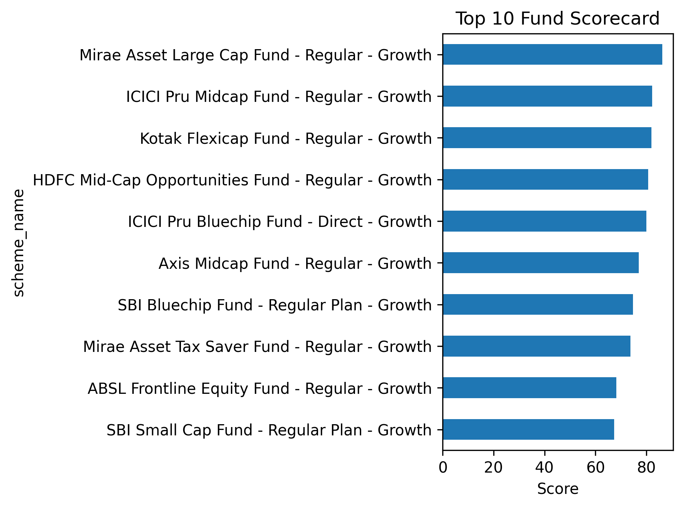
Performance Metrics - Scorecard
Scorecard combines 3-year return, Sharpe, Alpha, expense ratio and maximum drawdown ranks.
The model gives a balanced comparison instead of relying on return alone.
Outputs include fund_scorecard.csv and performance metrics tables.

Slide 8
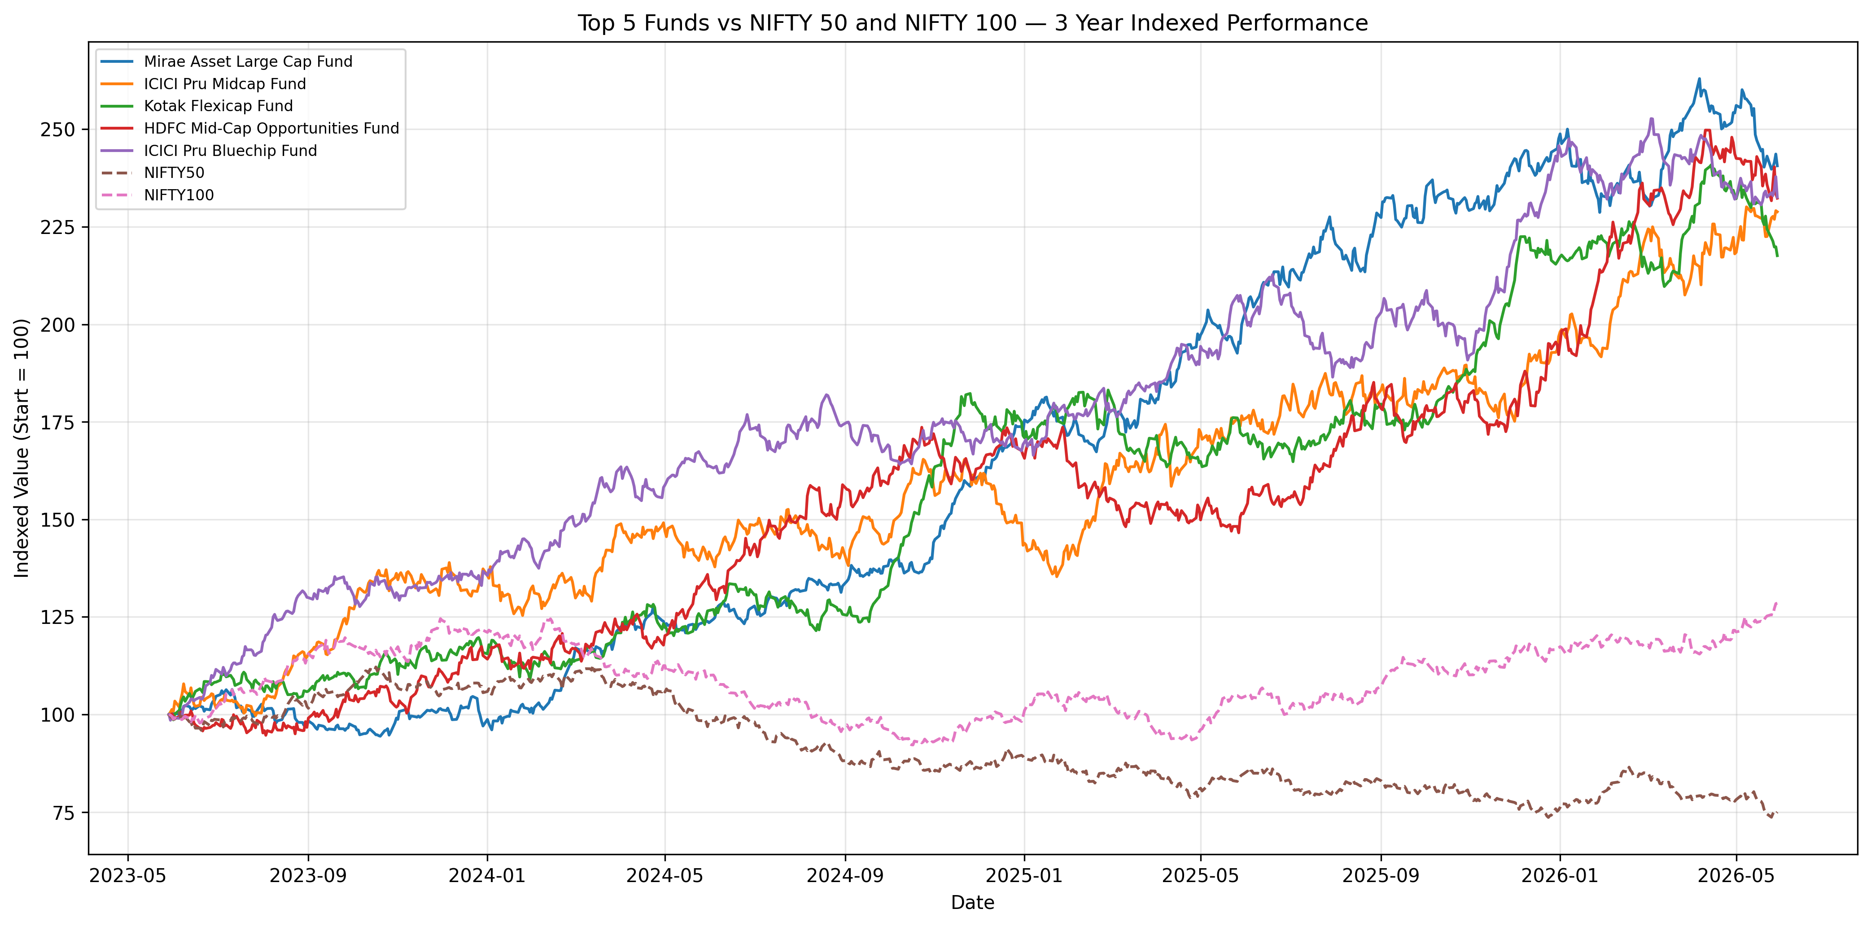
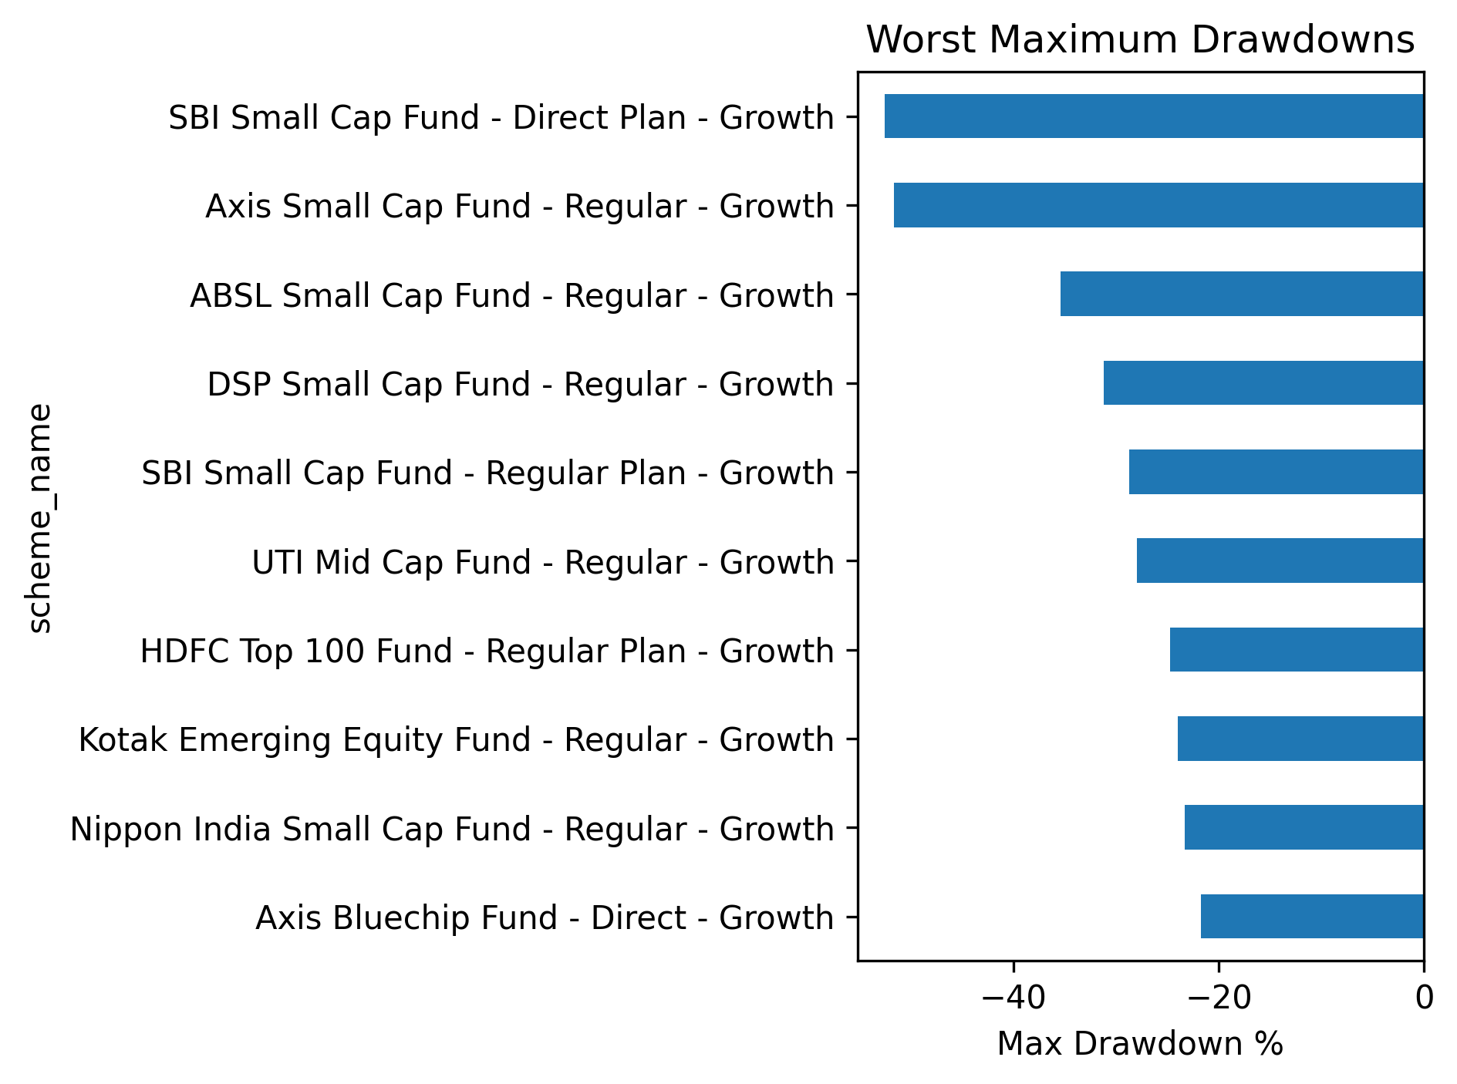
Performance Metrics - Benchmark and Drawdown
Benchmark comparison tracks top funds versus Nifty 50 and Nifty 100.
Drawdown analysis captures downside risk and market stress behavior.

Slide 9
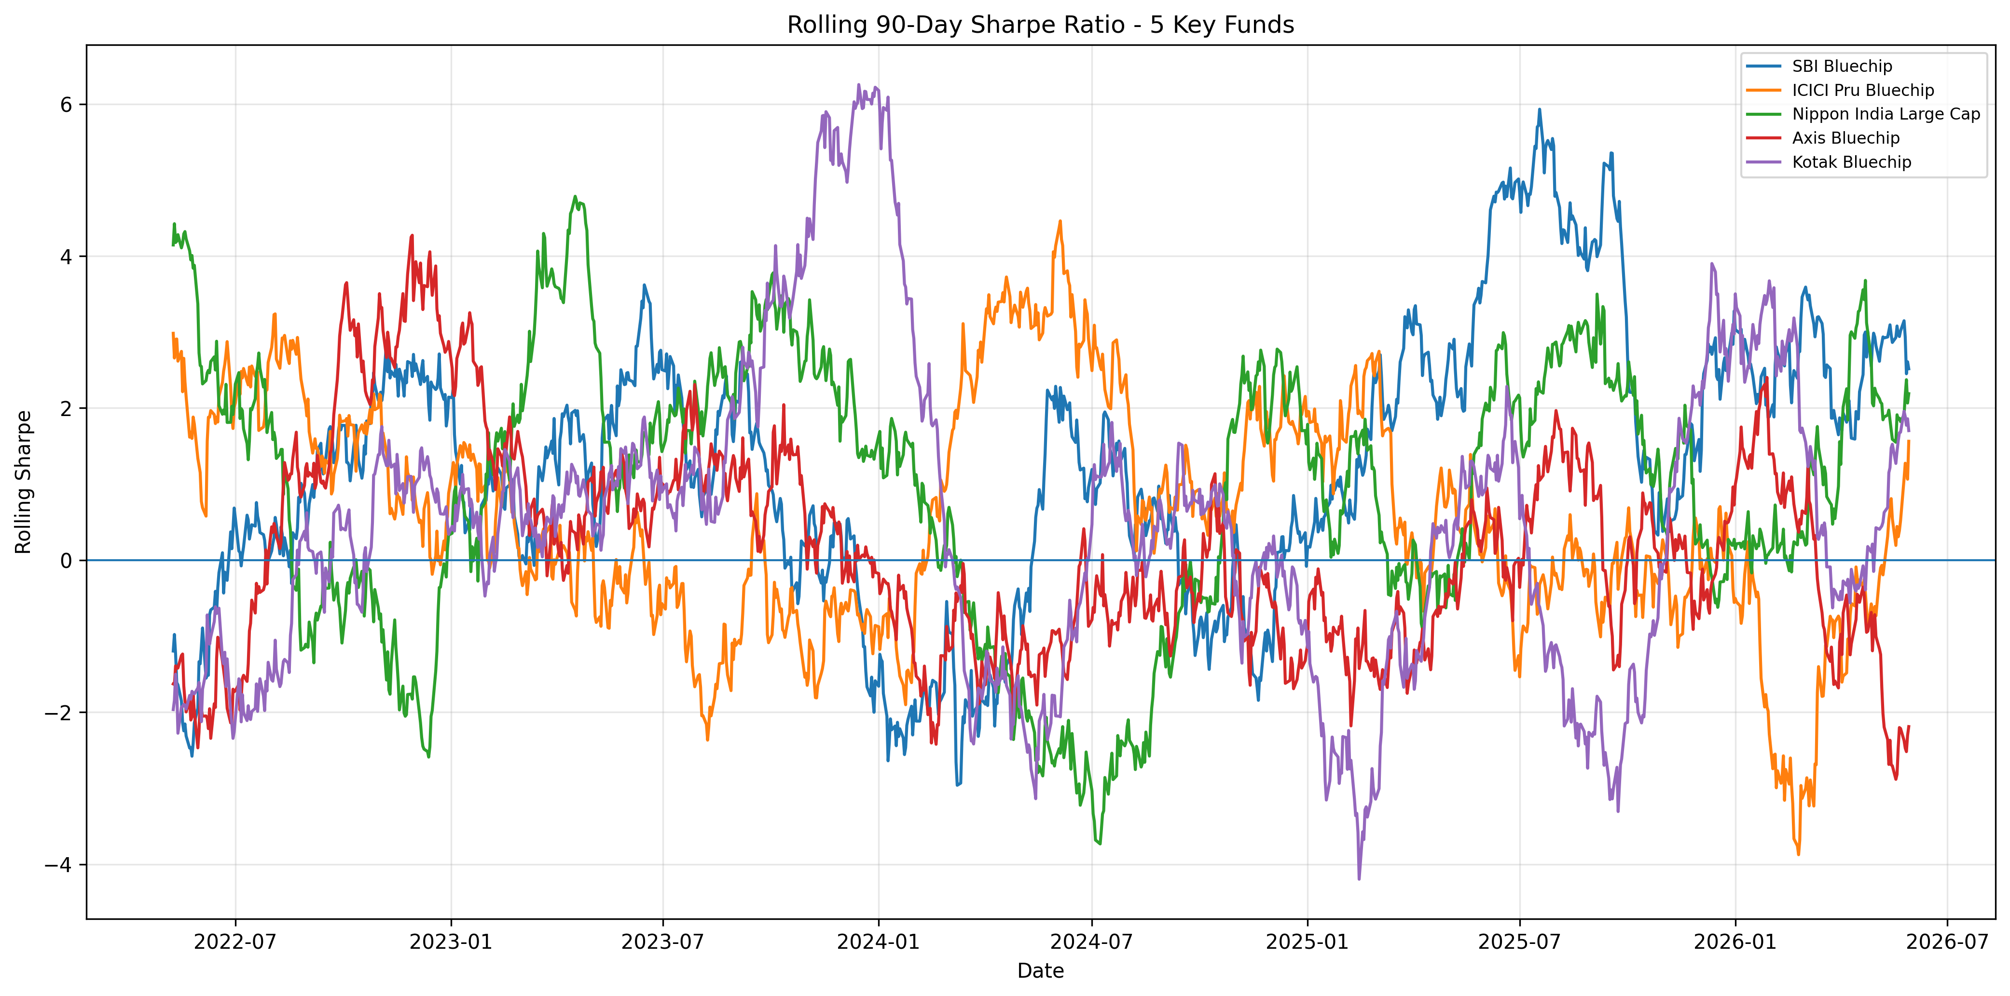
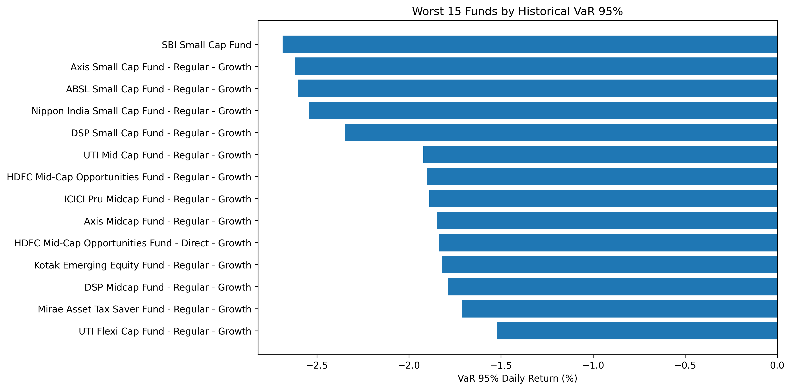
Advanced Analytics
Historical VaR and CVaR estimate downside risk from daily returns.
Rolling 90-day Sharpe tracks changing risk-adjusted performance.
Cohort analysis, SIP continuity and HHI concentration add investor and portfolio intelligence.

Slide 10
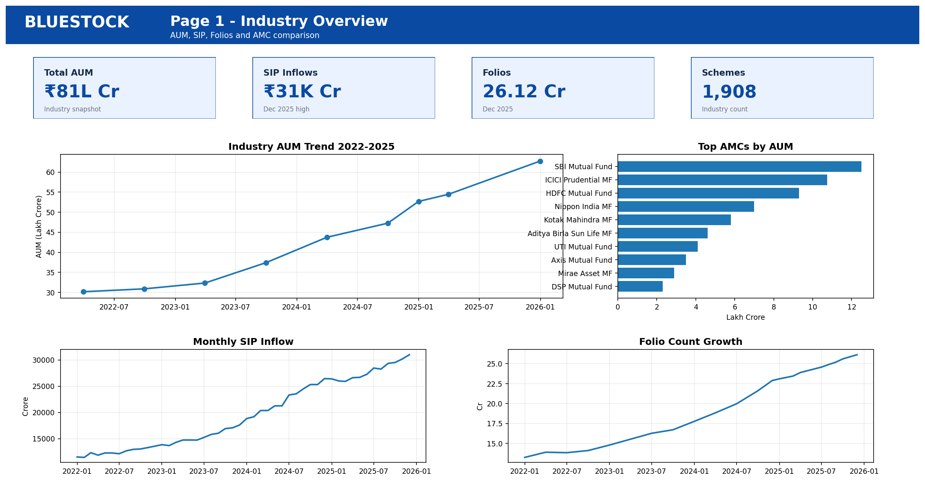
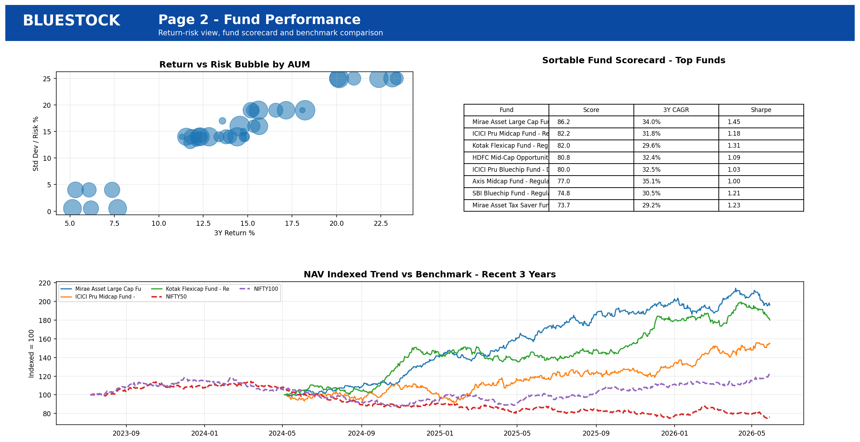
Dashboard Screenshots - Overview and Performance

Slide 11
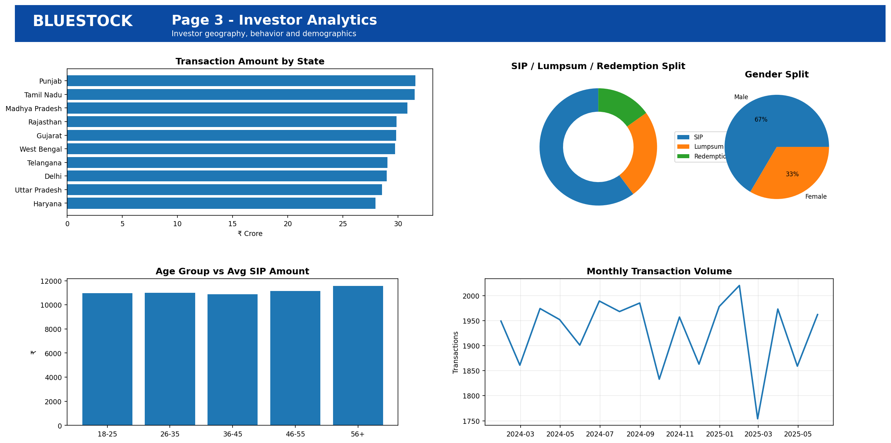
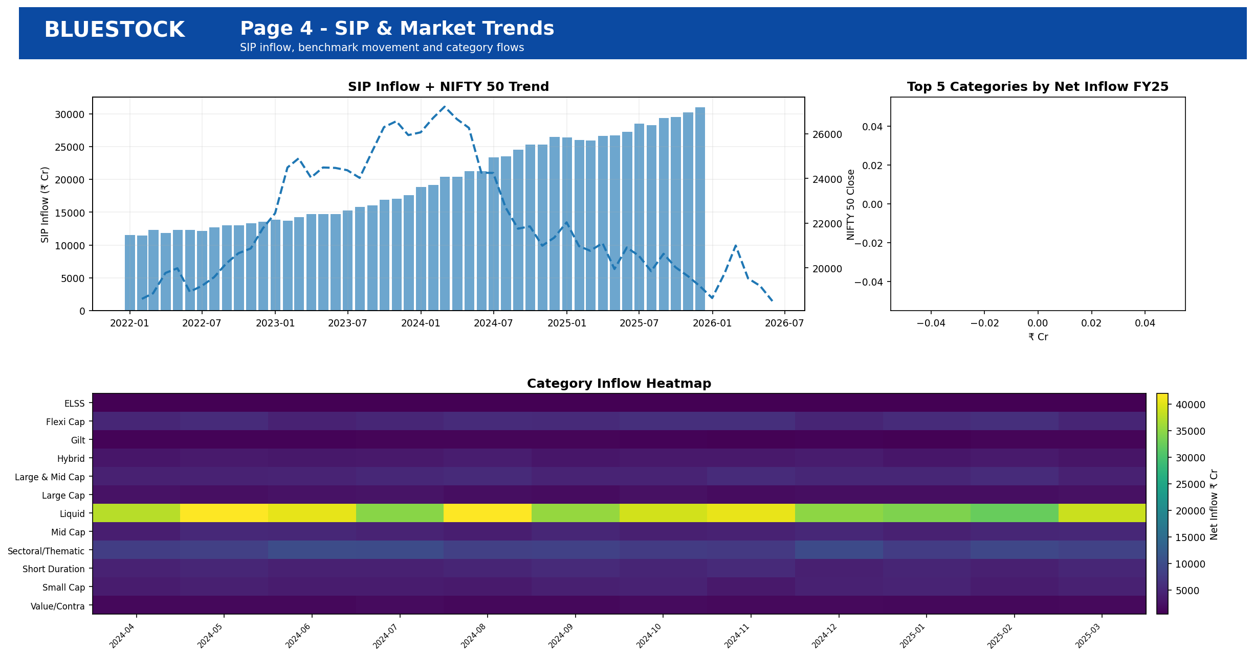
Dashboard Screenshots - Investor and Market

Slide 12
Key Findings & Thank You
SIP inflow reaches Rs 31,002 Cr in the latest tracked month.
Folio count reaches 26.12 Cr, showing strong investor participation.
SBI Mutual Fund leads the latest AUM snapshot in the dataset.
Risk-adjusted metrics and downside risk are essential for fund recommendation.
Thank you.

