Slide 1
Yoga pose estimation using deep learning
Internal Guide:
B. Vijay Kumar
Asst Professor
Presented BY:
G.GANESH
19671A1216
Information technology

Slide 2
INTRODUCTION
Like every exercise, it is most important to practice yoga poses accurately as any abnormal posture is not productive and tends to cause harm.
This suggests having an instructor around while performing yoga. It is not always possible to have an instructor or to join yoga classes with nowadays lifestyle. An AI-based system helps to identify yoga poses and gives feedback or suggestions to users.
These instructions help users improve their poses so that it is productive and not detrimental. The challenges in this project are key points should be detected without any missing points and models should work properly even when body parts are overlapped. they are nearly the same poses with a slight difference in them

Slide 3
ABSTRACT
The fundamental goal of Yoga pose detection and is provide standard and correct yoga postures using computer vision. If the yoga posture is not done properly, it can result in serious injuries and long-term issues. Analyzing human poses to detect and correct yoga poses can benefit humans living a healthier life in their homely environment. This project focuses on exploring the different approaches for yoga pose classification, so we are using Pose Net and KNN classifier. Using such deep learning algorithms, an individual can get the correct/ideal way/method to perform that specific yoga asana that he/she is trying to do. Using computer vision techniques and Open Pose (an open-source library), human pose estimation is used to estimate an individual's Yoga posture. The suggested system recognize the difference between the actual and target positions and corrects the user with high accuracy by offering real-time visual output and necessary instructions to correct the identified pose.

Slide 4
EXISTING SYSTEM
A Hindu spiritual and ascetic discipline, a part of which, including breath control, simple meditation, and the adoption of specific bodily postures, is widely practiced for health and relaxation
Yoga poses accurately as any abnormal posture is not productive and tends to cause harm. This suggests having an instructor around while performing yoga..

Slide 5
DRAW BACKS
It is not always possible to have an instructor or to join yoga classes with nowadays lifestyle
In fast-paced lifestyles, many people prefer self-learning so it not always possible to consult the mentor

Slide 6
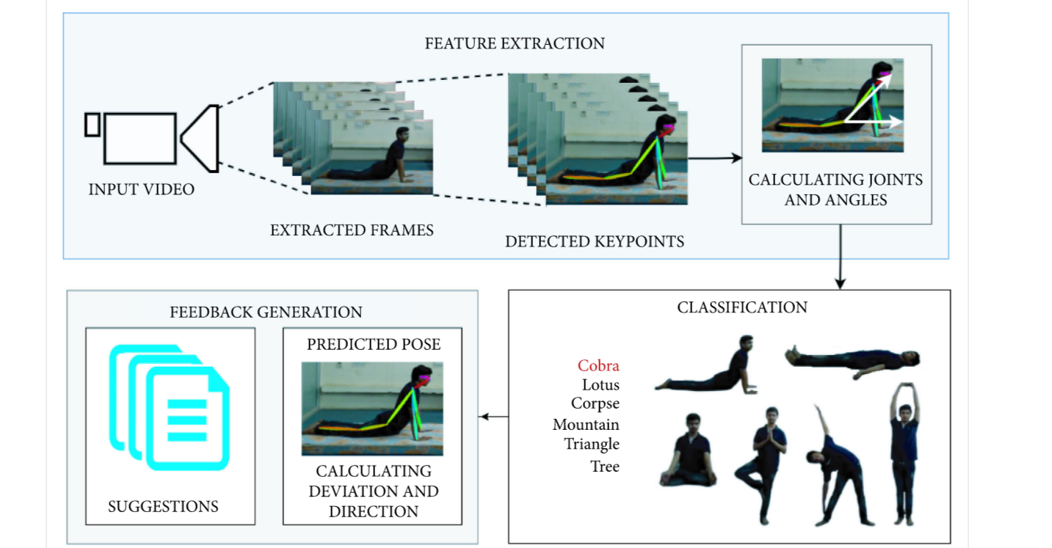
PROPOSED SYSTEM

Slide 7
Proposed system
The proposed system is confined to 6 yoga poses, where there are a total of more than 80 yoga poses. The proposed dataset can be expanded by adding required yoga pose key points.
The technology may also be used to make real-time predictions and self-training on a mobile device.
detect incorrect yoga posture and also advise the user to improve the pose by specifying where the yoga pose is going wrong

Slide 8
Software requirements
Language: Python
Packages: CV2, Pandas, mediapipe etc.
IDE: VS code
Operating system: windows 10 and above

Slide 9
Hardware requirements
Hard disk: 256.0 GB
RAM: 4.0GB
Processor: intel core i3 or i5
Web cam

Slide 10
Functional requirements
Input video
Extracted frames
Feature extraction
Detected key points with body joints
Calculating joints and angles
Classification
Feed back generation

Slide 11
Non Functional Requirements
Reliable
Flexible
Maintanable

Slide 12
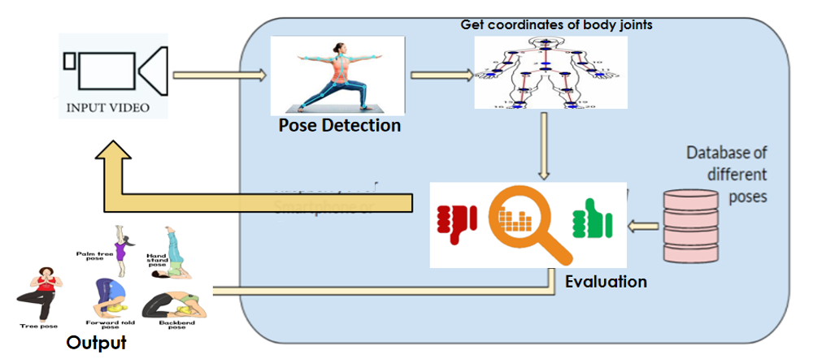
System Architecture

Slide 13
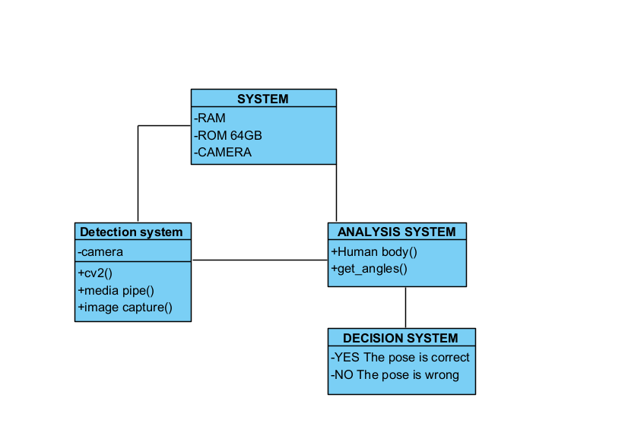
Class Diagram

Slide 14
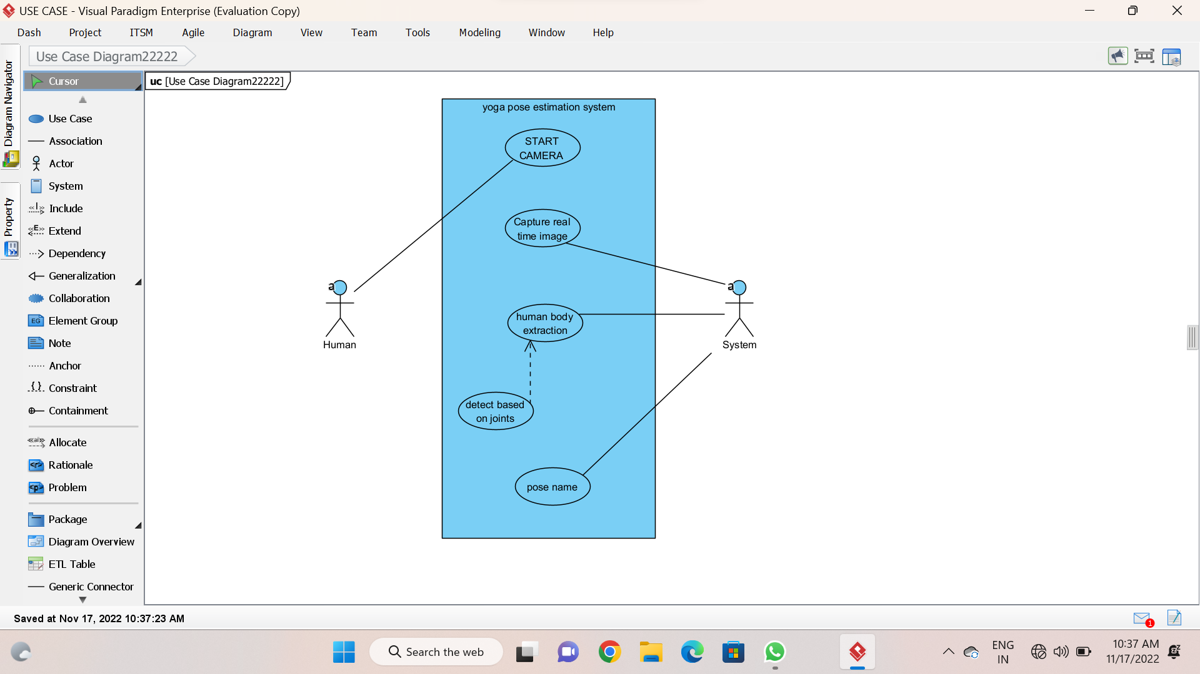
Use case diagram
<<Include>>

Slide 15
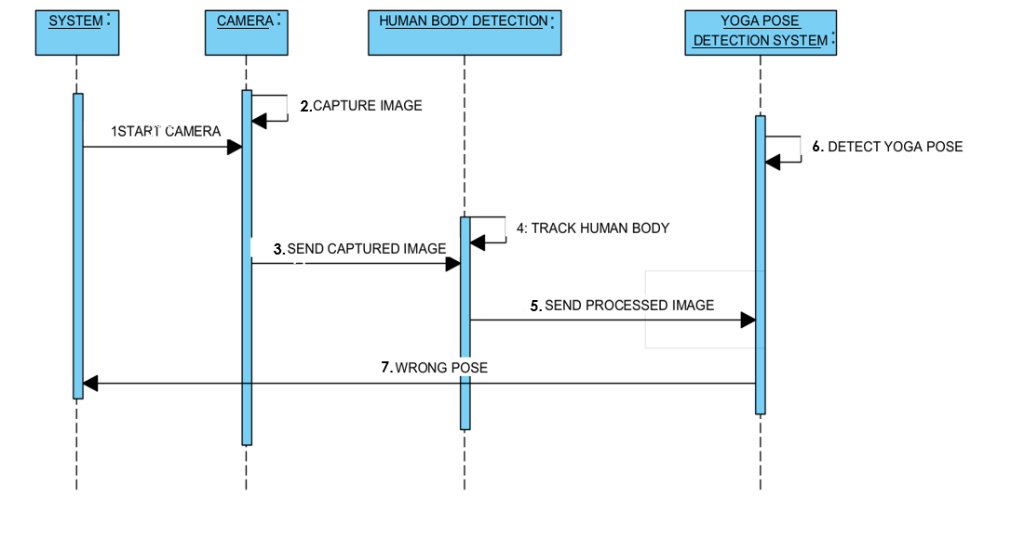
Sequence Diagram

Slide 16
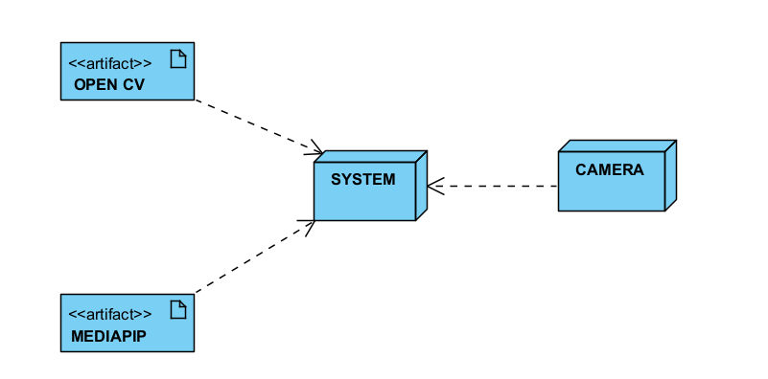
Deployment diagram

Slide 17
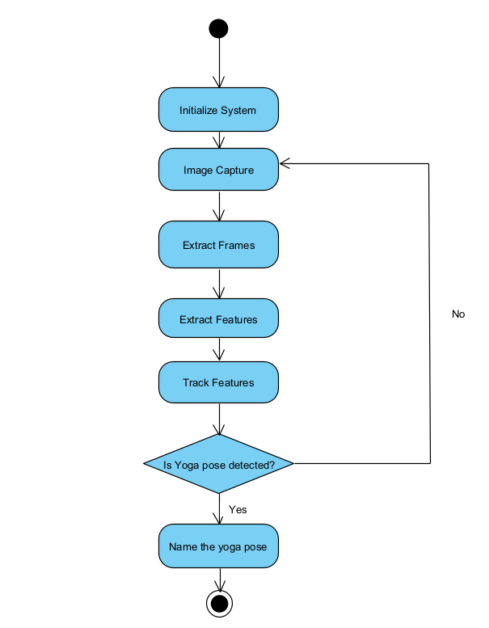
Activity diagram

Slide 18
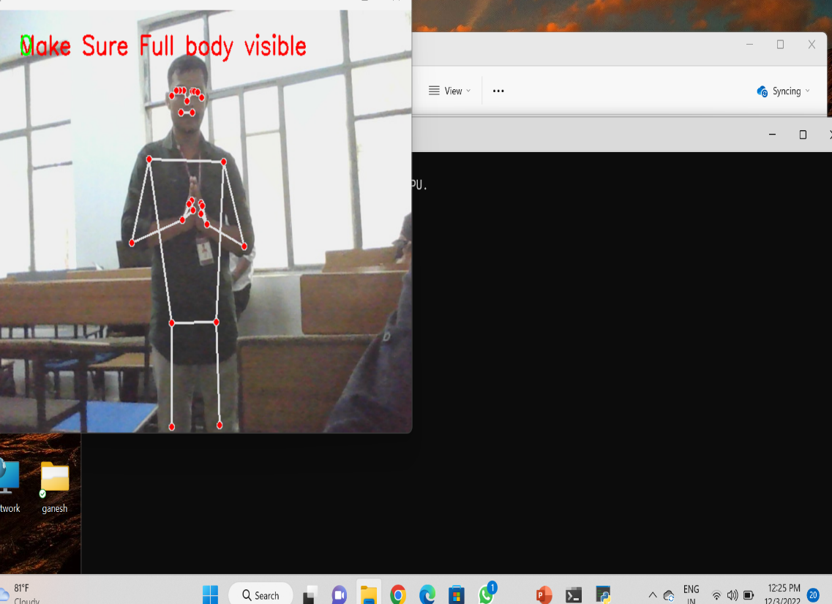
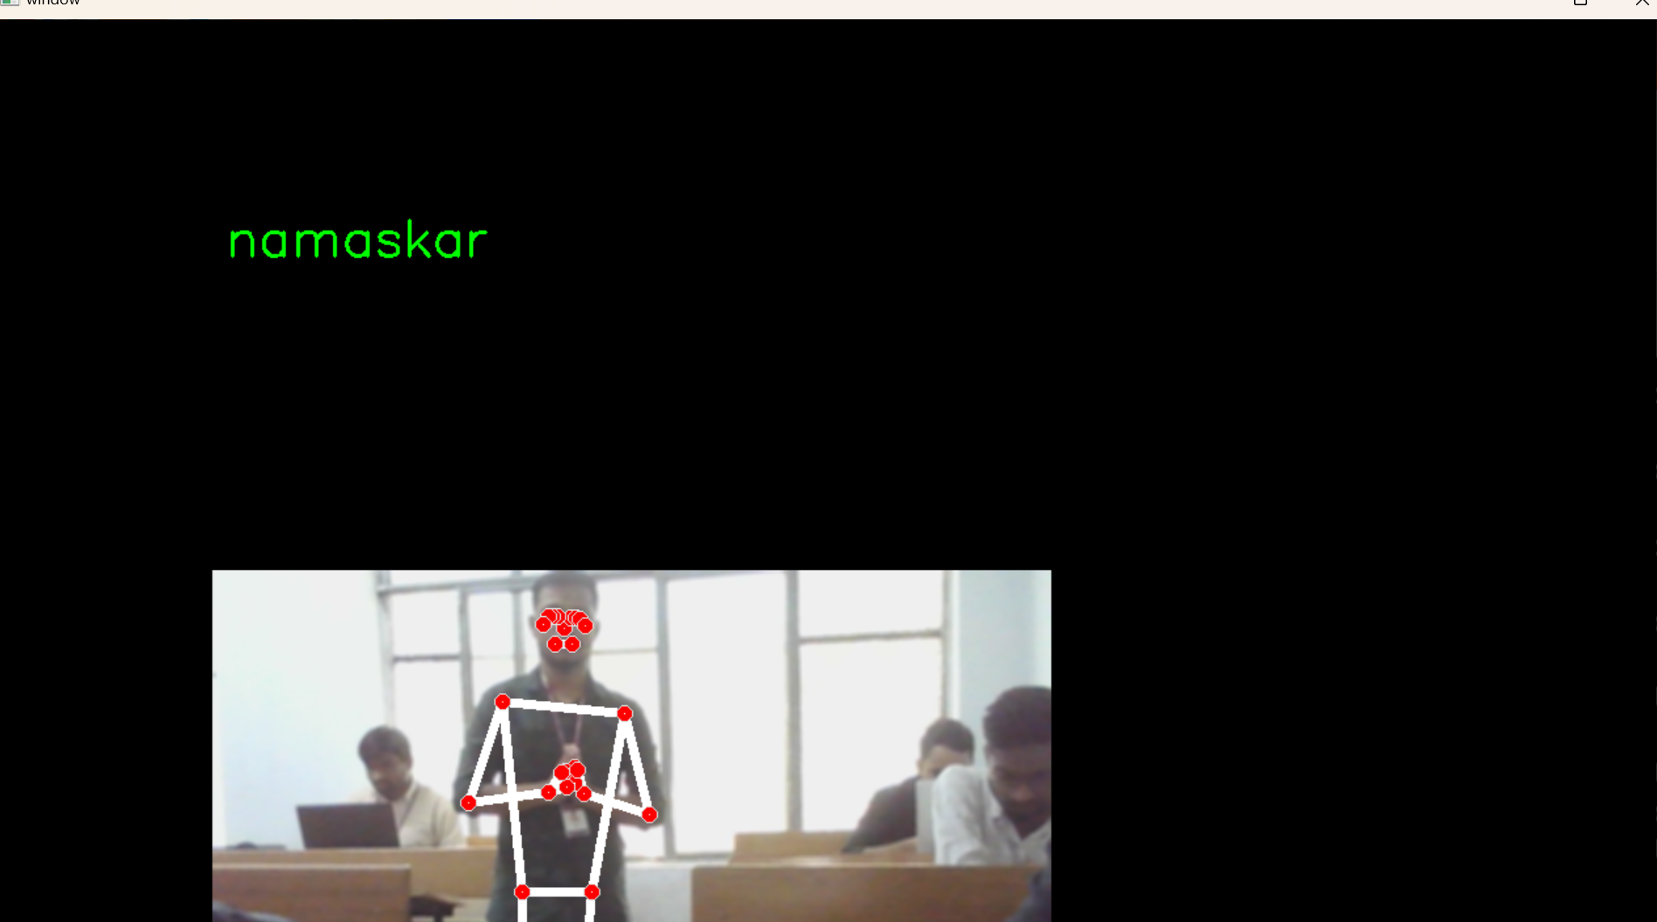
Result Screens
Training Yoga pose
Output

Slide 19
Conclusion
yoga pose estimation is different as it has to localize and assemble human body parts on the basis of an trained yoga poses of the human body . Application of yoga pose estimation in fitness and sports can help prevent injuries and improve the performance of people’s workout.

Slide 20
Future Enhancement
Multi-person yoga pose estimation is a whole new problem in itself and has a lot of scope for future research
It need to develop which may not perform well in cases of overlap between group of people or overlap between body parts.
pose estimation in crowded scenarios would have multiple persons which will involve tracking and identifying pose of each individual

Slide 21
THANK YOU !

