Slide 1


Web Scraping and Exploratory Data Analysis of Flipkart Tv’s data

Slide 2

About Me:
Hi, I’m Ganesh, a tech enthusiast currently learning Python, Data Analysis, and SQL. I enjoy exploring how data and AI can make complex ideas simple and accessible. I believe in continuous learning and improving with every project I work on.

Slide 3
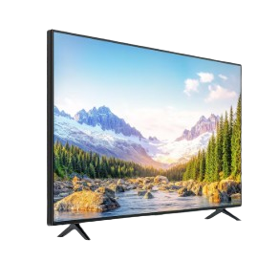
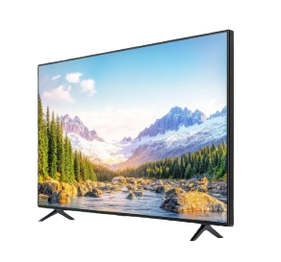
Content:
Introduction
Business problem
Objectives
Web Scraping
Tools Used
Data Cleaning
Data Visualization
Key Business Q/A
Conclusion
Experience & Challenges

Slide 4
Introduction:
Flipkart is one of India’s largest and most influential e-commerce platforms, offering a wide range of products across categories such as electronics, fashion, home appliances, groceries, and more. Founded in 2007 by Sachin and Binny Bansal.
The Flipkart TV Data Analysis project focuses on exploring product details, pricing patterns, and customer ratings from Flipkart’s online marketplace.
Data was collected through web scraping and refined for meaningful insights using Python libraries like Pandas, Seaborn, and Matplotlib.
The dataset includes information on TV brands, display sizes, prices, and ratings.
Through visualization techniques such as heatmaps and trend charts, the study identifies key factors influencing price and popularity.
This project highlights how data analysis helps understand market trends and customer preferences in India’s growing smart TV industry.

Slide 5

Business Problem:
Flipkart’s TV data is scattered across various web pages and formats, making it difficult to analyze price patterns and product features effectively.
Consumers and sellers lack structured insights into brand performance, pricing trends, and customer preferences.
There is a need for organized data analysis to uncover meaningful patterns and support better product comparisons and market understanding.

Slide 6

Objectives:
To analyze and compare Flipkart TV products based on brand, price, display size, and customer ratings.
To provide data-driven insights that help buyers and sellers understand pricing patterns and brand performance.
To explore how different factors like display size and rating influence overall pricing and popularity.
To visualize key market trends and identify the most preferred TV features among customers.

Slide 7






Tools Used:

Slide 8

Web Scraping:
Flipkart’s official website was chosen as the main source for extracting TV product information.
Used browser developer tools (Inspect Element) to locate key HTML tags containing product details.
Applied Python’s BeautifulSoup and Requests libraries to scrape structured data from multiple pages.
Automated HTTP requests were used to gather large volumes of TV listings efficiently.
The collected data was cleaned, formatted, and stored in tabular form for further analysis and visualization.

Slide 9

Data Cleaning Steps:
Removed unwanted symbols, tags, and extra spaces from product names and specifications.
Standardized brand, display type, and resolution fields for consistent data representation.
Converted price and rating columns from string/object to numeric types for accurate analysis.
Handled missing values in columns such as brand, rating, or price using appropriate defaults.
Organized and harmonized key attributes like screen size and price range for clear trend analysis.

Slide 10

Data Visualization:
Helped uncover hidden patterns and relationships among price, brand, rating, and screen size.
Simplified complex data into clear, interpretable visuals using heatmaps, bar charts, and scatter plots.
Enabled quick comparison of brand performance and pricing trends across multiple TV categories.
Supported data-driven insights by translating raw numbers into meaningful visual stories.
Highlighted correlations between customer ratings and pricing using focused heatmaps.
Enhanced decision-making and presentation clarity through visually engaging and informative plots.

Slide 11
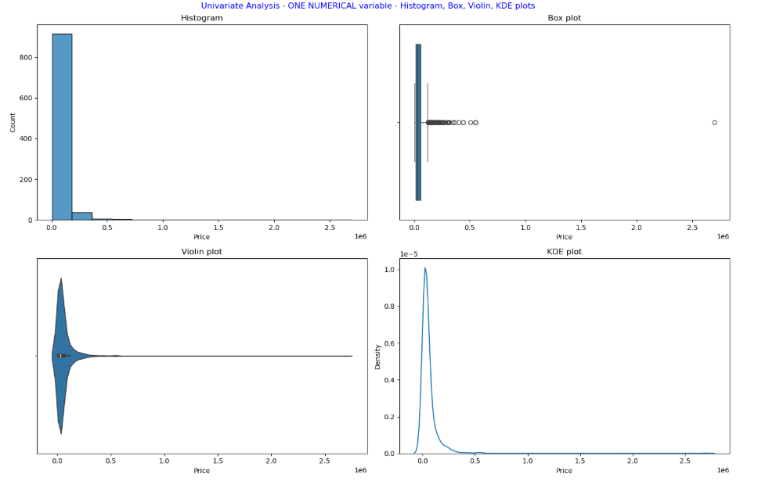
Univariate Analysis
1. Price Distribution
Most TVs are priced between ₹15,000 and ₹35,000, indicating strong customer demand for mid-range models.
Only a small portion of TVs are above ₹60,000, showing that premium models occupy a limited market share.

Slide 12
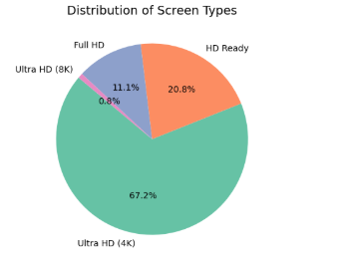
Ultra HD (4k) dominate the listings, making up the majority of available models on Flipkart.
Ultra HD (8k) and Full HD TVs are fewer in number, reflecting their premium nature and higher price segment
2. Screen Type Distribution

Slide 13
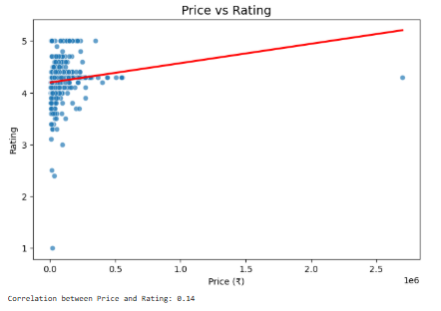
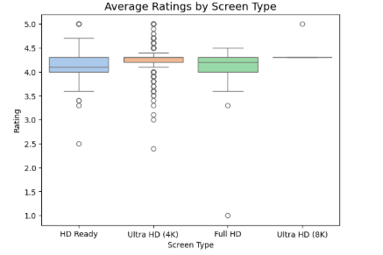
Bi-variate Analysis
1. Price vs Rating
2. Average Rating by Screen Type
There is no strong correlation between Price and rating — many affordable TVs (₹10K–₹20K) receive equally high ratings (4.2+).
On average, 4K TVs have slightly higher ratings (~4.3) compared to HD Ready (~4.1) models.

Slide 14
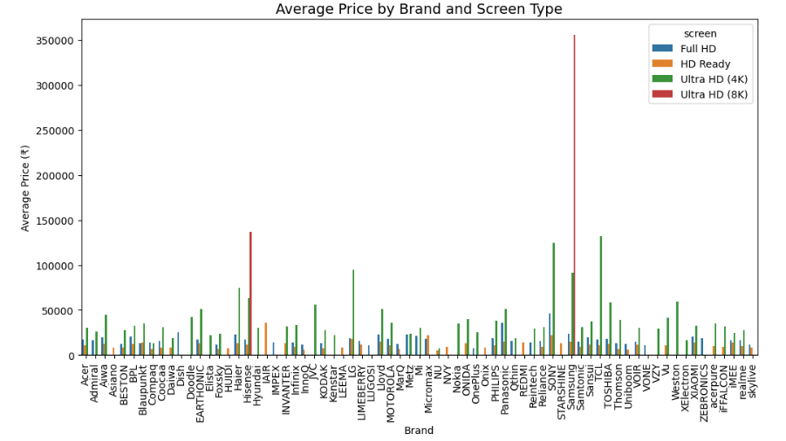
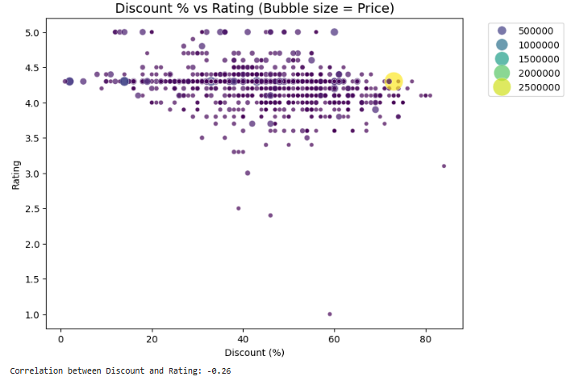
Multi-Variate Analysis
1. Brand vs Screen Type vs Average Price
2. Discount %, Price & Ratings Relationship
Premium brands like Sony and Samsung dominate the 4K category with higher average prices (₹60K–₹1L+), while realme, Foxsky, and Coocaa target the budget HD/Full HD segments (<₹20K).
TVs with moderate discounts (30–50%) have the highest average ratings, whereas those with very high discounts (>70%) often have lower ratings.

Slide 15
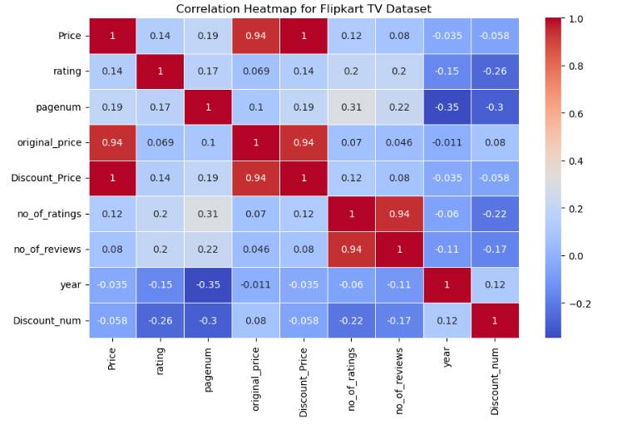
Correlation of Numerical Columns Heatmap
Price shows very weak correlation with both Rating and Year, implying that pricing patterns are largely independent of customer feedback or release time.
Rating and Year exhibit a slight negative correlation, suggesting newer TVs have received fewer or slightly lower ratings.
Overall, no strong linear relationships exist among numeric variables, indicating that other non-numeric factors (like brand, screen type, or display size) influence product trends more significantly

Slide 16

Key Business Questions
Which brand offers the widest range of TVs across different price segments?
What is the average rating difference between budget and premium TVs?
Which display types (Ultra HD, Full HD, HD Ready) dominate the Flipkart listings?
How have TV prices and ratings changed across recent years?
Which brands perform best in terms of customer satisfaction and pricing consistency?

Slide 17
Conclusion:
Dominance of Popular Brands
Brands like Samsung, LG, and Mi dominate the Flipkart marketplace, offering a wide range of TVs across multiple price segments and maintaining strong customer ratings.
Pricing Patterns and Market Segments
Most TVs fall within the ₹15,000–₹35,000 range, showing customer preference for affordable mid-range models, while premium brands attract a niche audience.
Customer Satisfaction Trends
Average ratings remain consistently high (4.0–4.5), indicating that most listed TVs deliver reliable quality and positive user experiences.
Display Type Popularity
Ultra HD (8k)TVs are the most common, while Ready HD models appear in smaller numbers but cater to the high-end segment with advanced display technologies.
Feature and Price Relationship
Correlation results show that price, year, and rating have weak relationships, suggesting that pricing depends more on brand reputation and features than on release year or customer ratings.

Slide 18
Experience– Web Scraping & Data Analysis:
Scraped Flipkart TV product data from multiple pages using Python (BeautifulSoup, pandas).
Cleaned and standardized data fields such as brand, price, rating, and screen size for uniform analysis.
Created visualizations (heatmaps, bar charts, and distributions) to explore pricing and rating trends.
Gained hands-on experience in the complete data workflow: scraping → cleaning → analysis → visualization.
Understood how data visualization simplifies complex datasets, making patterns and relationships easier to interpret.
Enhanced skills in data-driven storytelling, transforming raw data into actionable market insights.

Slide 19
Challenges – Web Scraping & Data Analysis:
Inconsistent HTML structures across different Flipkart product pages.
Missing or incomplete details in brand, rating, or price fields.
Handling duplicate listings and cleaning unstructured text data.
Dealing with request limits and slow scraping speed during data extraction.
Selecting the most informative visualizations to present clear and impactful insights.
Ensuring accurate data type conversion for numeric columns like price and rating.
Maintaining data consistency while merging scraped data from multiple pages or sources.

Slide 20
Thank you.

