Slide 1

MUSIC STORE MANAGEMENT SYSTEM
SUBMITTED BY : G. SAI GANESH REDDY

Slide 2
About me
I am G. Sai Ganesh Reddy, and I completed my B.Tech in 2024. Although my background is in Electronics, I am very interested in working with data, and this interest led me to join a Data Science course at Innomatics.
LinkedIn : https://www.linkedin.com/in/sai-ganesh-reddy-guntaka-409572268/
GitHub : https://github.com/GaneshGuntaka

Slide 3
Agenda
Objective of the Project
ER Diagram and schema explanation
Key analysis questions (use cases)
SQL query results with screenshots or summaries
Final business insights and recommendations
Conclusion (Key finding overall)
Q&A Slide
Your Experience/Challenges working on SQL – Data Analysis Project.

Slide 4
Objective of the Project:
To design and implement a relational database for a music store.
To apply SQL concepts (joins, aggregations, subqueries) on real-world data.
To analyze customer behavior, sales trends, and music preferences.
To generate insights that support business decisions like promotions, top customer targeting, and popular genre focus.

Slide 5
Schema Tables & Relationships:
Customer – Invoice – Invoice Line – Track – Album – Artist – Genre – MediaType form the sales and music hierarchy.
Employee – Customer link for support representatives.
Playlist – Playlist Track – Track manage curated lists.
Key Relationships
Customer → Invoice → Invoice Line → Track → Album → Artist → Genre.
Employee → Customer (support rep).
Many-to-many handled through Playlist Track.

Slide 6
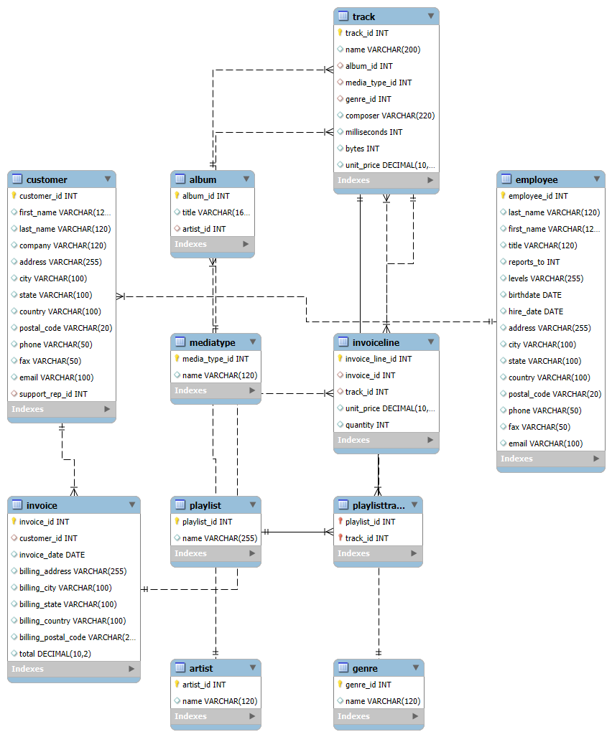
ER Diagram:

Slide 7
Key analysis questions (use cases):
Who is the senior-most employee based on job title?
Which countries generate the most invoices?
Which are the top 3 invoices by total value?
Which city has the highest revenue (best customers)?
Who is the best customer overall?
List Rock music listeners (email, name, genre).
Top 10 artists who wrote the most Rock tracks.
Tracks longer than average song length.
How much has each customer spent on each artist?
Most popular music genre by country.
Top customer in each country based on spend.

Slide 8
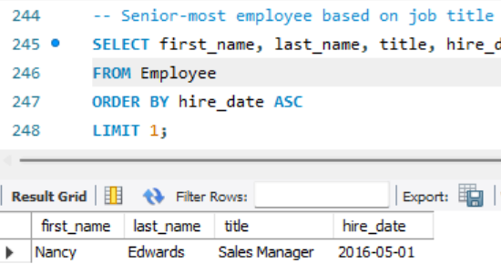
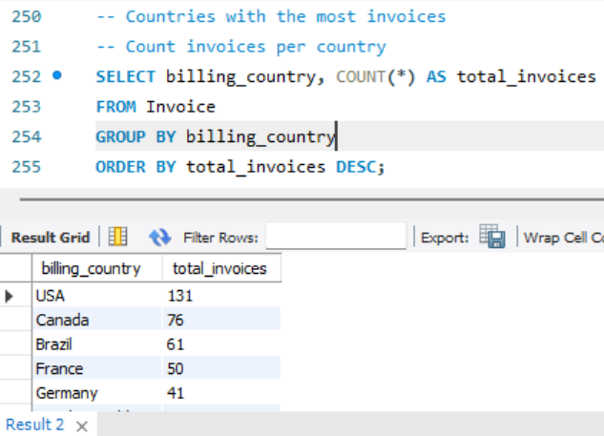
SQL query results with screenshots:
1. Senior most employee based on job title: 2. Count invoices per country:

Slide 9
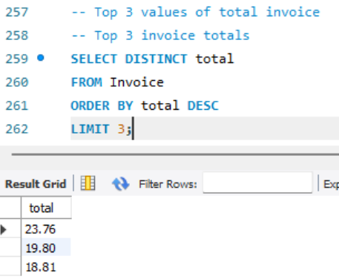
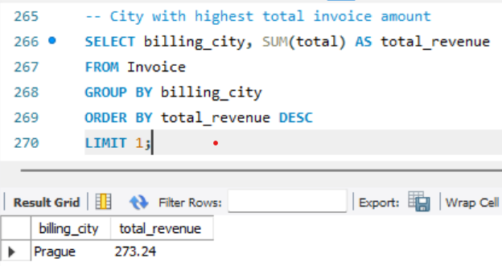
3. Top 3 invoices total: 4. City with highest total invoice amount:

Slide 10
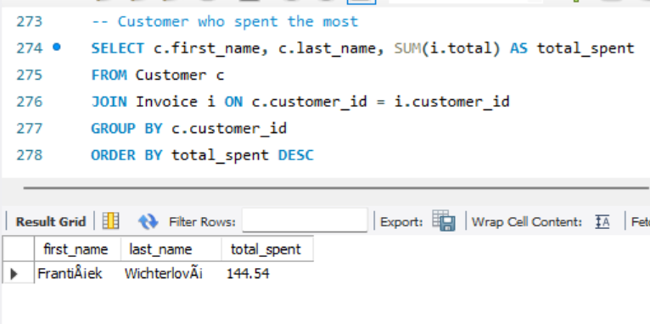
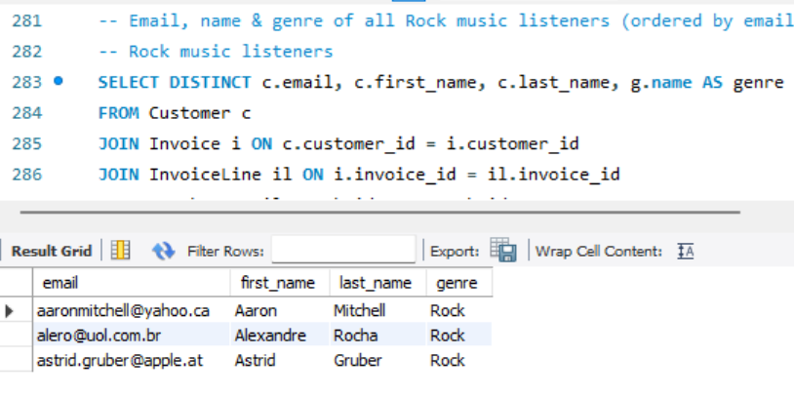
5. Customer who spent the most: 6. Rock music listeners:

Slide 11
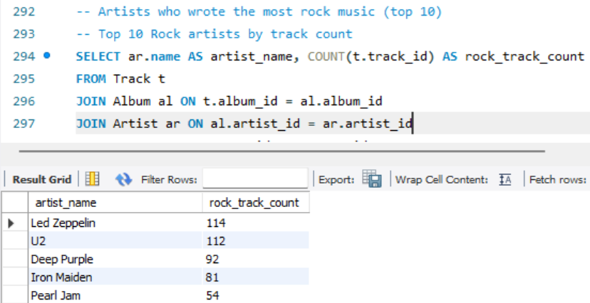
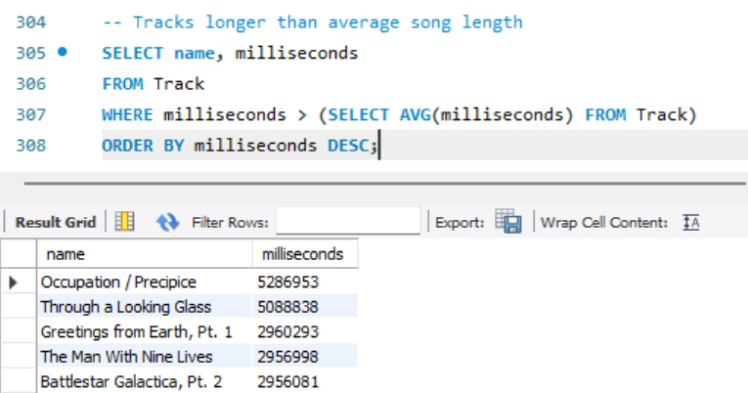
7. Top 10 rock artists by track count: 8. Tracks longer than avg song length:

Slide 12
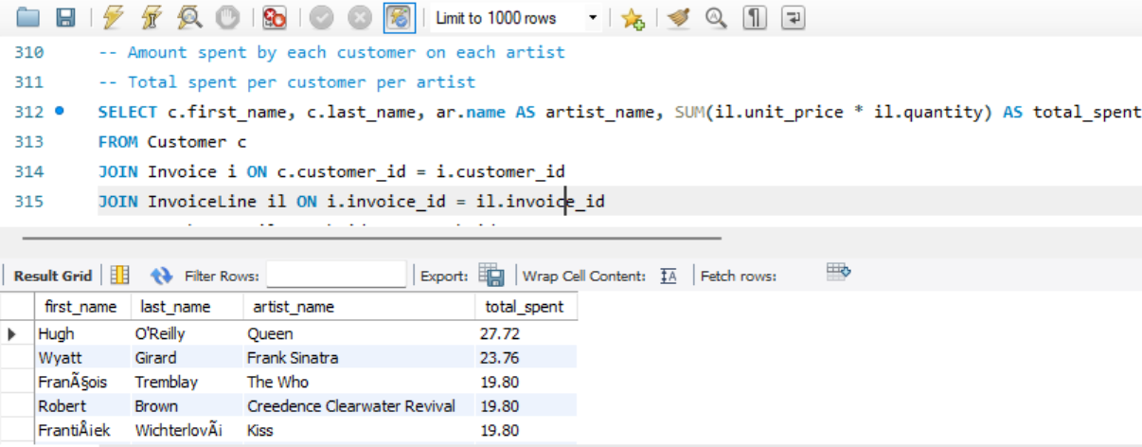
9. Amount spent by each customer on each artist:

Slide 13
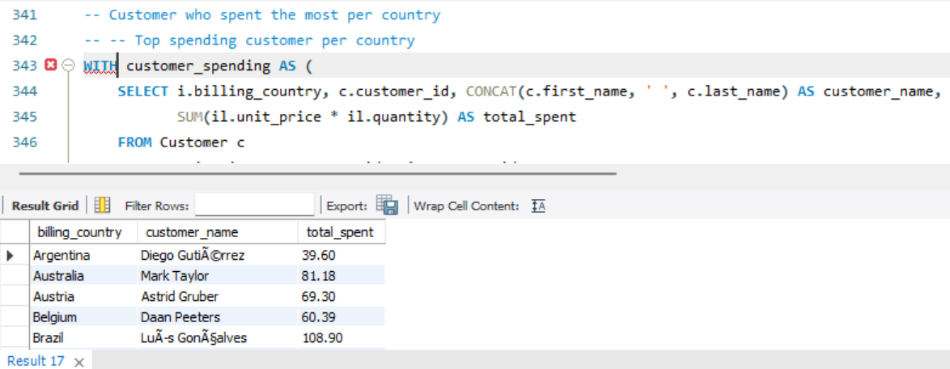
10. Customer who spent the most per country:

Slide 14
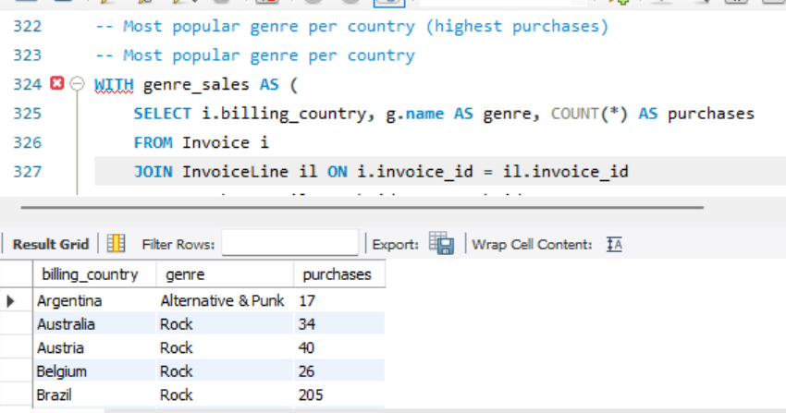
11. Most popular genre per country:

Slide 15
Final business insights and recommendations:
Revenue Concentration: Few countries and cities generate most revenue. Focus marketing there.
Customer Segmentation: A handful of high-value customers drive sales → target with loyalty programs.
Genre Trends: Rock is globally most popular. Promote Rock-focused albums/events.
Artist Promotion: Top artists contribute heavily; underperforming artists may need discounts/promotions.
Geographical Strategy: Organize festivals in top-spending cities (e.g., Prague).

Slide 16
Conclusion (Key finding overall):
Rock is the dominant genre across multiple countries.
Few customers (VIPs) contribute to majority of sales.
Certain cities/countries are hotspots for revenue.
SQL analysis helps in identifying who, what, and where to focus business strategies.

Slide 17
ANY QUESTIONS ??

Slide 18
Experience & Challenges:
Experience:
Applied SQL joins, subqueries, aggregations on a real dataset.
Learned database design and relational schema building.
Challenges Faced:
Handling large CSV imports (track, invoice Line).
Understanding foreign key relationships while writing joins.
Aggregating across multiple tables for business logic (top customer/genre).
Outcome:
Improved confidence in SQL.
Ability to derive insights from raw relational data.

Slide 19

THANK YOU

