Slide 1
Loan Credit Risk Analysis
Ganesh Jalakam

Slide 2
1. Problem Statement
The loan providing companies find it hard to give loans to the people due to their insufficient or non-existent credit history. Because of that, some consumers use it as their advantage by becoming a defaulter. Suppose you work for a consumer finance company which specializes in lending various types of loans to urban customers. You must use EDA to analyze the patterns present in the data. This will ensure that the applicants capable of repaying the loan are not rejected.
When the company receives a loan application, the company must decide for loan approval based on the applicant’s profile.
Two types of risks are associated with the bank’s decision:
If the applicant is likely to repay the loan, then not approving the loan results in a loss of business to the company.
If the applicant is not likely to repay the loan, i.e., he/she is likely to default, then approving the loan may lead to a financial loss for the company.
The data given below contains the information about the loan application at the time of applying for the loan. It contains two types
of scenarios:
The client with payment difficulties: he/she had late payment more than X days on at least one of the first Y instalments of the loan in our sample.
All other cases: All other cases when the payment is paid on time.
When a client applies for a loan, there are four types of decisions that could be taken by the client/company:
Approved: The Company has approved loan Application
Cancelled: The client cancelled the application sometime during approval. Either the client changed her/his mind about the
loan or in some cases due to a higher risk of the client he received worse pricing which he did not want.
Refused: The company had rejected the loan (because the client does not meet their requirements etc.).
Unused offer: Loan has been cancelled by the client but on different stages of the process.
In this case study, you will use EDA to understand how consumer attributes and loan attributes influence the tendency of default.

Slide 3
2. Current Loan Application Data Analysis

Slide 4
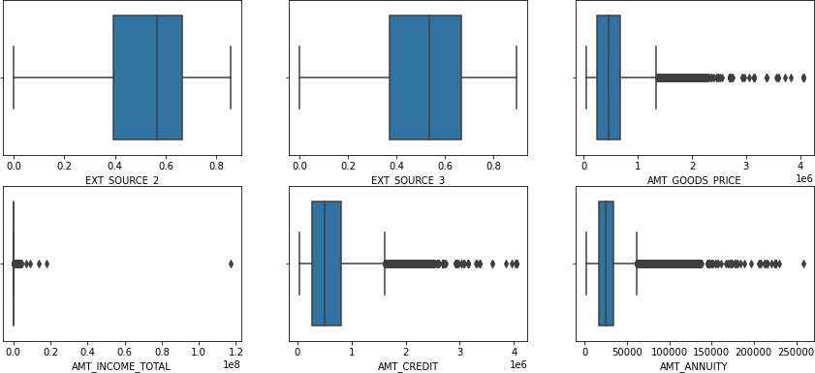
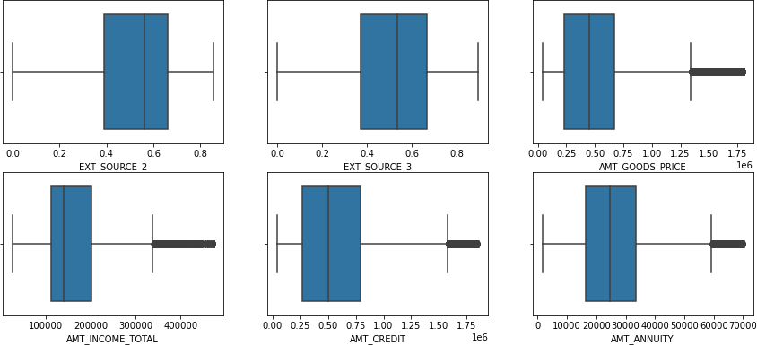
2.1 Handling Outliers
Observation:
From the above plots, we can see the outliers for the following variables:
AMT_GOODS_PRICE
AMT_INCOME_TOTAL
AMT_CREDIT
AMT_ANNUITY
We can clearly state that there is a huge difference between 99th percentile and max value for AMT_GOODS_PRICE, AMT_INCOME_TOTAL, AMT_CREDIT,
AMT_ANNUITY variables. We can safely drop the records which falls outside of 99th percentile for these variables.
After Treating Outliers:
Result:
Although the resulted plots still contains outliers even after we deleted some records, it is still continuous in nature. Hence these can be treated as normal values.

Slide 5
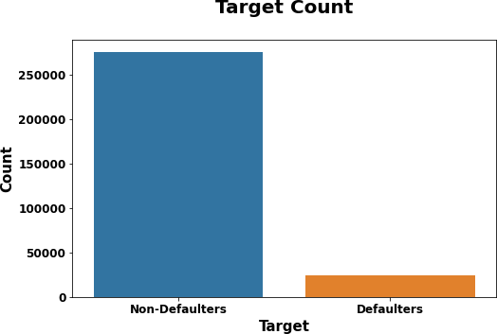
2.2 Checking Data Imbalance
TARGET VARIABLE
Observation:
We can clearly see that there is high data imbalance between Defaulters and Non-Defaulters. We have 91.82% clients marked as Non- defaulters and rest 8.18% marked as Defaulters.

Slide 6
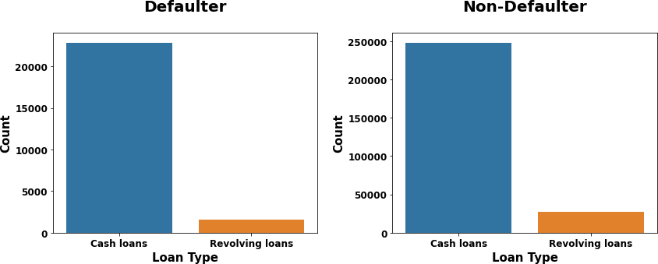
2.3 Univariate and Segmented Univariate Analysis
Type of Loan
Observation:
We can clearly see that most of the clients prefers applying for cash loans than revolving loans in both Defaulters and Non-Defaulters cases.

Slide 7
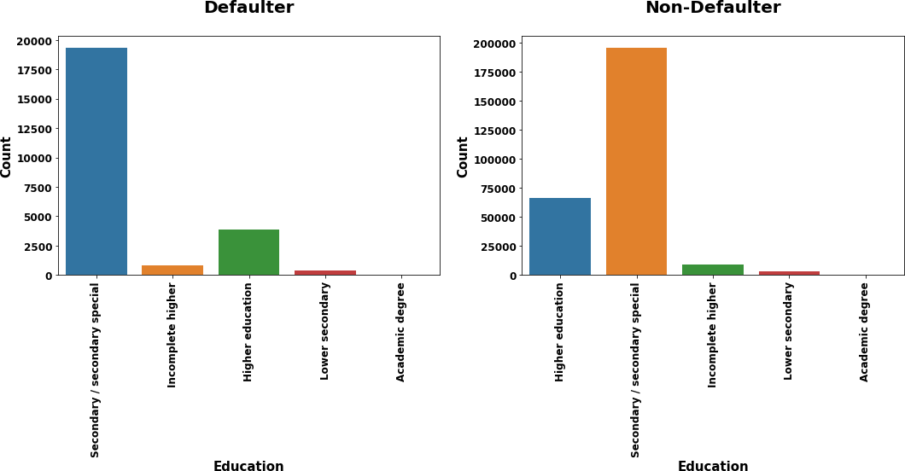
Client Educational Background
Observation:
We can see that most of the clients who cleared bank loans have pursued secondary education followed by higher education.

Slide 8
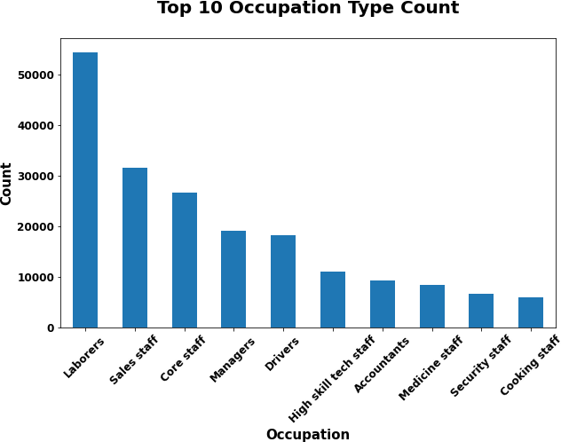
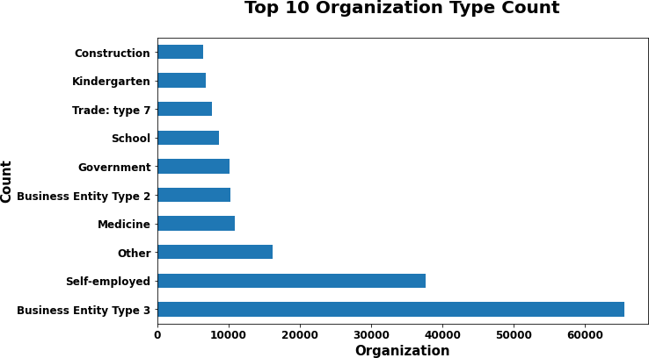
Client Occupation and Organization Background
Observation:
We have most of the clients with Occupation as Laborers from top 10 list who shown more interest for loan followed by Sales
staff, Core staff and Managers.
Observation:
We have most of the clients belongs to Business Entity Type
3 class from top 10 list who shown more interest for loan followed by Self-employed.

Slide 9
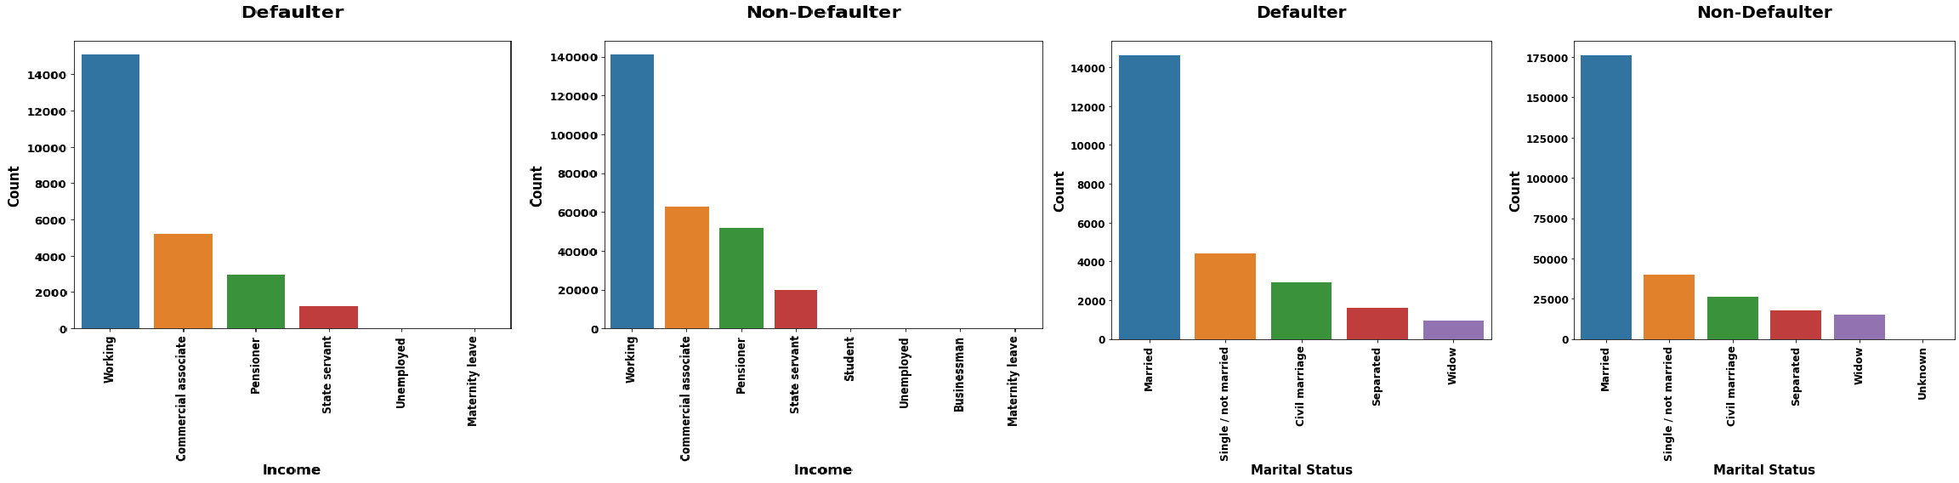
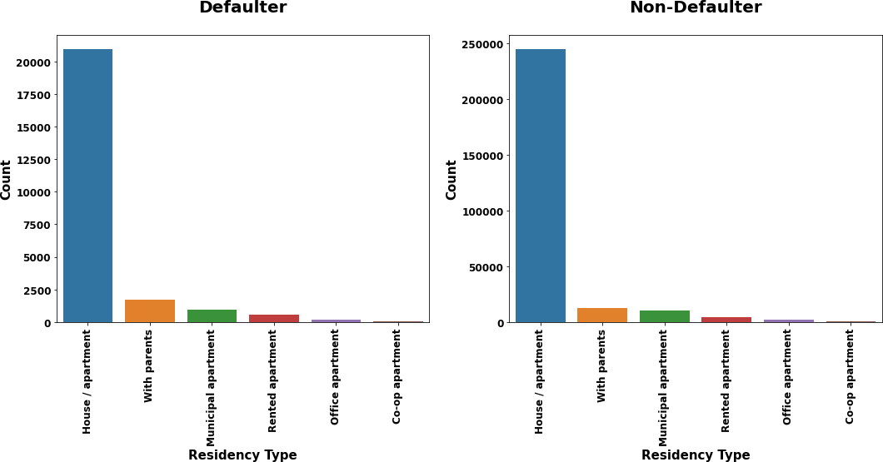
Client Status Information
Observation:
Most of clients (both defaulters and non-defaulters) belongs to "Working group.
Next best group/class is Commercial associate followed
by Pensioner and State servant.
Most of the clients (Defaulters and Non-Defaulters) are Married.
Next best group is Single followed by Civil marriage.
Most of the clients are residing in house/appartment and have high data imbalance compared with other types for Defaulters and Non-Defaulters.
Few clients comes under the group staying with parents followed
by Municipal apartment, Rented apartment. Very few clients residing in office apartment and co-op apartment.

Slide 10
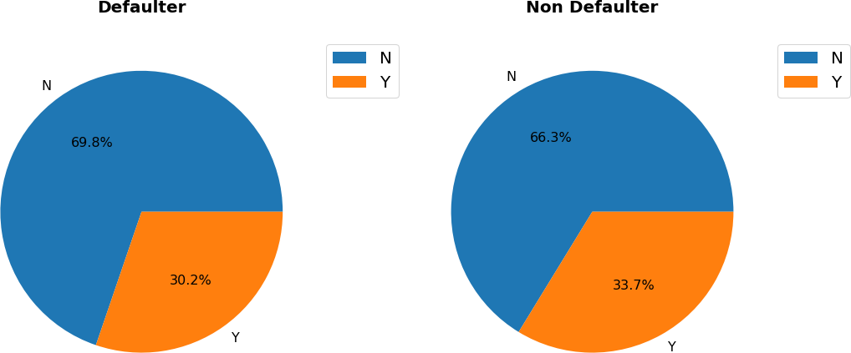
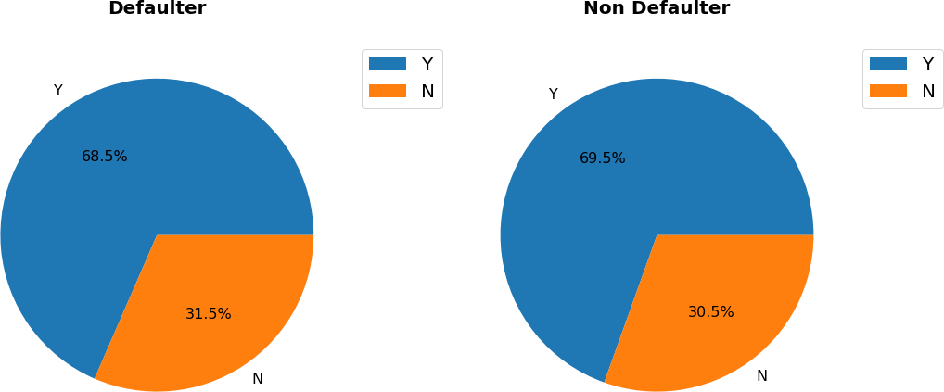
Client Asset Details
Client Own Car
Client Own House
Observation:
From the above plots we can say that:
We have around 69.8% clients from the total number of defaulters who doesn't own car.
We have around 31.5% clients from the list of number of defaulter who doesn't own house.
In both the assets, defaulters have less ratio than non-defaulters.

Slide 11
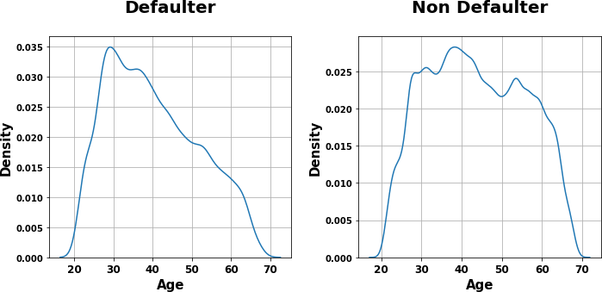
Client Age Group
Observation:
In defaulter case,
Most of the clients belong to age group between 25 and 40.
Number of clients gradually decreases when age increases.
In Non-defaulter case,
Most of the clients belong to age group between 25 and 55.
Very few clients are present from the age 60.

Slide 12
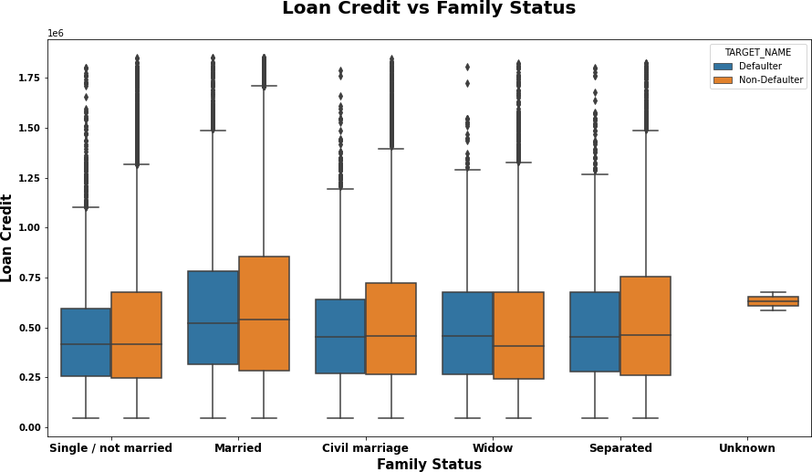
2.4 Bivariate and Multivariate Analysis
Loan Credit Sanctioned for each Family Status type w.r.t Target Variable
Observation:
Highest and Average loan amount credited for Married status for both defaulters and non-defaulters are having higher in number than other status types (excluding Unknown).
Average loan amount credited for the client who belongs to Widow status for defaulters is greater than non-defaulters. Bank has to consider this factor while providing loan to this type.

Slide 13
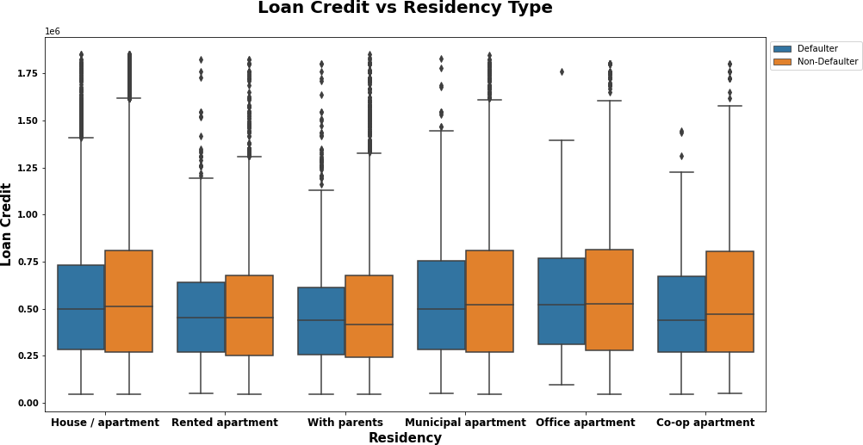
Loan Credit Sanctioned for each type of Clients Residency w.r.t. Target Variable
Observation:
Average loan amount sanctioned is similar for House/Apartment, Municipal apartment and Office apartment types.
For both defaulters and non-defaulters, highest loan credit provided for the client who resides in House/apartment.
Defaulters who provided with high loan credit and lives in house/apartment are the most in population and continuous in nature who haven't cleared loan on time compared with other residency types. Bank has to consider this while providing loan to this type.

Slide 14
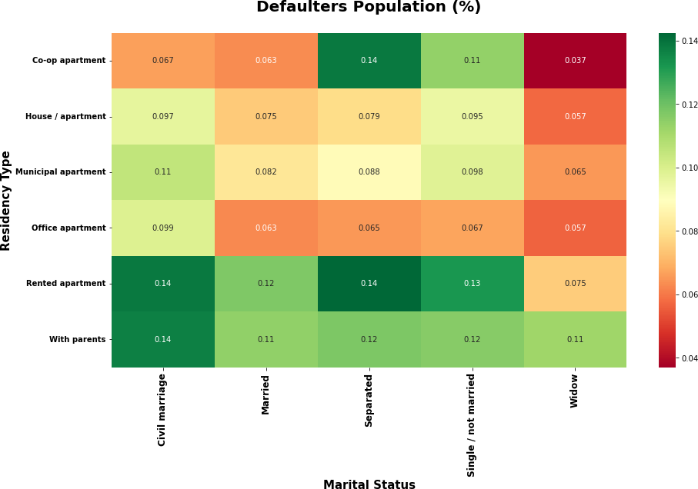
Check Defaulters Population in each Family Status and Residency Type
Observation:
From the above plot we can clearly say that a greater number of defaulters are staying either in Rented apartment or with parents especially whose marital status is civil marriage, separated or single/not married
We also have decent number of defaulters with Married or Widow status who resides in rented apartment or with parents.
We also have high number of defaulters under co-op apartment residency type with marital status as separated or single/not married.
We have less amount of defaulters population for other residency types.

Slide 15
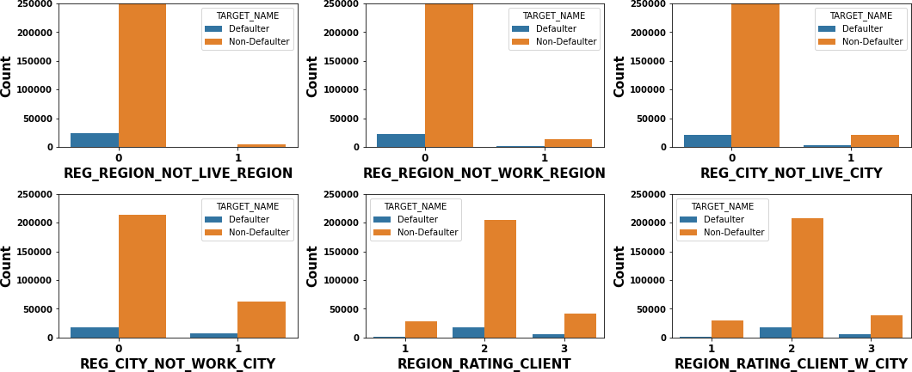
Region Related Information
Observation:
Defaulter rate is highest when REG_REGION_NOT_WORK_REGION=0, REG_REGION_NOT_LIVE_REGION=0, REG_CITY_NOT_LIVE_CITY=0, REG_CITY_NOT_WORK_CITY=0 i.e. permanent address and working address is same.
More number of Applicants/clients have Region rating of 2 (both region and city levels).

Slide 16
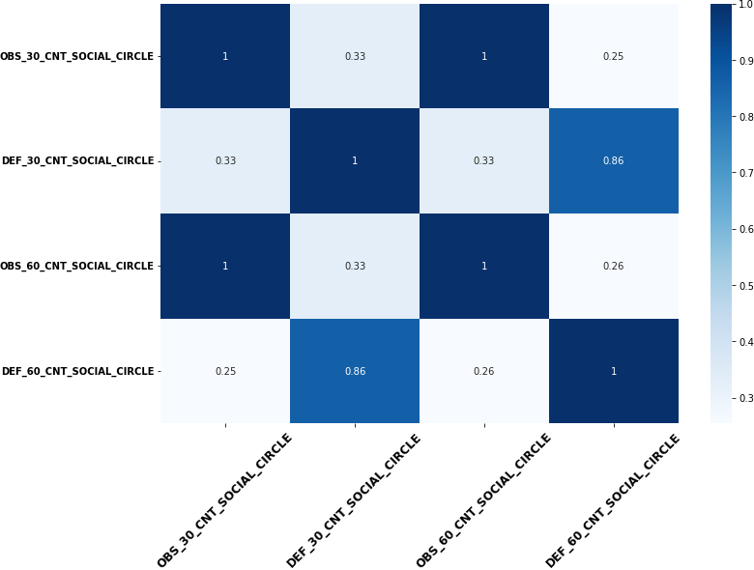
Client Social Circle
Observation:
DEF_30_CNT_SOCIAL_CIRCLE and DEF_60_CNT_SOCIAL_CIRCLE are highly correlated i.e., if the number of observations of client's social surroundings defaulted on 30 DPD increases then the number of observations of client's social surroundings defaulted on 60 DPD also increases.
OBS_30_CNT_SOCIAL_CIRCLE and OBS_60_CNT_SOCIAL_CIRCLE are identical columns and we can have any one of the feature in consideration and other can be ignored.

Slide 17
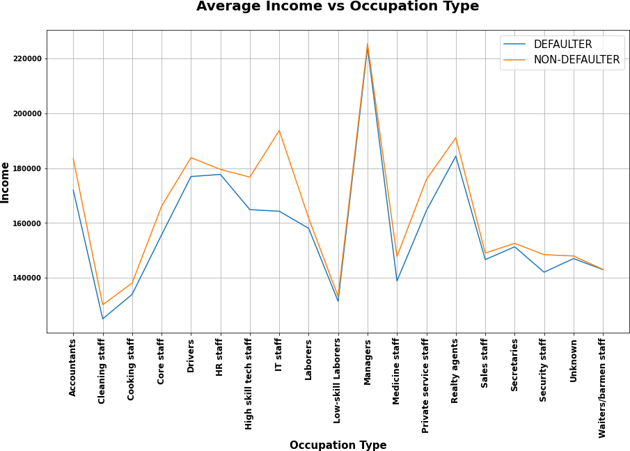
Average Income Salary for each Occupation Type w.r.t Target variable
Observation:
We can see that Managers have highest average income salary compared with other occupation types for both Defaulters and Non-
Defaulters.
Next best highest average income salary present for IT staff followed by Realty agents, Accountants and Drivers.
Defaulters having less average income for all the occupation types compared with Non-Defaulters.

Slide 18
2.5 Top 10 Correlation for Client with Payment Difficulties and Other Cases
Top 10 Correlation Variables for Non-Defaulters
(Client without any Payment Difficulties)
(OBS_30_CNT_SOCIAL_CIRCLE, OBS_60_CNT_SOCIAL_CIRCLE)
(AMT_GOODS_PRICE, AMT_CREDIT)
(REGION_RATING_CLIENT_W_CITY,
REGION_RATING_CLIENT)
(CNT_CHILDREN, CNT_FAM_MEMBERS)
(REG_REGION_NOT_WORK_REGION, LIVE_REGION_NOT_WORK_REGION)
(DEF_60_CNT_SOCIAL_CIRCLE, DEF_30_CNT_SOCIAL_CIRCLE)
(LIVE_CITY_NOT_WORK_CITY,
REG_CITY_NOT_WORK_CITY)
(AMT_GOODS_PRICE, AMT_ANNUITY)
(AMT_ANNUITY, AMT_CREDIT)
(DAYS_EMPLOYED, DAYS_BIRTH)
Top 10 Correlation Variables for Defaulters (Client with Payment Difficulties)
(OBS_30_CNT_SOCIAL_CIRCLE, OBS_60_CNT_SOCIAL_CIRCLE)
(AMT_CREDIT, AMT_GOODS_PRICE)
(REGION_RATING_CLIENT_W_CITY, REGION_RATING_CLIENT)
(CNT_FAM_MEMBERS, CNT_CHILDREN)
(DEF_30_CNT_SOCIAL_CIRCLE, DEF_60_CNT_SOCIAL_CIRCLE)
(LIVE_REGION_NOT_WORK_REGION,
REG_REGION_NOT_WORK_REGION)
(REG_CITY_NOT_WORK_CITY, LIVE_CITY_NOT_WORK_CITY)
(AMT_CREDIT, AMT_ANNUITY)
(AMT_ANNUITY, AMT_GOODS_PRICE)
(FLAG_DOCUMENT_6, DAYS_EMPLOYED)

Slide 19
3. Previous Loan Application Data Analysis

Slide 20
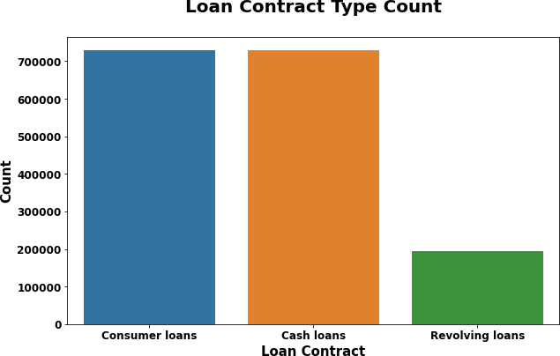
3.1 Univariate Analysis
Loan Contract Type In Previous Application
Observation:
We can say that majority of the clients applied either Consumer loans or Cash loans type. Applicants counts for both of these clients are almost similar.
We have a smaller number of applicants/clients who applied for Revolving loans.

Slide 21
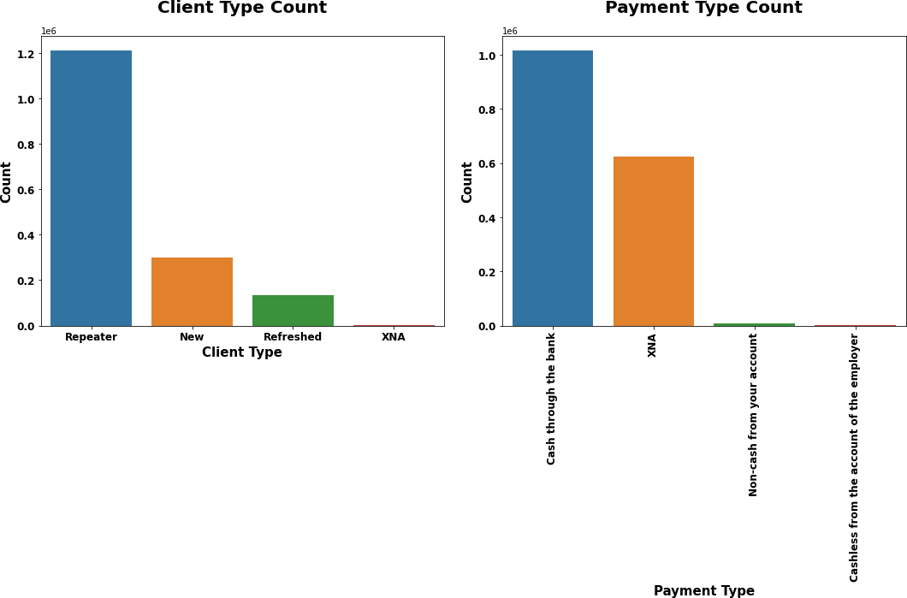
Client Previous Application Type and Mode of Payment Preferred
Observation:
Most of the clients are repeater.
'Cash through the bank' is the most frequently used payment method.

Slide 22
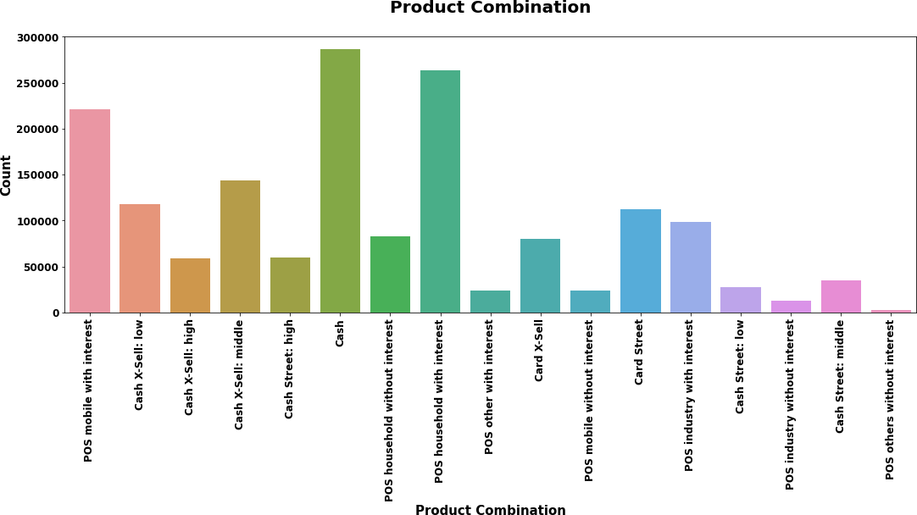
Product Combination Type For Which Loan Applied
Observation:
Highest number of clients applied for cash loan followed by POS household with interest and POS mobile with interest products.

Slide 23
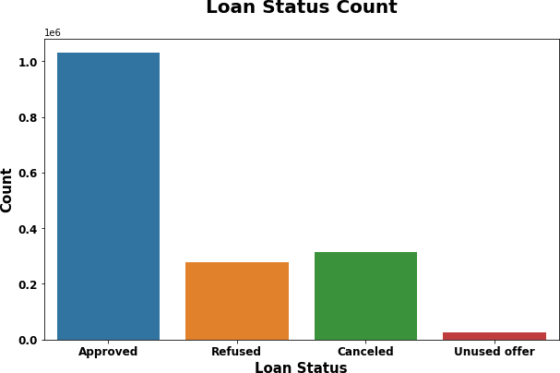
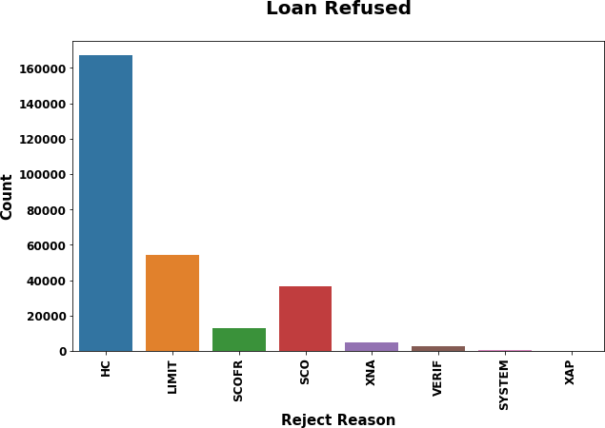
Loan Application Status and Reason For Rejection
Observation:
Observation:
Majority of the previous loan applications got approved.
Some of the other applications are in cancelled or refused status.
Very less applications are in Unused offer status.
'HC', 'LIMIT' and 'SCO' (descending order) are the most common reasons for loan refused/rejected.

Slide 24
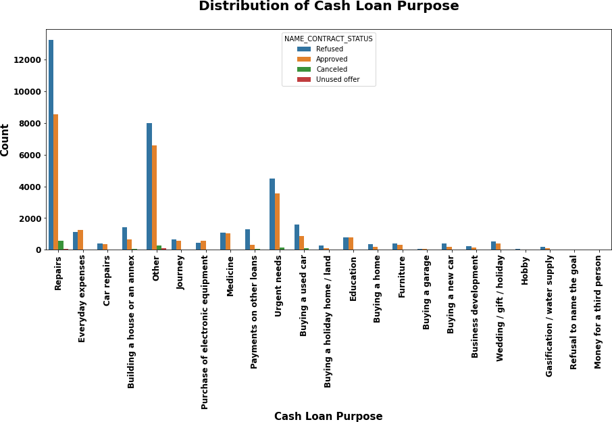
3.2 Bivariate and Multivariate Analysis
Loan Contract Status For Each Cash Loan Type
Observation:
Maximum number of the loans are rejected which have loan purpose as Repairs.
Payments of other loans has much higher rejection than approval.
Education loan has almost equal rates of approvals and rejections.

Slide 25
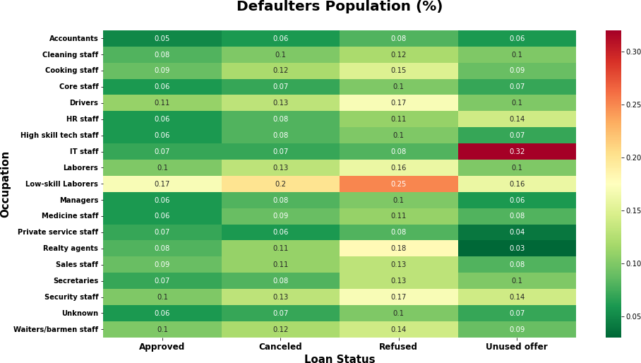
Check Defaulters From Previous Application - Occupation vs Loan Status
Observation:
More number of defaulters loan applications got rejected whose occupation is Low skilled Laborers.
Less number of defaulters loan applications got rejected whose occupations are Private service staff, IT staff, Accountant and Manager.

Slide 26
4. Conclusion
Bank/Finance Company must consider the following factors before providing loan to the clients:
From the experience/previous data, a client whose occupation is of Manager, IT staff, Accountant and Private Service Staff are less defaulters and able to clear the loans without any issue.
High loan repayment success rate from the clients whose age is between 25 and 50. This makes
sense as most of them are working professionals with good income salary.
Provide loan to the client who own assets like own car or house will be a good consideration and high chance of loan repayment from them.
Though 'Repair' Purpose have higher chance of loan repayment, but they also have highest
chance of being a defaulter. So, need to be more cautious in paying the loan for 'Repair' Purpose.
Beware of providing loan to low skilled laborers as they had high percentage of defaulter's rate in the previous applications.
Client's Income type is the most important driving factor to decide loan sanction. It gives us a risk estimate of loan repayment. Do the background verification such as client's working profession, living region, current family status etc., before providing the loan.

