Slide 1

Medical Store Management
RNS INSTITUTE OF TECHNOLOGY
BENGALURU - 98
DEPARTMENT OF INFORMATION SCIENCE & ENGINEERING
Presentation on Internship
Ganesh K
USN: 1RN18IS046
TechieAid
Internal Guide
Ms. Priyanka M R
Asst. Prof, Dept of ISE, RNSIT
External Guide
Mr. Ramesh
TechieAid

Slide 2
AGENDA
Abstract
About the Company
Introduction
Literature Survey
Requirements
System Design
Detailed Design
Implementation
Testing
Conclusion and Future Enhancements
References
Q & A

Slide 3
ABSTRACT
Medical Store Management System is very helpful to manage sales information of Medical Store.It can easily keep the record of Hospitals who done regular business deals.This software is comprehensiveness and the simple by which it handles complex tasks easily.
The main purpose of the system is to make the sales information manage simply and effectively
.
customers and companies’ management and transactions are entered on computers and saved on computers and can be accessed as in the form of the reports and can be updated very easily on computers.
It is quite difficult to maintain the stoke of the medicines in the store and reflect it with the database. So, the owner can place order for new Medicines And replace expired medicines.
The project Sales and purchase management system for medicines is to develop software based information of Medicine selling.
Visualizing the huge opportunity, this is an effort to maximize the business through the development of this software and keeping the data and thus increasing the customer base from the local as well as global markets around the world.
My ongoing project is a software application because nowadays software is a prominent tool of marketing mantra. With the advent of the software technologies, world has become a global village. Every year, millions more people around the world are added to the existing customer base. So considering a big hike in the revenue in this booming sector and one of the successful businesses through this software one should be proud to have such a technical deal.
By the help of this software “It has to save time, it has to be convenient & it has to work everywhere” which helps us to keep records of customers, items records and bill details with less effort.

Slide 4
About the Company
TechieAid is IT services company registered under Govt. of India, Ministry of Micro, Small & Medium Enterprises (MSME).
TechieAid offers Software Development Services, Staffing Solutions, Technology Training, Leadership & Soft Skills Training and Coaching & Mentoring
TechieAid core team comes with 20+ years of industry experience

Slide 5
INTRODUCTION
The project Sales and purchase management system for medicines is to develop software based information of Medicine selling.
Visualizing the huge opportunity, this is an effort to maximize the business through the development of this software and keeping the data and thus increasing the customer base from the local as well as global markets around the world.
My ongoing project is a software application because nowadays software is a prominent tool of marketing mantra. With the advent of the software technologies, world has become a global village. Every year, millions more people around the world are added to the existing customer base. So considering a big hike in the revenue in this booming sector and one of the successful businesses through this software one should be proud to have such a technical deal.
By the help of this software “It has to save time, it has to be convenient & it has to work everywhere” which helps us to keep records of customers, items records and bill details with less effort.

Slide 6
LITERATURE SURVEY
Evaluation of the performance of open-source RDBMS and triplestores for storing medical data over a web service
An integral part of a system that manages medical data is the persistent storage engine. For almost twenty five years Relational Database Management Systems(RDBMS) were considered the obvious decision, yet today new technologies have emerged that require our attention as possible alternatives. Triplestores store information in terms of RDF triples without necessarily binding to a specific predefined structural model. In this paper we present an attempt to compare the performance of Apache JENA-Fuseki and the Virtuoso Universal Server 6 triplestores with that of MySQL 5.6 RDBMS for storing and retrieving medical information that it is communicated as RDF/XML ontology instances over a RESTful web service. The results show that the performance, calculated as average time of storing and retrieving instances, is significantly better using Virtuoso Server while MySQL performed better than Fuseki.

Slide 7
Requirements
Software required for development:
Operating System:
Windows 10
Front End :
Microsoft Visual Studio 2019
Back End:
Microsoft SQL Server 2016
Hardware requirement for development:
Processor:
Pentium IV500MHz or higher
Memory-RAM:
128MB or higher RAM
Memory-CACHE:
128MB or higher RAM
Hard Disk:
40GB or higher

Slide 8
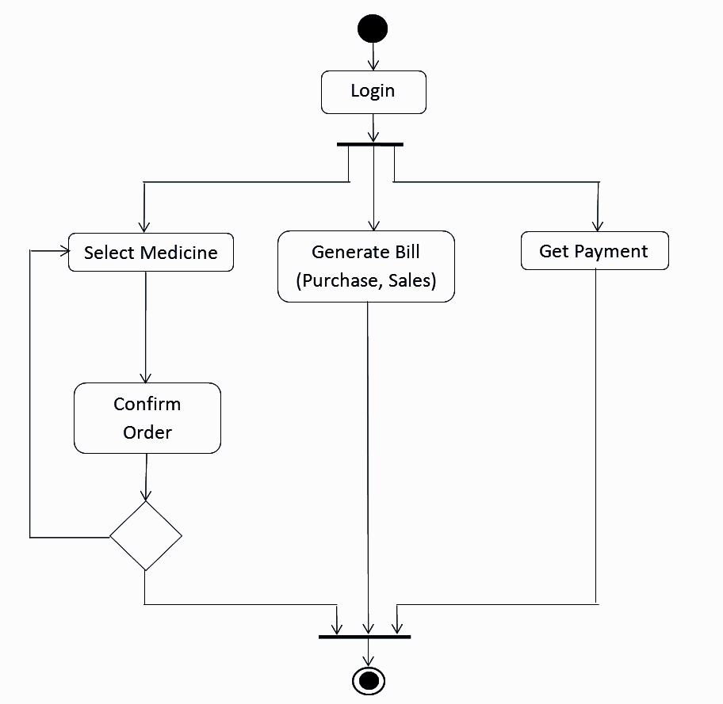
System Design
Architecture diagram / System design

Slide 9
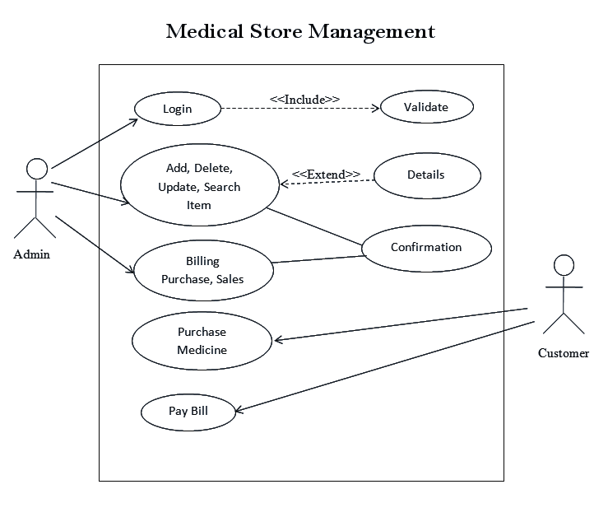
Detailed Design
Use-case diagrams

Slide 10
Implementation / Coding
Sample Code:
using System;
using System.Collections.Generic;
using System.ComponentModel;
using System.Data;
using System.Drawing;
using System.Linq;
using System.Text;
using System.Windows.Forms;
namespace Medical_store
{
publicpartialclassitemStock : Form
{
public itemStock(Medical_store.Mdi_parent1 parent)
{
InitializeComponent();
this.MdiParent = parent;
}
privatevoid itemStock_Load(object sender, EventArgs e)
{
this.stockTableAdapter.Fill(this.medicalDataSet1.Stock);
}
privatevoid button1_Click(object sender, EventArgs e)
{
this.Close();
}
privatevoid dataGridView1_CellContentClick(object sender, DataGridViewCellEventArgs e)
{

Slide 11
Design
The user characteristics of the user show which kind of user are dealing with the system.
Administrator is the person who is taking care of whole the organization system. The admin is having rights to decide whether to allow the insertion, deletion, modification etc performed on details of customers. The admin can also apply changes in rent as well as area setting as per situations.
This software provides many facilities to admin like he/she can easily get information of any customer or any staff details just put their and select IDs in the combo box. By just one clicking the admin can get whole information about the pending money list and model no wise, name wise, date wise report generation is also main task of the system.
Without Login into the system no one can be change or modify the database that is set by the owner of the project.
Thus all the activities which are necessary for the proper functioning of system are performed by this user called OWNER who had made this project.

Slide 12
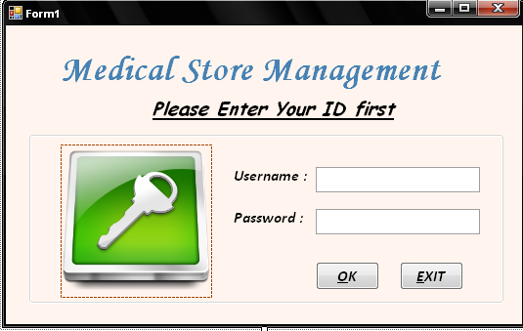
Login Page

Slide 13
CONCLUSIONS
This process system is more easy and reliable to use then manual system.
There is a security system with password in the system that the manual system never had and there was theft of the data being stolen.
There are difference forms for every record, there necessary to company to have maintained of data.
There is also feature of showing the previous customer detail.
Finally we have to come to the conclusion that whatever the medical store requirements is present in this software.

Slide 14
Future Enhancements
In next version master can change rate & type of Medicines company & rate.
In next version master can change rate& type of the table.
As well as they can also add new Medicines details.
We will also include the new modules in next version.
Solve all the limitations of the project.
Create a database in XML so system can be more flexible for various Operating Systems.

Slide 15
REFERENCES
Microsoft Visual C# Step by Step (Developer Reference Edition).
Learn SQL Tutorial – javatpoint
MS SQL Server Tutorial (tutorialspoint.com)
C# Tutorial - GeeksforGeeks
What is .NET Framework? Explain Architecture & Components (guru99.com)

Slide 16
Question and Answer

Slide 17
THANK YOU

