Slide 1
Analyzing the human eye gaze pattern while attending the online test

Slide 2
Members in the team
S.no | Name of the person | Roll number
1 | Adwaita | CB.EN.U4CSE21403
2 | Hari kesav | CB.EN.U4CSE21420
3 | K Ganesh | CB.EN.U4CSE21426
4 | K Akhila Pavani | CB.EN.U4CSE21433

Slide 3
Content
Introduction
Dataset Collection
Preprocessing
Canny edge
Harris Corner

Slide 4
Introduction
The study of human eye gaze patterns during online tests provides critical insights into how individuals engage with digital assessments, revealing their focus, attention, and cognitive strategies. By leveraging eye-tracking technology, researchers can enhance the design and effectiveness of online learning environments, making them more intuitive and accessible. This research not only contributes to the fields of cognitive psychology and education but also offers practical applications in improving online testing interfaces for a diverse range of learners.

Slide 5
Common questions asked
How is the data collected?
How are you determining who is cheating or not?
What is the relationship between eye gaze patterns and the types of questions asked in an online test?
How do distractions within the online testing environment affect eye gaze patterns and test performance?
Can eye gaze patterns predict areas of difficulty within the test material for individual learners?

Slide 6

Literature Review
Introduction
Background: With the shift towards online education, maintaining student engagement has become a challenge. Traditional methods for gauging attention are less effective in virtual classrooms.
Problem Statement: The paper addresses the need for an automated, non-intrusive method to evaluate student engagement and attentiveness during online classes.
Objective: To develop a computer vision-based system that can accurately track eye movements and classify student attention levels.

Slide 7
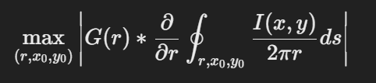
Eye Tracking and Pupil Detection Algorithms
Face and Eye Detection: Description of the initial step of locating the user's face and eyes within the video feed, possibly using the Haar Cascade classifier (Rectangular Features, Adaptive Learning), which is known for its effectiveness in detecting facial features through machine learning algorithms.
Pupil Detection Techniques: Discussion on the specific algorithms applied for pupil detection:
Daugman's Algorithm: It uses the integro-differential operator on a circular region to find the iris boundary and detect the pupil.
Hough Circular Transform: Detecting circular patterns (the iris and pupil) in the eye region identified in the previous step.
Blob Detection: This method identifies the pupil by looking for areas that are significantly darker than the surrounding iris and sclera.
Centroid Detection: Calculating the geometric center of the detected pupil area to determine the gaze direction accurately.
Gaze Direction Classification
Geometric Model for Gaze Estimation: The methodology would explain the geometric model used to estimate the gaze direction based on the detected pupil position. It might involve mapping the pupil's position to screen coordinates to determine where the student is looking.
Classification of Gaze Directions: Details on how the gaze direction is classified into distinct categories (e.g., looking at the screen, looking away) and the criteria used for classification. This part is essential for determining the attention state.
Attention Analysis
Defining Attention States: The paper would describe how the system categorizes the student's attention level based on eye gaze patterns. It would detail the criteria for categorizing attention into states such as alert, sleepy, and not attentive.
Algorithm for Attention Evaluation: An in-depth discussion of the algorithm or set of rules applied to analyze eye gaze data over time to evaluate the student's attentiveness. This could include frequency and duration of gaze away from the screen, blink rate analysis, and other metrics indicative of engagement or fatigue.

Slide 8
Interpretation of Results
Algorithmic Limitations and Efficiency: The document implies that setting the correct binarization threshold is crucial for the success of both centroid and blob detection algorithms. These algorithms significantly outperformed others when the threshold was appropriately adjusted. The paper also pointed out that facial occlusion and the stability of the subject's head pose significant challenges to the effectiveness of pupil detection and eye gaze tracking.
Graphical Representation: The results were also presented graphically, emphasizing the superior performance of centroid detection over other methods, with blob detection also being a viable option for pupil identification.
Conclusion from Analysis
The detailed analysis underscores the importance of algorithm selection and parameter tuning in the context of eye gaze tracking and attention analysis systems. It highlights the practical challenges faced during implementation, such as the need for significant processing resources and the impact of environmental factors like facial occlusion and head stability. The comparative analysis reveals that while some algorithms may struggle with accuracy and reliability, methods like centroid detection show promise for effective pupil detection, serving as a critical component in developing systems aimed at assessing attention levels in e-learning environments.
Pupil Detection Results
Accuracy Measurement: Accuracy was assessed using a confusion matrix for each of the four algorithms:
Hough Transform: Demonstrated an accuracy of 42.85%, making it relatively ineffective and unreliable.
Daugman Algorithm: Showed a slightly better accuracy of 43.33%, but still considered ineffective.
Blob Detection: Achieved a respectable accuracy of 63.33%.
Centroid Detection: Emerged as the most accurate with 76.66%, indicating it as the most effective method among those tested.
Specific Challenges: The study also highlighted that all algorithms struggled with facial occlusion and were unable to detect the pupil when the head was not stable. This instability was attributed to the reliance on the orientation and stability of the face for detection, especially using the haar cascade method.
Interpretation of Results
Algorithmic Limitations and Efficiency: The document implies that setting the correct binarization threshold is crucial for the success of both centroid and blob detection algorithms. These algorithms significantly outperformed others when the threshold was appropriately adjusted. The paper also pointed out that facial occlusion and the stability of the subject's head pose significant challenges to the effectiveness of pupil detection and eye gaze tracking.
Graphical Representation: The results were also presented graphically, emphasizing the superior performance of centroid detection over other methods, with blob detection also being a viable option for pupil identification.
Conclusion from Analysis
The detailed analysis underscores the importance of algorithm selection and parameter tuning in the context of eye gaze tracking and attention analysis systems. It highlights the practical challenges faced during implementation, such as the need for significant processing resources and the impact of environmental factors like facial occlusion and head stability. The comparative analysis reveals that while some algorithms may struggle with accuracy and reliability, methods like centroid detection show promise for effective pupil detection, serving as a critical component in developing systems aimed at assessing attention levels in e-learning environments.

Slide 9
Dataset Generation
Initial Calibration: Utilizing a gaze recorder tool, participants first undergo a calibration process to align the system with their eye movements. This involves a dynamic 9-dot calibration technique, ensuring precise tracking throughout the experiment.
Test Administration: Following calibration, a question paper is displayed on the screen. Participants are given 30 seconds to engage with the content. This time constraint is imposed by the limitations of the gaze recorder tool's free version.
Heatmap Generation: After completing the test, the system processes the collected data to produce a heatmap. This visualization highlights regions on the screen where the participant's gaze was most frequently focused, indicating areas of attention and interest.
Objective: The aim is to leverage this dataset to develop an automated system capable of distinguishing between cheating and non-cheating behaviors during tests based on eye gaze tracking and analysis.
Dataset Compilation: The experiment is repeated with multiple participants to gather a comprehensive dataset :
Honest: Labelled for participants whose gaze patterns suggest adherence to the expected focus areas, without indications of cheating behavior.
Cheat: Assigned to participants exhibiting gaze patterns that stray significantly from the focal area, suggesting potential cheating behavior.

Slide 10
Plan Of Action
Understanding The Problem
Creating The Dataset
Pre-Processing The Data
Training A model
Ananlysing The Edges and Corners
1
2
3
4
5

Slide 11
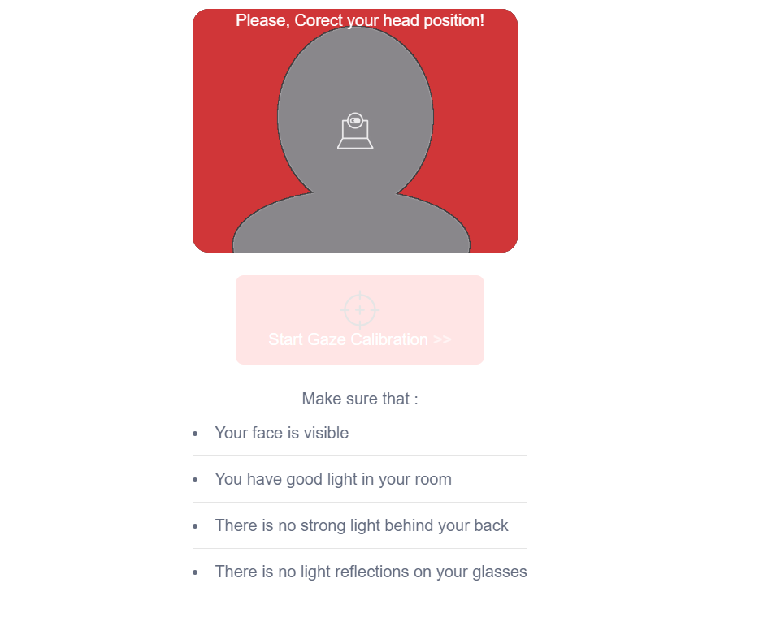
Gaze Recorder
If you need a utility that can track your eye movement while you are operating your computer, GazeRecorder is one of the best software for that.
Doing this might come in handy especially if you are developing certain accessibility-related software solutions, as it can provide you with significant insight about your eye movement behavior.
Aside from enabling you to track your eye movement, this application also lets you capture video recordings so that you can save the results on your computer and use them for your future projects.
GazeRecorder measures the intuitive gaze and the interactional behavior.

Slide 12
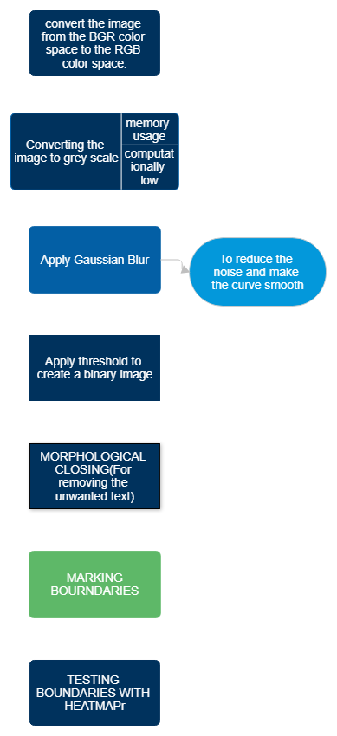
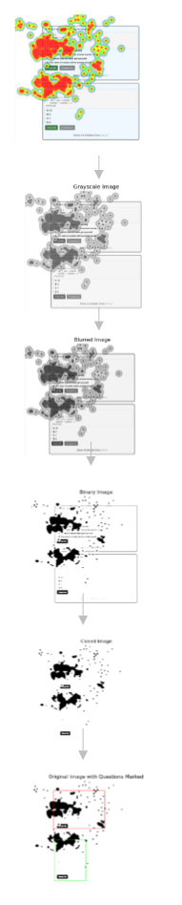
IMPLEMENTATION FLOW OF PREPROCESSING FOR EYE GAZE DETECTION

Slide 13
PRE - PROCESSING
Color Space Conversion: The image is converted from BGR to RGB color space. This step ensures compatibility with libraries or tools that expect the RGB format for accurate color representation, especially important for displaying images with correct colors.
Grayscale Conversion: Converting the image to grayscale simplifies it by collapsing the color information into a single intensity channel. This reduction is beneficial for most computer vision tasks, as it lowers the computational complexity and focuses on the intensity variation, which is often more relevant than color for feature detection.
Gaussian Blurring: Applying Gaussian blur smooths the image by averaging pixel values with their neighbors. It helps reduce noise and detail in the image, making it easier to detect larger, more relevant patterns or features by eliminating fine, irrelevant variations.
Binary Thresholding: This process segments the image into foreground and background by converting it into a binary image based on a threshold. It simplifies the analysis by focusing on the significant parts of the image, usually by highlighting areas of interest and suppressing the less relevant background.
Morphological Closing: The closing operation, which is a dilation followed by an erosion, helps to close small holes and gaps in the foreground objects. This step is crucial for creating more continuous and solid object shapes, making it easier to analyze their structure and spatial relationships.

Slide 14
Grayscale Conversion
What is Grayscale Conversion?
Definition: Grayscale conversion transforms a color image into shades of gray, consolidating the information across color channels into a single intensity channel. This process results in an image composed of varying shades of gray, where each pixel represents the brightness of the original color at that location.
Color to Grayscale: In color images, each pixel's color is determined by a combination of red, green, and blue values. Grayscale conversion averages or weights these values to produce a single brightness value. A common method involves applying specific weights to the RGB channels.
Significance of Grayscale Conversion
Reduces Complexity: By converting to grayscale, the amount of data to be processed is significantly reduced since the image is represented by a single channel rather than three. This simplification speeds up computational tasks and reduces resource requirements.
Enhances Algorithm Efficiency: Many algorithms for tasks like edge detection, thresholding, and feature extraction perform more efficiently on grayscale images. The reduced complexity allows these algorithms to focus on texture and shape instead of color variations.
Impact on Image Processing and Analysis
Feature Detection and Recognition: Grayscale images highlight structural properties and contrast differences, facilitating the detection of edges, shapes, and patterns without the distraction of color.
Preprocessing Step for Further Analysis: Grayscale conversion is often the first step in a sequence of preprocessing operations aimed at preparing images for more complex analyses, such as segmentation, classification, or tracking movements, including eye gaze.

Slide 15
Gaussian Blur
Kernel in Gaussian Blur
Definition: A kernel, also known as a convolution matrix or mask, is a small matrix used to apply effects like blurring, sharpening, embossing, edge detection, and more to an image. In the context of Gaussian blur, the kernel represents the weights given to neighboring pixels when computing the new value of a specific pixel.
Structure: The kernel is structured according to the Gaussian function. Its size (e.g., 3x3, 5x5, etc.) determines how many neighboring pixels are considered in the blurring process. The values within the kernel decrease as they move away from the center, following the Gaussian distribution curve. This means that pixels closer to the target pixel have a higher influence on the final result than those further away.
Application: The kernel is applied to every pixel in the image by taking the dot product of the kernel and the portion of the image it covers. The result is a weighted average that determines the new intensity of the central pixel, effectively blurring the image.
Standard Deviation (σ) in Gaussian Blur
Role of Standard Deviation: The standard deviation (σ) of the Gaussian distribution plays a crucial role in controlling the extent of blurring. It determines how "spread out" the bell curve is, which in turn affects how rapidly the weights decrease as you move away from the center of the kernel.
Effect on Blurring: A larger σ results in a wider bell curve, meaning that pixels farther away from the central pixel have more influence on the blurring effect. This leads to a more pronounced blur.

Slide 16
Binary Thresholding
Threshold Selection
The selection of an appropriate threshold value is a critical decision in binary thresholding. This value determines the cutoff point for classifying pixel values into two groups: those that will be turned black (typically set to 0) and those that will be turned white (typically set to 255). The goal is to choose a threshold that best separates the objects of interest from the background or distinguishes between different features within the image. There are several approaches to threshold selection:
Manual Selection: Involves visually inspecting the image or its histogram and choosing a threshold value that appears to best separate the desired features from the background. This method is straightforward but can be imprecise and inconsistent across different images.
Automatic Selection:
Adaptive Thresholding: Instead of a single global threshold value, adaptive thresholding calculates different thresholds for different regions of the image. This method is particularly useful for images with varying lighting conditions across the scene.
Histogram-based Methods: Analyze the image's histogram to find peaks and valleys that can suggest a suitable threshold, often used in bimodal images where the histogram shows two distinct peaks corresponding to the background and foreground.

Slide 17
Morphological Operations
Dilation: Expands the shapes in an image, typically increasing the area of white (or foreground) regions. It can fill small holes and connect disjoint regions but may also merge closely located objects.
Erosion: Reduces the shapes in an image, effectively shrinking the area of white regions. It can remove small noise and detach slightly connected objects but may also break thin connections and reduce object sizes.
Opening: A sequence of erosion followed by dilation. This operation is used to remove small objects or noise from an image without significantly affecting the size of the larger objects present.
Closing: A sequence of dilation followed by erosion. It fills small holes and gaps within the objects in an image, smoothing the object outlines without significantly changing their size.

Slide 18
EDGE DETECTION – CANNY ALGORITHM
The Canny Algorithm makes use of two concepts: the Gradient Operator and the Laplacian Operator.
The first step involves smoothing the image with the Gaussian operator, where 'n' and 'sigma' are parameters for Gaussian which is convoluted with the image 'I'.
Then, apply the gradient operator to compute the image gradient using the Sobel operator. This provides two numbers: the derivative in the x-direction and the derivative in the y-direction, which aids in computing the magnitude of the gradient at each pixel.
Orientation is computed at each pixel based on the magnitude of the gradient, where brighter points indicate higher magnitude, thus providing the direction of the edge.
While a 2D Laplacian operator is typically used, in the Canny algorithm, a 1D Laplacian operator is applied along the direction of the edge. This approach ensures that the result is not affected by variations along other dimensions, yielding a more reliable outcome.
To detect edges, the algorithm checks for zero crossings in the Laplacian operator. If a zero crossing is found, an edge exists. The parameter value of sigma affects the smoothness of the image, thereby influencing edge detection. A higher sigma value results in fewer detected edges, while a lower value detects more edges, making it more convenient to identify the edges of interest.

Slide 19
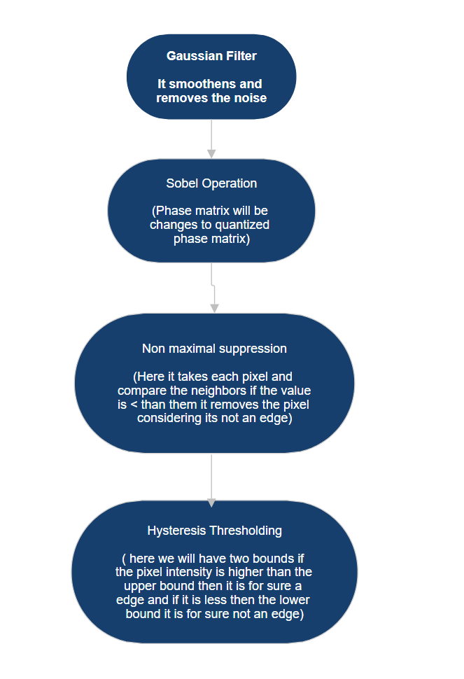
How Canny Algorithm Works

Slide 20
CORNER DETECTION – HARRIS ALGORITHM
The Harris Corner Detection algorithm detects corners in an image through the following steps:
1 Convert Image to Grayscale: Simplify the image by reducing it to one color channel.
2. Calculate Image Gradients: Determine how the image brightness changes in the horizontal and vertical directions.
3. Compute Gradient Products: Calculate the products of the gradients for each pixel.
4. Apply Gaussian Filter: Smooth the gradient products to reduce noise.
5. Calculate Harris Response: Evaluate a mathematical formula for each pixel to measure the likelihood of a corner.
6. Thresholding: Identify potential corners by selecting pixels with a Harris response above a certain value.
7. Non-maximum Suppression: Refine corner detection by keeping only the strongest corner candidates within a local area.
8. Output Corner Points: Finalize and output the positions of detected corners.
This process identifies points in the image where edges meet or the gradient direction changes sharply, which are typically considered corners.

Slide 21
Summary
Eye gaze detection using OpenCV encompasses the utilization of advanced computer vision methodologies to discern the direction in which an individual is looking. Initially, facial recognition algorithms are employed to pinpoint the facial area, followed by precise localization of the eyes within the detected face regions. Techniques such as Haar cascades, canny models facilitate accurate eye identification. Subsequently, intricate features like eye landmarks or iris segmentation are extracted to estimate the precise direction of the gaze. This information can then be utilized for a myriad of applications including but not limited to human-computer interaction, gaze-based control systems, or even driver monitoring systems in automotive contexts. The success of such systems heavily relies on the robustness of the algorithms deployed, as well as their ability to operate effectively in diverse environmental conditions, ensuring reliable and precise gaze estimation.

Slide 22
Thank you

