Slide 1
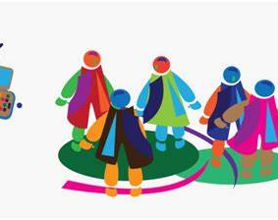
Campaign

Slide 2

What is Campaign?
A Campaign refers to a strategic and organized series of activities ,efforts or initiatives aimed at achieving specific goals or objectives within a set of timeframe

Slide 3
Types of Campaigns:
Marketing
Political
Fundraising
Health awareness
Social Media

Slide 4
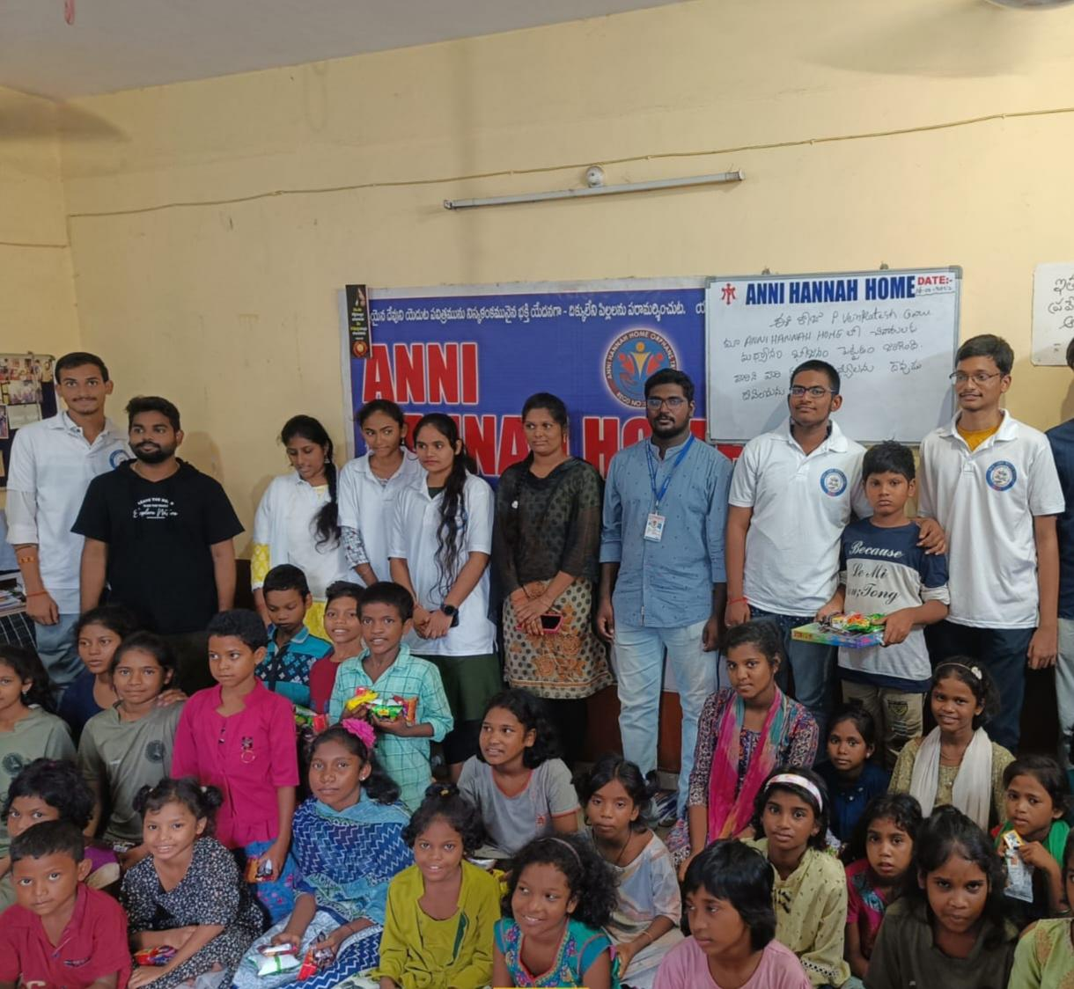
What Inspired me ?

Slide 5
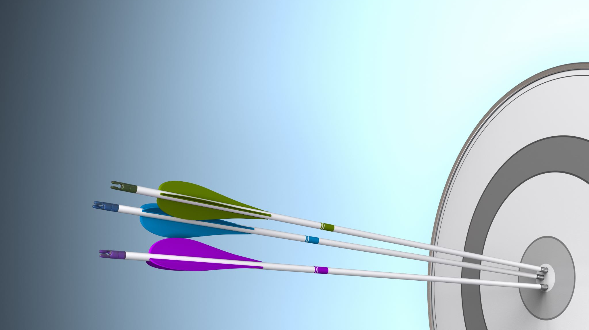
Benefits of Campaigns:

Slide 6

Thank you

