Slide 1
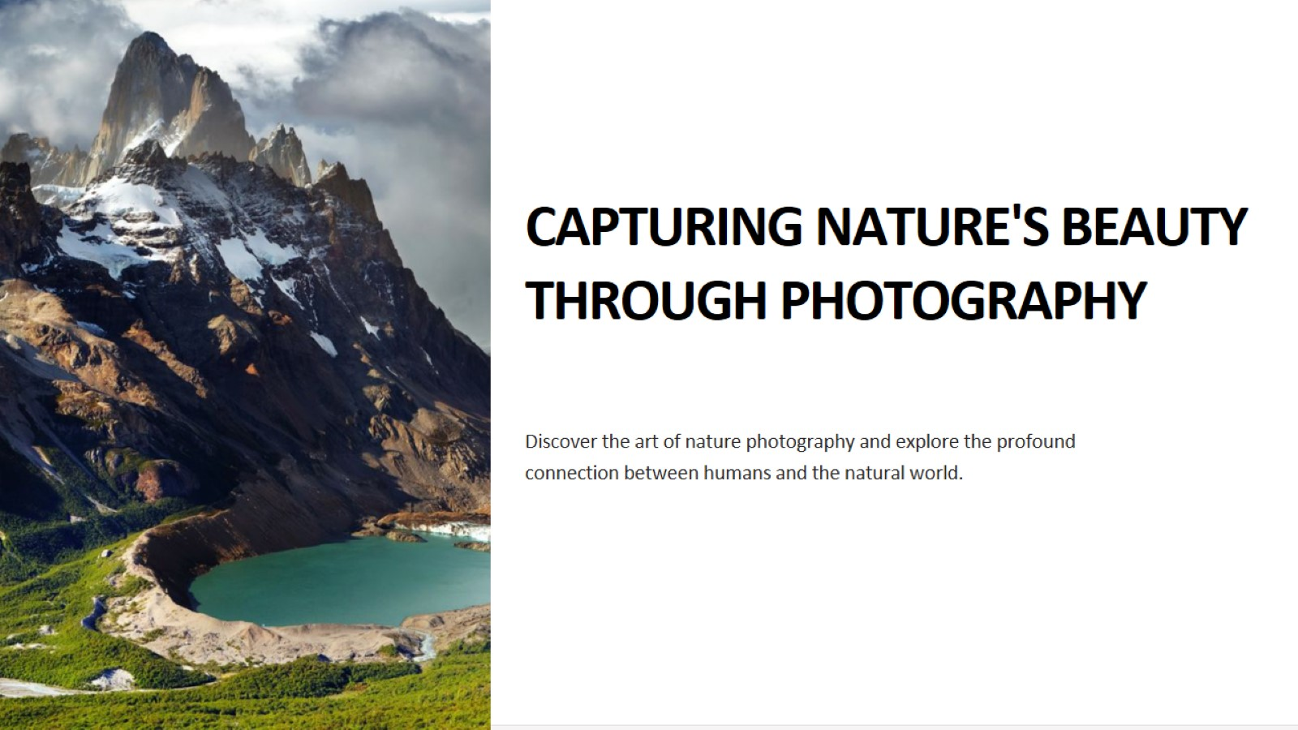
Notes:
Good [morning/afternoon/evening], ladies and gentlemen. Today, I am thrilled to take you on a visual and emotional journey through the captivating world of nature photography. In this presentation, we will explore the art of capturing nature's beauty through the lens of a camera, delving into the techniques, emotions, and significance behind this timeless art form.

Slide 2
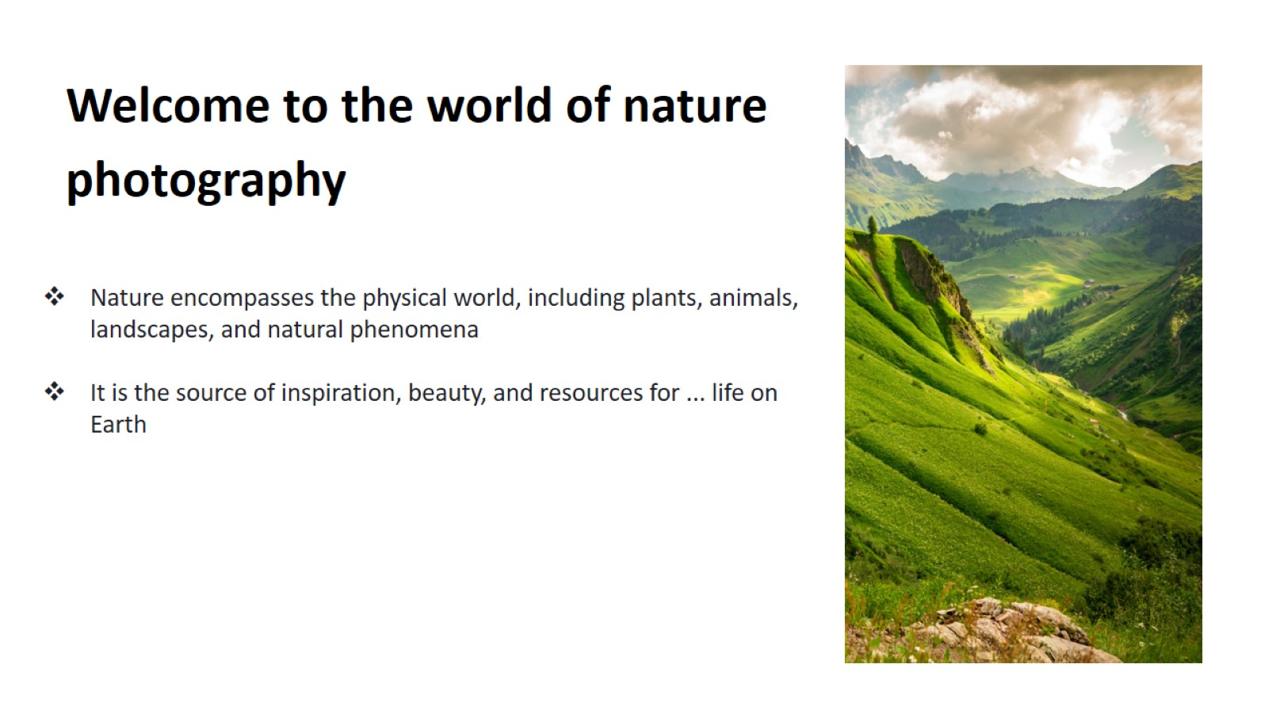
Notes:
Nature photography is a medium that allows us to freeze moments of natural splendor in time, preserving the breathtaking landscapes, the delicate details of flora and fauna, and the ephemeral beauty of the world around us.

Slide 3
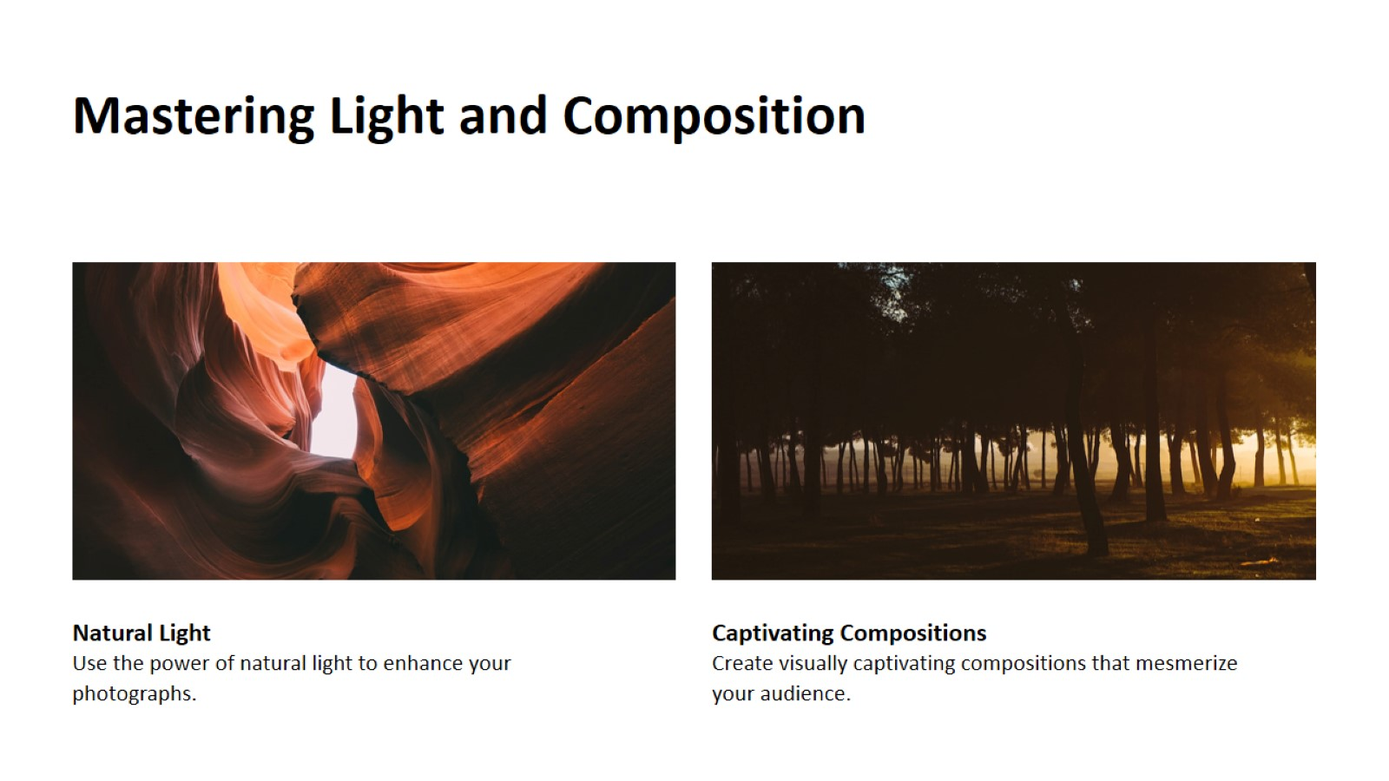
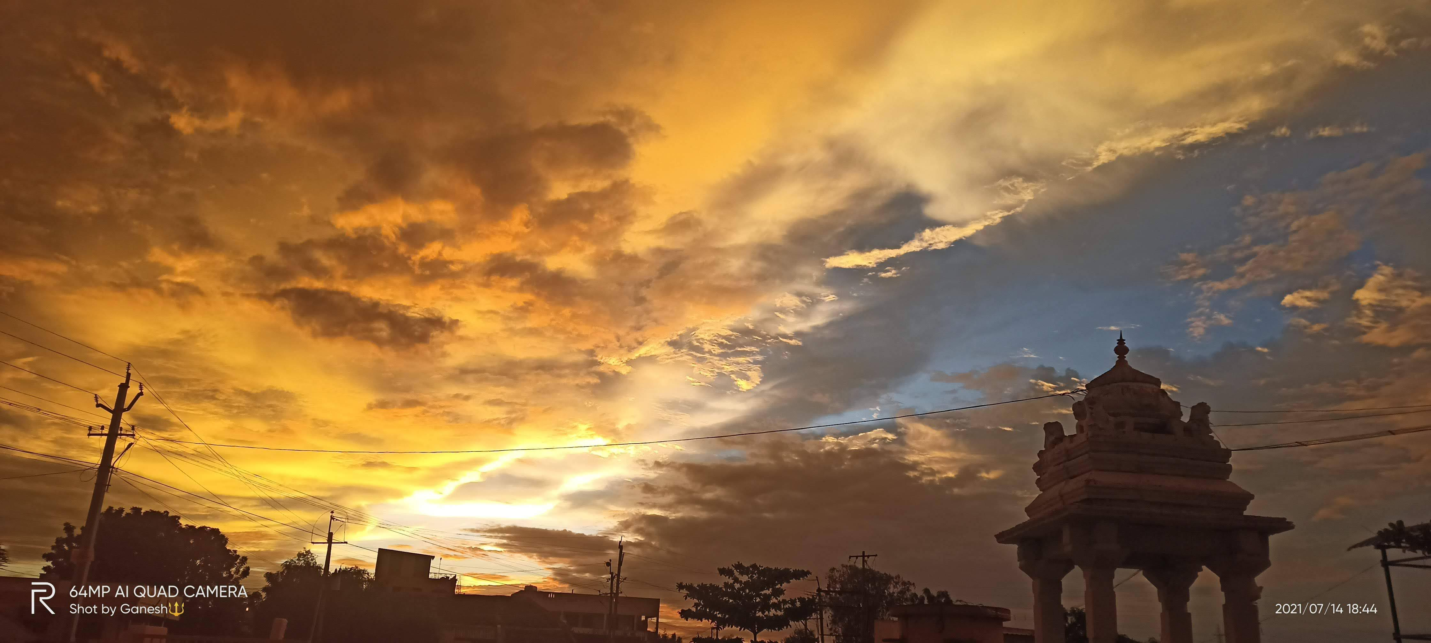
Notes:
Mastering light and composition in photography is about understanding how light interacts with your subject and using it to create visually compelling and emotionally impactful images. It's about harnessing the power of light to evoke mood, drama, and storytelling in your photographs.
Composition, on the other hand, involves arranging the elements within your frame in a way that is visually pleasing and effectively communicates your intended message.

Slide 4
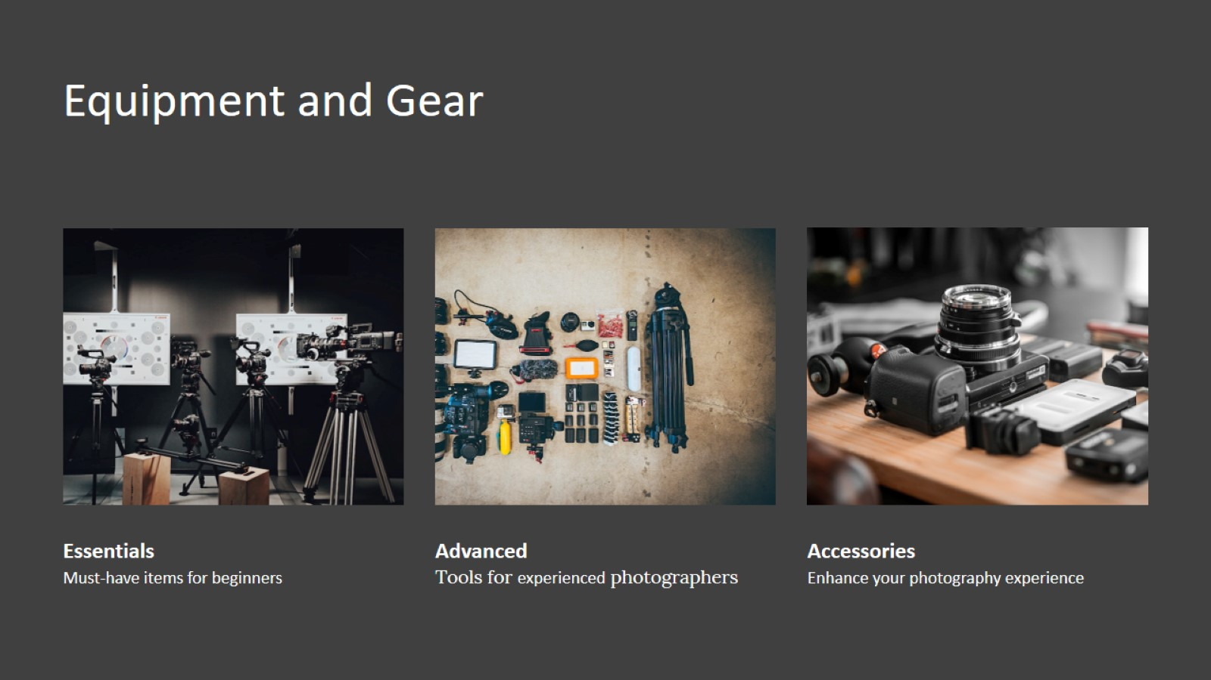
Notes:
Equipment and gear for nature photography are the tools that help you capture the beauty of the natural world.
Your camera is the most essential piece of equipment, and choosing the right one depends on your specific needs and budget.
Lenses are also crucial, as they allow you to zoom in on distant subjects or capture wide landscapes.
Tripods provide stability for long exposures and telephoto shots, while filters can enhance colors and manage light.

Slide 5
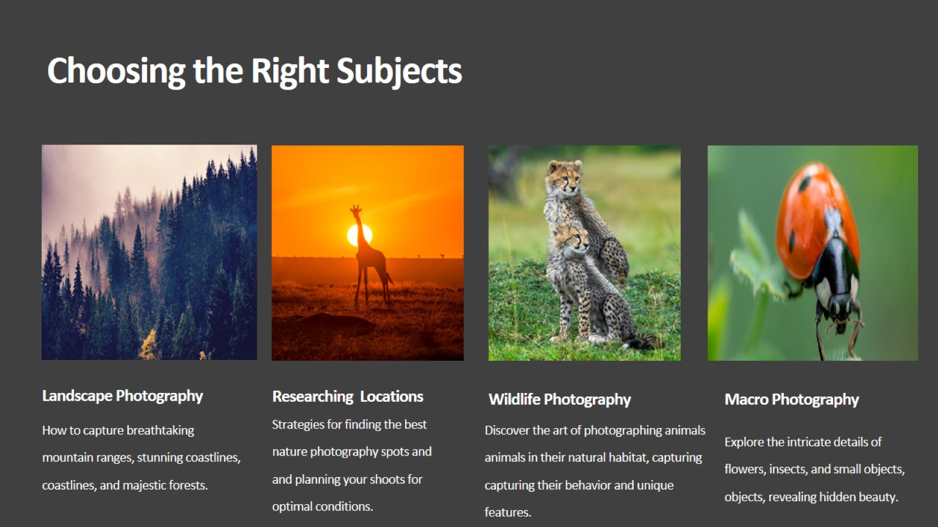
Notes:
Choosing the right subject for nature photography is about finding beauty and storytelling in the natural world.
By choosing the right subject, you have the opportunity to share your perspective and create images that inspire, provoke thought, and foster a deeper appreciation for the world around us.

Slide 6
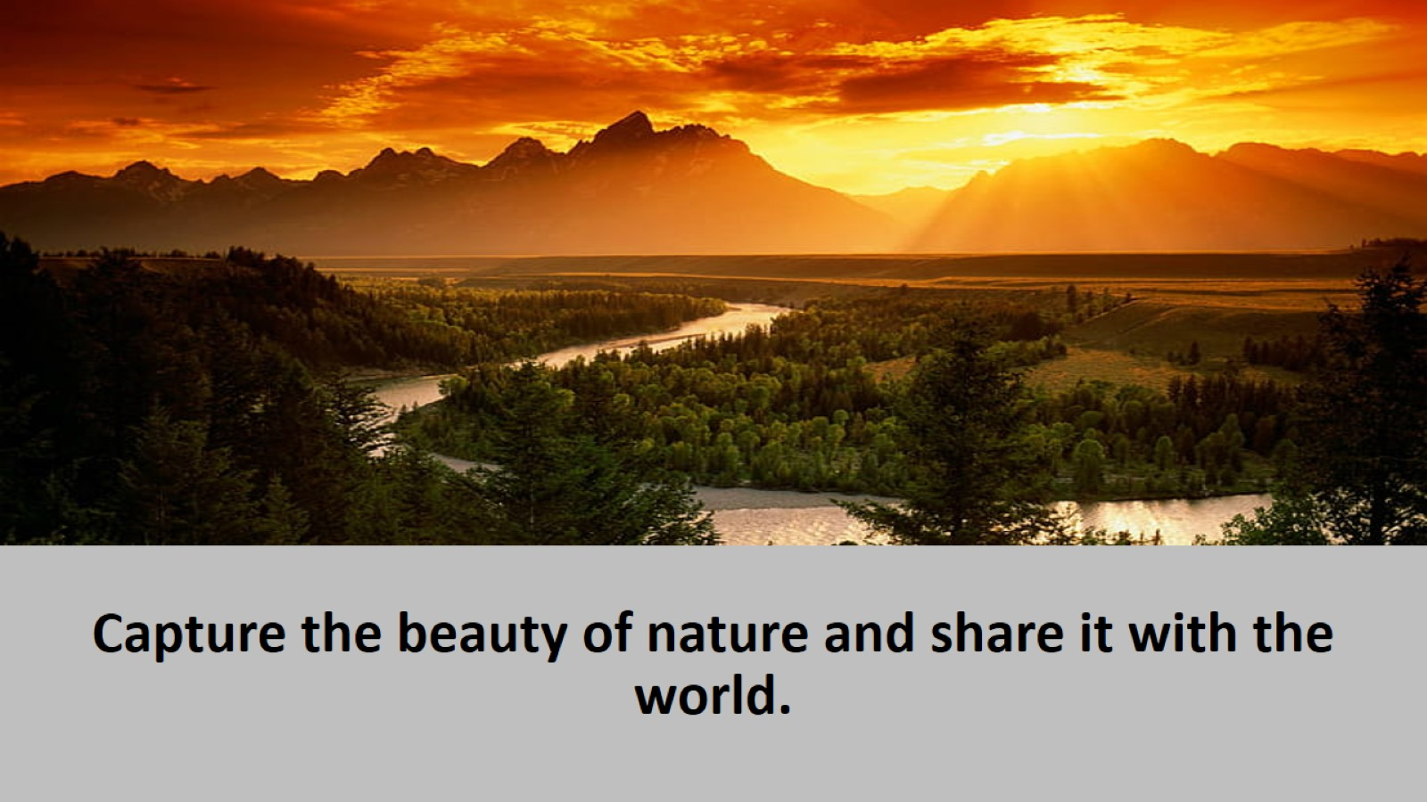

Slide 7
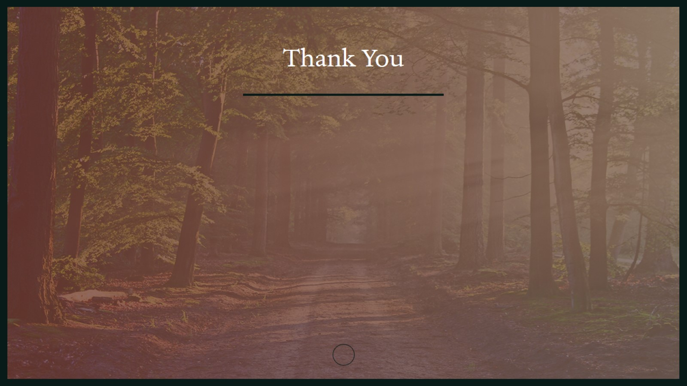
Thank You

