Slide 1
Deep Neural Networks for Video Analysis of Human Pose Estimation
Authors:
Eralda Nishani, Betim Cico Prepared By : Ganesh Kumar Korra
Student ID: 700761716

Slide 2
Motivation
GPU technology has enhanced and made a big divergence and large data set has been added to have a good improvement in deep learning.
Such Computer vision tasks as human pose estimation for instance are made possible by these developments.
Mobile apps in gaming, retail technology, medicine, and gesture interface.

Slide 3
Problem Statement
Saying that determination of the position of a human body in the sequence of frames of a video is somewhat more than a trivial activity because people’s movements are complex and videos can be rather of poor quality.
Because of the requirements that such applications have, for example the need to produce models in a short amount of time, highly accurate, applications such as gesture recognition in sign language videos need automation.

Slide 4
Objectives
It should be noted though that deep learning is made possible by the enhancement in the GPU as well as the data sources with large sizes of data.
There are many branches under this category; one of them is human pose estimation.
Application in video gaming, Augmented as well as Virtual reality, medical field, and physical movement recording devices.

Slide 5
Contributions
Systematic categorization of 119 research papers focused on Industry 4.0.
Ideas for the enhancement of the CNN architectures for supposed enhancements in accuracy.
Utilizing RNNs for modeling temporal dependencies, which is a key component of videos.
Introducing concepts of unsupervised learning paradigms, so that extra unlabeled videos could be used.

Slide 6
Results
Most of the explored works were based on the image search strategies and applied CNNs as well as supervised learning.
Journal articles available on the research topic have increased dramatically since 2012.
Suggestions of areas that require enhancement in human pose estimation work.

Slide 7
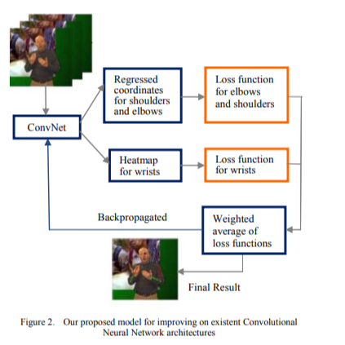
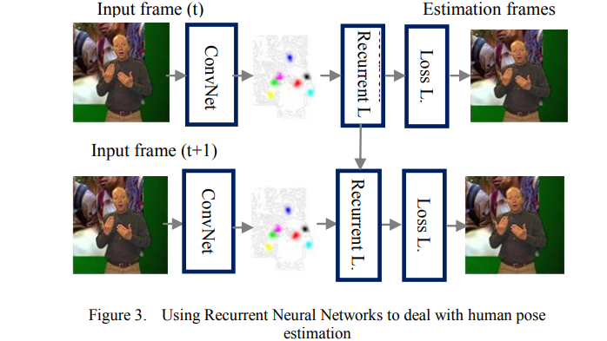

Slide 8
Critical Analysis
Proposing improvements over the CNN architecture can lead to a better mean accuracy but increasing specific aspects of the CNNs’ architecture entails specific considerations when designing the loss functions to use.
One benefit that RNNs have over static models is better temporal analysis although they are quite computationally expensive.
Unsupervised learning is able to minimize the requirement of labelled data but relies heavily on the kind of features extracted.

Slide 9
References
Zhang, S., Yang, H., & Yin, Z.-P. (2016). Transferred Deep Convolutional Neural Network Features for Extensive Facial Landmark Localization. IEEE Signal Processing Letters, 23(4), 478–482. doi:10.1109/lsp.2016.2533721
L. Deng, "A tutorial survey of architectures, algorithms, and applications for deep learning," APSIPA Transactions on Signal and Information Processing, vol. 3, 2014.
J. Schmidhuber, "Deep learning in neural networks: An Overview," Elsevier, 2014.

