Slide 1
KERBEROS
Presented by
By M.V Ganesh Raju
4/4 B1 27

Slide 2
Kerberos
Trusted key server system developed at MIT
Provides a centralized authentication server for network whose function is to authenticate users to servers and servers to users.
Relies exclusively on symmetric encryption, making no use of public-key encryption.
Two versions in use: 4 & 5
Notes:
Kerberos 4 is an authentication service developed as part of Project Athena at MIT.
The problem that Kerberos addresses is this: Assume an open distributed environment in which users at workstations wish to access services on servers distributed throughout the network.
We would like for servers to be able to restrict access to authorized users and to be able to authenticate requests for service. In this environment, a workstation cannot be trusted to identify its users correctly to network
services. In particular, the following three threats exist:
1. A user may gain access to a particular workstation and pretend to be another user operating from that workstation.
2. A user may alter the network address of a workstation so that the requests sent from the altered workstation appear to come from the impersonated workstation.
3. A user may eavesdrop on exchanges and use a replay attack to gain entrance to a server or to disrupt operations.
In any of these cases, an unauthorized user may be able to gain access to services and data that he or she is not authorized to access. Rather than building in elaborate authentication protocols at each server, Kerberos provides a centralized authentication server whose function is to authenticate users to servers and servers to users. Unlike most other authentication schemes described in this book, Kerberos relies
exclusively on symmetric encryption, making no use of public-key encryption.
Two versions of Kerberos are in common use. Version 4 [MILL88, STEI88]
implementations still exist. Version 5 [KOHL94] corrects some of the security deficiencies
of version 4 and has been issued as a proposed Internet Standard (RFC 4120
and RFC 4121)

Slide 3
Kerberos Requirements
First published report on Kerberos identified its requirements as:
Security
Reliability
Transparency
Scalability
Implemented using an authentication protocol based on Needham-Schroeder
Notes:
The first published report on Kerberos [STEI88] listed the following
requirements.
• Secure: A network eavesdropper should not be able to obtain the necessary
information to impersonate a user. More generally, Kerberos should be strong
enough that a potential opponent does not find it to be the weak link.
• Reliable: For all services that rely on Kerberos for access control, lack of
availability of the Kerberos service means lack of availability of the supported
services. Hence, Kerberos should be highly reliable and should employ a distributed
server architecture with one system able to back up another.
• Transparent: Ideally, the user should not be aware that authentication is taking
place beyond the requirement to enter a password.
• Scalable: The system should be capable of supporting large numbers of clients
and servers. This suggests a modular, distributed architecture.

Slide 4
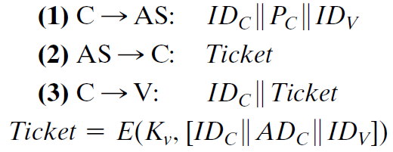
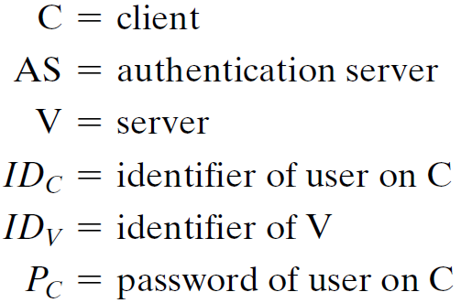

Kerberos 4 Overview
It’s a basic third-party authentication scheme
It has an Authentication Server (AS)
users initially authenticate with AS to identify self .
AS checks it’s DB whether the password is correct and whether that the users has permitted access to a server V.
AS provides a non-corruptible authentication credential (ticket granting ticket encrypted using a secret key) to convince the server that the user is authentic.
Notes:
The core of Kerberos is the Authentication and Ticket Granting Servers – these are trusted by all users and servers and must be securely administered.

Slide 5
Need for a More Secure Authentication Dialogue
However, under this scheme, it remains the case that a user would need a new ticket for every different service.
If a user wished to access a print server, a mail server, a file server, and so on, the first instance of each access would require a new ticket and hence require the user to enter the password.
The second problem is that the earlier scenario involved a plaintext transmission of the password [message (1)].
An eavesdropper could capture the password and use any service accessible to the victim.
To solve these additional problems, we introduce a scheme for avoiding plaintext passwords and a new server, known as the ticket-granting server (TGS).
Notes:
The core of Kerberos is the Authentication and Ticket Granting Servers – these are trusted by all users and servers and must be securely administered.

Slide 6
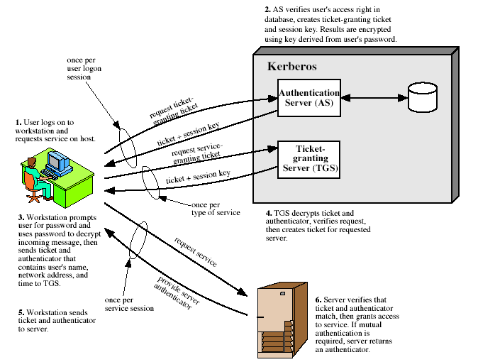
Notes:
Stallings Fig 14.1. Discuss in relation to Table 14.1 which details message exchanges.

Slide 7
Kerberos Realms
a Kerberos environment consists of:
a Kerberos server having the user ID and hashed passwords of all registered users in its database.
a number of Kerberos registered servers, sharing a secret key each with the server
Such an environment is termed a realm
typically a single administrative domain
If there are multiple realms ( Networks of clients and servers under different administrative organizations ), their Kerberos servers must share secret keys and trust the other realms

Slide 8
Kerberos Version 5
It was developed in the mid 1990’s
It provides improvements over v4
It addresses environmental shortcomings such as:
Encryption algorithm
In v4 only DES can be used to encrypt but here any encryption can be used
Network protocol
Earlier only IP addresses supported here other address types such as ISO network addresses can be used.

Slide 9
Byte order
Earlier byte ordering of its own choosing by the sender.
However now established conventions such as Abstract Syntax Notation One (ASN.1) and Basic Encoding Rules (BER), are used which provide an unambiguous byte ordering.)
Ticket lifetime-bit
Lifetime values in v4 are encoded in an 8-bit quantity in units of five minutes.
Thus, the maximum lifetime that can be expressed is 28 * 5 = 1280 minutes (a little over 21 hours).
This may be inadequate for some applications (e.g., a long-running simulation that requires valid Kerberos credentials throughout execution).
In version 5, tickets include an explicit start time and end time, allowing tickets with arbitrary lifetimes.

Slide 10
Authentication forwarding:
Version 4 does not allow credentials issued to one client to be forwarded to some other host and used by some other client.
This capability if allowed, would enable a client to access a server and have that server access another server on behalf of the client.
For example, a client issues a request to a print server that then accesses the client’s file from a file server, using the client’s credentials for access.
Version 5 provides this capability.
Inter-realm authentication:
In version 4, interoperability among N realms requires on the order of N^(2) Kerberos-to-Kerberos relationships, as described earlier.
Version 5 supports a method that requires fewer relationships, as described shortly.

Slide 11
Apart from these environmental limitations, there are technical deficiencies in the version 4 protocol itself and version 5 attempts to address these. They are:
Double Encryption
The tickets provided to clients are encrypted twice—once with the secret key of the target server and then again with a secret key known to the client.
The second encryption is not necessary and is computationally wasteful.
PCBC Encryption
Encryption in version 4 makes use of a nonstandard mode of DES known as propagating cipher block chaining.

Slide 12
It has been demonstrated that this mode is vulnerable to an attack involving the interchange of cipher text blocks.
PCBC was intended to provide an integrity check as a part of the encryption operation.
Version 5 provides explicit integrity mechanisms, allowing the standard CBC mode to be used for encryption.
In particular, a checksum or hash code is attached to the message prior to encryption using CBC.
Session Keys
Each ticket includes a session key that’s used by the client to encrypt the authenticator.
However, because the same ticket may be used repeatedly to gain service from a particular server, there is the risk that an opponent will replay messages from an old session to the client or the server.

Slide 13
In version 5, it is possible for a client and server to negotiate a sub-session key, which is to be used only for that one connection.
A new access by the client would result in the use of a new sub-session key.
Password attacks
Version 5 provides a mechanism known as pre-authentication, which should make password attacks more and very difficult as compared to the version 4, but it does not prevent them.

Slide 14
Additional Elements added in Version 5
Realm:
Indicates realm of user
Options:
Used to request that certain flags be set in the returned ticket
Times:
Used by the client to request the following time settings in the ticket:
from: the desired start time for the requested ticket
till: the requested expiration time for the requested ticket
rtime: requested renew-till time
• Nonce:
A random value to be repeated in message to assure that the response is fresh and has not been replayed by an opponent

Slide 15
