Slide 1
Portable Weather Station with Web based Data Visualisation and Analytics
TEAMMATES:
SHEELAVANT N SAI KRISHNA – 18BEC0905
G V GANESH MAURYA – 18BEC0128
GYAN VALLABH K – 18BEC0899
NAKKA PAVAN KALYAN – 18BEC0847
IoT Fundamentals ECE3501
J - Component
Review - 1

Slide 2
Abstract
Weather information that is sent to personal devices nowadays are generalised for a particular region. This project consists of weather monitoring system that gets environmental data. Interfaced with an IoT data visualisation platform, this data will then be used for visualisation and analysis. An interactive weather dashboard will display info based on this data. Finally, it will be simplified as real-time notifications sent to the user’s mobile device. (Notifications like rain alerts, regular climate updates). This weather station can be further improvised by making it portable. This will make sure instantaneous and accurate weather information is accessible easily.

Slide 3
Introduction
The aim of this project is to design a weather station with real time notifications for climatology monitoring, interface it to a cloud platform and analyse weather parameters.
We use a Raspberry Pi interfaced with SenseHat to sense environmental conditions.
Node Red and IFTTT is used to send notifications to the user’s mobile phone.
Finally we use Initial State to receive, analyse and visualize the data sent by Sense Hat.

Slide 4
Literature Survey
S. No | Author | Year of Publication | Title of Paper | Abstract
1. | A.C. GHEORGHE, M.S. CHIRAN | 2017 | Raspberry Pi based Weather Station | The paper proposes the development of a weather station made up from a Raspberry Pi 3 and the Sense Hat shield. The shield used in this application has sensors for temperature, humidity and pressure. The weather station can connect to the internet wirelessly or with a standard UTP (Unshielded twisted pair) connection, this connection gives us the ability to take part in a scientific community for the sole purpose to monitor the weather all around the world. The program for the weather station is made in Python, the program language is easy to used and very versatile.

Slide 5
S. No | Author | Year of Publication | Title of Paper | Abstract
2. | G. GOVARDHAN, S. JAVEED HUSSAIN AND S. A. K. JILANI | 2016 | A Smart Gadget to Analyze the Weather Changes Using SenseHat Sensor and Internet of Things(IoT) | In present days, as the technology improves day by day, every one seems to automate most of the possible things to take advantage in providing ease in life. The main objective of this paper is to develop project which monitors the weather with temperature, pressure and humidity values. Method: The proposed method is to build our very own weather dashboard, using Raspberry pi SenseHat and wifiusb nano adapter which captures the weather inside and outside of house over time and sends the data to ThingSpeak. Findings: The code used for the proposed method is developed in python language, which is a default programming language provided by Raspberry Pi and Store’s the results in new channel API Thing speak key, which is an IoT application. Improvements: The reliability of the proposed work can be further improved by using Wireless Sensor Nodes at different places.

Slide 6
Components Used
SenseHat - The Sense HAT is an add-on board for the Raspberry Pi. The board allows us to make measurements of temperature, humidity, pressure, and orientation, and to output information using its built-in LED matrix.
Raspberry Pi – The Raspberry Pi is a low cost, credit-card sized computer that plugs into a computer monitor or TV, and uses a standard keyboard and mouse. Receive data from SenseHAT and send it to the web.
NodeRed - Node-RED is a programming tool for wiring together hardware devices, APIs and online services. In our project we use it to push data to IFTTT.
IFTTT IoT Platform - To send notifications to Mobile device.
Initial State – To receive, analyse and visualise weather data.

Slide 7
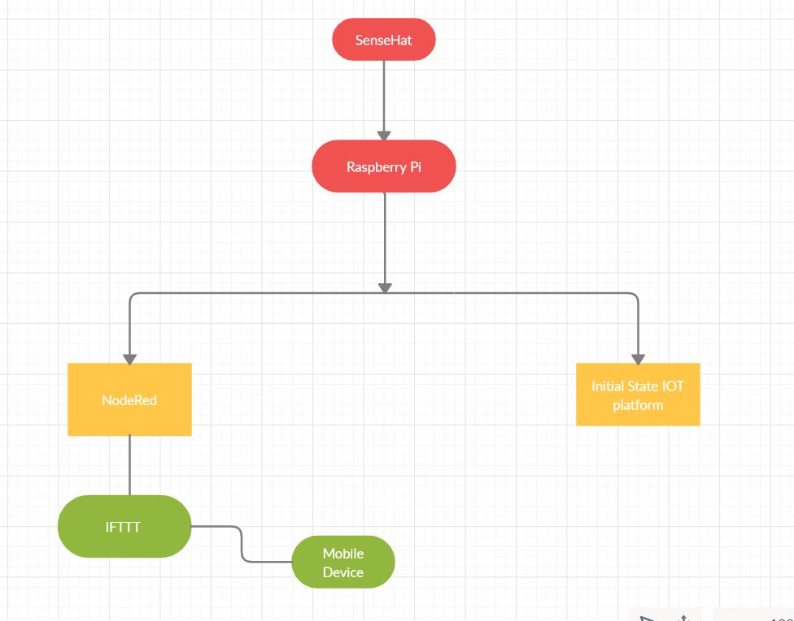
Block Diagram

Slide 8
Conclusion
Sense Hat is a very powerful Raspberry Pi add-on which is used to make measurements of temperature, humidity, pressure. It also has a built in accelerometer and a gyroscope. A version of this is also used in the International Space Station.
In this project we also used another very powerful software tool called Initial State that is used to visualize and predict weather data.
If we require weather data at any particular time instant Sense Hat send us the data. And if we want to analyse the weather for the next couple of days then we can use the visualization provided by Initial State.
Hence this application is useful to keep track of weather, and the weather station can connect to the internet by adding it to a scientific community made up of several weather stations built from Raspberry Pi+ Sense Hat to monitor weather around the world.

Slide 9
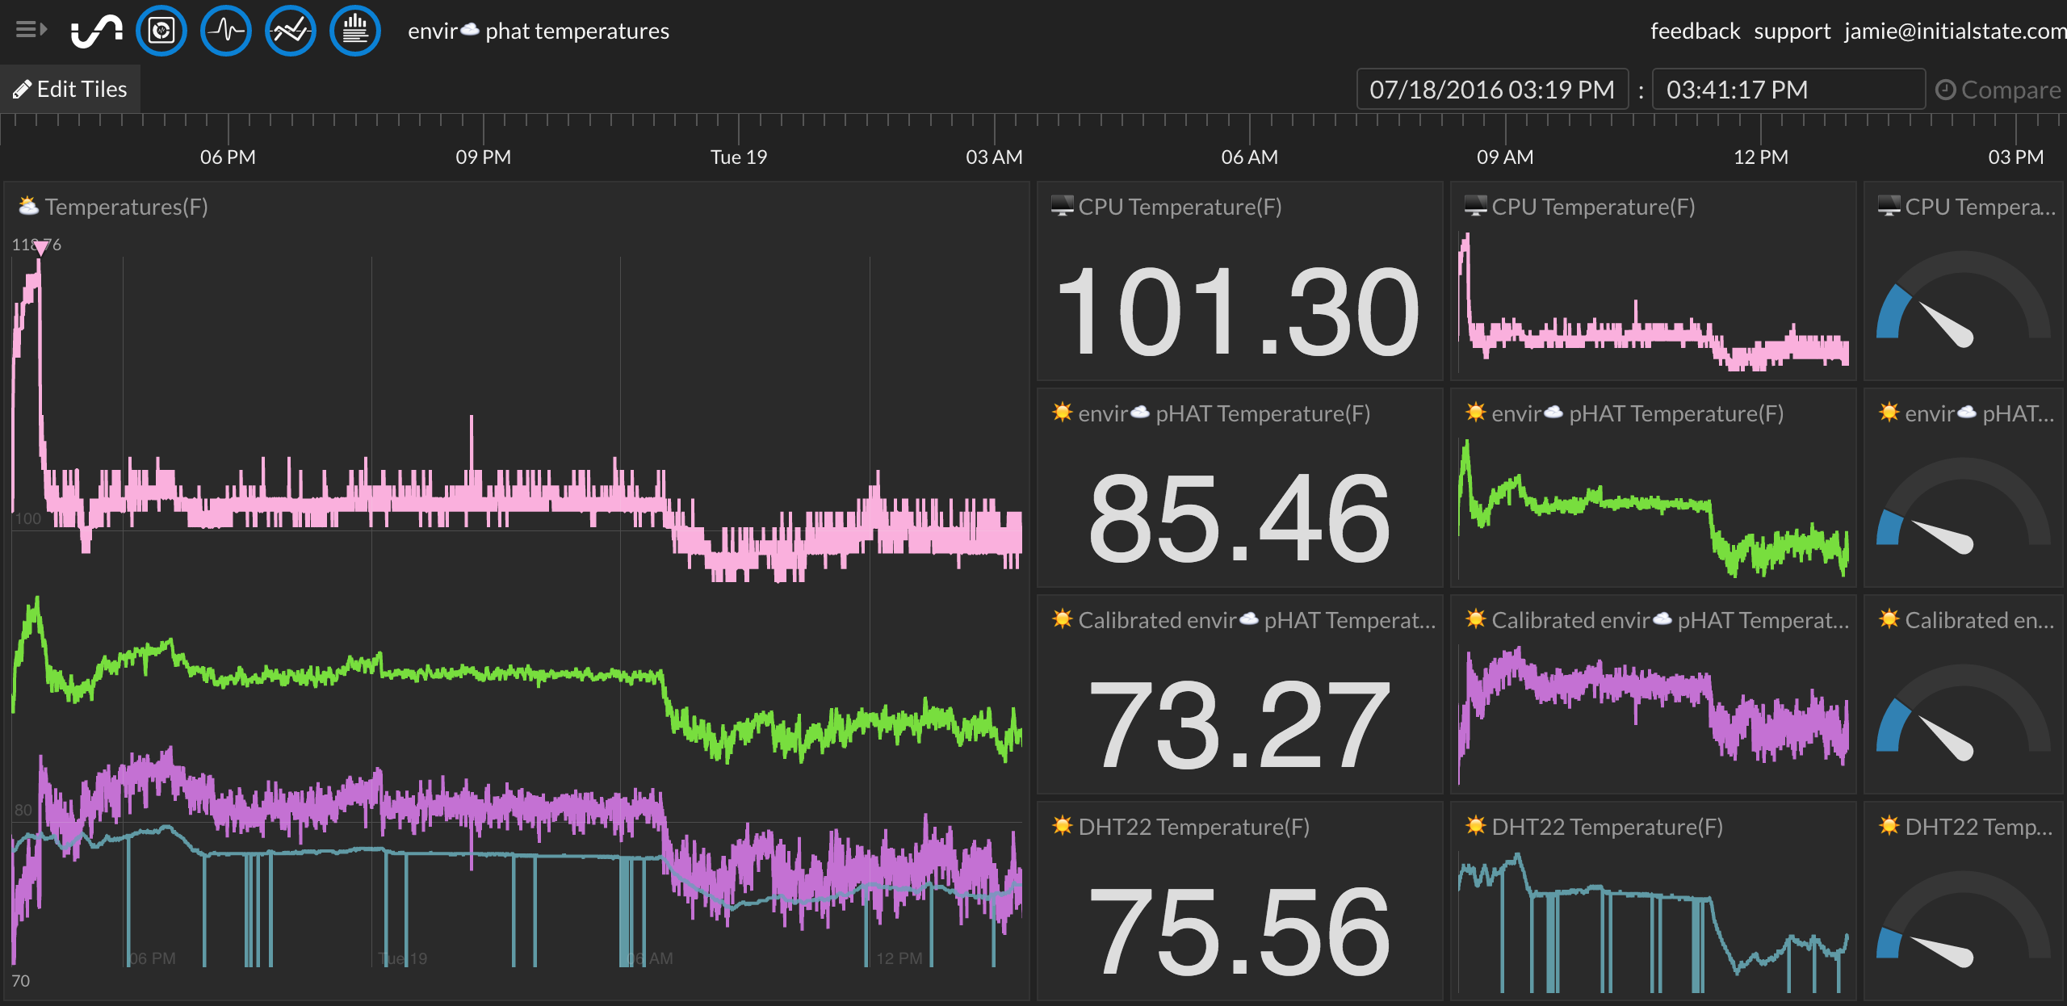
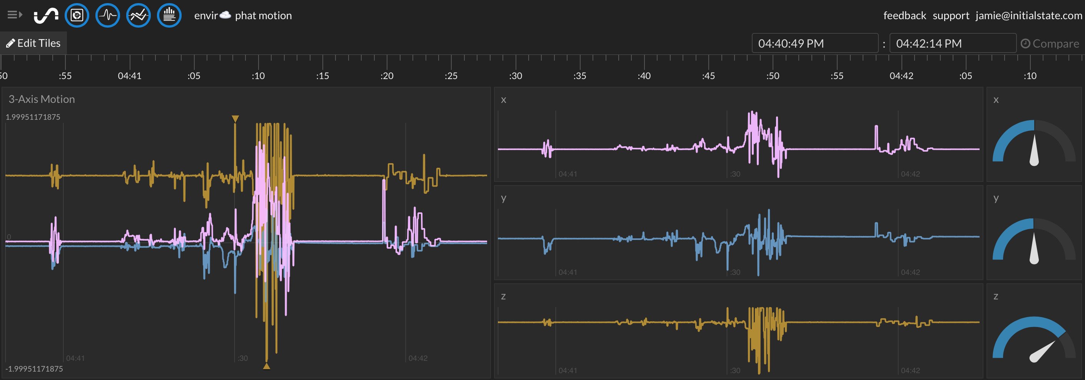
Expected Results

Slide 10
Thank You

