Slide 1
Portable Weather Station with Web based Data Visualisation and Analytics
TEAMMATES:
SHEELAVANT N SAI KRISHNA – 18BEC0905
G V GANESH MAURYA – 18BEC0128
GYAN VALLABH K – 18BEC0899
NAKKA PAVAN KALYAN – 18BEC0847
IoT Fundamentals ECE3501
J - Component
Review - 2

Slide 2
Introduction
The aim of this project is to design a weather station with real time notifications for climatology monitoring, interface it to a cloud platform and analyse weather parameters.
We use a Raspberry Pi interfaced with SenseHat to sense environmental conditions.
Node Red and IFTTT is used to send notifications to the user’s mobile phone.
Finally we use Initial State to receive, analyse and visualize the data sent by Sense Hat.

Slide 3
Initial State:
Initial State is an IOT platform which is used for Data Visualization.
Using this we can get we can get weather Information of any place in the world.
It can display current humidity, wind speed, wind degree, dew Point, snow fall,etc...
We can also predict when it will rain or the chance of snow fall, etc...

Slide 4
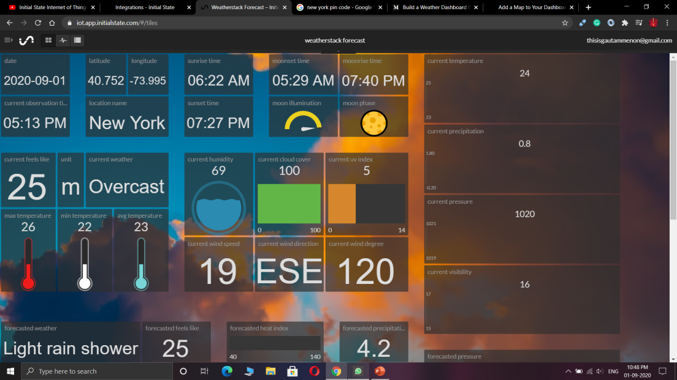
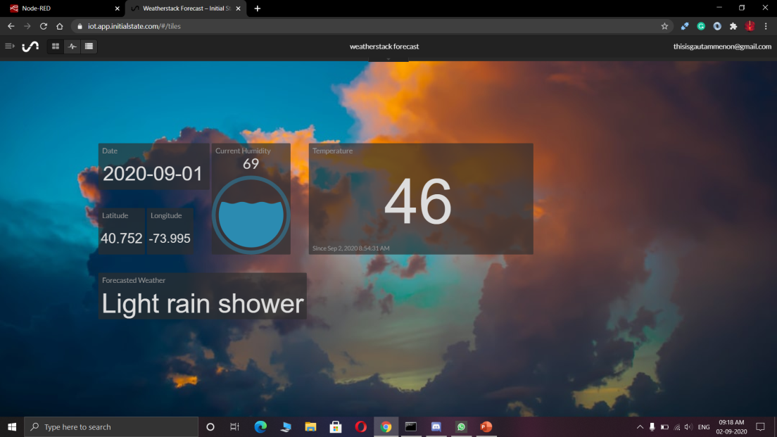
Initial State Output:

Slide 5
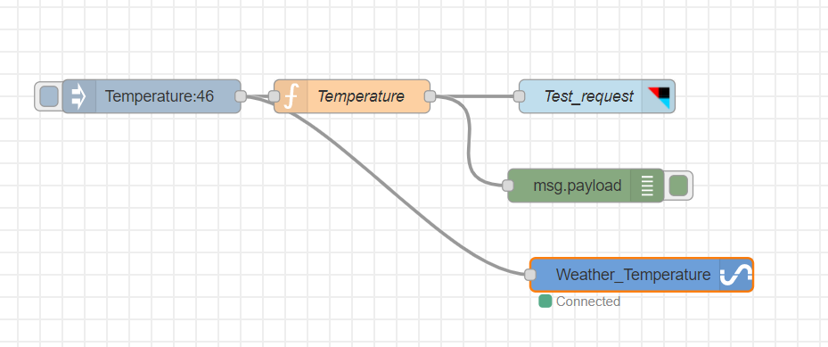
Implementation in Initial State
Here we are taking custom input through Node-RED and displaying the values in Initial State.
When we connect Raspberry Pi, the Raspberry Pi sends values to a cloud and from there we can get the values and display them in Initial State.

Slide 6
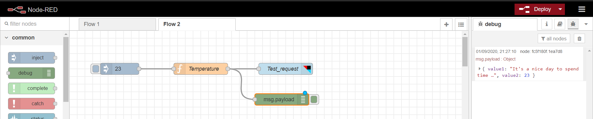
Node-Red Output
Node-RED is a programming tool for wiring together hardware devices, APIs and online services. In our project we use it to push data to IFTTT.
In our project we created a node-red flow chart that sends notifications to our mobiles using IFTTT platform.
Flow chart is given below :

Slide 7
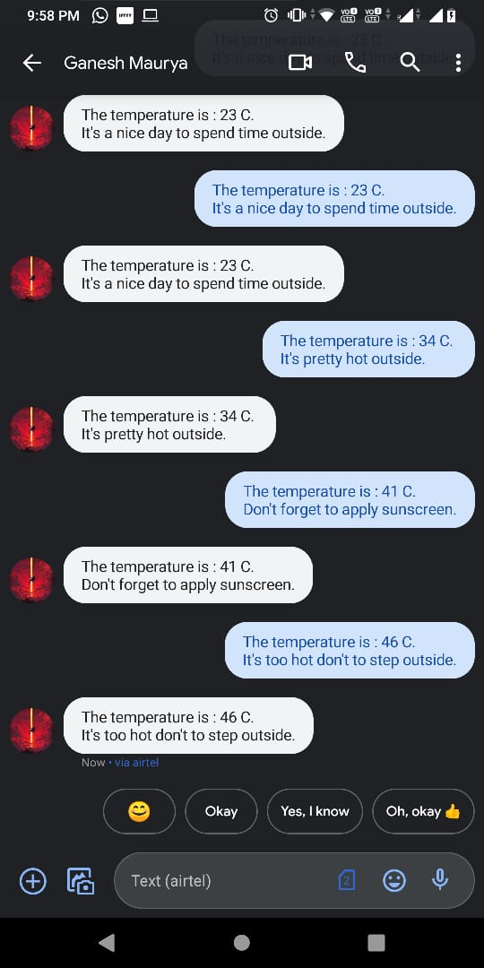
As you can see here Node-RED using IFTTT send a notification to our mobile device.
The first like displays the temperature and the second line displays the message
according to the temperature value.
In this prototype we gave customized input but in the final along with temperature, pressure and humidity will also be displayed.

Slide 8
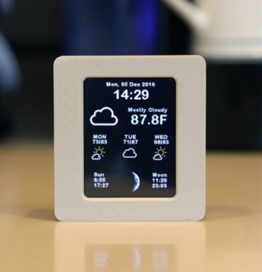
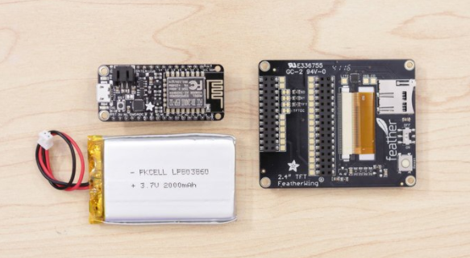
Further Improvements
As the hardware part is yet to be done we are planning to use a more cheaper and better device than SenseHat.
For this we have selected HUZZAH with ESP8266.
Other addons are 2.4" TFT Feather Wing 320x240 Touchscreen, 2000mAh Rechargeable Battery.
This will make the device more portable that you can carry in your pockets and the screen will make it easy to see the information whenever we want.

Slide 9
Thank You

