Slide 1



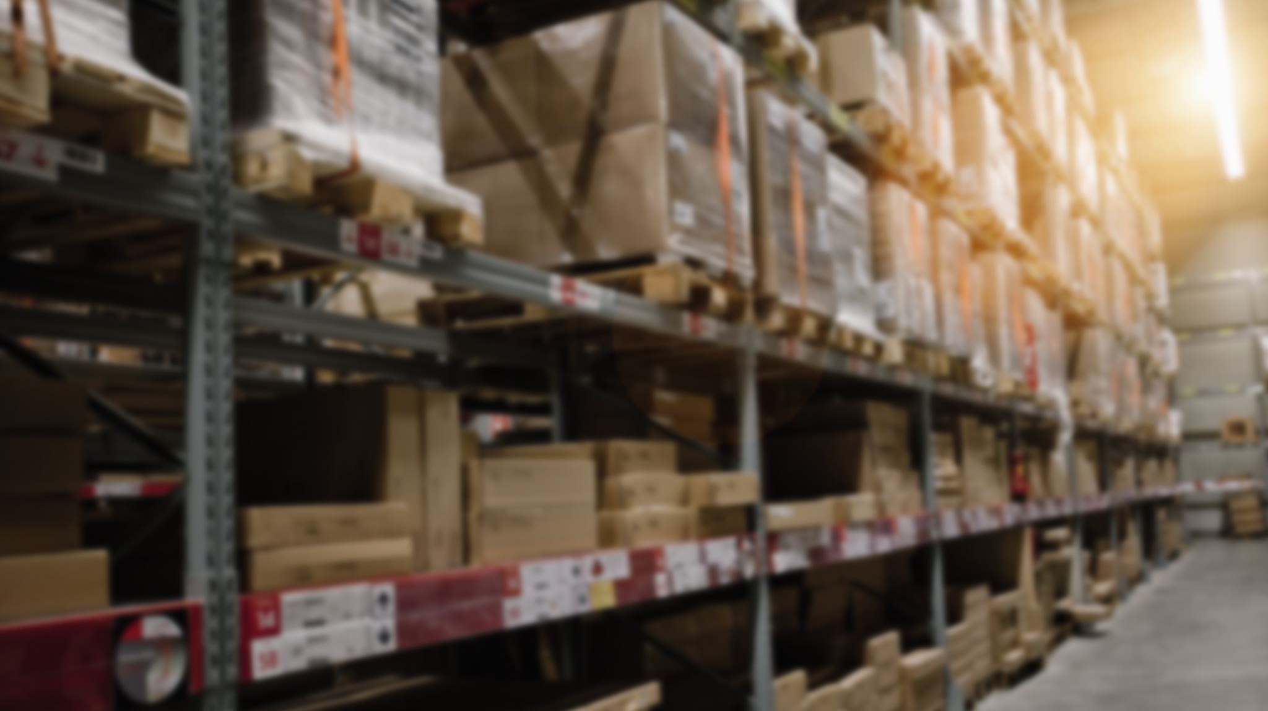
Consumer Goods Ad–hoc Insights

Slide 2
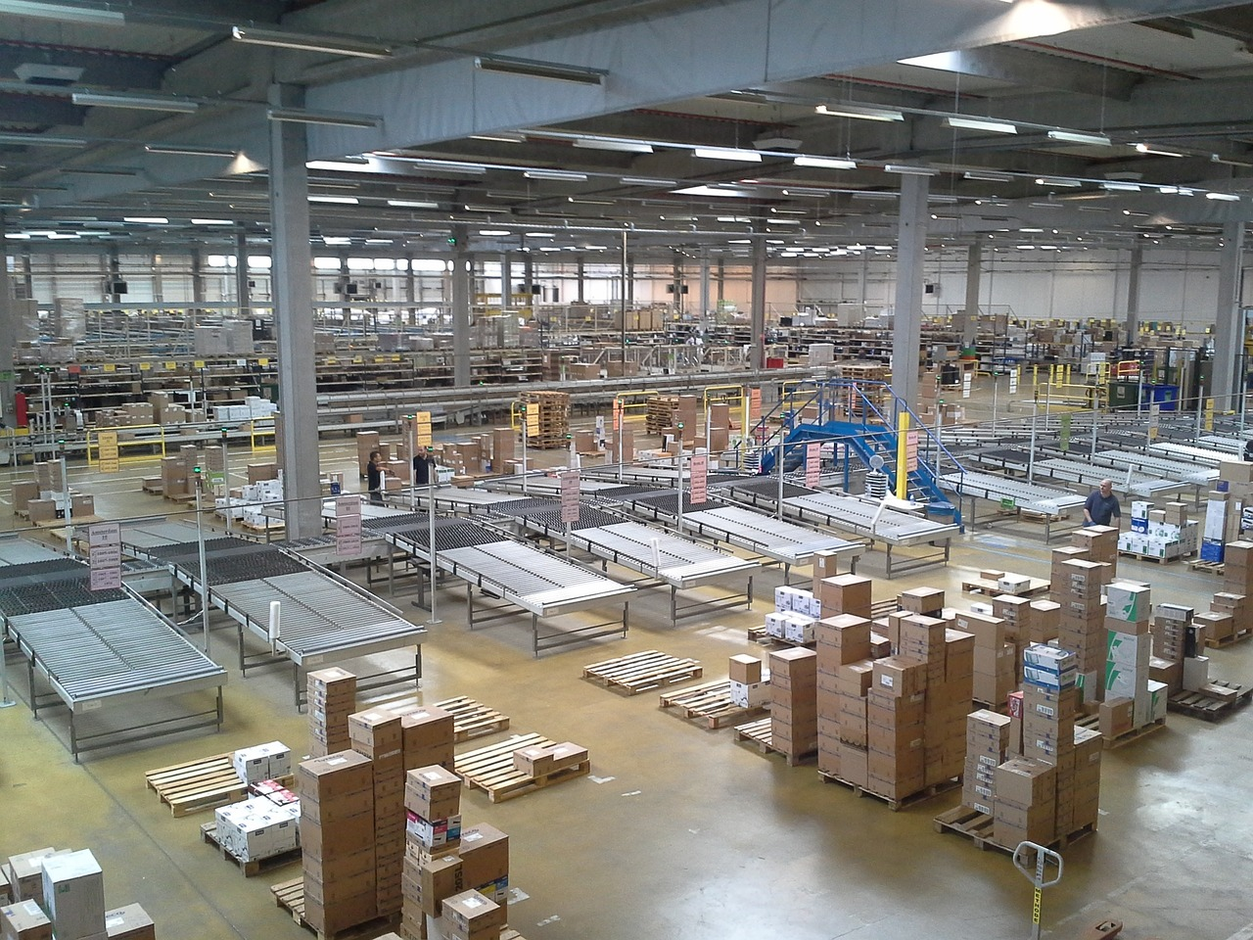
AGENDA
Background/ context.
Getting familiar with Atliq’s Business Model – Their Markets and Product lines.
Getting familiar with Input data.
Ad-hoc requests along with the Queried Results, Visualizations and Insights.

Slide 3
BACKGROUND/CONTEXT
Our Company
Atliq Hardware's (fictitious company) – one of the leading computer hardware producers in India.
Background
The management noticed that they do not get enough insights to make quick and smart data-informed decisions.
Problem
There are 10 ad-hoc requests for which the company needs insights.
Approach
Run a SQL query to answer these requests. Convert it into visualizations and present the insights to the top-level management.

Slide 4
Atliq’s product Classification
PC
P & A
N & S
Desktop
Notebook
Peripherals
Notebook
Networking
Storage
Business
laptop
Gaming
laptop
Graphic card
Batteries
WI FI
Extenders
External
SSD
Personal
laptop
Business
laptop
Internal HDD
Keyboard
USB flash
drives
Personal
laptop
Mother Board
Mouse
Processor

Slide 5
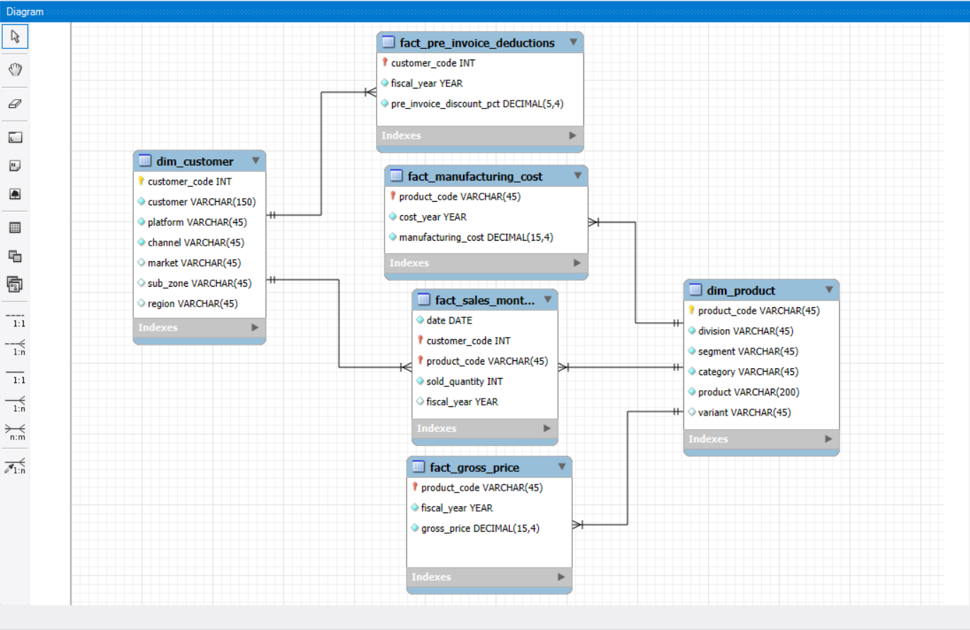
Getting familiar with Input data.
Input data consists of sales data for FY 2020 and FY 2021, along with different other dimension tables like customer details, product details,.etc.

Slide 6
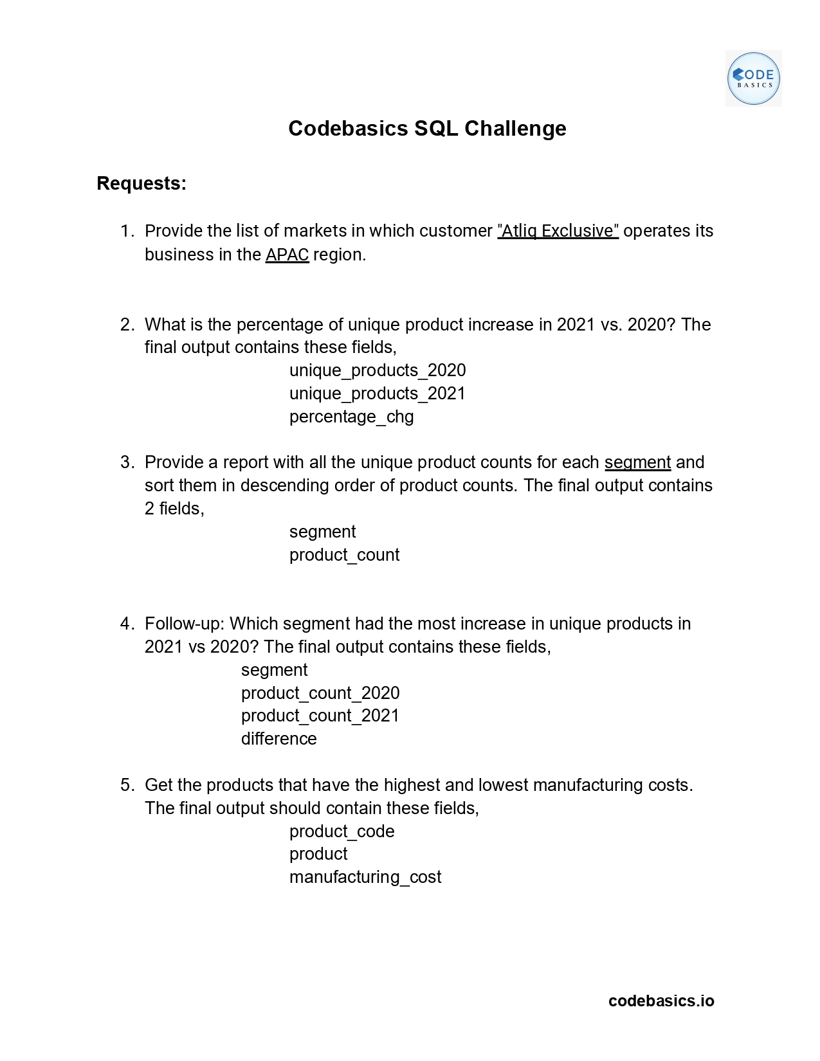
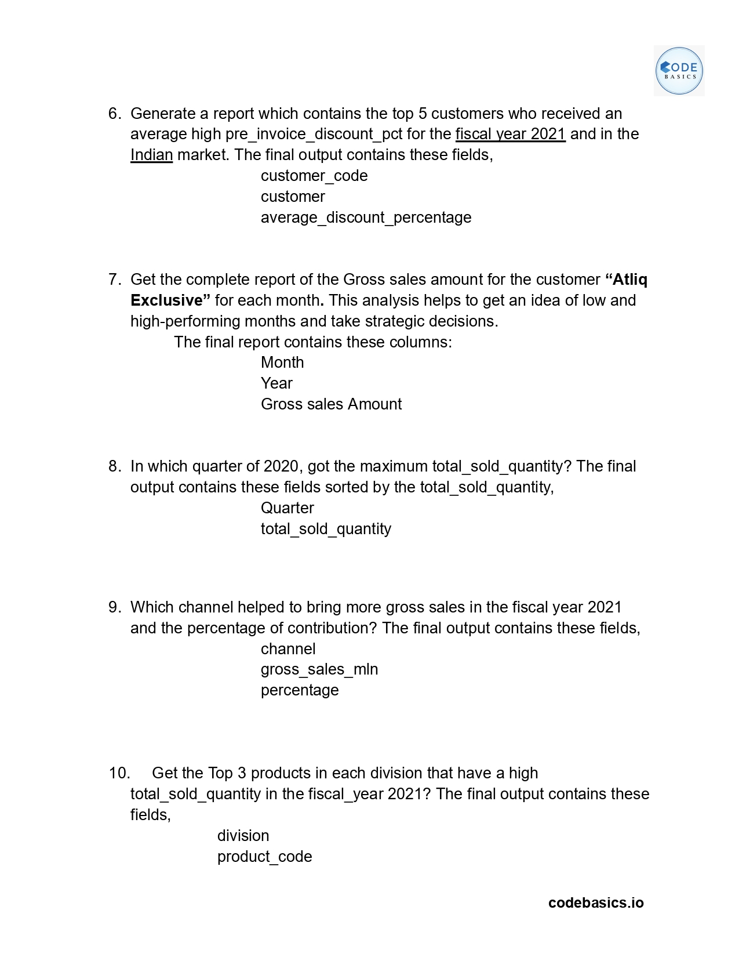
Ad-hoc Requests
Let’s dive into the Queried results, Visualizations, and Insights.

Slide 7
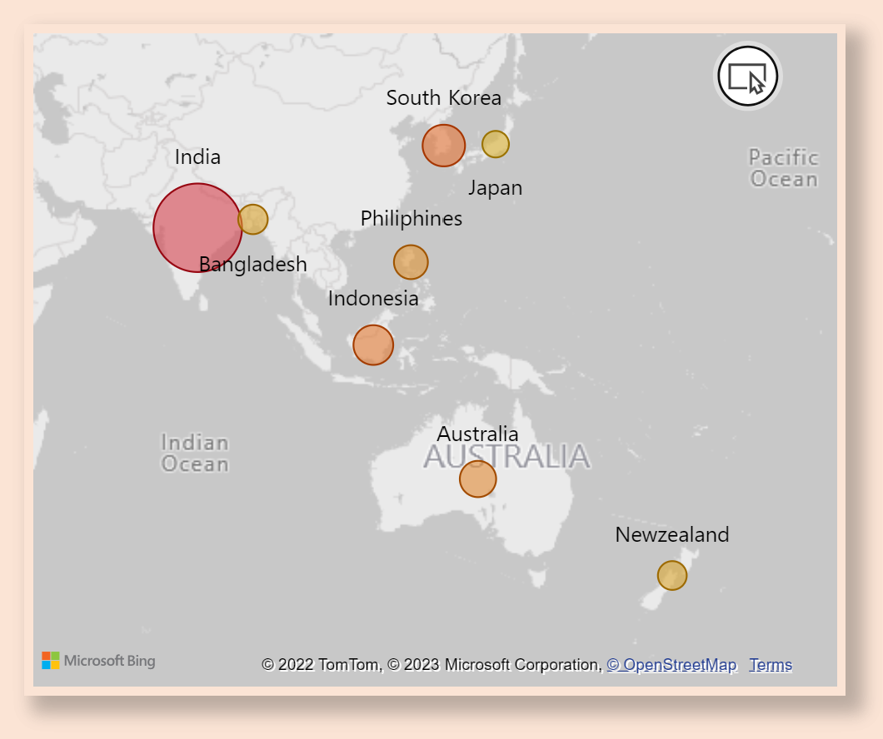
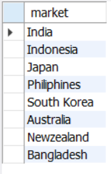
#Req-1: Provide the list of markets in which customer "Atliq Exclusive" operates its business in the APAC region.
These are the ‘8’ countries in the ‘APAC’ region where Atliq Exclusive operates its business.
Overall, Atliq sold 3.85 million goods in the "APAC" region in FY 2020 and FY 2021. India had the most products sold (1.9 million) out of all the countries in this region, while Japan had the fewest (0.06 million).

Slide 8
#Req-2: What is the percentage of unique product increase in 2021 vs. 2020? The final output contains these fields, unique_products_2020,
unique_products_2021,
percentage_chg
Count of Unique products in FY-2020: ‘245’
Count of Unique products in FY-2021: ‘334’
Insight: "Atliq demonstrated a 33.6% increase in unique products By releasing new items in 2021 compared to 2020”, This indicates a strong push for innovation, which enhances the company's growth potential and strengthens its competitive edge in the market.

Slide 9
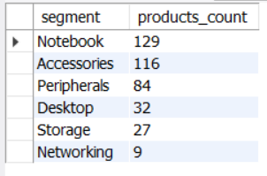
#Req-3: Provide a report with all the unique product counts for each segment and sort them in descending order of product counts. The final output contains 2 fields,
Segment,
product_count
After drill-down to each segment, it’s evident that Notebooks, Accessories, and peripherals are averaging around 110, whereas the remaining three segments are lagging with an average of 23 products per segment.
To boost sales and provide a wider range of products for consumers, production should concentrate on new developments in these three areas (desktop, storage, and networking).

Slide 10
Insight: "The Notebook, Accessories, and Peripherals segments show strong product diversity and growth in production compared to other segments. However, Desktop, Storage, and Networking segments lag behind and require increased focus on manufacturing growth across various product categories to enhance overall performance."

Slide 11
#Req-4: Follow-up: Which segment had the most increase in unique products in 2021 vs 2020? The final output contains these fields,
Segment,
product_count_2020,
product_count_2021,
difference

Slide 12
Out of all the product categories, Accessories has seen the newest product introductions.
By developing new products, Storage & Networking is increasing its production at a very modest rate.

Slide 13


#Req-5: Get the products that have the highest and lowest manufacturing costs. The final output should contain these fields, product code,
product,
manufacturing cost
Highest Manufacturing Cost
Lower Manufacturing Cost
$ 240.54
$ 0.89
A6120110206
AQ HOME Allin1 Gen 2 (Plus 3)
Category: personal Desktop
A2118150101
AQ Master wired x1 Ms (Standard)
Category: Mouse

Slide 14
#Req-6: Generate a report which contains the top 5 customers who received an average high pre_invoice_discount_pct for the fiscal year 2021 and in the Indian market. The final output contains these fields, customer_code,
customer,
average_discount_percentage
The highest avg_pre_Invoice_discount_pct was given to “FLIPKART”.
The lowest avg_pre_Invoice_discount_pct was given to “AMAZON”.

Slide 15
#Req-7: Get the complete report of the Gross sales amount for the customer “Atliq Exclusive” for each month. This analysis helps to get an idea of low and high-performing months and make strategic decisions. The final report contains these columns: Month,
Year, &
Gross sales Amount.

Slide 17
Insight:
"In both FY-20 and FY-21, Atliq Exclusive saw a drastic decline in sales during March 2020, dropping to $0.8 million due to the impact of COVID-19 and the global chip shortage. However, post-lockdown, sales steadily grew month by month. Notably, November recorded the highest gross sales in both fiscal years (2020 and 2021)."

Slide 18
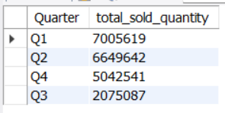
#Req-8: In which quarter of 2020, got the maximum total sold quantity? The final output contains these fields sorted by the total_sold_quantity.
Quarter,
total_sold_quantity

Slide 20
Insight: "In FY-2020, Q3 (March, April, May) recorded the lowest sales with 2.1 million units sold, accounting for just 10% of the total sold quantity, primarily due to the impact of COVID-19. In contrast, Q1 was the highest contributor, with 7 million units sold, representing 34% of the total sales for the year.“
To mitigate future declines in Q3, the company should consider offering discounts or promotional offers during this period to boost sales."

Slide 21
#Req-9: Which channel helped to bring more gross sales in the fiscal year 2021 and the percentage of contribution? The final output contains these fields, channel gross_sales_mln percentage

Slide 23
Insight: "The Retailer channel generated the highest gross sales at $1,219.1 million, contributing 73% of the total sales. In contrast, the Distribution channel reported the lowest sales, with only $188.0 million, representing just 11% of the total.“
My Opinion: When Atliq expands into other countries through the Distribution channel, they should indeed focus on understanding customer behavior in those regions. This includes analyzing local preferences, purchasing habits, and the strength of competitors.

Slide 24
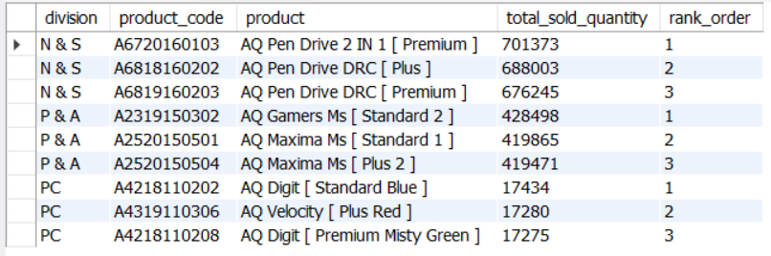
#Req-10: Get the Top 3 products in each division that have a high total_sold_quantity in the fiscal_year 2021? The final output contains these fields, division, product_code, product, total_sold_quantity, rank_order

Slide 25



The “Pendrive” is the most selling product in N&S division, which were around 7 lakh in quantity.
The “Mouse” is the most selling product in P&A division, which were around 4 lakh in quantity.
The “Personal Laptops” is the most selling product in N&S division, which were around 17 Thousands in quantity.

Slide 26
END THANK YOU

