Slide 1

N.B.K.R Institute of science and technology
DS ASSIGNMENT
2024 - 2025

Slide 2
TITLE: Voting System [team no: 13]
Team Members:
1. M. Ganesh [24KB1A05BE]
2. P. Srinadh [24KB1A05EQ]
3. M. Vasu [24KB1A05AR]
Subject: Data Structures
College: N.B.K.R Institute of Science And Technology
Branch: Computer Science And Engineering
Section: C
Year: 1st
Semester: 2nd

Slide 3
Introduction
Objective:
Create a simple and secure voting system using C programming.
Features:
- 5 Candidates
- Vote Recording
- Result Display
- Password Protection

Slide 4
System Overview
Password Authentication:
- Only authorized users can access voting.
Voting Functionality:
- Voters select candidates.
Results Display:
- Votes counted and displayed on request.

Slide 5
Key Code Sections
Password Check:
- Uses strcmp to verify password.
Vote Storage:
- Array to store votes: votes[5].
Candidate Names:
- Stored in a 2D array.

Slide 6
Voting Process Flow
- Enter password
- If correct:
- Display candidates
- Accept vote
- Option to view results or exit
- If incorrect:
- Deny access

Slide 7

Git HuB
https://github.com/GaneshMylapur001/voting-system-in-c
Files Added:
https://github.com/GaneshMylapur001/voting-system-in-c/blob/main/Output%20Softcopy.docx
https://github.com/GaneshMylapur001/voting-system-in-c/blob/main/VotingSystem%5Bword%20doc%5D.docx
https://github.com/GaneshMylapur001/voting-system-in-c/blob/main/Voting_System_Project_Report.docx
https://github.com/GaneshMylapur001/voting-system-in-c/blob/main/main.c
https://github.com/GaneshMylapur001/voting-system-in-c/blob/main/main.exe

Slide 8
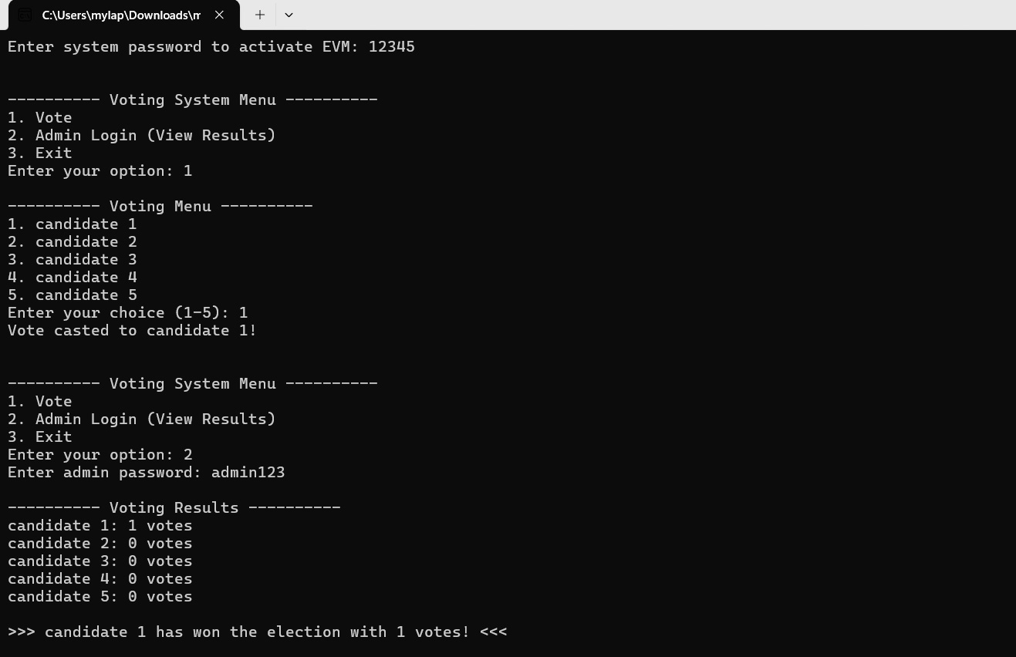
Output

Slide 9
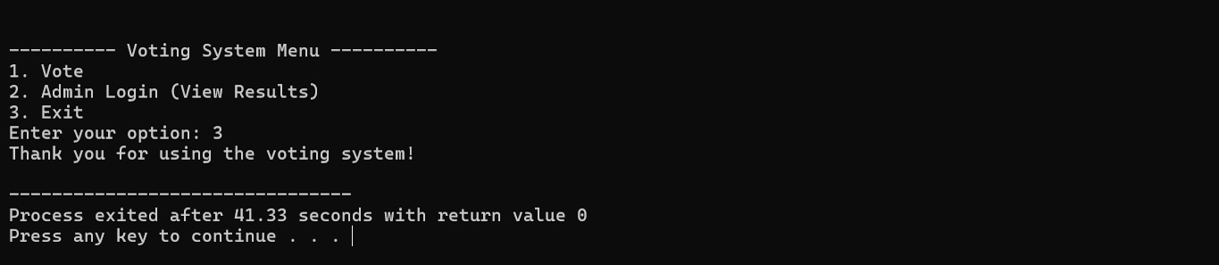

Slide 10
Conclusion
Successfully created a basic voting system in c.
Demonstrated:
- Secure access
- Efficient vote recording
- Real-time result viewing

Slide 11
Thank you

