Slide 1
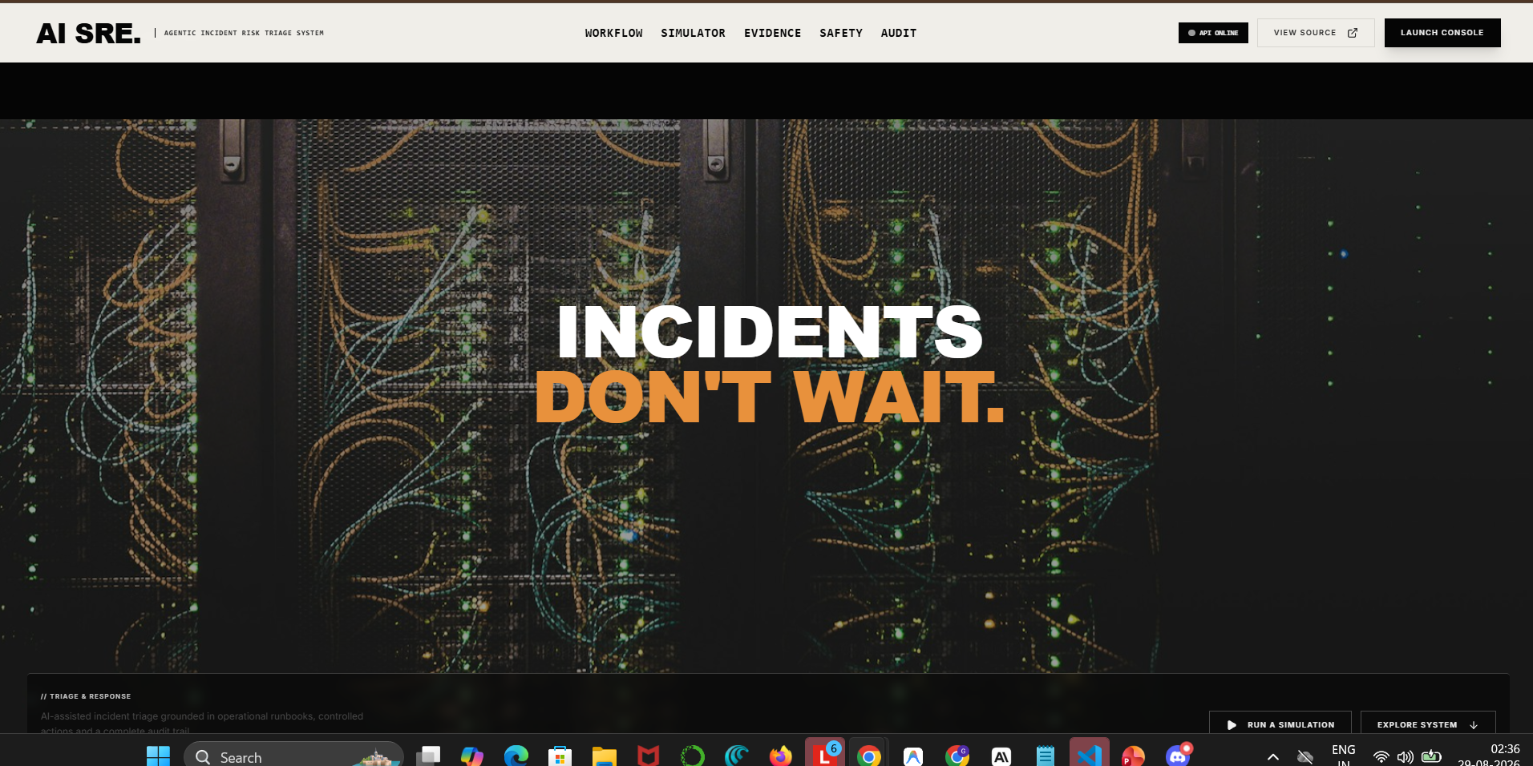
1
2
3
4
SCROLL 01 — NAVBAR + HERO
1
Navigation labels are too small for a primary header.
2
Unexplained black band creates a broken transition before the hero.
3
Hero image is too dark; orange headline introduces an isolated palette.
4
Supporting copy and actions are clipped below the viewport.
Notes:
[Sources]
- User-provided localhost screenshot: 885b09ef-259b-4ee0-b454-683362caa02d.png
- Repository: https://github.com/GaneshNair007/agentic_ops
Target fix:
Replace the hero with a bright, high-resolution web photo of a blue-lit data-centre corridor. Keep the UI black/white. Put copy inside a solid black left panel or a strong local veil; never dim the entire image. Motion: one 600–800px reversible image-mask reveal, not a separate empty scroll state.

Slide 2
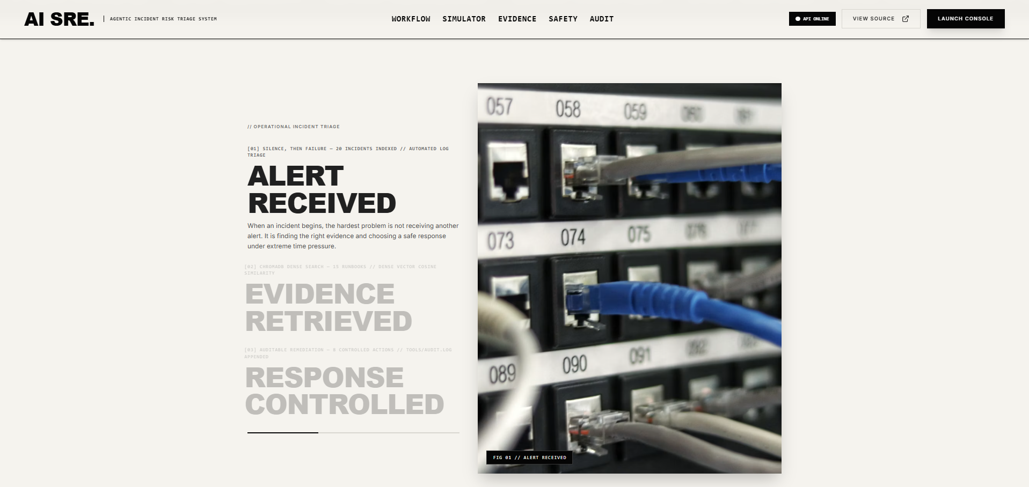
1
3
4
2
SCROLL 02 — WORKFLOW / STATE 1
1
The scene begins with too much empty cream space.
2
Inactive stages are so pale that they look disabled or missing.
3
One blurred cable photograph cannot carry all three workflow states.
4
The image and text occupy only the middle half of a wide viewport.
Notes:
[Sources]
- User-provided localhost screenshot: 0e66557e-18c2-4ba2-b292-44d008f6e6ea.png
- Repository: https://github.com/GaneshNair007/agentic_ops
Target fix:
This is the first state of one pinned workflow, not a separate section. Use a 45/55 split across 92vw. Body text minimum 18px. Inactive stages remain #5A5A5A, never near-white. Use three different but cohesive web images: alert LEDs, network cables, engineer reviewing a dashboard.

Slide 3
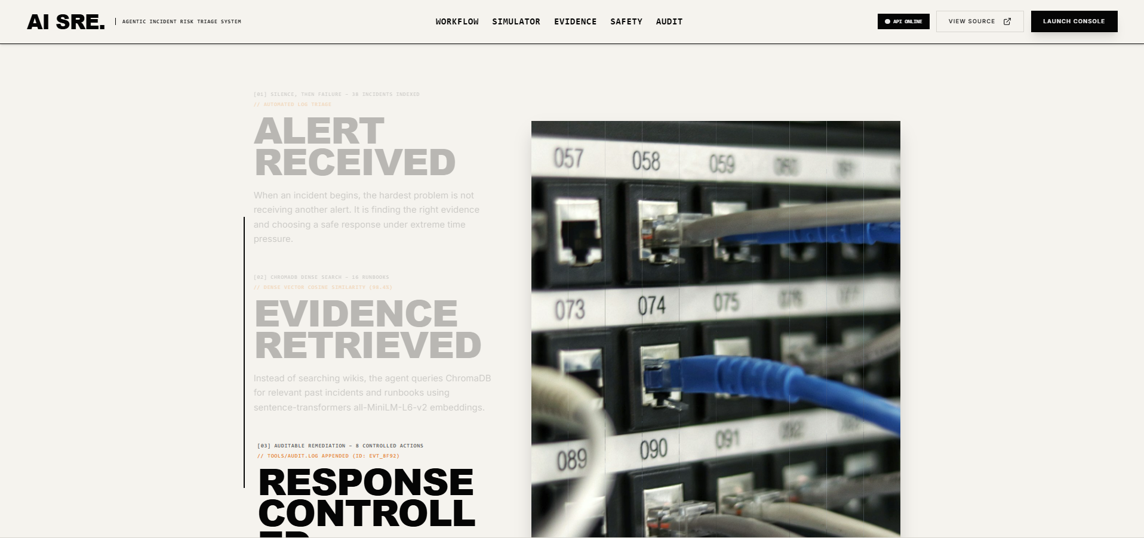
1
2
3
4
SCROLL 03 — WORKFLOW / REPEATED STATE
1
This repeats Scroll 02 without enough visual change.
2
Active and inactive copy remains extremely low contrast.
3
The same photograph is reused; the promised image transition is absent.
4
Final heading is cut off, proving the pinned height/timing is wrong.
Notes:
[Sources]
- User-provided localhost screenshot: 406e3432-46a2-4d61-a82d-5195264a0bbc.png
- Repository: https://github.com/GaneshNair007/agentic_ops
Target fix:
Merge Scrolls 02 and 03 into one workflow section with three clear internal states. Each state must change headline, body, image and progress position. If a scroll increment does not create a meaningful new state, remove that scroll distance.

Slide 4
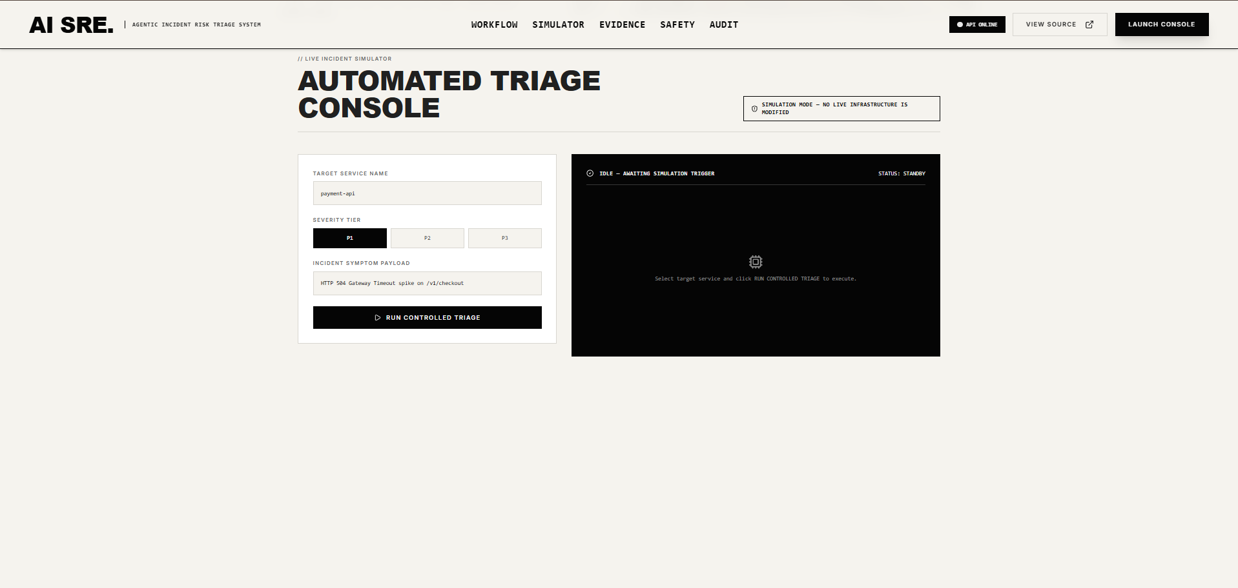
1
2
3
4
SCROLL 04 — INCIDENT SIMULATOR
1
Simulator controls are small and trapped in another bordered box.
2
Input labels and values are too small to scan comfortably.
3
The black output panel is empty instead of previewing pipeline stages.
4
Nearly half the viewport is unused blank space.
Notes:
[Sources]
- User-provided localhost screenshot: 9ef6a1ef-d7a4-48e3-a8f3-f725eb14c166.png
- Repository: https://github.com/GaneshNair007/agentic_ops
Target fix:
Use a full-width 40/60 split with 18px controls. The idle output must show five labelled pipeline stages and a subtle real infrastructure image. On run, animate only real returned events. Section height should be content-driven; remove the dead lower half.

Slide 5
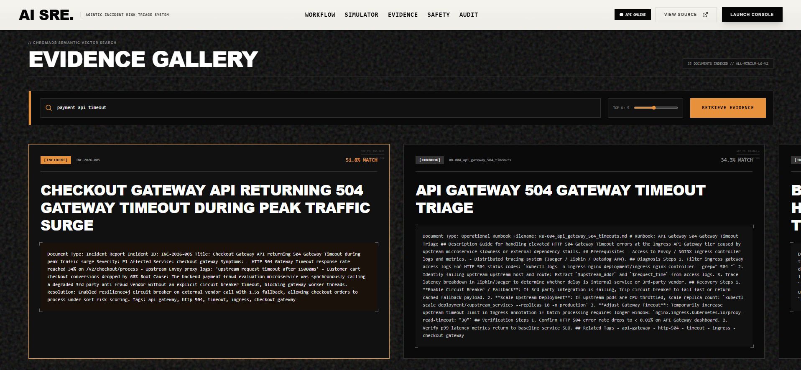
1
2
5
3
4
SCROLL 05 — EVIDENCE GALLERY
Noisy texture competes with every word and input.
Search controls use tiny technical labels and inconsistent orange accents.
Evidence body is an unreadable wall of raw text.
1
2
3
4
Cards repeat the same dense terminal treatment with no visual hierarchy.
5
Horizontal content is clipped at the viewport edge.
Notes:
[Sources]
- User-provided localhost screenshot: f738de73-cd7c-4138-b171-2bb46a16f79c.png
- Repository: https://github.com/GaneshNair007/agentic_ops
Target fix:
Replace the texture with a clean white background. Use one large result at a time: 40% bright web image, 60% structured evidence. Show title, type, score, 3-line excerpt and expandable details. Use black/white UI; relevance may use one small photo-derived accent.

Slide 6
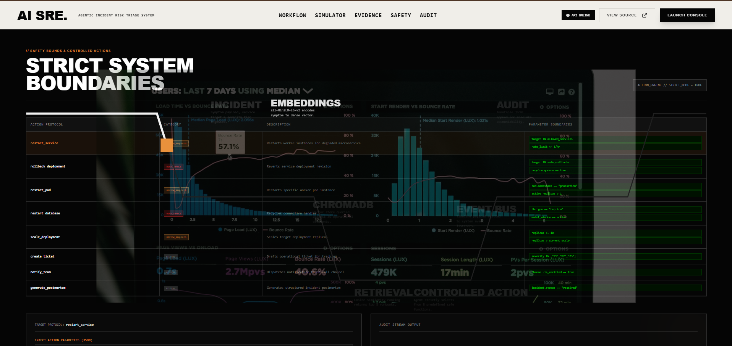
1
2
3
4
5
SCROLL 06 — SAFETY / CONTROLLED ACTIONS
Charts, table, photograph and SVG path are stacked into one illegible layer.
Architecture labels disappear beneath unrelated analytics graphics.
Green parameter boxes and orange accents break the visual system.
1
2
3
4
Text is microscopic; normal users cannot compare actions or constraints.
5
The section tries to explain architecture and actions simultaneously.
Notes:
[Sources]
- User-provided localhost screenshot: 0eb45fda-9596-4827-b344-c1b67243424b.png
- Repository: https://github.com/GaneshNair007/agentic_ops
Target fix:
Split this into two sections. Architecture gets one clean animated path. Controlled actions become full-width ruled rows with 18px copy and one bright web image on hover. Delete all unrelated charts. No data layer may sit behind readable text.

Slide 7
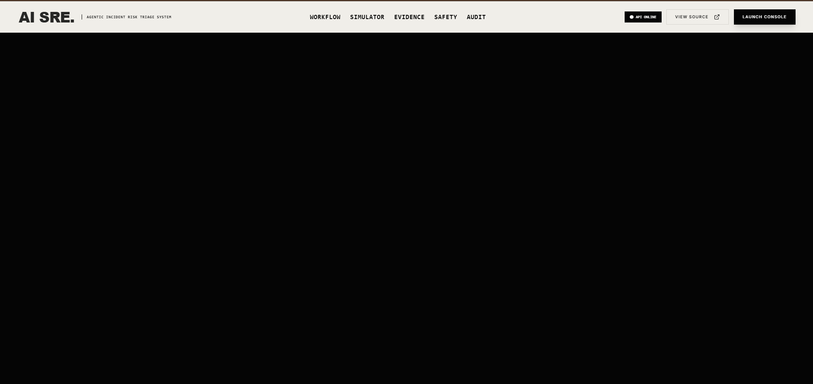
1
2
SCROLL 07 — CRITICAL BLANK STATE
1
The entire scroll state is blank black.
2
Likely causes: pinned spacer, zero-opacity content, bad z-index or failed trigger cleanup.
3
Users receive no feedback and may assume the website crashed.
4
Remove this scroll distance completely until valid content renders.
Notes:
[Sources]
- User-provided localhost screenshot: af6e6309-1c77-4118-aa75-93bd655ed3c3.png
- Repository: https://github.com/GaneshNair007/agentic_ops
Target fix:
Critical functional bug. Inspect ScrollTrigger pin spacing, trigger start/end values, element opacity, z-index and conditional rendering. Add a no-JS/reduced-motion finished state. This frame must never exist in the final site.

Slide 8
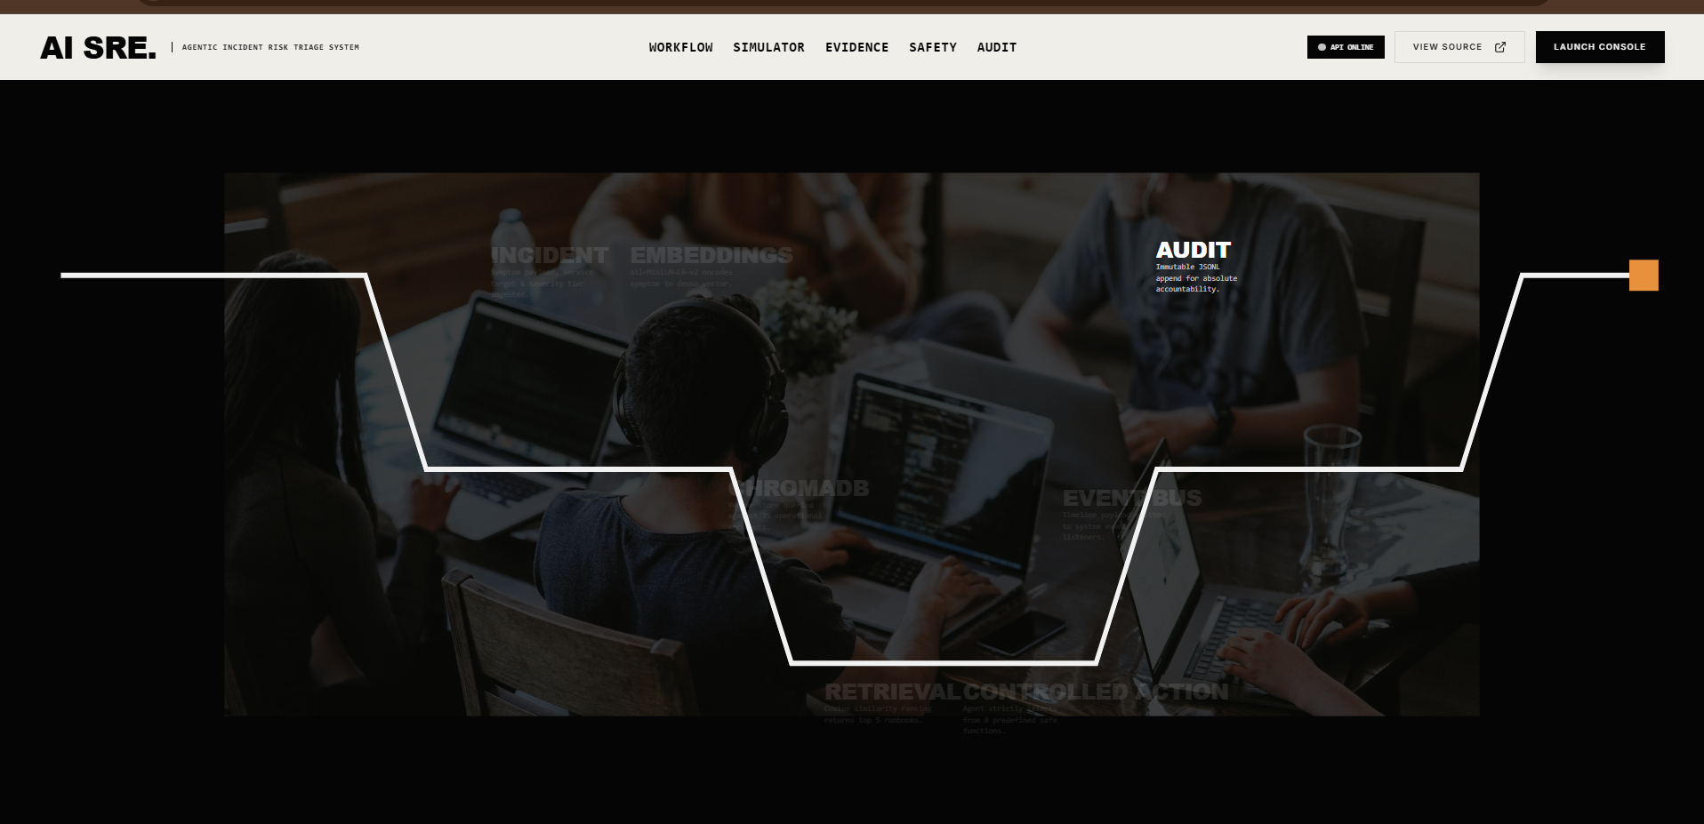
1
4
2
3
SCROLL 08 — ARCHITECTURE
1
Architecture labels are hidden by a heavy dark overlay.
2
The oversized white path cuts across the image without explaining sequence.
3
Most component descriptions are effectively invisible.
4
Generic team photography does not show the technical system being described.
Notes:
[Sources]
- User-provided localhost screenshot: 0cfeac54-0a6f-4fd6-a468-9d50855d20cd.png
- Repository: https://github.com/GaneshNair007/agentic_ops
Target fix:
Use a clean white or black surface with six readable nodes and one cyan signal line. Place a bright control-room web photo in a separate 40% image column, never beneath labels. Animate one node at a time; keep inactive nodes readable.

Slide 9
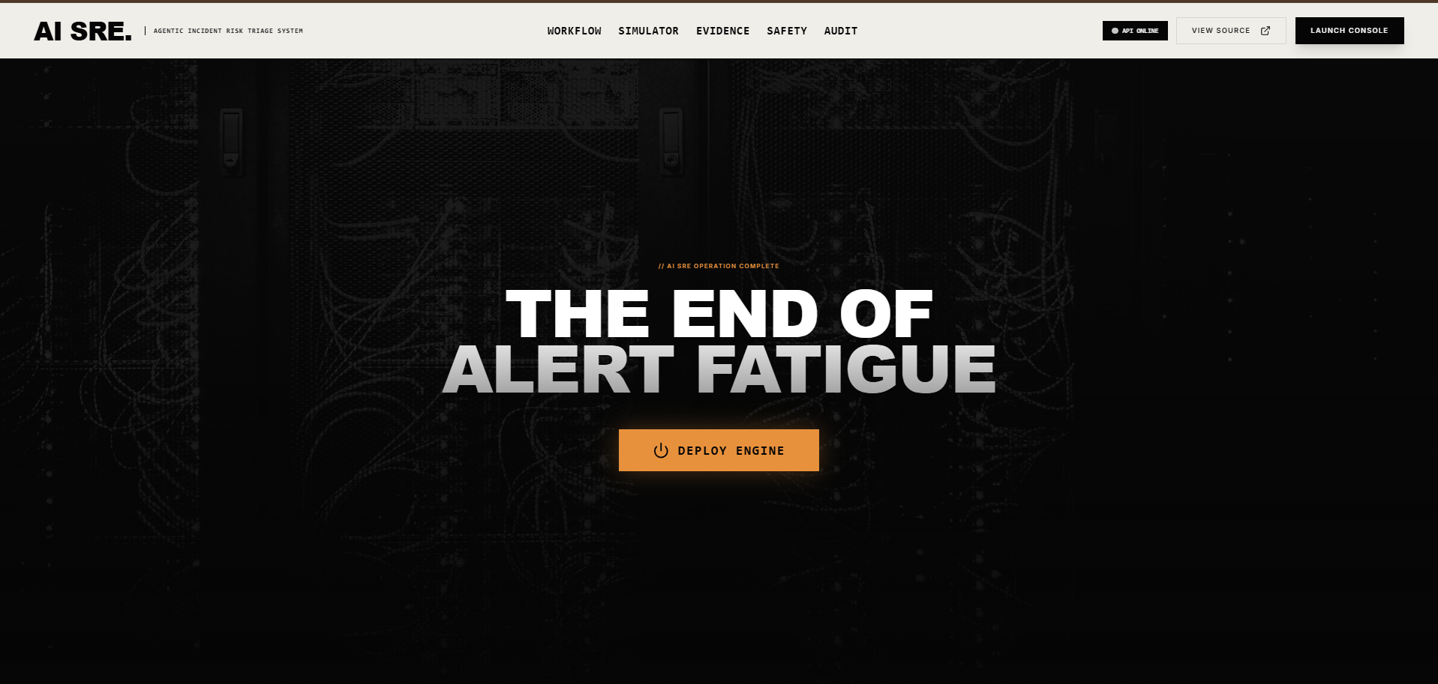
1
2
3
4
SCROLL 09 — CLOSING
1
Hero server image is repeated, weakening the close.
2
The slogan makes an unsupported promise about ending alert fatigue.
3
‘Deploy Engine’ is the wrong action for a simulation-first project.
4
The extreme darkening removes the colour direction requested for imagery.
Notes:
[Sources]
- User-provided localhost screenshot: 0e182d8b-55b8-43e0-89fb-9261dc58649b.png
- Repository: https://github.com/GaneshNair007/agentic_ops
Target fix:
Use a new bright web image of fibre-optic/network flow. Replace the claim with ‘Evidence. Control. Accountability.’ Use CTA ‘Run a simulation’. Preserve image colour and provide a solid black text region rather than darkening the entire visual.

