Slide 1

DEPARTMENT OF COMPUTER SCIENCE AND ENGINEERING
Professional Training - 1
PROPERTY BOOKING WEBSITE USING FULL STACK WEB DEVELOPMENT
PROJECT STUDENTS GUIDE
Pachipala Ganesh 42110927 Ms.Triveni

Slide 2
AGENDA
Certificate
Introduction
Abstract
Objective
System Architecture / Ideation Map
Module Implementation
Conclusion
References

Slide 3
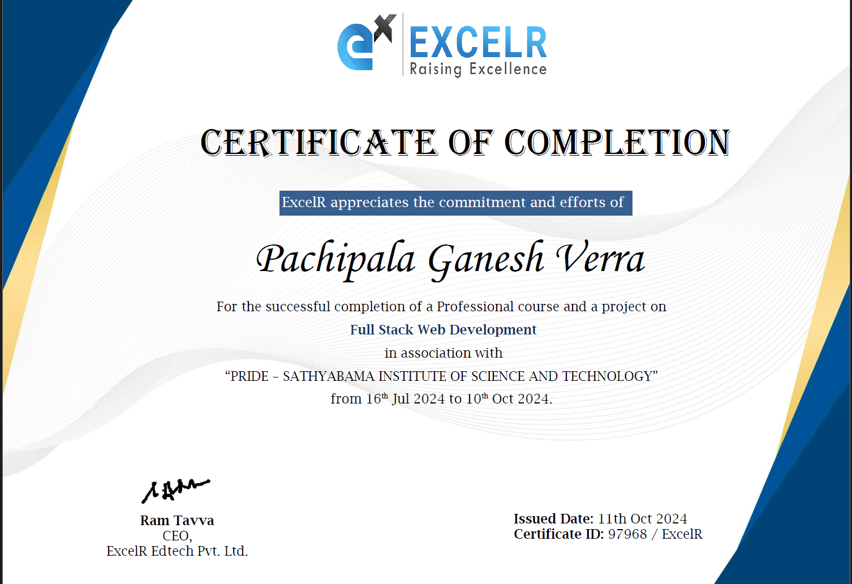
COURSE CERTIFICATE

Slide 4
INTRODUCTION
Develop user-friendly property booking website for property search and booking.
Use HTML, CSS, JavaScript, and backend frameworks.
Focus on intuitive UI, property search, listing management, user authentication, and secure booking.

Slide 5
ABSTRACT
The Property Booking Website mini project report presents the development of a web- based application designed to facilitate the search and booking of real estate properties. The objective of the project is to create a user-friendly platform that enables users to browse through property listings, view detailed information, and make bookings securely and conveniently.
The project utilizes technologies such as HTML, CSS, JavaScript, and a backend framework to construct an intuitive and responsive user interface. The backend implementation includes database management and integration of essential functionalities such as property search, property listing management, user registration and authentication, and secure booking processing.

Slide 6
OBJECTIVE
Current Property Booking websites lack user-friendly interfaces, struggle to provide comprehensive property information, and lack efficient communication tools between buyers and sellers. There's a need for a platform that simplifies property search, improves data quality, and streamlines communication for a better user experience.
Hence There is need to develop a user-friendly Property Booking website. Here our website comes into action as it has a user-friendly interface and provide comprehensive property information about the property.

Slide 7
LITERATURE SURVEY
The evolution of property booking websites has witnessed a transformative journey, progressing from basic property listings to sophisticated platforms offering immersive experiences. Studies underscore the pivotal role of user experience and interface design in these platforms, emphasizing intuitive navigation, categorized property listings, and high-quality visuals as key drivers of user engagement and satisfaction. Moreover, research highlights the integration of cutting-edge technologies like augmented reality (AR), virtual reality (VR), and artificial intelligence (AI) as catalysts for enhancing property visualization and aiding decision-making for potential buyers or renters.

Slide 8
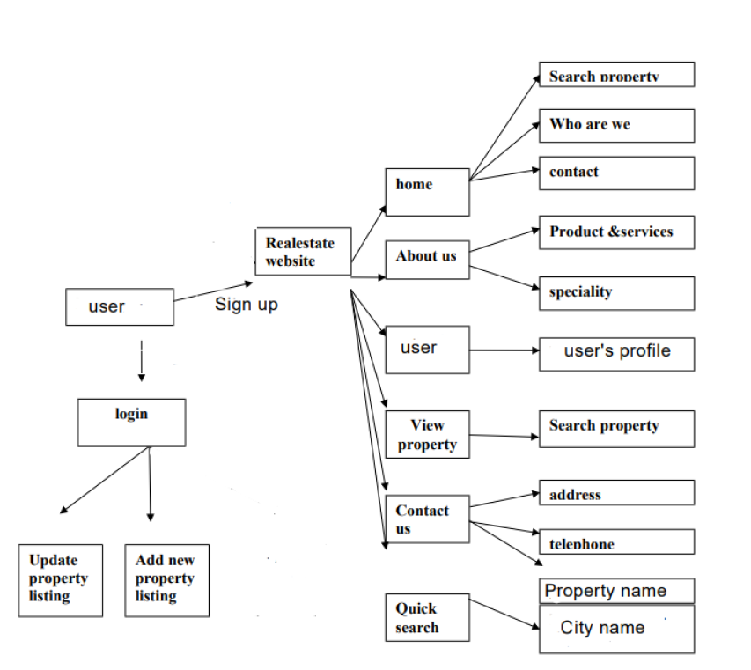
SYSTEM ARCHITECTURE / IDEATION MAP

Slide 9
MODULE IMPLEMENTATION
In order to implement the Website the hardware and software requirements are :
HARDWARE REQUIREMENTS: Processor : i3/Intel or above, Operating System : Windows 7 +, RAM : 2GB (min), Hardware Devices : Desktops, Tablets, Mobiles, Hard Disk : 128GB (min), Keyword : Standard.
SOFTWARE REQUIREMENTS: Technology implemented: Full-Stack Web Development, Language Used : HTML, CSS, JavaScript, React, Database : MongoDB Atlas /Compass, VCS : Git/GitHub, Web Browser : All Existing Browser, IDE : VsCode.

Slide 10
CONCLUSION
The development of a real estate website booking system brings significant value to the real estate industry by simplifying the property booking process and enhancing the overall user experience. By successfully implementing key features such as an intuitive user interface, advanced search functionality, detailed property listings, and a secure booking system, the booking system improves efficiency and convenience for property seekers and property owners alike.
Through the creation of a real estate website booking system, developers gain hands- on experience in web development, database management, user interface design, and system integration. They apply their technical skills and knowledge of technologies such as HTML, CSS, JavaScript, and backend frameworks to create a functional and user-friendly platform. Additionally, they learn about the importance of data security, privacy, and performance optimization in the context of a booking system.
The real estate website booking system project also provides valuable insights into the real estate industry, its dynamics, and the challenges faced by property buyers and sellers. Developers gain an understanding of the importance of effective communication, accurate property information, and a streamlined booking process. By implementing a secure and convenient booking system, they contribute to building trust and confidence among users.

Slide 11
REFERENCES
WEBSITES:
https://developer.mozilla.org/en-US/
https://www.w3schools.com/
https://css-tricks.com/
https://tailwindcss.com/
BOOKS:
React in Action by Mark Tielens Thomas
The Full Stack Developer: Your Essential Guide to theEveryday Skills Expected of a Modern Full Stack WebDeveloper By Chris Northwood.

Slide 12
THANK YOU
We thank God, Our Department, Guide, Panel Members, Supportive Professors and all Technical and non-technical staff who helped us in our Project.

