Slide 1

Infrastructure Managed Services – Remote Shared Services
Managing Digital Ecosystem
Pro-Active rather than Reactive
Intelligent enough to give Basic Root Cause Idea
24 x 7 x 365 Availability
Instant Service Response

Slide 2
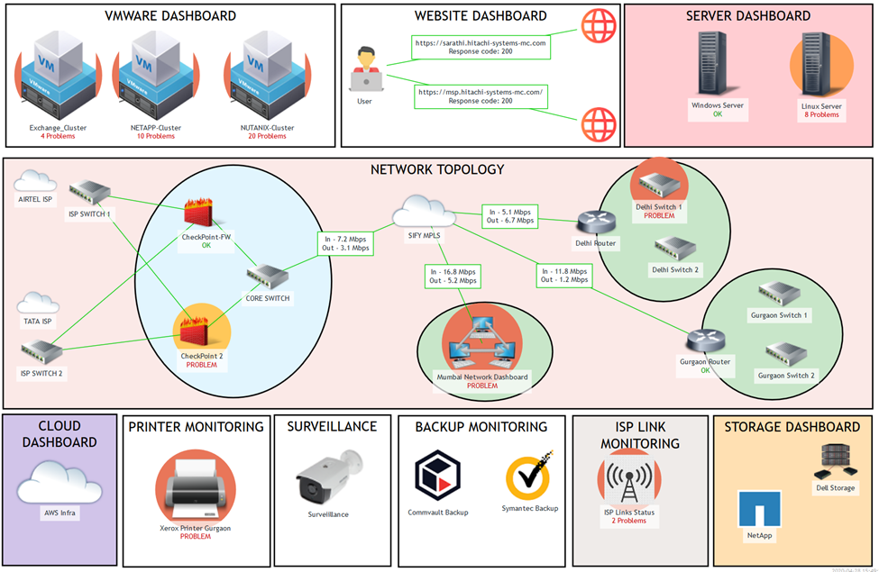
Integrated Single View Dashboard for Enterprise Infrastructure Monitoring
Aerial View to keep an eye on the entire digital ecosystem

Slide 3
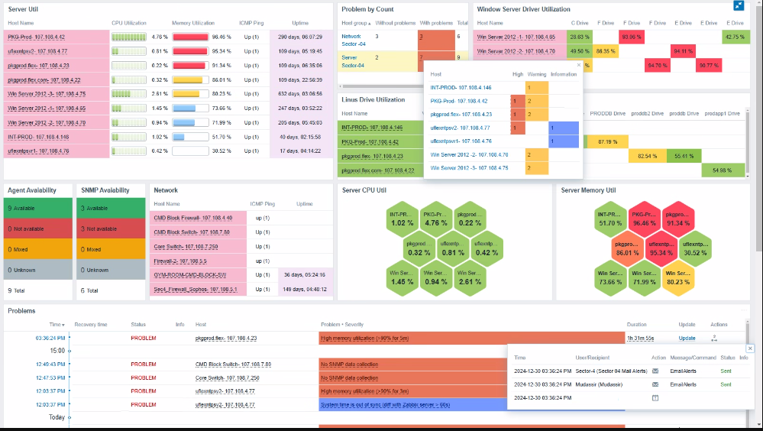
Single View Dashboard – Multiple OS Server Util

Slide 4
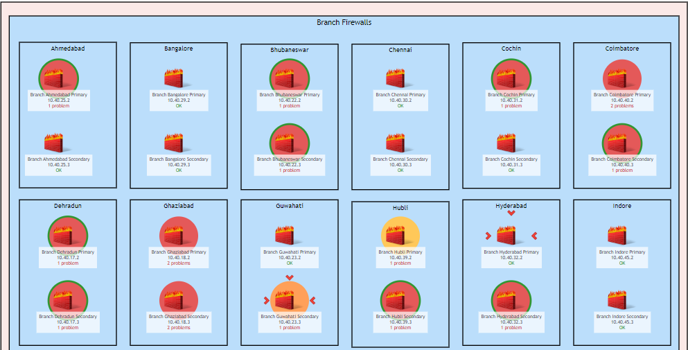
Individual Branches - Map View

Slide 5
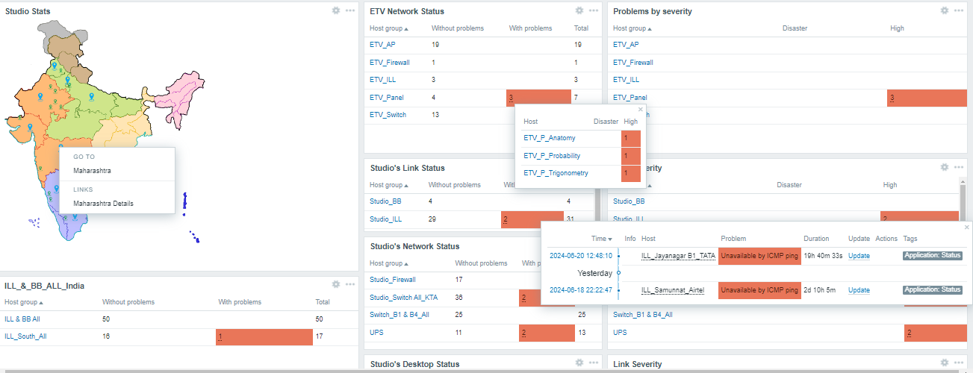
India & State-wise Map View

Slide 6
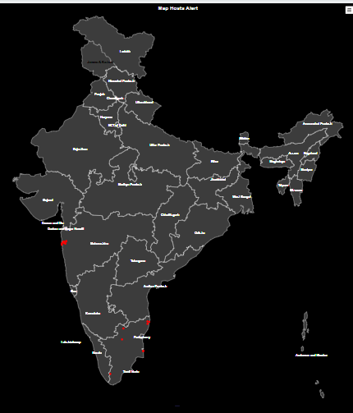
Integrated Map View of Infrastructure
With the India Map view, administrators can monitor and manage IT assets in specific regions of India.
This is particularly useful for organizations with distributed infrastructure across the country, enabling efficient troubleshooting and maintenance

Slide 7
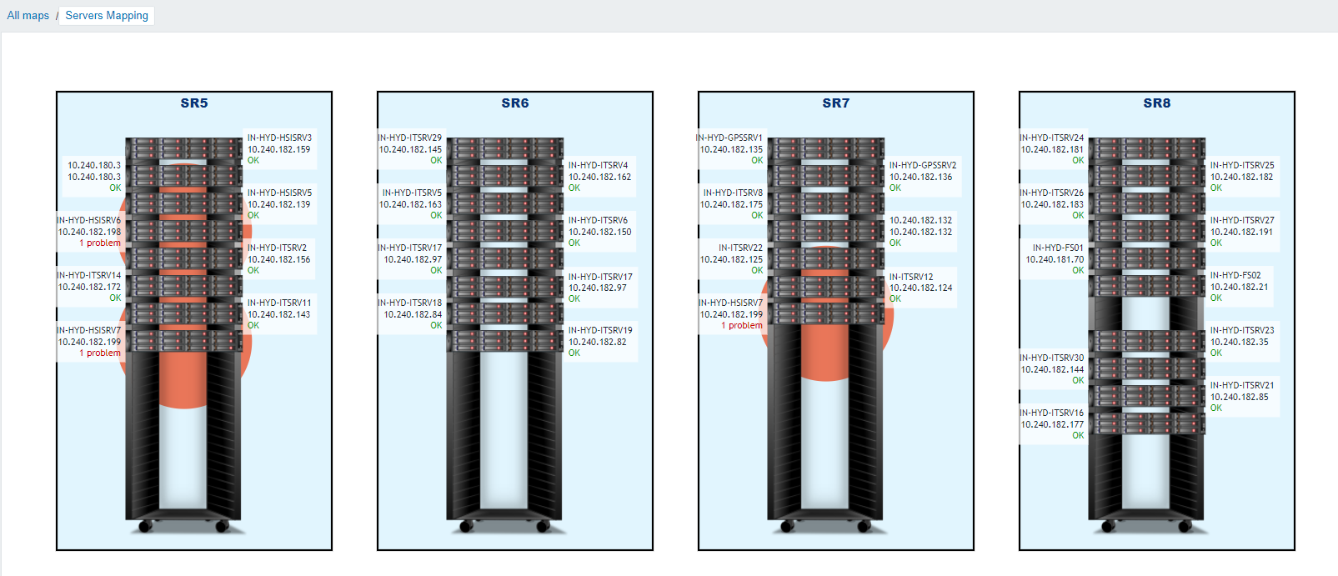
Integrated Single View Dashboard for Server Hardware mapping
Dell PowerEdge Hardware and its Server mapping for Status and Problem view over which Dell Rack
Real-time Status and Problem View Map

Slide 8
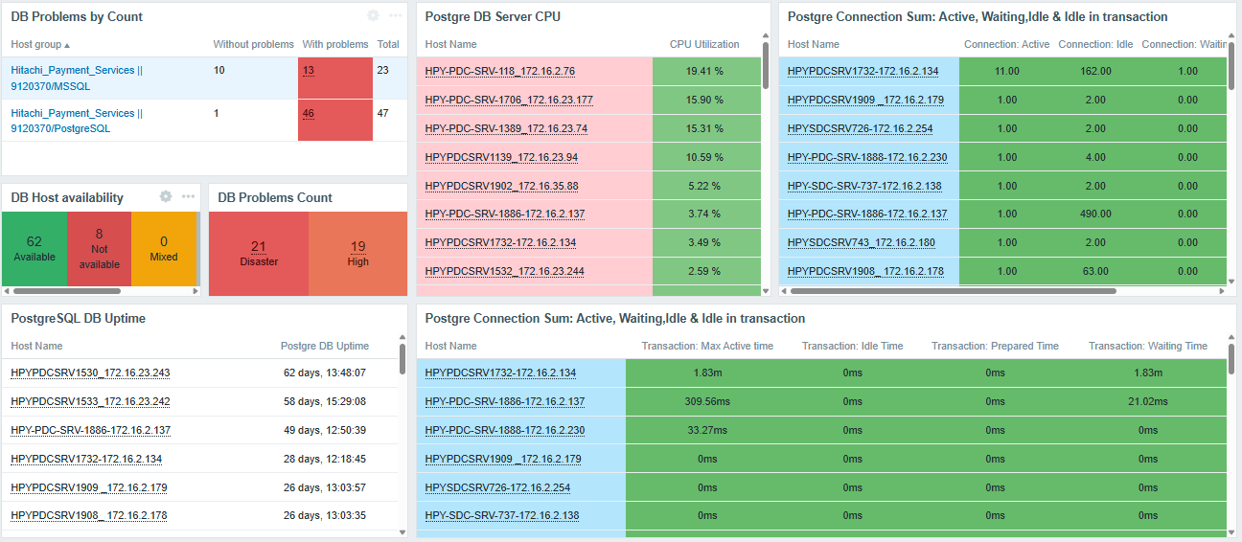
Single View Dashboard for Database

Slide 9
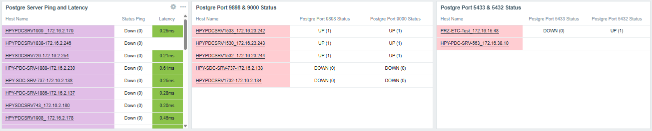
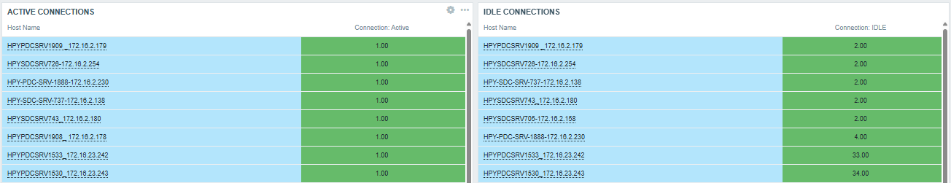
Single View Dashboard for Database

Slide 10
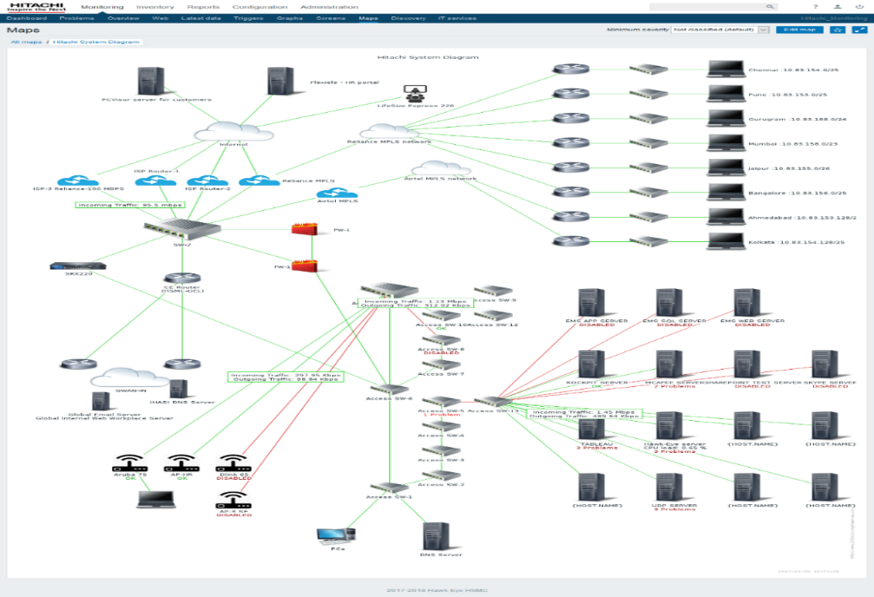
Integrated Single View Dashboard for Enterprise Infrastructure Monitoring
Digital Ecosystem Monitoring
Single Window Dashboard
Aerial View to keep an eye on entire digital ecosystem

Slide 11
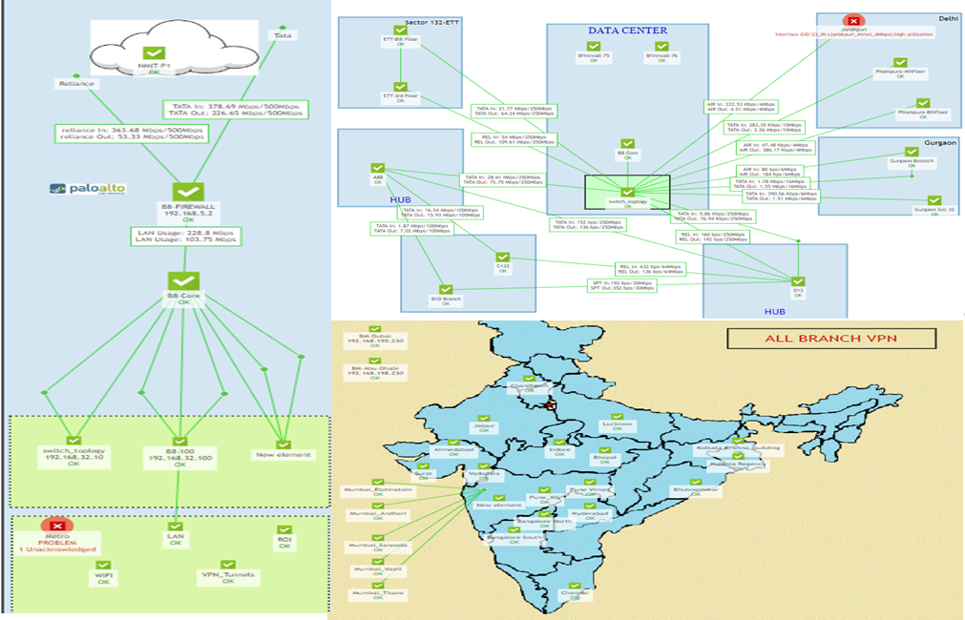
Integrated Single View Dashboard for Enterprise Network Infrastructure Monitoring
Network Monitoring
Aerial view of the network performance
Proactive monitor & management of LAN,WAN,MPLS, Wireless and surveillance infrastructure
Provide dashboard with connecting links between devices
Monitors critical equipment metrics (temperature, voltage ,Network Protocols like OSPF, Traffic )closely
Identify device issues and sends alerts ahead of time to avoid any device failure
Proactive identify problem area with the devices. This allows IT to rectify the problem by device replacement or troubleshooting

Slide 12
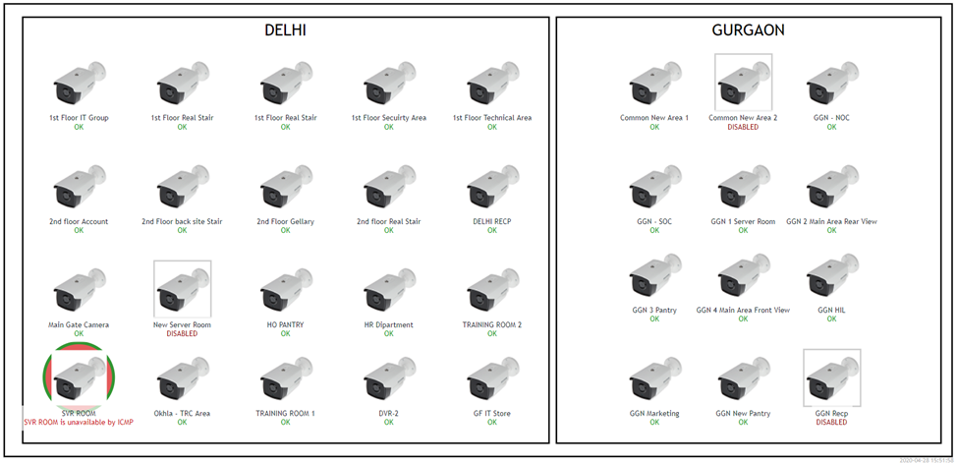



Integrated Single View Dashboard for Surveillance Monitoring
Digital Ecosystem Monitoring
Single Window Dashboard
Aerial View to keep an eye on entire digital ecosystem
NOC Operator
NOC Operator
NOC Operator

Slide 13
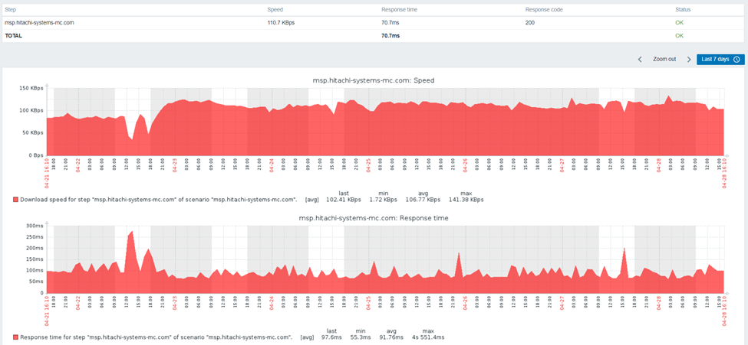
Integrated Single View Dashboard for Web Application Monitoring
Website Monitoring
Web Monitoring & Synthetic Monitoring
Keep an Eye on Web Applications
Ensure great performance at all times across all user locations
Get meaningful SLA monitoring reports out of the box.
NOC Operator
NOC Operator
NOC Operator

Slide 14
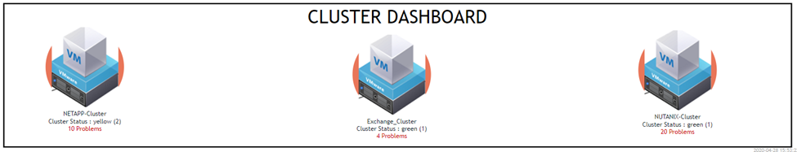
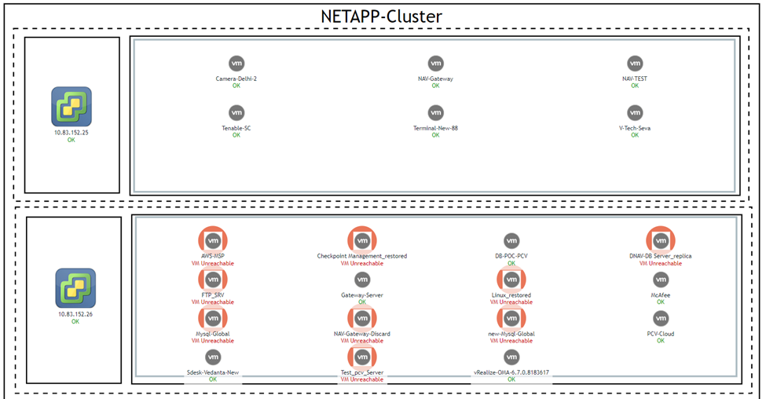
Integrated Single View Dashboard for Virtualization Cluster
Real time storage availability & performance monitoring and management
Notes:
Generally people only monitor the storage i.e. controllers / vdisks / volumes but they forget to look into SAN Switches & storage mapped to server and VM’s where actual utilization is happening as the most of the OEM tools bundled do not have visibility to that layer.
IOPS at the server for connected Volume of Storage and IOPS of Vhdx (virtual HDD) assigned to VM are monitored. In case IOPS go below the desired /designed threshold, triggers can be given.
This helps proactively monitor the Application running on the VM’s as VM Storage IOPU issues can directly impact end-user application performance.

Slide 15
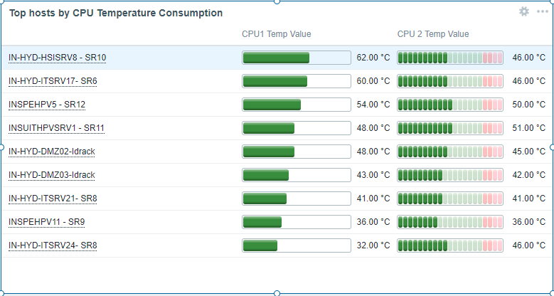
Integrated Single View Dashboard for Server Hardware
Real time Utilization & Performance Monitoring
Notes:
Generally people only monitor the storage i.e. controllers / vdisks / volumes but they forget to look into SAN Switches & storage mapped to server and VM’s where actual utilization is happening as the most of the OEM tools bundled do not have visibility to that layer.
IOPS at the server for connected Volume of Storage and IOPS of Vhdx (virtual HDD) assigned to VM are monitored. In case IOPS go below the desired /designed threshold, triggers can be given.
This helps proactively monitor the Application running on the VM’s as VM Storage IOPU issues can directly impact end-user application performance.

Slide 16
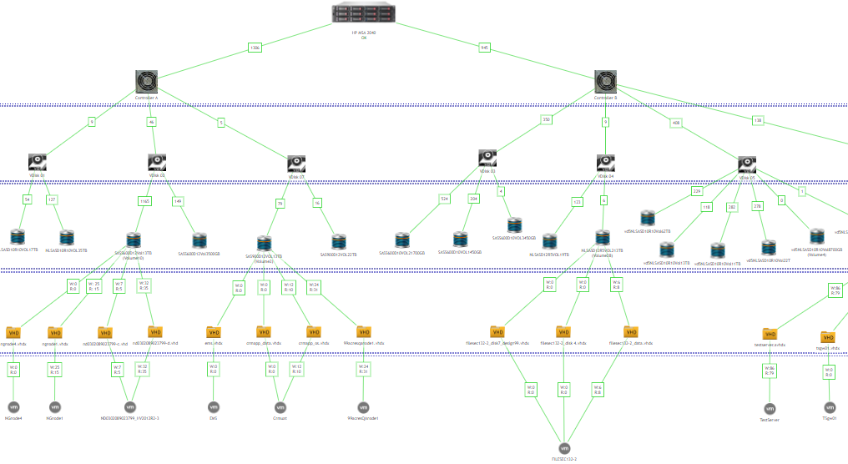
Integrated Single View Dashboard for Storage to VM to APP
Performance monitoring of VMs on a single dashboard with hierarchical tracking of each layer inside and outside the storage devices.
Real time storage availability & performance monitoring and management
Storage I/O hotspot detection
Visibility of Storage utilization till end point level
Monitor IOPS of virtual HDD assigned to VMs.
Notes:
Generally people only monitor the storage i.e. controllers / vdisks / volumes but they forget to look into SAN Switches & storage mapped to server and VM’s where actual utilization is happening as the most of the OEM tools bundled do not have visibility to that layer.
IOPS at the server for connected Volume of Storage and IOPS of Vhdx (virtual HDD) assigned to VM are monitored. In case IOPS go below the desired /designed threshold, triggers can be given.
This helps proactively monitor the Application running on the VM’s as VM Storage IOPU issues can directly impact end-user application performance.

Slide 17
HSI’s IP - Enterprise Infrastructure Monitoring
Server Monitoring
Network Monitoring
Backup / Storage Monitoring
Cloud Monitoring
Reporting (PDF and Excel Report )
Additional Monitoring Features
CPU , Disk
Memory , NIC
Firewall Monitoring
CPE Monitoring
Wifi/Access Point Monitoring/MPLS Monitoring
Interface Port-Wise Bandwidth and Other Metrics.
SSL / VPN Tunnel Status Monitoring
FW Sensor Monitoring
Uptime of Storage Resources
Hardware health check
IOPS
Snapshot Status
Veeam- Backup Jobs
Veritas- Backup Jobs
AWS and Azure Integration
GCP , Docker and Kubernetes Monitoring
Availability Reports for Devices
Availability Reports with Downtime on Trigger and Threshold
PDF Report (Graphs)
Capacity Report in Excel and PDF.
Capacity Report based on the Metrics like Port Status, Incoming, Outgoing Traffic etc.…
Latest Data PDF Report withGraph.
Dashboard Schedule Report.
Host Inventory CSV Export Option.
Upload, Download & Delete Document Option.
IP Blacklist Monitoring
Server to Server Reachability Monitoring
ISP Speed Test
Virtual Infra Monitoring
VMware Host& VM Monitoring
HyperV Host & VM Monitoring
Web Monitoring
Customization
Response Time of Website
Response Code
Download Speed
Customized Dashboards
Multiple Widgets to Customized Dashboard.
Statistical Dashboard
Customized Script as per need like GPU Util or any other metrics.
Customized Maps
Branch-Wise or State-Wise Map
India Map for Devices Status
Service Monitoring
Email Server Monitoring
Active Directory Web Services / IIS
Distributed File Replication Service [DFRS]/ NT File Replication Service [NTFRS]
Background Intelligence Transfer Service [BITS]
DNS Cache/ DHCP
Netlogon/ RPCSS
W3SVC/ WPAS
Lanman Server/ Workstation
Port and Event Log Monitoring
Exchange Services
Mail Queue Monitoring
O365
Hardware Monitoring
Trigger events
Discovery events
Auto registration events
AD Events
DNS / RPC / SMB
Global Catalogue
Server/Network Hardware Monitoring
Component Failure , Power Supply .
Temp Status, Raid Status .Physical / Virtual Disk.
Database Monitoring
Oracle
MySQL
MSSQL
Mongo DB
Postgres
DB2

Slide 18
3. HSI EIM - Enterprise Infrastructure Monitoring – Contd.
AWS Monitoring
Azure Monitoring
Expanded Monitoring Horizon
From Agent based to Agentless AWS Monitoring through API of AWS Monitor
Services which can be monitored:
AWS Autoscaling
AWS ECR
AWS ECS Service
AWS ELB
AWS Guard Duty
AWS GLUE Service
AWS IAM
AWS Instance Status Check
AWS Logs
AWS RDS Instance
AWS Redis
AWS SFTP
AWS Volume Status
AWS VPN Tunnel
AWS WORKSPACE MONITORING V2
AWS SQS Lamda
AWS APIGATEWAY
AWS RDS
AWS S3 Bucket Metrics
Template Host AWS ECS CloudWatch
From Agent based to Agentless Azure Monitoring through API of Azure Monitor
Services which can be monitored:
SQL Databases
Azure Webapp
Azure VM Discovery
Azure Storage account
Azure Redis
Azure Network Discovery
Azure MySql
Azure CosmoDB
Azure AKS
Azure PostgreSQL Flexible Server
Azure PostgreSQL Single Server
Azure Microsoft SQL Serverless Database
Azure Microsoft SQL Database
Prometheus & Grafana Integration
Docker Monitoring
Integration with Microsoft Teams for sending alerts
HA Proxy Load Balancer
Enhanced Vcentre Monitoring using Vpoller Module
Enhanced SQL Server Monitoring with following parameters
Security details (Users/ passwords etc.)
Better Performance parameters
Error Logs monitoring for higher severity
Locks and Deadlocks monitoring with PID
Missing Indexes
QNAS and Dell MD Series Storage Device Monitoring
Rundeck Automation
It allows administrator to run tasks on any number of nodes from a web based or CLI
Action done by Rundeck based on triggers generated on Enterprise Infra Monitoring (EIM) Platform
Few of the workflows:
A Service stops running
EIM generates trigger/ Alert
Rundeck executes job
Rundeck sends acknowledgement to EIM
EIM received acknowledgement and problem closed

Slide 19
Recognition from Technology Partners
Trend Micro
Top Performing Partner 2022
Fortinet
Best Growth Partner 2022
NetApp
Partner of the Year India
Netskope
Growth Partner of the Year Award
Forcepoint
Partner of the Year - APAC
VMware
FY 20 Rainmaker Award
VMware
FY 20 Partner of the Year Award
Microfocus
Parnter of the year 2022 India
AWARDS
Dell Technologies
Excellence in Marketing Spend and Return Award
AMD
AMD EPYC Excellence Award - H1 FY20
Nutanix
Partner of the Year 2022 India
BlackBerry
India Partner of the Year
Forescout
Most Valuable Player in India
Commvault
Top Emerging Partner
Commvault
Top Competitive Win
VAR India
Best Solution Category
CRN
CRN Excellence Awards - Data Center Category
SOPHOS
Cloud Partner of the Year - UAE
Dell Technologies
Partner of the year Hyperconverged
Nutanix
Partner of the Year
Notes:
Update Award slide

Slide 20
Industry Recognitions
World HRD Congress
Business Leader of the Year - Anuj Gupta
2022
VAR India
Best Solution Provider 2019
CRN Excellence Award 2019
Hyper Converged Infrastructure
SME Channels Summit
Partner Elite 2018
AWARDS
Hitachi Ltd.
Inspiration of the Year Global Award
Grand Prix 2019
HR Talent Management Awards
Young HR Leader of the Year – Shradha Puri
Dell EMC
Lifetime Achievement Award – Tarun Seth

