Slide 1
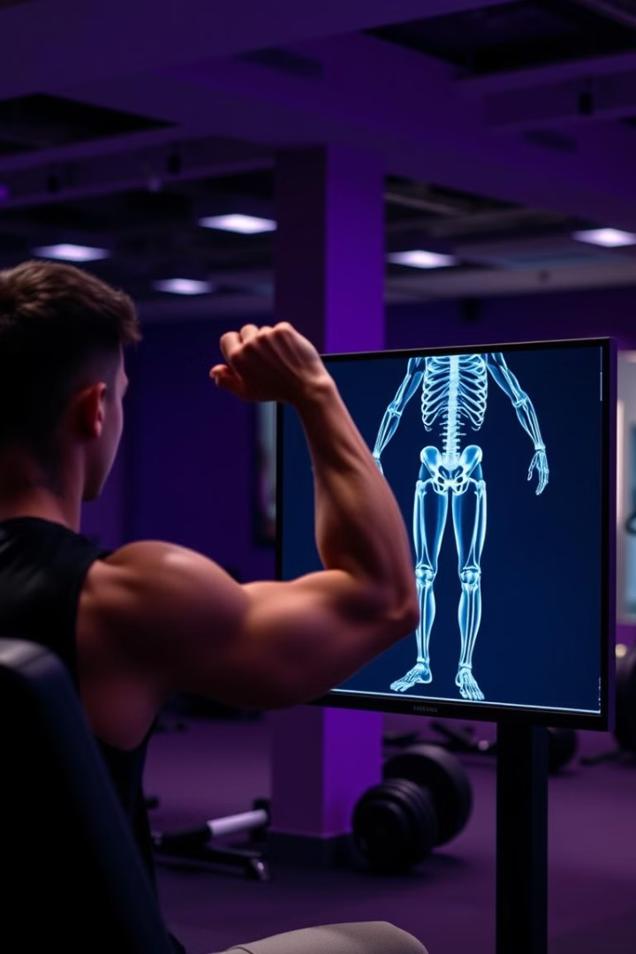

Bicep Curl Counter Using Computer Vision
This presentation will showcase a innovative project that leverages computer vision techniques to automatically count and track bicep curl repetitions, providing valuable feedback for fitness enthusiasts and trainers.

Slide 2
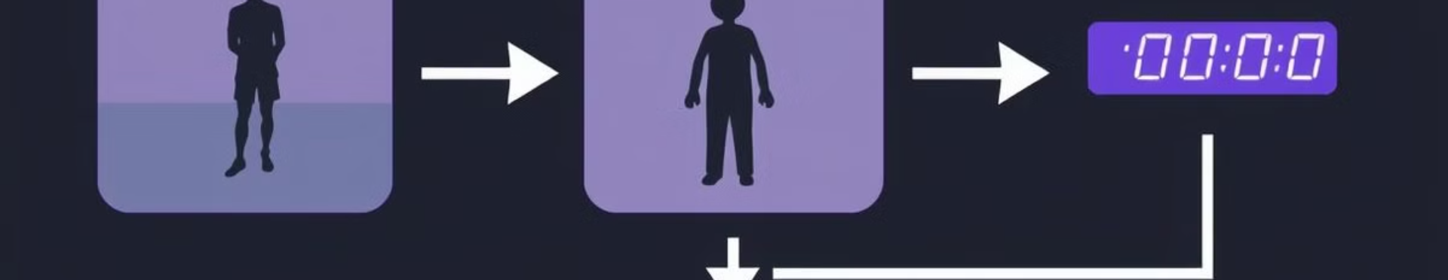
Overview of the Project
1
Real-time Bicep Curl Tracking
2
Pose Estimation
3
Intuitive Visualization
By estimating the user's arm and body pose, the system can accurately identify and track the bicep curl motion.
The project includes a user-friendly interface to display the counted reps and provide meaningful workout insights.
The system can detect and count bicep curl repetitions in real-time using advanced computer vision algorithms.

Slide 3
Leveraging YOLOv8 for Human Detection
YOLOv8 Object Detection
Robust Performance
Real-time Inference
The project utilizes the latest version of the YOLOv8 object detection model to accurately identify and localize people in the camera frame.
YOLOv8 provides state-of-the-art object detection capabilities, ensuring reliable human detection even in complex gym environments.
The efficient implementation of YOLOv8 enables the system to perform human detection and localization in real-time.

Slide 4
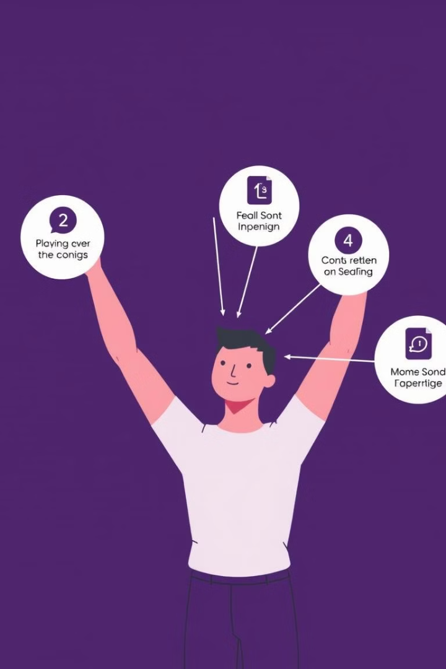



Extracting Arm Keypoints with OpenCV
Pose Estimation
OpenCV's powerful pose estimation models are used to identify and track the user's arm keypoints during the bicep curl exercise.
Arm Angle Calculation
By monitoring the changes in arm angle over time, the system can accurately detect the start and end of each bicep curl rep.
Real-time Tracking
The system processes the video stream in real-time, providing instant feedback on the user's bicep curl performance.

Slide 5

Tracking Bicep Curl Repetitions
Arm Angle Monitoring
Repetition Counting
The system continuously tracks the user's arm angle during the exercise, looking for the characteristic "curl" motion.
The total number of detected reps is displayed in real-time, providing the user with immediate feedback on their workout progress.
1
2
3
Rep Identification
By analyzing the changes in arm angle, the system can accurately identify the start and end of each bicep curl repetition.

Slide 6
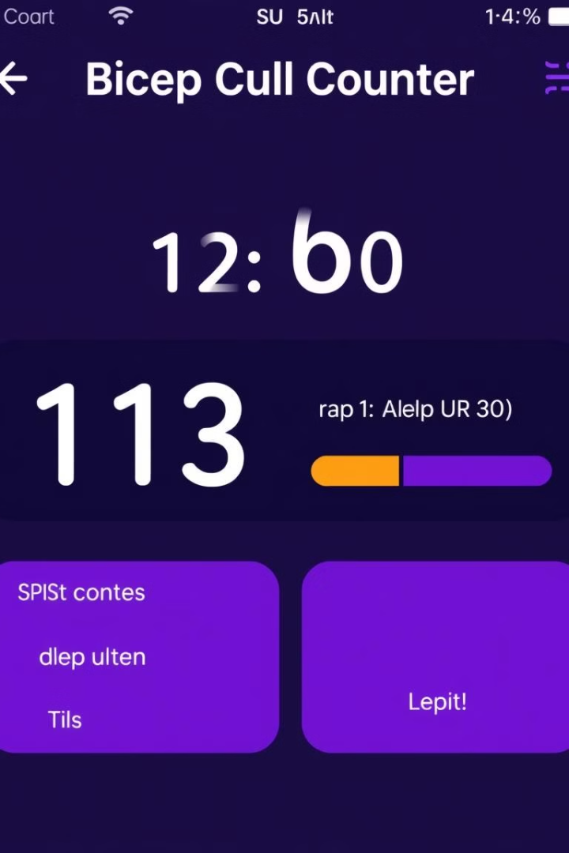



Visualizing the Bicep Curl Counter
Time Elapsed
The application tracks the total duration of the workout session.
Reps Over Time
A graph displays the user's rep count over the course of the workout.
Customization
Users can adjust settings like rep threshold and sensor sensitivity to personalize the experience.

Slide 7
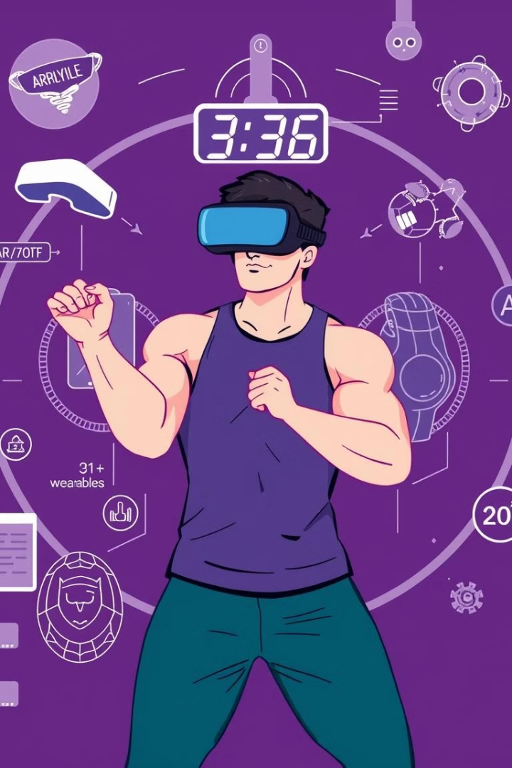
Conclusion and Future Enhancements
Conclusion
Future Enhancements
This project demonstrates the power of computer vision and deep learning in enhancing the fitness experience. The bicep curl counter provides valuable insights and real-time feedback to users.
Potential improvements include integration with wearable devices, personalized workout plans, and expanded exercise tracking capabilities using advanced AI and AR/VR technologies.

