Slide 1


DEPARTMENT OF ARTIFICIAL INTELLIGENCE AND MACHINE LEARNING
OPTICHAIN: MULTI-AGENT SUPPLY CHAIN PLANNING PLATFORM
AD23731 Foundations of Agentic AI | Mini-Project
Team Members
Ganesh S (231501046)
Gokulakrishnan S (231501054)

Slide 2

Problem Statement
Supply Planning Needs Verifiable Numbers
Inefficient Planning Workflow
01 DATA SCATTERED ACROSS SHEETS
How can a supply decision be made from a plain-English request while every quantity, cost and delivery figure stays tied to a verifiable source, and a human planner can still review and adjust the plan?
▼
02 LLMS INVENT QUANTITIES AND COSTS
▼
03 RULE SYSTEMS IGNORE TEXT FEEDBACK
Planners piece together forecasts, supplier prices, routes and policy from several spreadsheets and documents.
General-purpose LLMs sound plausible but invent quantities, costs and lead times that cannot be audited.
Policy documents exist but are not consulted automatically when a plan is produced.
▼
04 WHAT-IF NEEDS A FULL MANUAL RERUN
▼
05 NO TRACEABLE, AUDITABLE PLAN

Slide 3
Proposed System: Planning Pipeline
Combines intent parsing, five specialist agents, policy RAG, MILP optimisation and human review in one LangGraph pipeline.
1
Natural-Language Query
2
Intent Parsing
3
Multi-Agent Fact Collection
Planner types a plain-English request; the React UI sends it to the FastAPI /decisions endpoint.
Gemini (or deterministic mock parser) extracts product, quantity, horizon, lead time and risk preference.
Demand, Supplier, Route, Inventory and Risk agents read only their own PostgreSQL tables.
4
MILP Optimization
5
Validate and Replan
6
Review and Recommendation
OR-Tools minimises procurement, transport, holding and risk-penalty cost under capacity and MOQ limits.
Validator checks demand coverage and capacity; infeasible plans replan with relaxed constraints (max two).
Planner approves or gives feedback; the recommendation attributes every figure to its source.

Slide 4
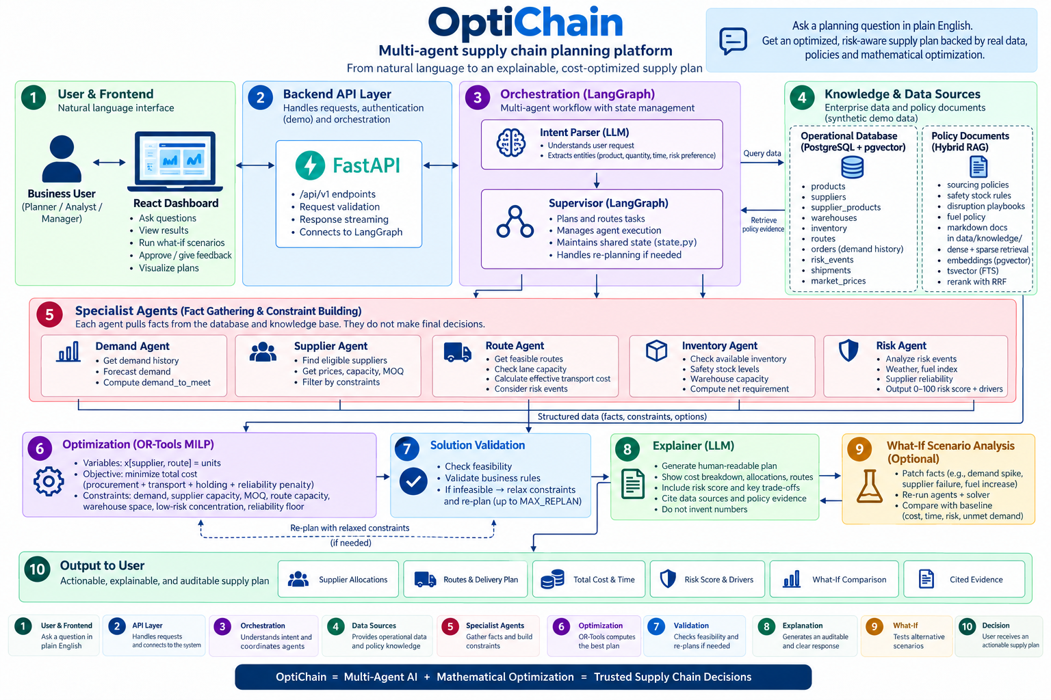
Proposed System: Architecture

Slide 5
Agent Components
Eleven agent and service components; the supervisor, optimizer and validator coordinate the eight shown here.
1
Intent Parser
2
Demand Agent
3
Supplier Agent
4
Route Agent
Product, quantity, horizon, risk
Forecast and net requirement
Price, capacity, MOQ, lead time
Lanes, fuel factor, disruptions
5
Inventory Agent
6
Risk Agent
7
Policy RAG Agent
8
HITL Review Agent
Stock, safety stock, net buy
0-100 score from reliability and events
Hybrid policy retrieval
Feedback to solver constraints

Slide 6
Module: OR-Tools MILP Optimizer
The solver, not the language model, produces every quantity, cost and delivery figure.
COST 01
Procurement
Unit prices from the selected supplier offers in the database
COST 02
Transport
Lane cost with fuel factor and any what-if fuel multiplier
COST 03
Holding
Cost of carrying stock across the four distribution centres
COST 04
Risk Penalty
Penalty from supplier reliability, risk tier and open risk events
RULE 05
Constraints
Supplier capacity, MOQ and net demand after stock and safety stock
OBJECTIVE AND VALIDATION
Minimise total cost = procurement + transport + holding + risk penalty. The validator then checks coverage and capacity, with up to two relaxed replans.

Slide 7
Module: Human-in-the-Loop and What-If
Every plan starts as pending_review; the planner stays in authority over the final decision.
1
Pending Review
2
Approve
3
Apply Feedback
4
Linked Replan
5
Compared
Every completed plan waits for the planner.
Plan status set; no new plan is created.
e.g. "exclude supplier SUP-C, max lead time 25 days".
Feedback becomes constraints; child plan links to parent.
Cost, delivery time, risk and unmet demand.
What-If Scenario Types
Safety and Governance Guarantees
Supplier failure: named supplier excluded
Demand increase: quantity scaled up
Price / fuel increase: prices or lane multiplier up
Route disruption: lane capacity set to zero
Inventory shortage: on-hand stock scaled down
Natural language: sentence parsed into the above
✓ Never overwritten: the original plan and parent-child chain are preserved.
✓ Traceable: each figure is attributed to the database, forecast, solver, policy or user input.
✓ Decision support: plans are not automated purchase orders; the planner has final authority.

Slide 8
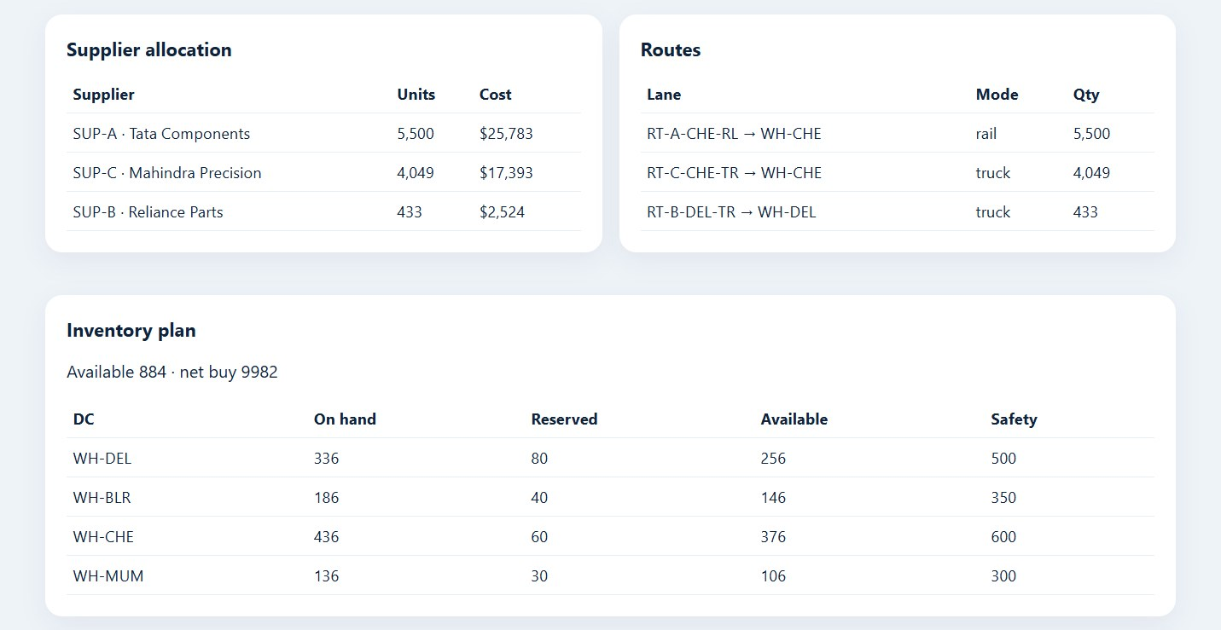
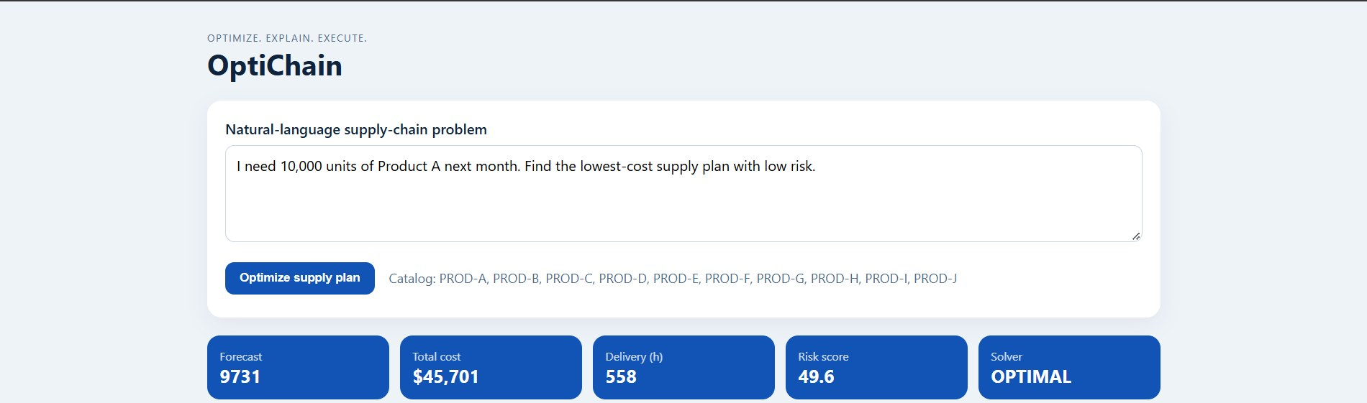
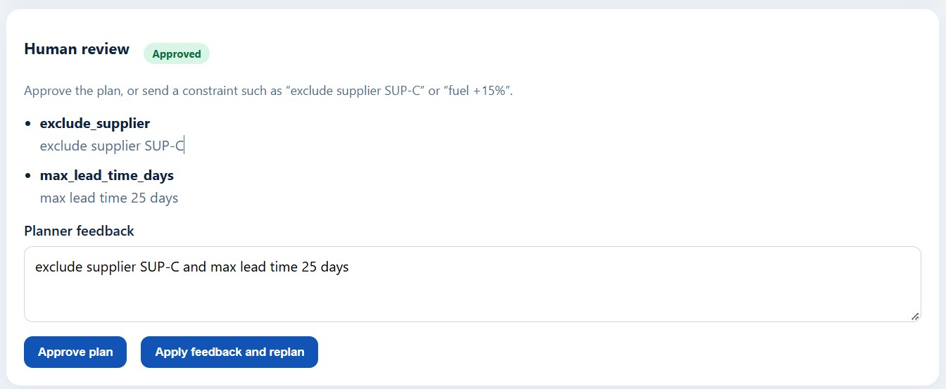
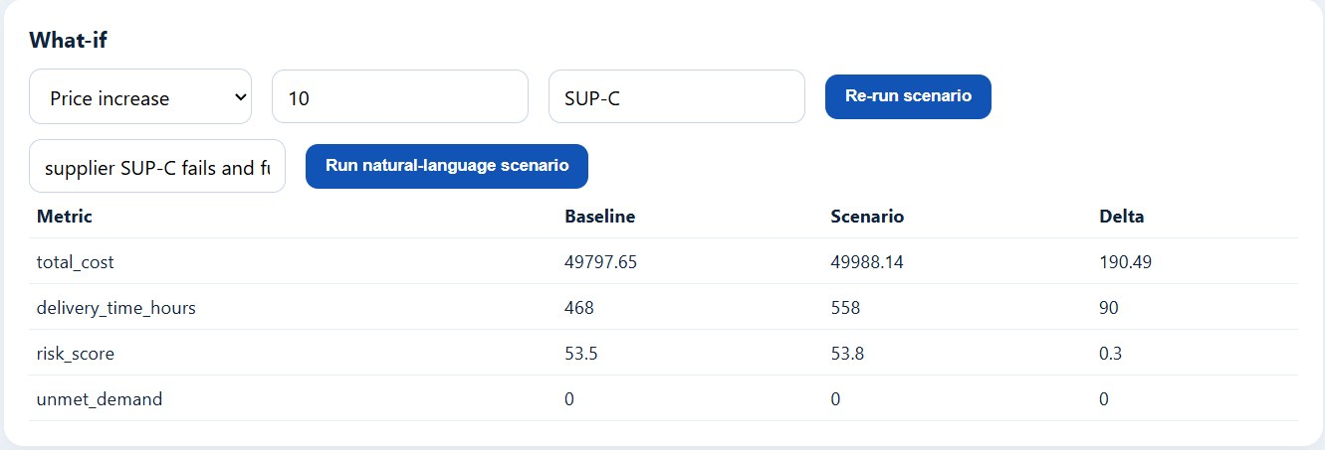
Outputs / Results
Query input, KPI cards and solver status
Supplier allocation, routes and inventory plan
Human review panel and constraint feedback
What-if comparison against the baseline

Slide 9
Project Conclusion
KEY PILLAR
Auditable, Solver-Grounded Supply Planning
Language vs Mathematics
The LLM parses and explains; OR-Tools produces every quantity, cost and delivery time.
OptiChain turns plain-English planning requests into optimised, sourced buy-and-ship plans using five specialist agents, OR-Tools MILP, hybrid policy RAG and human review. The language model never owns a number.
KEY PILLAR
Human in Authority
Approve or give feedback; replans link to the parent and the original plan is kept.
KEY PILLAR
Prototype Foundation
Synthetic data, no authentication yet; formal quantitative evaluation is the next step.

Slide 10
Thank You

