Slide 1
NAME- Ganesh Towar PRN no - 201804001 Project Presentation :BookMyAppointment

Slide 2
What is BookMyAppointment
BookMyAppointment is an online market place for services, where service providers can list their services on the site and clients can book appointment for the service from site. BookMyAppointment accounts for the services like Psychologist, Consultant, Salon, Dentist, etc,( evey service that requires booking an appointment )

Slide 3
What is marketplace?
An online marketplace is a site that connects sellers with buyers. It's often known as an electronic marketplace and all transactions are managed by the website owner. Companies use online marketplaces to reach customers who want to purchase their products and services.
Example of online marketplace are Amazon, Flipcart ,Ebay , BookMyShow

Slide 4
Existing problems and applications
There is no existing platform that can book appointments and aggregate the services under one platform so that users can explore the services nearby and book appointment at one click.
A person needs to find out the service provider in the area then find the way to contact them and book an appointment through call. He needs to call every service provider just to know about rates and available timing.
You can’t book an appointment in non-working hours and there is no legit conformation of the booked appointment.

Slide 5
What BookMyAppoinment is doing different
BookMyAppointment website creates a marketplace for the service providers to list their services on the website and the user can explore the services and select the service and service provider that suits them best without making multiple call to compare the service providers. The app will provide the Address, Email, Name, Visiting fees of the service provider to the user. You would receive an verification code to confirm your Appointment.

Slide 6
Technical Feasibility
The process of proving that the concept is technically possible. Objective: The objective of the technical feasibility step is to confirm that the product will perform and to verify that there are no production barriers. Product: The product of this activity is a working model.
This complete this project we need to use programing languages like python, Django framework , html, css , bootstrap and dbsqlite , each of the requirements are easily available
So the project is technically feasiable

Slide 7
Economic feasibility
The economic feasibility step of business development is that period during which a break-even financial model of the business venture is developed based on all costs associated with taking the product from idea to market and achieving sales sufficient to satisfy debt or investment requirements.
This project require the funds for hosting the sites and as the costumer base grows we can charge commissions for booking appointments
So this project is economically feasible as it has near zero operating cost and turn profitable in future.

Slide 8
Operational feasibility
Operational feasibility is the measure of how well a proposed system solves the problems, and takes advantage of the opportunities identified during scope definition and how it satisfies the requirements identified in the requirements analysis phase of system development.
Currently the project can easily be used to book appointment and solves all the problems that are unsolved by the current market competitor.
So this project is operationally feasible.

Slide 9
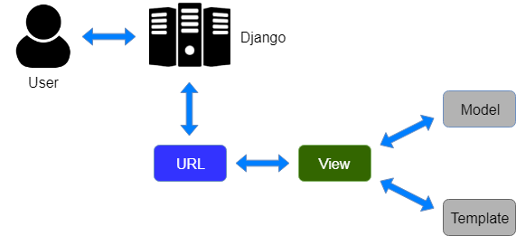
MVT framework

Slide 10
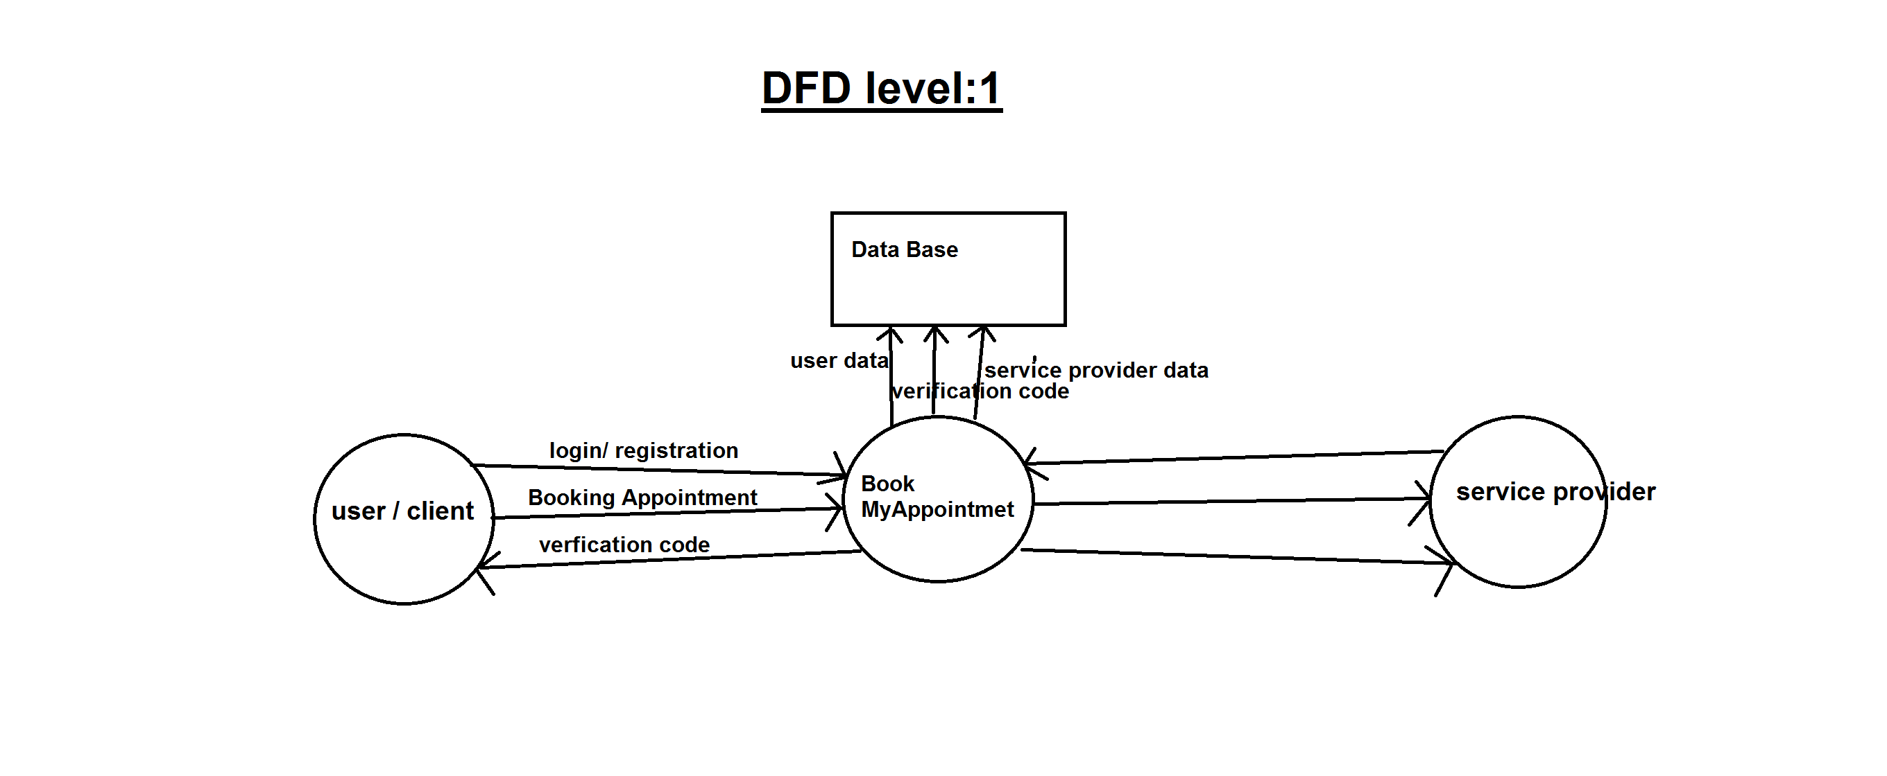

Slide 11
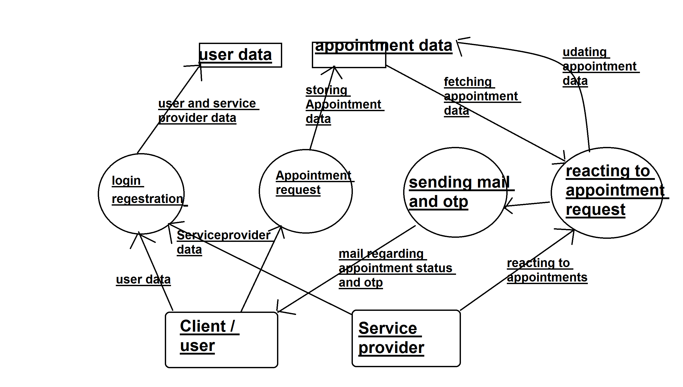

Slide 12
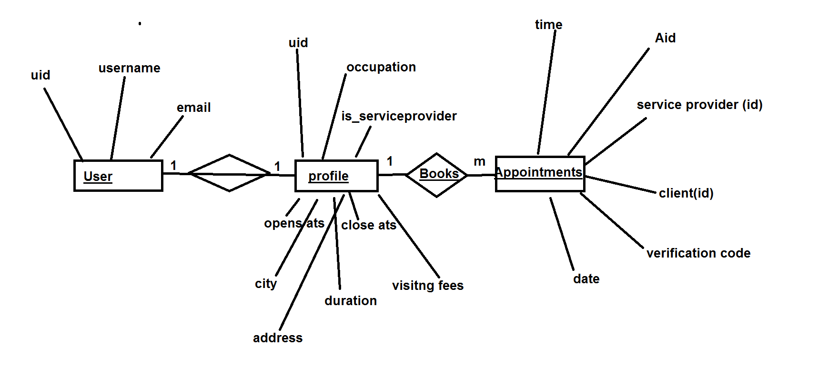
ER Diagram

Slide 13
Future scope
Host this website online and grab audience
Collect data and Insert data in database
We can add payment gate way and improve on interface of the website as we expand our team.

Slide 14
Thank you

