Slide 1
Classification Models-1

Slide 2
Overview of Classification
A person arrives at the emergency room with a set of symptoms that could possibly be attributed to one of three medical conditions. Which of the three conditions does the individual have?
An online banking service must be able to determine whether or not a transaction being performed on the site is fraudulent, on the basis of the user’s IP address, past transaction history, and so forth

Slide 3
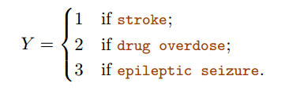
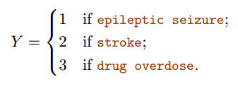
Why Not Linear Regression?
Suppose that we are trying to predict the medical condition of a patient in the emergency room on the basis of her symptoms.

Slide 4
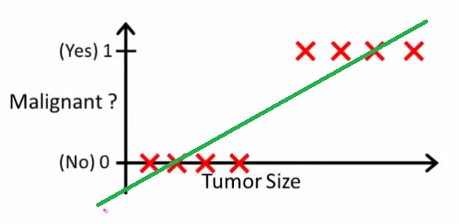
Why Not Linear Regression?
Consider now binary example of tumor malignant or benign
Threshold set to 0.5

Slide 5
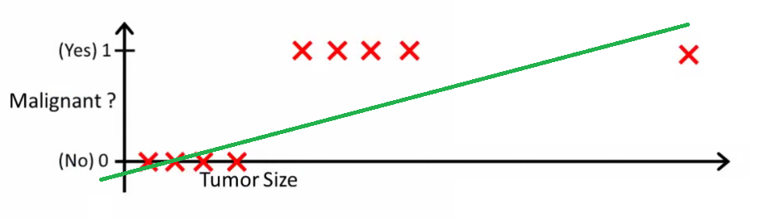
Why Not Linear Regression?
Consider now binary example of tumor malignant or benign
We have to again change threshold to 0.2

Slide 6
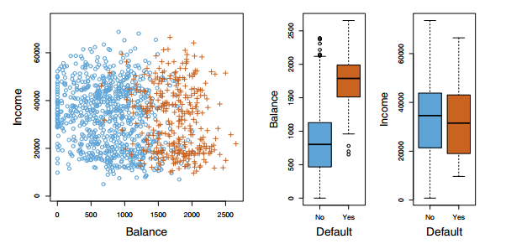
Logistic Regression

Slide 7
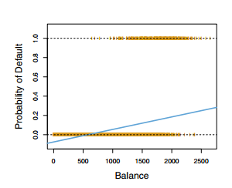
Logistic Regression
Logistic Regression models probability P(x)=P(y=1/X)
how should we model p(x)?
But we discussed
p(x) = B₀+B₁x

Slide 8
Logistic Regression
Logistic Regression models probability P(x)=P(y=1/X)
how should we model p(x)?
But we discussed
p(x) = B₀+B₁x
Issues in this model:
How probability could be negative
How probability could be more than 1
Solution: just use model which has values between [0,1]

Slide 9

What is odds ?
Values of the odds close to 0 and ∞
on average nine out of every ten people with an odds of 9 will default
0.9/(1-0.9) = 9
Odds are traditionally used instead of probabilities in horse-racing

Slide 10
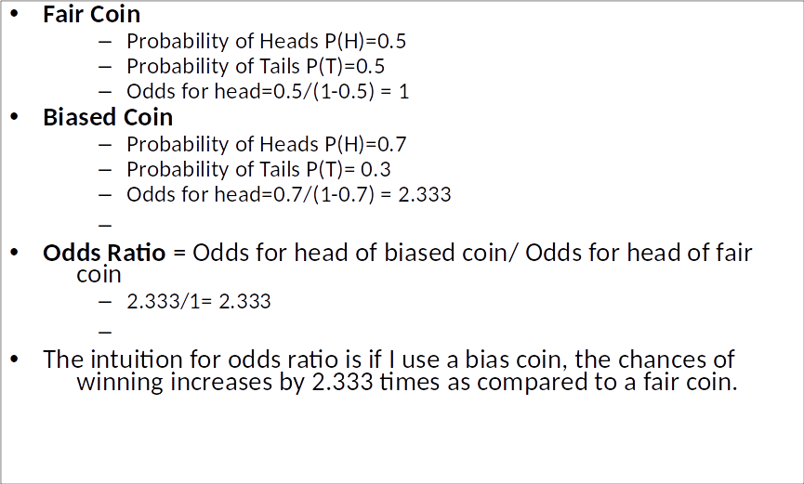
What is odds ratio?

Slide 11
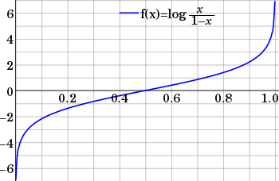
Log odds
Logits is logarithm of odds
It converts [0,1] probability to [-∞,∞]

Slide 12

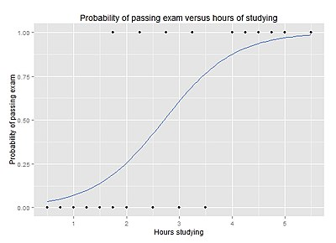

Logistic Regression
= exp(B₀+B₁X)

Slide 13
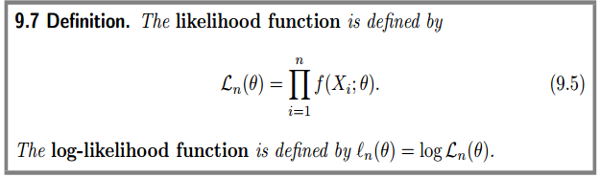
Maximum likelihood estimator

Slide 14

Logistic regression

Slide 15


Multiple Logistic Regression

Slide 16
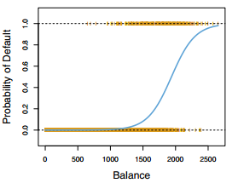
Logistic Regression
It is classification method but than why it called regression?
What if number of class > 2?

