Slide 1
K Nearest Neighbours Classification

Slide 2
Overview
Used to classify objects based on closest training examples in the feature space
Feature space: raw data transformed into sample vectors of fixed length using feature extraction (Training Data) Top 10 Data Mining Algorithm
Among the simplest of all Data Mining Algorithms
Classification Method
Implementation of lazy learner
All computation deferred until classification
KNN is non parametric technique

Slide 3
Why lazy learner?
KNN is a typical example of a lazy learner. It is called lazy not because of its apparent simplicity, but because it doesn't learn a discriminative function from the training data but memorizes the training dataset instead.

Slide 4
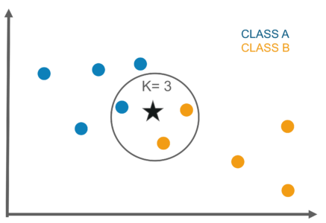
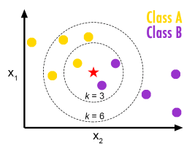
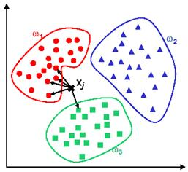
Intuition

Slide 5
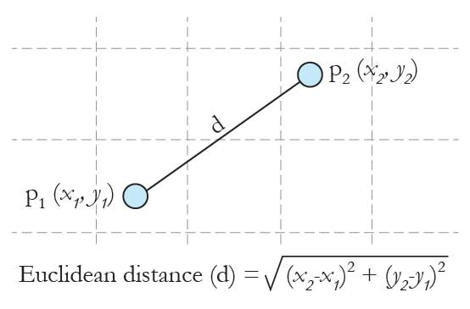
Distance Measures
Euclidean Distance

Slide 6
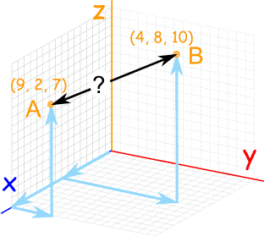
Distance Measures
Euclidean Distance

Slide 7
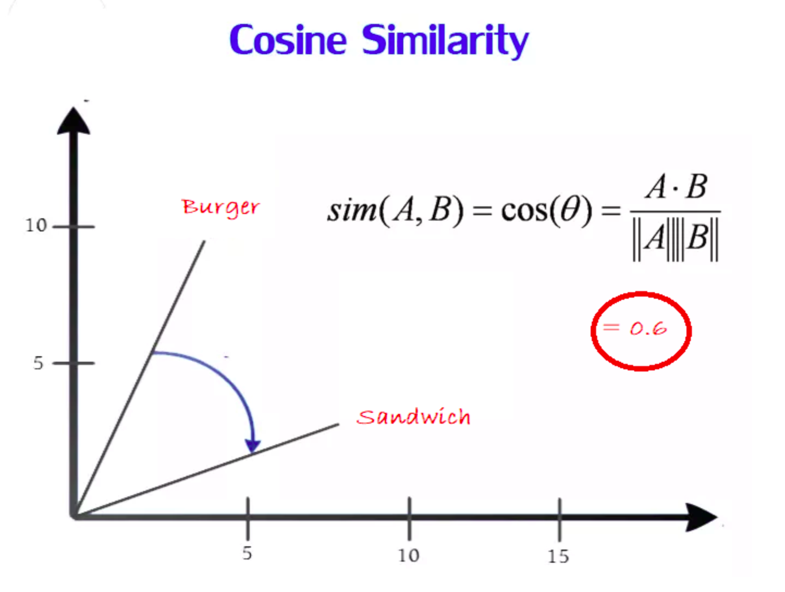
Distance Measures
Euclidean Distance
Cosine Similarity

Slide 8
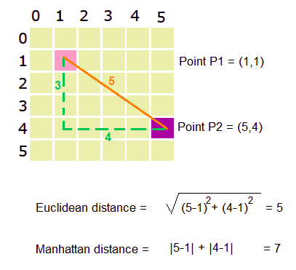
Distance Measures
Euclidean Distance
Cosine Similarity
Manhattan distance

Slide 9
Distance Measures
Euclidean Distance
Cosine Similarity
Manhattan distance

Slide 10
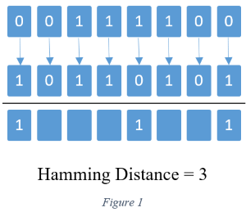
Distance Measures
Euclidean Distance
Cosine Similarity
Manhattan distance
Hamming distance

Slide 11
K Nearest Neighbour Continued...
Accuracy of all NN based classification, prediction, or recommendations depends solely on a data model, no matter what specific NN algorithm is used.
Scaling issues
Attributes may have to be scaled to prevent distance measures from being dominated by one of the attributes.
Height of a person may vary from 4’ to 6’
Weight of a person may vary from 100lbs to 300lbs
Income of a person may vary from $10k to $500k
Nearest Neighbor classifiers are lazy learners
No pre-constructed models for classification

Slide 12
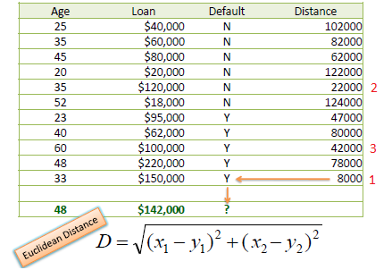
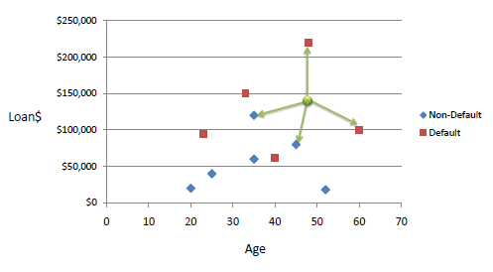
KNN process

Slide 13
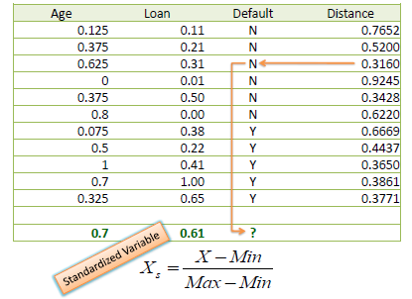
To overcome KNN scaling issue

Slide 14
K Nearest Neighbour : Advantages
Simple technique that is easily implemented.
Building model is inexpensive.
Extremely flexible classification scheme.
Does not involve preprocessing.
Well suited for
Multi-modal classes (classes of multiple forms)
Records with multiple class labels
Can sometimes be the best method.

Slide 15
Some useful links
https://www.saedsayad.com/flash/KNN_flash.html
https://yihui.name/animation/example/knn-ani/
https://www.saedsayad.com/k_nearest_neighbors.htm
https://www.analyticsvidhya.com/blog/2017/09/30-questions-test-k-nearest-neighbors-algorithm/

