Slide 1
IoT-Based Smart Drain Monitoring System
An innovative solution using Raspberry Pi Pico W, ultrasonic sensor, and MQ-135 gas sensor for real-time monitoring of drainage systems via Blynk Cloud.

Slide 2
Problem Statement
Urban drainage systems often suffer from blockages and harmful gas buildup, leading to flooding and health hazards. Current manual monitoring methods are inefficient and risky.

Slide 3
Proposed Solution
Deploy an IoT-based monitoring system with sensors to measure water levels and detect toxic gases, enabling remote supervision via a mobile application.

Slide 4
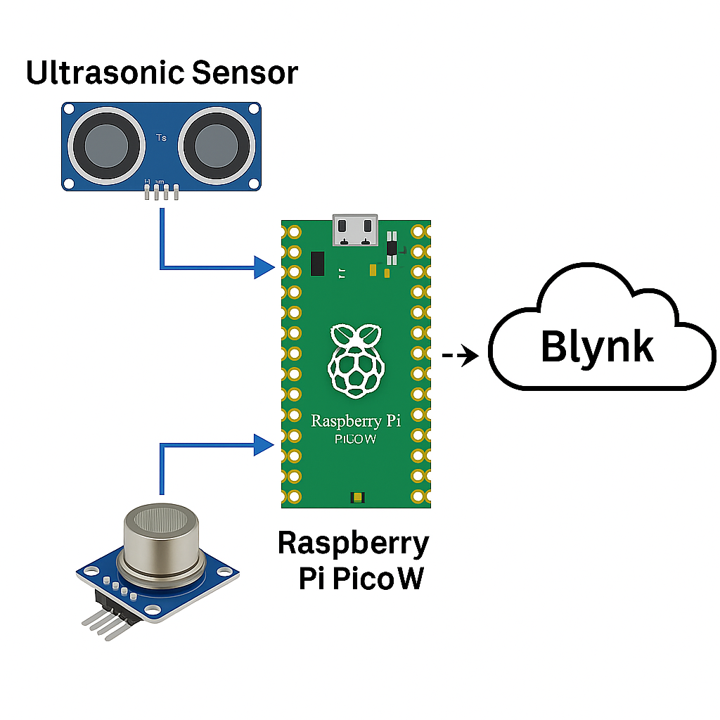
System Architecture
• Raspberry Pi Pico W as the core controller
• Ultrasonic sensor for water level detection
• MQ-135 for gas concentration detection
• Wi-Fi connectivity to Blynk Cloud
• Real-time alerts on mobile devices

Slide 5
Hardware Components
• Raspberry Pi Pico W
• Ultrasonic Sensor (HC-SR04)
• MQ-135 Gas Sensor
• Connecting wires and enclosure
• Power supply

Slide 6
Software Components
• MicroPython firmware
• Blynk IoT mobile application
• Sensor data acquisition scripts
• Wi-Fi communication module

Slide 7
Working Principle
1. Sensors detect water level and gas concentration.
2. Raspberry Pi Pico W processes the readings.
3. Data is sent to Blynk Cloud via Wi-Fi.
4. Alerts are triggered if thresholds are exceeded.

Slide 8
Advantages
• Real-time monitoring
• Low-cost and scalable
• Easy deployment
• Reduced manual inspection risks
• Ideal for smart city applications

Slide 9
Results & Applications
• Continuous monitoring of drainage conditions
• Early warning of potential blockages or hazards
• Can be adapted for industrial and municipal wastewater management

Slide 10
Conclusion
This IoT-based smart drain monitoring system improves urban infrastructure management, enhances public safety, and reduces maintenance costs through automation and real-time data analysis.

