Slide 1

Dynamic Public Parking Pricing System Based on Real-Time Demand Prediction
CSA0925-PROGRAMING WITH JAVA
Research Scholar
D. Chand basha(192424218)
Ganeshram. M(192321060)
Monish. S(192311132)
Saveetha School of Engineering
Supervisor
Dr. Sivasankar C
Dept of CSE
Saveetha School of Engineering

Slide 2


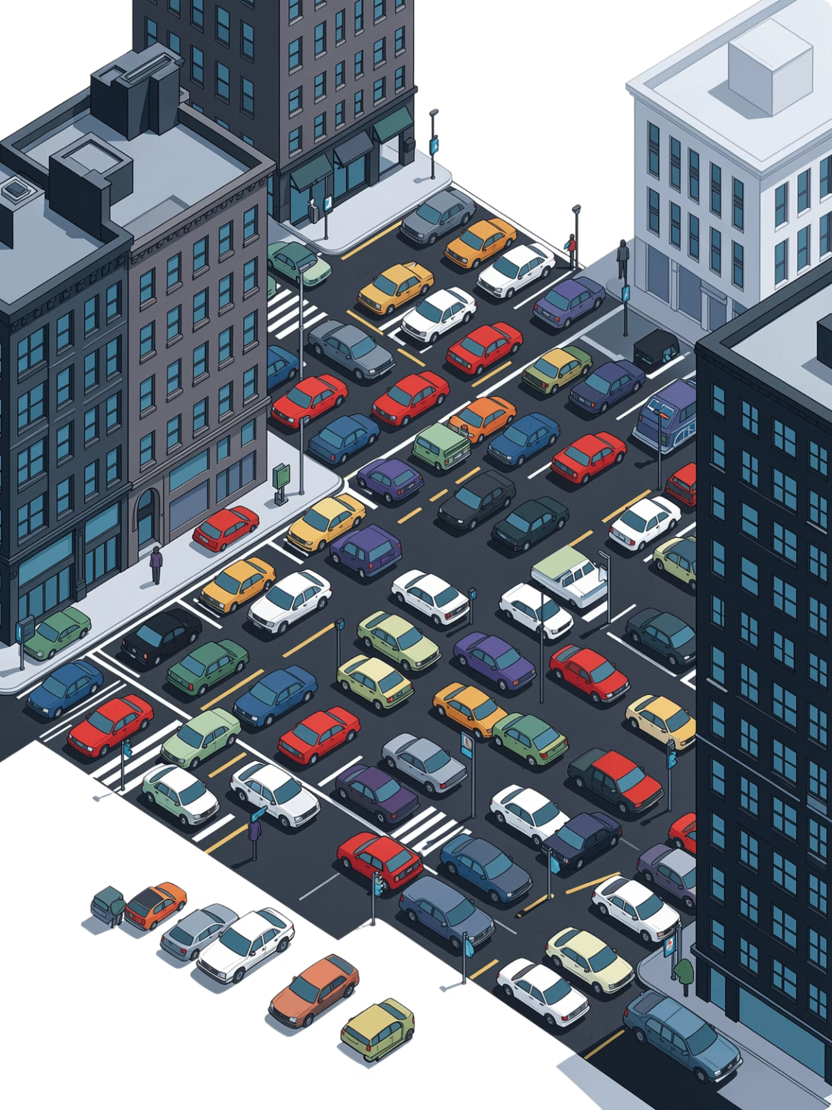
Problem Background
Rapid urbanization has significantly increased the number of vehicles in cities.
Traditional parking systems use fixed pricing regardless of parking demand.
High-demand areas become overcrowded, while other parking spaces remain underutilized.
Drivers spend considerable time searching for available parking, increasing traffic congestion and fuel consumption.
Fixed pricing leads to inefficient parking space utilization and reduced operational efficiency.

Slide 3
Problem Statement
Fixed parking prices fail to reflect real-time demand.
High-demand areas become overcrowded while other parking lots remain underutilized.
Drivers waste time searching for parking, increasing congestion and fuel consumption.
Existing systems lack intelligent demand prediction and adaptive pricing.
A dynamic pricing system using real-time demand prediction can optimize parking utilization, reduce traffic, and improve user satisfaction.

Slide 4
Project Objectives
Primary Goal: To develop a Dynamic Public Parking Pricing System that predicts real-time parking demand and dynamically adjusts parking prices.
1
2
3
Objective 1
Objective 2
Objective 3
[e.g., Achieve ≥90% demand prediction accuracy using historical and real-time occupancy data]
[e.g., Reduce average parking search time by ≥25% within the target zone]
[e.g., Deploy a responsive user notification system with latency under 5 seconds]
Scope: The project focuses on implementing a dynamic parking pricing system that uses real-time and historical parking data to predict demand and adjust parking fees accordingly.

Slide 5
Literature Survey
S.No | Year | Author(s) | Title | Key Contribution / Findings | Research Gap / Limitation
1 | 2022 | Ali & Shah | IoT-Based Smart Parking Monitoring System | Developed an IoT-enabled parking monitoring system using occupancy sensors and cloud connectivity for real-time parking availability. | Does not support dynamic pricing or parking demand prediction.
2 | 2023 | Zhang et al. | Machine Learning-Based Parking Demand Prediction | Applied machine learning algorithms to forecast parking demand using historical occupancy and traffic data. | Prediction accuracy decreases during special events and unexpected traffic conditions.
3 | 2023 | Zhou & Lee | Dynamic Parking Pricing Using Demand–Supply Analysis | Proposed a demand-based pricing model to optimize parking occupancy and improve revenue. | Relies mainly on historical data; ignores real-time weather and event information.
4 | 2024 | Sarker et al. | Smart Parking Management System with IoT Integration | Integrated IoT sensors, mobile applications, and cloud services for real-time parking management and monitoring. | High deployment cost and limited scalability for large metropolitan cities.
5 | 2024 | Mabrouk et al. | Deep Learning-Based Parking Demand Forecasting | Utilized deep learning models to predict parking demand and recommend optimal pricing strategies. | Requires large datasets and high computational resources for training.

Slide 6
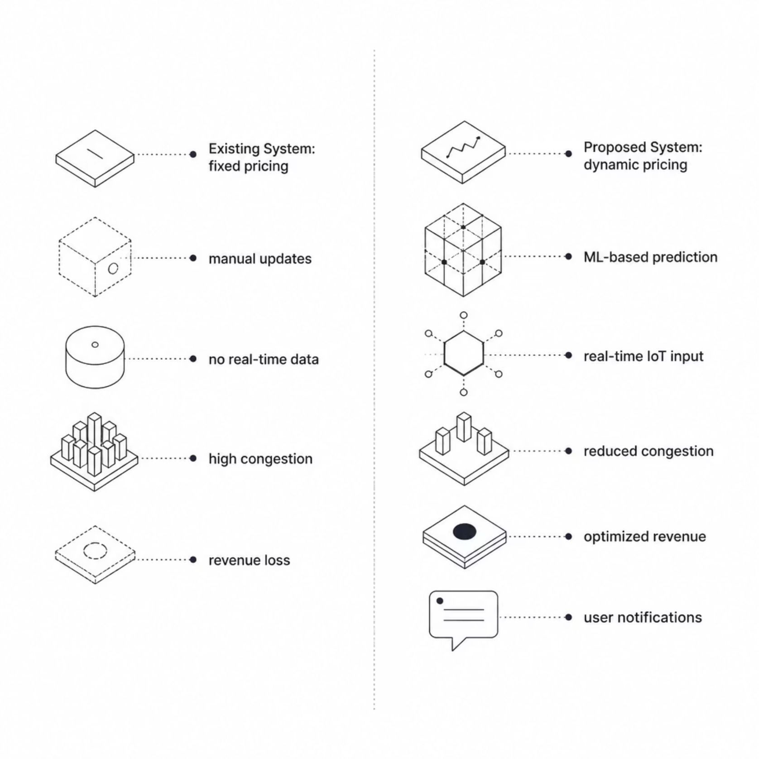
Existing vs. Proposed System

Slide 7
System Requirements
Functional Requirements
Non-Functional Requirements
Hardware & Software Stack
Real-time demand prediction from live sensor feeds
Automated dynamic price adjustment per zone/lot
User notifications via mobile app / display boards
Scalable architecture supporting N+ parking zones
System latency < 5 seconds end-to-end
99.5% uptime SLA for production deployment
Hardware: [Sensors, edge devices, servers, IoT gateways]
ML Frameworks: [TensorFlow, scikit-learn, PyTorch]
Databases: [ PostgreSQL, InfluxDB, Redis]
Data Sources: [Occupancy feeds, traffic APIs, weather data]

Slide 8
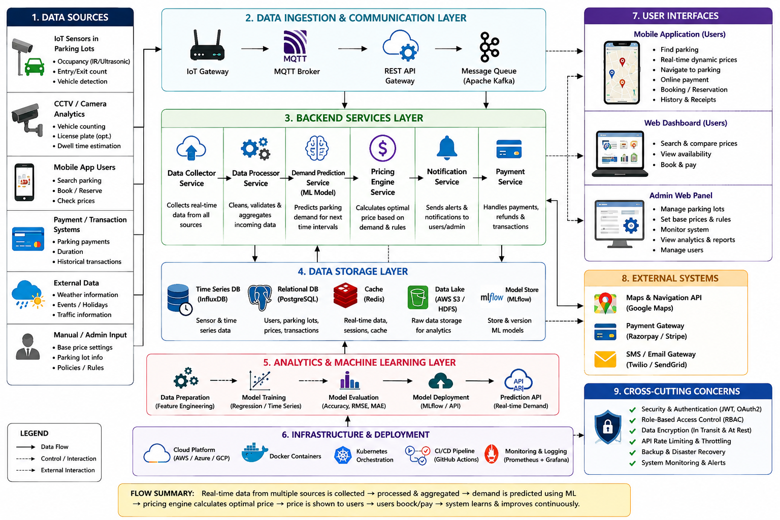
System Architecture

Slide 9
Project Planning
Work Breakdown Structure
01
Milestones:
Requirements & Research
Key Milestones & Risks
[Timeline — Weeks 1–3]
✅ Prototype ready — [Target date]
✅ ML model trained and validated — [Target date]
✅ Full system deployed — [Target date]
02
System Design
[Timeline — Weeks 4–6]
03
Key Risks:
Development & ML Training
Data Availability: Sensor coverage gaps or incomplete historical datasets
Model Accuracy: Overfitting to specific zones; generalization challenges
User Adoption: Resistance from drivers or operators to dynamic pricing
[Timeline — Weeks 7–14]
04
Testing & Validation
[Timeline — Weeks 15–18]
05
Deployment & Documentation
[Timeline — Weeks 19–22]

Slide 10
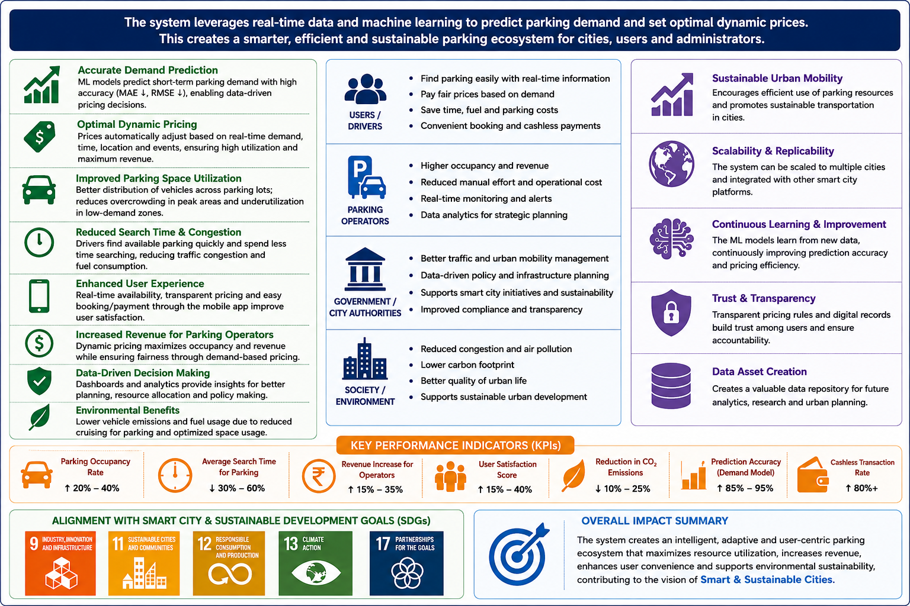
Expected Outcomes & Impact
Deliverables
Benefits
Fully functional dynamic pricing system
Trained and validated ML demand prediction model
Research paper and technical documentation
Reduced parking search time for drivers
Optimized parking revenue for city authorities
Lower vehicle emissions from reduced cruising
Future Work
Multi-city and multi-zone deployment at scale
Integration with autonomous vehicle routing systems
[Additional extensions — EV charging, public transit linkage]

Slide 11


