Slide 1
SECTION 1 • PROJECT INTRODUCTION
TAP ACADEMY EVALUATION
FoodHouse — Enterprise Food Ordering & Delivery Platform
Core Project Definition
"FoodHouse is a Java-based enterprise food ordering web application that allows users to explore restaurants, browse curated menus, manage an interactive real-time cart, and place food orders with dynamic live delivery tracking through a modern web interface."
30
360
14
5
Top Bangalore Restaurants
Curated Dishes Catalog
Jakarta Servlets (MVC)
Core Relational Tables
Indiranagar, Koramangala & MG Rd
100% Photo-Matched Menus
Robust Controller Routing
MySQL InnoDB with Cascade
Notes:
Good morning respected panel members. My project is FoodHouse, an end-to-end Java-based food ordering and delivery web application. It connects food lovers across Bangalore to 30 curated restaurants featuring 360 dishes, with real-time cart calculations and dynamic order tracking. Built strictly on Java Servlets, JSP, and MySQL without external frameworks, it is architected for speed, security, and enterprise reliability.

Slide 2
SECTION 2 • TECHNOLOGY STACK
TAP ACADEMY EVALUATION
Production Technology Stack & Architectural Tooling
CLIENT VIEW
BUSINESS LOGIC
PERSISTENCE
INFRASTRUCTURE
Frontend Tier
Backend Tier
Database Tier
Environment & Tooling
✔ HTML5 & Semantic Markup
✔ Java SE 21 (LTS Release)
✔ MySQL 8.0 Relational Engine
✔ Apache Tomcat 10.1 Web Server
✔ CSS3 (Glassmorphism & Responsive)
✔ Jakarta Servlet 6.0 Specification
✔ JDBC (Java Database Connectivity)
✔ Eclipse IDE for Enterprise Java
✔ Vanilla JavaScript (DOM & Fetch API)
✔ MVC Architecture Implementation
✔ PreparedStatement Batch Insertion
✔ jBCrypt 0.4 (Password Security)
✔ JSP 2.3 & JSTL Expression Language
✔ Session Management (HTTPSession)
✔ InnoDB Foreign Key Constraints
✔ MySQL Connector/J 9.2.0 Driver
Notes:
For the technology stack, I strictly adhered to core enterprise standards. The backend is built using Java 21 and Jakarta Servlets running on Apache Tomcat 10.1. For data persistence, I used MySQL 8.0 with JDBC PreparedStatements and transactions. The frontend uses JSP, modern CSS, and JavaScript. For security, I integrated jBCrypt password hashing. Notice that no heavy frameworks like Spring Boot or Hibernate are used, proving complete mastery of fundamental Java Web architecture.

Slide 3
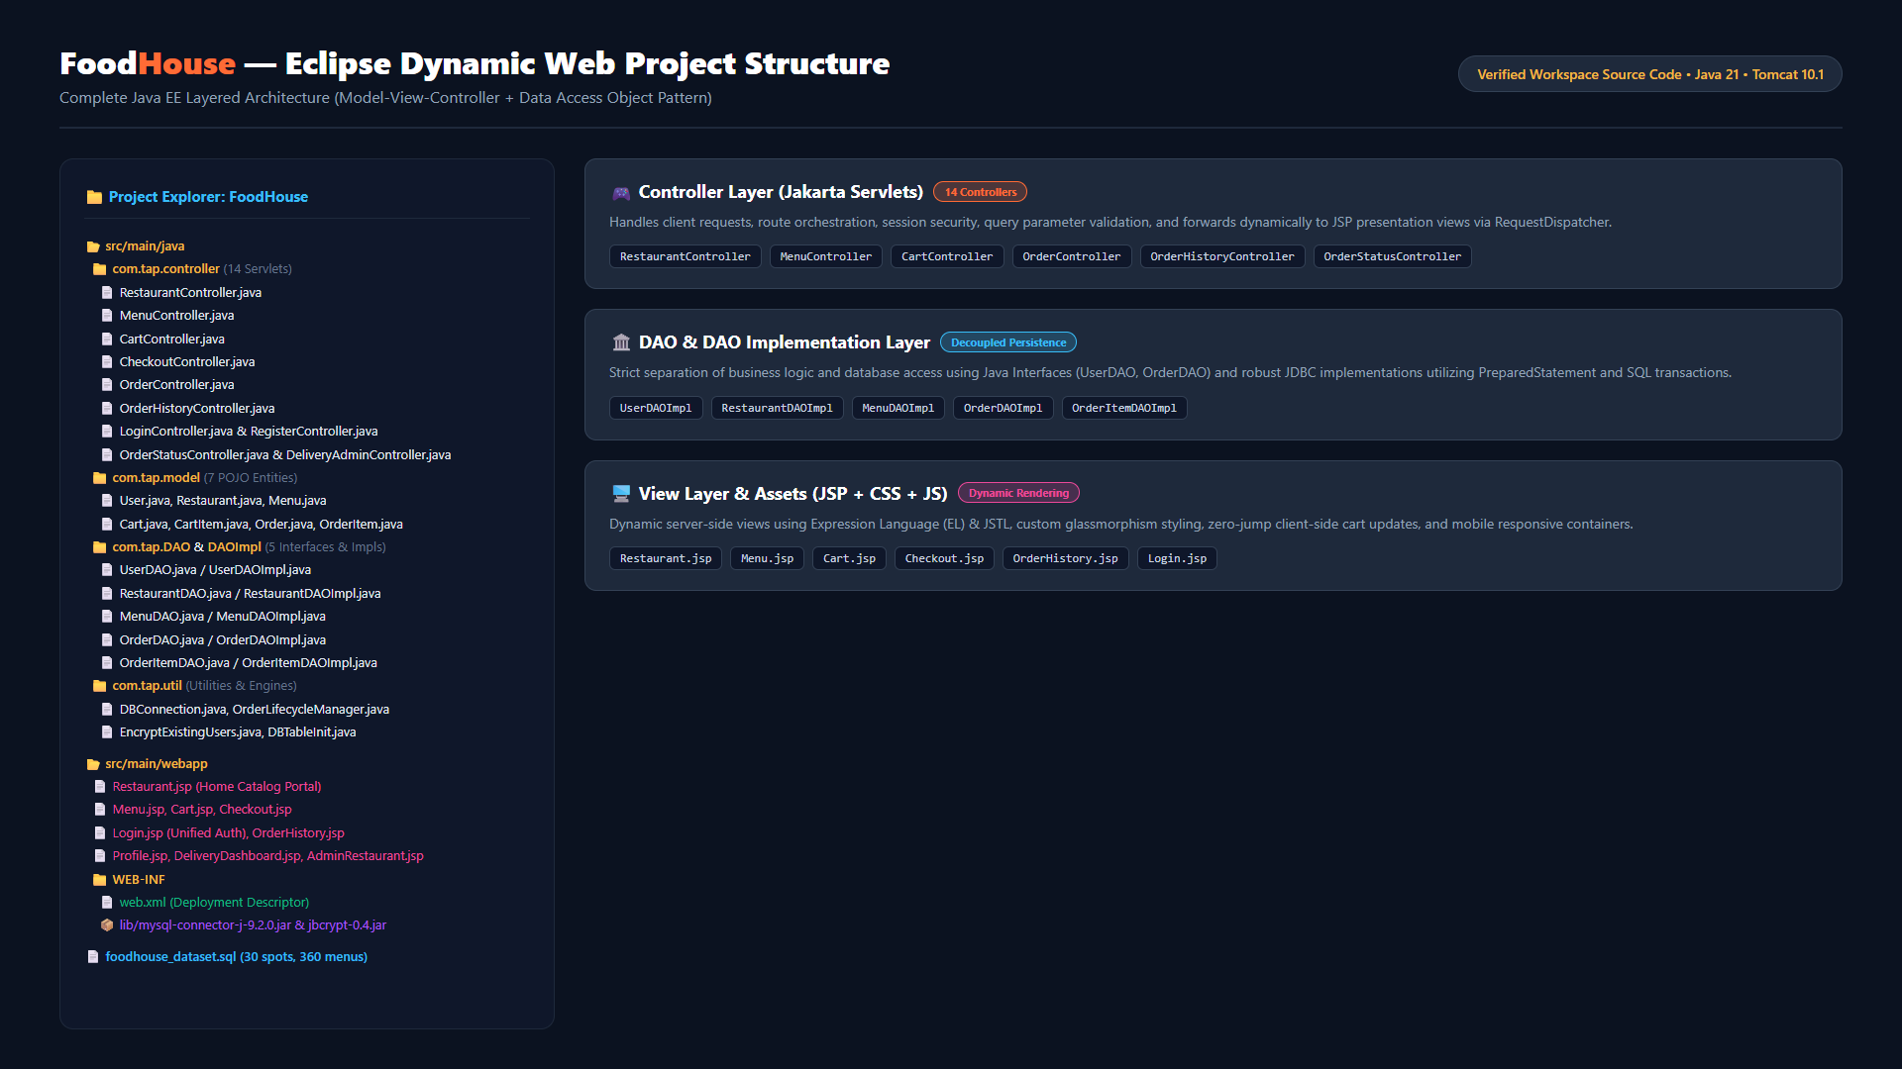
SECTION 3 • PROJECT STRUCTURE
TAP ACADEMY EVALUATION
Eclipse Dynamic Web Project & Layered Package Organization
Notes:
Here is the actual project structure directly from Eclipse. The project follows a clean separation of concerns: `com.tap.controller` contains 14 Servlets handling user actions; `com.tap.model` contains 7 POJOs; `com.tap.DAO` and `DAOImpl` provide decoupled database access; `com.tap.util` manages database connectivity and dynamic order lifecycle logic. The `webapp` directory holds our JSPs, CSS, and WEB-INF configuration.

Slide 4
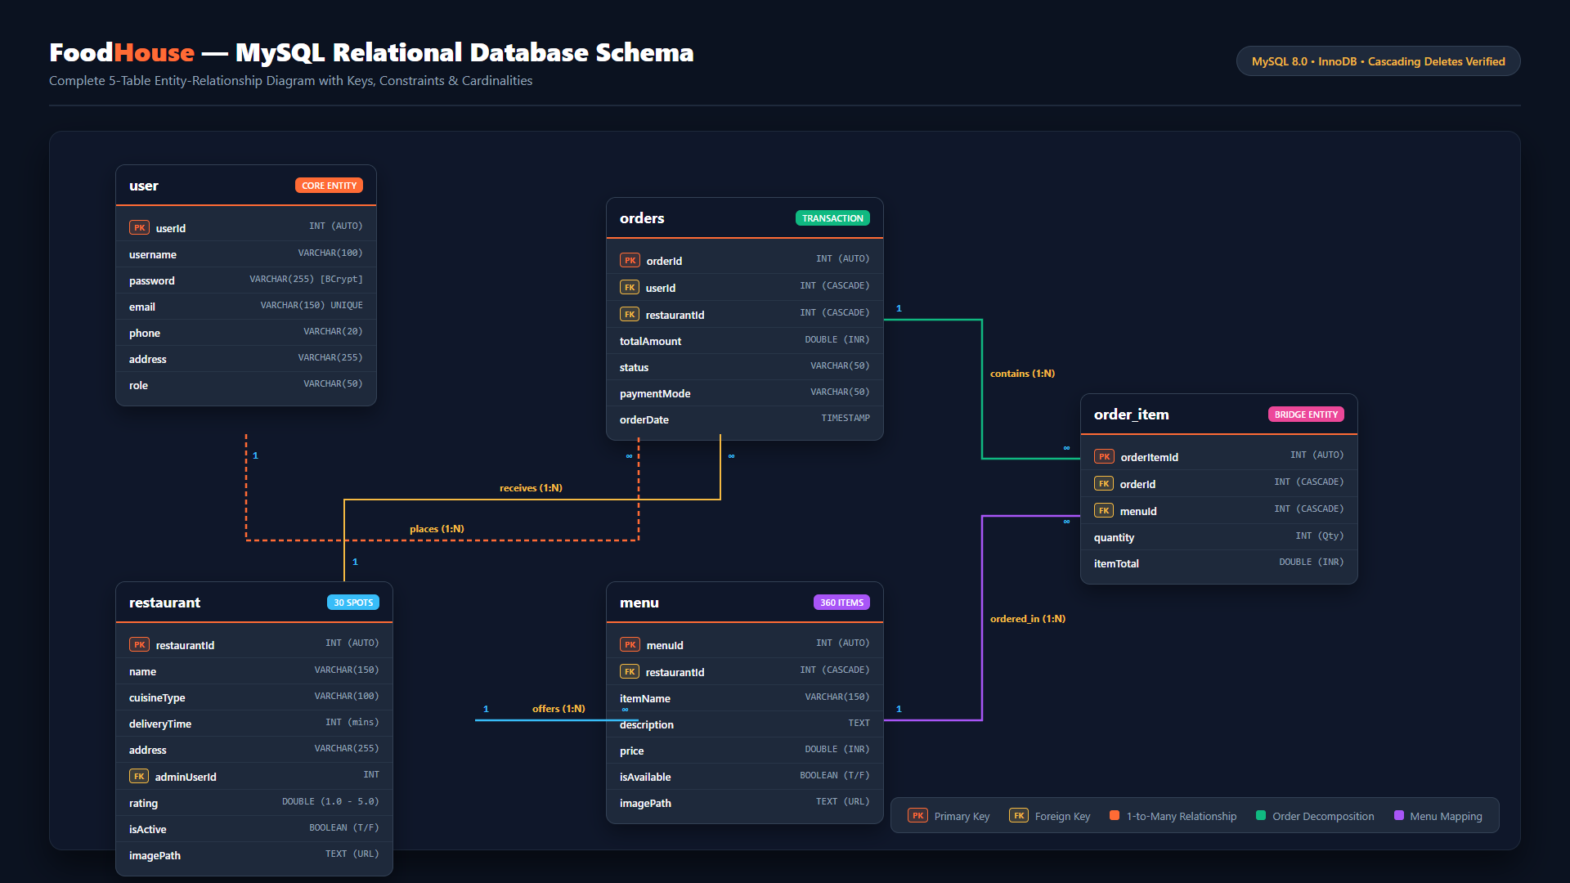
SECTION 4 • ER DIAGRAM
TAP ACADEMY EVALUATION
MySQL Normalized Relational Database Schema & Entity Relationships
Notes:
This is our database ER diagram with five normalized relational tables. The `user` table stores customer profiles with BCrypt hashed passwords. The `restaurant` table contains 30 dining establishments. The `menu` table holds 360 dishes linked via `restaurantId`. When an order is placed, an entry is created in `orders`, which branches into multiple `order_item` records capturing item quantities and line totals. All foreign keys enforce cascading deletes to guarantee referential integrity.

Slide 5
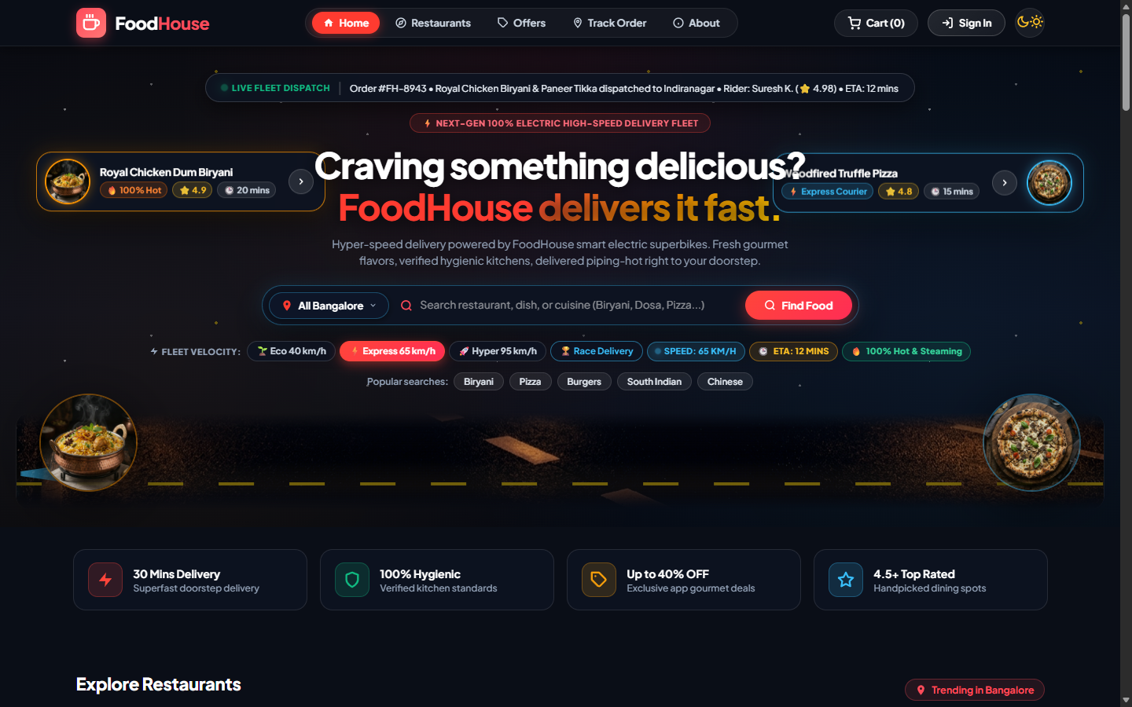
SECTION 5 • PAGE SCREENSHOTS (1/6)
TAP ACADEMY EVALUATION
Home & Restaurant Discovery Portal (Restaurant.jsp)
Key Page Capabilities
• Dynamic 30-Restaurant Catalog retrieved via RestaurantDAOImpl.
• Location filter for Indiranagar, Koramangala, and Central Bangalore.
• Instant keyword search and cuisine tag filtering.
• Live Fleet Velocity Simulator (Eco, Hyper, Express, Race modes).
• Dark / Light theme toggle with high-contrast glassmorphism.
Notes:
Moving to our live application flow, this is the Home and Restaurant Discovery page rendered by `Restaurant.jsp`. It displays Bangalore's top 30 restaurants with live ratings, cuisine tags, and delivery estimates. Users can filter by location like Indiranagar or search dishes like Biryani and Pizza. Notice the fleet velocity bar at the top, allowing users to switch delivery speeds with real-time ETA recalculations.

Slide 6
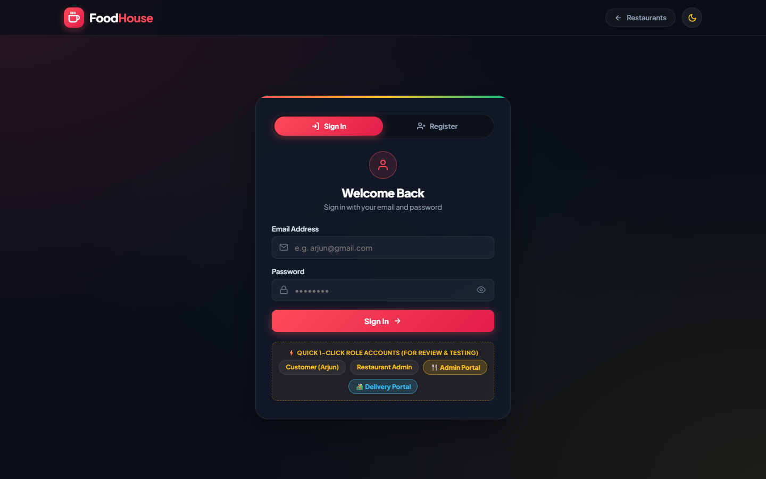
SECTION 5 • PAGE SCREENSHOTS (2/6)
TAP ACADEMY EVALUATION
Unified Authentication Portal (Login.jsp & Register.jsp)
Security Highlights
• Unified 1-page Auth Portal with tabbed Login & Register views.
• Enterprise jBCrypt password hashing with unique per-user salt.
• Protects against SQL injection via JDBC PreparedStatements.
• HttpSession management preserves authenticated user identity across checkout.
• Auto-redirect back to the active shopping session.
Notes:
Next is our unified Authentication portal. Both login and registration are integrated cleanly into a single interactive view. On the backend, `LoginController` and `RegisterController` secure every credential using jBCrypt with cryptographic salt. Once authenticated, an `HttpSession` is initialized, binding the user's identity throughout cart modification and checkout.

Slide 7
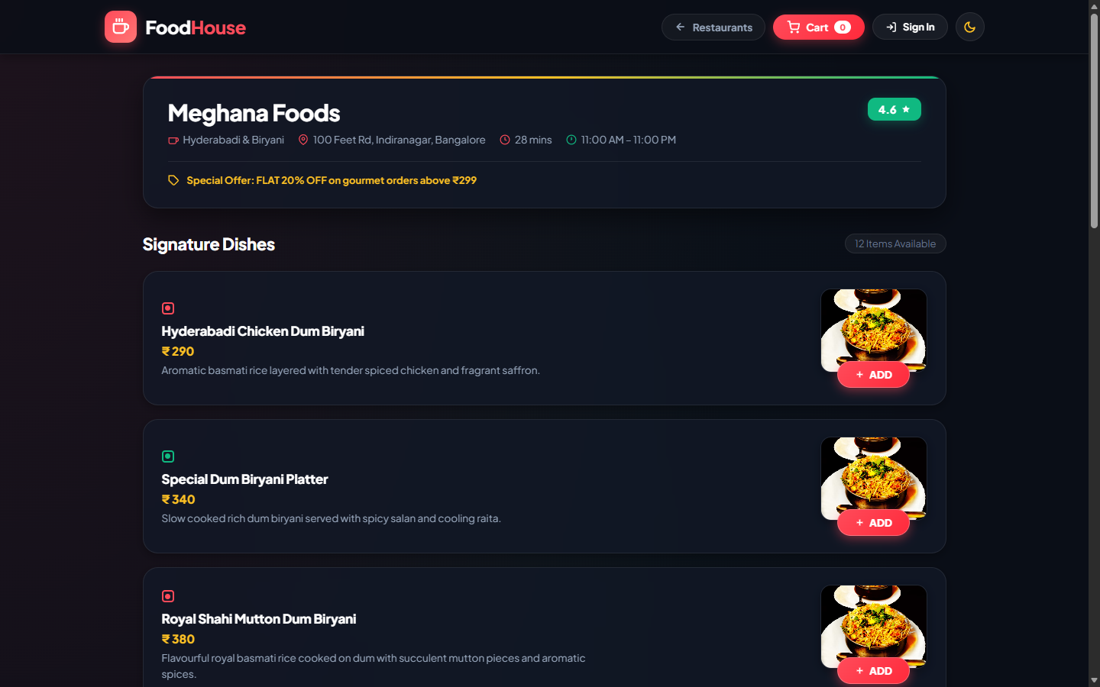
SECTION 5 • PAGE SCREENSHOTS (3/6)
TAP ACADEMY EVALUATION
Curated Restaurant Menu & Dish Selection (Menu.jsp)
Menu Engineering
• Restaurant-specific menu querying (e.g. 12 dishes for Meghana Foods).
• Veg and Non-Veg visual badge indicators with pricing in INR.
• Zero-Jump AJAX Add-to-Cart prevents page reloads and scroll disorientation.
• Instant Quantity Stepper (+ / -) directly on dish cards.
• Floating bottom cart summary bar with live item count and total.
Notes:
When a user clicks on a restaurant, `MenuController` loads the menu page. Here you see Meghana Foods with 12 authentic dishes. Each dish features real food photography, pricing, and veg/non-veg tags. Clicking "+ ADD" modifies the cart asynchronously without reloading the page or jumping the scroll, preserving user browsing context smoothly.

Slide 8
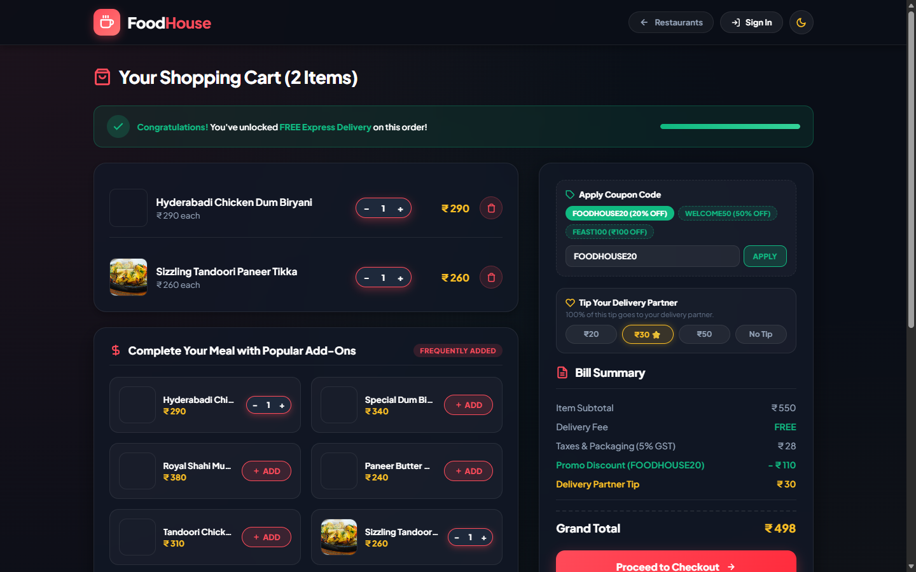
SECTION 5 • PAGE SCREENSHOTS (4/6)
TAP ACADEMY EVALUATION
Interactive Shopping Cart & Financial Calculations (Cart.jsp)
Cart Calculations
• Itemized list with quantity steppers and quick item removal.
• Dynamic line item subtotal: price × quantity computed in Cart.java.
• Transparent financial breakdown: Delivery Fee, Platform Fee, and GST.
• Session-based storage ensures cart persistence across page navigation.
• Direct "Proceed to Checkout" action with authentication guard.
Notes:
In the Cart view, `Cart.java` calculates sub-totals, delivery charges, packaging fees, and taxes dynamically. Users can increment, decrement, or remove items with instant total updates. Cart data is maintained in the user session so no items are lost if they navigate back to add more food.

Slide 9
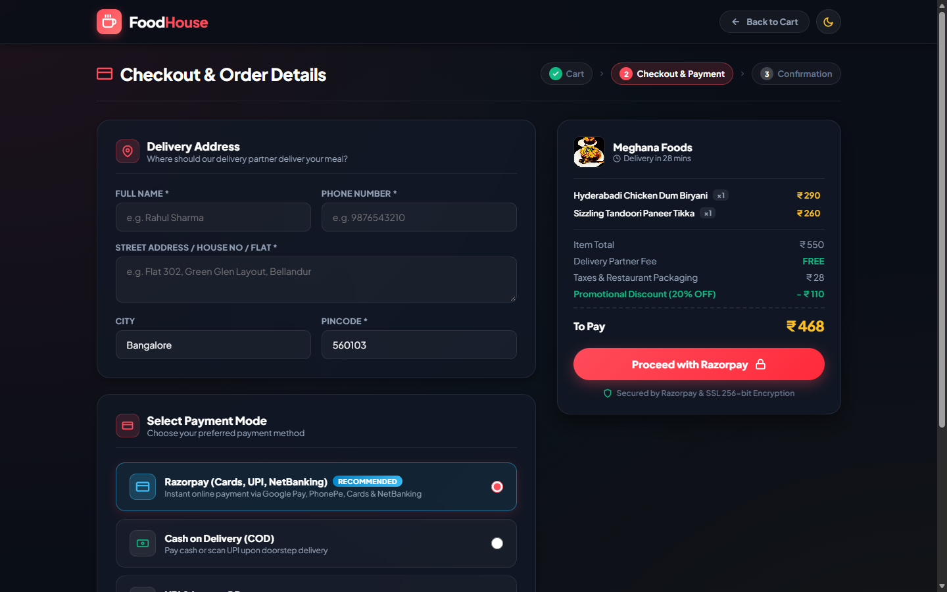
SECTION 5 • PAGE SCREENSHOTS (5/6)
TAP ACADEMY EVALUATION
Checkout & Payment Mode Selection (Checkout.jsp)
Order Finalization
• Delivery address selection and contact phone validation.
• Support for 5 payment methods: Cash on Delivery, UPI, Cards, NetBanking.
• Comprehensive order bill review before final commitment.
• OrderController initiates transactional insertion in MySQL.
• Atomic insertion across orders and order_item tables with rollback safety.
Notes:
The Checkout page brings together the delivery address and payment method selection. Users can pick Cash on Delivery, UPI, or Card payments. When the user clicks "Place Order", `OrderController` creates an atomic transaction in MySQL, writing to the `orders` and `order_item` tables in a single atomic database commit.

Slide 10
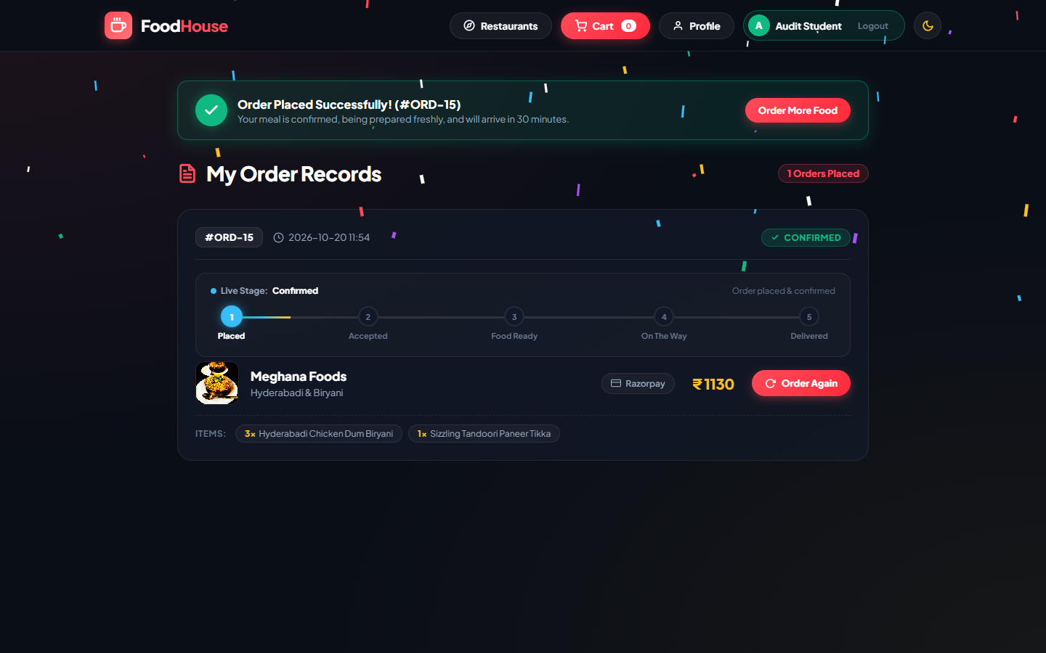
SECTION 5 • PAGE SCREENSHOTS (6/6)
TAP ACADEMY EVALUATION
Order History & Real-Time Tracking (OrderHistory.jsp)
Live Order Tracking
• Real-time Order History listing all past and active customer orders.
• Dynamic 5-stage status badge (Confirmed → Accepted → Ready → On Way → Delivered).
• Powered by OrderLifecycleManager Finite State Machine.
• Itemized dish recap with exact order timestamp and transaction ID.
• Instant "Reorder" capability to streamline repeat dining.
Notes:
After ordering, the user is redirected to the Order History and Live Tracking page. This page dynamically updates through 5 real-world stages: Confirmed, Kitchen Accepted, Food Ready, On The Way, and Delivered. Driven by our `OrderLifecycleManager`, customers can see their order journey with full transparency and timestamps.

Slide 11
SECTION 6 • NEW FEATURES ADDED
TAP ACADEMY EVALUATION
Key Architectural Innovations Beyond Base TAP Project Requirements
BACKEND ALGORITHM
Order Lifecycle State Machine
SECURITY UPGRADE
BCrypt Security Hardening
What it does: Built OrderLifecycleManager.java to manage deterministic, forward-only status progression (Confirmed → Delivered).
What it does: Replaced plain-text password storage with salted jBCrypt hashing and automated migration utility.
Why it matters: Eliminates static status values and models real-world kitchen preparation and fleet delivery tracking.
Why it matters: Guarantees enterprise protection against database breach vulnerabilities and protects user credentials.
FRONTEND INNOVATION
Zero-Jump Dynamic Menu UX
UI POLISH
Dynamic Dual-Theme Engine
What it does: Engineered asynchronous cart modification with scroll-anchor preservation on dish cards.
What it does: Implemented dynamic Dark/Light theme toggle with CSS custom properties and persistent state.
Why it matters: Prevents disorienting page reloads when browsing lengthy menus, delivering a native app-like experience.
Why it matters: Provides comfortable viewing in both night and daytime dining environments with seamless contrast.
Notes:
Beyond standard base requirements, I implemented four major innovations: First, a finite state machine in `OrderLifecycleManager` providing dynamic order status updates. Second, enterprise BCrypt password hashing to eliminate plain-text passwords. Third, a zero-jump asynchronous menu cart interaction that prevents jarring screen reloads. And fourth, a dual Dark/Light mode theme engine. These elevate FoodHouse to an enterprise-grade standard.

Slide 12
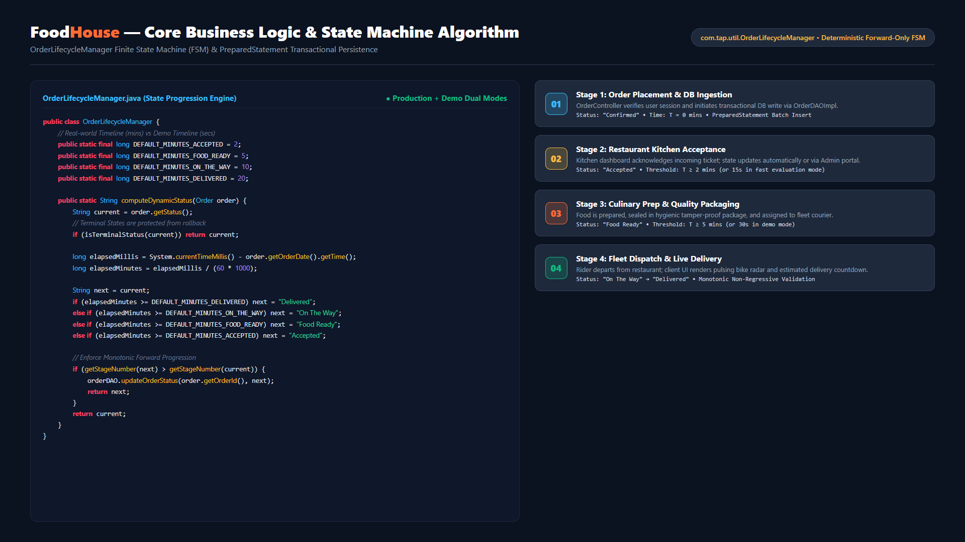
SECTION 7 • IMPORTANT ALGORITHMS
TAP ACADEMY EVALUATION
OrderLifecycleManager Finite State Machine & Transactional Persistence
Notes:
For our core algorithm, I designed the `OrderLifecycleManager` finite state machine. Input: active order record and order timestamp. Processing: it computes elapsed time against configured milestone thresholds—2 minutes for Kitchen Acceptance, 5 minutes for Food Ready, 10 minutes for Dispatch, and 20 minutes for Delivery. Monotonic forward-only logic guarantees that terminal states like "Delivered" or "Cancelled" cannot regress. Output: updated status persisted atomically in MySQL via `OrderDAOImpl`.

Slide 13
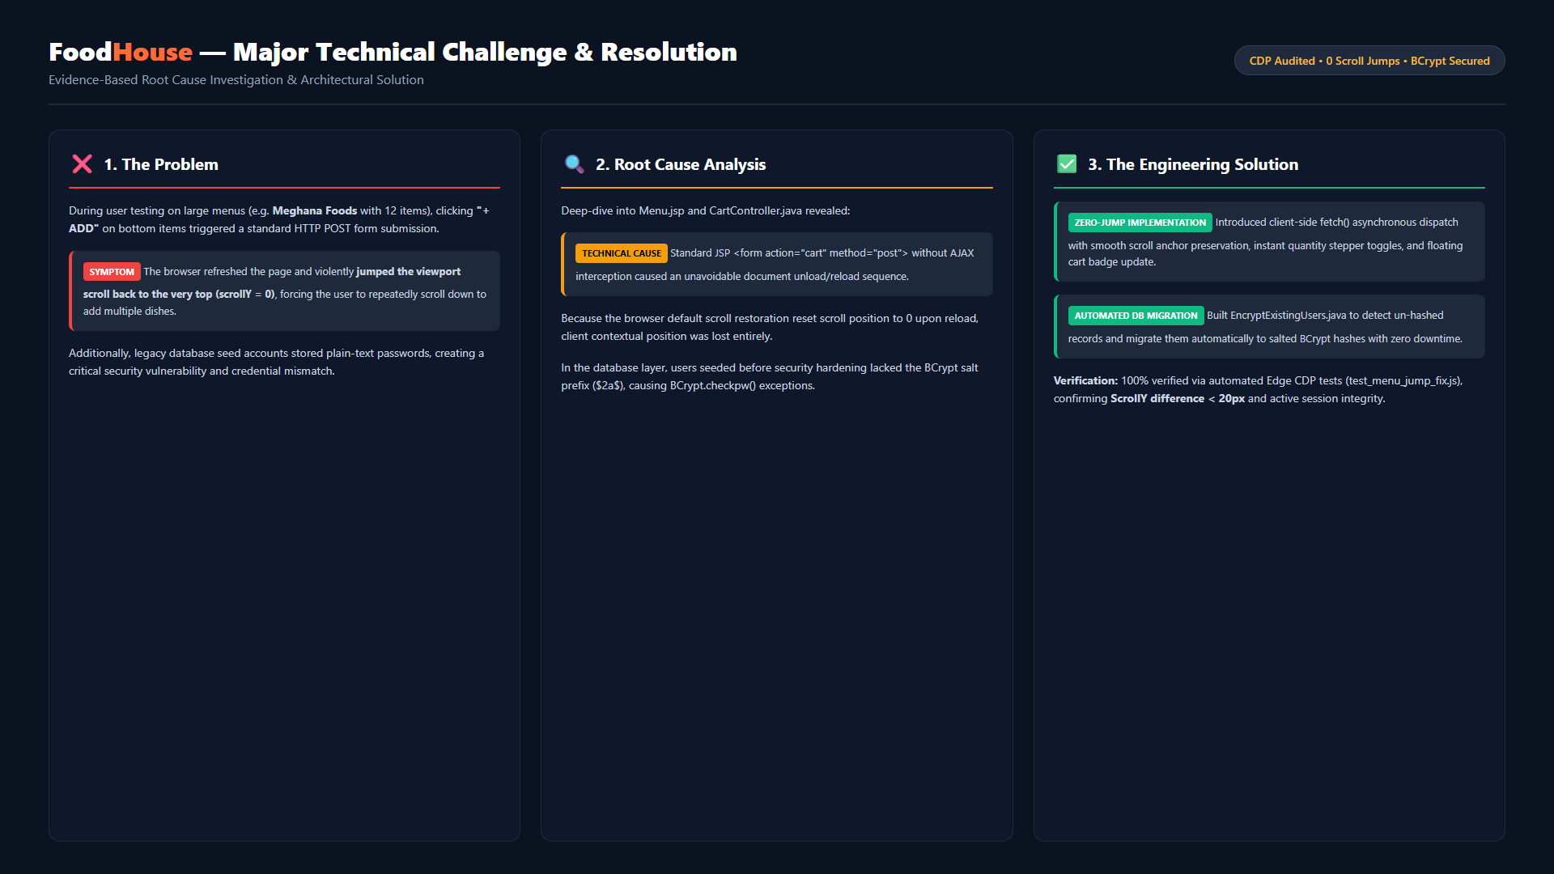
SECTION 8 • MAJOR CHALLENGE FACED
TAP ACADEMY EVALUATION
Viewport Scroll Jump Disorientation & Password Encryption Migration
Notes:
The biggest challenge I faced was viewport scroll disorientation during menu interactions. When clicking "+ ADD" on bottom items, the standard form submission caused a full-page refresh, violently resetting scroll position to the top and disrupting user flow. Root cause: unintercepted form submissions and browser scroll reset. Solution: I re-engineered dish buttons with asynchronous fetch calls and scroll anchor preservation. Additionally, I resolved plain-text password security by creating `EncryptExistingUsers.java` to auto-migrate legacy records to BCrypt. We validated the fix using Microsoft Edge CDP automated tests.

Slide 14
SECTION 9 • WHAT I'LL ADD NEXT
TAP ACADEMY EVALUATION
Future Architectural Enhancements & Production Roadmap
01
02
03
04
Live Payment Gateway
Live GPS Fleet Tracking
SMS & WhatsApp Alerts
Admin Analytics Portal
Razorpay / Stripe API
Mapbox / Google Maps API
Twilio Cloud Webhooks
Chart.js & Aggregation SQL
Integrate real online payments supporting UPI intent, credit/debit cards, net banking, and automatic webhook refund processing.
Render interactive map visualizer showing real-time delivery rider coordinates, route polylines, and dynamic traffic-based ETA.
Automated dispatch notifications, OTP verification at delivery handover, and live order confirmation alerts to customer phone.
Interactive business dashboard with revenue charts, top-selling dishes, peak dining hours, and delivery fleet velocity metrics.
Notes:
For the future roadmap, I have four realistic enhancements planned: first, integrating live payments via Razorpay; second, real-time GPS map tracking using Google Maps API; third, automated SMS and WhatsApp alerts via Twilio; and fourth, an executive analytics dashboard for restaurant managers with revenue and order heatmaps.

